Slide 1
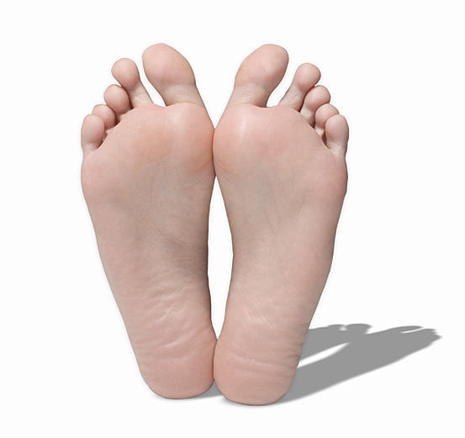
THE SOLE
Dr. SARANGDHAR KUMAR
DEPARTMENT OF ANATOMY
ROHILKHAND MEDICAL COLLEGE
BAREILLY

Slide 2
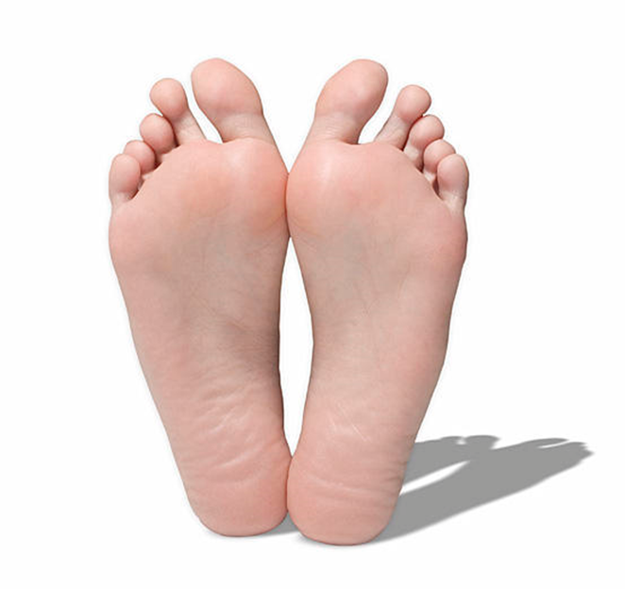
IT IS AN UNDERSURFACE OF FOOT
THAT BEARS WEIGHT OF THE BODY & SUBJETED TO MAXIMUM BEAR AND TEAR
HENCE IT IS COVERED BY THICK SKIN WITH KERATINIZED LAYER OF EPIDERMIS

Slide 3
SKIN –
  Both epidermis & dermis are much thicker
  Due to intermittent pressure
  Show few flexure creases at the site of skin movement
  Devoid of hair, sebaceous gland
  Provided with numerous sweat gland

Slide 4
SUPERFICIAL FASCIA –
  Made of fibro-fatty tissue
  Contains cutaneous nerves & vessels
  Cushion of fibro-fatty tissue is more abundant at three sites –
    Posterior tubercle of calcaneus
    Heads of metatarsal bone
    Pulp of terminal digits

Slide 5
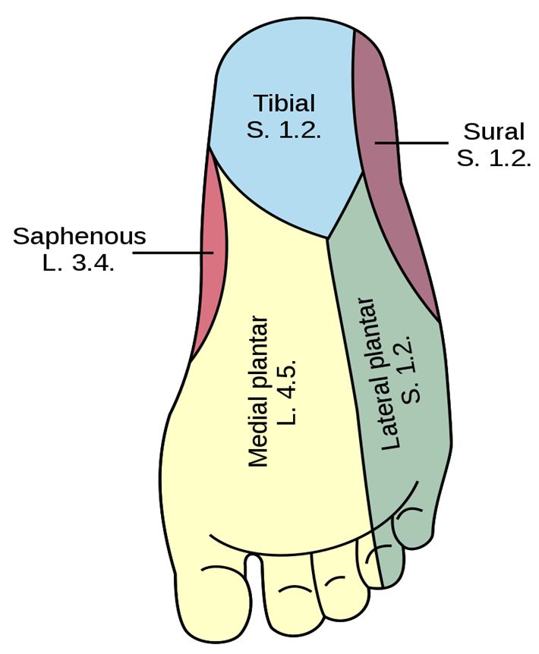
SENSORY NERVE SUPPLY –
  Over weight bearing area of heel – calcaneal branch of tibial nerve (S1,S2)
  Medial part of sole including medial 3 ½ toes – medial planter nerve (L4,L5)
  Lateral part of sole including lateral 1 ½ toes – lateral planter nerve (S1,S2)

Slide 6
ARTERIAL SUPPLY OF HEEL –
  BY TWO SOURCE –
    Medial aspect – medial calcaneal branch (posterior tibial artery)
    Lateral aspect – lateral calcaneal branch of peroneal artery)
    If the posterior tibial artery is blocked above the origin of its medial calcaneal branch
              Or
    if the medial calcaneal artery is injured
    It is likely to cause necrosis of skin covering the heel

Slide 7
DEEP FASCIA or PLANTAR APPONEUROSIS –
  Composed of compact bundle of collagen fiber
  Morphologically represents distal continuation of Plantaris tendon
  Consists of three part –
        Medial part
        Central part
        Lateral part

Slide 8
Medial part
Thin
Covers the abductor hallucis muscle
Central part
Thick
Lateral part
Thin
Covers the abductor digiti minimi muscle
Covers the flexor digitorum brevis muscle

Slide 9
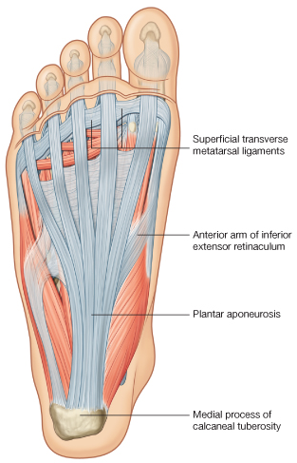
Attachment of plantar aponeurosis –
  Posteriorly – medial tubercle of calcaneus
  Anteriorly – it splits into five bands one for each digit
    Opposite metatarsal head each band split into superficial & deep strata
    Superficial stratum – attached to dermis(by skin ligaments)
    Deep stratum – split into two slips & enclose the flexor tendon and blend with fibrous flexor sheath & deep transverse metatarsal ligament
  Each side - medial & lateral metatarsal bone by medial & lateral intermuscular septa

Slide 10
Function of plantar aponeurosis –
  It maintain the longitudinal arch of foot acting as tie beams
  It protects the plantar vessels & nerves
  It provide the origin of superficial group of plantar muscle
  It divides the sole into compartment & sub-compartment

Slide 11
MUSCLE S OF SOLE –
The intrinsic muscle & tendon passing through sole is arranged in four layer
18 intrinsic muscle & 4 tendon of extrinsic muscle
Nerves & vessels travels through two neurovascular planes
  1st neurovascular plane – b/w 1st and 2nd layer
  2nd neurovascular plane – b/w 3rd and 4th layer

Slide 12
Muscle of sole
1st layer
Abductor hallucis
Flexor digitorum brevis
Abductor digiti minimi
4th layer
Dorsal interossei (4)
Plantar interossei (3)
Tendon of peroneus longus & tibialis posterior
2nd layer
Tendon of long flexor muscle (FHL,FDL)
Lumbrical muscle(4)
Flexor digitorum accessorius
3rd layer
Flexor hallucis brevis
Adductor hallucis
Flexor digiti minimi brevis

Slide 13
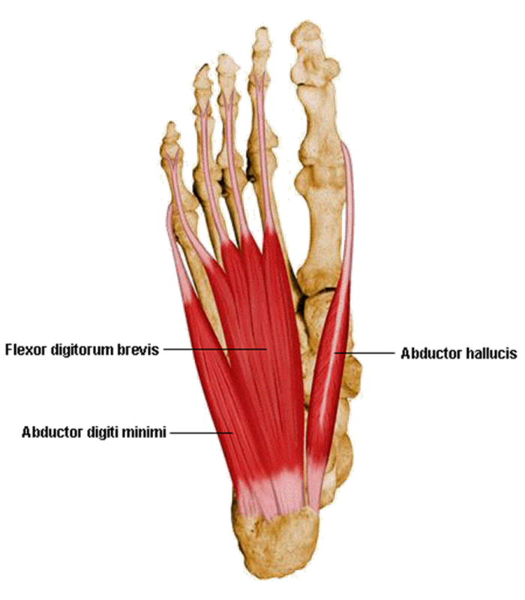
Muscle in 1st layer –
  Three in numbers
  Lies beneath the plantar aponeurosis
  Extends from heel to toe
  All arise from calcaneus
    Abductor hallucis
    Flexor digitorum brevis
    Abductor digiti minimi

Slide 14
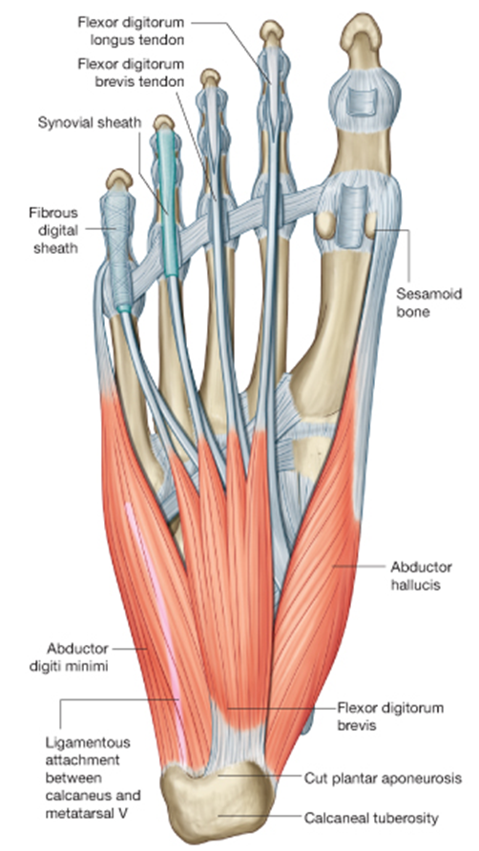
ABDUCTOR HALLUCIS –
  Origin –
    Medial tubercle of calcaneus
    Flexor retinaculum
    Medial intermuscular septa
    Plantar aponeurosis
  Insertion –
    Base of proximal phalanx of great toe (medial side)
  Nerve supply –
    Trunk of medial plantar nerve
  Action –
    Abduct the great toe

Slide 15
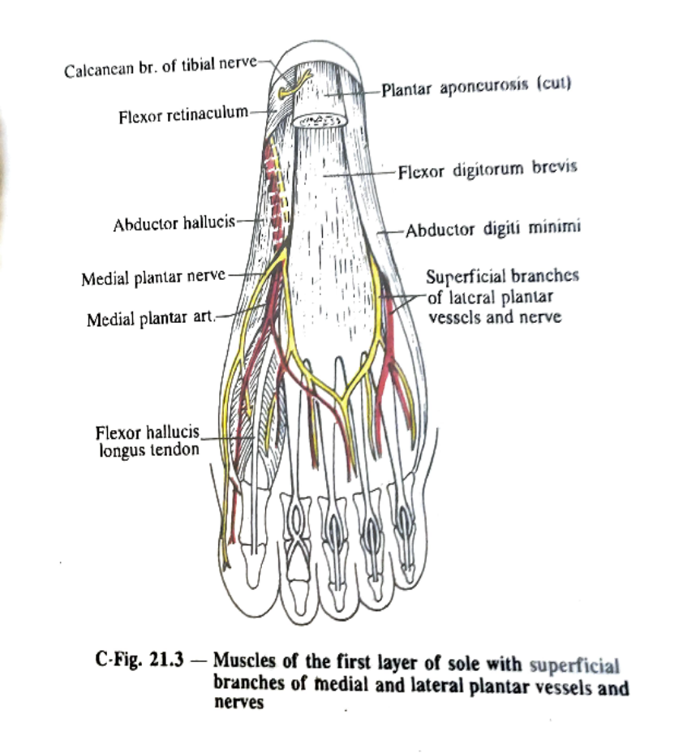
FLEXOR DIGITORUM BREVIS –
  Lies deep to central part of plantar aponeurosis
  Origin –
    Medial tubercle of calcaneus
    Plantar aponeurosis
    Medial & lateral intermuscular septa
  Insertion –
    Muscle divide into 4 tendon for lateral 4 toes
    Enter into flexor fibrous sheath along with tendon flexor digitorum longus
    At the base of proximal phalanx splits & enclose tendon of FDL and then decussate and attached to the side of middle phalanx
  Nerve supply -
    Trunk of medial plantar nerve
  Action -
    Plantar flexion of lateral four toes

Slide 16

ABDUCTOR DIGITI MINIMI –
  origin –
    Medial & lateral tubercle of calcaneus
    Plantar aponeurosis
    Lateral intermuscular septa
  Insertion –
    Proximal phalanx of little toes (lateral side)
WOOD MUSCLE- Sometimes fibers of this muscle inserted into tubercle of 5th metatarsal bone
  Nerve supply –
    Trunk of lateral plantar nerve
  Action –
    Abduct of little toe

Slide 17
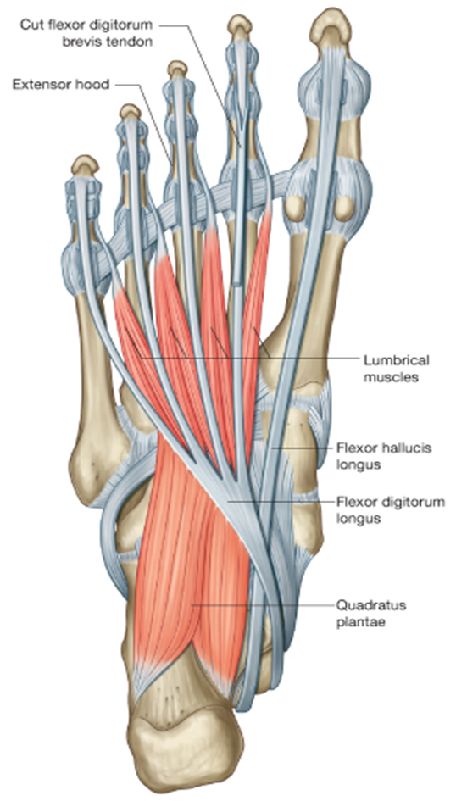
Muscles of 2nd layer –
  It consists of
  2 extrinsic tendon-
    Flexor hallucis longus
    Flexor digitorum longus
  2 Sets of intrinsic muscles-
    Flexor digitorum accessorius (quadratus plantae)
    4- Lumbricals

Slide 18
Quadratus plantae –
  Origin- arises by two head
    Medial head – medial surface of calcaneus
    Lateral head – lateral tubercle of calcaneus
  Insertion –
    Conjoined muscle belly is attached into the lateral side of tendon of FDL
  Nerve supply –
    Trunk of lateral plantar nerve
  Action –
    It assists FDL muscle to flex lateral 4 toes

Slide 19
Lumbrical muscles –
    4 in number
    1st – unipennate
    Rest - bipennate
  Origin -
    arises from adjacent side of tendon of FDL
  Insertion –
    Base of proximal phalanx of lateral 4 toes , dorsal digital expansion
  Nerve supply –
    1st – medial plantar nerve
    Rest – deep branch of lateral plantar nerve
  Actions –
    Plantar flexion at metatarsophalangeal joints & dorsiflexion at interphalangeal joints

Slide 20
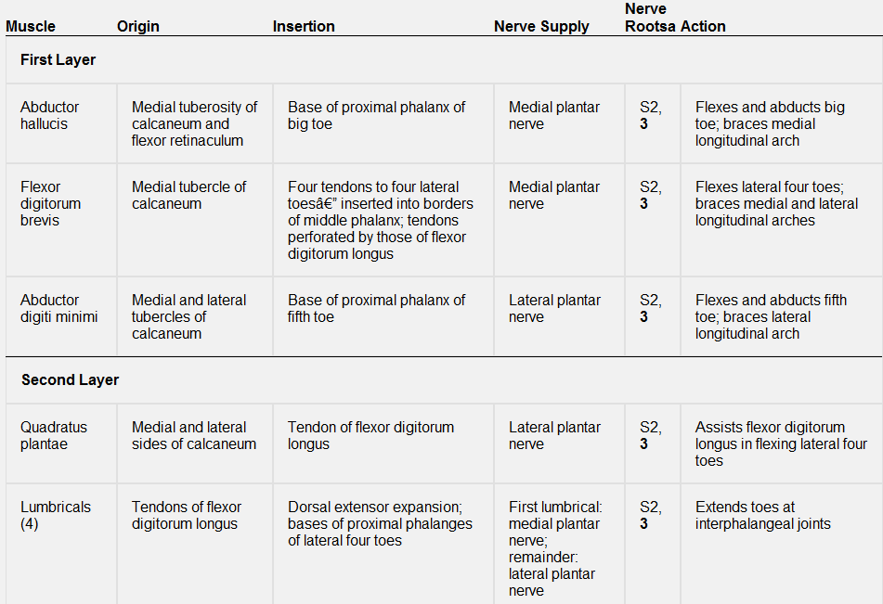

Slide 21
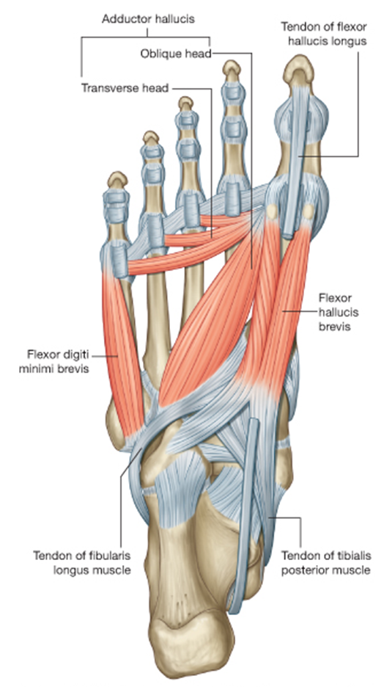
Muscles of 3rd layer –
  Three in number
  2 for great toe & 1 for little toe
  They are confined within the metatarsal region
    Flexor hallucis brevis
    Adductor hallucis
    Flexor digiti minimi brevis

Slide 22

Flexor hallucis brevis-
Forms bipennate muscle that covers the plantar surface of 1st metatarsal bone
Origin –
bifurcated tendinous origin
  Lateral band- from plantar surface of cuboid bone
  Medial band – from three cuneiform bone
Insertion –
  Medial tendon – medial side of base of proximal phalanx of great toe
  Lateral tendon – on lateral side of base of proximal phalanx of great toe
Nerve supply - medial plantar nerve
Action - plantar flexion of great toe at metatarsophalangeal joint

Slide 23

Adductor hallucis –
  Origin -
    Arises by two heads
  Oblique head –
    From base of 2nd to 4th metatarsal bone & sheath of peroneus longus
  Transverse head -
    Has no bony origin
    It arises from deep transverse metatarsal ligament & plantar metatarso-phalangeal ligament of 3rd to 5th toes
Plantar arterial arch & deep branch of lateral plantar nerve leis deep to oblique head
  Insertion -
    Lateral side of base of proximal phalanx of great toe
  Nerve supply –
    Deep branch of lateral plantar nerve
  Action -
    Adduct the great toe

Slide 24
Flexor digiti minimi brevis –
  Origin –
    Plantar surface of base of the 5th metatarsal bone
  Insertion –
    Lateral side of base of proximal phalanx of little toe
  Nerve supply -
    Superficial branch of lateral plantar nerve
  Action –
    Plantar flexion of little toe

Slide 25
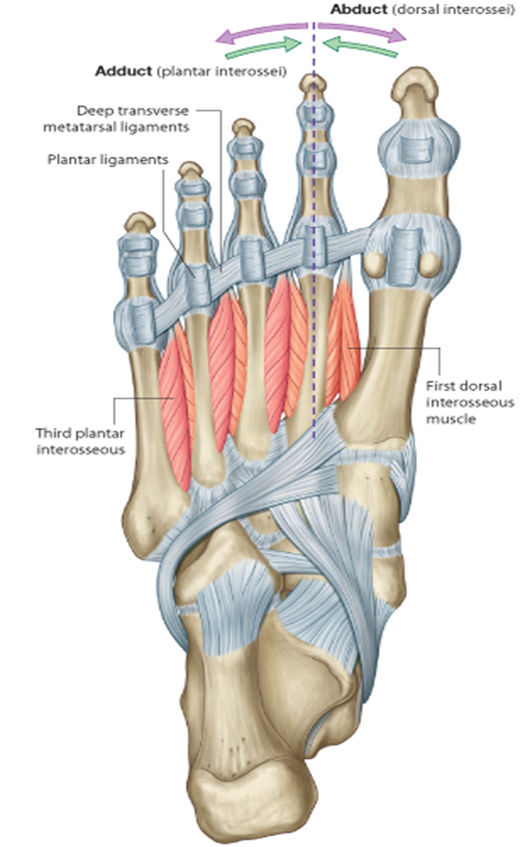
Muscles of 4th layer –
  It contains –
  7 Intrinsic muscles
    4 Dorsal interossei
    3 Plantar interossei
  2 Extrinsic tendons
    Peroneus longus
    Tibialis posterior

Slide 26
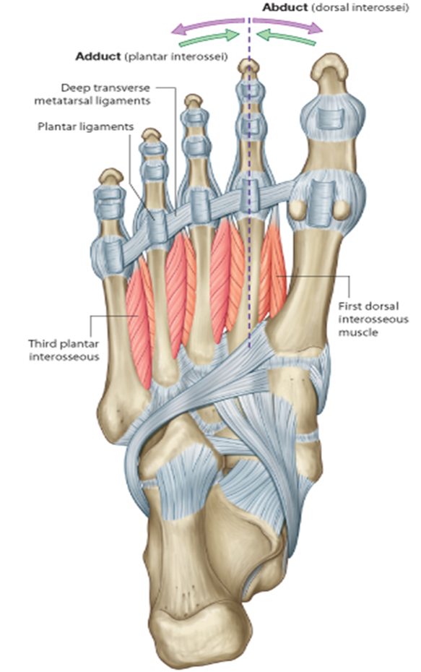
Dorsal interossei –
    4 in number
    Are number from medial to lateral
    Bipennate muscle
    Abductors of toes
  Origin -
    Arises from adjacent sides of shafts of five metatarsal bone
  Insertion –
    1st – medial side of the base of proximal phalanx of 2nd toe
    2nd ,3rd & 4th - lateral side of base of proximal phalanx of 2nd , 3rd & 4th toes respectively
  Nerve supply –
    All dorsal interossei supplied by deep branch of lateral plantar nerve , except 4th

Slide 27

Plantar interossei –
    3 in number
    Unipennate muscles
    Adductors of lateral three toes
  Origin –
    Arises from medial side of plantar surface of shafts of lateral three metatarsal bones
    1st – from 3rd metatarsal bone
    2nd - from 4th metatarsal bone
    3rd - from 5th metatarsal bone
  Insertion –
    On medial side of the base of proximal phalanx of 3rd ,4th & 5th toes
  Nerve supply –
    Deep branch of lateral plantar nerve except 3rd

Slide 28
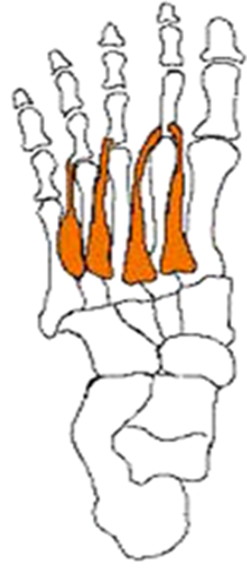
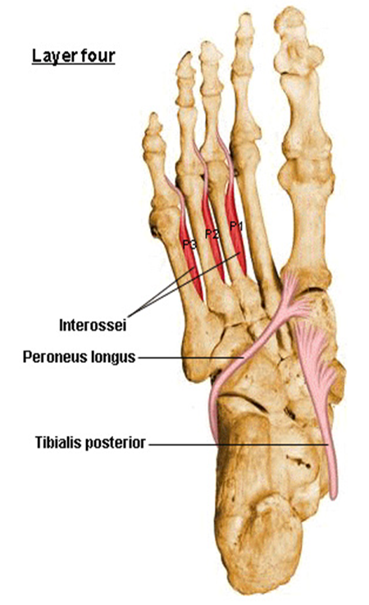

Slide 29
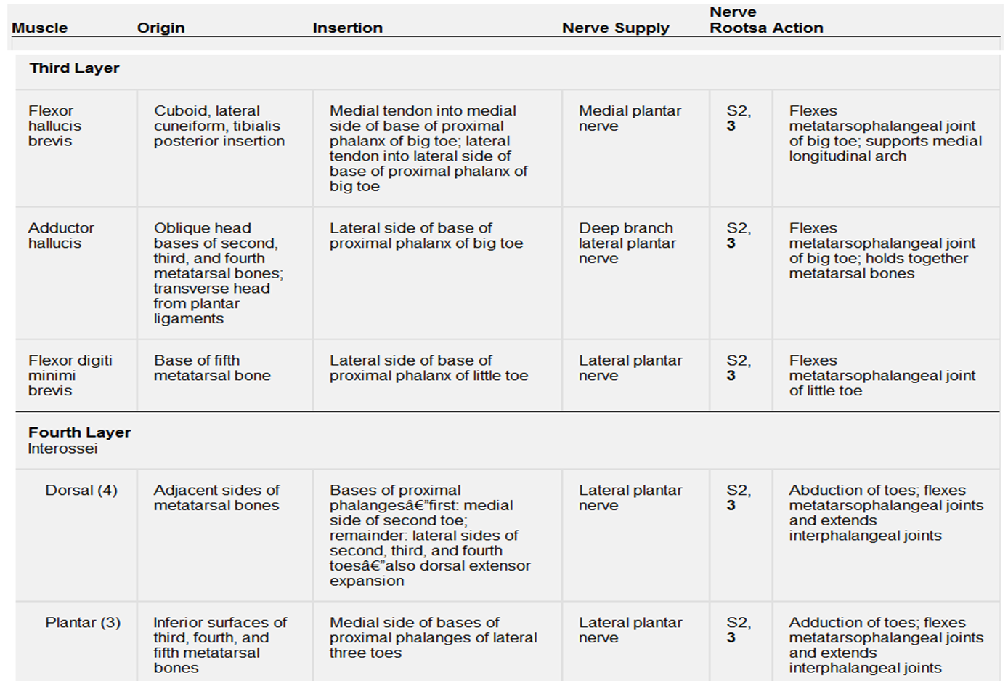

Slide 30
NERVES & VESSELS OF THE SOLE

Slide 31
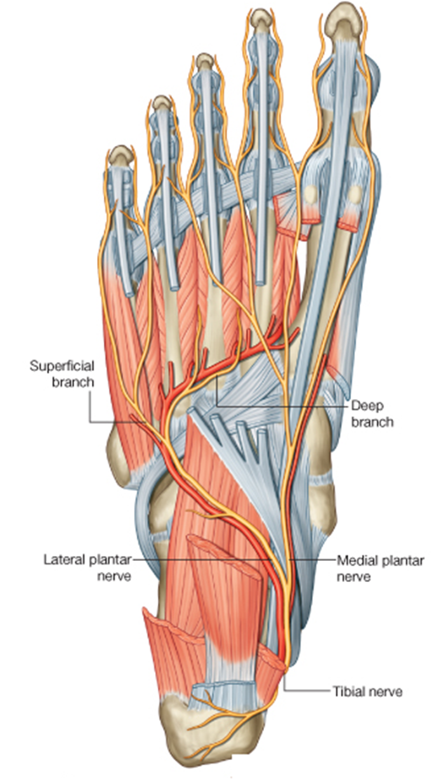
Nerve of the sole –
  Contains medial & lateral plantar nerve
  Which are the terminal branch of tibial nerve
  Begin deep to flexor retinaculum
  Enter the sole under cover of abductor hallucis

Slide 32
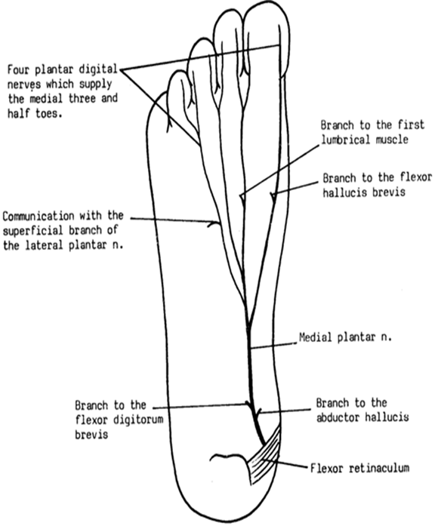
Medial plantar nerve –
  Larger terminal branch
  Passes deep to abductor hallucis
  Then appear b/w abductor hallucis & FDB
  End by dividing into one proper digital nerve for big toe three common plantar digital nerve
Branches –
  Cutaneous
  Muscular
  Articular

Slide 33

Muscular branch –
Main trunk –
  Abductor hallucis
  FDB
  FHB
  1st Lumbricals
Cutaneous branch –
  One proper digital
  Three common digital
    Each common digital divides into two proper digital nerve
    And supply medial three and half digits

Slide 34
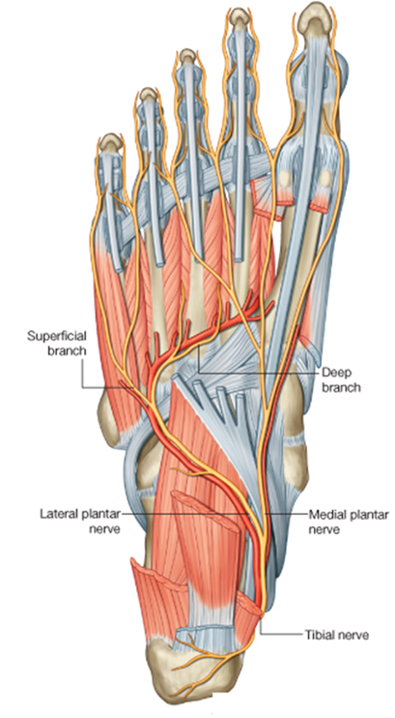

Slide 35
Lateral plantar nerve –
  Smaller terminal branch
  Begins deep to flexor retinaculum
  Enter the sole under cover of abductor hallucis
  Then it passes obliquely (forward & laterally ) across the sole
  At the tuberosity of 5th metatarsal bone it divides into superficial & deep branch

Slide 36

Branches –
Main trunk –
  Flexor digitorum accessorius
  Abductor digiti minimi
Superficial branch- supplies three muscle
  FDMB
  3rd plantar interossei
  4th dorsal interossei
  Cutaneous branch for lateral one & half digits
Deep branch – supplies nine muscles
  2nd ,3rd& 4th Lumbricals
  1st ,2nd & 3rd dorsal interossei
  1st & 2nd plantar interossei
  Adductor hallucis

Slide 37
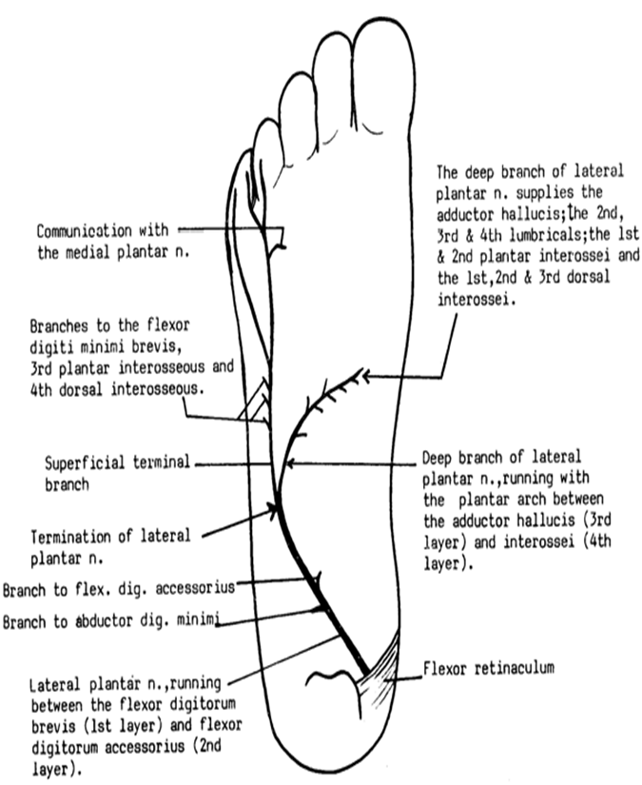

Slide 38
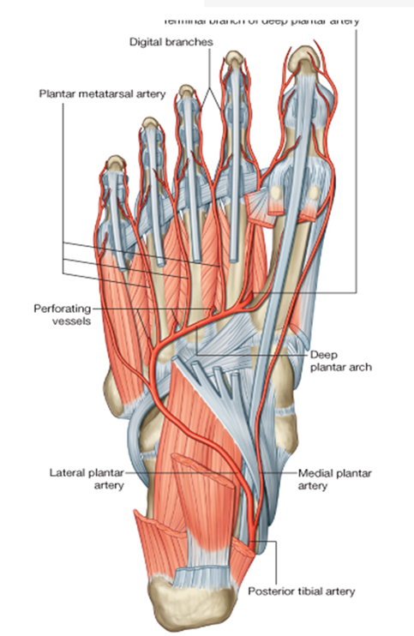
Arteries of sole –
Medial & lateral plantar artery
Terminal branch of posterior tibial artery
Divisions of arteries takes place beneath the flexor retinaculum

Slide 39
Medial plantar artery –
Smaller terminal branch of posterior tibial artery
Lies along the medial border of foot
Appear in the sole deep to abductor hallucis

Slide 40
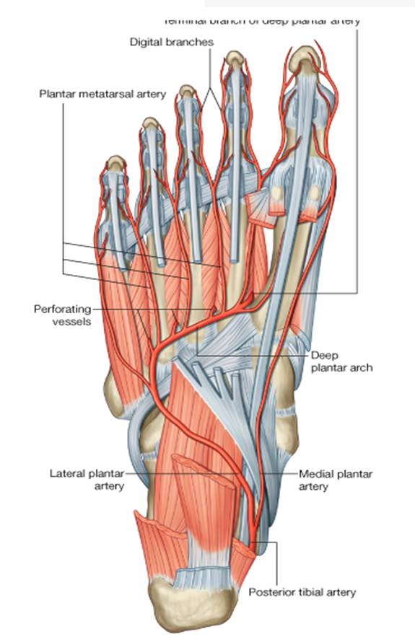
Lateral plantar artery –
Larger terminal branch posterior tibial artery
It passes forward & laterally between 1st & 2nd of muscles of sole
At the base of 5th metatarsal bone it divides into superficial & deep branch

Slide 41

Superficial branch supply skin of lateral side of sole & little toe
Deep branch turn forward & medially beneath the oblique head of adductor hallucis & forms plantar arch
And reach to the gap b/w the two head of 1st dorsal interosseous
And anastomose with dorsalis pedis artery

Slide 42

Plantar arch –
  convex distally across base of 2nd ,3rd , & 4th metatarsal bones
  Direct continuation of deep branch lateral plantar artery
  Lies b/w 3rd & 4th layers of muscles of the sole
Branches –
  Three proximal perforating arteries
  Four plantar metatarsal arteries

Slide 43
Applied anatomy
Plantar fasciitis -
  Chronic inflammation of posterior bony attachment of plantar aponeurosis
  Pain in heel
  common in people who have stand for long period of time
Policeman’s heel –
  Plantar fascia may tear at its apex
  More common in police
Calcaneal spur –
  Ossification at the apex of the aponeurosis lead to formation of calcaneal spur
Morton’s metatarsalgia –
  Neurofibroma occur on digital nerve supplying adjacent side of 3rd & 4th toes
  There is a usually communication b/w most lateral digital plantar nerve & medial branch of lateral plantar nerve
  Neurofibroma may arise at communication
  Pressure of the tight fitting shoe may be cause this condition, which results in severe pain in 3rd & 4th toes

Slide 44
THANK YOU

