Slide 1
TEMPORAL & INFRATEMPORAL REGION
Dr. SARANGDHAR KUMAR
DEPARTMENT OF ANATOMY
RMCH, BAREILLY

Slide 2
Session goal -
At the end of this presentation, students should be able to :
  Describe the boundaries and contents of the temporal and infratemporal fossa
  Describe the attachments, actions and innervations of the muscles of mastication
  Describe the branches of the Mandibular division of the trigeminal nerve (V3)
  Name the branches of the maxillary artery and the tributaries of the maxillary vein
  Describe the otic ganglion
  Describe the temporomandibular joint (TMJ)

Slide 3
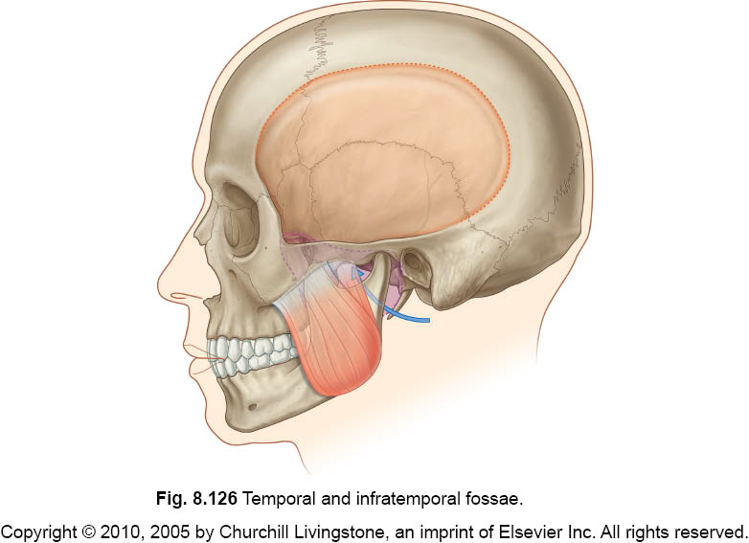
Overview of the temporal and infratemporal region
Temporal fossa
Spaces on the side of the head located superior and inferior to the zygomatic arch and are connected through the gap deep to it
Zygomatic arch
Infratemporal fossa

Slide 4
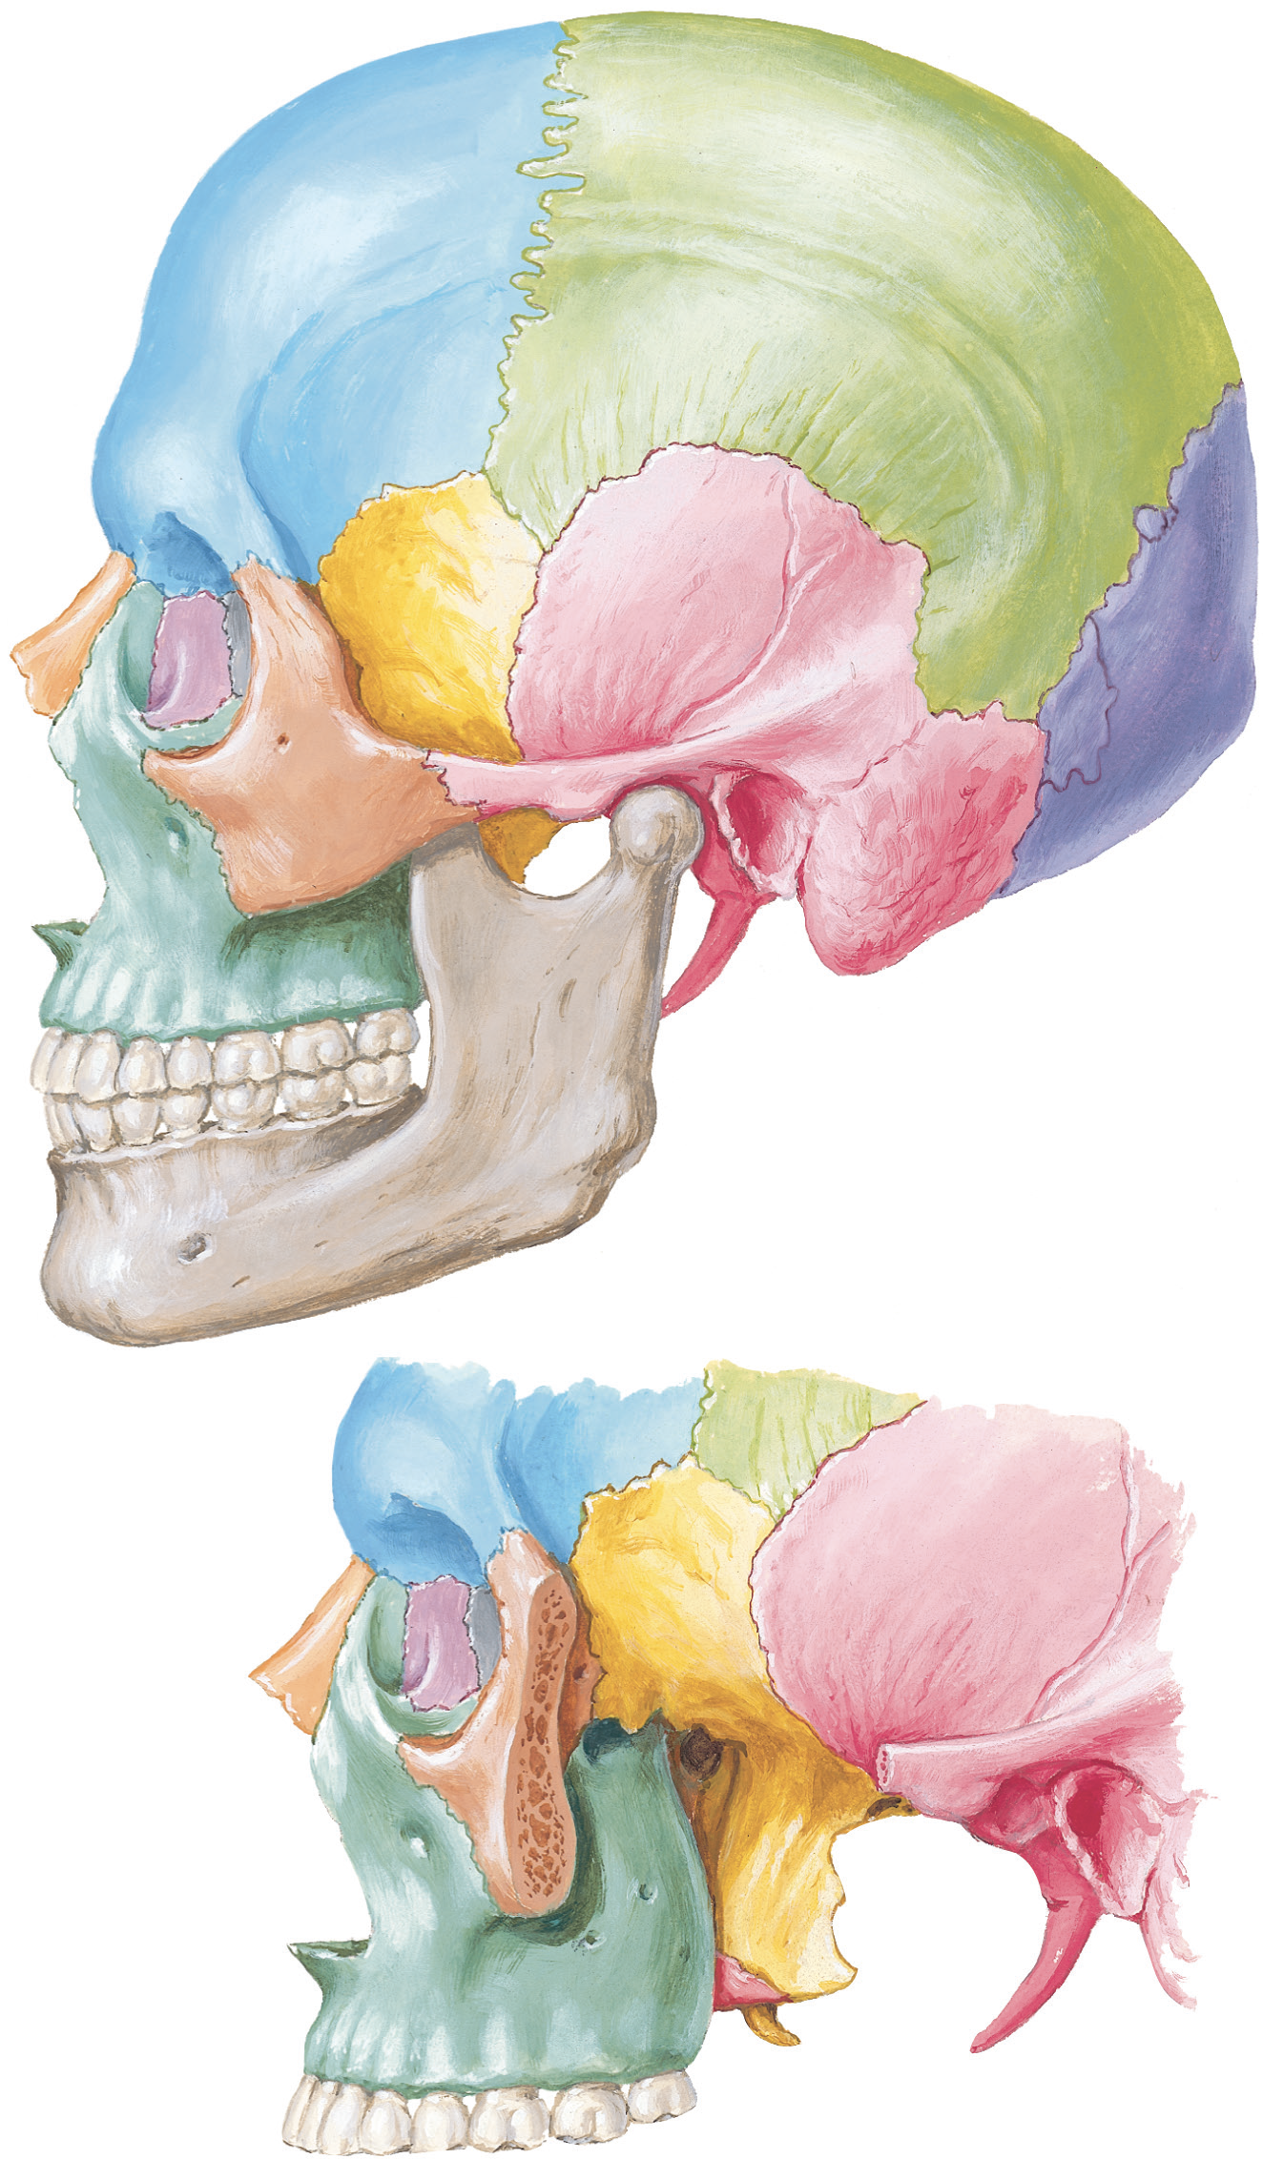
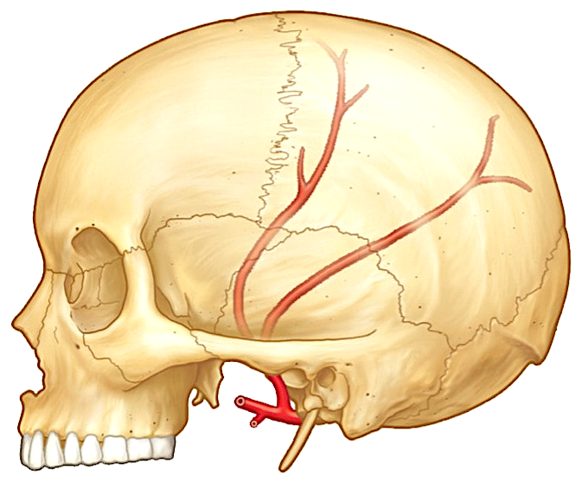
Bony landmarks
Frontal bone
Parietal bone
Superior and inferior
temporal lines
Anterior branch of
middle meningeal artery
Pterion
Greater wing
of sphenoid
Pterion
Squamous part of
temporal
bone
Zygomatic
bone
Zygomati arch
Posterior branch of
middle meningeal artery
Skull (lateral view)
Pterion
  An H-shaped region where frontal, sphenoid (greater wing), parietal and squamous part of temporal bones meet each other
  Anterior branch of middle meningeal artery lies deep to it, fracture of this region leads to epidural ( extradural) hematoma

Slide 5
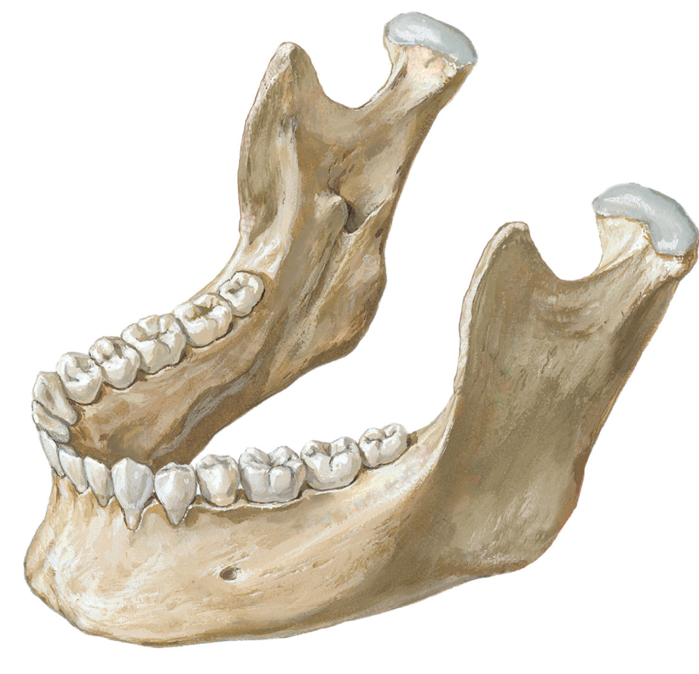
Coronoid process
Head
Pterygoid fovea
Condylar process
Neck
Lingula
Mandibular foramen
Ramus
Angle
Mental
protuberance
Mental foramen
Body
Mandible

Slide 6
Temporal region
Region of the head which overlies temporal fossa
Situated on each side of the skull
Infront of auricle & above the zygomatic arch
Boundaries-
  Above & Behind - Temporal line
  Below & Behind - Supra mastoid crest
  Below & Infront - open
  Infront - Temporal surface of zygomatic bone
  Floor - of temporal region is formed by the temporal fossa
  Roof - formed by temporal fascia
Superior & inferior temporal line
pterion
Infratemporal fossa

Slide 7
Temporal fossa
Superior and inferior
temporal lines
Boundaries
  Anteriorly
    Frontal and zygomatic bones
  Superiorly
    Superior temporal line
  Laterally
    Zygomatic arch
  Inferiorly
    Communicates with infratemporal fossa
  Floor
    Bones forming the pterion (frontal, parietal, squamous part of the temporal, greater wing of the sphenoid)
Pterion
Infratemporal fossa
Notes:
Superior temporal line – for attachment of temporal fascia, inferior temporal line - for attachment of temporalis muscle

Slide 8
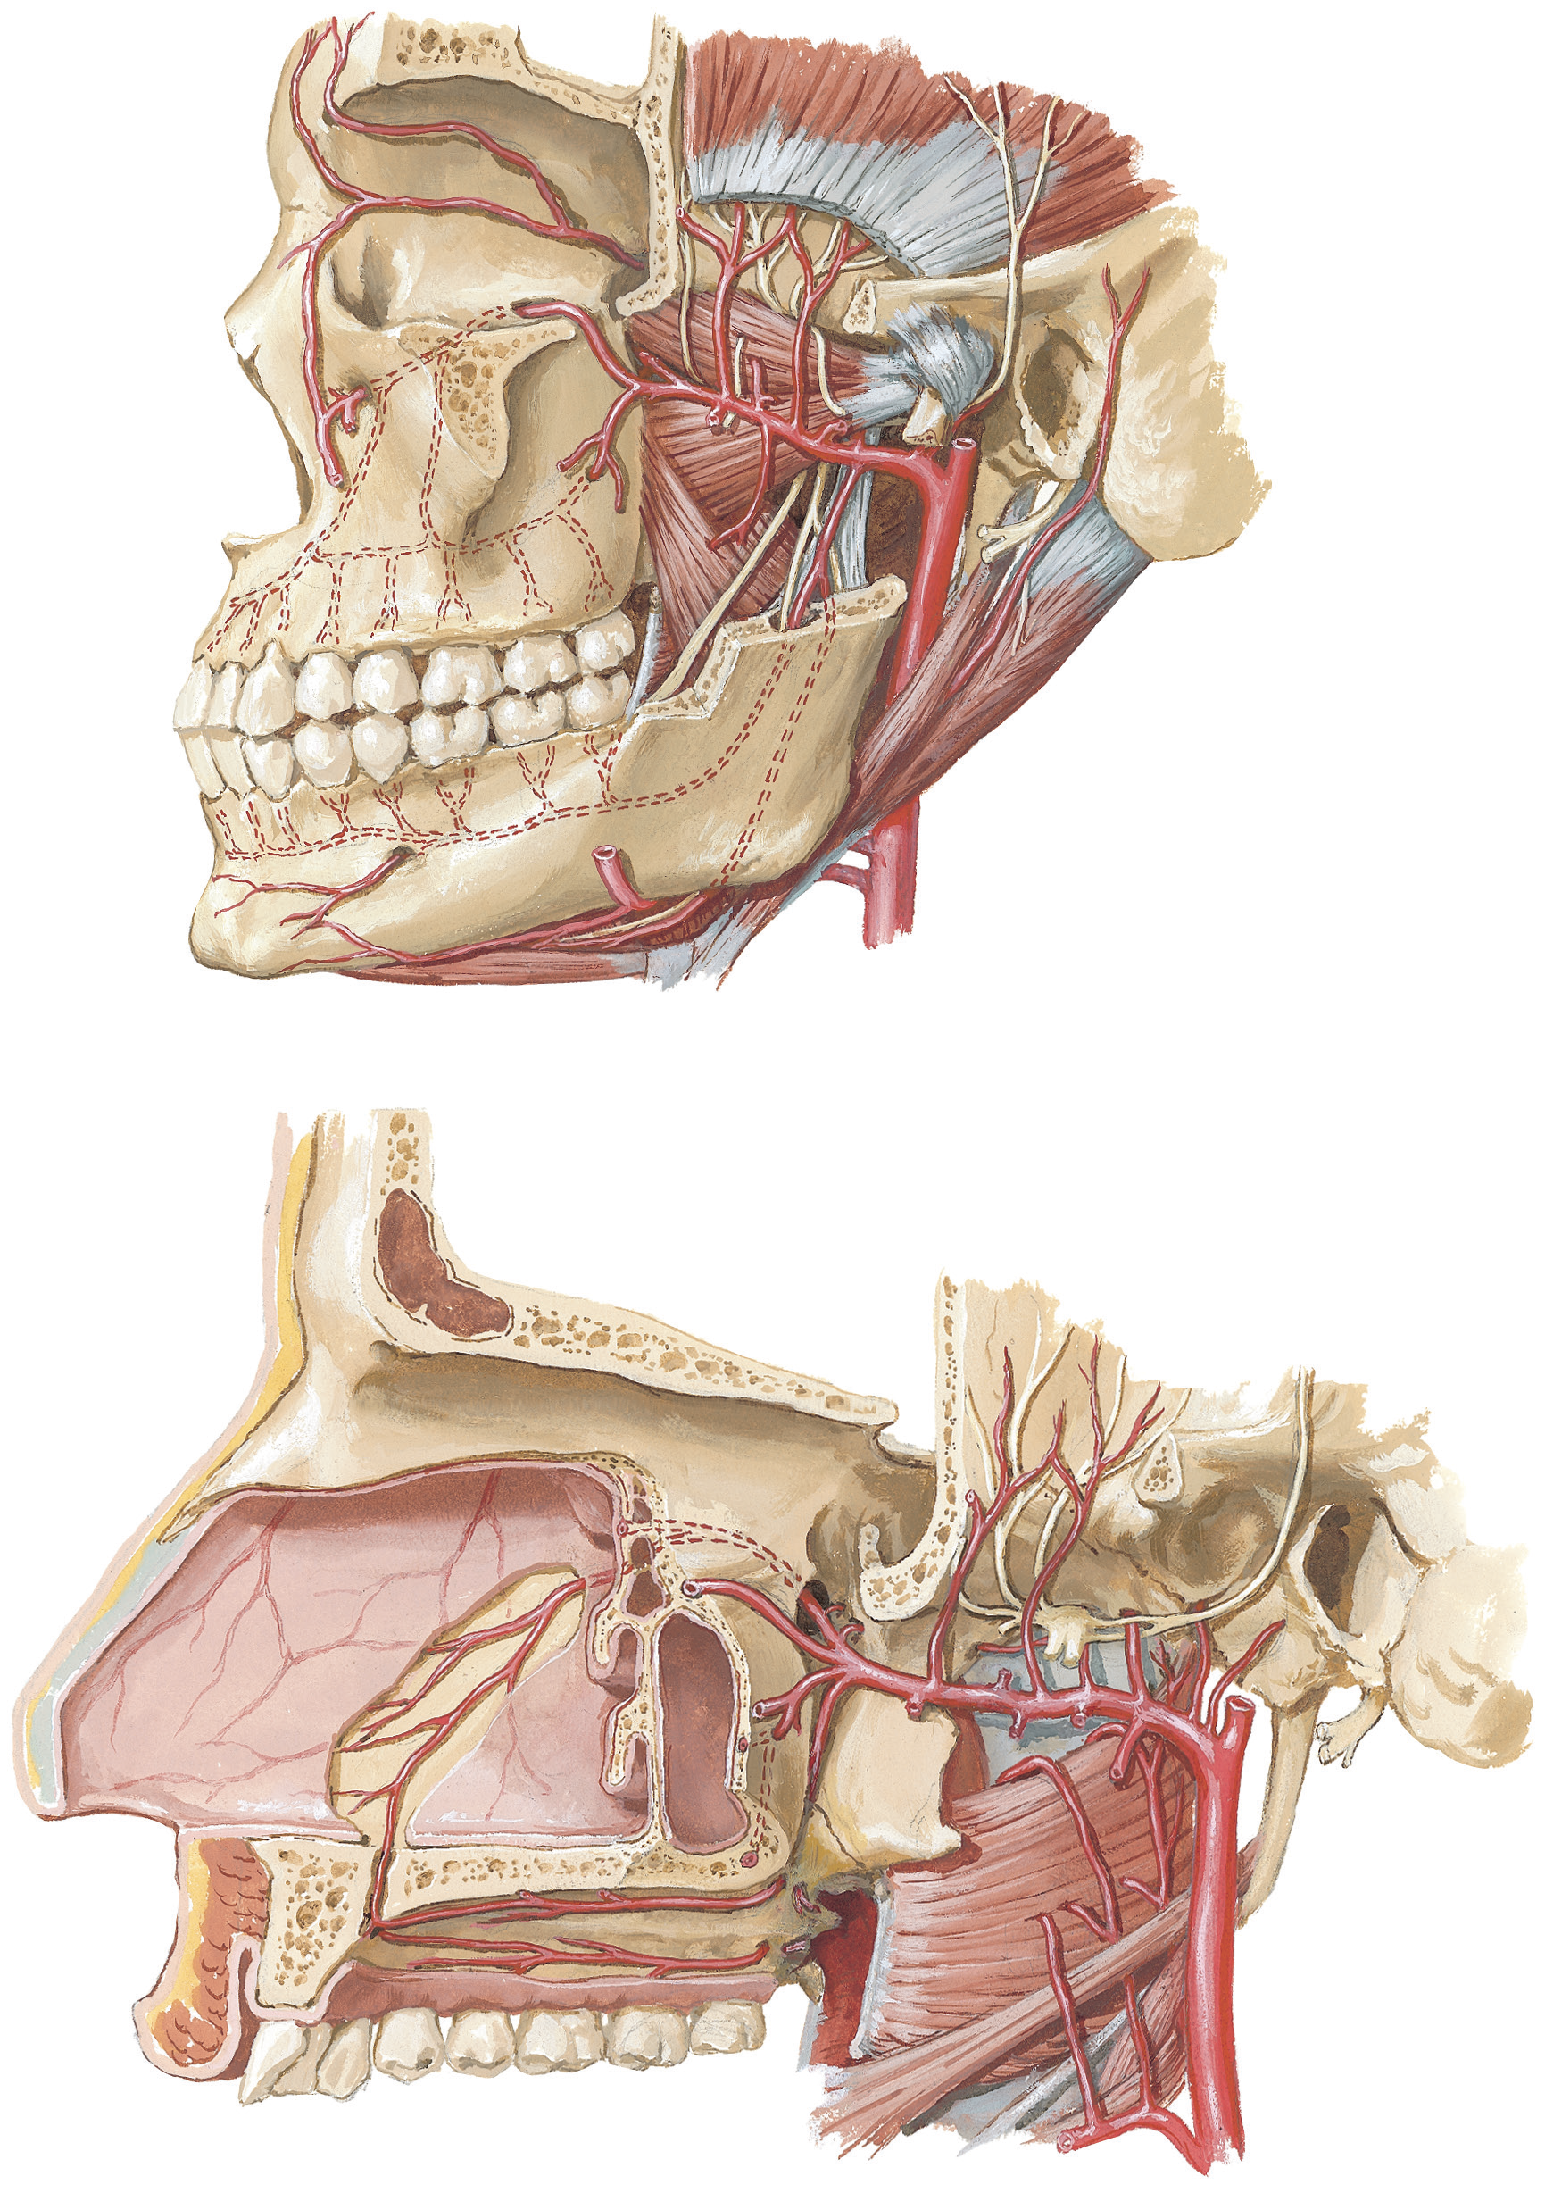
Contents of Temporal fossa –
Temporalis muscle & Its covering fascia
Deep temporal nerves & vessels
Auriculo tempoaral nerve
Superficial temporal artery
Buccal artery
Deep temporal arteries
Temporalis
Masseteric artery
Pterygoid artery

Slide 9
Infratemporal fossa
Zygomatic arch
Irregular fossa situated below to middle cranial fossa, deep and inferior to zygomatic arch, deep to ramus of mandible, and posterior to maxilla
Between the pharynx & ramus of the mandible
Boundaries
  In front- posterior surface of body of maxilla
  Behind- styloid process & carotid sheath
  Medially- lateral pterygoid plate
  Laterally- ramus of the mandible & coronoid process
  Above- infra temporal surface of greater wing of sphenoid
  Below- open & continuous with tissue space around pharynx and oesophagus
Infratemporal fossa
Lateral
pterygoid
plate

Slide 10
Communications of Infratemporal fossa
Infront – with orbit through inferior orbital fissure.
Medially – with Pterygopalatine fossa through Pterygo-maxillary fissure.
Above & laterally – with temporal fossa through gap deep to zygomatic arch
Above & medially – with middle cranial fossa through foramen ovale & spinosum

Slide 11
Contents of the infratemporal fossa
  Muscles – parts of temporalis, medial pterygoid, lateral pterygoid muscles
  Branches of mandibular division of trigeminal nerve
  Chorda tympani nerve
  Branches of maxillary artery
  Pterygoid venous plexus
  Otic ganglion

Slide 12
Muscles of mastication
Four in number
Masseter muscle
Temporalis muscle
Medial pterygoid muscle
Lateral pterygoid muscle

Slide 13
Muscle of mastication
All the four muscles take origin from cranium & inserted into the mandible.
All the four muscles of mastication develops from the mesoderm of 1st pharyngeal arch
Innervated by the nerve of 1st pharyngeal arch (Mandibular nerve)
All the muscle moves on TMJ
Buccinator is regarded as accessory muscle of mastication

Slide 14
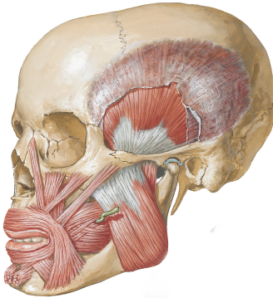
Masseter
It is quadrilateral muscle
Situated between face and parotid region
Consist of three layers.
Origin-
Superficial layer- Ant. 2/3rd of lower border of zygomatic arch
Middle layer- Post. 1/3rd of lower border of zygomatic arch
Deep layer- Deep surface of zygomatic arch
Insertion-
Outer surface of ramus & angle of the mandible
Nerve- Ant. Division of mandibular nerve
Action- strong elevator of mandible & also protrudes mandible
Masseter

Slide 15
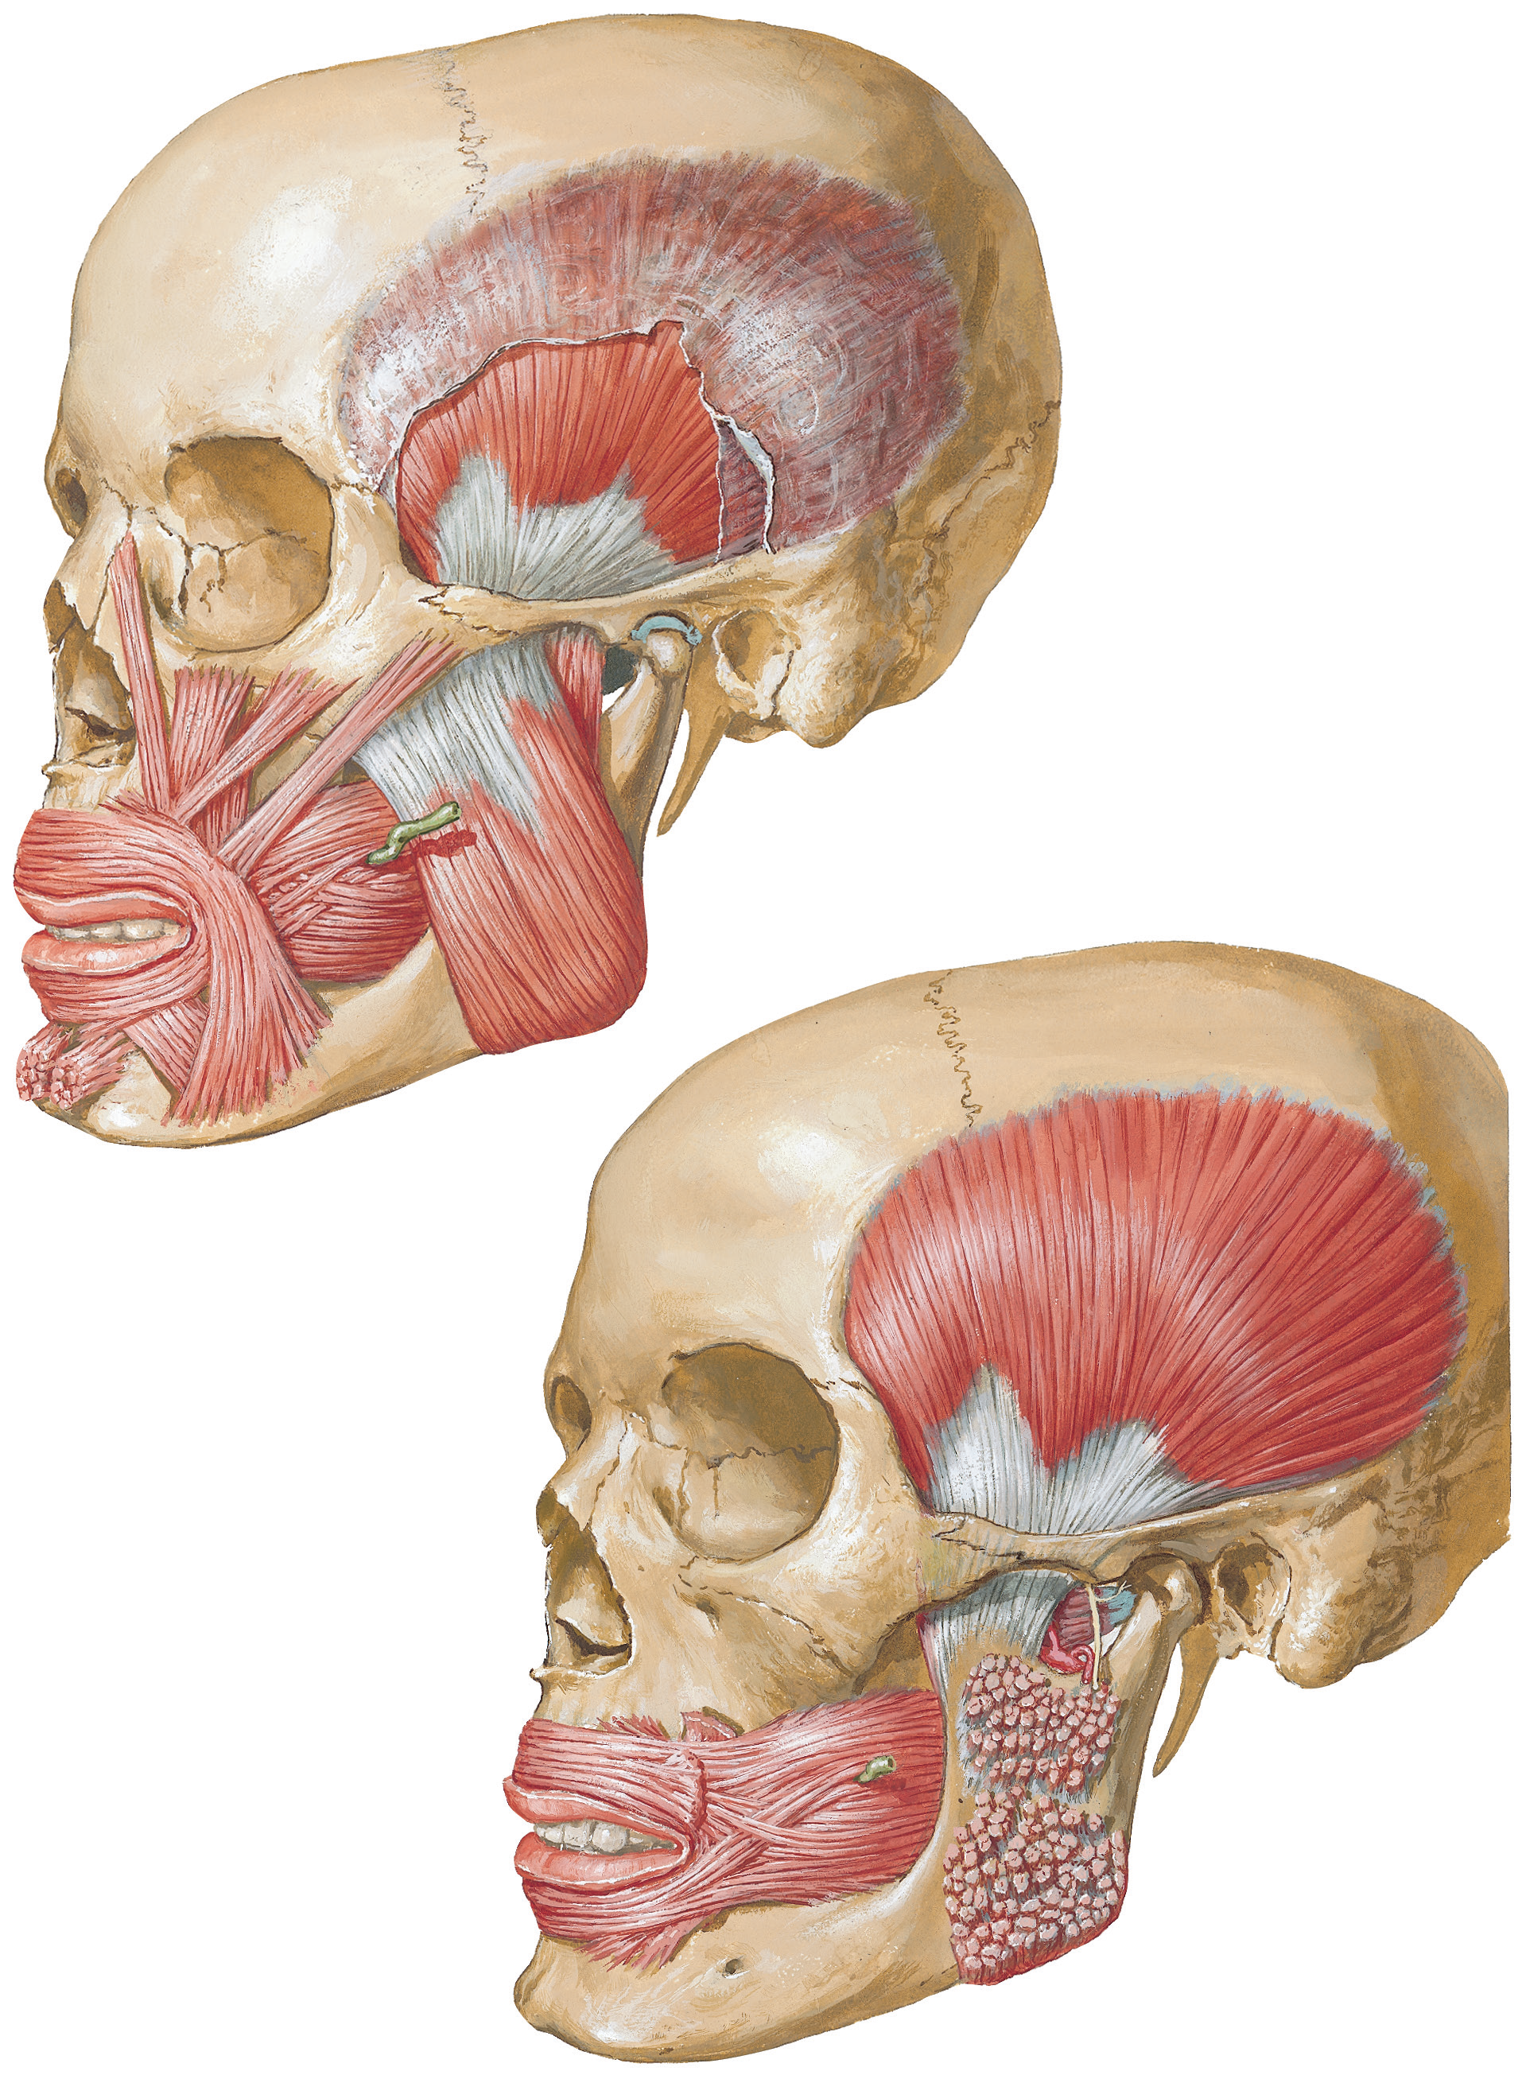
Temporalis
Covered by a thick temporal fascia
  Attached superiorly to superior temporal line, inferiorly it split and attaches on medial and lateral surface of zygomatic arch.
Origin – fan shaped muscle
  Floor of temporal fossa and deep surface of temporalis fascia.
Insertion
  Coronoid process and anterior border of ramus of mandible.
Innervation
  Deep temporal branches of anterior division of mandibular nerve.
Action
  Elevates mandible, posterior horizontal fibers retracts the mandible.
Temporal
fascia
Zygomatic
arch
Temporalis
Notes:
Triangular muscle with broad origin and narrow insertion

Slide 16
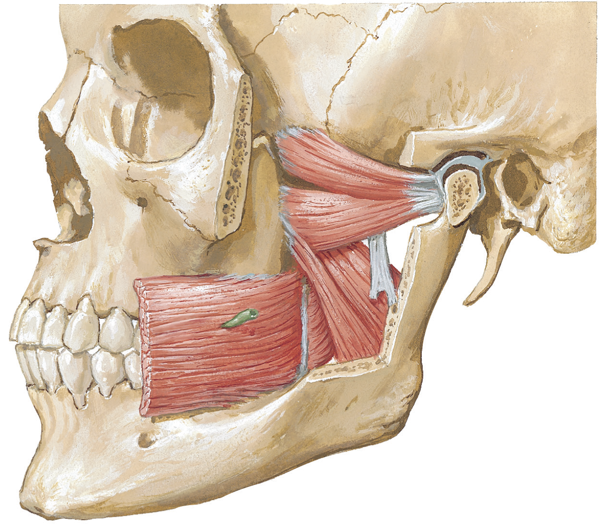
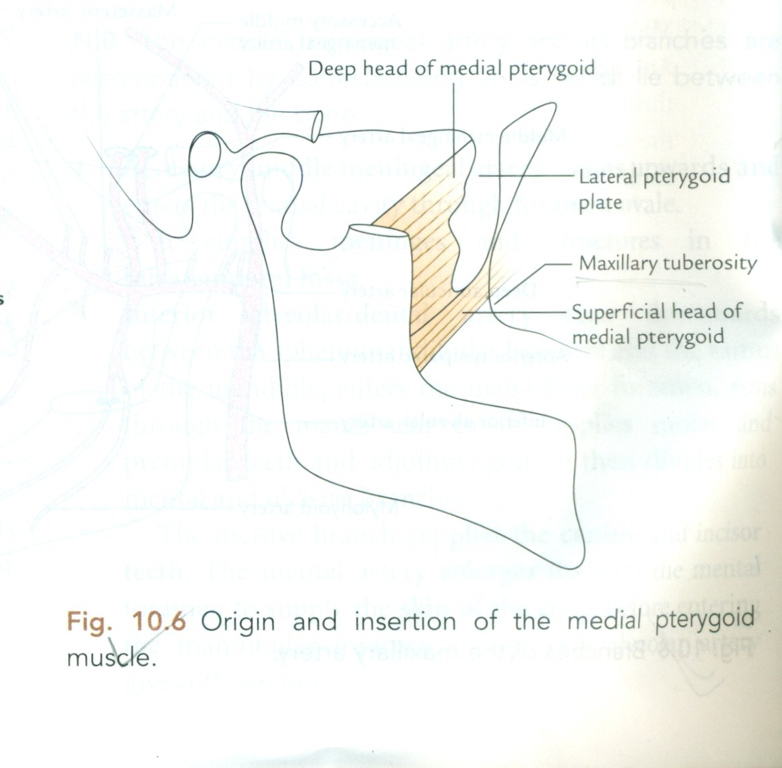
Medial pterygoid
Quadrangular in shape, has two head.
Origin
  Deep head: attaches on the medial surface of the lateral pterygoid plate.
  Superficial head: attaches on the pyramidal process of the palatine bone and tuberosity of the maxilla.
Insertion
  Medial surface of ramus and angle of the mandible
Innervation
  Trunk of Mandibular nerve.
Action
  Elevates mandible, protrudes the mandible.
Medial pterygoid

Slide 17
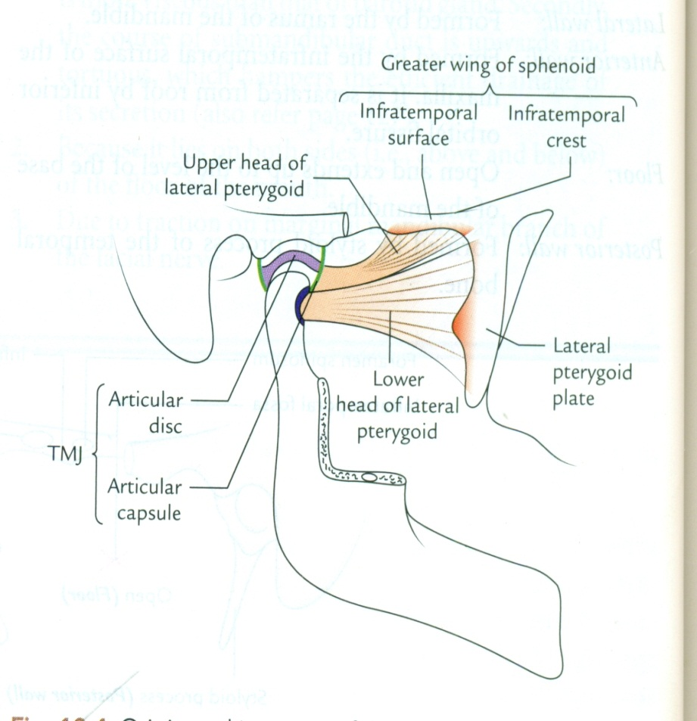
Lateral pterygoid
Lateral pterygoid
Triangular in shape, has two head.
Origin
  Upper head: infratemporal surface and infratemporal crest of the greater wing of sphenoid.
  Lower head: lateral surface of lateral pterygoid plate.
Insertion
  Upper head: artcular disc and capsule of temporomandibular joint.
  Lower head: neck of mandible (pterygoid fovea).
Innervation
  Anterior division of Mandibular nerve.
Action
  Depress chin, protrudes the mandible.
Notes:
The primary function of the lateral pterygoid muscle is to pull the head of the condyle out of the mandibular fossa along the articular eminence to protrude the mandible. A concerted effort of the lateral pterygoid muscles helps in lowering the mandible and opening the jaw, whereas unilateral action of a lateral pterygoid produces contralateral excursion (a form of mastication), usually performed in concert with the medial pterygoid
Unlike the other three muscles of mastication, the lateral pterygoid is the only muscle of mastication that assists in depressing the mandible (opening the jaw). At the beginning of this action it is assisted by the digastric mylohyoid and geniohyoid muscles.

Slide 18
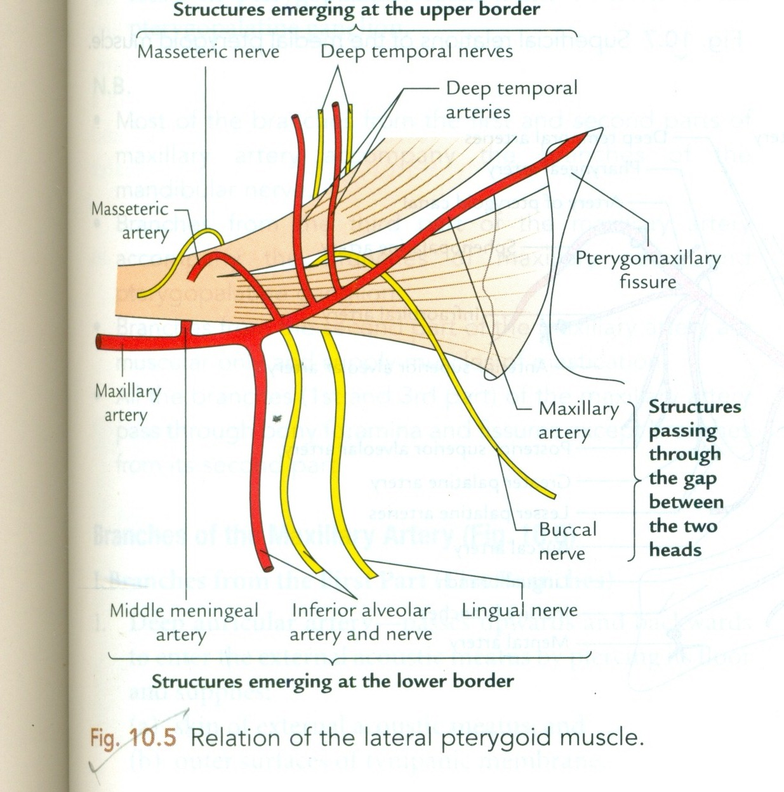
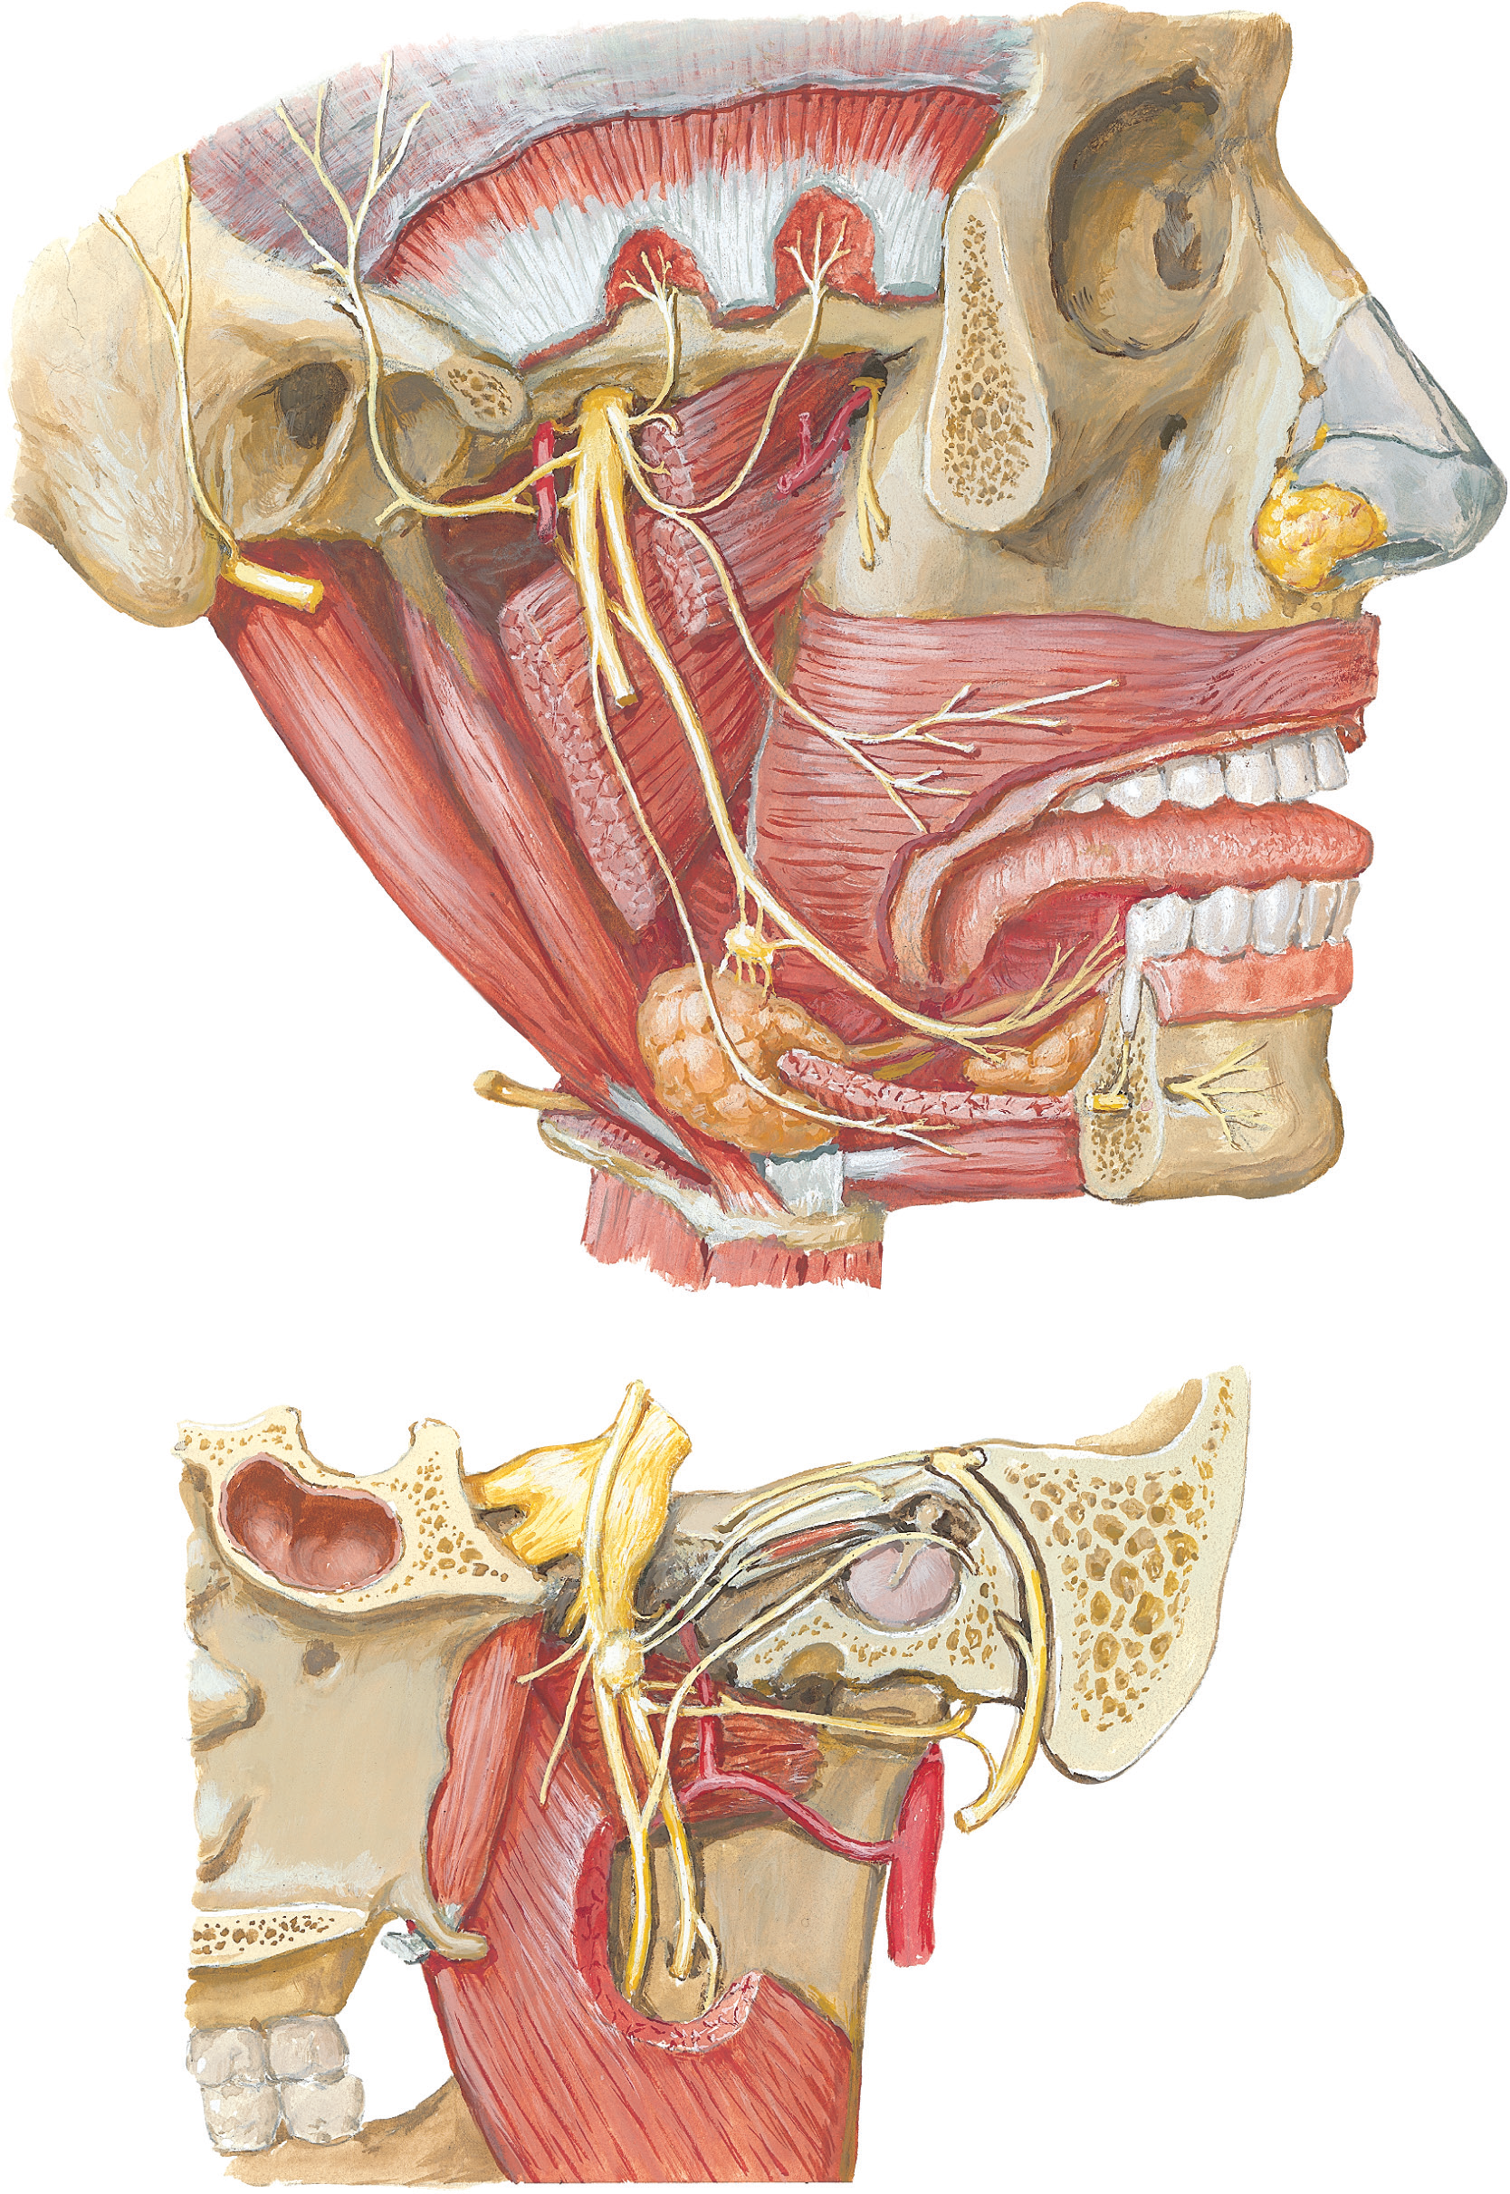
Relation of lateral ptergoid muscle
Superficial –
masseter
Ramus of the mandible
Tendon of temporalis
Maxillary artery
Deep –
Mandibular nerve & its branches
Chorda tympani nerve
Middle memingeal artery
Sphenomandibular ligament
Deep head of medal pterygoid muscle

Slide 19
Maxillary artery
Lateral pterygoid
muscle
Maxillary
artery
Large terminal branch of external carotid artery.
Runs horizontally; superficial or deep to the lateral pterygoid muscle.
Enters pterygopalatine fossa by passing through the pterygomaxillary fissure.
Lateral pterygoid divides it into three parts – 1st part proximal, 2nd part superficial or deep, 3rd part distal to the lateral pterygoid muscle.
The first and second parts of the maxillary artery are in the infratemporal fossa whereas the third part is in the pterygopalatine fossa
Superficial temporal
artery
External carotid
artery
Maxillary
artery
External
carotid
artery
Notes:
The first and second parts of the maxillary artery are in the infratemporal fossa, whereas the third part is in the pterygopalatine fossa.
1st part branches - Middle meningeal artery – foramen spinosum; rupture is cause of epidural hemorrhage , Accessory meningeal artery – foramen ovale, inferior alveolar, anterior tympanic, deep auricular
2nd part – muscular, buccal artery
3rd part branches - Infraorbital artery, sphenopalatine artery, posterior superior alveolar artery (middle and anterior are branches of infraorbital artery), artery of pterygoid canal, pharyngeal artery, descending palatine artery

Slide 20
Branches of the maxillary artery
1st part (mandibular)
  Inferior alveolar
    Enters mandibular foramen.
  Middle meningeal
    Encircled by two roots of auriculotemporal nerve before entering foramen spinosum.
  Accessory meningeal
    Enters cranial cavity through foramen ovale.
  Anterior tympanic
    Supplies tympanic membrane.
  Deep auricular
    Supplies external acoustic meatus.
Inferior alveolar a.
Auriculotemporal n.
Anterior
tympanic a.
Deep auricular a.
Middle meningeal a.
Accessory meningeal a.

Slide 21
Branches of maxillary artery
2nd part (pterygoid)
Mainly muscular
  Deep temporal
    Ascends deep to temporalis muscle.
  Masseteric
    To masseter muscle.
  Pterygoid
    To medial and lateral pterygoid muscles.
  Buccal
    Courses with buccal nerve to supply Buccinator muscles, buccal fat pad, buccal mucosa.
Buccal artery
Deep temporal arteries
Masseteric artery
Pterygoid artery

Slide 22
Branches of maxillary artery
3rd part (pterygopalatine )
Posterior superior alveolar artery
  Supply the molar & premolar teeth
  Mucous membrane of maxillary sinus
Infra –orbital artery
  In orbit- it gives two branches- orbital branch & ant. superior alveolar
  In face – medial angle of eye &lacrimal sac, side of nose& upper lip
Greater palatine artery
  Supply mucous membrane of roof of mouth & gums
  Lesser palatine branch- soft palate & palatine tonsil
Pharyngeal artery
  Supply –mucous membrane of nasopharynx, auditory tube & sphenoidal sinus

Slide 23
Artery of pterygoid canal
  Supply -pharynx, auditory tube & tympanic cavity
Spheno- palatine artery
  It is the continuation of maxillary artery
  Enter the nasal cavity through nasopalatine foramen
  Divides into two branches-
  - posterior lateral nasal branch- sphenoidal & ethmoidal air sinus
  - posterior septal branch

Slide 24
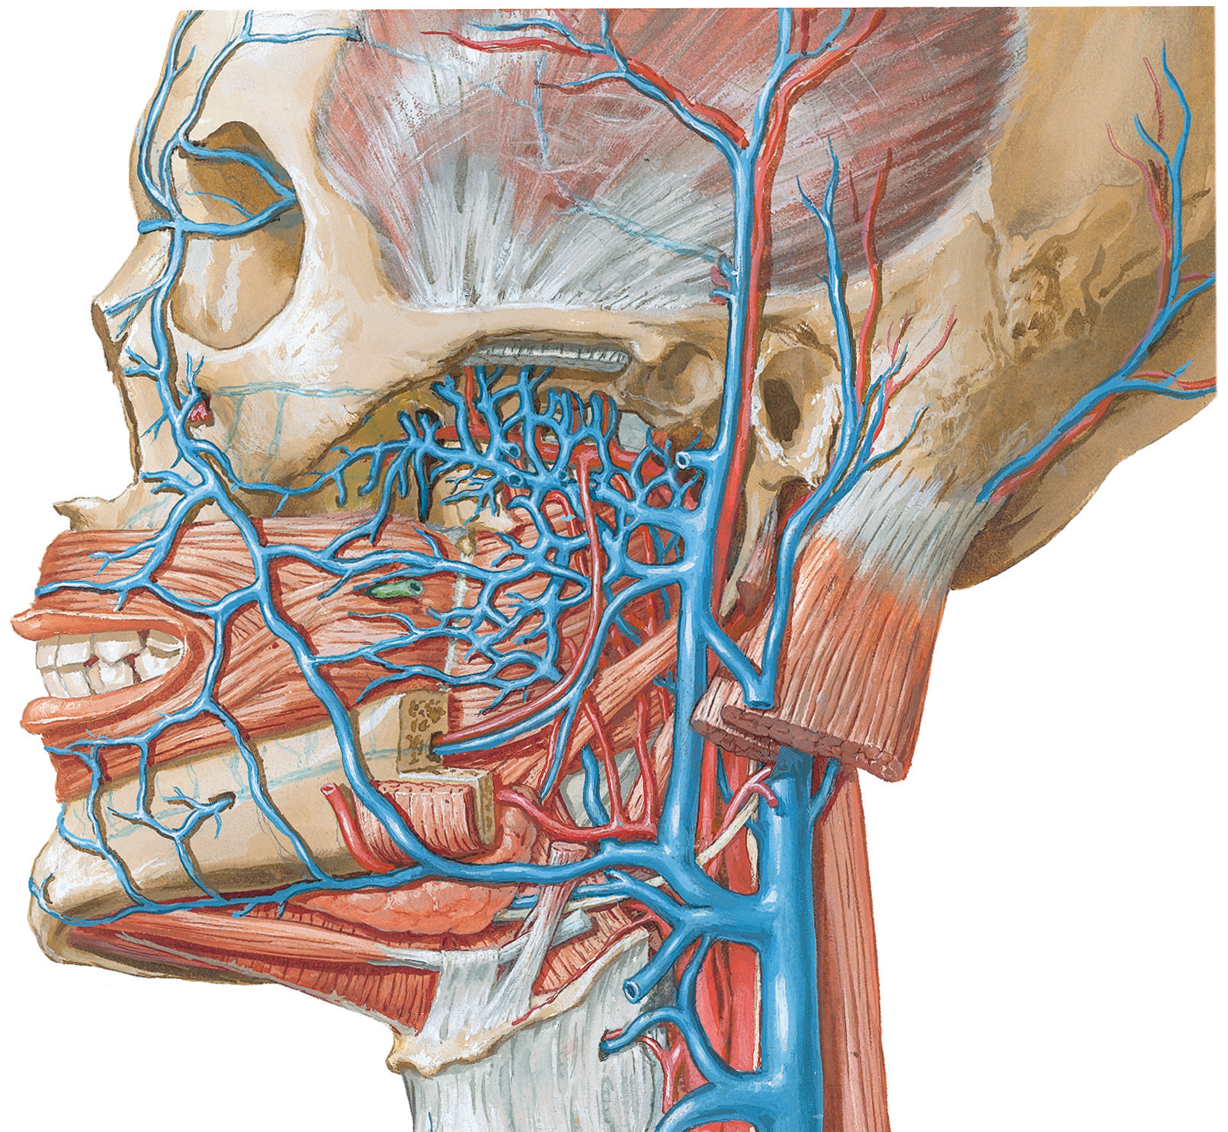
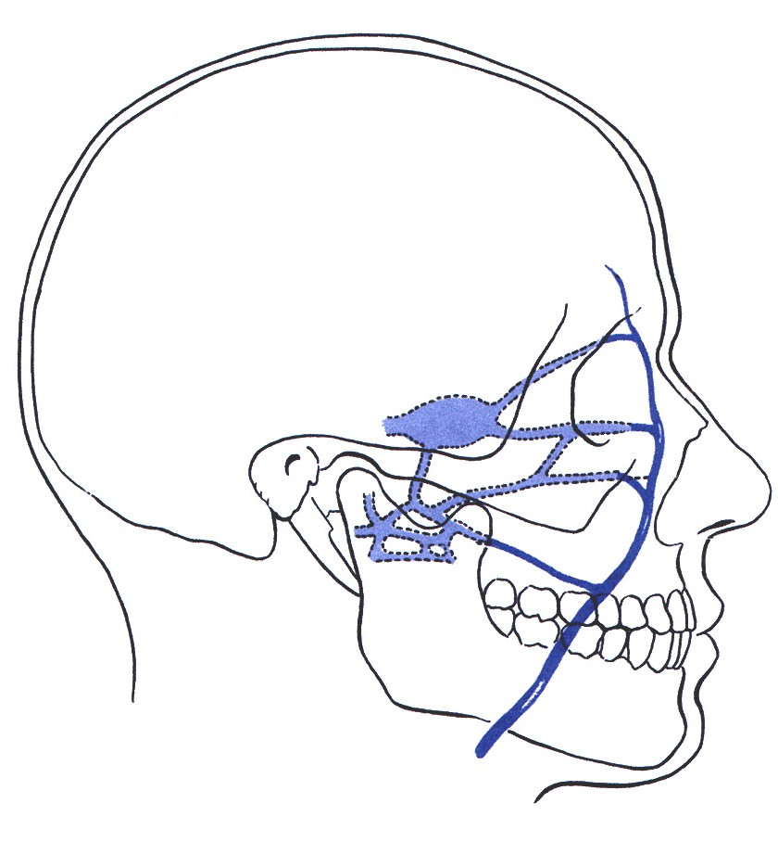
Pterygoid venous plexus
Deep facial
vein
Pterygoid venous plexus
It is networks of small veins
Lies around and within the lateral pterygoid muscle.
Drains into the maxillary vein.
Communicates with facial vein through deep facial vein and with cavernous sinus via emissary veins.
Infection of danger area of the face could go into cavernous sinus through emissary vein and cause cavernous sinus thrombosis.
It possibly acts as peripheral heart to pump stagnant venous blood by contraction of lateral pterygoid muscle during movement of yawning
Maxillary vein
Facial vein
Cavernous sinus
Superior and inferior ophthalmic veins
Deep facial vein
Facial vein
Emissary vein
Pterygoid venous plexus

Slide 25
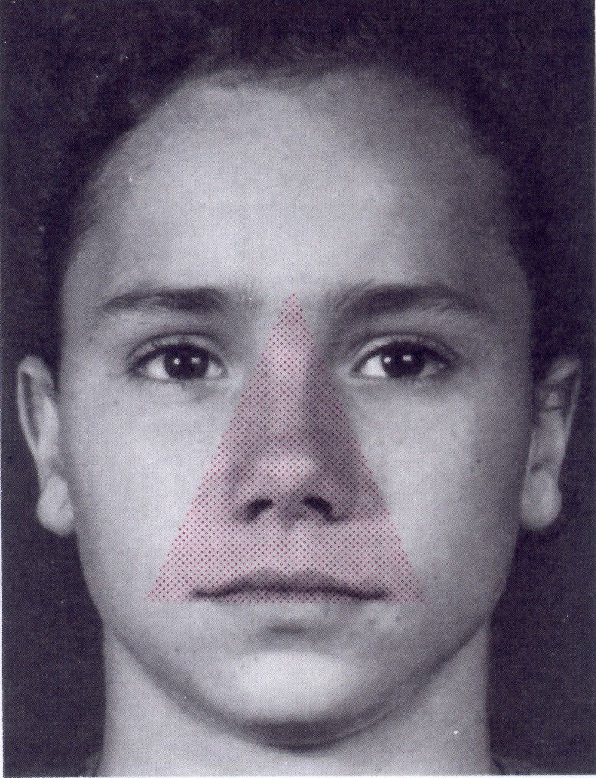
Danger area of the face

Slide 26
Mandibular nerve
Motor root
Sensory root
Largest branch of three division of trigeminal nerve.
It is the nerve of 1st branchial arch
Has a large sensory and a smaller motor root which fuse to form a trunk.
Sensory root is derived from trigeminal ganglion whereas motor root arises directly from Pons
Exit cranial cavity through foramen ovale to enter the infratemporal fossa.
Trunk divides into anterior and posterior division.
Trunk lies between tensor veli palatini ( medially) & lateral pterygoid muscle (laterally)
Mandibular nerve

Slide 27
Branches of mandibular nerve
From the main trunk
  Meningeal branch (recurrent branch / nervous spinosus)
    Re-enter cranial cavity through foramen spinosum to innervate Dura mater in the middle cranial fossa.
  Nerve to medial pterygoid
    Innervates medial pterygoid muscle, tensor tympani muscle, and tensor veli palatini muscle.
Nerve to medial pterygoid
Medial pterygoid muscle

Slide 28
Branches of mandibular nerve
From Anterior division
Muscular branches
  Deep temporal
  Nerve to lateral pterygoid
  Nerve to masseter
Sensory branch
  Long buccal nerve
    Passes between the two heads of the lateral pterygoid muscle
    Innervates the skin of the cheek and buccal mucosa
Deep temporal nerves
Long
buccal
nerve
Notes:
The long buccal nerve does NOT innervate the buccinator muscle. The buccinator muscle is innervated by the buccal branch of the facial nerve (CN VII).

Slide 29
Branches of mandibular nerve
From Posterior division
Mainly sensory
Three branches:
  Inferior alveolar nerve.
  Lingual nerve.
  Auriculotemporal nerve.
Auriculotemporal nerve
Inferior alveolar
nerve
Lingual
nerve
Notes:
The long buccal nerve does NOT innervate the buccinator muscle. The buccinator muscle is innervated by the buccal branch of the facial nerve (CN VII).

Slide 30
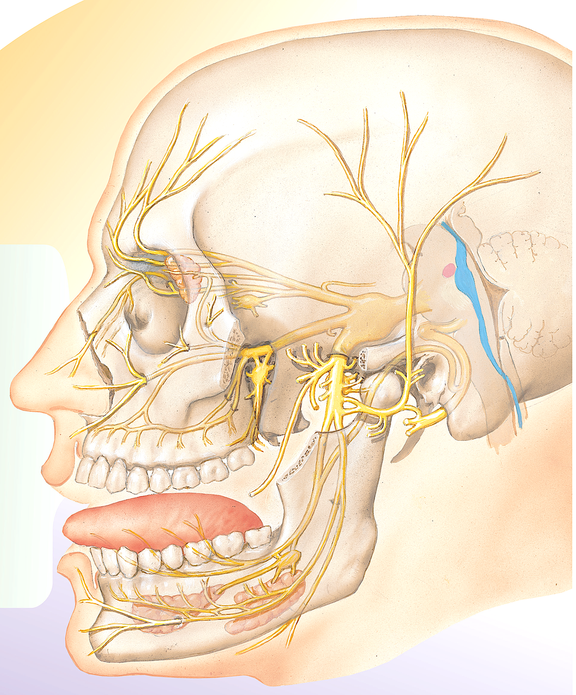
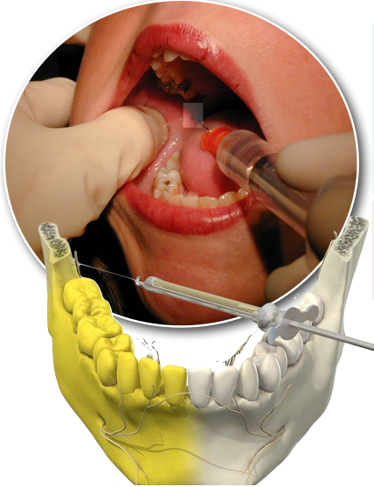
Inferior alveolar
nerve
Inferior alveolar nerve in mandible
Inferior alveolar
nerve block
Inferior alveolar nerve
  Enters the mandibular canal of mandible. Innervates all of the mandibular teeth.
  Exits the mandibular canal through the mental foramen as mental nerve to innervate the skin over the chin.
  Inferior alveolar nerve block is done by injecting anesthetics one cm. above and behind the mandibular third molar or / by palpating the lingula .
Notes:
In dentistry, an inferior alveolar nerve block is done by injecting anesthetic 1 cm above and behind the mandibular third molar tooth. Such a block will result in temporary numbness on the chin because the mental nerve is also anesthetized as are the mandibular teeth on the ipsilateral side. When necessary, the dentist can also anesthetize the lingual nerve at the same time (first the inferior alveolar nerve is anesthetized and then the needle is retracted and anesthetic pushed again to
anesthetize the lingual nerve and finally the needle completely retracted from the tissue).

Slide 31
Nerve to mylohyoid
  Motor nerve.
  Lies in the same sheath with the inferior alveolar nerve.
  Leaves inferior alveolar nerve before entering inside the mandibular canal.
  Innervates the mylohyoid and anterior belly of the digatric.
Mylohyoid muscle
Inferior alveolar
nerve
Nerve to mylohyoid
Anterior belly of digastric muscle

Slide 32
Lingual nerve
  Lies between the medial pterygoid muscle and ramus of the mandible in the infratemporal fossa.
  Joined by Chorda tympani branch of facial nerve.
  In the floor of the oral cavity it lies just underneath the oral mucosa very close to the mandibular third molar tooth
    Could get damage during extraction of the third molar tooth.
  Sensory to the anterior two-third of the tongue.
Chorda tympani
Lingual
nerve

Slide 33
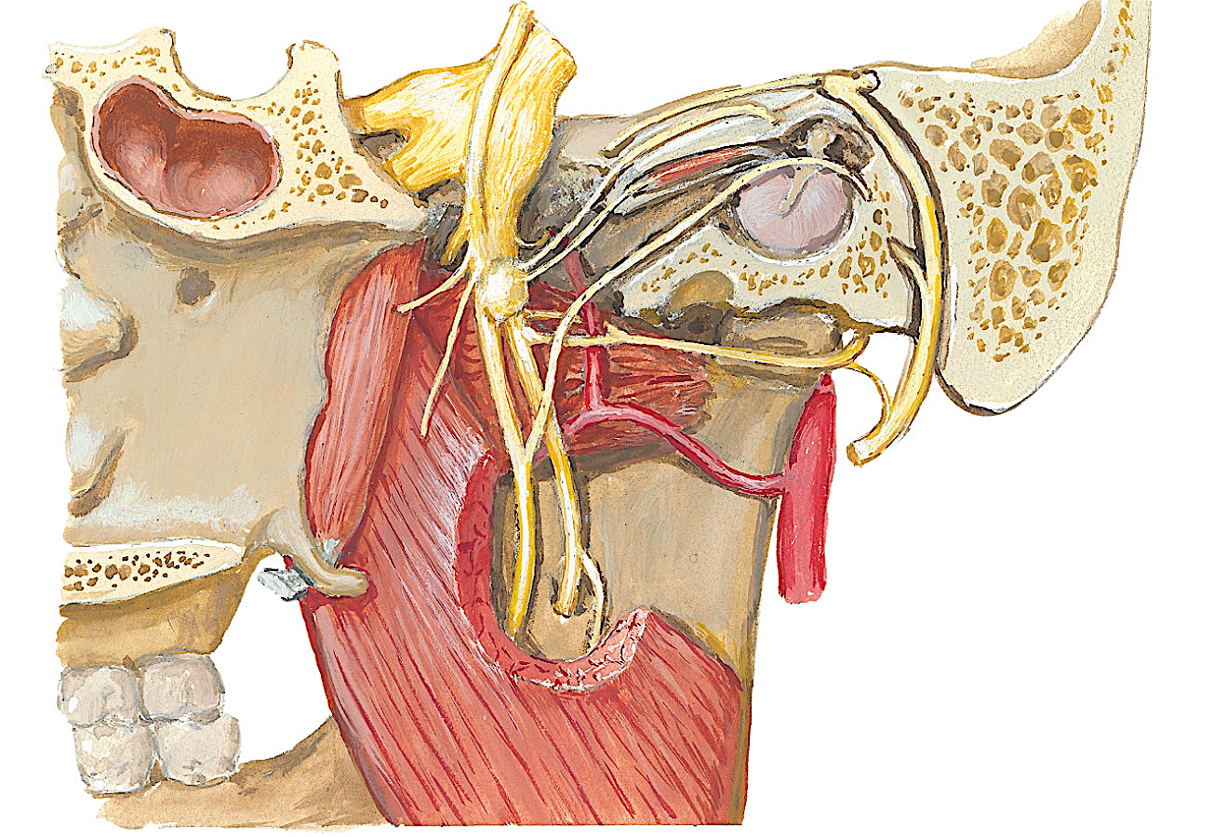
Chorda tympani
Facial nerve
Chorda tympani nerve
  Branch of the facial nerve (CN VII).
  Exits the middle ear cavity through the petrotympanic fissure to join the lingual nerve in the infratemporal fossa.
  Conveys taste from the anterior two-thirds of the tongue.
  Carry pre ganglionic parasympathetic axons to the submandibular ganglion.
Lingual nerve
Chorda tympani
Lingual
nerve
Submandibular ganglion

Slide 34
Auriculotemporal nerve
  Formed by two roots that encircle the middle meningeal artery.
  Runs with superficial temporal vessels
  Gives sensory branches to auricle and scalp.
  Relays the postganglionic parasympathetic fibers to the parotid gland.
Auriculotemporal nerve
Middle meningeal artery

Slide 35
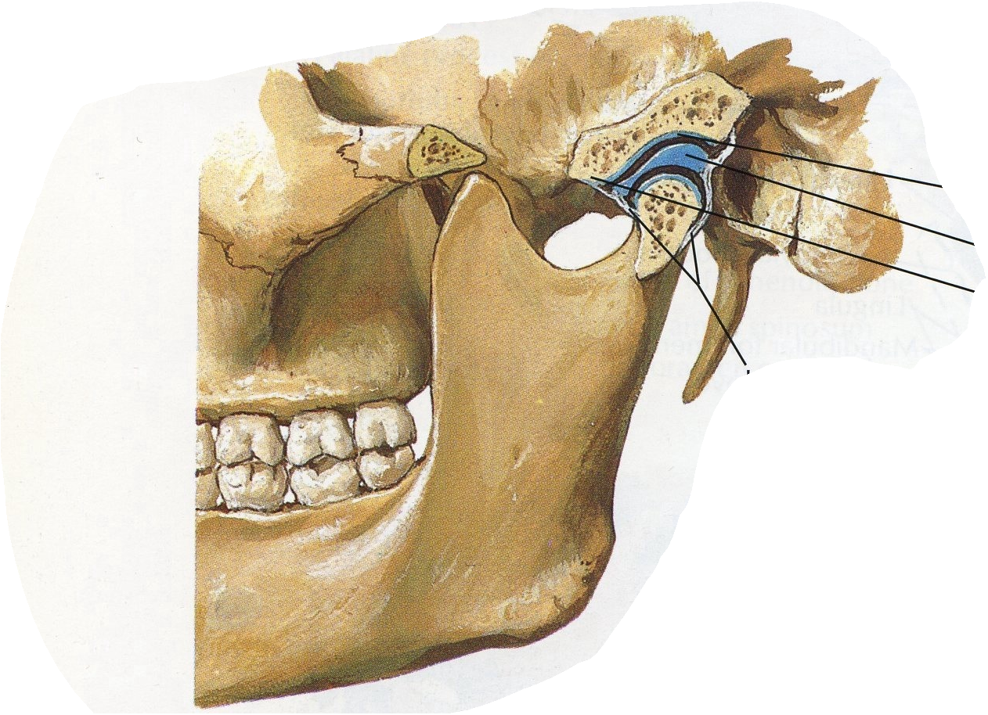
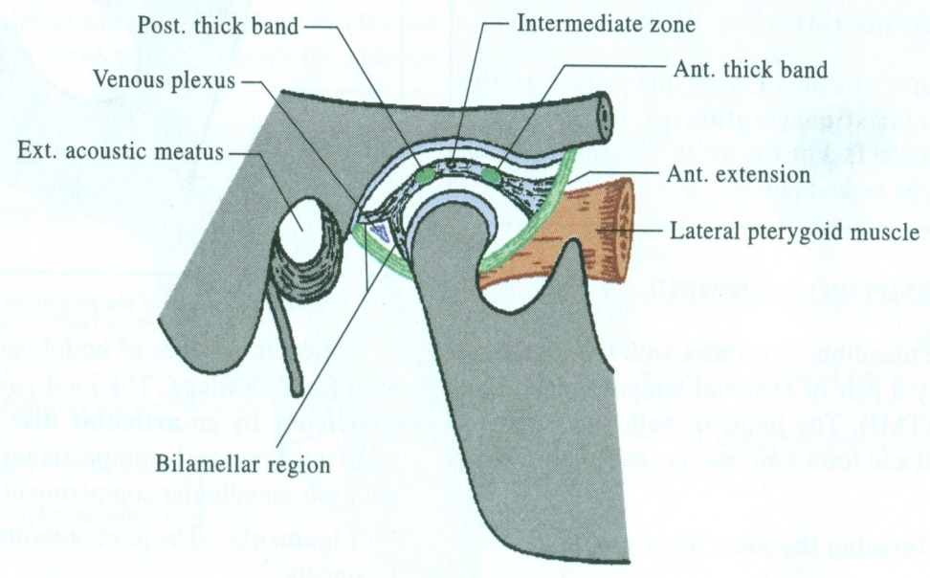
Temporomandibular joint (TMJ)
Articulation between cranium & mandible
Helps in mastication & opening and closing of mouth
Features-
Single bone(mandible) articulate with Rt.& Lt. mandibular fossa (temporal) bone
Cranial components are immobile while mandibular component is mobile.
Articular surface is covered by a fibrocartilagenous (articular) disc which divide joint cavity in two compartments:
  Superior compartment – gliding movements of protrusion and retrusion occur
  Inferior compartment – depression and elevation occur; side to side movements (grinding and chewing)
Types of joint-
Modified, hinge type of synovial joint
Articular surface-
-Above- Mandibular fossa & articular tubercle
-Below- Head (condyle) of the mandible
Mandibular fossa
Articular disc
Articular tubercle
Joint capsule

Slide 36
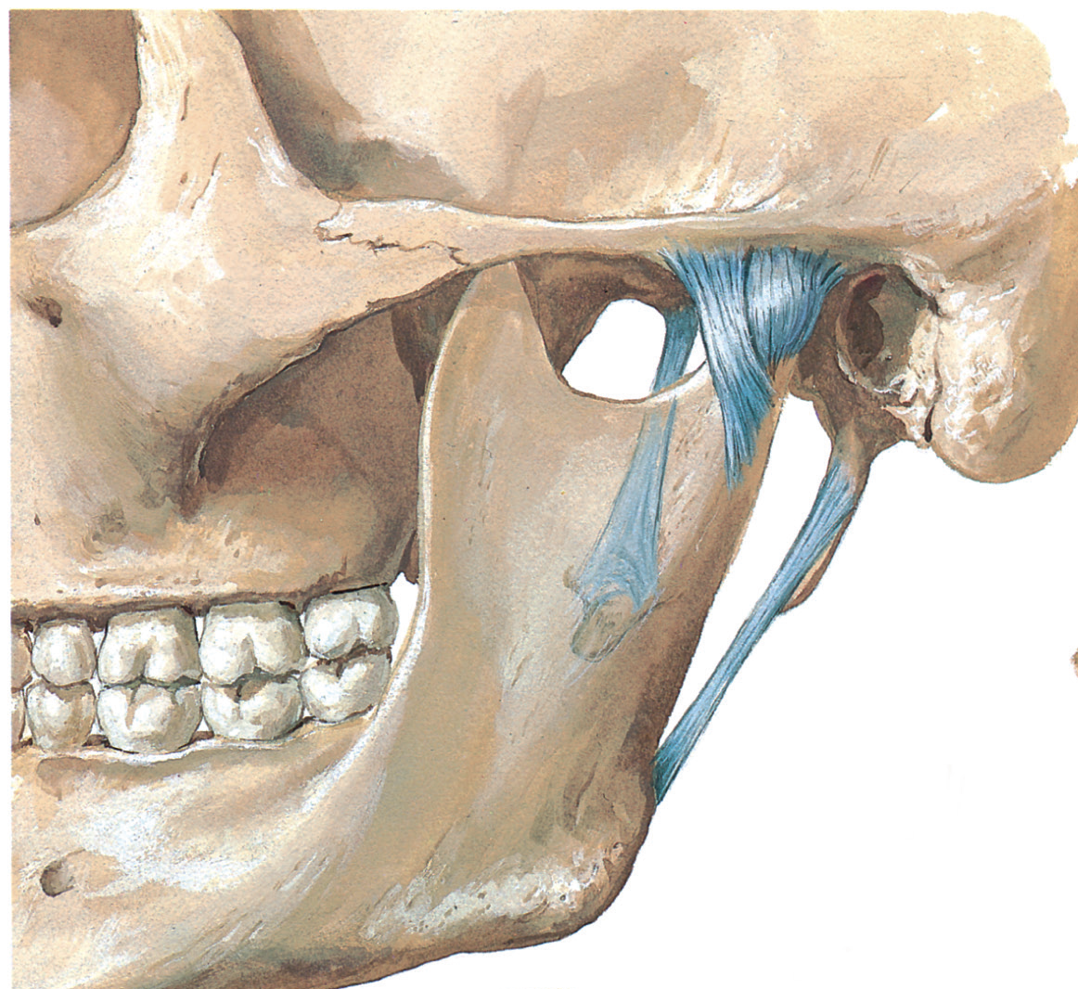
Ligaments of the temporomandibular joint (TMJ)
Fibrous capsule
Lateral ligament
Sphenomandibular ligament
Stylomandibular ligament
Fibrous capsule
  Attached to margin of articular area on temporal bone and around neck of mandible, lined internally by synovial membrane.
Lateral ligament
  Extends from tubercle of zygomatic arch to neck of mandible, strengthens the joint laterally.
Sphenomandibular ligament
  Extends from spine of sphenoid to lingula of mandible. Stabilizes temporomandibular joint medially.
  Derived from Meckel’s cartilage of 1st pharyngeal arch
Stylomandibular ligament
  Extend from styloid process to angle of mandible.

Slide 37
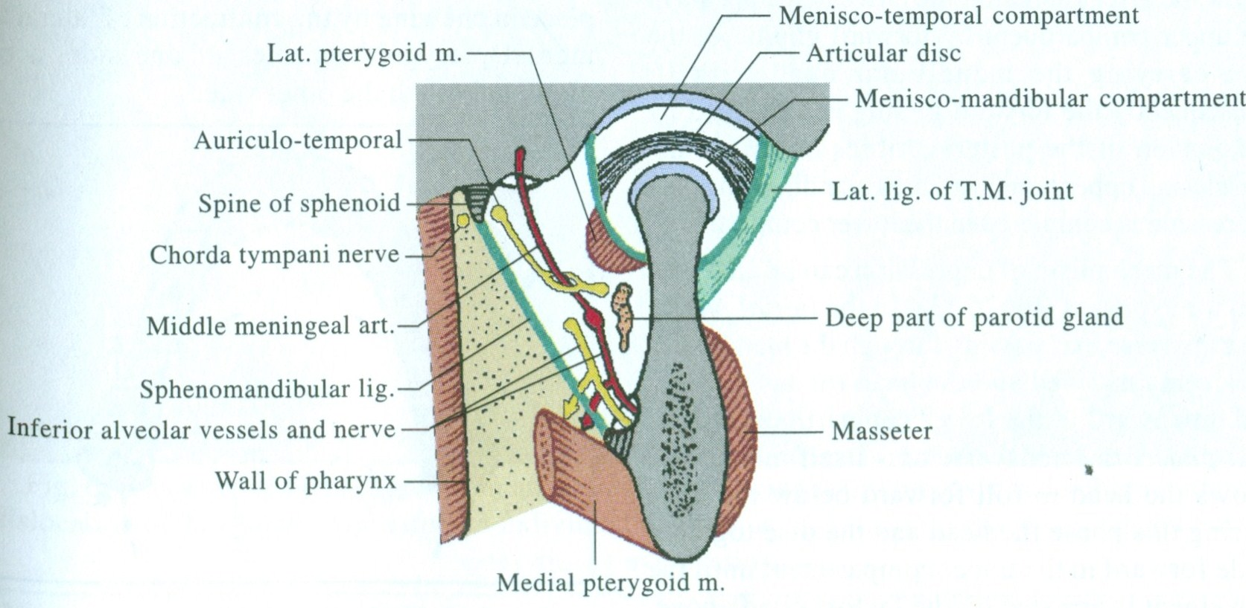
Buccal artery
Relations of TMJ
In front-
Lateral pterygoid
Temporalis
Masseteric nerve & vessels
Behind-
Parotid gland
Superficial temporal vessels
Auriculotemporal nerve
External acoustic meatus
Laterally-
Subcutaneous
Medially-
Lateral pterygoid
Roots of auriculotemporal nerve
Spine of the sphenoid
Spheno-mandibular ligament
Above-
Floor of Middle cranial fossa
Below-
Maxillary artery & veins Chorda tympani nerve
Deep temporal arteries
Masseteric artery
Pterygoid artery

Slide 38
Arterial supply-
superficial temporal artery
maxillary artery
Nerve supply-
Auriculo-temporal nerve
Masseteric nerve.

Slide 39
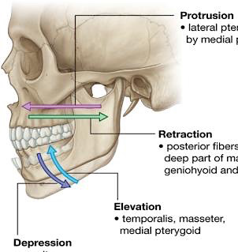
Movements of the temporomandibular joint (TMJ)
Movements of mandible | Muscles
Elevation (close mouth) | Temporal, masseter, and medial pterygoid
Depression (open mouth) | Lateral pterygoid, suprahyoid and infrahyoid muscles
Protrusion (protrude chin) | Lateral pterygoid, masseter, and medial pterygoid
Retrusion (retrude chin) | Temporalis
Lateral movements (grinding and chewing) | Temporalis of same side pterygoids of opposite side, masseter

Slide 40
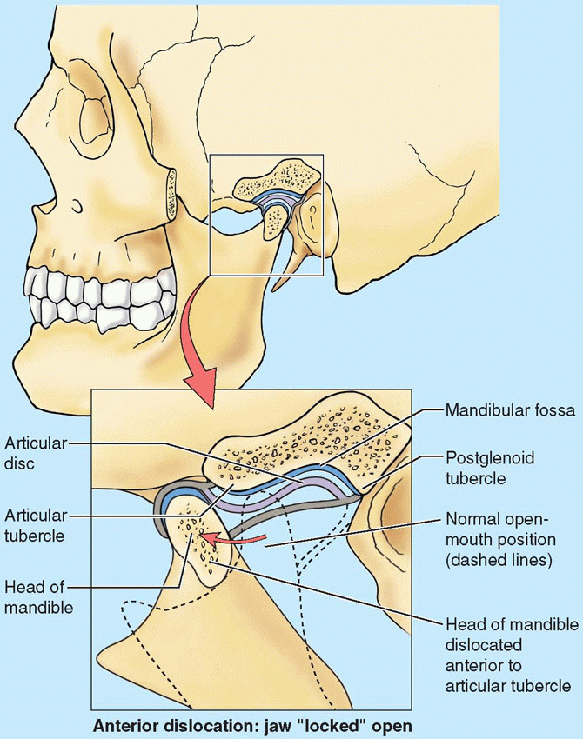
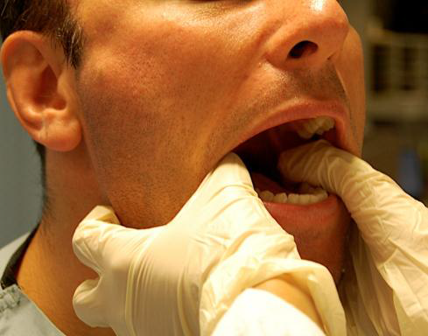
Clinical correlates
TMJ may become inflamed from degenerative arthritis (may be associated with joint clicking -crepitus)
Dislocation of TMJ
  A sideways blow to chin when
  mouth is open dislocates TMJ on
  side that received blow.
  Excessive contraction of lateral pterygoids may cause heads of mandible to dislocate anteriorly and anterior to articular tubercles.
  May accompany fractures of the mandible.
  Mandible remains depressed and the mouth is held open.

Slide 41
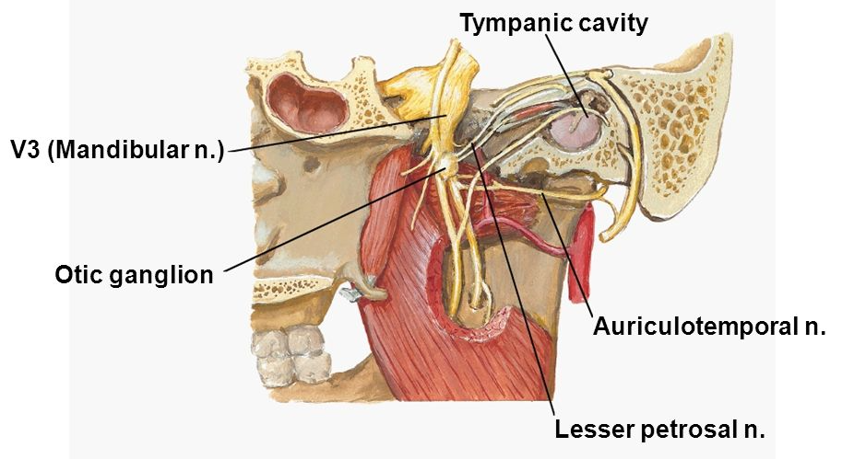
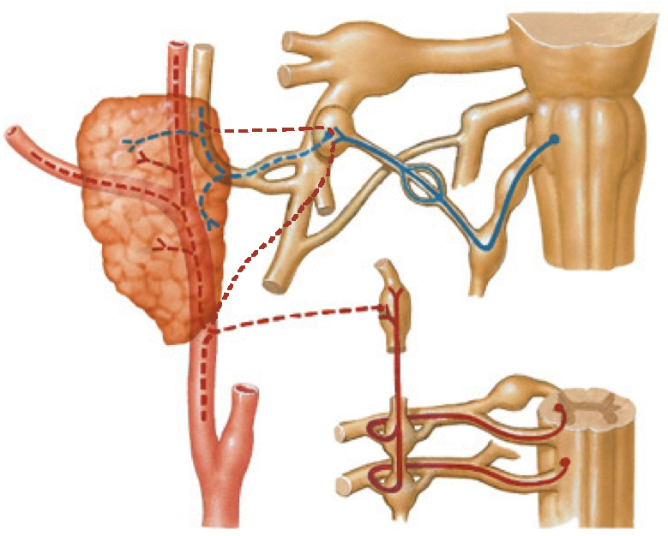
Otic ganglion
It is small, oval parasympathetic ganglion
2-3 mm in size
Situated in infratemporal fossa
Topographically- mandibular nerve
Functionally- glossopharyngeal nerve
  Situation-
Below the foramen ovale
Medial to trunk of mandibular nerve
Lateral to tensor veli palatini
Infront of middle meningeal artery
Behind the medial pterygoid

Slide 42
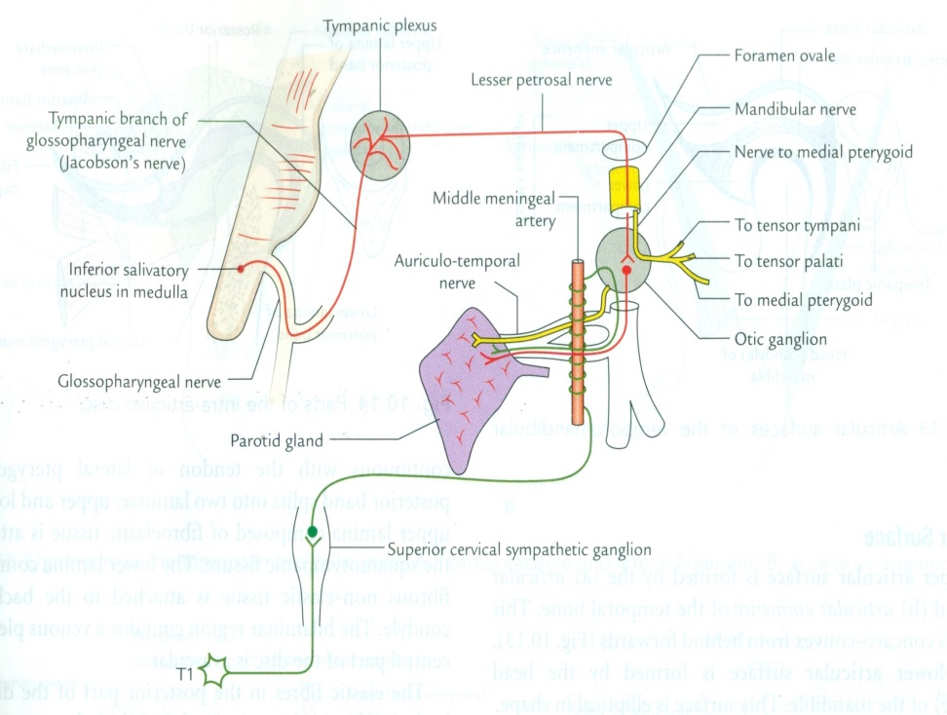
Connections (components)-
  Parasympathetic
    Lesser petrosal nerve (branch of tympanic plexus which is formed by tympanic branch of glossopharyngeal nerve.
    Preganglionic fibers- arises from inferior salivatory nucleus of the medulla. These are the only fibers which synapse in ganglion,
    Post ganglion fibers- run inside auriculotemporal nerve and give secretomotor fibers to parotid gland
  Sympathetic
    Post ganglion fibers forming plexus around middle meningeal artery from superior cervical ganglion
  Sensory
    Auriculotemporal nerve from trigeminal ganglion.

Slide 43
Branches-
Postganglionic parasympathetic – secretomotor to the parotid gland
Postganglionic sympathetic- vasomotor to parotid gland
Fibers from nerve to medial pterygoid – passes through otic ganglion and supply the tensor veli palatini & tensor tympani muscles
Otic ganglion is connected to the Chorda tympani nerve & nerve to pterygoid canal ( alternate root of taste pathway from ant.2/3rd of the tongue to the geniculate ganglion of facial nerve)

Slide 44
Summary
Pterion – bones forming it, artery deep to it.
Muscles of mastication, attachment on mandible, nerve supply, actions.
TMJ – type of joint, ligaments.
Maxillary artery – 1st part branches – middle meningeal artery, inferior alveolar artery, accessory meningeal artery
  2nd part – muscular branches.
Danger area of face
Mandibular nerve – branches from trunk, ant. division, post. division.
Otic ganglion – components (parasympathetic, sympathetic, sensory).

Slide 45
THANKS

