Slide 1
SURFACE MARKING
HEAD & NECK

Slide 2
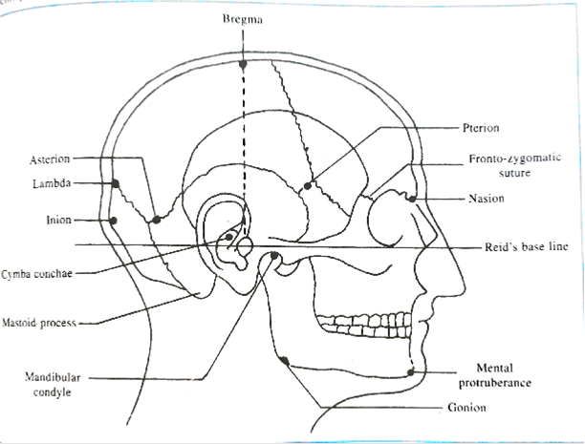
Surface landmarks

Slide 3
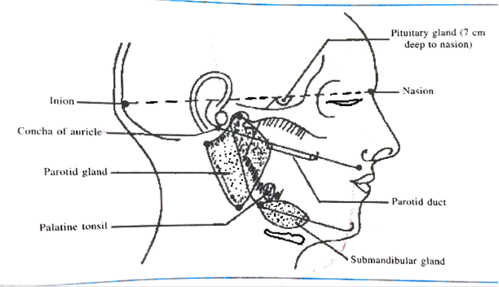
Surface marking of parotid & submandibular glands

Slide 4
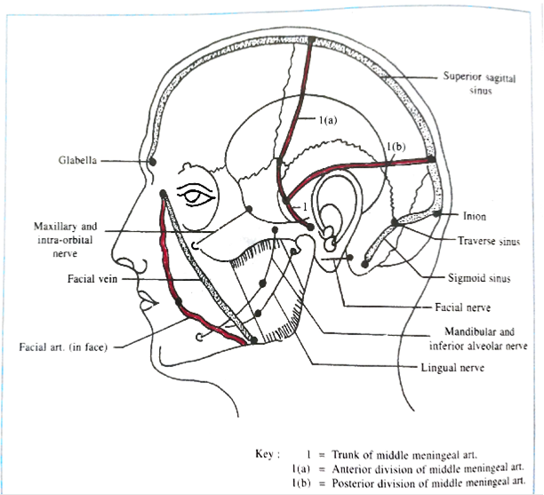
Surface marking of some important arteries & nerves

Slide 5
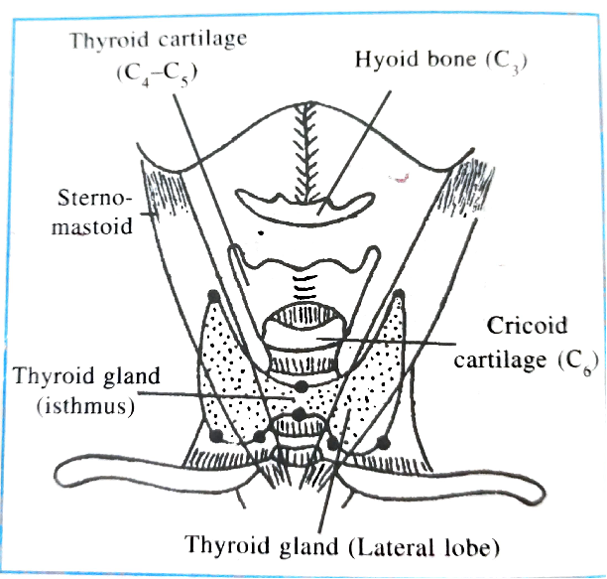
Surface marking of thyroid gland

Slide 6
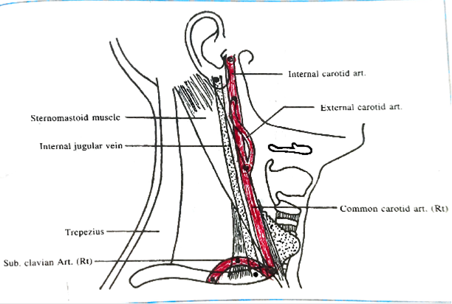
Surface marking of common, external & internal carotid artery

