Slide 1
SURFACE ANATOMY
LOWER LIMB
Dr.SARANGDHAR KUMAR
DEPARTMENT OF ANATOMY
ROHILKHAND MEDICAL COLLEGE

Slide 2
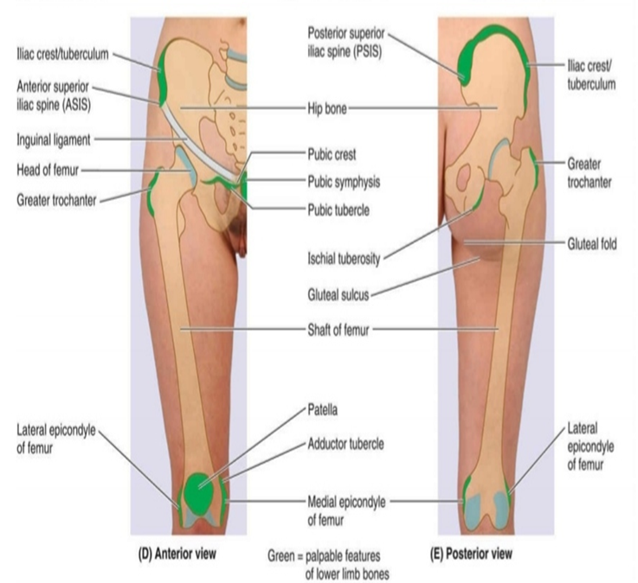
Anterior superior iliac spine –
  palpated at lateral end of fold of groin
Pubic symphysis-
  central point of pubis
Pubic tubercle –
  2cm lateral to pubic symphysis (from midline)
Tubercle of iliac crest –
  felt 5cm behind the ASIS
Greater trochanter of femur –
  8cm below the iliac tubercle (hand ‘s breadth below the iliac tubercle
Iliac crest –
  can be palpated throughout its whole length at lower part of back

Slide 3
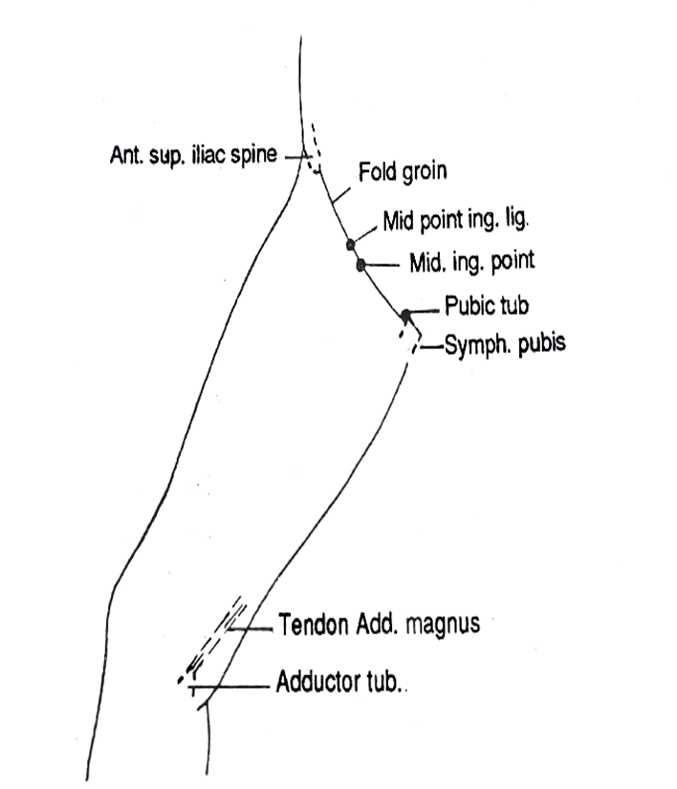
Inguinal ligament –
  felt in the fold of groin at the junction of abdomen & anterior aspect of thigh
Mid inguinal point-
  point midway b/w ASIS and pubic symphysis
Mid point of inguinal ligament –
  point midway b/w pubic tubercle and ASIS

Slide 4

Tuberosity of ischium –
  can be palpated 5 cm above the gluteal fold & same distance from the median plane
Adductor tubercle –
  5 cm above the medial epicondyle of femur
Lateral epicondyle of femur
Medial epicondyle of femur
Patella

Slide 5


Slide 6
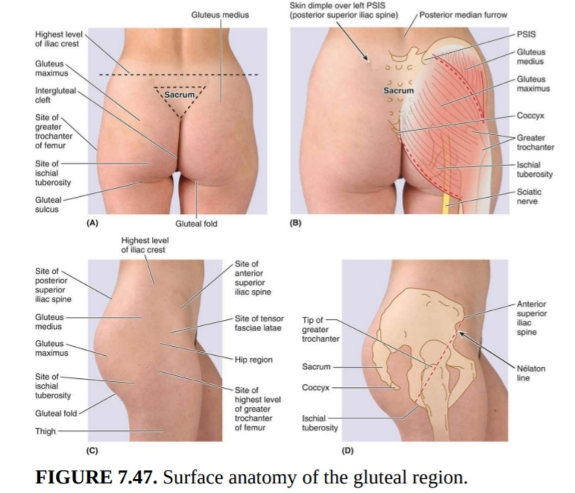

Slide 7
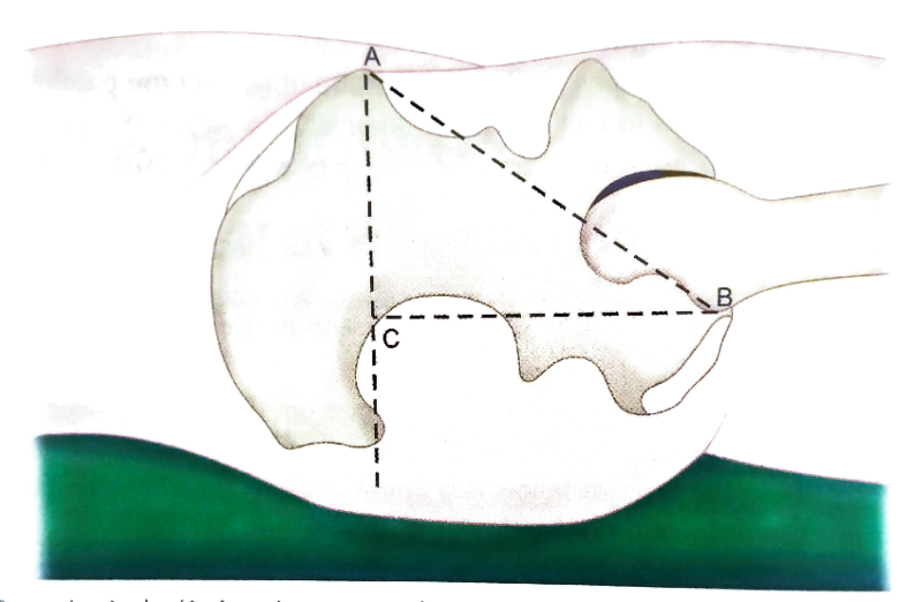
Nelaton’s line –
  an imaginary line extending from ASIS to ischial tuberosity
  This in supine position
  Tip of the the greater trochanter normally lies at the level or below this line
Bryant’s triangle –
  This is marked in supine position
  Draw a line from anterior superior iliac spine to greater trochanter
  Draw a vertical line from anterior superior iliac spine downwards
  Draw a line from greater trochanter to vertical line

Slide 8
Clinical importance of Nelaton’s line & Bryant’ triangle -
If greater trochanter lies above the Nelaton’s line, this indicates hip dislocation or hip fracture
The Bryant’s triangle helps to find out supra- trochanteric shortening of hip by comparison of both sides
  The most common cause of shortening of hip-
    Dislocation of hip
    Fracture of neck of femur
    Coxa vera

Slide 9
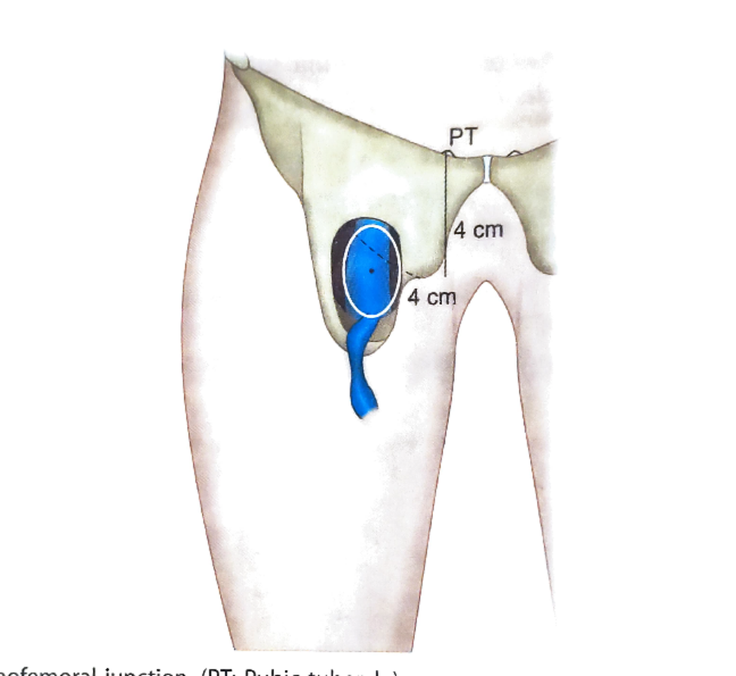
Front of the thigh
Saphenous opening-
  Mark the pubic tubercle
  Put a point 4 cm below & lateral to the pubic tubercle
  Draw an oval opening around the point

Slide 10
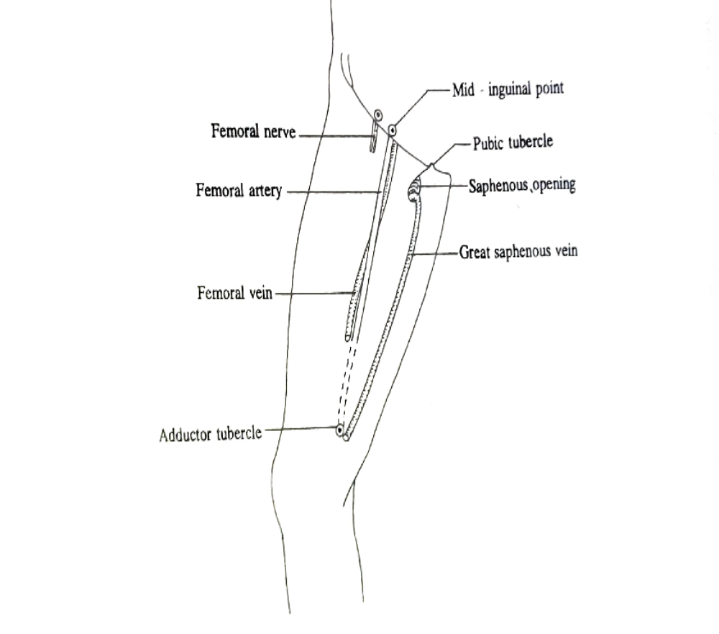
Long saphenous vein –
  Mark a point 2 cm infront of medial malleolus
  Mark a point at the adductor tubercle
  Mark a point at sapheno-femoral junction

Slide 11
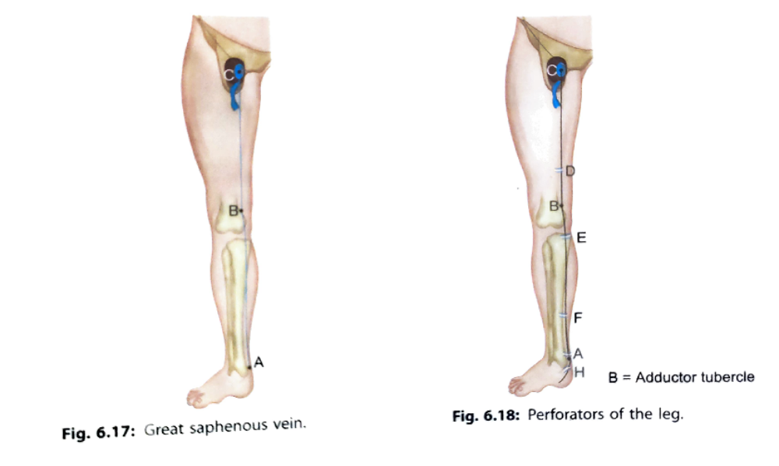

Slide 12
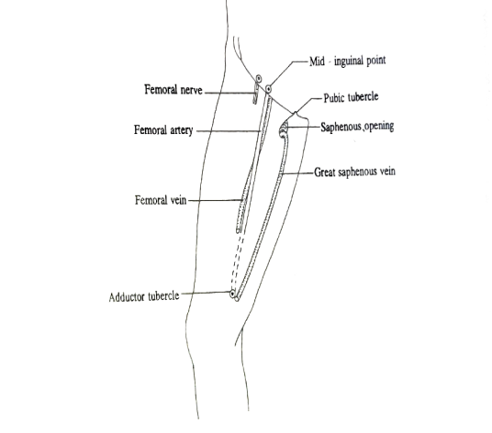
Femoral artery –
  Mark the mid inguinal point
  Mark the adductor tubercle (located about 5 cm above the medial condyle)
  Joins the two point by a line
  Upper 2/3rd of this line represents the artery

Slide 13

Femoral nerve –
  Put a point 1.2 cm lateral to the mid inguinal point
  Draw vertical line 2.5 cm long from the above point

Slide 14
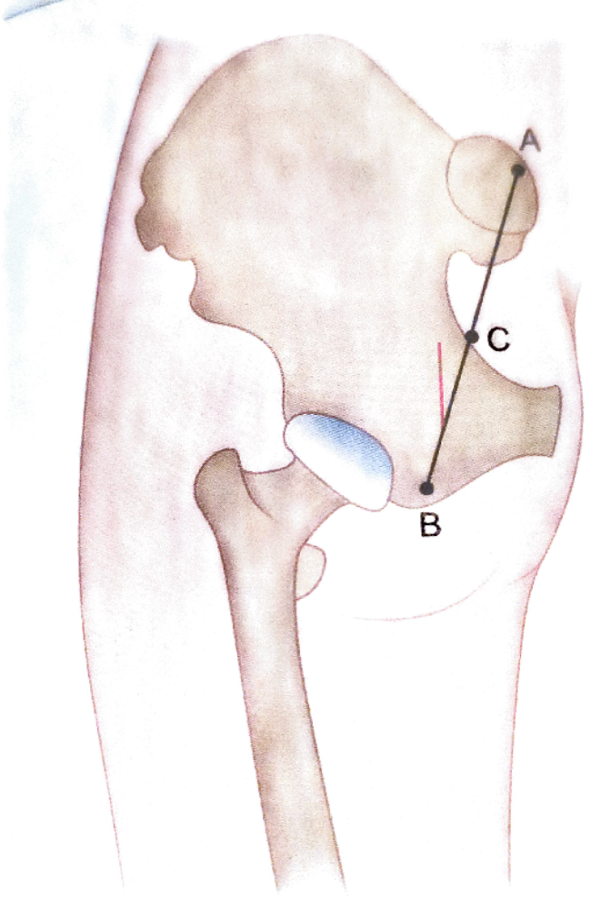
Gluteal region & back of thigh
Inferior gluteal artery –
  Mark the posterior superior iliac spine & ischial tuberosity
  Joins two points
  Mark the mid point of this line
  Draw a line downward about 2.5 cm lateral to the mid point

Slide 15
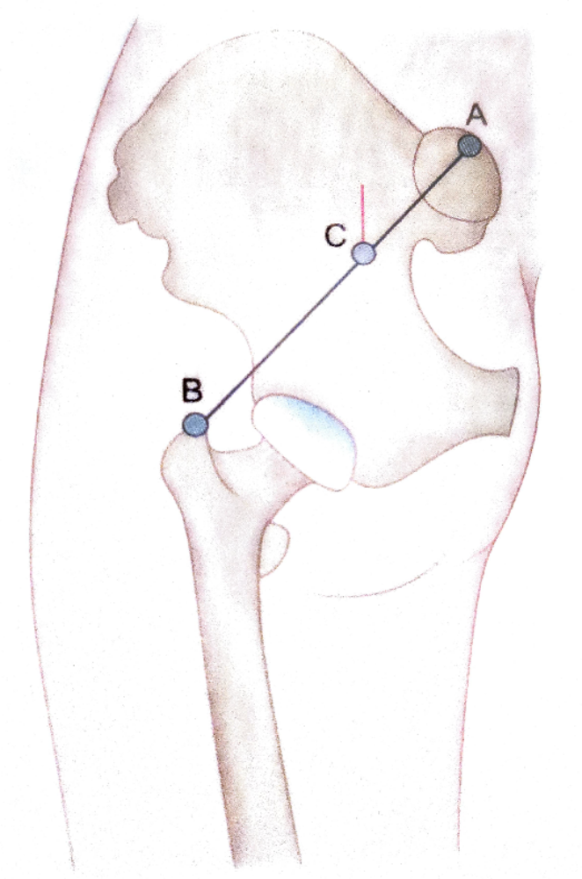
Superior gluteal artery –
  Mark the posterior superior iliac spine and greater trochanter
  Join the two point
  Draw a line upwards from the junction of lateral 2/3rd and medial 1/3rd
  This indicates the stem of superior gluteal artery

Slide 16
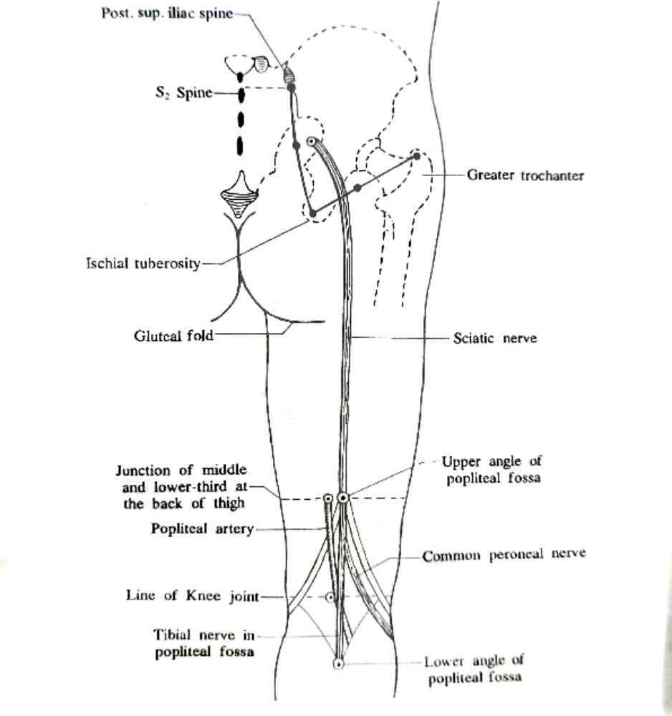
Sciatic nerve –
  Draw a line joining the posterior superior iliac spine and ischial tuberosity
  Take a point 2.5 cm lateral to mid point of that line
  Draw another line joining ischial tuberosity and apex of greater trochanter
  Take a point just medial to that line
  Put a point at upper angle of popliteal fossa
  Then join the points to represents sciatic nerve

Slide 17
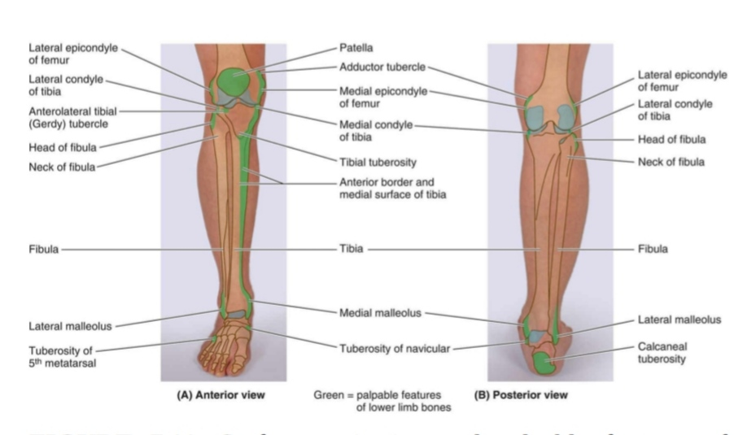
Leg & Foot
Important landmarks –
  Tibial tuberosity - subcutaneous projection of upper end of tibia
  Anterior border of tibia
  Head of the fibula – forms slight elevation on posterolateral aspect of upper part of leg and lies vertically below the lateral condyle of femur
  Neck of the fibula - constricted upper part of shaft of fibula

Slide 19
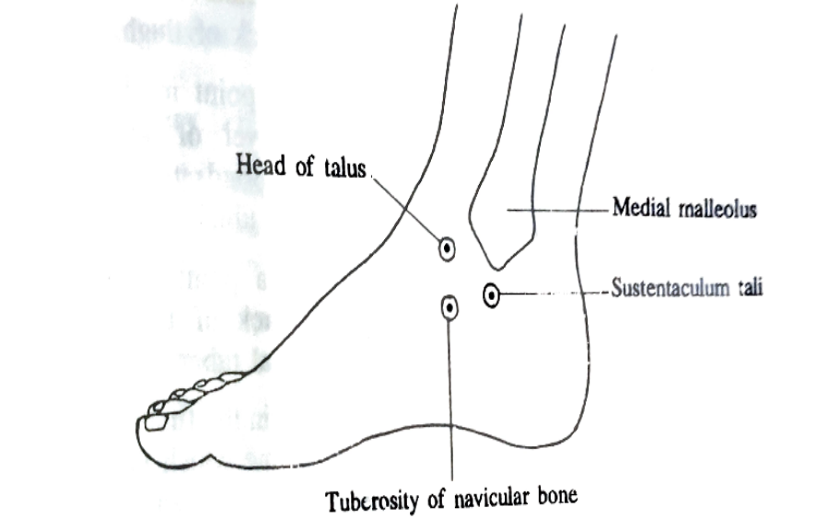
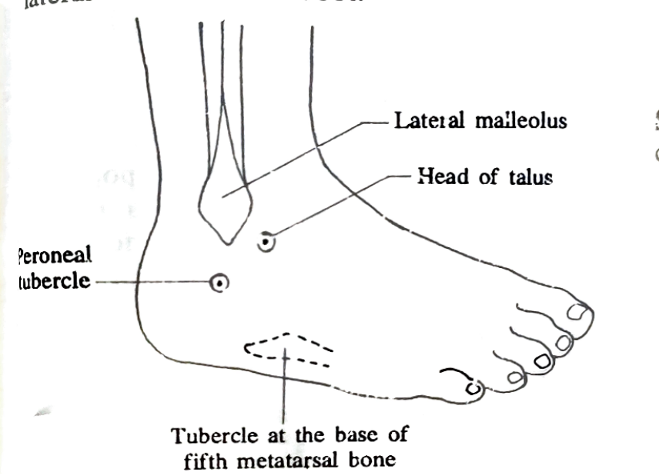
Medial malleolus
Lateral malleolus
Sustentaculum tali –
  can be felt 2 cm vertically below the medial malleolus
Tuberosity of navicular bone –
  felt 2.5 cm infront of Sustentaculum tali

Slide 20
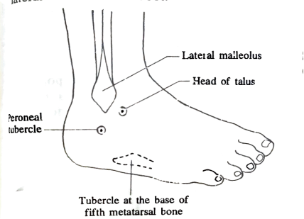
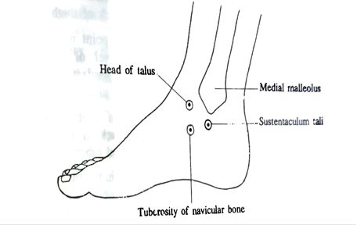
Peroneal tubercle –
  lies 2 cm below the tip of lateral malleolus
Tubercle of base of 5thmetatarsal bone –
  can felt half-way along the lateral border of foot
Head of talus –
  lies 3 cm infront of lower end of tibia

Slide 21
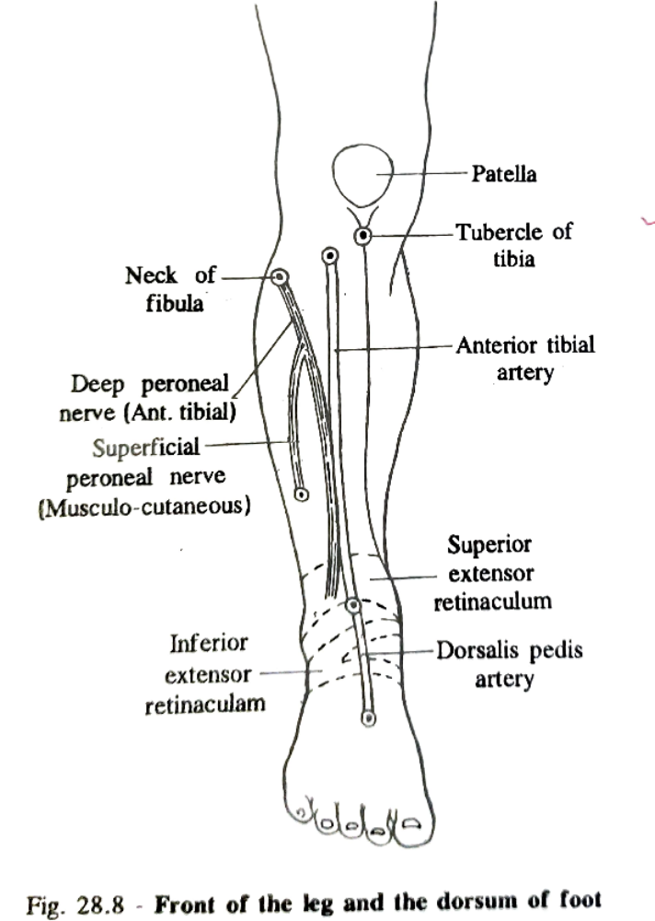
Anterior tibial artery –
  Mark a point 2.5 cm below the medial side of head of fibula
  Put a mark midway b/w two malleoli

Slide 22
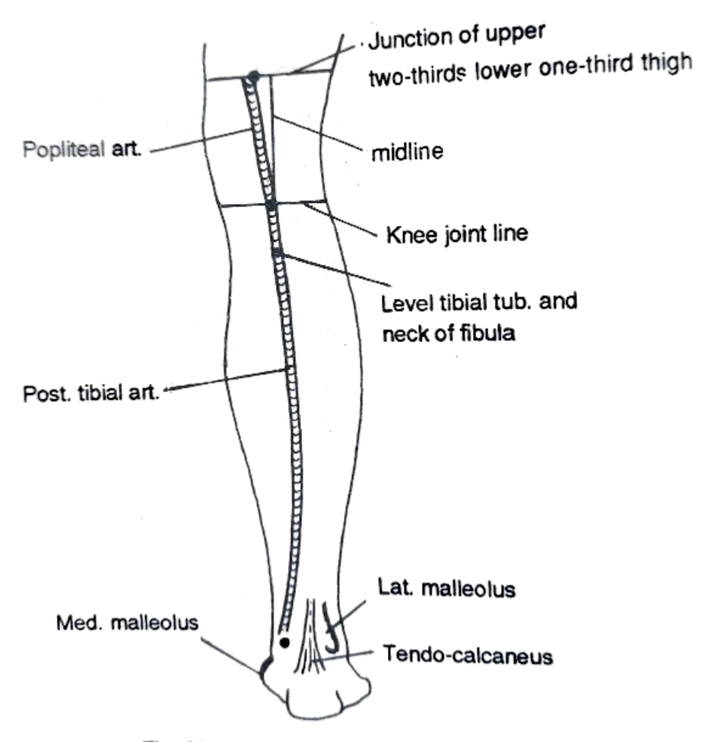
Popliteal artery –
  Draw a horizontal line on the back of thigh at the junction of middle & lower third of the thigh
  Draw an another horizontal line at the level of upper margin of tibial condyle
  Draw a middle line b/w above two horizontal lines
  Put a point 2.5 cm medial to middle line on first horizontal line
  Put a mark on back at the level of tibial tuberosity

Slide 23
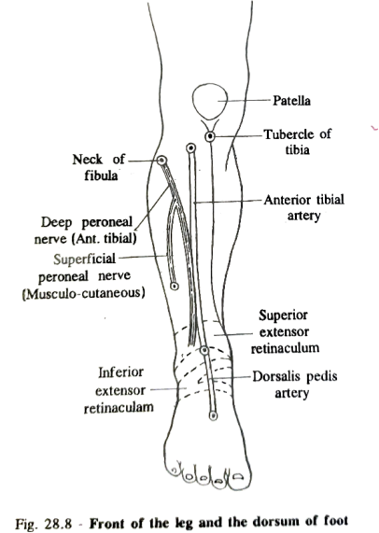
Dorsalis pedis artery –
  A point midway b/w two malleoli
  Another point at the proximal end of first inter- metatarsal space
  Peripheral arterial pulsation of dorsalis pedis artery, anterior tibial artery & posterior tibial artery is felt during clinical examination of lower limb
  This diagnostic importance in peripheral arterial disease, thromboangitis obliterans

Slide 24
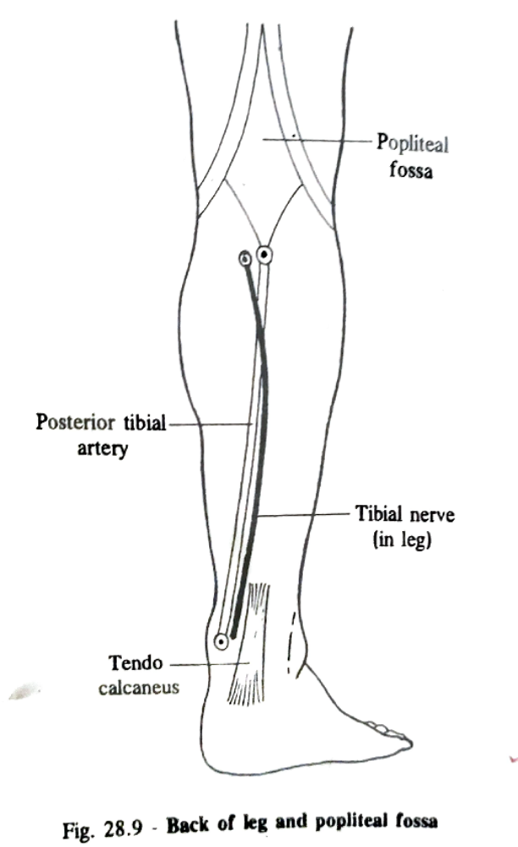
Posterior tibial artery –
  Put a point in the middle line of leg at the level of neck of fibula
  Another point midway b/w medial malleolus & tendo-clacaneus

Slide 25
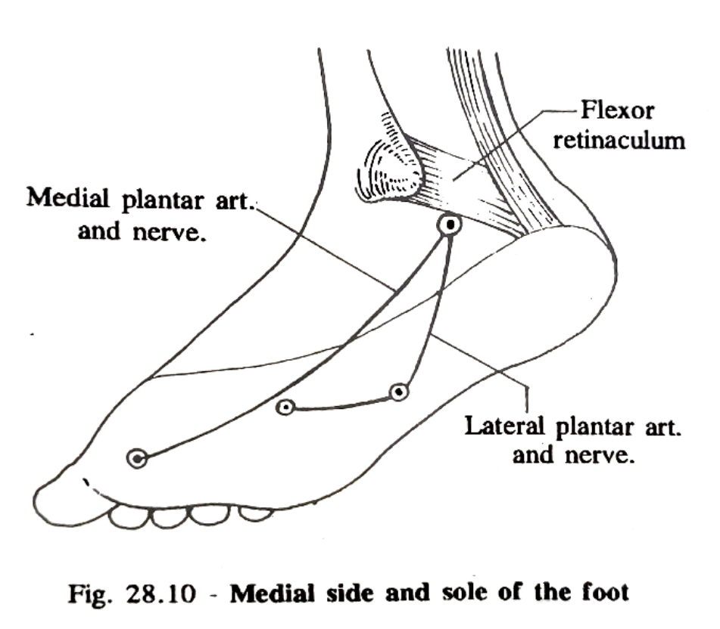
Lateral plantar artery & nerve –
  A point midway b/w medial malleolus & prominence of heel
  A point 2.5 cm medial to tubercle of 5th metatarsal bone
  A point at the proximal end of first inter -metatarsal space
Medial plantar artery & nerve –
  A point midway b/w medial malleolus and prominence heel
  Take another point in the first interdigital cleft as far as navicular bone

Slide 26
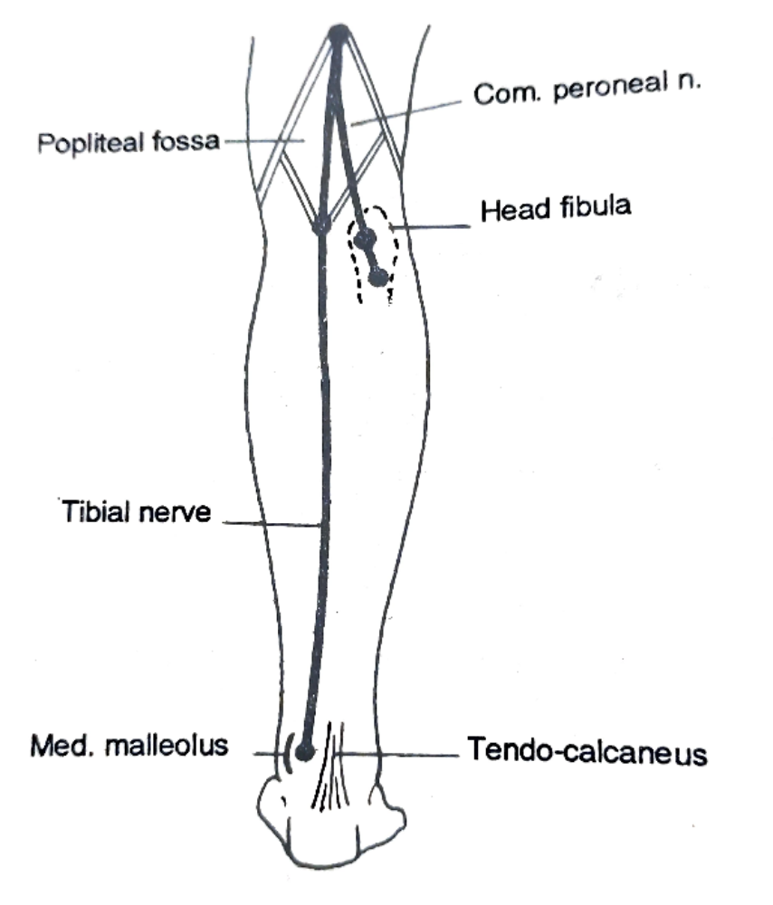
Tibial nerve –
  Put a point on upper limit of popliteal fossa
  Put another point on lower limit of popliteal fossa
  Mark a point midway b/w medial malleolus and tendo-calcaneus
Common peroneal nerve –
  Mark the upper angle of popliteal fossa
  Mark a point on the back of the head of the fibula
  Mark the on the lateral side neck of the fibula
Deep peroneal nerve –
  Put a point on lateral side of neck of the fibula
  Mark a point midway b/w two malleoli

Slide 27

Deep peroneal nerve –
  Put a point on lateral side of neck of the fibula
  Mark a point midway b/w two malleoli

Slide 28
THANK YOU

