Slide 1
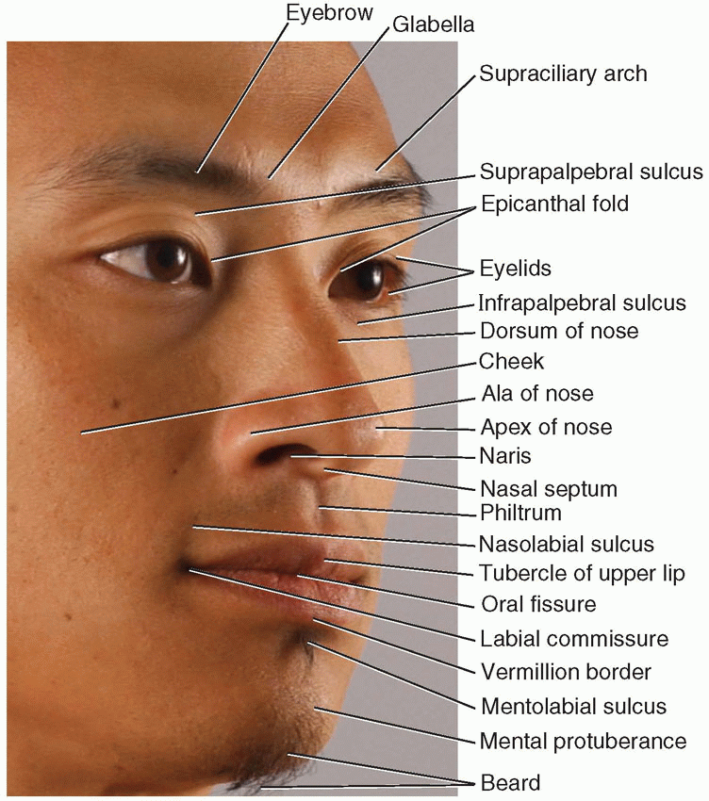
SURFACE ANATOMY OF HEAD & NECK
Dr.Sarangdhar Kumar
Department of Anatomy
Rohilkhand Medical College & Hospital,Bareilly

Slide 2
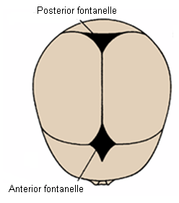
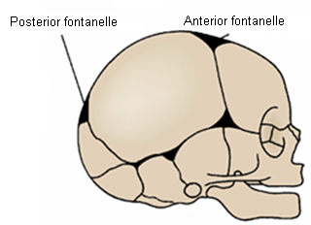
Important surface landmarks of head
Anterior fontanelle
  Between frontal bone infront and two halves of parietal bones behind
  Bregma in adult
Posterior fontanelle
      Between squamous part of occipital bone and posterior border of two parietal bones
      Lambda

Slide 3
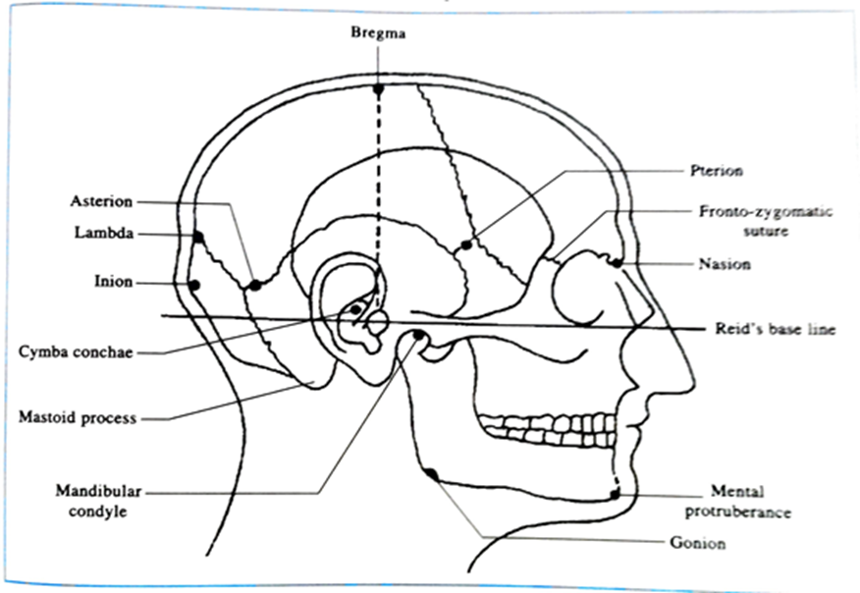

Slide 4
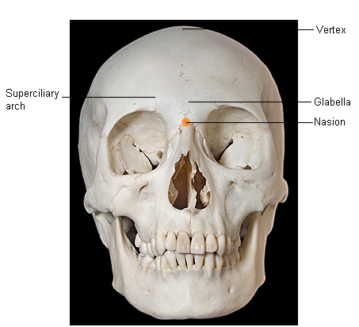
Nasion
  Depression in the midline at root of nose
Glabella
  Meeting point of two superciliary arches
Vertex
  Highest point on skull in the sagittal plane

Slide 5
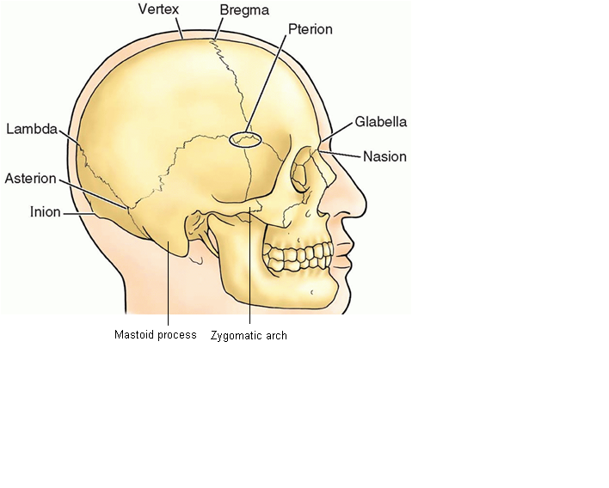
Pterion
  Lie 1.5 inch above midpoint of zygomatic arch
  Beneath it lies anterior branch of MMA
Zygomatic arch
  Extend forward in front of ear
  Above is temporal fossa
  Attached to lower margin is masseter muscle
Mastoid process of temporal bone
  Projects downward and forward behind the ear
  Develop after 2 years
Asterion
  4 cm behind the external acoustic meatus
  1.25 cm above to meato-ionic line
Notes:
MMA – middle meningeal artery

Slide 6
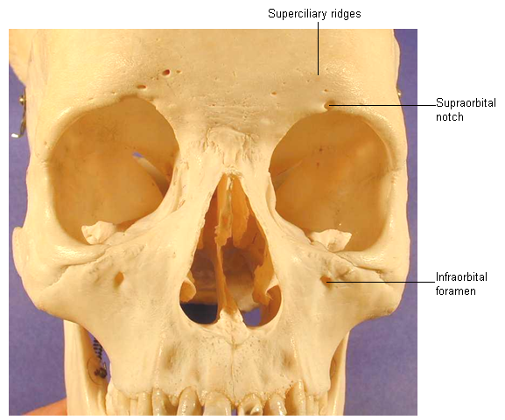
Orbital margin
  Formed by frontal, zygomatic and maxillary bones
Superciliary ridges (arch)
  Two prominent ridges on the frontal bones above the upper margin of orbit
  Deep to these ridges on either side of midline lie frontal air sinuses
Supraorbital notch
  Junction of medial and intermediate third of upper margin of orbit
Infraorbital foramen
  Lie 5mm below lower margin of orbit, on a line drawn from the supraorbital notch
  Transmit infraorbital nerve and vessels
Maxillary air sinus
  Situated within maxilla below infraorbital foramen each side

Slide 7
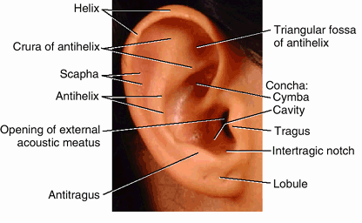
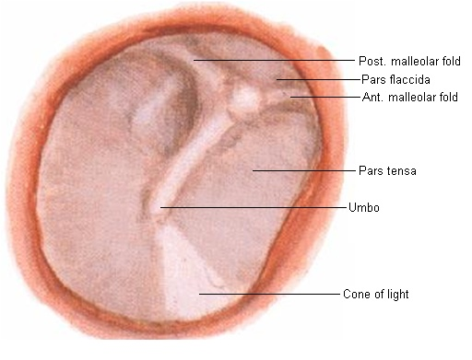
Auricle and external acoustic meatus
  Lie in front of mastoid process
  To examine the tympanic membrane
    In the adult
      Auricle should be pulled upward and backward
    In children
      Slightly downward and backward
Tympanic membrane
  Gray and concave toward the meatus
  Most depressed part is called umbo
  Caused by attachment of handle of malleus on its medial surface

Slide 8
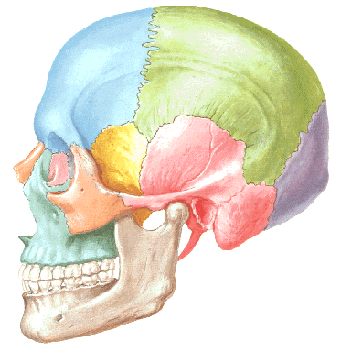
Suprameatal triangle
  Anterior
    Posterior border of the external acoustic meatus
  Superior
    Posterior root of the zygomatic arch
  Posterior
    A line joining the two
Mastoid antrum lie 2cm deep to it in adult but only 2mm deep in new born

Slide 9
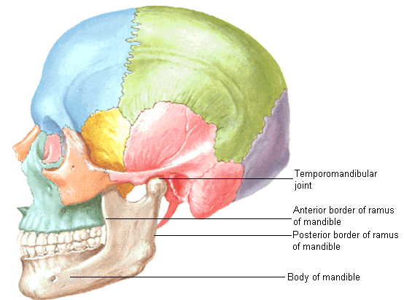
Temporomandibular joint
  Easily palpated in front of auricle while opening the mouth
Anterior border of ramus of mandible
  Felt deep to anterior border of masseter muscle
Posterior border of ramus of mandible
  Felt deep to posterior border of masseter muscle
Body of mandible
  Best examined by having one finger inside the mouth and another on outside

Slide 10
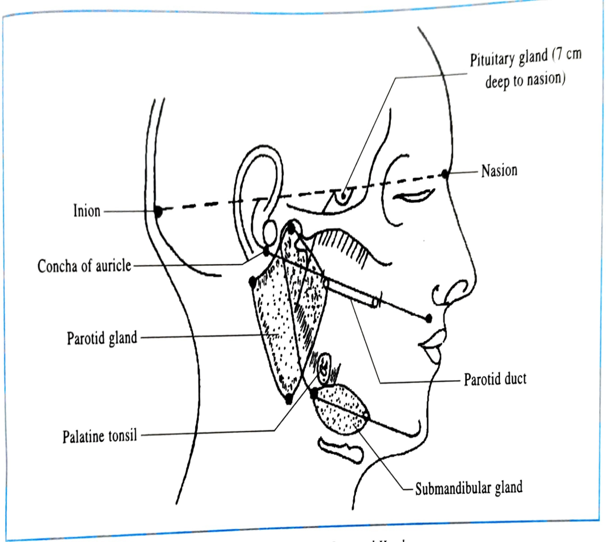
Parotid gland
Anterior border-
  A point on upper border of mandibular condyle
  A point above the center of masseter
  A point 2cm below &behind the angle of mandible
Upper border-
  A point on upper border of mandibular condyle
  A point on mastoid process
Posterior border-
  Straight line joining tip of mastoid process & 2cm below and behind the angle of mandible
Parotid duct
  A point at the lower border of choncha
  Another point midway between ala of the nose & red margin of upper lip

Slide 11
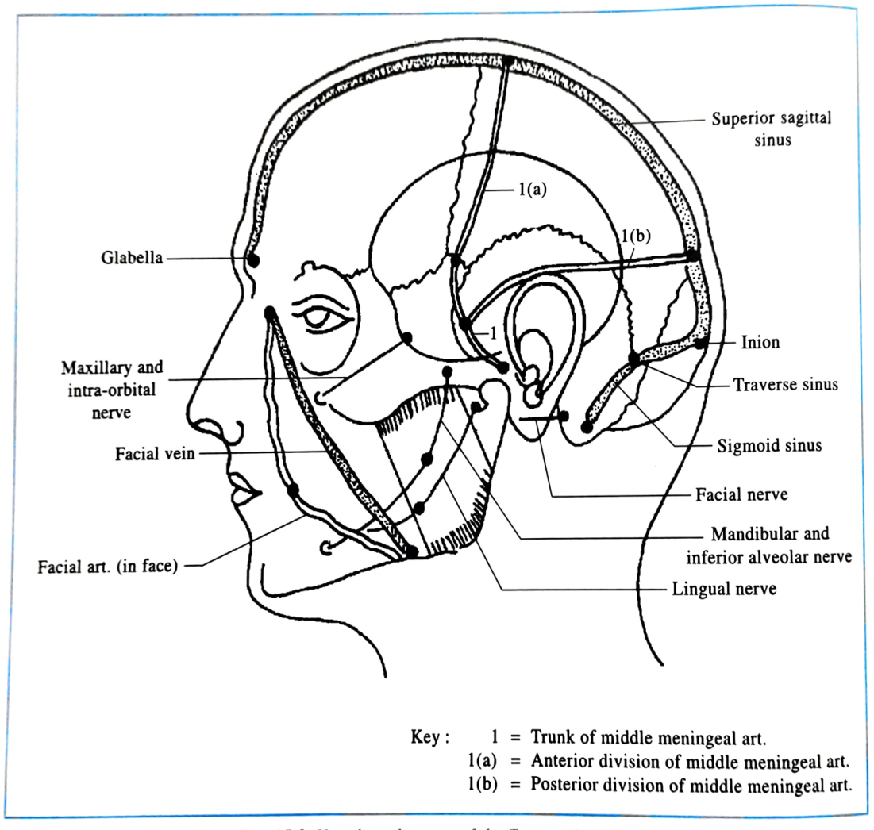
Facial artery
A point on the mandible at the antero inferior angle of the masseter
A point about 1.25 cm lateral to the angle of the mouth
A point at the medial angle of the eye join these points by wavy line
Facial nerve
  Stylomastoid foramen
    Situated about 2.5 cm from surface, opposite middle of anterior border of mastoid process
  Horizontal line from this point to ramus of mandible overlies stem of nerve

Slide 12
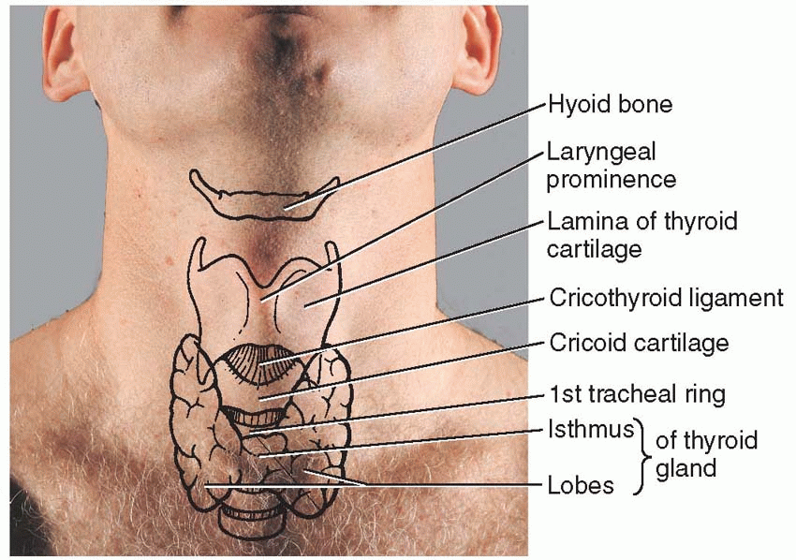
Surface landmarks of neck
Anterior aspect
Symphysis menti
  Junction of two half of mandible
Submental triangle
  Between symphysis menti and body of hyoid bone
Body of hyoid bone
  Opposite 3rd cervical vertebra
Upper border of thyroid cartilage
  Opposite 4th cervical vertebra
Cricoid cartilage
  At level of 6th cervical vertebra
Notes:
Cricoid cartilage level – C6, junction of larynx and trachea, junction of pharynx and esophagus, middle cervical ganglion, inferior thyroid artery enters inside thyroid gland

Slide 13
Thyrohyoid ligament/ membrane
  Between hyoid bone and thyroid cartilage
Cricothyroid ligament
  Between cricoid cartilage and thyroid cartilage
Cricotracheal ligament
  Junction of cricoid cartilage and 1st tracheal ring
1st tracheal ring
  Just below cricoid cartilage
    Isthmus of thyroid gland
      In front of 2nd, 3rd and 4th tracheal ring
Notes:
Thyrohyoid ligament is pierced by the superior laryngeal vessels and the internal branch of the superior laryngeal nerve.

Slide 14
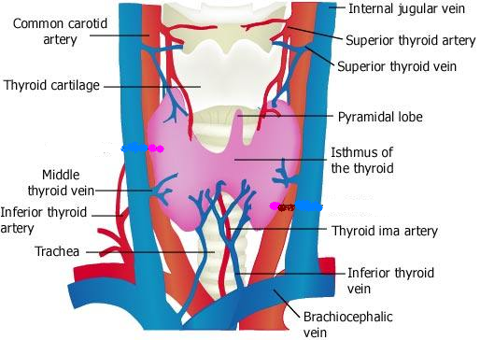
Inferior thyroid vein
  In front of 5, 6 and 7th tracheal ring
Thyroid ima artery
  When present ascends in front of trachea to isthmus of thyroid gland, from brachiocephalic artery
Notes:
Thyroid ima artery usually arises from brachiocephalic trunk or arch of aorta

Slide 15
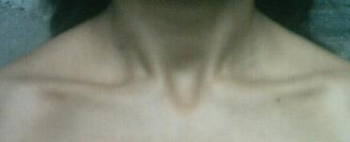
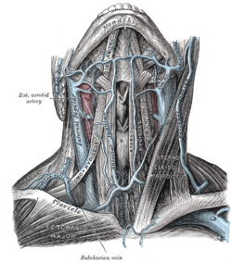
Suprasternal notch (Jugular notch)
  Superior border of manubrium
  Lie opposite the lower border of body of 2nd thoracic vertebra
Jugular venous arch
  Two anterior jugular vein are connected with each other just above suprasternal notch

Slide 16
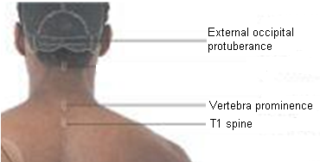
Surface landmarks of neck
(Posterior aspect)
External occipital protuberance
  Bony prominence on back of skull
  Line joining nasion to this protuberance superiorly indicates the position of falx cerebri, superior sagittal sinus
Superior nuchal line
  Curved line extending from external occipital protuberance to mastoid process
  Gives attachment to trapezius and sternocleidomastoid
Vertebra prominence
  Spine of 7th cervical vertebra
Ligamentum nuchae
  From spine of 1st to 7th cervical vertebra

Slide 17
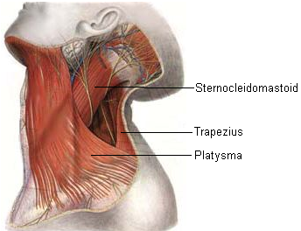
Surface landmarks of neck
(Lateral aspect)
Sternocleidomastoid muscle
  Can be palpated from sternum and clavicle to mastoid process
  Divide neck into anterior and posterior triangle
Trapezius muscle
  Can be felt by asking the patient to shrug his shoulders
Platysma muscle
  Can be seen as a sheet of muscle by asking the patient to clinch the jaw firmly

Slide 18
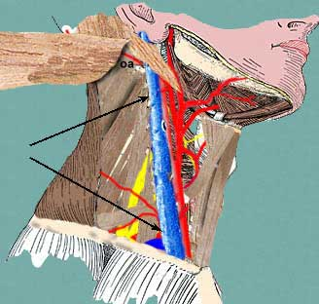
Anterior triangle of neck
  Carotid sheath
    Marked out by line joining the sternoclavicular joint to a point mid way between tip of mastoid process and angle of mandible
    At the level of upper border of thyroid cartilage CCA divides in ECA and ICA. Pulsation of these arteries can be felt at this level

Slide 19
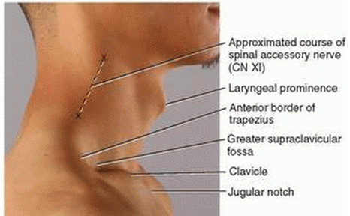
Posterior triangle of neck
  Nerve point
    Mid point of SCM
  Accessory nerve
    Line from nerve point to trapezius
Notes:
SCM – sternocleidomastoid

Slide 20
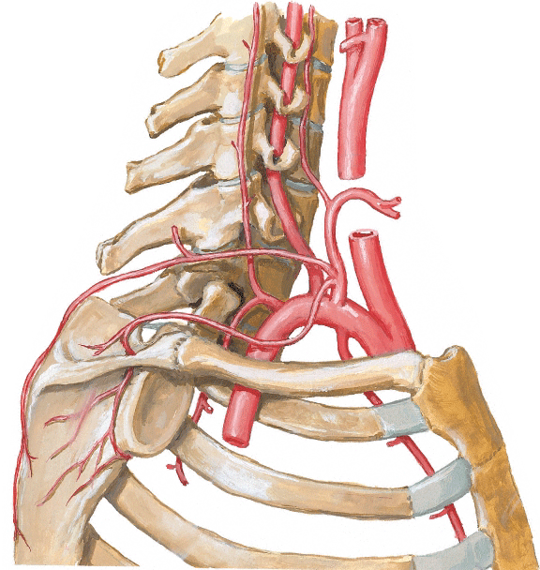
Subclavian artery
  Indicated by curved line, which passes upward from the sternoclavicular joint for about 0.5 inch and then downward to the middle of clavicle
  Here it lies on upper surface of 1st rib, that is pulsation can be felt
  Subclavian vein lie behind the clavicle

Slide 21
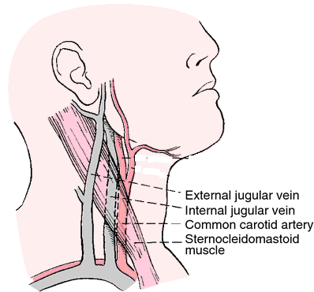
External jugular vein
  Lie in superficial fascia deep to platysma
  Passes downward from the region of angle of mandible to middle of the clavicle
  Perforates the deep fascia just above the clavicle and drains into the subclavian vein

Slide 22
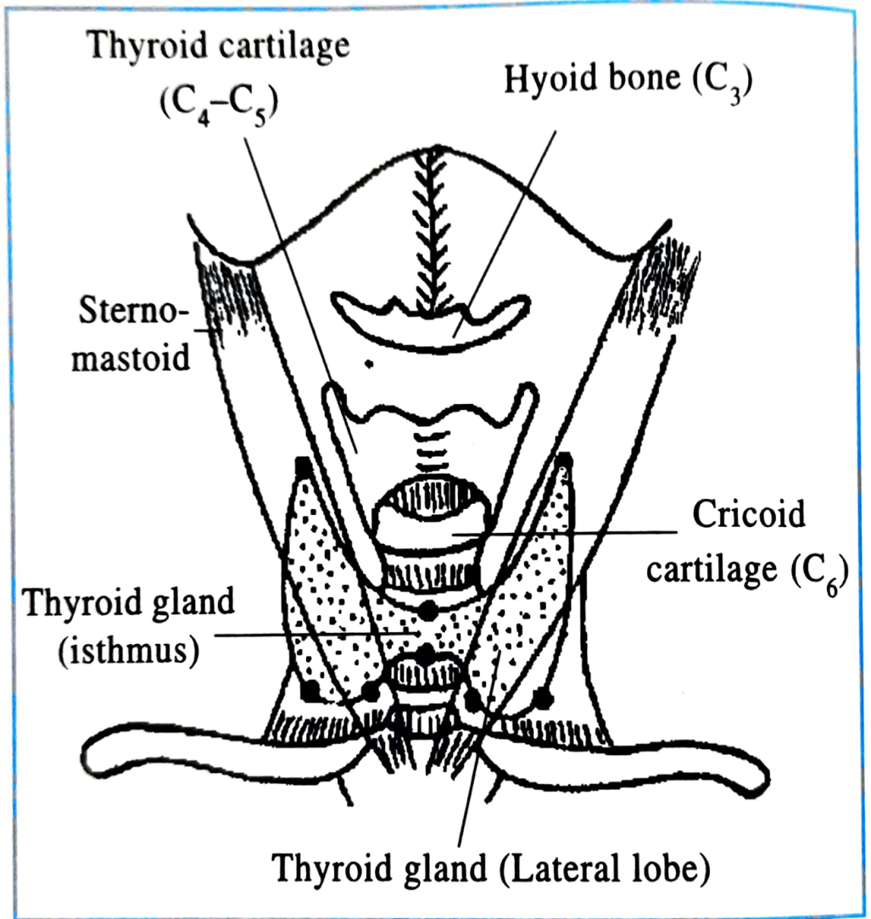
Thyroid gland
For isthmus-
  Take a point 1 cm below the cricoid arch, draw a 1.5 cm horizontal line
  Take another point 1.25 cm below from the previous point, draw a 1.5 cm long horizontal line
For lateral lobe-
  Take a point 1cm below the lateral end of lower border of isthmus
  A point 2.5cm lateral to the previous one
  Put a point on anterior border of SCM at the level of laryngeal prominence
  Then join the lateral end of upper border of isthmus

