Slide 1
SUPRARENAL GLAND or
ADRENAL GLAND

Slide 2
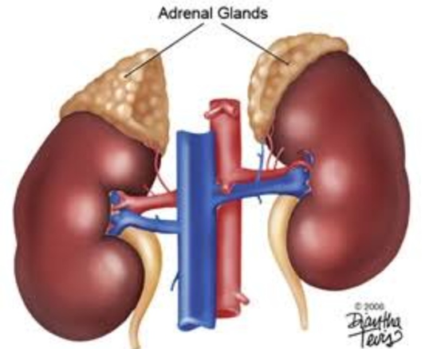
Introduction
Paired endocrine gland
Golden yellow in colour
Lies above the upper pole of each kidney
It is enclosed in same compartment along with kidney by renal fascia

Slide 3
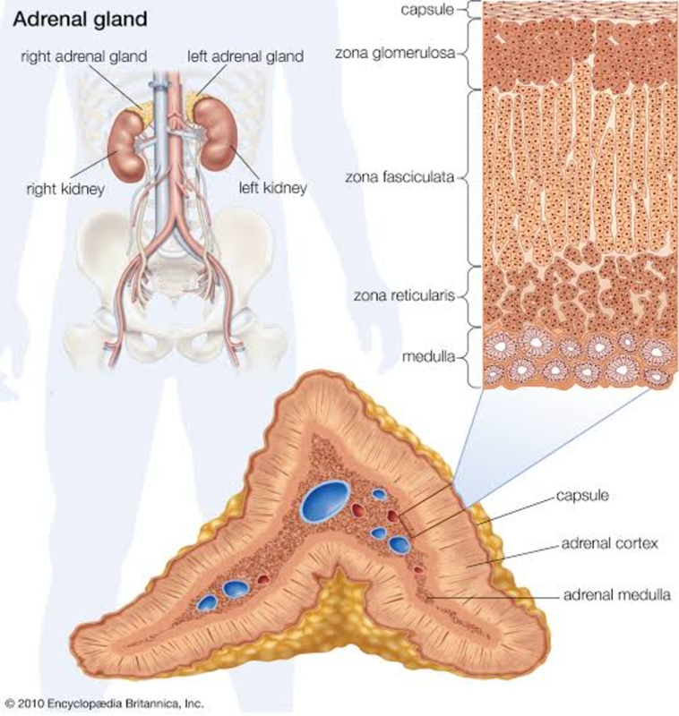
Each gland consists of outer cortex & inner medulla
Phylogenetically, developmentally, structurally & functionally both parts are entirely distinct from each other
Cortex –
  mesodermal in origin
  Secrets steroid hormones
    Mineralocorticoids
    Glucocorticoids
    Sex hormones
Medulla –
  develops from neural crest cell
  Contains chromaffin cells
  secrets epinephrine & norepinephrine

Slide 4
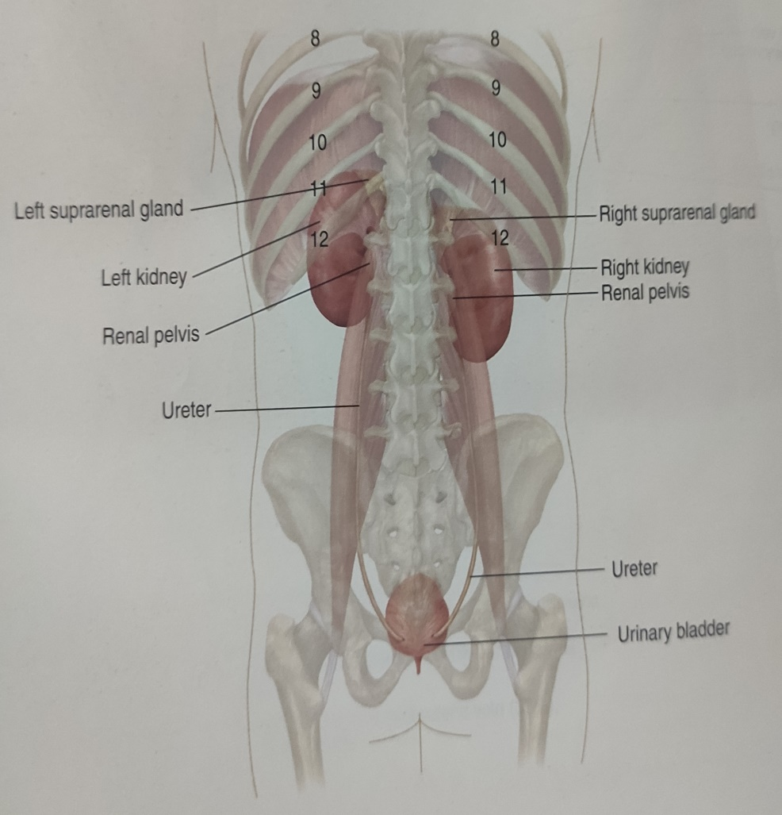
Location
Lies retroperitoneally in posterior abdominal wall on either side of vertebral column
In epigastrium region infront of crus of diaphragm opposite the vertebral end of 11th ICS & 12th rib

Slide 5
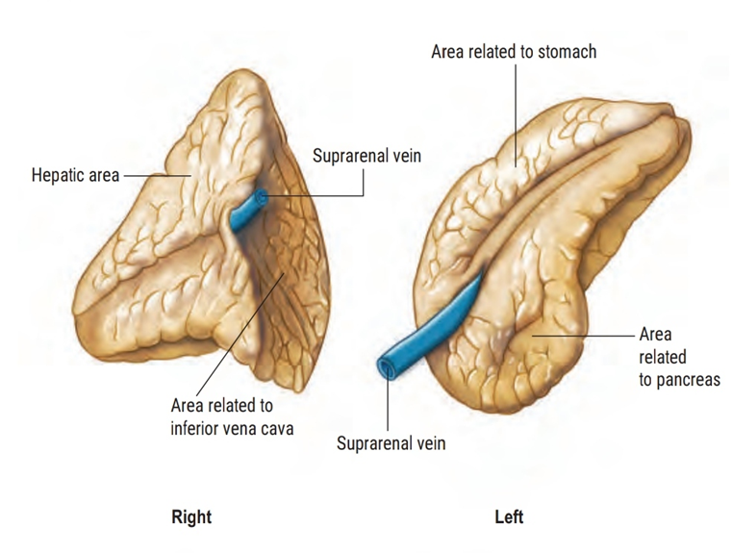
Size & Shape
Size
    Height – 50 mm
    Breadth – 30 mm
    Thickness – 10 mm
    Weight – about 5 gms
Shape
    Right suprarenal gland
      pyramidal or triangular in shape
    Left suprarenal gland
      semilunar in shape

Slide 6
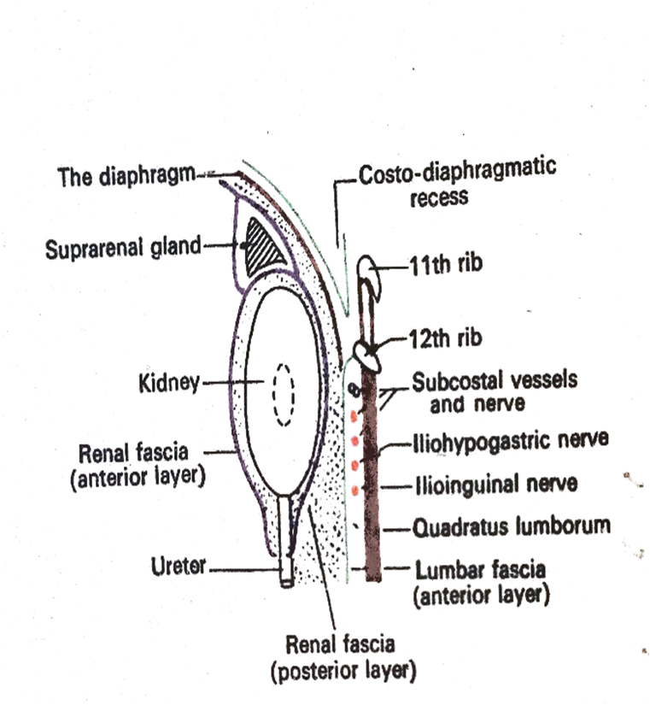
Capsule
True capsule
  Derived from condensation of fibrous stroma of gland
False capsule
  Derived from renal fascia

Slide 7
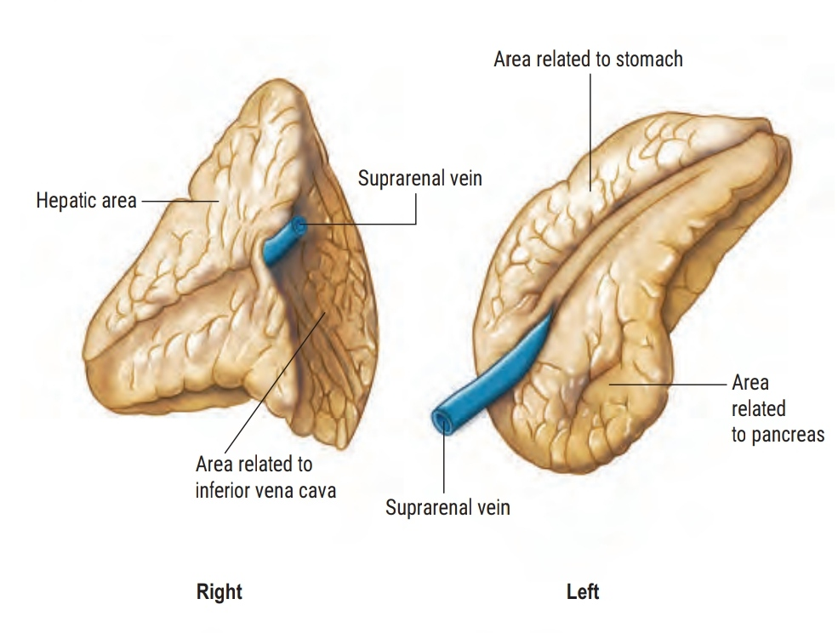
Right suprarenal gland
Pyramidal or triangular in shape
It presents –
  Base , apex , two surfaces & two borders
Base
  Directed below
  overlaps the upper end of right kidney
Apex
  Directed above
  overlapped by IVC

Slide 8
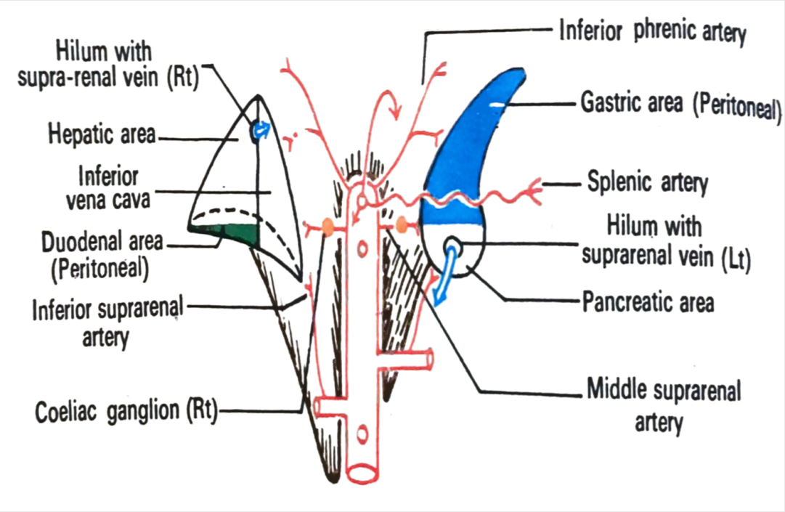
Surfaces - anterior surface & posterior surface
  Anterior surface
    Divided into two area by vertical ridge
    Medial area – non-peritoneal & related with IVC
    Lateral area - Presents upper larger area & lower smaller area
      Larger area – non-peritoneal & related with bare area of liver
      Smaller area – covered with peritoneum derived from inferior layer of coronary ligament

Slide 9
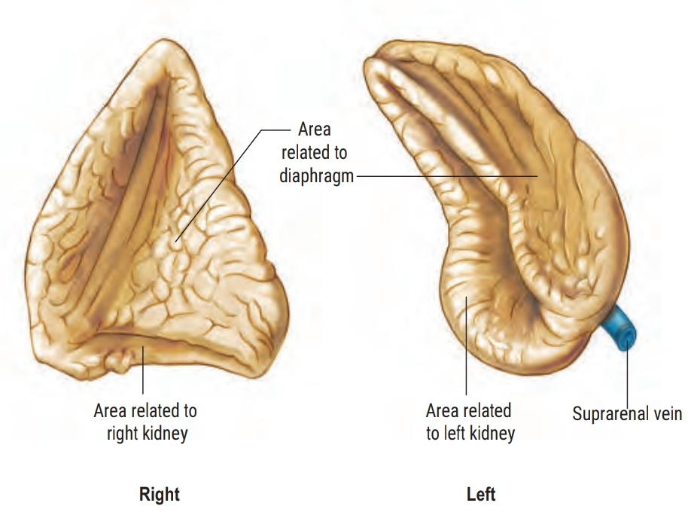
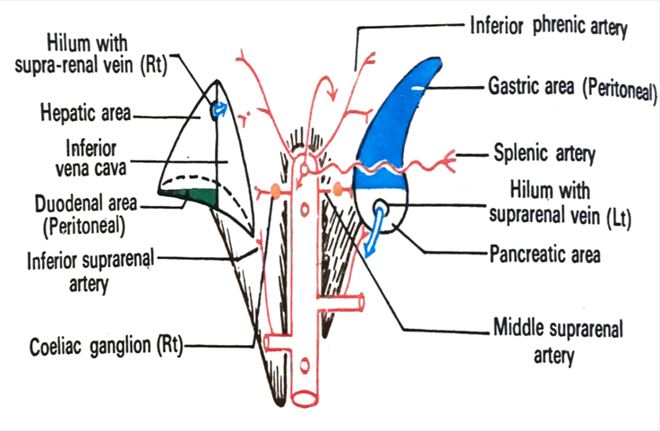
  Posterior surface
    Divided into curved ridge into upper area & lower area
      Upper area – convex & contact with diaphragm
      Lower area – concave & related with anterior surface & medial border of right kidney
Border – lateral & medial border
  Lateral border – overlapped by liver
  Medial border – related with right coeliac ganglia & right inferior phrenic artery

Slide 10
Left suprarenal gland
Longer & near to vertebral column than right one
Semilunar in shape
It presents – two ends , two surfaces & two borders
Ends –
  Lower end – rounded & presents hilum through which left suprarenal vein passes
  Upper end – narrow , some times related to medial end of spleen

Slide 11
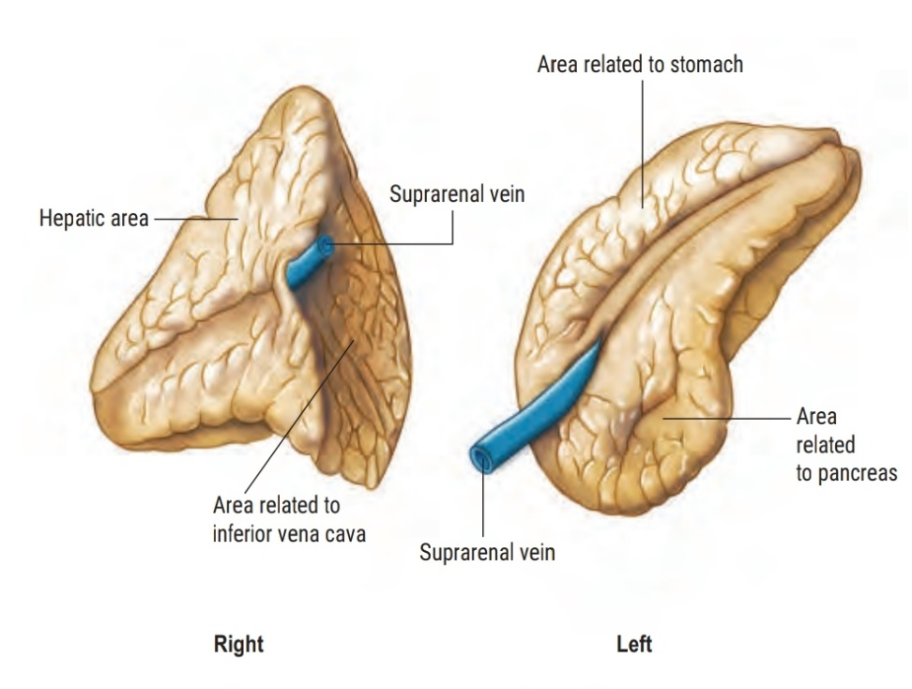
Surfaces –
  Anterior surface – presents upper & lower area
    Upper area – peritoneal & it covered by peritoneum of lesser sac
    Related with posterior surface of cardiac end of stomach
    Lower area – non- peritoneal & related with body of pancreas
  Posterior surface – divided curved ridge into two areas
    Lateral area – related with upper part of medial border& anterior surface of left kidney
    Medial area – related with left crus of diaphragm

Slide 13

Borders –
  Lateral border –
    concave
    overlaps the left kidney
  Medial border –
    convex
    related with
      left coeliac ganglion
      left inferior phrenic artery
      left gastric artery

Slide 14

Structure of suprarenal gland
Each gland consists of –
  Outer – cortex
  Inner – medulla
Cortex is essential for life & consists of cells which posses basophilic cytoplasm & lipid droplets
Medulla forms 1/10th of entire gland & is surrounded by cortex except at hilum

Slide 15
Cortex –
  Arranged in three zones
  Outside inwards
    Zona glomerulosa
    Zona fasciculata
    Zona reticularis

Slide 16
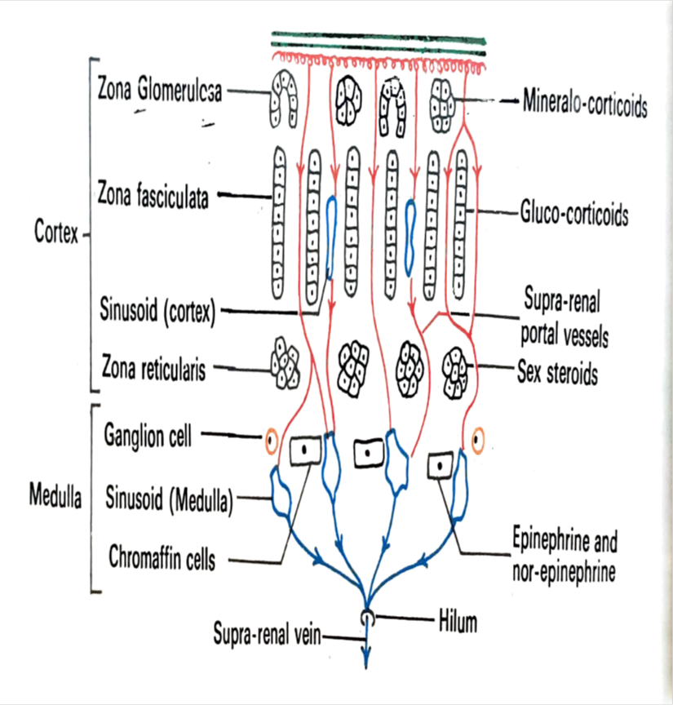
Zona glomerulosa
  Forms 15% of total volume of gland
  Small polyhedral cells
  Arranged in arched column
  Secrets mineralocorticoids ,which regulate sodium & potassium balance in the body
  Activities of this zone is regulated by renin angiotensin mechanism

Slide 17

Zona fasciculata
  Thickest of three zones
  Forms 65% of total volume of gland
  Polyhedral cells arranged in straight cords & separated by capillaries & sinusoids
  Secrets glucocorticoids ,which regulates the carbohydrate & protein metabolism

Slide 18
Zona reticularis
  Consists of irregularly arranged cells
  It is germinative zone
  It secrets sex hormones (oestrogen) which regulate secondary sex characters

Slide 19
Medulla
  Consists of-
    chromaffin cells
      Tall columnar
      Basophilic cytoplasm contains membrane bound granules
      Chromaffin reaction - Stained brown with potassium bichromate
      Secrets – epinephrine & norepinephrine
    Ganglion cells
    Capillaries & sinusoids

Slide 20
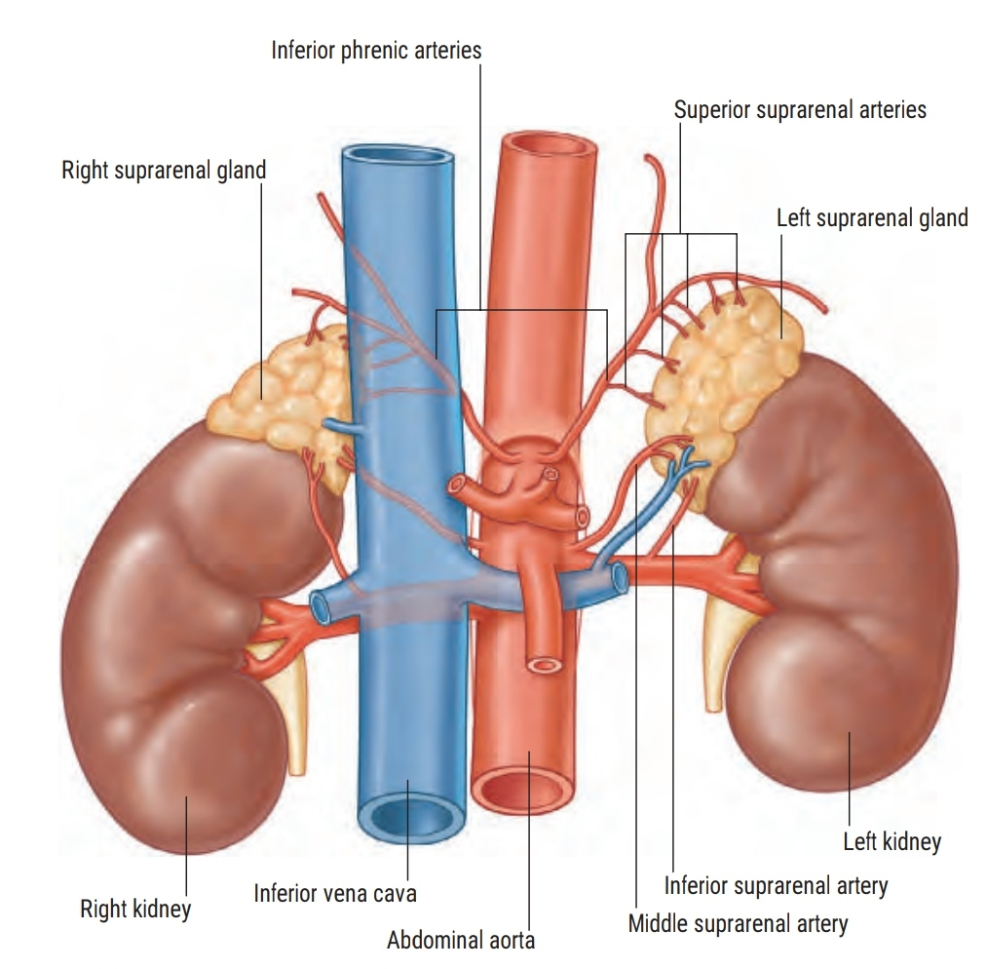
Blood supply
Arterial supply
  Supplied by following arteries –
    Superior suprarenal artery
      Branch of inferior phrenic artery
    Middle suprarenal artery
      Branch of abdominal aorta
    Inferior suprarenal artery
      Branch of renal artery
Venous drainage
  Right suprarenal vein
    Drains into IVC
  Left suprarenal vein
    Drains into left renal vein

Slide 21
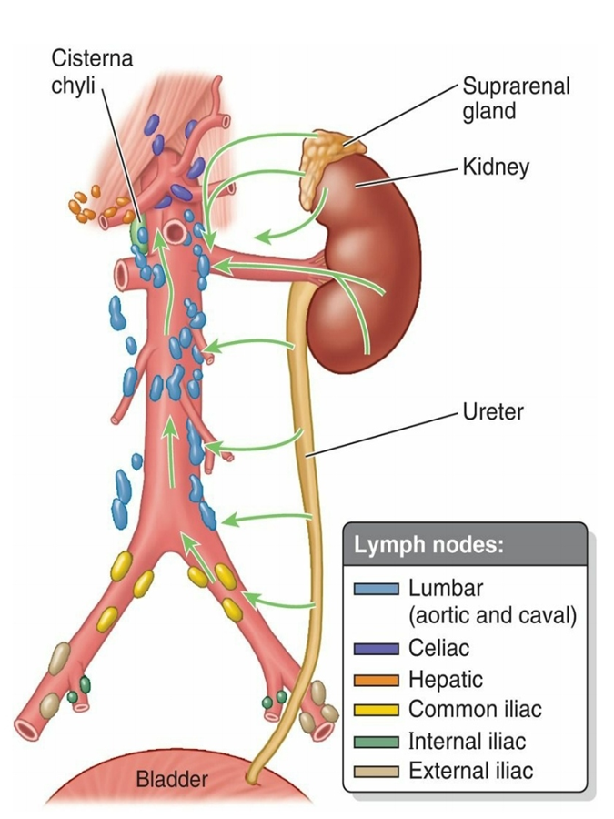
Lymphatics drainage
Lymphatics drainage
  Into lateral aortic groups of lymphnodes

Slide 22
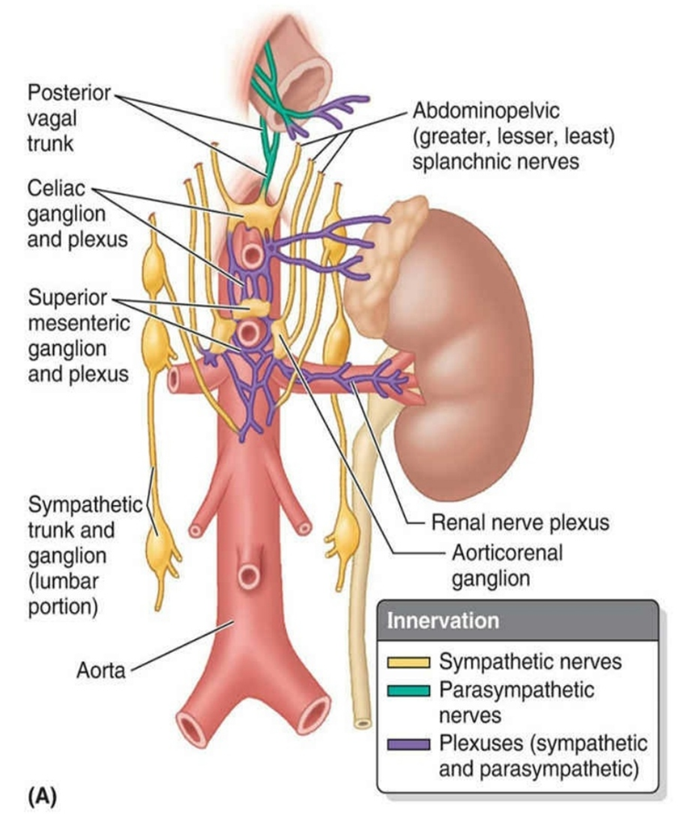
Nerve supply
Nerve supply –
  Medulla –
    Has sympathetic nerve supply
    T8 – L1 (coeliac plexus )
  Cortex –
    It is controlled by ACTH of adenohypophysis

Slide 23
Applied anatomy
Addison’s diseases
  Due to deficiency of mineralocorticoids
  Characterized by –
    Increase pigmentation
    Muscular weakness
    Weight loss
    Hypotension
Conn’s syndrome
  Due to adrenal hyperplasia with excessive secretion of mineralocorticoids
  Characterized by –
    Hypertension
    Oedema (due to sodium & water retention )
    Hypokalemia

Slide 24
Cushing’s syndrome
  Adrenal hyperplasia with excessive secretion of glucocorticoids
  Manifested by
    Moon shaped face
    Truncal obesity
    Hypertension
    Hirsutism in female
    Weakness & wasting of limbs
Adreno-genital syndrome
  Due to Excessive secretion of sex hormone
  Results in masculinization of female & precocious in male

Slide 25
Pheochromocytoma
    (pheo = dark, chromo = colour & cytoma = tumour)
  Due to tumour in medulla of suprarenal gland
  Produces paroxysmal hypertension(episodic & volatile high BP) due to secretion of large amount of catecholamine
  Manifested with
    Increase Skin sensation
    Increase Flank pain
    Increase heart rate & Blood pressure (palpitation)
    Weight loss

Slide 26
THANK YOU

