Slide 1
SUBMANDIBULAR REGION
SARANGDHAR KUMAR
DEPARTMENT OF ANATOMY
ROHILKHAND MEDICAL COLLEGE, BAREILLY

Slide 2
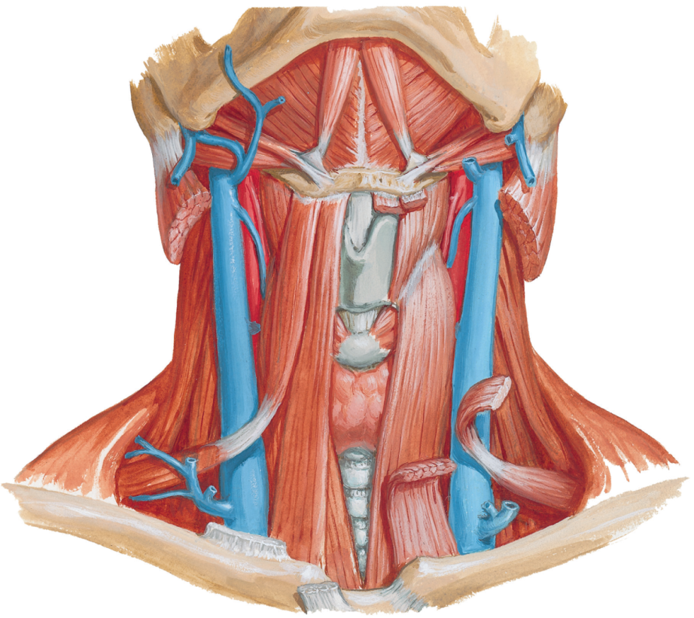
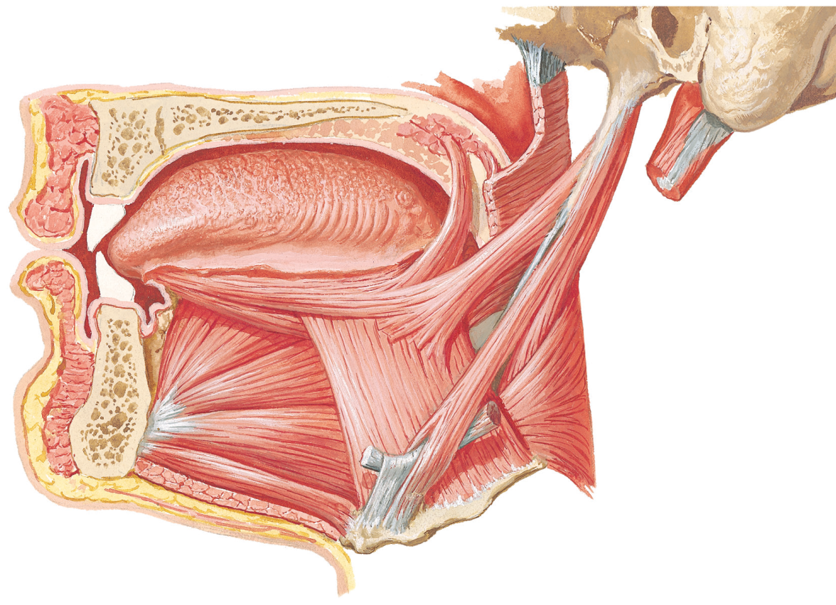
Submandibular region
Deeper structure in area between mandible and hyoid bone, including floor of mouth and root of tongue
Contains-
  Submandibular & sublingual glands
  Suprahyoid muscles
  Extrinsic muscles of tongue- Hyoglossus, Genioglossus & Stylogossus
  Lingual artery & parts of facial artery
  Hypoglossal nerve & Submandibular ganglion
Digastric muscle (anterior belly)
Mylohyoid muscle
Stylohyoid muscle
Digastric muscle
(posterior belly)
Tongue
Styloid process
Stylogossus
Stylohyoid muscle
Genioglossus
Hyoglossus
Geniohyoid muscle
Hyoid bone

Slide 3
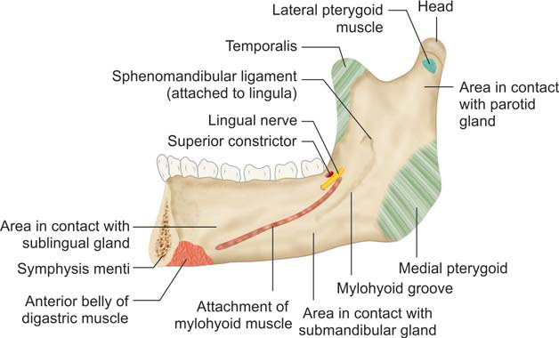
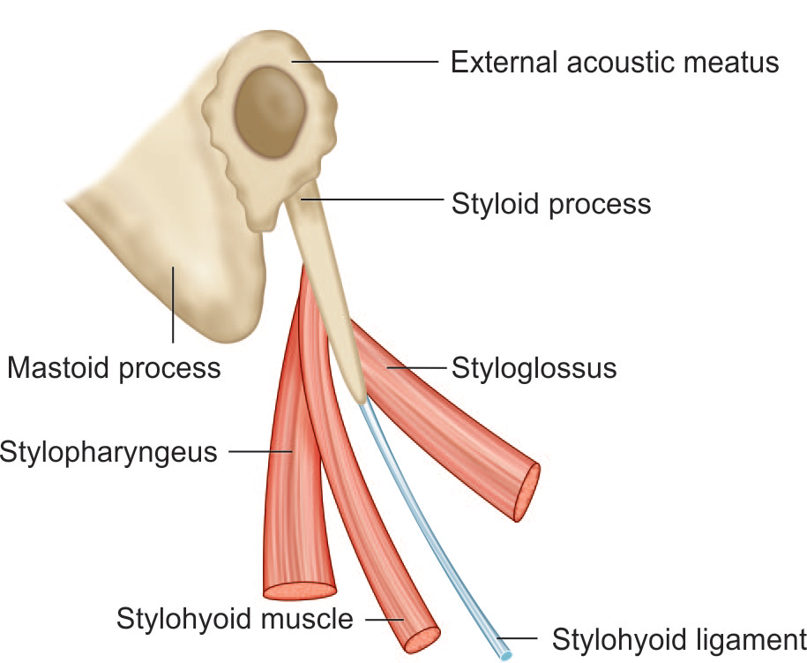
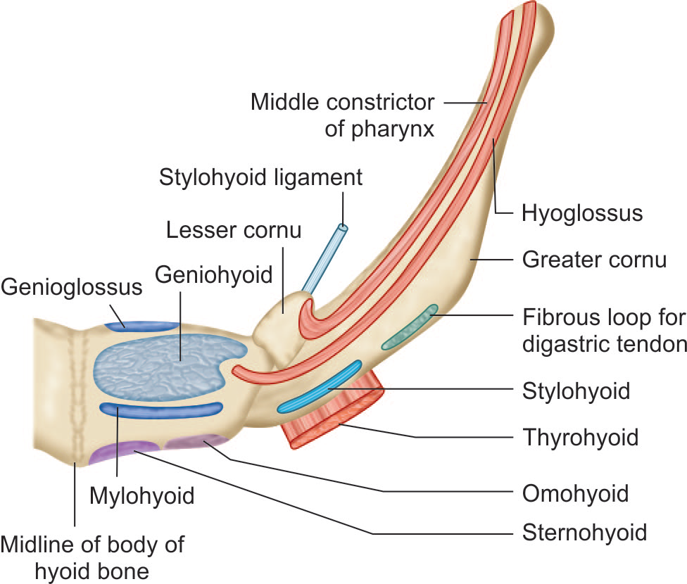

Slide 4

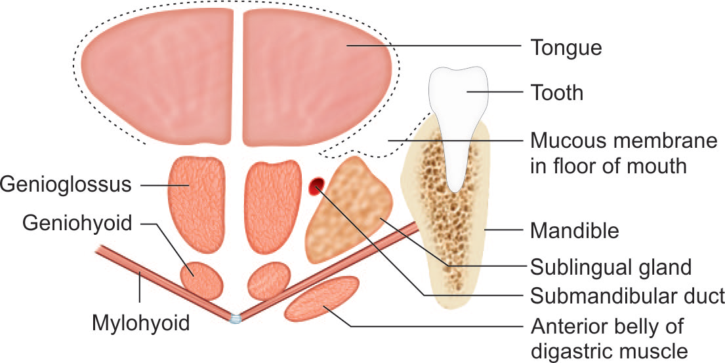
Muscles-
Suprahyoid muscles
    Digastric
    Stylohyoid
    Mylohyoid
    Geniohyoid
Digastric muscle (anterior belly)
Mylohyoid muscle
Stylohyoid muscle
Digastric muscle
(posterior belly)

Slide 5
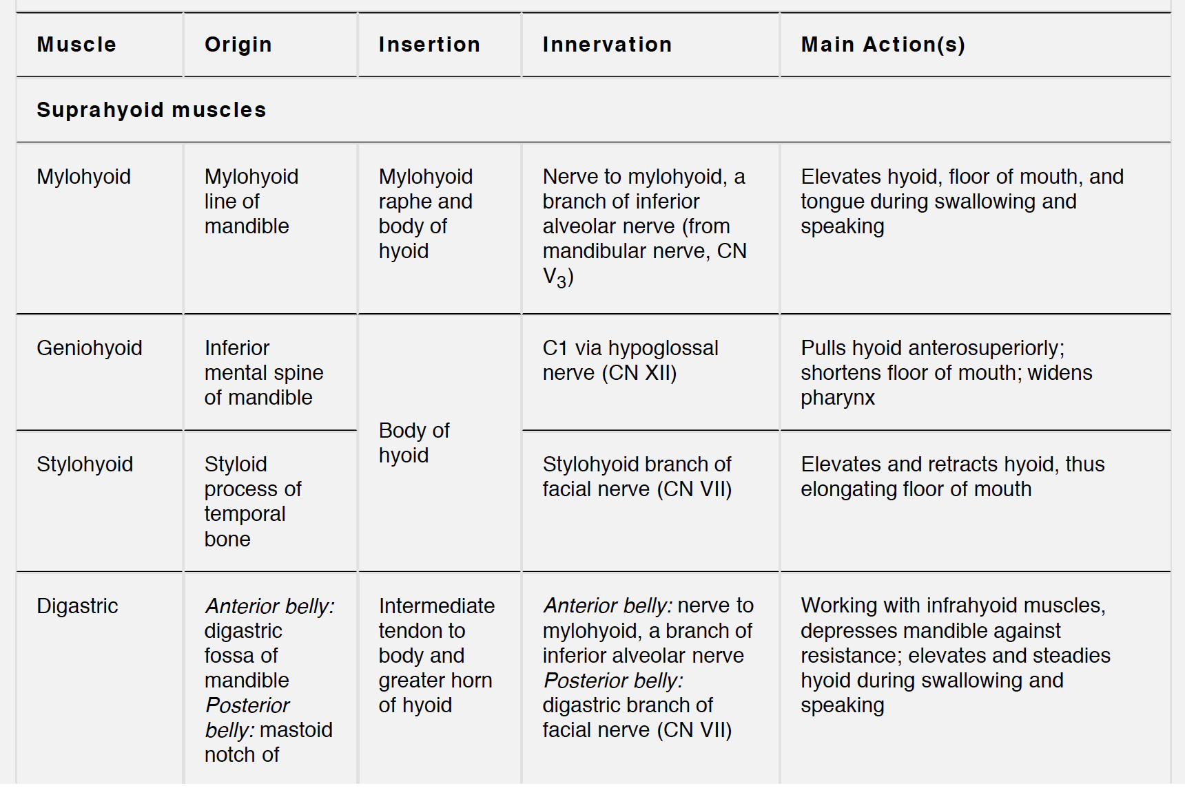

Slide 6
Muscles-
Extrinsic muscle of tongue
  Hyoglossus (key muscle)
  Genioglossus
  Stylogossus
  Palatoglossus
Styloid process
Styloglossus
Stylohyoid muscle
Genioglossus
Hyoglossus
Geniohyoid muscle
Hyoid bone

Slide 7
Muscle | Origin | Insertion | Action | Nerve supply
Hyoglossus | Greater cornu and lateral part of body of hyoid | Side of tongue | Depresses tongue | Hypoglossal nerve
Genioglossus | Superior genial tubercles on the Posterior surface of symphysis menti of mandible | Majority of fibers insert into the ventral aspect of tongue forming the bulk of the tongue muscle. Lower fibers insert into the hyoid bone | Protrudes tongue out of mouth by pulling posterior part forwards. “Safety muscle of the tongue” | Hypoglossal nerve
Stylogossus | Anterior and lateral aspect of the tip of the styloid process | Side of tongue | Pulls tongue upwards and backwards | Hypoglossal nerve
Palatoglossus | Oral aspect of the palatine aponeurosis | Side of tongue | Muscles of both sides acting together bring the Palatoglossus arches together closing the aperture from oral cavity to pharynx | Cranial part of accessory nerve

Slide 8
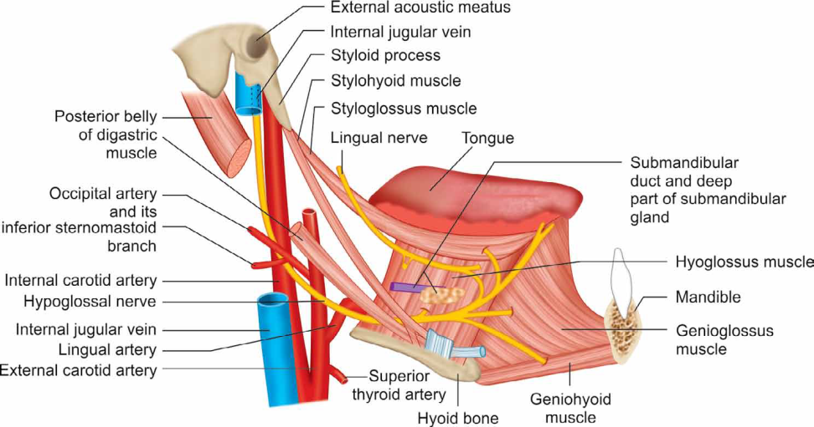
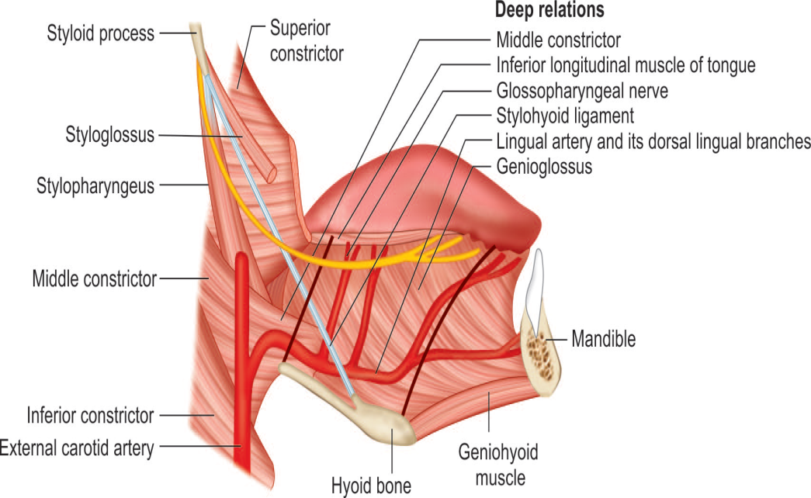
Relations of hyoglossus muscle
Structures passing deep to posterior border
  Glossopharyngeal nerve
  Stylohyoid ligament
  Lingual artery
Structures superficial to muscle
  Lingual nerve
  Submandibular ganglion (suspended from the lingual nerve)
  Deep lingual vein
  Submandibular gland (deep part)
  Submandibular duct
  Sublingual gland (part of)
  Styloglossus muscle
  Stylohyoid muscle
  Hypoglossal nerve
  Mylohyoid muscle
  Digastric tendon and pulley
Structures deep to muscle
  Glossopharyngeal nerve
  Stylohyoid ligament
  Lingual artery
  Genioglossus muscle, Middle & inferior constrictor of pharynx

Slide 9
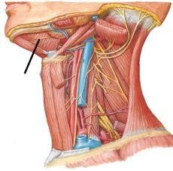
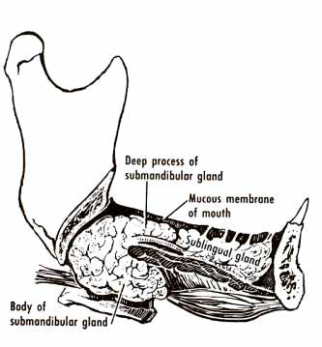
Submandibular gland
Large salivary gland
Located in the anterior part of Digastric triangle
Weight – 15-20 gms.
Shape – ‘J’- shaped
Divided by mylohyoid muscle in superficial (body) and deep part
It is partially covered between two layers of deep cervical fascia

Slide 10
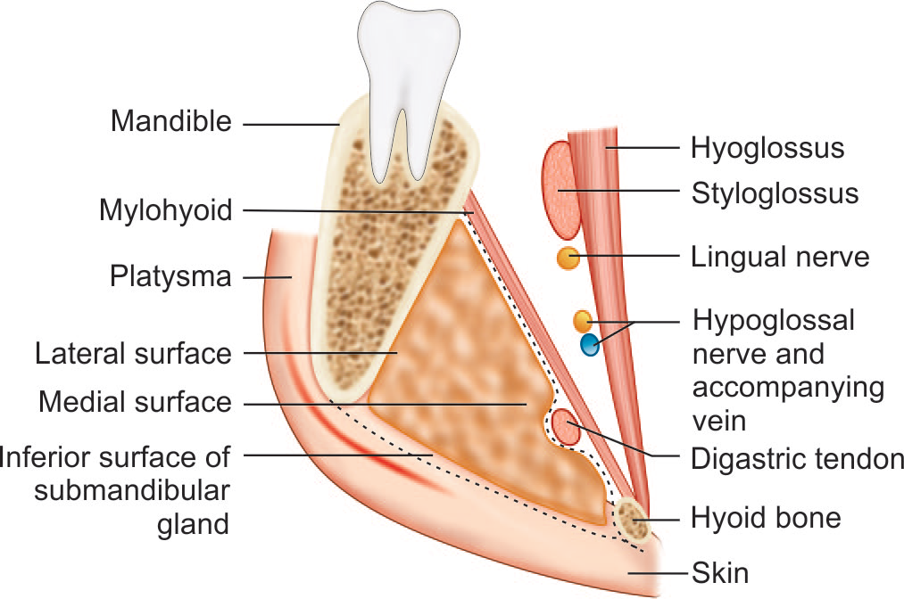
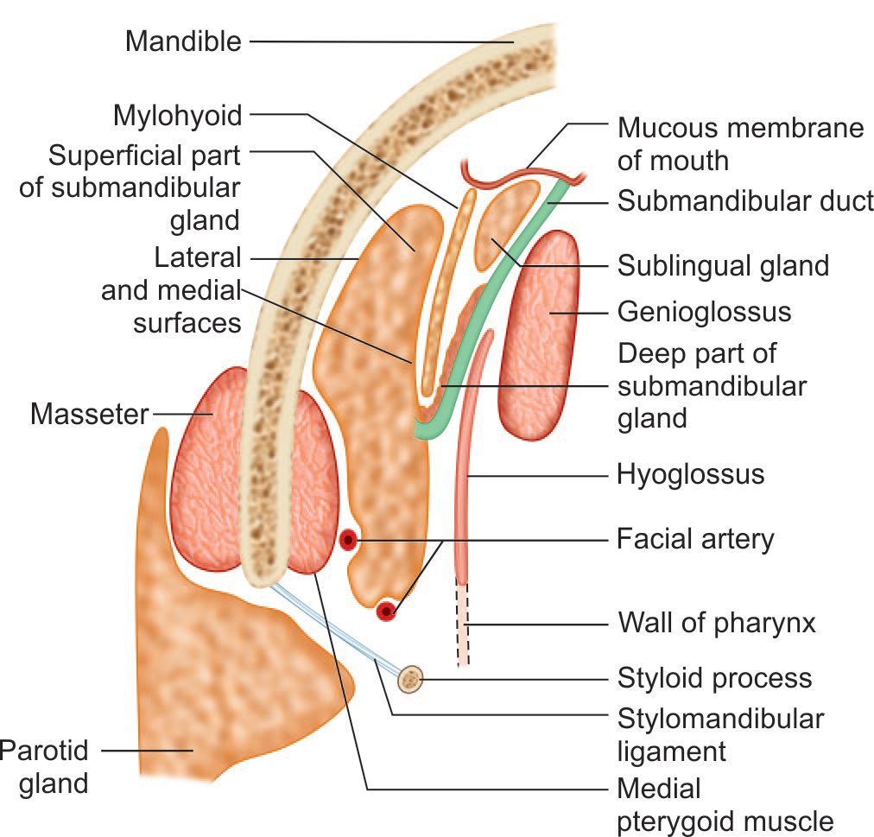
Superficial part-
It fills the Digastric triangle
Extends –
  Superiorly -deep to the mandible up to the mylohyoid line
  Inferiorly- posterior belly of digastric & mylohyoid muscle
It has three surfaces-
    Inferior surface
    Lateral surface
    Medial surface

Slide 11

Relations
Inferior surface- Skin ,SFF, Platysma, Cervical branch of facial nerve, Deep fascia ,Facial vein
Lateral surface- submandibular fossa of mandible
Medial surface-
  Anterior part- mylohyoid, mylohyoid nerve & vessels, submental branch of facial artery
  Middle part- Hyoglossus, Stylogossus, Lingual artery, Hypoglossal nerve
  Posterior part- Stylohyoid, Stylogossus & Glossopharyngeal nerve

Slide 12
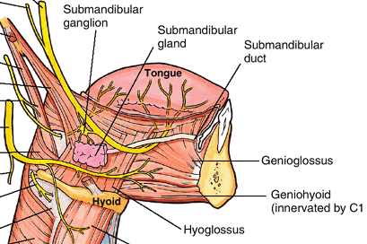
Deep part-
  Lies deep to mylohyoid and superficial to hyoglossus & styloglossus
  Extend-
    Anteriorly- continue with superficial part
    Posteriorly- post. end of sublingual gland
  Relations –
    Laterally- mylohyoid
    Medially-hyoglossus
    Above- lingual nerve & submandibular ganglion
    Below- hypoglossal nerve

Slide 13
Submandibular duct (Wharton's duct)
Thin walled duct about 5cm long, emerges at anterior end of deep part
Runs forwards on hyoglossus, between lingual and hypoglossal nerve
At anterior border of hyoglossus duct is crossed by lingual nerve
Opens on the floor of mouth on summit of sublingual papilla, at side of frenulum of tongue
Lingual nerve
Hypoglossal nerve

Slide 14
Blood supply ,Nerve supply & Lymphatics
Artery
  Lingual artery, facial artery
Veins
  Common facial or lingual vein
Lymph
  Submandibular lymph node
Nerve supply
    Secretomotor
    Parasympathetic component of VII though submandibular ganglion

Slide 15
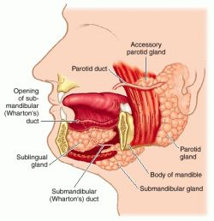
Sublingual gland
Smallest of 3 salivary gland
Lies above mylohyiod, in the sublingual fossa below mucosa of floor of mouth
Ducts open into floor of mouth by about 15 ducts on the summit of sublingual fold
Blood supply is from lingual and submental arteries
Nerve supply is similar to submandibular gland

Slide 16
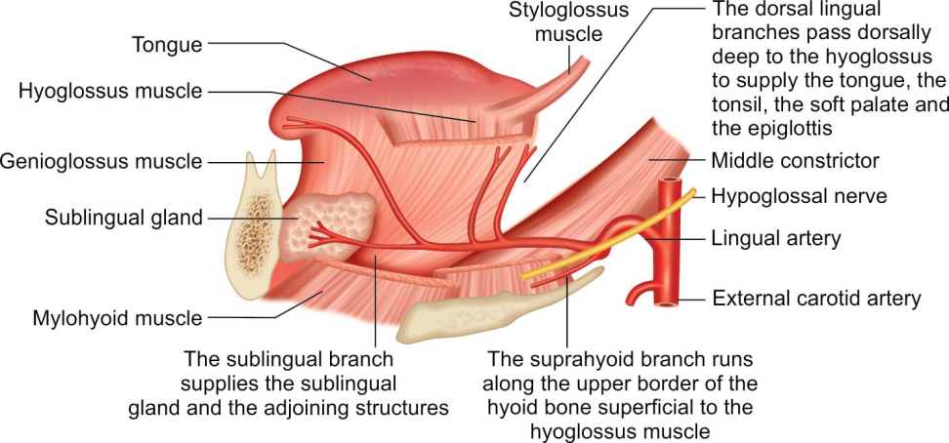
ARTERIES
Lingual artery
  Arises from the external carotid artery
  Opposite the tip of the greater cornu of the hyoid bone
  It loops upward & forward lies deep to hyoglossus
  Divided into three parts by the hyoglossus muscle.
The first part –
  lies before the hyoglossus (in carotid triangle)
The second part –
  lies deep to the muscle on middle constrictor of pharynx
The third part –
  runs upwards along anterior border of hyoglossus & lies on genioglossus musle
Branches –
  Suprahyoid branch
  Dorsal lingual branch
  Sublingual branch
  Deep lingual artery

Slide 17
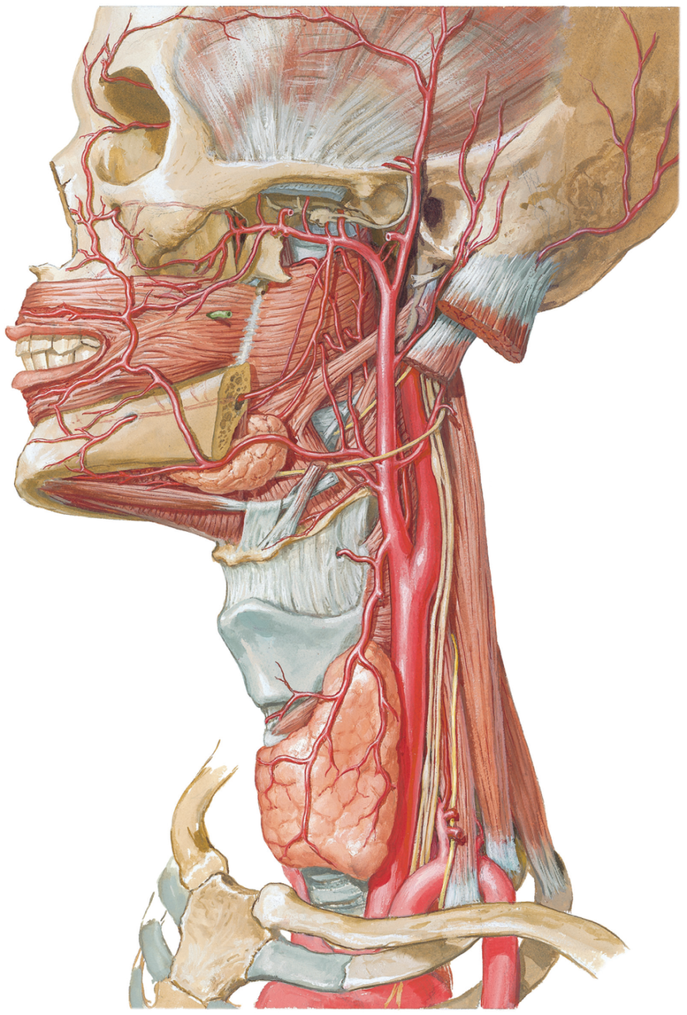
Facial artery
  Branch of external carotid artery
  Loops upward close to outer surface of pharynx and tonsil
  Lies deep to submandibular gland
  Hooks around lower border of mandible at anterior margin of masseter to enter face
  Ascends around lateral margin of mouth and terminates at medial angle of eye by anastomosing with dorsal nasal branch of ophthalamic artery
Facial artery
Lingual artery

Slide 18
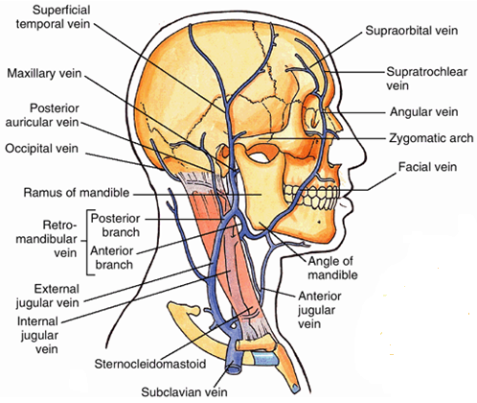
Facial vein
Angular vein formed at medial angle of eye by union of supraorbital and supratrochlear veins – facial vein
Descends behind facial artery to lower margin of body of mandible
Crosses superficial to submandibular gland and is joined by anterior division of retromandibular vein and ends into internal jugular vein
Tributaries correspond to the branches of facial artery

Slide 19
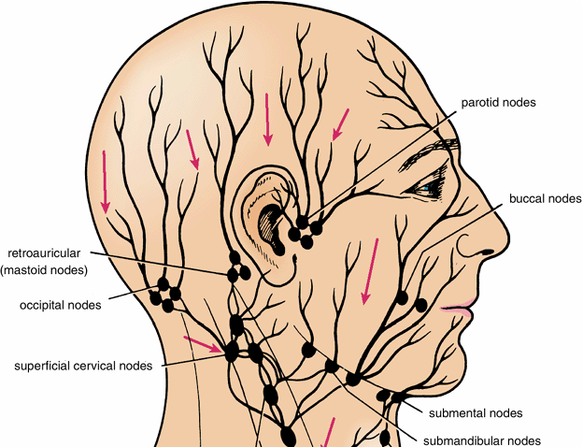
Submandibular lymph nodes
Submandibular nodes
  Lie superficial to submandibular gland
  Receive lymph from front of
  Scalp,
  Nose,
  Cheek, Upper lip, Lateral part of lower lip,
  Frontal, Maxillary, Ethmoid air sinuses,
  Upper and Lower teeth (except lower incisors),
  Anterior 2/3 of tongue (except tip),
  Floor of mouth and vestibule, Gums

Slide 20
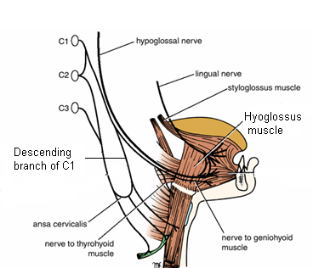
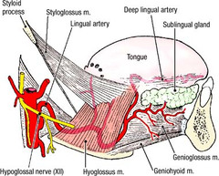
Hypoglossal nerve
Arises by about 10-15 rootlets from medulla
Leaves the cranium through hypoglossal canal
After existing cranial cavity it is joined by branches of C1
In the neck it loops around occipital artery and passes between external carotid and internal jugular vein
Passes above the hyoid bone on the lateral surface of hyoglossus deep to mylohyiod muscle

Slide 21
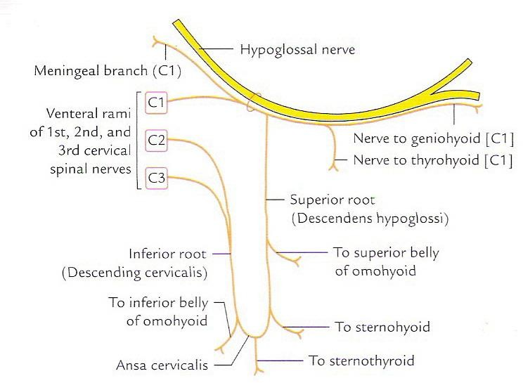
Branches
All the muscles of tongue except palatoglossus which is supplied by vagus through pharyngeal plexus
  Meningeal branch which enter cranial cavity through hypoglossal canal and supply meninges of posterior cranial fossa
C1 fibers
  Thyrohyoid and geniohyoid

Slide 22
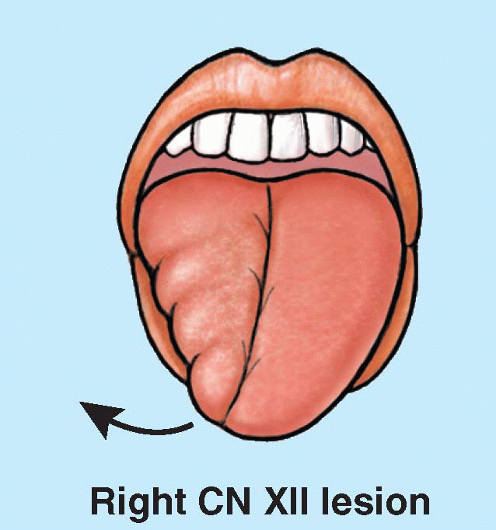
Effects of lesion
Ipsilateral paralysis of tongue
When tongue is protruded its apex deviates toward the paralyzed side

Slide 23
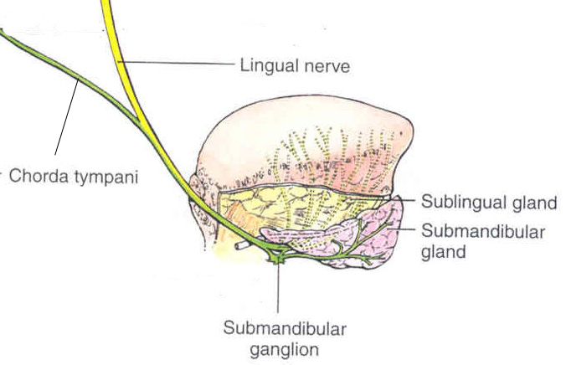
Submandibular ganglion
It is peripheral parasympathetic ganglon
It carries secretomotor fibers to submandibular & sublingual gland
Topographically related to the lingual nerve, but functionally it is connected to Chorda tympani
Location
  Lies on surface of hyoglossus muscle inferior to sub-mandibular duct
Parasympathetic root
  Chorda tympani
Sympathetic root
  Fibers from superior cervical ganglion come from plexus on facial artery
Sensory root
  Lingual nerve
Main distribution
  Sublingual and submandibular glands

Slide 24
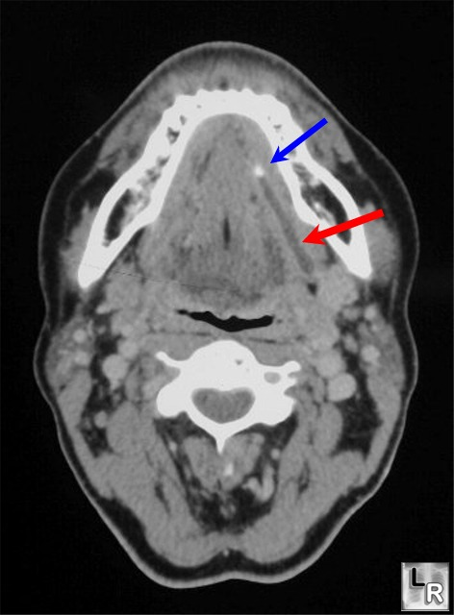
Applied
Common site of calculus
  Tense swelling below body of mandible which is greatest before and during meal and reduced in size in between meal is diagnostic
Excision of submandibular gland for calculus or tumor
  Done by incision below angle of jaw since the mandibular branch of facial nerve passes posteroinferior to angle of jaw the incision must be placed more than 1 inch below angle to preserve nerve
Contrast-enhanced CT of the neck demonstrates a stone (blue arrow) in the submandibular region of a dilated Wharton's Duct (red arrow)

