Slide 1
SPINAL CORD
SARANGDHAR KUMAR
DEPARTMENT OF ANATOMY
ROHILKHAND MEDICAL COLLEGE
BAREILLY

Slide 2
OBJECTIVES:
At the end of the lecture, the students should be able to learn and describe the:
- Anatomy of spinal cord with clinical application
- Three layers of meninges covering the spinal cord and meningeal spaces and their clinical applications.
- Spinal nerve- Dorsal and ventral roots, dorsal root ganglion, ventral and dorsal rami
- The structure of the spinal cord, its blood supply and clinical anatomical correlations.

Slide 3
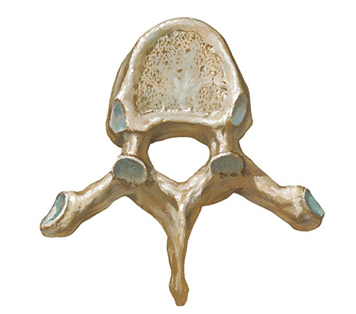
THORACIC VERTEBRA
BODY
Costal facet for the
head of the rib
VERTEBRAL
FORAMEN
PEDICLE
Costal facet for the
tubercle of the rib
LAMINA
SPINE
- Vertebral canal contains the spinal cord and meninges.

Slide 4
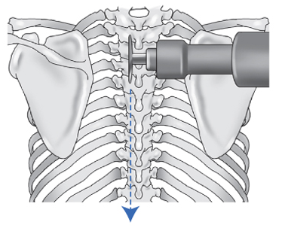
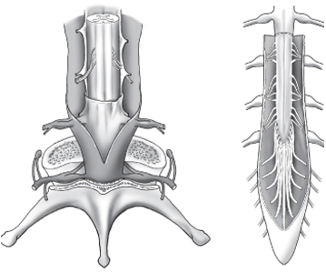
DISSECTION STEPS
LAMINECTOMY:
Make two vertical cuts on the back of laminae as indicated by the dotted lines from T6 to L4 vertebral level and expose the spinal cord.

Slide 5
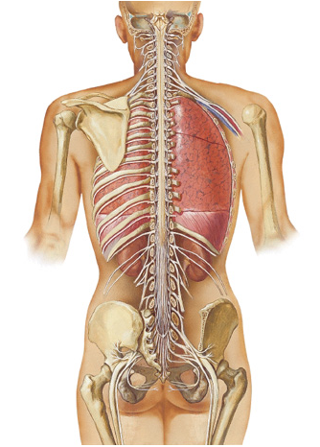
EXTENT OF THE SPINAL CORD
The spinal cord is a delicate tubular structure made up of nervous tissue and supporting cells, protected inside the vertebral canal and covered by three layers of meningeal coverings.
It measures about 45 cm /18 inches in length in an adult.
It extends from the spinomedullary junction to L1/L2 vertebra in the adult.
A Spinal segment is a portion of the spinal cord, which gives rise to one pair of spinal nerves. There are 31 spinal segments.
There are 31 pairs of spinal nerves
C1 - C8 spinal nerves,
T1 - T12 spinal nerves
L1 - L5 spinal nerves,
S1 - S5 spinal nerves
Co1 spinal nerve
Foramen magnum
In the Adult:
Spinal cord ends at
Lower border of L1 /
Upper border of L2 vertebra

Slide 6
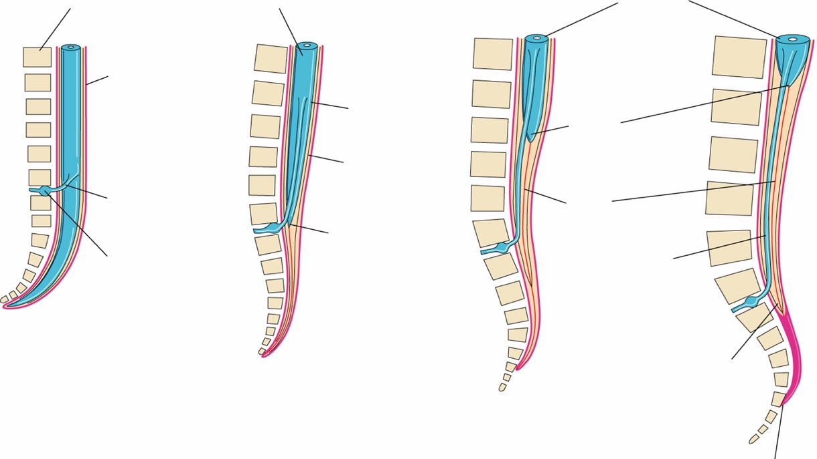
VARIOUS STAGES OF DEVELOPMENT OF SPINAL CORD
Body of vertebra
Spinal cord
Spinal cord
L1
L1
L1
L1
Dura mater
Pia mater
Conus
medullaris
Arachnoid
L3
S1
Root of
1st sacral
nerve
Filum
terminale
S1
Conus medullaris
S1
Spinal ganglion
Root of
1st sacral
nerve
C1
S1
C1
A
C1
End of dura and
Arachnoid sac (S2)
End of embryonic period: 8 weeks gestation- Spinal cord occupies the entire length of the
Vertebral canal.
B
C
D
C1
Fetus: 24 weeks
S1
Newborn
L3
Adult
L1/L2

Slide 7
SPINAL CORD ENLARGEMENTS
Cervical enlargement
From C4 - T1 spinal segments
Contains cell bodies of nerve fibers
forming Brachial plexus to
supply the upper limb
Lumbar / Lumbosacral enlargement
From L2 - S3 spinal segments,
Contains cell bodies of nerves forming
Lumbosacral plexus to supply the lower limb

Slide 8
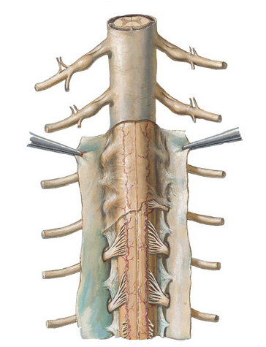
MENINGEAL COVERINGS OF THE SPINAL CORD
Dura mater: Tough fibrous membrane, made up of 2 layers:
Outer endosteal layer- It forms the endosteum for the vertebral canal.
Inner meningeal layer- it forms covering for the spinal cord. The space outside this layer is called Epidural space.
Nerve supply: Meningeal branches of spinal nerves. They are sensory nerves and the dura mater has pain receptors.
Arachnoid mater:
Delicate, thin, transparent membrane on the inner side
of the dura mater. It is separated from dura mater by
subdural space. Bleeding in this space gives rise to
Subdural hematoma.
Pia mater:
Fuses with the spinal cord and carries blood supply to
the spinal cord.
Dura mater
Arachnoid mater
Pia mater
(fused with
spinal cord)

Slide 9
MENINGEAL COVERINGS OF THE SPINAL CORD
Subarachnoid space:
It is a space between arachnoid mater and pia mater.
It contains CSF (cerebrospinal fluid) and spinal
vessels.
Delicate strands of connective tissue called arachnoid trabeculae connect arachnoid mater and pia mater.
Modifications of Pia mater:
Ligamentum denticulatum (21 pairs):
They are lateral extensions of the pia mater, pierce the
arachnoid to attach to the dura mater.
Filum terminale:
It is a fibrous tissue covered by the extension of pia
mater and extends from the lower end of the spinal
cord (Conus medullaris) and attaches on to the dorsal
aspect of coccygeal vertebra #1.
Linea splendens:
Thickened band of pia mater along anterior median fissure
Arachnoid mater
Pia mater
(fused with
spinal cord)
Ligamentum denticulatum

Slide 10
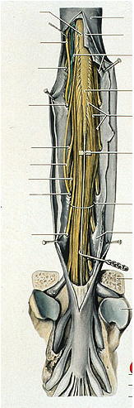
SPINAL CORD
Filum terminale:
Pia mater is adherent to the surface of the spinal cord. At the lower end of the spinal cord, Filum terminale (made up of connective tissue covered by the Pia mater) descends from the lower end of the spinal cord and attaches on to the dorsal aspect of the first piece of Coccyx.
The filum terminale is divided into two parts:
Filum terminale internum – It lies inside the dura mater and arachnoid mater sacs and ends at S2.
Filum terminale externum – It extends below the dura/arachnoid sac and gets attached to posterior surface of first piece od coccyx.
Cauda equina:
Since in the adult, the spinal cord ends at the lower border of L1 vertebra, the lower spinal nerves descend down obliquely like a tail of a horse to exit their respective intervertebral foramina.
This collection of ventral and dorsal nerve roots of the spinal nerves with filum terminale is collectively known as Cauda equina.
Conus medullaris:
Lower tapering end of the spinal cord is like a cone and is called Conus medullaris.
Conus
medullaris
Filum
terminale
Cauda equina

Slide 11
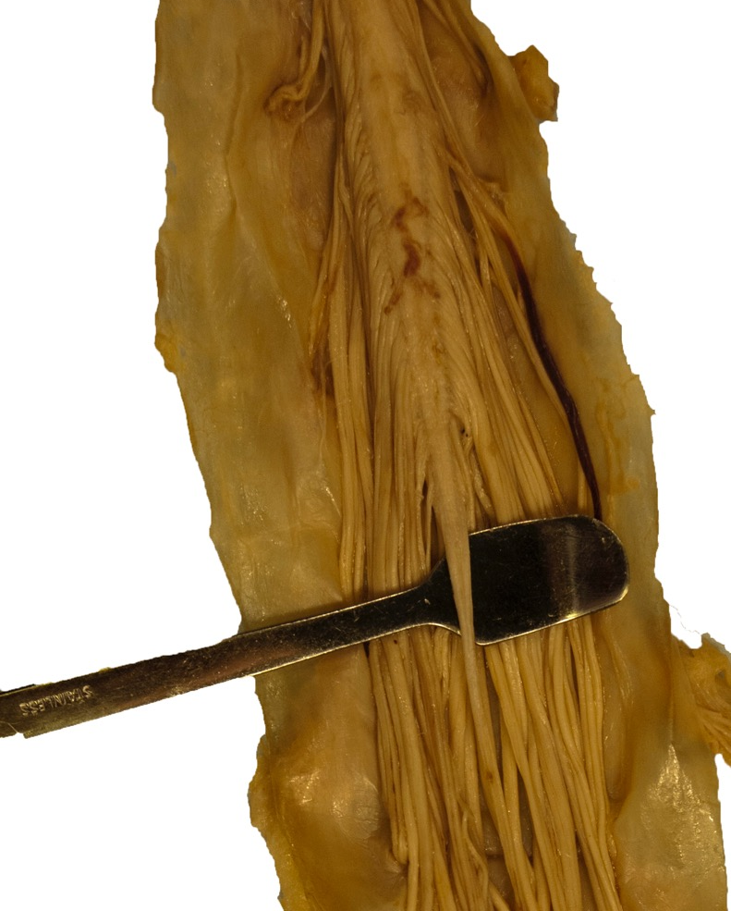
SPINAL CORD
Lumbar
enlargement
Conus
medullaris
Filum Terminale
internum
Cauda equina
(made up of ventral/dorsal nerve roots)

Slide 12
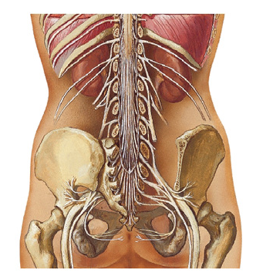
SPINAL CORD AND MENINGES
Level
L1
In adult, the spinal cord ends at the lower border of L1 vertebra./Upper border of L2
Whereas in the new born the spinal cord ends at the level of L3 vertebra.
Dura mater and arachnoid mater form the coverings for the spinal cord. They extend until the lower border of S2 vertebra.
Subdural space and subarachnoid space extend until 2nd sacral vertebra.
The Filum Terminale inside the Dural and Arachnoid mater is known as Filum terminale internum and the part of it below the Dural and Arachoid sheaths is known as Filum terminale externum which attaches on the dorsal aspect of coccygeal vertebra .
Level
S2

Slide 13
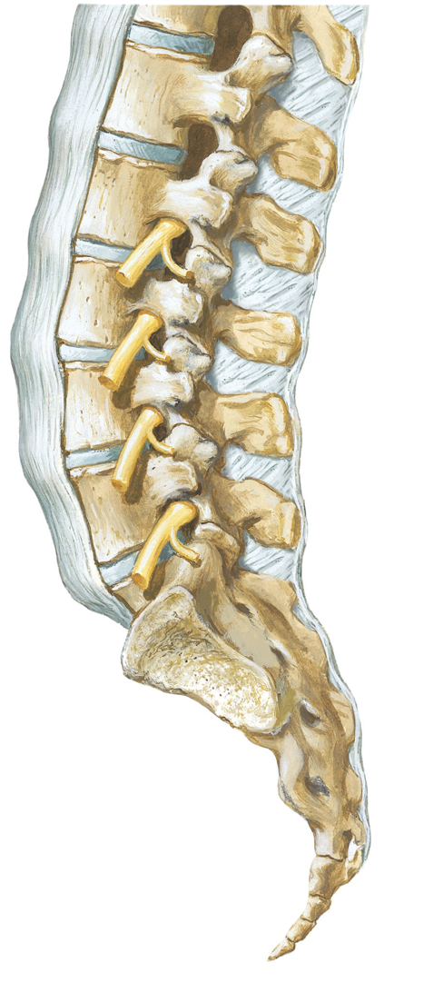
VERTEBRAL COLUMN
Intervertebral foramen
Anterior
longitudinal
ligament
Spinal nerve
Dorsal ramus of spinal nerve
Ventral ramus of spinal nerve
Supraspinous ligament
Interspinous ligament
Intervertebral
disc

Slide 14
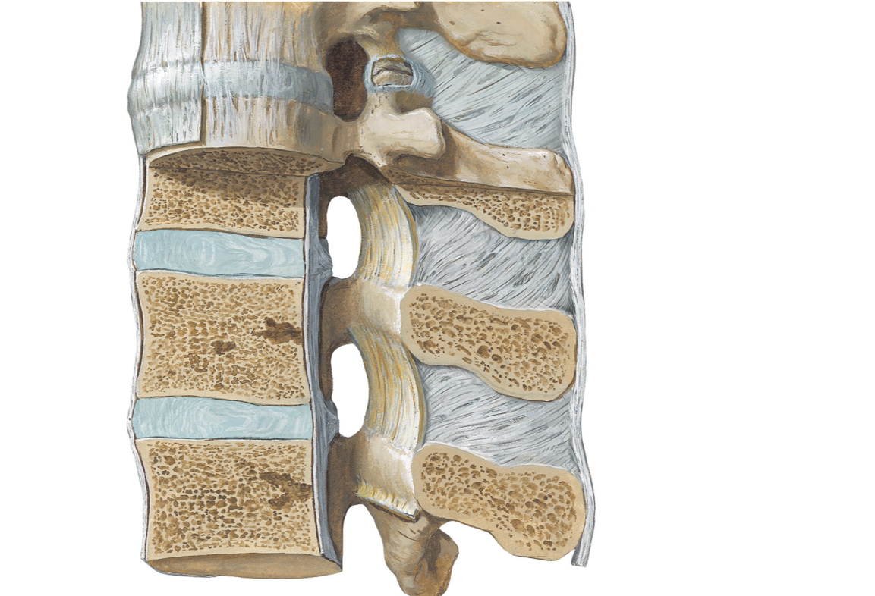
VERTEBRAL COLUMN
Supraspinous ligament
Interspinous ligament
Anterior
longitudinal
ligament
Ligamentum flavum
Posterior longitudinal ligament
VENTRAL
DORSAL

Slide 15
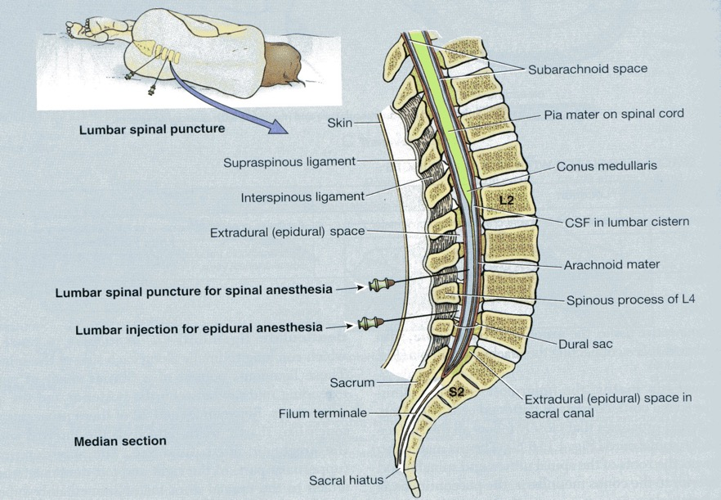
SPINAL TAP VERSUS EPIDURAL ANESTHESIA
Epidural block: Local anesthetic is injected into epidural space between L3 and L4 in the adult / the sacral hiatus or between L4 and L5 in new born for any surgical procedure for abdominal or lower limb surgery.
Lumbar puncture: To tap CSF from Subarachnoid space for diagnostic purposes / to inject local anesthetic into subarachnoid space for surgical procedures.
Lumbar puncture is done by flexing the vertebral column and injecting a needle between L3 and L4 in the adult / between L4 and L5 in new born. When the needle enters the subarachnoid space, CSF starts coming out drop by drop.

Slide 16
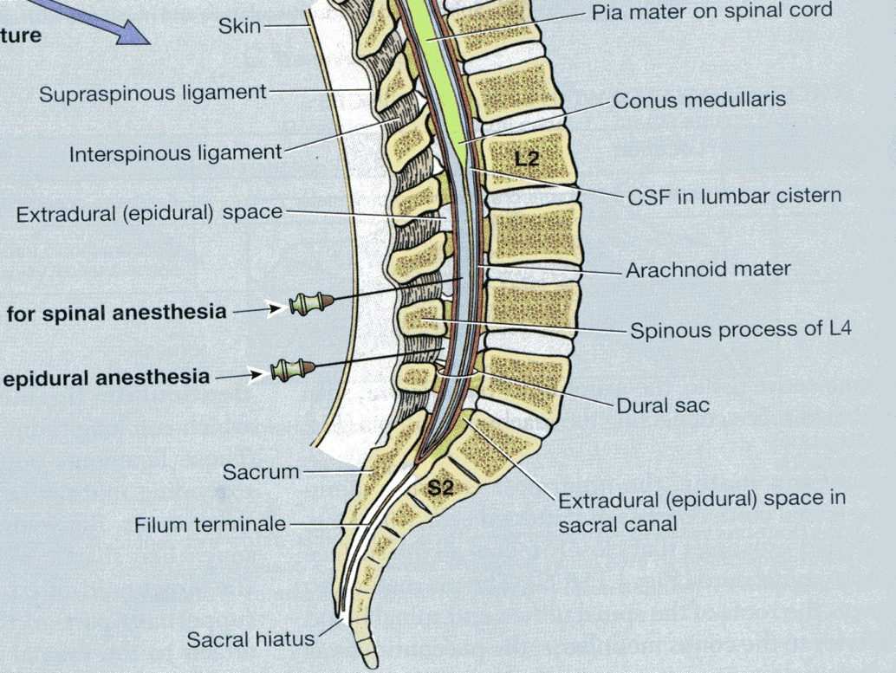
SPINAL VERSUS EPIDURAL ANESTHESIA
Spinal tap/Spinal anesthesia: Lumbar puncture needle pierces Skin, Superficial fascia, Thoracolumbar fascia, Supraspinous ligament, Interspinous ligament, Ligamentum flavum, Epidural space, Dura mater, Subdural space, Arachnoid mater and Subarachnoid space.
Epidural anesthesia: The needle for Epidural anesthesia pierces Skin, Superficial fascia, Thoracolumbar fascia, Supraspinous ligament, Interspinous ligament, Ligamentum flavum, Epidural space.

Slide 17
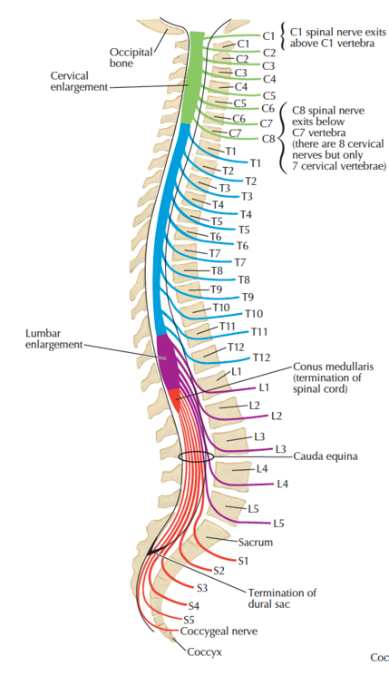
SPINAL NERVES
A Spinal segment is a portion of the spinal cord, which gives rise to one pair of spinal nerves. There are 31 spinal segments and 31 pairs of spinal nerves.
Spinal nerves: 31 pairs of spinal nerves
C1 - C8 spinal nerves
T1 - T12 spinal nerves
L1 - L5 spinal nerves
S1 - S5 spinal nerves
Co1 spinal nerve
Look at the relationship between the vertebral body and the spinal nerve
Important note:
Spinal nerve C1- passes above the atlas vertebra,
Whereas all the other Spinal nerves come out of the intervertebral foramen below the lower border of the corresponding vertebra

Slide 18
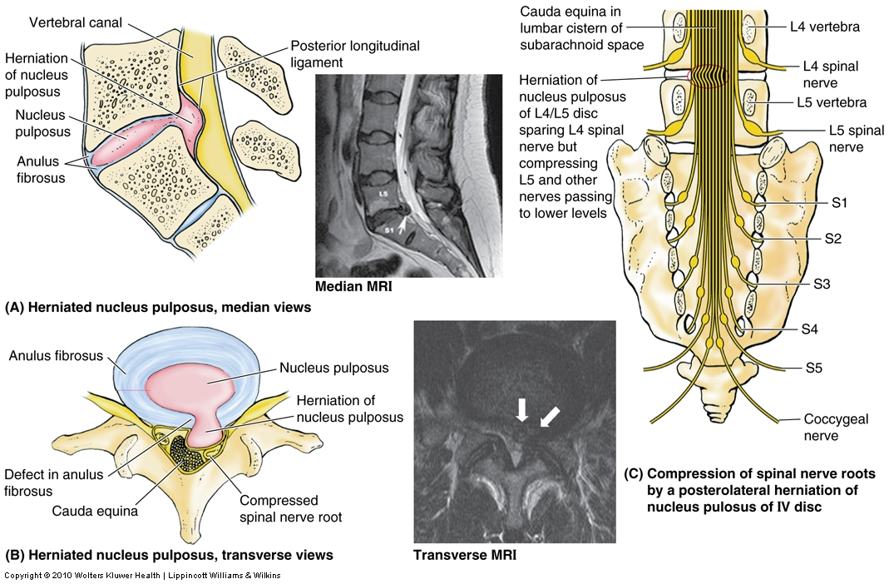
HERNIATED INTERVERTEBRAL DISC

Slide 19
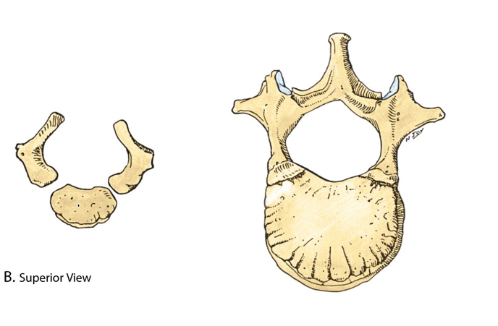
DEVELOPMENT OF VERTEBRA
Center of ossification
for vertebral arch
Center of ossification for the body
FETUS
ADULT

Slide 20
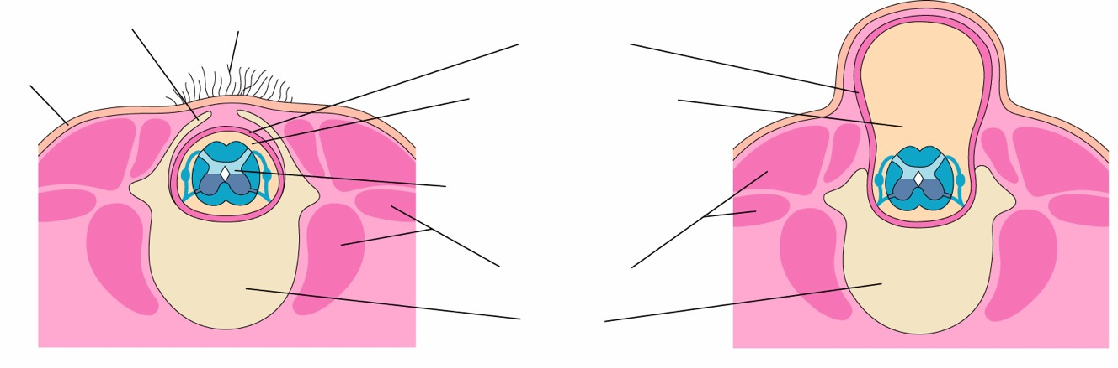
DEVELOPMENTAL ANOMALIES/VARIATIONS
Unfused vertebral
arch
Tuft of hair
Dura mater
Skin
Subarachnoid space
(containing cerebrospinal fluid)
Spinal cord
Back muscles
Vertebra
A
Spina bifida occulta
Failure of fusion of vertebral arches
/Laminae. A small defect may not be
Visible but you may see a tuft of hair at the site
B
Meningocele
A protrusion of meninges through a defect in the fusion of vertebral arches. The spinal cord lies in its normal position.

Slide 21
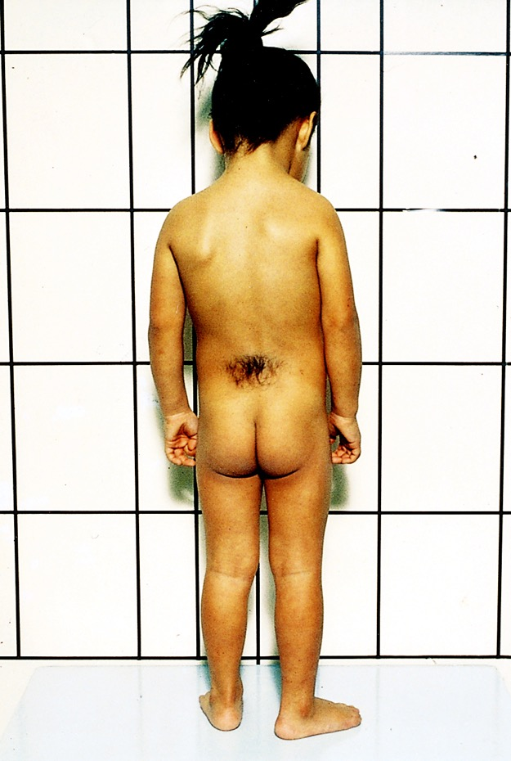
SPINA BIFIDA OCCULTA
Spina bifida occulta occurs in
10% of normal population,
Mostly affects the lumbosacral region (L4 – S1),
Is characterized by tuft of hair over the defect
No neurological symptoms

Slide 22
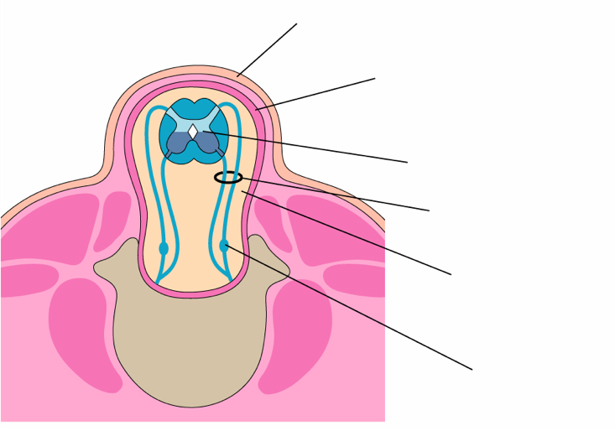
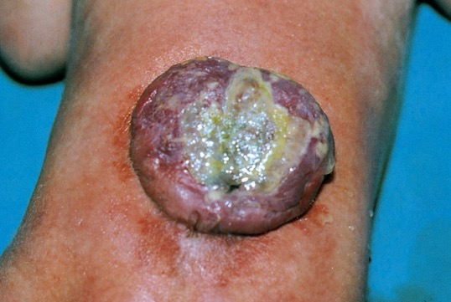
MENINGOMYELOCELE
Membranous sac
Dura mater
Displaced spinal cord
Roots of spinal nerve
Subarachnoid space
Spinal ganglion
The two vertebral arches are not well developed and fail to fuse with each other. The meninges and the spinal cord protrude through the gap and are exposed to the surface.
The patient shows neurological signs:
1. Loss of Bladder /Bowel control,
2. Partial or complete loss of sensations below the lesion,
3. Partial/complete paralysis of muscles of lower limbs (Paraperesis/ Paraplegia).

Slide 23
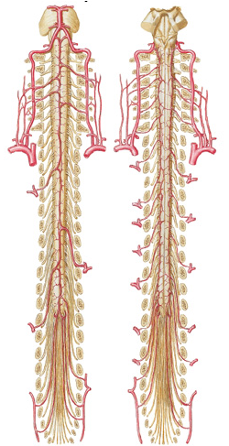
ARTERIAL BLOOD SUPPLY OF SPINAL CORD
- One longitudinally running Anterior spinal artery which arises from the two vertebral arteries.
- Two longitudinally running Posterior spinal arteries, which are branches of vertebral arteries / posterior inferior cerebellar arteries.
- Segmental arteries (radicular arteries): They run with dorsal and ventral roots of spinal nerves. They arise from vertebral artery, intercostal arteries, lumbar arteries, sacral arteries depending on the level of the spinal cord.
Arteria radicularis magna / Great artery of Adamkiewicz: It is more common on the left side. It is the biggest segmental/radicular artery from lower posterior intercostal / lumbar artery and supplies almost lower 2/3rd of the spinal cord including the lumbosacral enlargement.
Arteria
radicularis
magna
ANTERIOR POSTERIOR

Slide 24
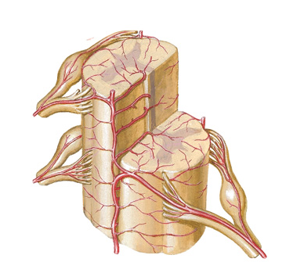
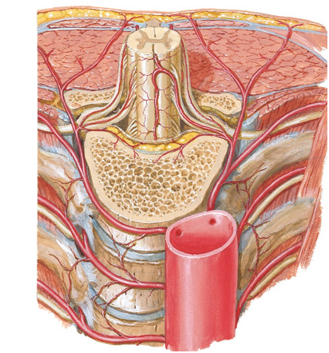
ARTERIES OF THE SPINAL CORD
Posterior spinal arteries
Segmental/
Radicular arteries
Anterior spinal artery
Aorta
Posterior intercostal
arteries

Slide 25
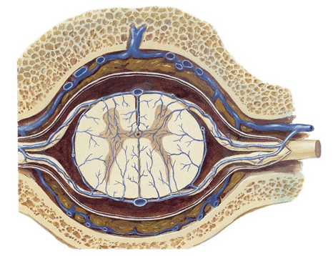
VEINS OF THE SPINAL CORD
Anterior spinal veins
Internal vertebral
Venous plexus
- There are 6 longitudinally running veins on the spinal cord- 3 anterior spinal and 3 posterior spinal longitudinal veins.
- They communicate freely with each other and with the radicular veins.
- Veins draining the spinal cord drain into internal vertebral venous plexus of Batson, which lies in the epidural space).
- Internal vertebral venous plexus passes through foramen magnum and communicate with dural venous sinuses.
- Internal vertebral venous plexus also communicates with external vertebral venous plexus.
Radicular veins
Posterior spinal veins

Slide 26
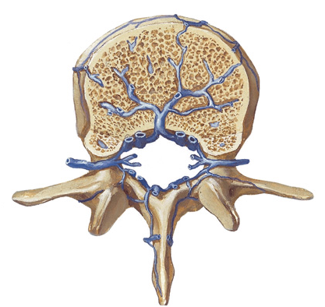
VERTEBRAL VENOUS PLEXUS
External vertebral
Venous plexus
Internal vertebral venous plexus
INTERNAL VERTEBRAL PLEXUS (BATSON’S VEINS): Internal vertebral venous plexus of Batson forms an extensive system of venous channels both within and alongside the spinal canal
- They provide direct communication from the venous return of the abdomen/pelvis and the lower body to the cranial cavity and spinal canal.
- There are no valves in Batson’s plexus and flow may be bi-directional with change of body position. It represents important pathway for metastasis for Prostate, Ovarian, Uterine or Colon cancers.

Slide 27
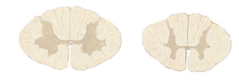
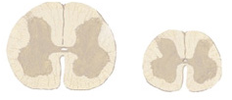
INTERNAL ANATOMY OF SPINAL CORD
CERVICAL
THORACIC
Dorsal horn
Lateral horn
(T1 to L2 segments)
Ventral horn
LUMBAR SACRAL
The transverse section of the spinal cord shows central canal, H-shaped Grey matter centrally and the surrounding White matter peripherally.
The Grey matter shows Dorsal horn and the Ventral horn.
The Grey matter in Spinal segments T1 to L2 segments also shows Lateral horn (Intermediolateral cell column).

Slide 28
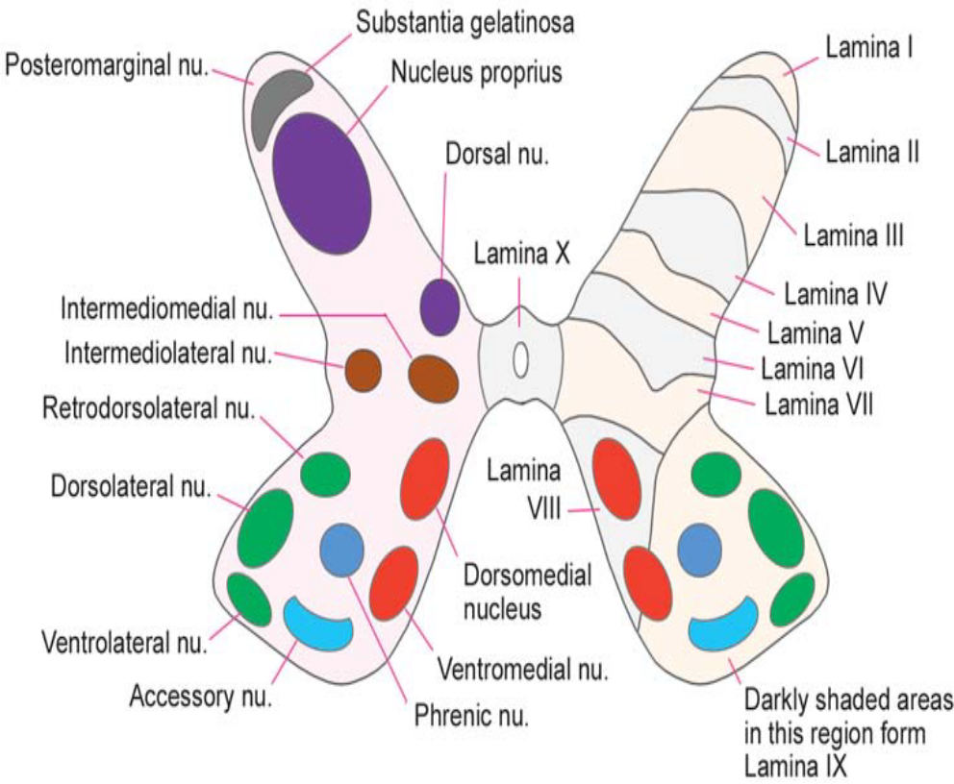
Nuclei in grey matter-
Anterior grey matter-
  Are motor nuclei
  They are arranged in three groups-
  medial
  lateral (cervical & lumbar enlargement)
  Central (cervical & lumbosacral segment)
Posterior grey matter-
  marginal nucleus
  substansia gelatinosa,
  nucleus proprius,
  dorsal nucleus(clarke’s column)
Lateral grey matter-
  Intermediomedial nucleus
  Intermediolateral nucleus

Slide 29
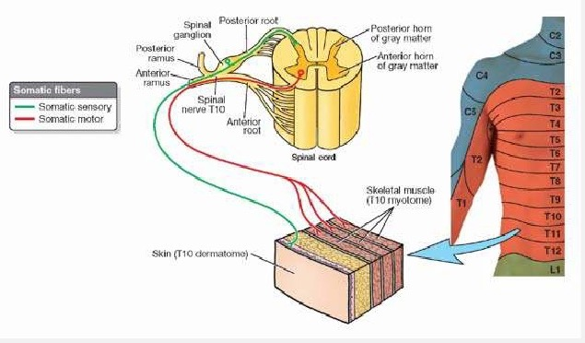
SPINAL NERVE
Dorsal root: It is sensory and carries sensory sensations from the body wall (Somatic afferent -SA) and viscera (Visceral afferent- VA)
Ventral root: It is motor and is made up of axons of ventral horn cells (Somatic efferent- SE) going to the skeletal muscles of the body and limbs. Ventral root also contains visceral efferent fibers (VE)
Dorsal root ganglion: is a collection of pseudounipolar neurons. Its peripheral process carries sensations from the skin/ viscera and its central process enters the spinal cord and makes synapses with interneurons and ventral horn neurons.

Slide 30
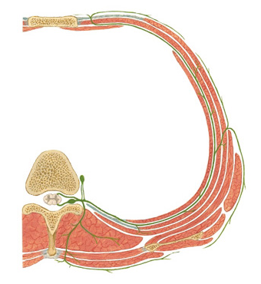
TYPICAL THORACIC SPINAL NERVE
There are 31 pairs of spinal nerves coming out of the spinal cord.
Each spinal nerve is a mixed nerve containing sensory, motor and sympathetic components.
Branches:
1. Grey and white rami communicantes with sympathetic ganglion
2. Dorsal ramus - Motor to deep muscles of back and sensory to skin of back.
3. Ventral ramus- Motor to limb musculature, muscles of trunk and sensory to skin of anterolateral trunk and skin of limbs.
Ventral ramus
Sympathetic ganglion
Grey and white
Rami communicantes
Dorsal ramus

