Slide 1
SECTIONS OF BRAIN
SARANGDHAR KUMAR
DEPARTMENT OF ANATOMY
ROHILKHAND MEDICAL COLLEGE
BAREILLY

Slide 2
Cerebrum
Largest part of brain
Occupies the anterior & middle cranial fossae of skull
Consists of two cerebral hemispheres, partially separated from each other by a longitudinal fissure
The floor of longitudinal fissure contains great commissure of white fibers, corpus callosum
Each cerebral hemisphere is covered by layer of grey matter , cerebral cortex
Cerebral cortex is not smooth surface but shows complicated folds known as gyri & grooves lying in between gyri are called sulci

Slide 3
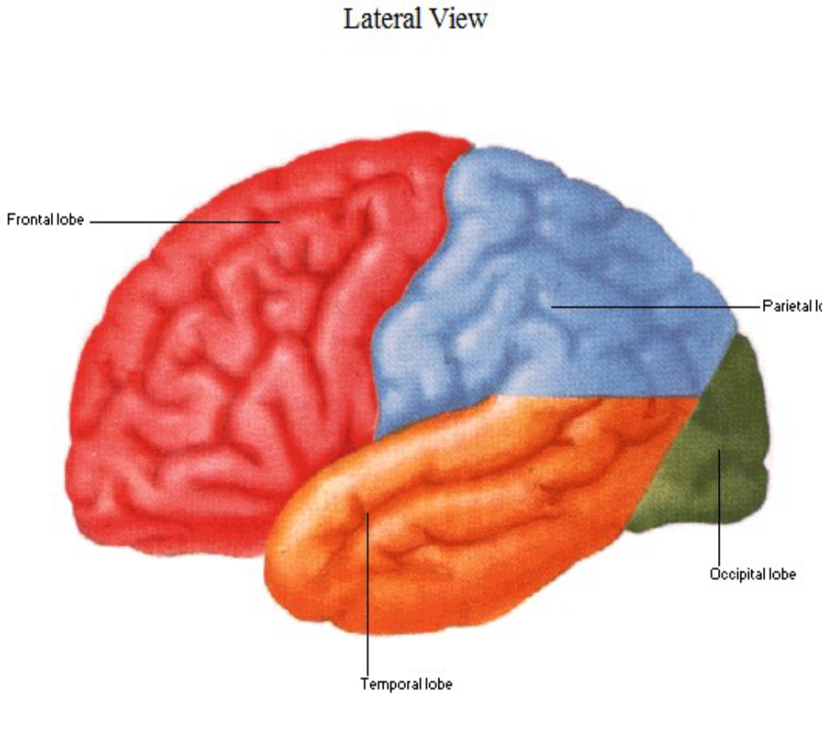
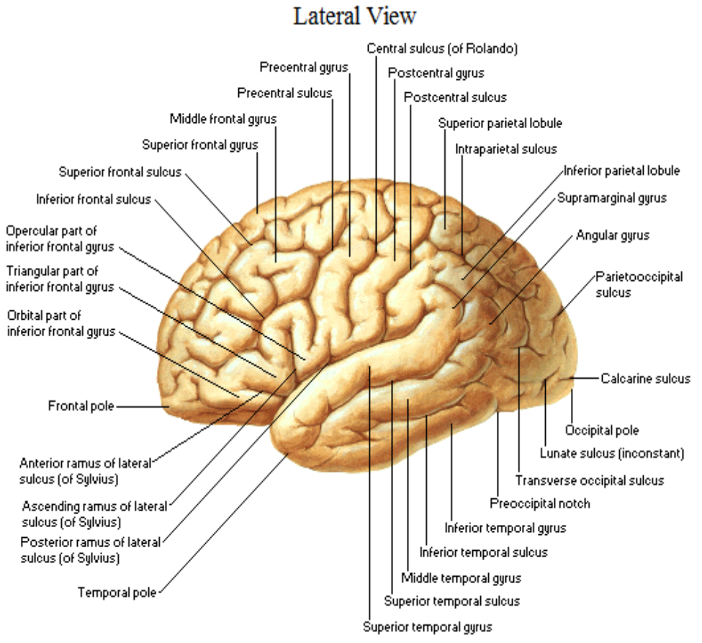

Slide 4
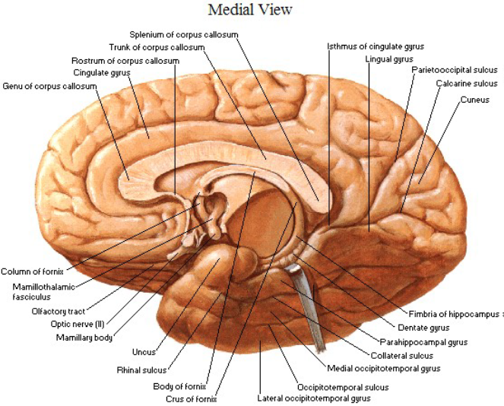

Slide 5
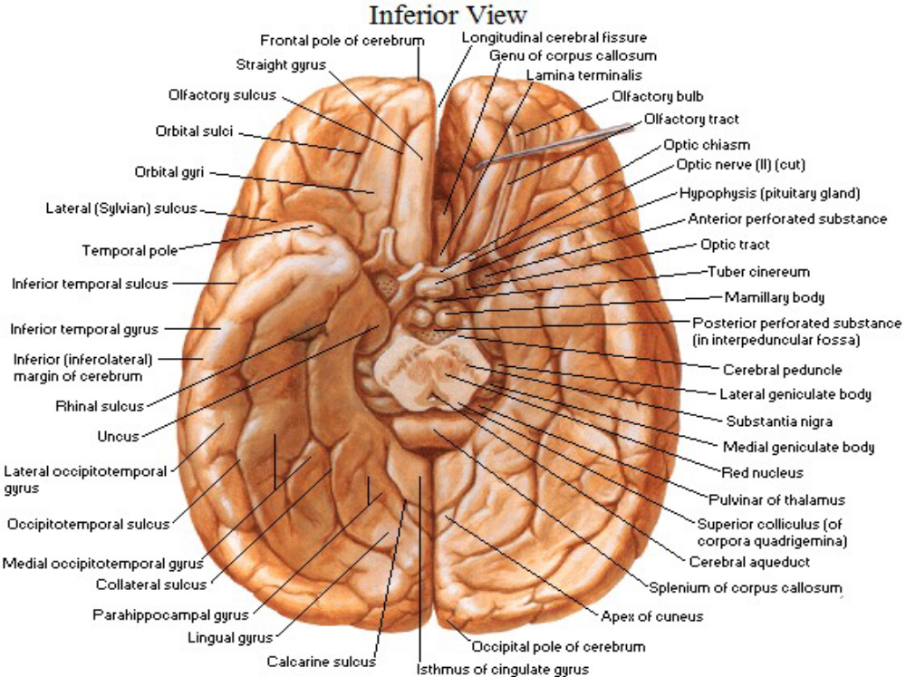

Slide 6
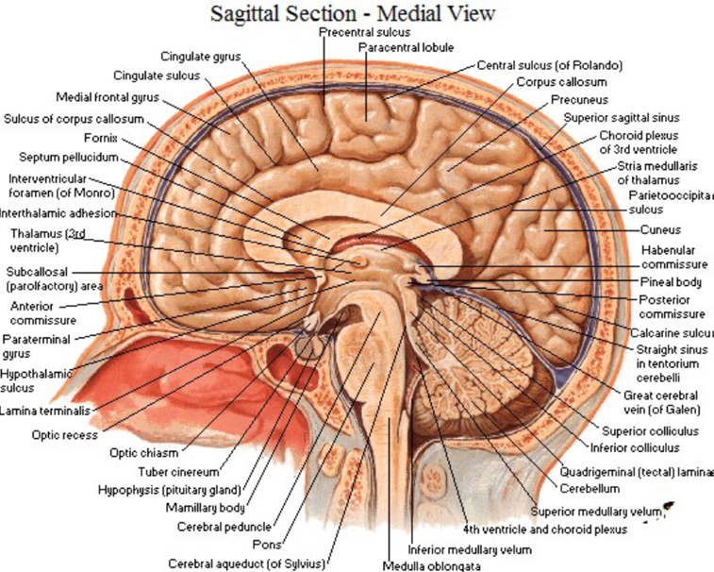

Slide 7
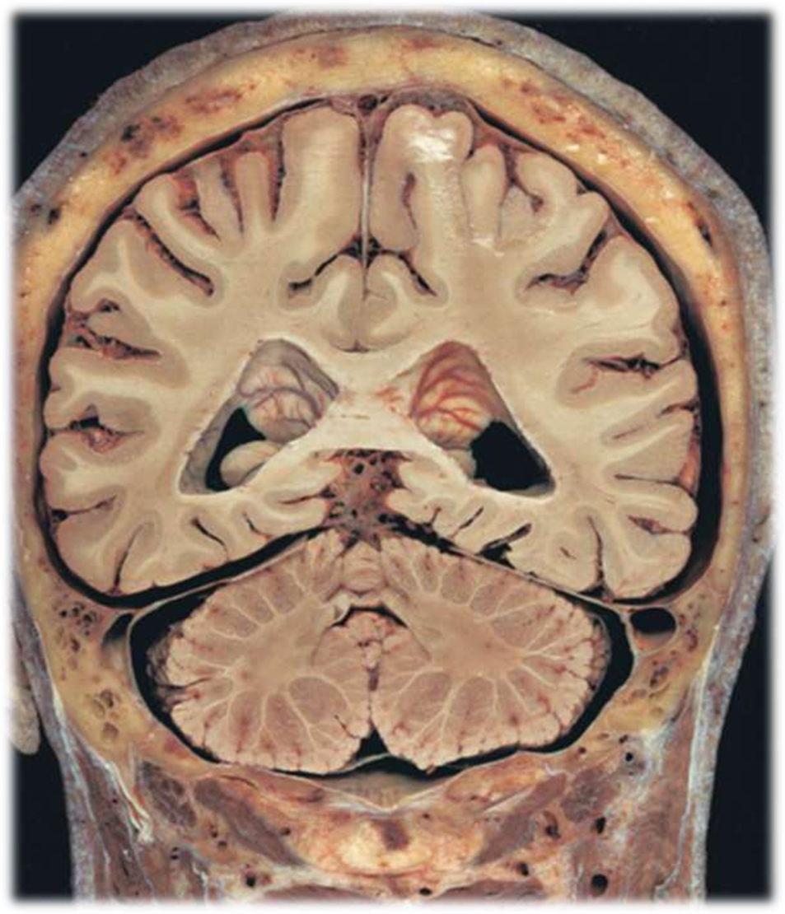
Coronal section of brain passing through the cerebellum showing its nuclei & the 4th ventricle
Dentate nucleus
Vermis
Posterior horn of LV
Cingulate sulcus
Superior middle and
inferior temporal gyri
4
3
5
5
2
5
1

Slide 8
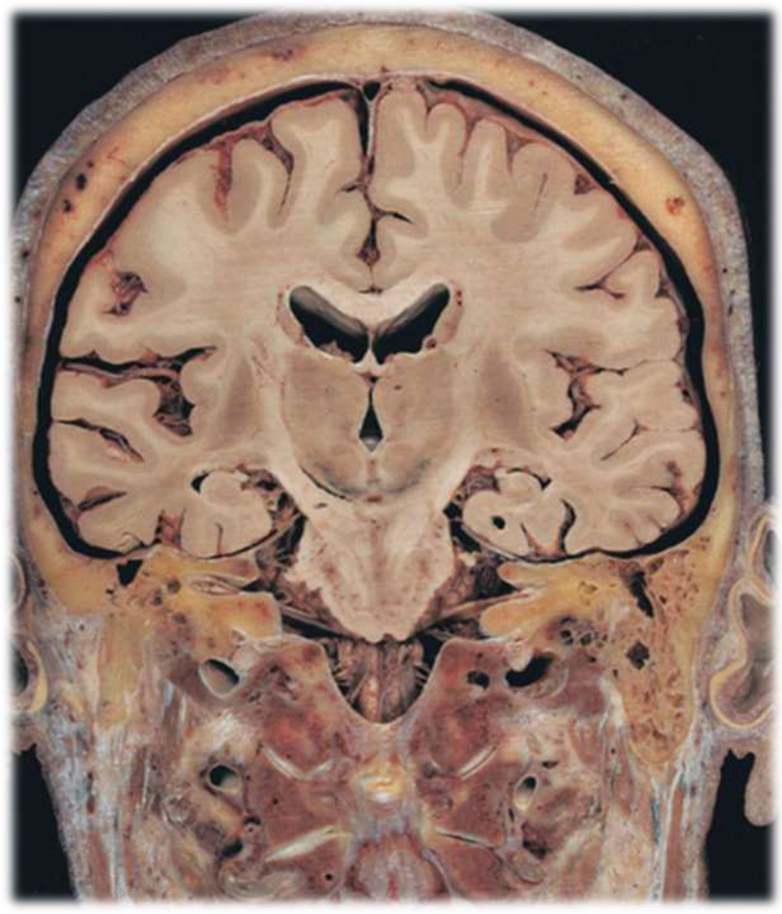
coronal section brain passing through the pons and mammillary body
Mammillary body
Pons
Internal capsule
Insula
Vertebral a.
Cingulate gyrus
Middle cerebral a.
Corpus callosum
Fornix
Thalamus
3rd ventricle
Claustrum
Putamen
Globus pallidus
Caudate n.
Hippocampus
Frontal gyrus
17
6
8
15
7
4
9
3
13
12
10
14
1
16
2
5
5
5

Slide 9
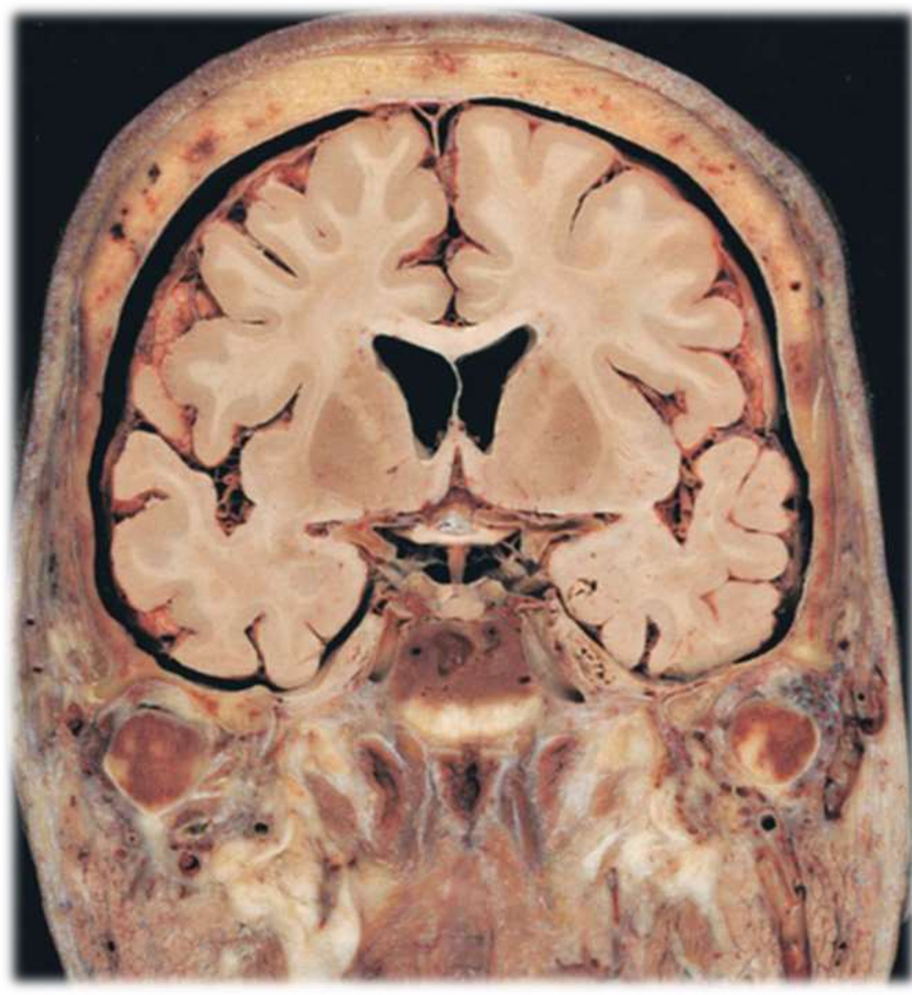
Coronal section of brain passing through the pituitary gland and optic tract
Optic chiasma
Pituitary gland
Sphenoid body
Medial occipito temporal gyri
Lateral occipito temporal gyri
Superior, middle &
inferior temporal gyri
7. Septum pellucidum
8. Corpus callosum
8
7
6
1
6
4
2
5
3

Slide 10
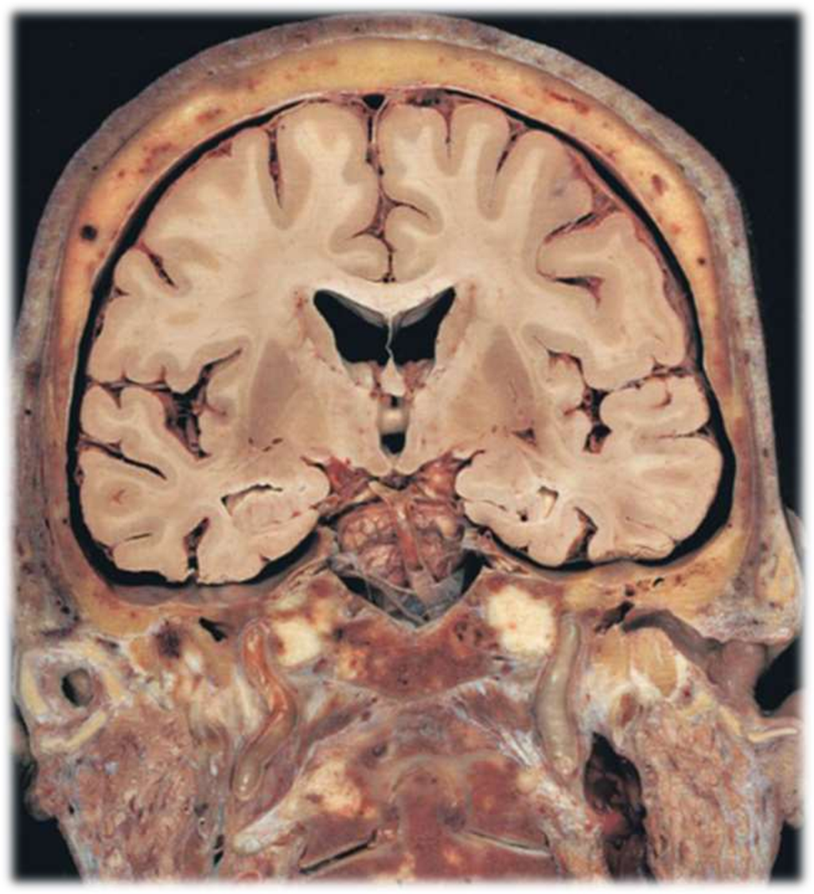
Coronal section passing through the basal ganglia and internal capsule
Superior frontal gyri
Cingulate gyri
Parahippocampal gyri
Superior, middle and inferior temporal gyri
Thalamus
Putamen
Globus pallidus
Clastrum
Insula
1
2
6
9
7
4
5
4
4
3

Slide 11
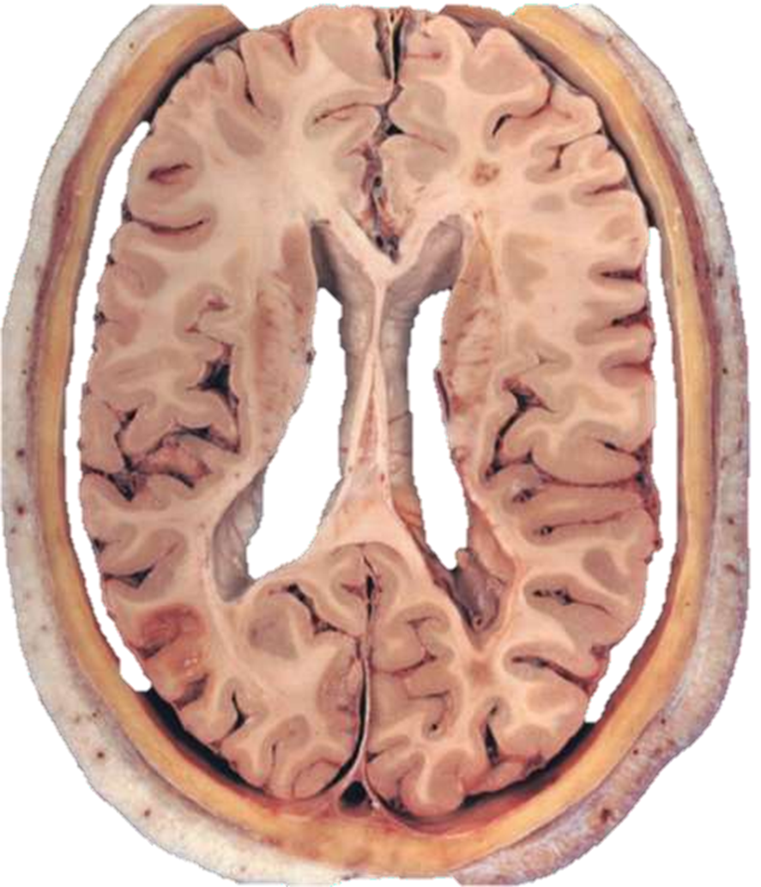
Horizontal section of brain passing through genu of corpus callosum
Parieto-occipital sulcus
Optic radiation
Lateral sulcus
Central sulcus
Body of caudate n.
Septum pellucidum
Insula
Claustrum
Putamen
Internal capsule
Genu of corpus callosum
Forceps minor
12
11
10
5
6
4
3
1
2

Slide 12
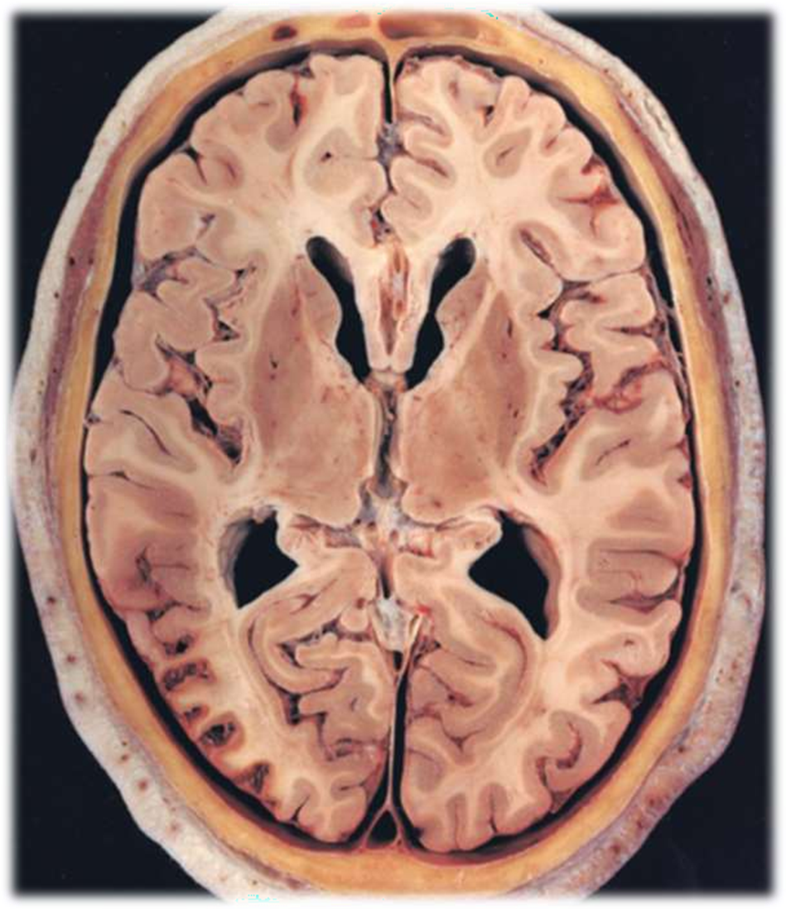
Horizontal section of brain passing through trunk of corpus callosum
Head of Caudate n
Thalamus
Putamen
Globus pallidus
Internal capsule
External capsule
Corpus callosum
3rd ventricle
7
1
5
3
4
8
2

Slide 13
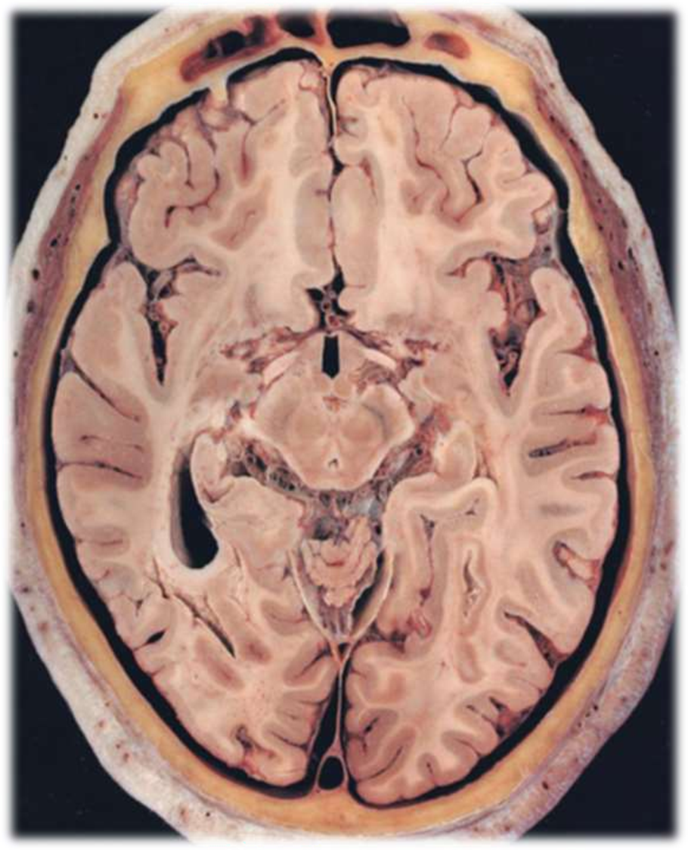
Horizontal section of brain passing through midbrain
Anterior cerebral artery
Middle cerebral artery
Posterior cerebral artery
Red nucleus
Crus cerebri
Substantia nigra
Tectum
Vermis
Insula
Cingulate gyrus
Uncus
Amygdala
10
1
2
5
4
6
3
7
11
8

Slide 14
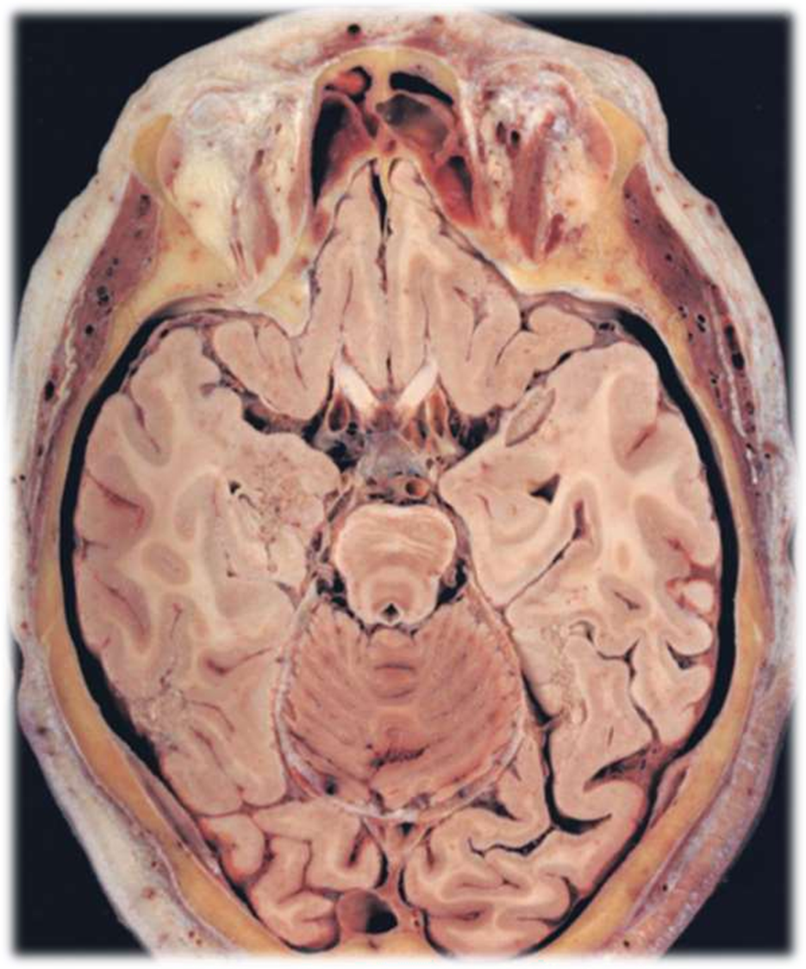
Horizontal section of brain passing through inferior collculi of midbrain
Rectus gyrus ( straight )
Optic nerve
Pituitary infundibulum
ICA
Basilar artery
Tectum ( inferior colliculi )
Inferior horn of lateral v.
Uncus
Hippocampus
1
2
4
3
8
7
9
6

Slide 15
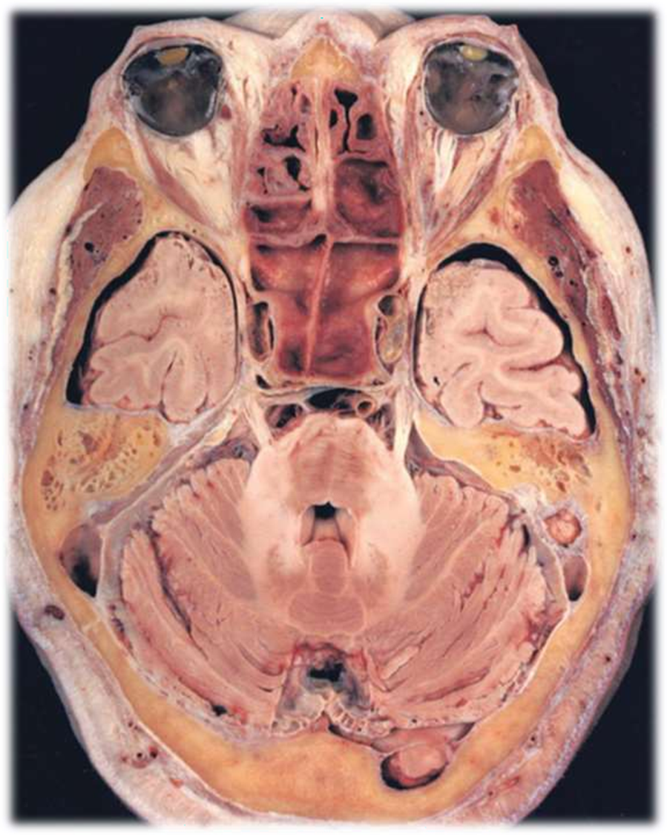
Horizontal section of brain passing through pons
Sphenoid sinus
Sella turcica
ICA
Temporal lobe
Pons
Middle cerebellar peduncle
4th ventricle
Mastoid air cells
1
3
4
2
5
8
7
6

Slide 16
THANK YOU

