Slide 1
SARFACE ANATOMY
OF
LOWER LIMB & THORAX
Dr. Sarangdhar Kumar
Department of Anatomy
RMCH, Bareilly

Slide 2
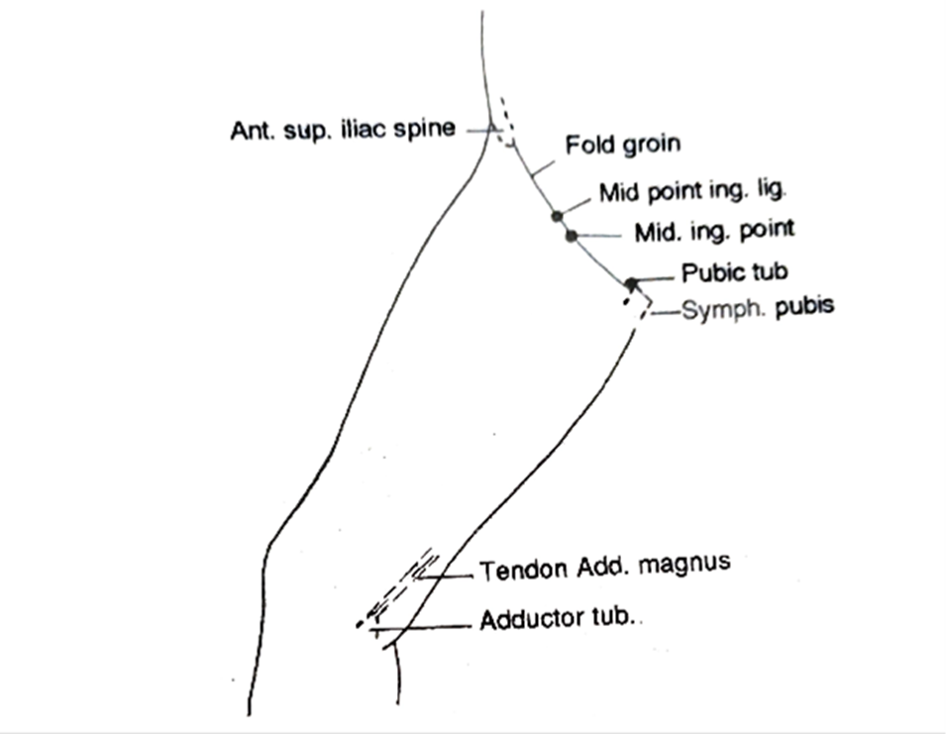
LOWER LIMB
Surface landmarks – Front of thigh

Slide 3
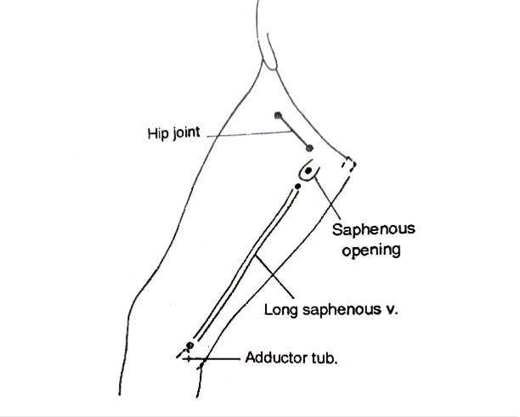
Hip Joint & Saphenous opening

Slide 4
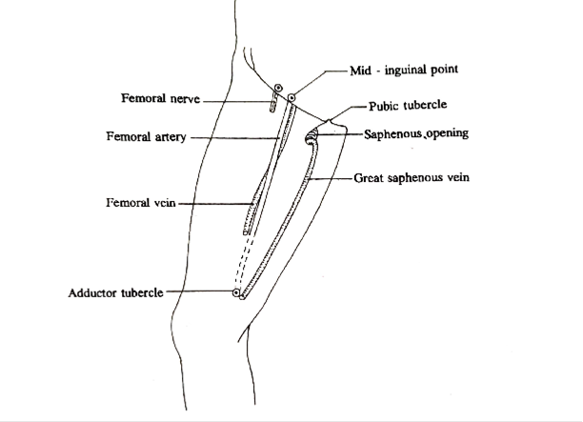
Femoral Nerves & Vessels

Slide 5
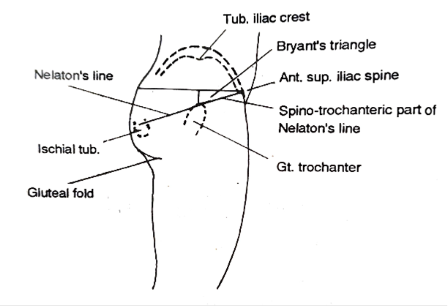
Surface landmarks- Gluteal region

Slide 6
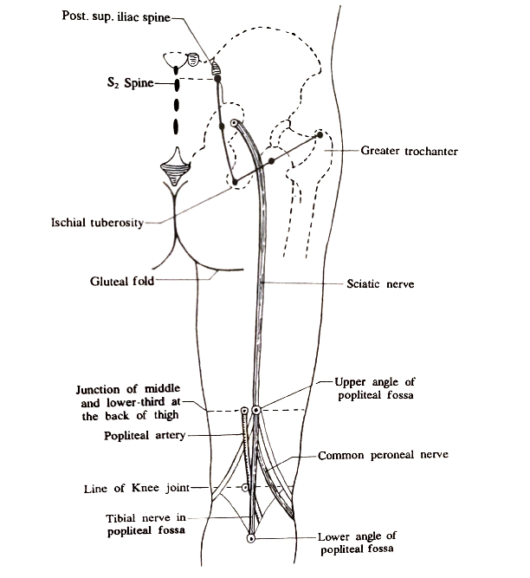
Sciatic Nerve

Slide 7
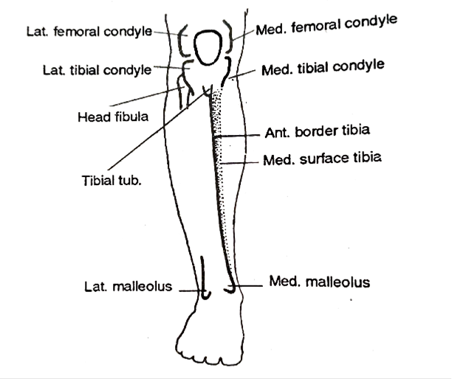
Surface landmarks- Leg

Slide 8
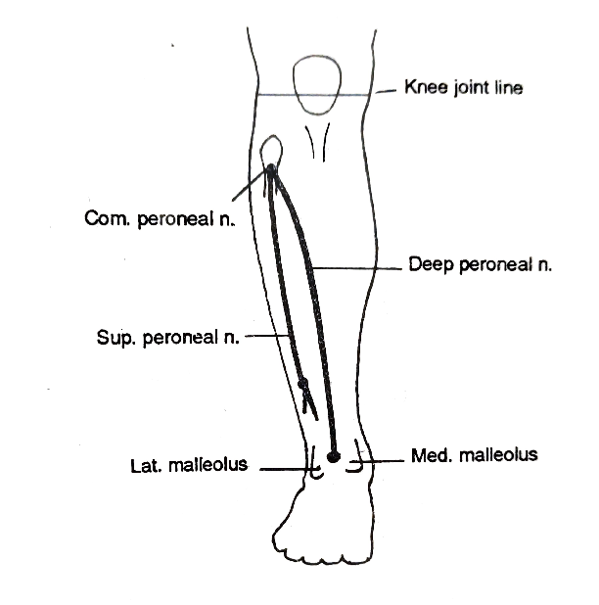
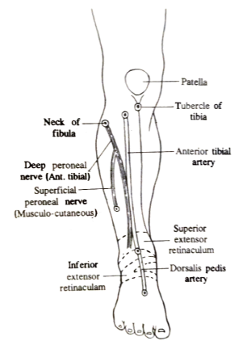
Peroneal Nerves

Slide 9
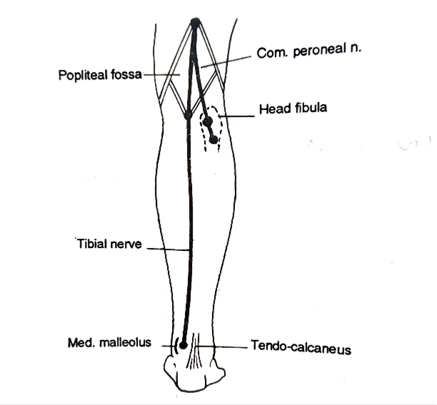
Common peroneal and Tibial nerves

Slide 10
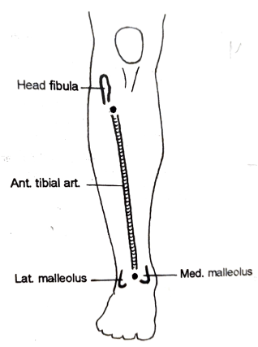
Anterior Tibial Artery

Slide 11
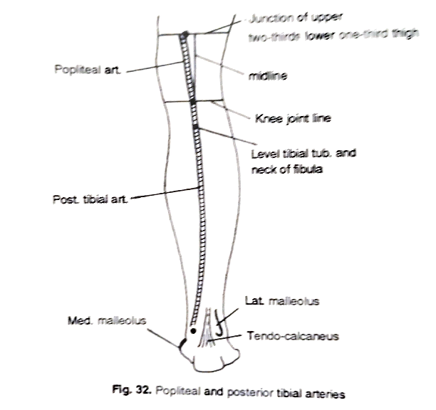
Popliteal and Posterior Tibial Artery

Slide 12
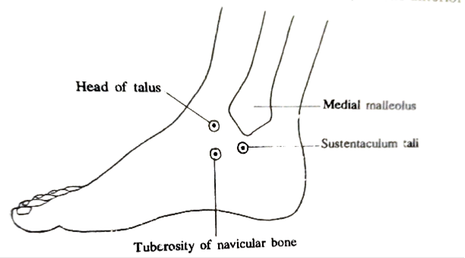
Surface landmarks- Foot

Slide 13
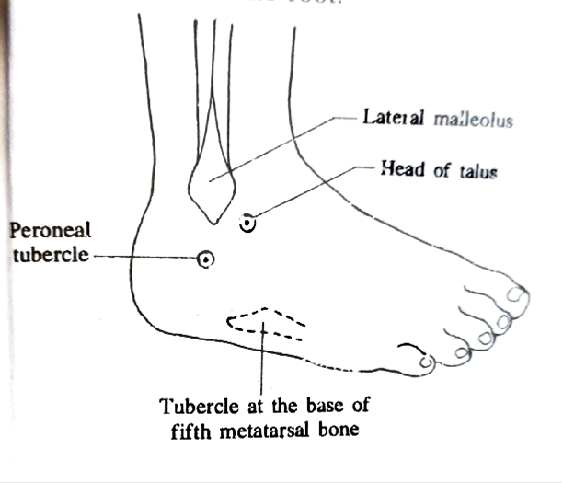
Cont….

Slide 14
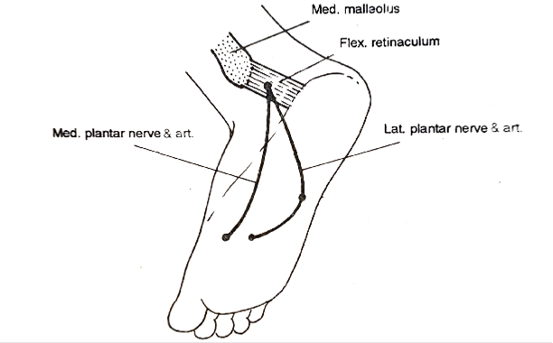
Medial and Lateral plantar nerve

Slide 15
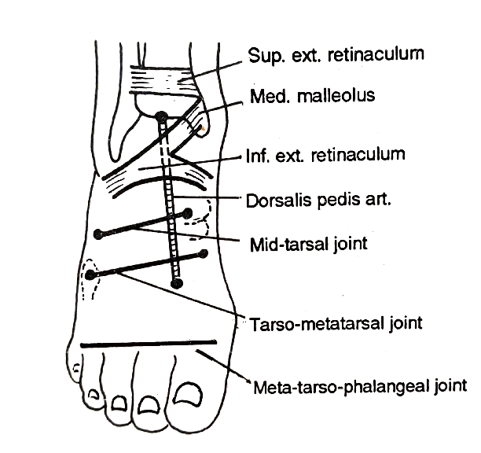
Dorsalis Pedis Artery

Slide 16
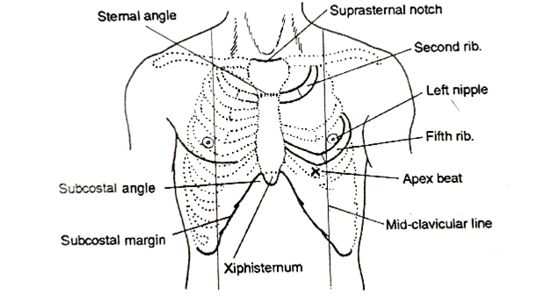
THORAX

Slide 17
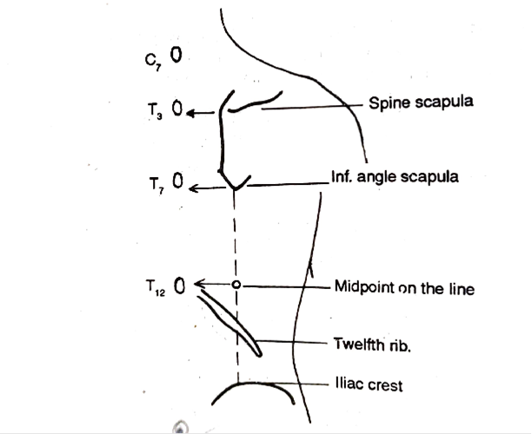
Cont…..

Slide 18
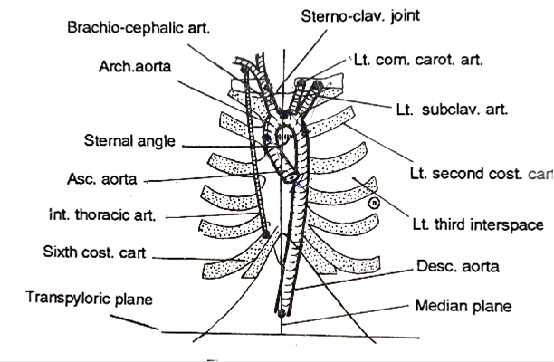
Arteries - Thorax

Slide 19
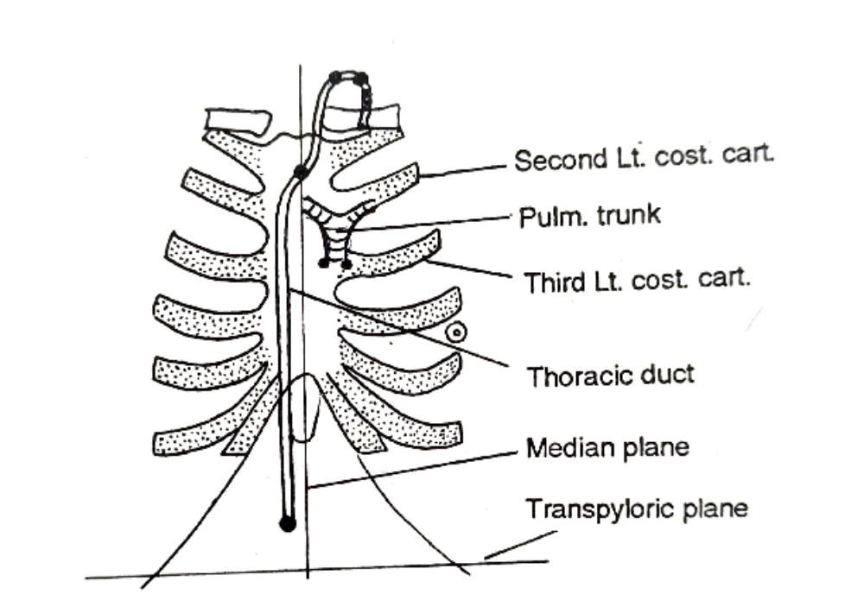
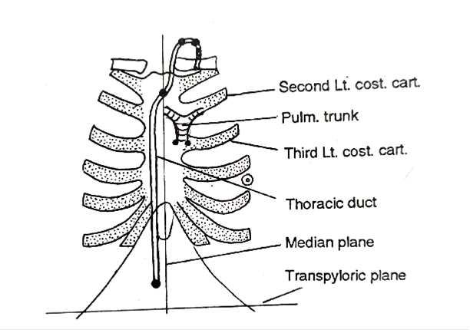
Thoracic duct

Slide 20
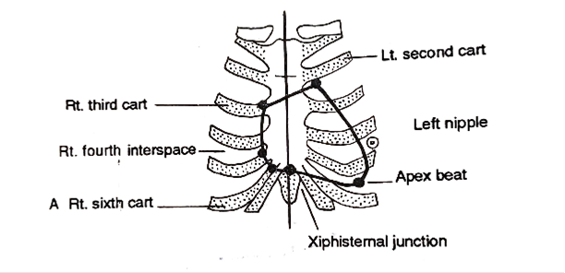
Heart – (Sterno-costal surface)

Slide 21
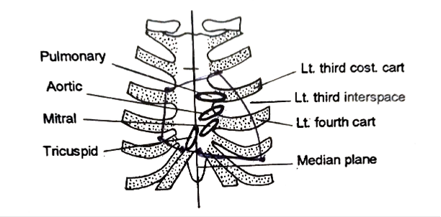
Cardiac orifices

Slide 22
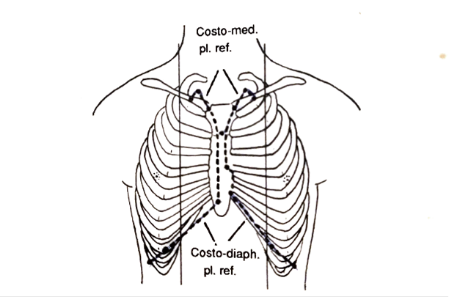
Pleura

Slide 23
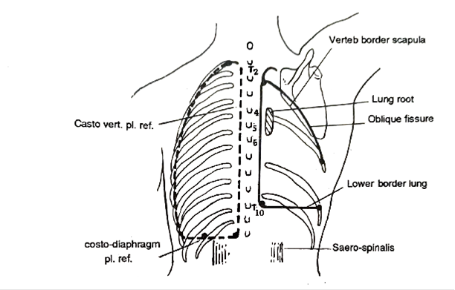
Cont….

Slide 24
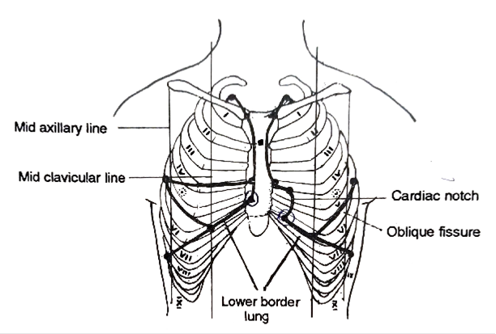
Lungs

Slide 25
Cont….

Slide 26
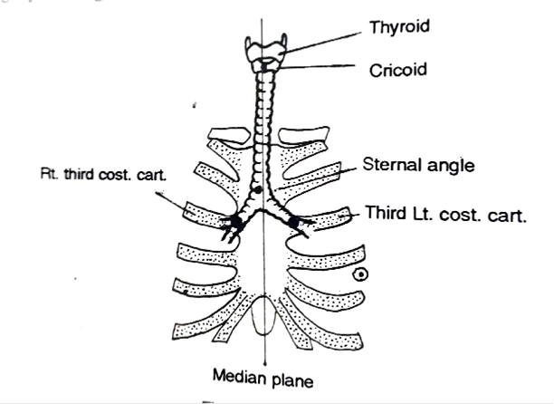
Trachea

Slide 27
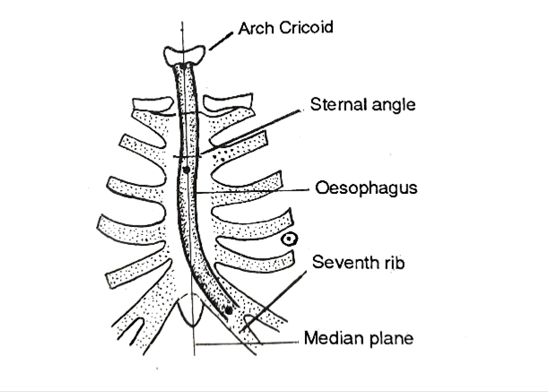
Oesophagus

Slide 28
THANK YOU

