Slide 1
RADIOLOGY
Abdomen & Pelvis

Slide 2
Radiological anatomy of abdomen & pelvis can be studied by
  Plain radiograph
  Special radiograph of GIT
  Pyelography (urography)
  Cholecystography

Slide 3
  Ultrasonography
  Computed tomography (CT Scan)
  Hysterosalpingography
  MRI of female pelvis with foetus in utero

Slide 4
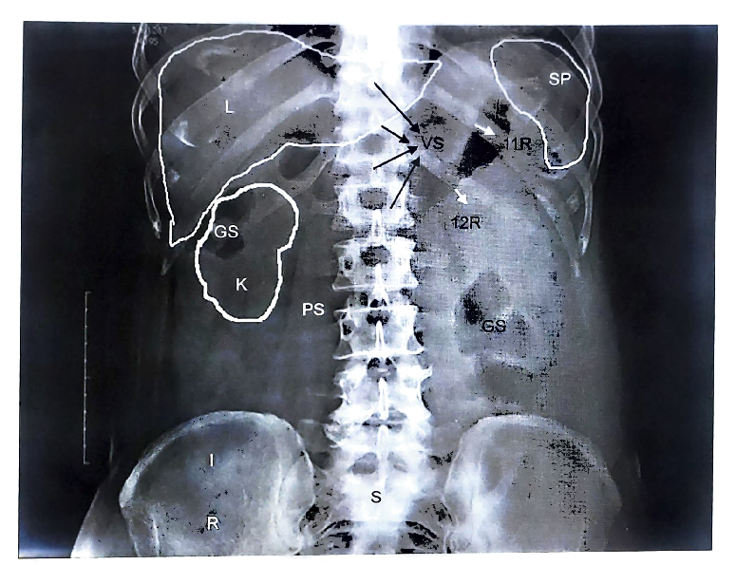
Plain radiograph

Slide 5
Special radiograph of GIT
Barium swallow examination
Barium meal examination
Barium enema
  Single contrast
  Double contrast

Slide 6
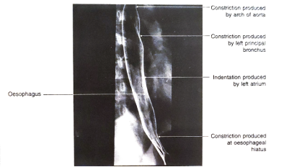
Barium swallow examination
Stomach is empty (6-8 hrs. before procedure)
Patient is instructed to swallow barium sulphate suspension
Radiographic image is taken immediately
Identified
  Oesophageal stricture
  Achalasia cardia
  Any mass projecting in lumen of oesophagus

Slide 7
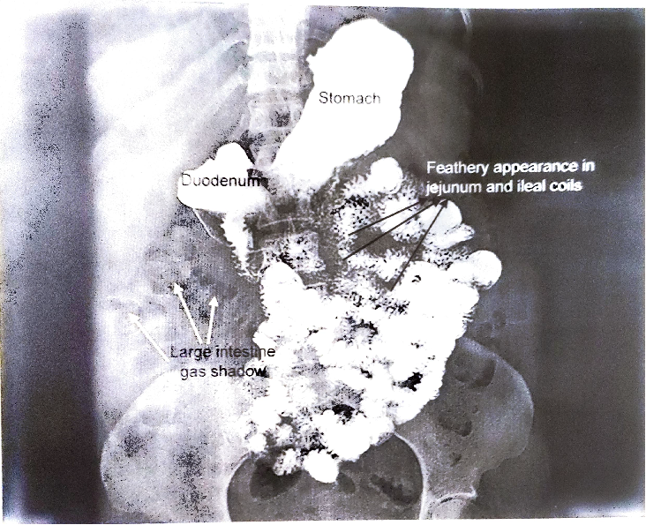
Barium meal examination
Barium sulphate suspension is given to the patient by orally
Radiographs are taken at the interval of 15 to 45 minutes
Stomach & small intestine are visualized

Slide 8
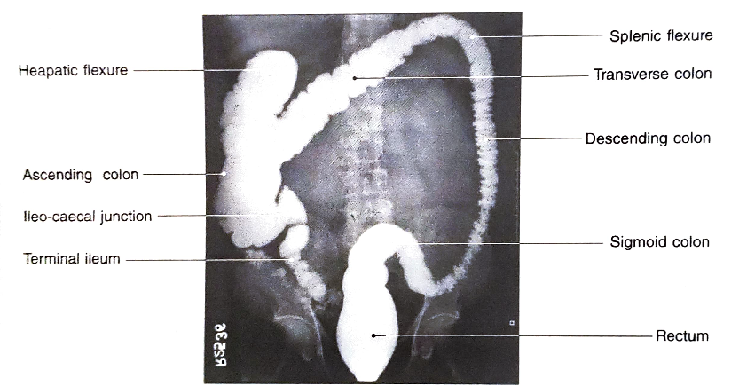
Barium enema examination
Single contrast
  Patient to be examined is given mild laxative at night before the day of examination
  On the day of examination
    Patient is first given plain water enema followed by 400-1200 ml barium enema through anal opening
    Then visualized by radiographically

Slide 9
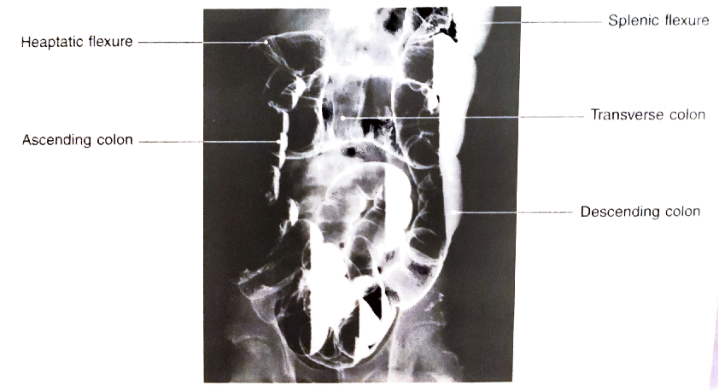
Double contrast
  Used to define mucosal anatomy of colon & rectum
  Barium enema is given to the patient followed by pushing air through anal orifice
  Then seen radiographically
  Identify large intestine diseases
    Like diverticulosis
    Colon carcinoma (apple core appearance of large intestine)

Slide 10
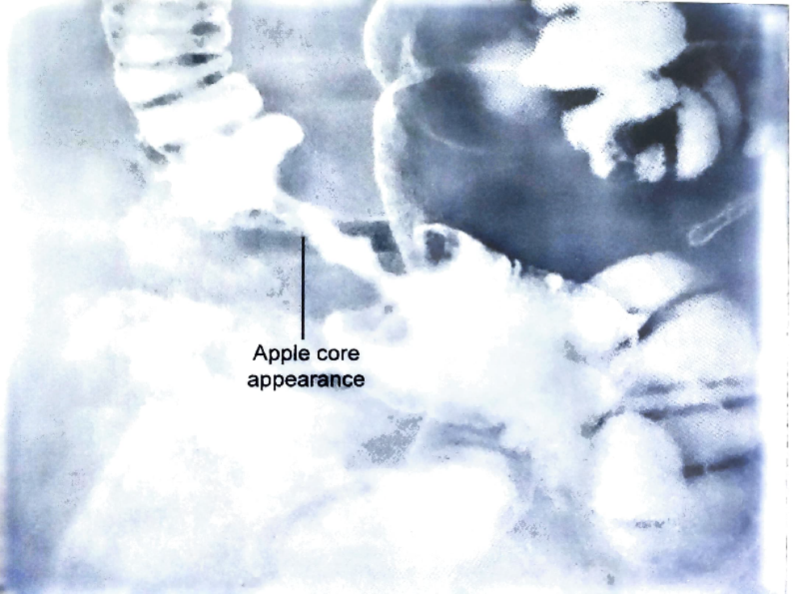

Slide 11
Pyelography
Radiological procedure to visualize urinary tract (KUB)
  Indications-
    Nephrolithiasis
    Ureterolithiasis
    Pyelonephritis
    Polycystic kidney
    Hydronephrosis
    Any renal injury

Slide 12
Intravenous pyelography(IVP)
  Patient is kept fasting overnight
  Before procedure patient is asked to empty his/her urinary bladder
  Then intravenous dye (Urograffin/Iohexol) is injected (300-600mg/kg body weight)
  Radiographs are taken at interval of 5 minutes, 15 minutes & 30 minutes

Slide 13
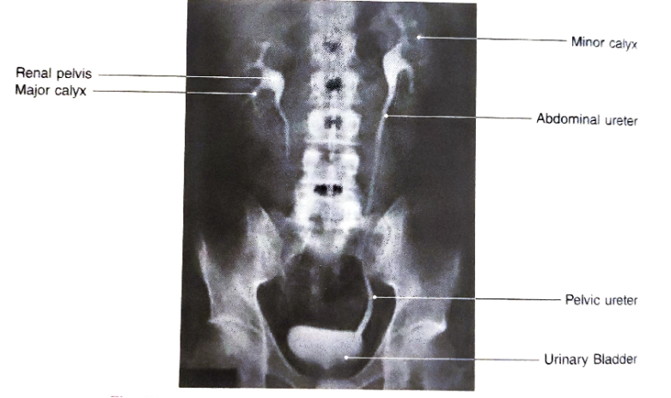
Structure can be seen are –
    Minor calyces
    Major calyces
    Renal pelvis
    Ureter
    Urinary bladder

Slide 14
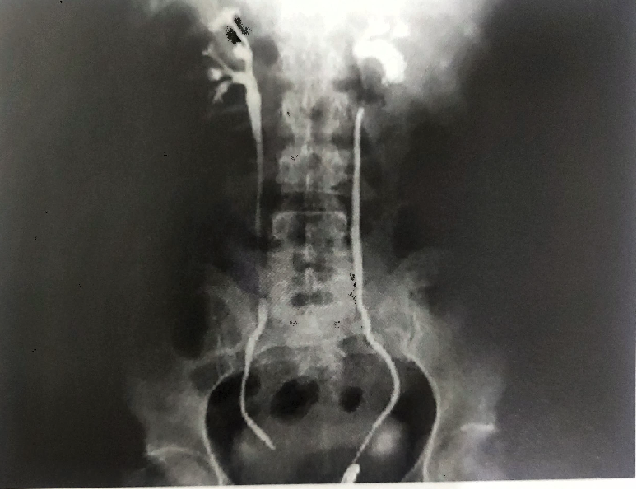
Retrograde or ascending pyelography
  Catheter is passed through ureteric orifice under the guidance of cystoscope
  Then sodium iodide dye (5-10 ml) is injected
  Radiographs or fluoroscopy is taken to visualize KUB
  Filling defects in UB may suggest ulcer/ polyps/ carcinomas

Slide 15
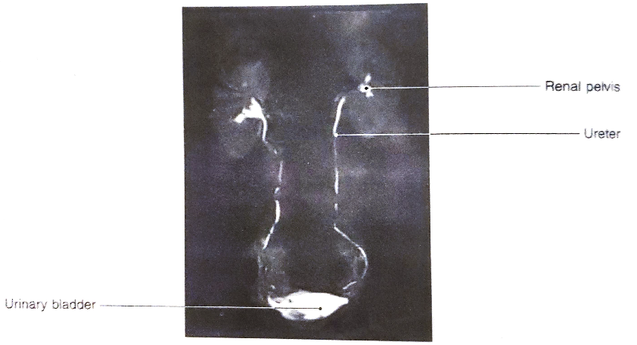
MR urography
  Indications –
    Urinary tract obstruction
    Haematuria
    Congenital anomalies of urinary tract

Slide 16
Cholecystography
Visualization of gall bladder after administration of radiopaque dye
Dye in the form of tablets containing iopanic acid (telepaque)

Slide 17
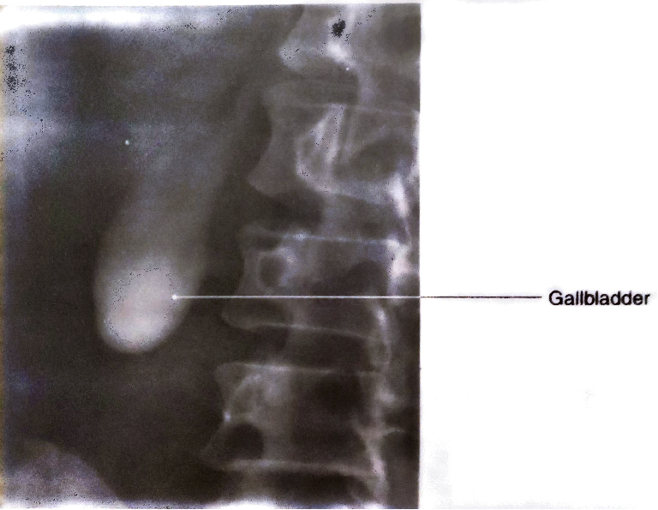
Oral cholecystography
  Indications –
    Cholelithiasis
    Carcinoma of gallbladder
    Any congenital anomaly of GB

Slide 18
Preparation of patients for procedure
  Two days before the procedure ,person can have normal meal
  One day before the procedure a very low fat diet is given
  Evening before the procedure radiopaque dye in form of pill(6 tablets) is given
  One tablets /hour

Slide 19
  Nothing is to be eaten once the pills are given
  On the morning of the procedure – nil orally
  Enema may be given to prevent the shadow of gas & intestinal contents
  Radiographs is taken

Slide 21
Magnetic resonance cholangiopancreatography
  Indications-
    Liver diseases
    Tumours , stones ,inflammation & congenital anomalies of GB, Bile duct ,pancreatic duct

Slide 22
Hysterosalpingography
Radiological visualization of uterus &fallopian tube after introducing radiopaque dye through vagina
Indications –
  Infertility
    To see shape of uterus
    To see tubal patency
  After permanent sterilization
    To check total occlusion of fallopian tube

Slide 23
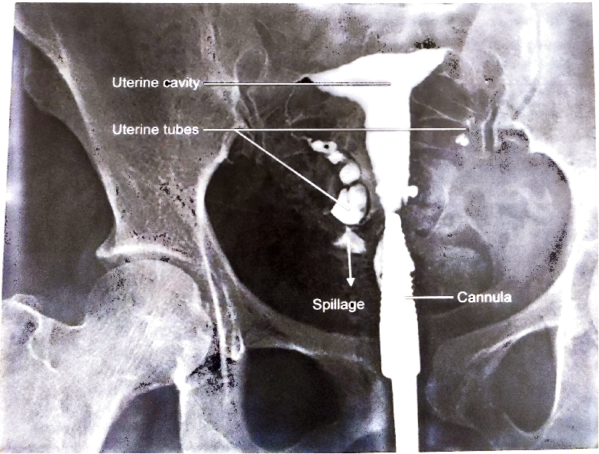
Procedure -
A cannula is introduced into the cervix through vagina
Radiopaque dye (Urograffin/ Iohexol) is injected
Then taken serial radiographs of pelvis

Slide 24
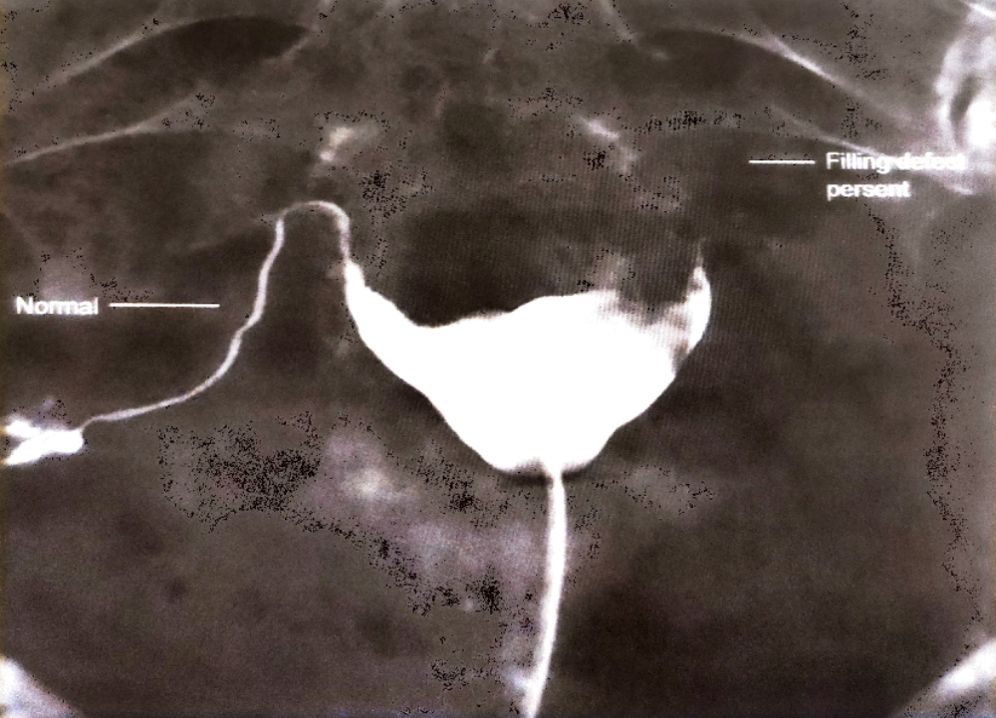

Slide 25
Ultrasonography

Slide 26
Computed tomography

Slide 27
Thank you

