Slide 1
RADIOLOGY LOWER LIMB
Sarangdhar kumar
Department of Anatomy
Rohilkhand Medical College
Bareilly

Slide 2
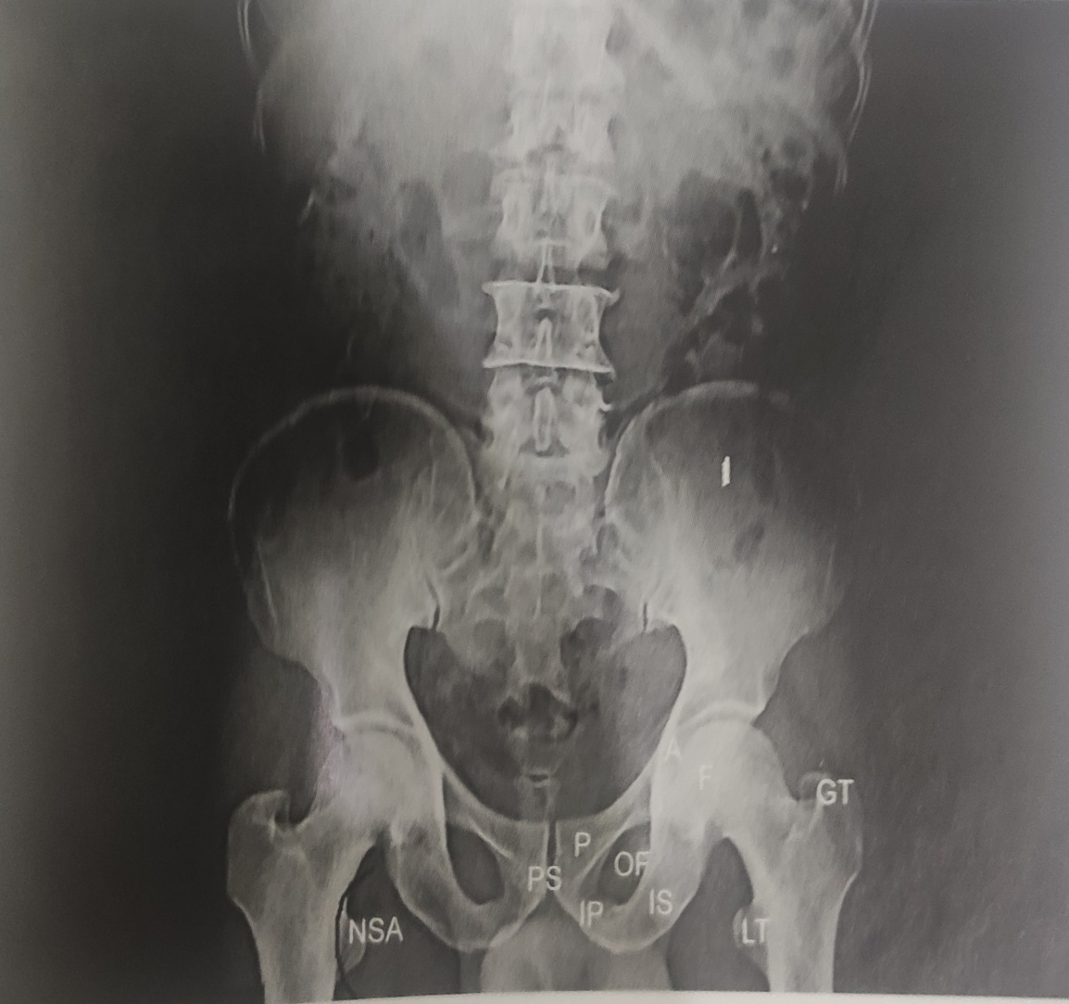
PLANE RADIGRAPH OF PELVIS ,LOWER LUMBER & HIP JOINT –
Normally viewed in anteroposterior view
The positon of lower limb should be in such away that-
  There is separation of lower limb at heels
  All toes are directed antero-medially
This position allow the femur to rotate slightly medially & femoral neck lies parallel to the radiographic film
In this position the shadows of upper end of femur & acetabular region are visualized better
Border of acetabular cavity & head of femur appears as curved lines

Slide 3
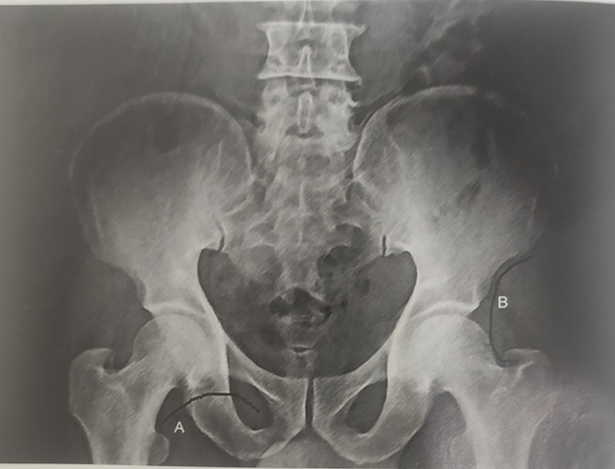
In normal AP view, two curved lines can be appreciated
  A. shenton’s line
  B. Another line can drawn along the external border of the ilium & upper border of the neck of femur
Discontinuity in the curved line is seen in fractures of neck of femur or in dislocation of hip joint

Slide 4
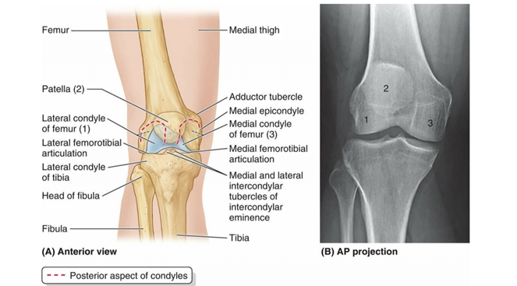
KNEE JOINT
Normally AP view & Lateral view are taken
AP view –
  Borders of the bones taking part in the joint formation present smooth white line (radiopaque line) due to presence of thin cortical bone tissue
  The joint space as radiolucent area, superimposed patellar shadow is seen on the shadow of lower end of femur
  Each side of patellar shadow there is shadow of medial & lateral condyles of femur
  Sometimes small shadow of sesamoid bone (fabella) is seen close to origin of lateral head of gastrocnemius

Slide 5
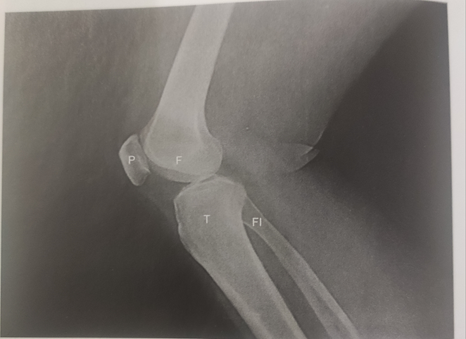
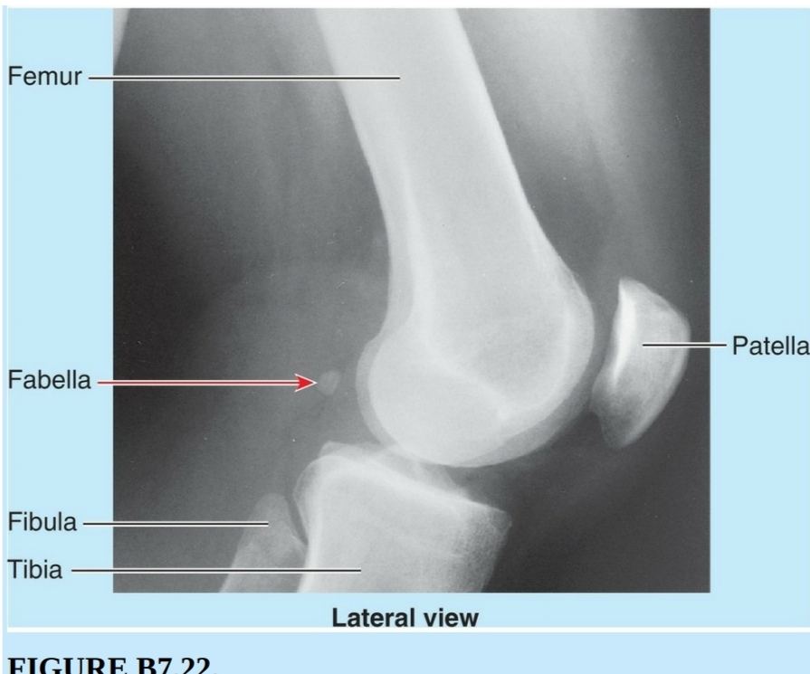
KNEE JOINT LATERAL VIEW –

Slide 6
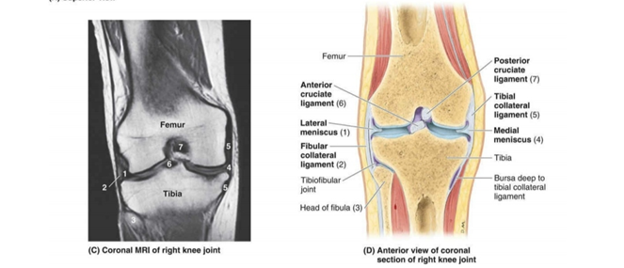
MRI OF KNEE JOINT-

Slide 7
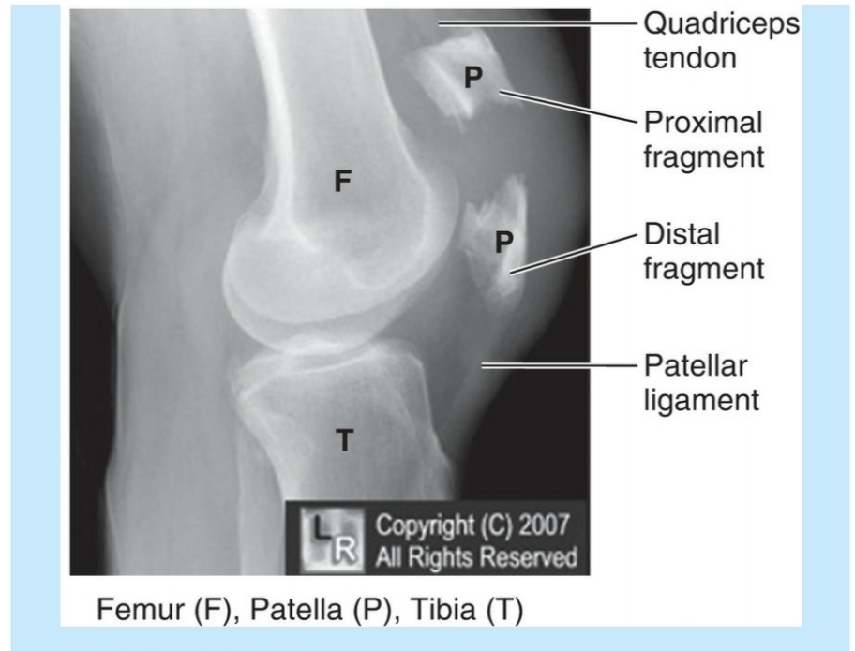
Patellar fracture

Slide 8
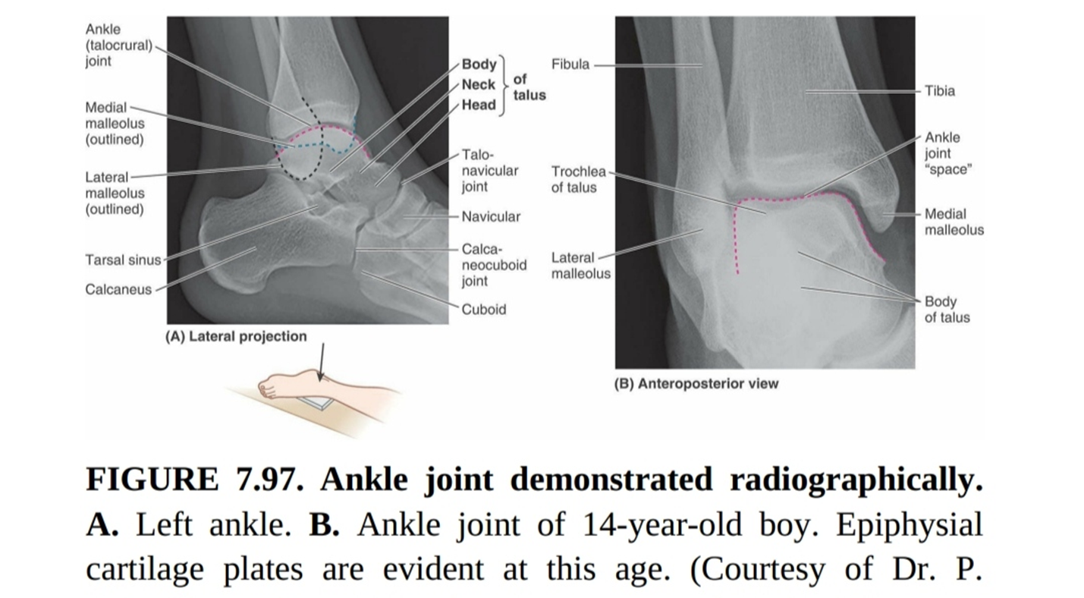
ANKLE JOINT

Slide 9
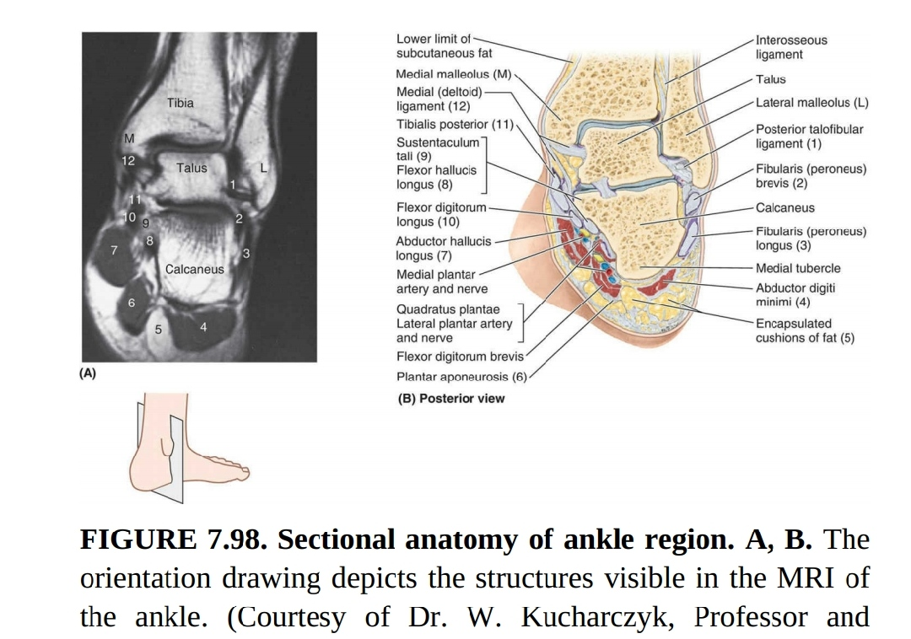

Slide 10
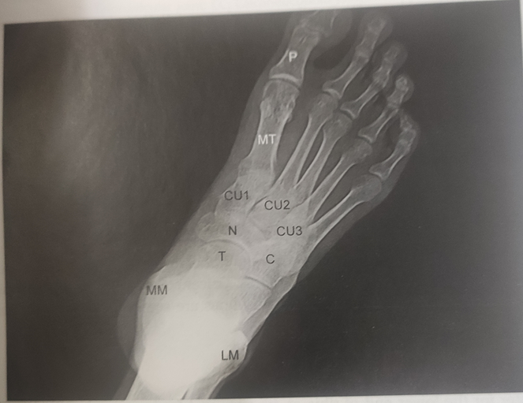
FOOT –
Plane radiograph of adult foot in Supero-inferior view-
Tarsal , metatarsal & phalanges are visualized
Medial malleolus & lateral malleolus are also visualized
Joint cavity appears radiolucent

Slide 11
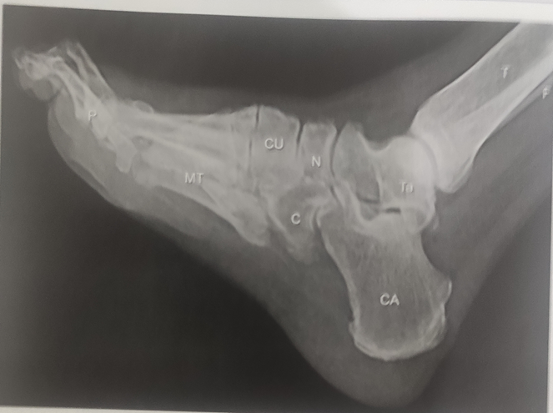
Plane radiograph of adult foot in lateral view -

Slide 12
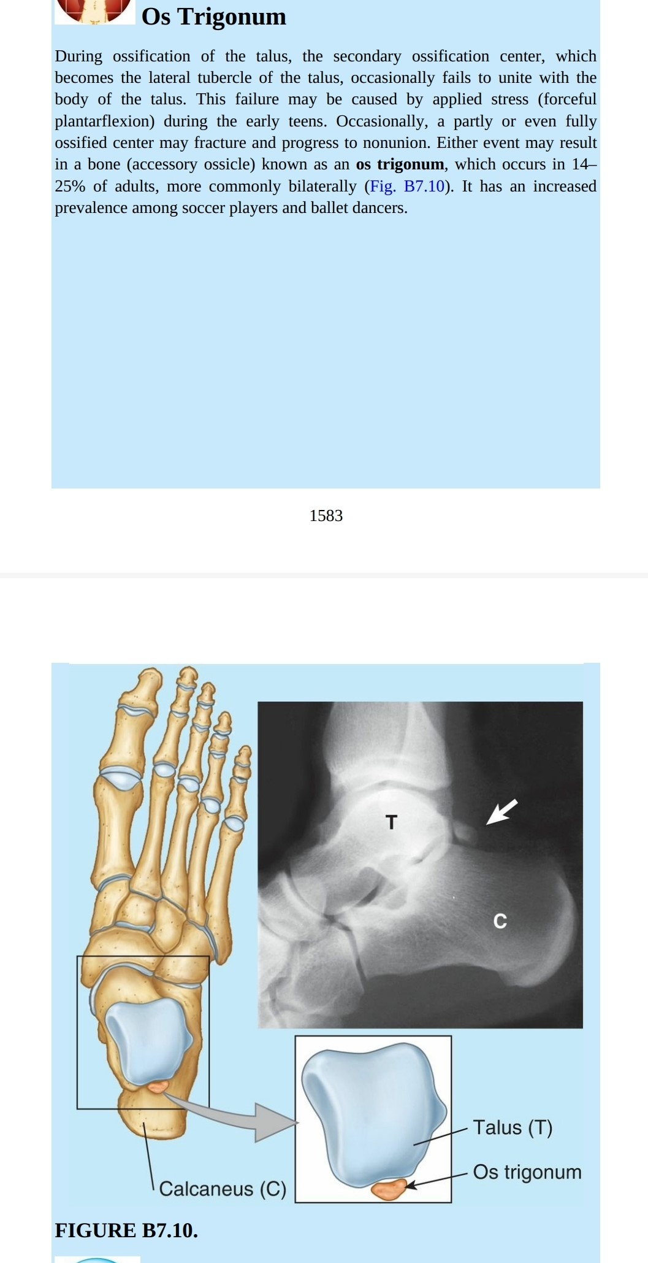

Slide 13
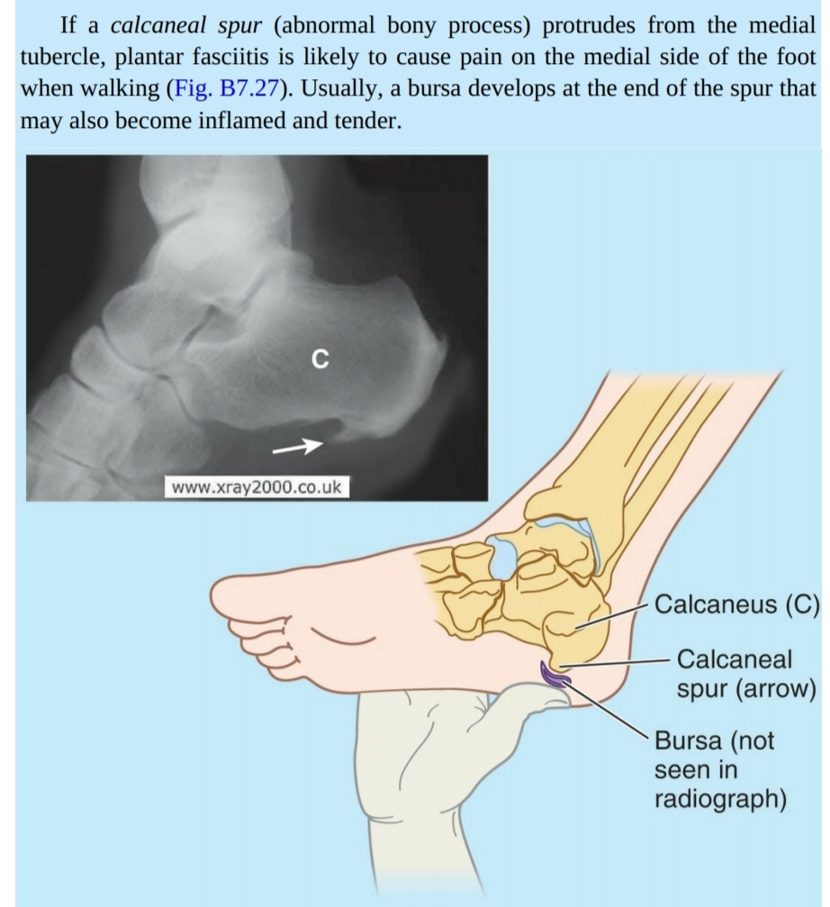

Slide 14
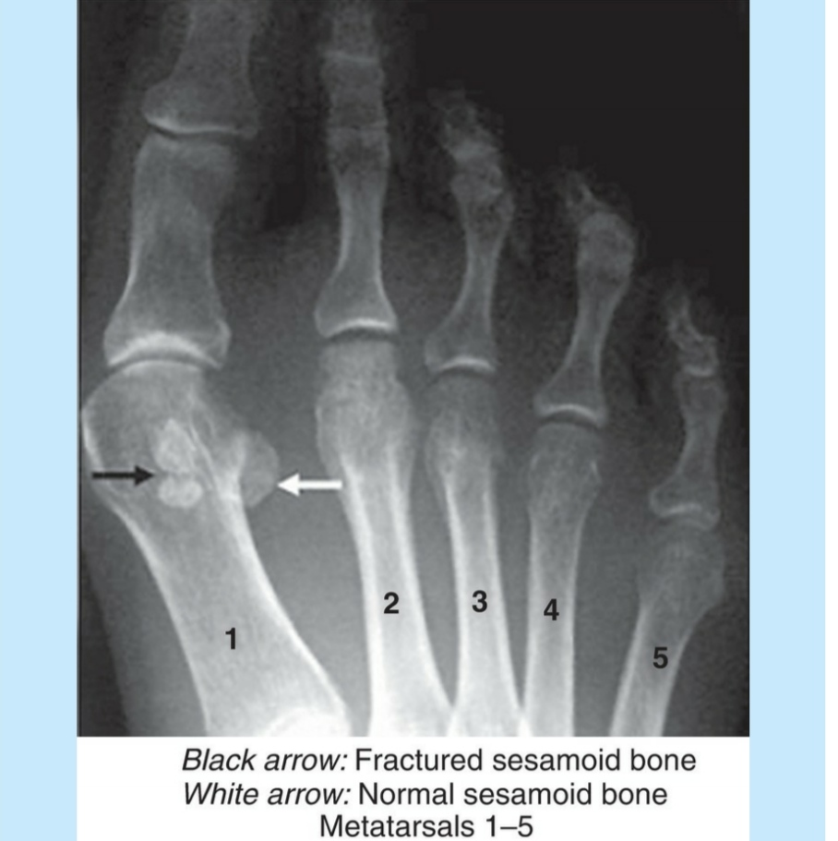
Fracture of sesamoid bone

Slide 15
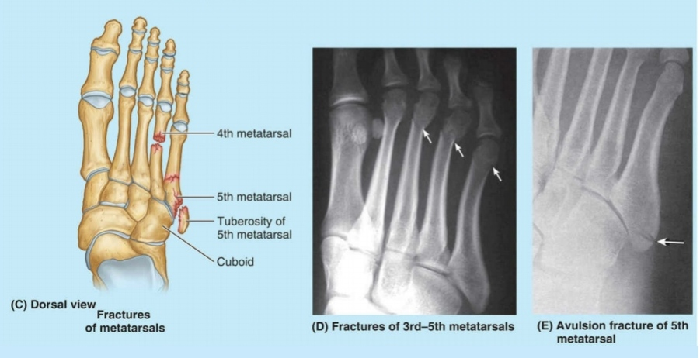

Slide 16
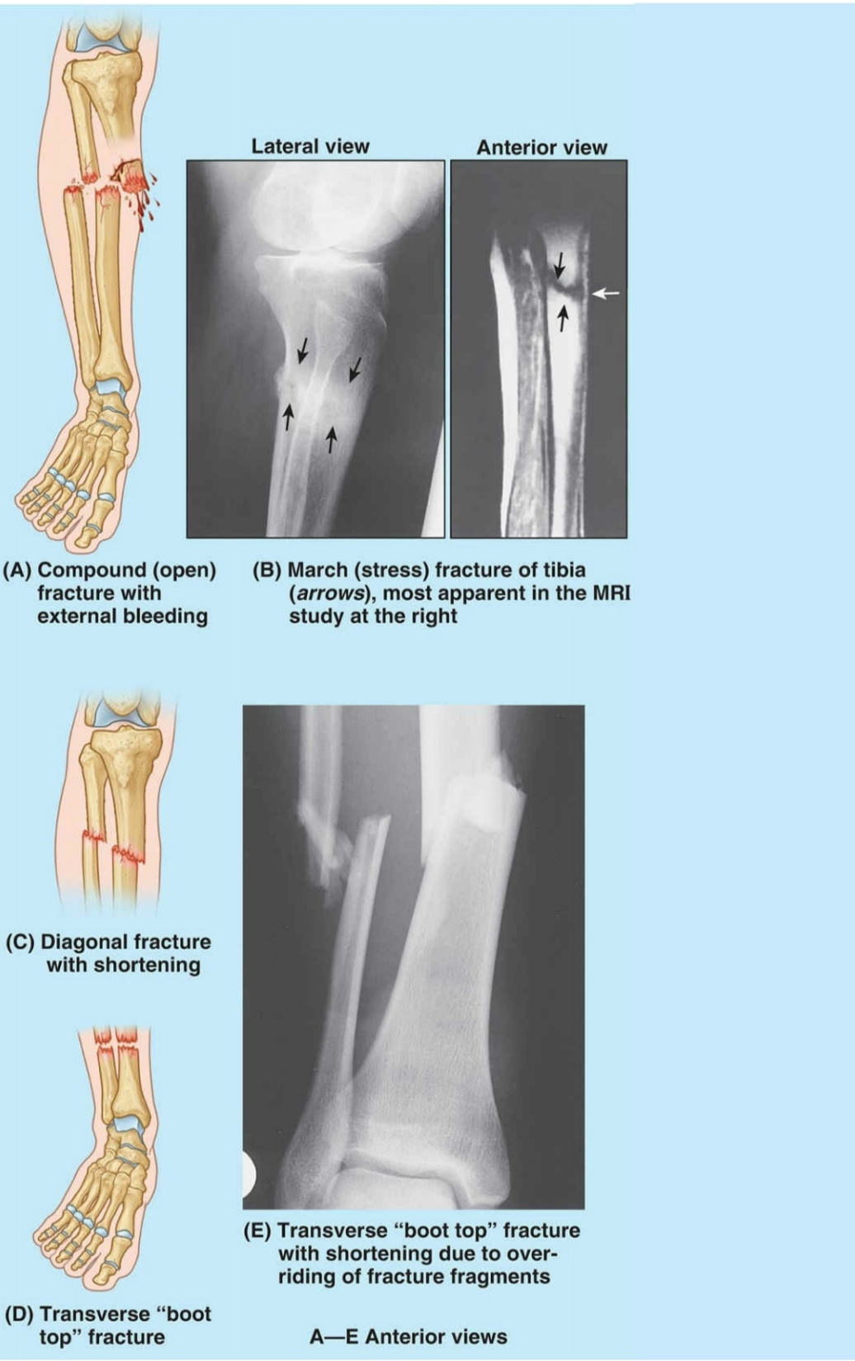
Fracture of leg bones

Slide 17
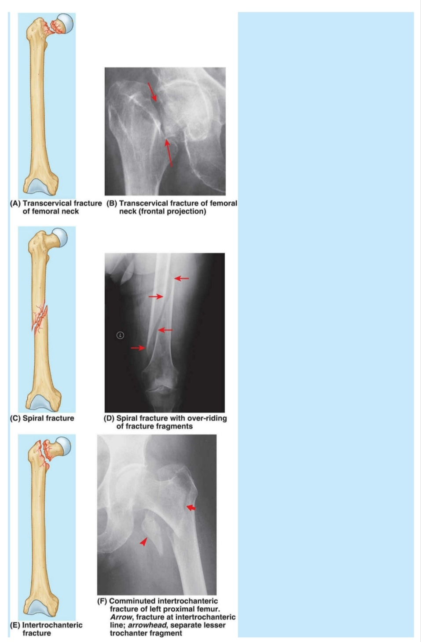
Fracture in femur bone

Slide 18
THANK YOU

