Slide 1
PORTAL VEIN
Sarangdhar kumar
Assistant professor
Department of Anatomy
Rohilkhand Medical College
Bareilly

Slide 2
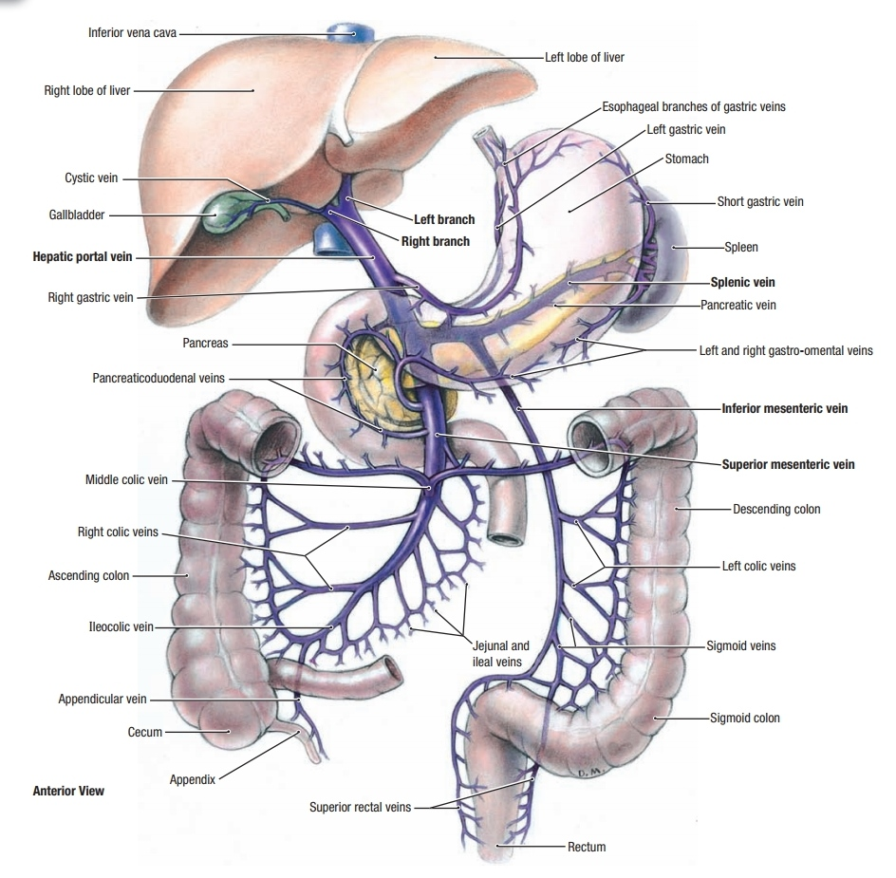
It is an important venous channel that collect the blood from
  Abdominal part of alimentary tract except rectum & anal canal
  And from Gall bladder Spleen & Pancreas
All these veins unit to form trunk of portal vein
It circulate through liver & divides into capillaries like sinusoids and finally drains into IVC via hepatic vein
Normal portal pressure – 5 – 15 mm of Hg

Slide 3
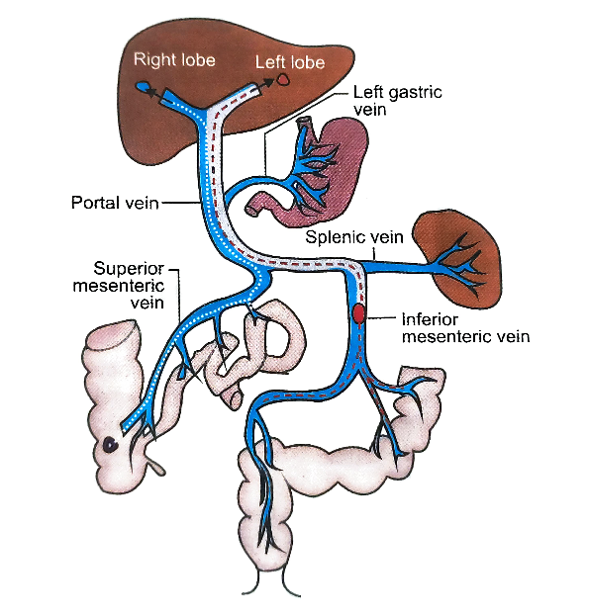
Peculiarities of portal vein
It begins like veins in capillaries plexus of gut & it terminates in hepatic sinusoids like artery
It convey the absorbed product of digested food
Devoid of valve
Acts as reservoir of blood (1/3rd of entire blood volume)
Two stream of blood circulate through trunk of this vein

Slide 4
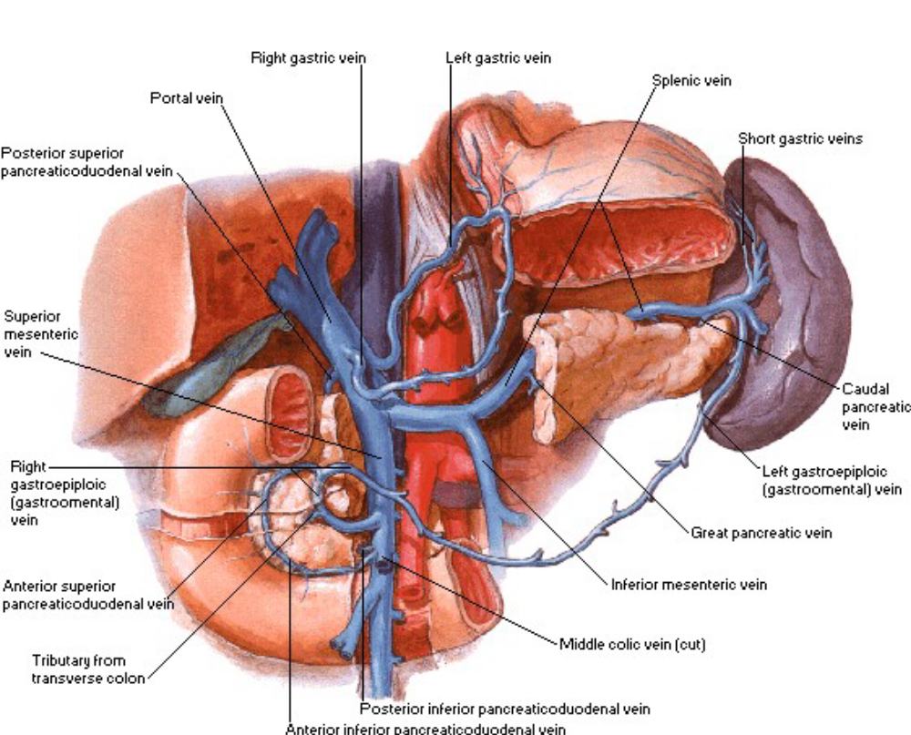
Formation
About 8 cm long
Formed by the union of two veins
  Splenic vein
  Superior mesenteric vein
Behind the neck of pancreas
At the level of L2 vertebra

Slide 5

Course
Divided into two parts
    Extrahepatic course
    Intrahepatic course
Extrahepatic course –
  After formation it passes upwards slightly to the right behind the neck of pancreas & 1st part of duodenum
  Then enter into right free margin of lesser omentum
  it reaches to porta hepatis & divides into right and left branches

Slide 6
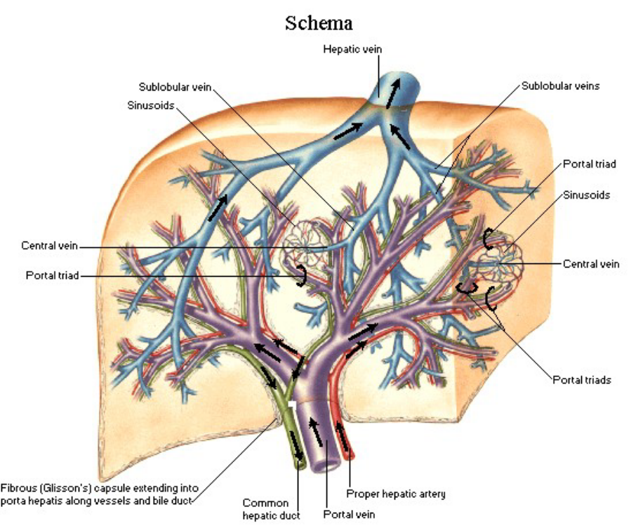
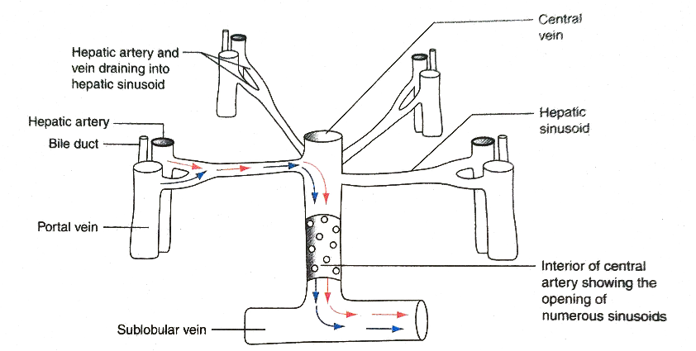
Intra hepatic course
  Portal canal – hepatic sinusoid – central vein – sub-lobular vein – hepatic vein – IVC

Slide 7
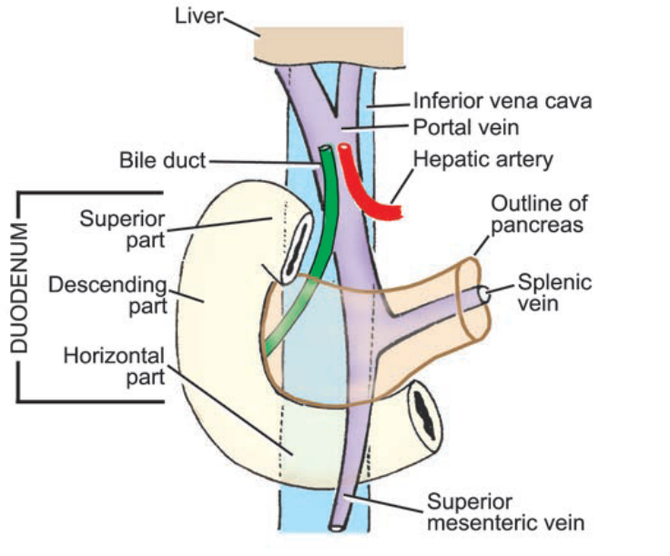
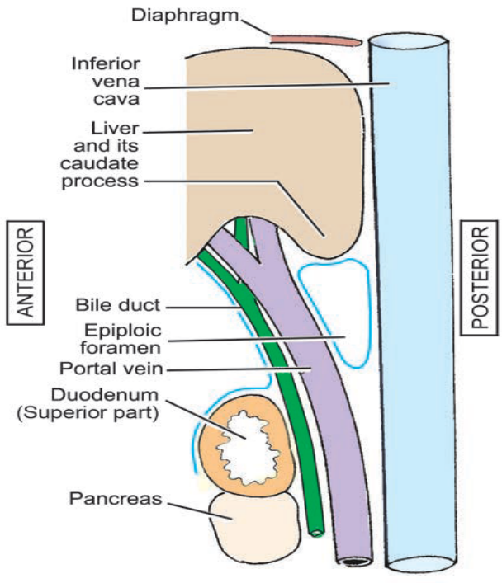
Relation
Infraduodenal part
    Infront – neck of pancreas
    Behind – IVC
    Rt side - bile duct
Retroduodenal part
    Infront – 1st part of duodenum
    Behind – IVC
Supraduodenal part
    Infront & to the right – bile duct
    Infront & to the left – hepatic artery
    Behind – IVC (separated by epiploic foramen )

Slide 8
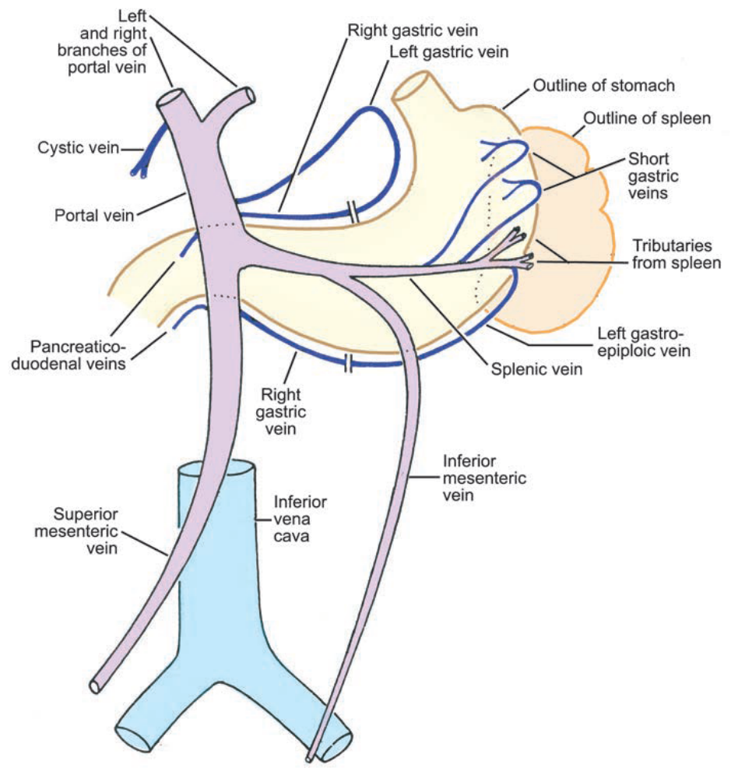
Tributaries of portal vein
Formative tributaries
  Splenic
  Superior mesenteric vein
Received by the trunk
  Right gastric vein
  Left gastric vein
Received by the two division of portal vein
  Cystic vein
  Paraumbilical vein
Occasional tributaries
  Inferior mesenteric vein
  Rt gastroepiploic vein
  Pre-pyloric vein

Slide 9
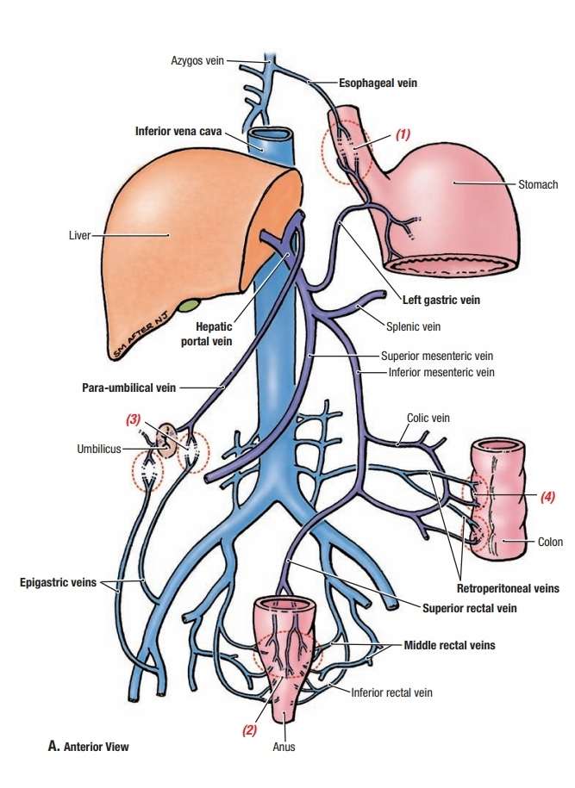
Porta-caval anastomosis
Collateral anastomosis between portal vein & systematic vein
It takes place at following sites
  At the lower end of oesophagus
  At the lower end of rectum & anal canal
  At umbilicus
  Behind the peritoneum on posterior abdominal wall
  At the bare area of liver
  In the falciform ligament
  At the fissure for ligamentum venosum
  In the posterior wall of vagina ( in female)

Slide 10
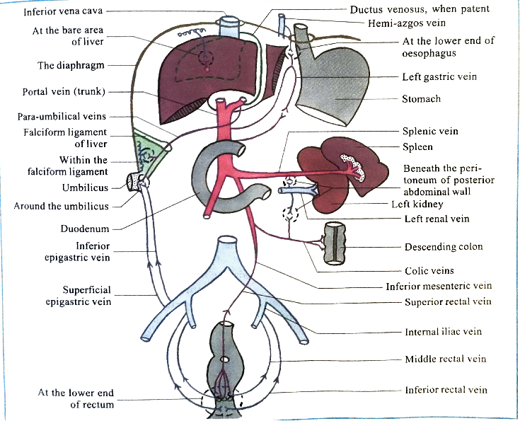

Slide 11

1. At lower end of oesophagus
  b/w oesophageal tributaries of left gastric vein + hemiazygos vein
Obstruction leads to Oesophageal varix (piles)
Rapture of varices leads to vomiting of blood (hematemesis )
2. At lower end of rectum & anal canal
  b/w superior rectal vein + middle & inferior rectal vein close to pectinate line
Obstruction leads to internal rectal piles

Slide 12
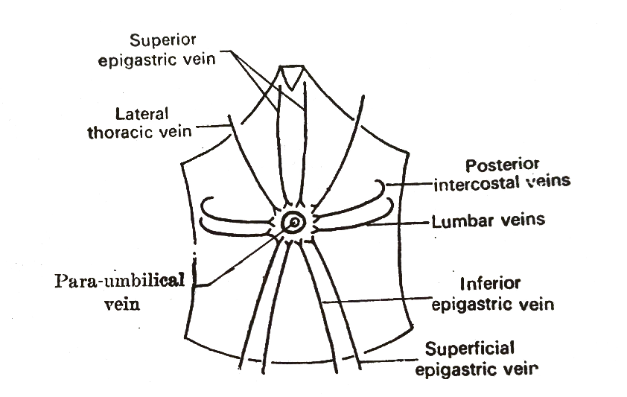
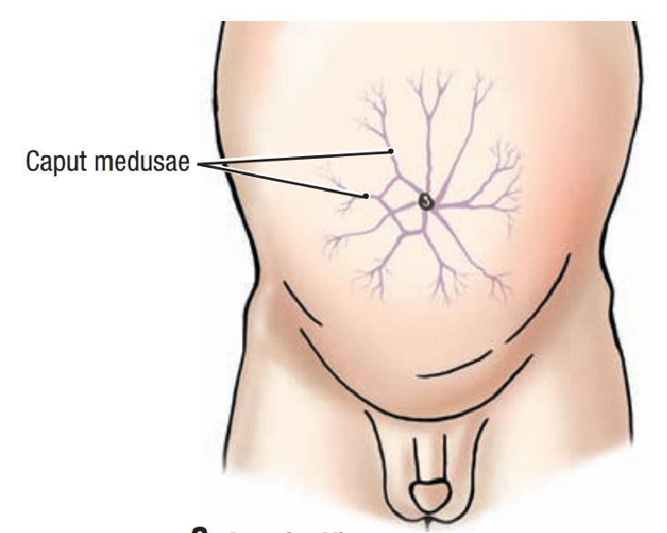
3. At the umbilicus
  Anastomosis b/w Paraumbilical vein and the following systematic veins
  Superior epigastric vein & lateral thoracic vein
  Superficial epigastric vein & inferior epigastric vein
  Posterior intercostal vein & lumbar vein
Obstruction leads to caput medusae

Slide 13
4. Behind the peritoneum on posterior abdominal wall
  Splenic vein & colic veins + renal veins & other tributaries of IVC
  Veins of Retzius
5. At the bare area of liver
  Portal radicles of liver + diaphragmatic vein

Slide 14
6. In the falciform ligament
  b/w paraumbilical vein + diaphragmatic vein by numerous small veins
  Accessory portal system of Sappey
7. At the fissure for ligamentum venosum
  b/w left branch of portal vein + IVC in foetal life via ductus venosus
  After birth ductus venosus fibrosed to form ligamentun venosum
  In rare condition it persists as porta-caval anastomosis
8. In posterior wall of vagina
  b/w superior rectal vein + vaginal venous plexus

Slide 15
Applied anatomy
Portal hypertension
  Due to obstruction of portal vein
  Causes of obstruction may be divided into intrahepatic & extrahepatic
    Intrahepatic causes – cirrhosis of liver
    Extrahepatic causes – portal vein thrombosis
  Obstruction to blood flow leads to stasis & rise in portal pressure
  Effects of portal hypertension are
    Splenomegaly
    Ascites
    Enlargement of porta-systematic collateral channels

Slide 16
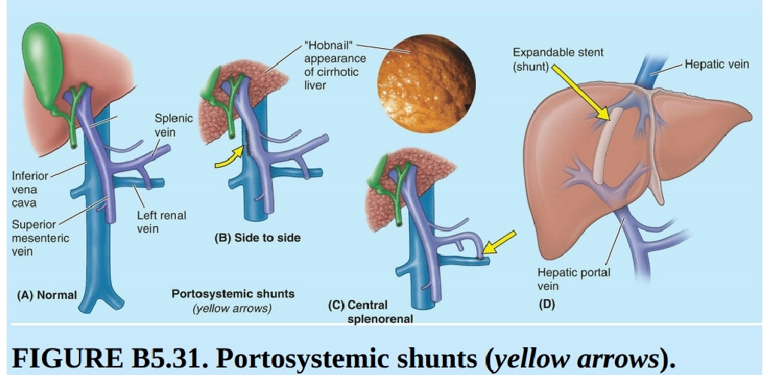
  Portosystemic shunt
  Surgical treatment of portal hypertension aims at creating a shunt between the portal vein (or superior mesenteric vein) and the inferior vena cava
  Alternatively, the splenic vein is cut and joined to the left renal vein , with or without splenectomy (splenorenal shunt)

