Slide 1
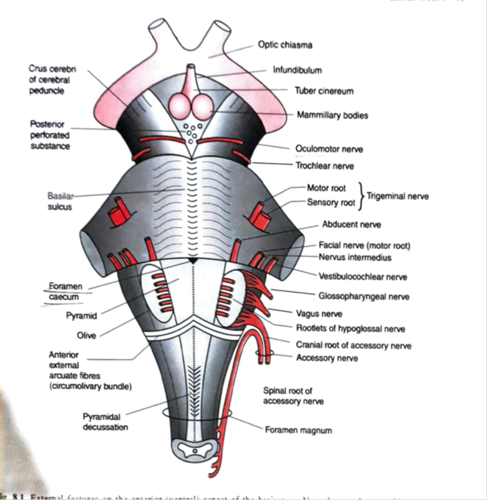
PONS
SARANGDHAR KUMAR
DEPARTMENT OF ANATOMY
ROHILKHAND MEDICAL COLLEGE
BAREILLY

Slide 2
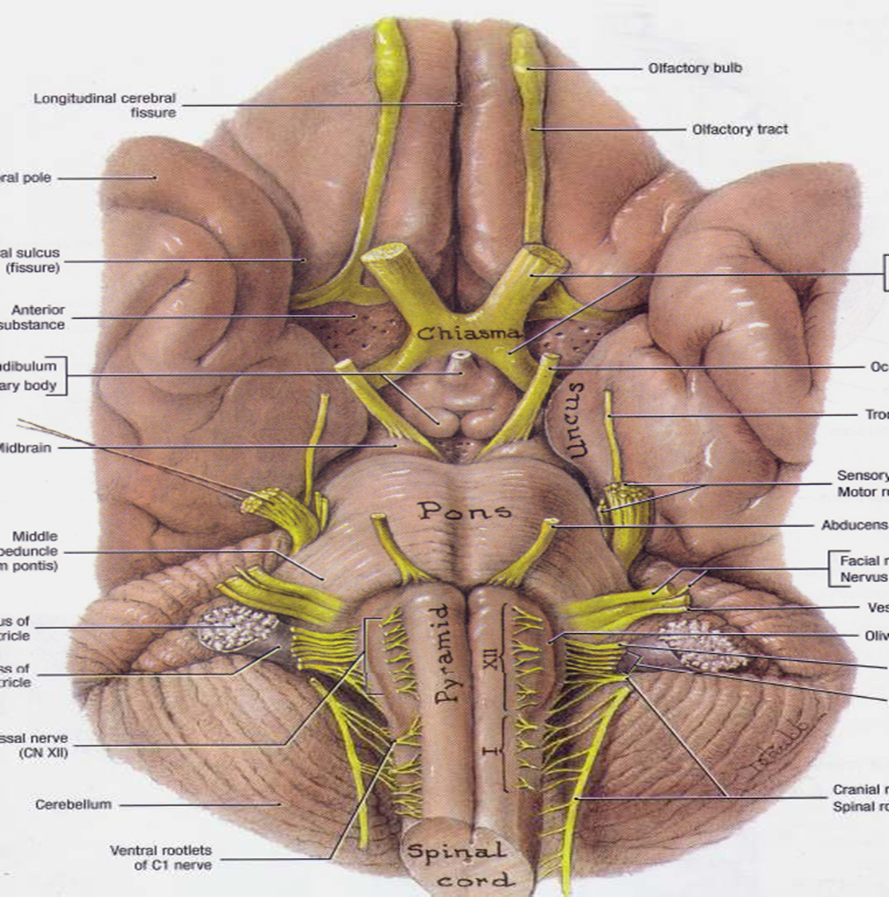
PONS
Middle part of brainstem
Forms a bridge between hindbrain and midbrain
Lies in posterior cranial fossa on the clivus
Either side it is continuous as the middle cerebellar peduncle and forming a bridge between two cerebellar hemisphere
It is about 2.5 cm long

Slide 3
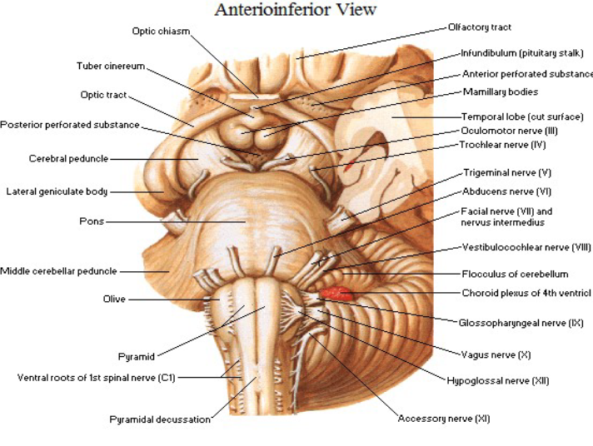
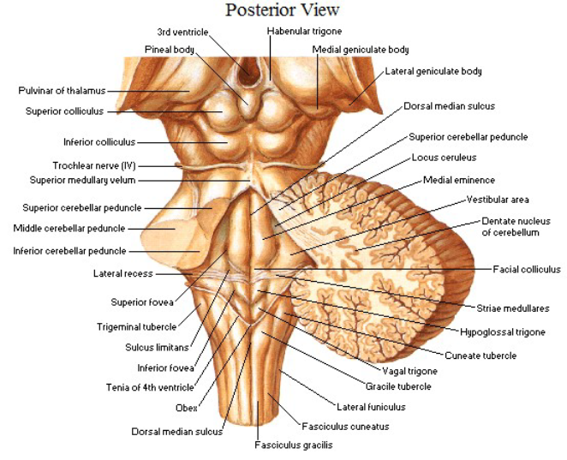

Slide 4

EXTERNAL FEATURES-
Two surfaces and two borders
Surfaces-
Ventral(anterior) surface –
    Convex
    Presents transversely ridge appearance due to underlying ponto-cerebellar fiber
    In median plane it presents vertical groove, basilar groove
    Trigeminal nerve is attached to the surface by two roots
    Ponto-medullary junction is by shallow groove and at this junction 6th ,7th & 8th CN are emerge

Slide 5
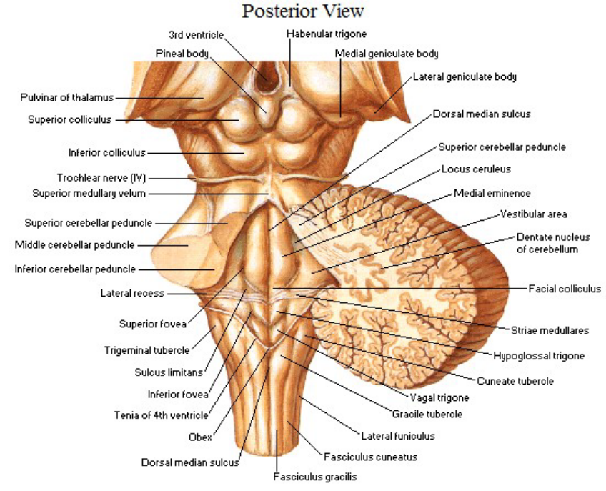
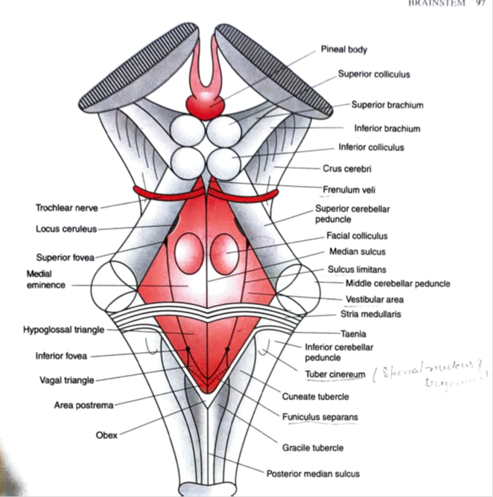
Dorsal(posterior) surface-
  It is covered by cerebellum & separated from it by cavity of 4th ventricle
  Triangular in shape and forms the upper part of floor of 4th ventricle
Borders
Superior border-
  Cerebral peduncles attached to this border
  Superior cerebellar artery is curved around this border
Inferior border –
  Anterior inferior cerebellar artery is curved around this border

Slide 6

Cerebello-pontine angle-
  A shallow triangular area
  Bounded by lateral aspect of pons, superior part of cerebellum & medial 1/3rd of superior margin of petrous temporal bone.
  Internal acoustic meatus & lateral aperture of 4th ventricle are located
  It contains 7th & 8th cranial nerve and labyrinthine artery
  The schwannoma is the tumor arising from schwann cell in sheath surrounding the nerve fibers in vestibular nerve

Slide 7
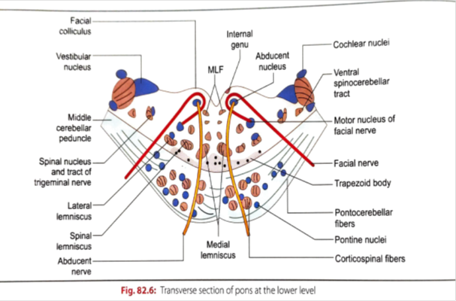
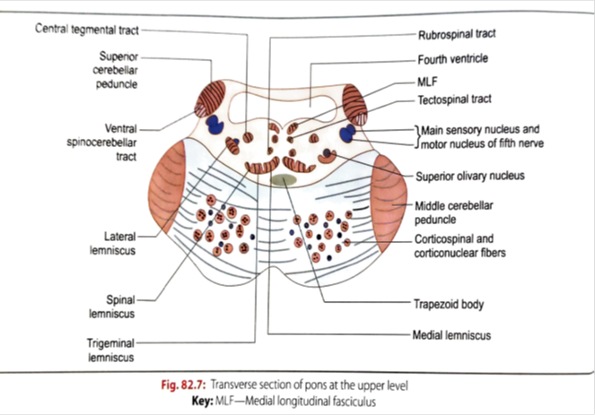
INTERNAL FEATURES
  Internal structure of pons is divided into anterior (basilar) part & posterior (tegmental) part
Basilar part –
  Upward continuation of pyramid
  Present uniform structure throughout the extent of pons
  It contains –
    pontine nucleus
    Corticospinal fibers & corticonuclear fibers
Tegmental part-
  Upward continuation of rest of the medulla except pyramid
  It shows considerable difference in gray & white matter in lower and upper part of pons

Slide 8

Tegmentum at lower pons-
Gray matter-
  Abducent nucleus
  Motor nucleus of facial nerve
  Superior salivatory nucleus, lacrimatory nucleus & inferior salivatory nucleus
  Spinal nucleus & tract of trigeminal nerve
  Vestibular nuclei
  Cochlear nuclei
  Superior olivary complex
White matter-
Consists of major ascending tract
  Medial lemniscus
  Spinal lemniscus
  Trigeminal lemniscus
  Lateral lemniscus
  Medial longitudinal bundle

Slide 9
Tegmentum at upper pons-
Gray matter –
  Contains all the four nuclei of trigeminal nerve
    Motor nucleus
    Main sensory nucleus
    Mesencephalic nucleus
    Spinal nucleus
White matter –
  Presents transverse band of white matter consists of
    Medial lemniscus
    Trigeminal lemniscus
    Spinal lemniscus
    Lateral lemniscus

Slide 10
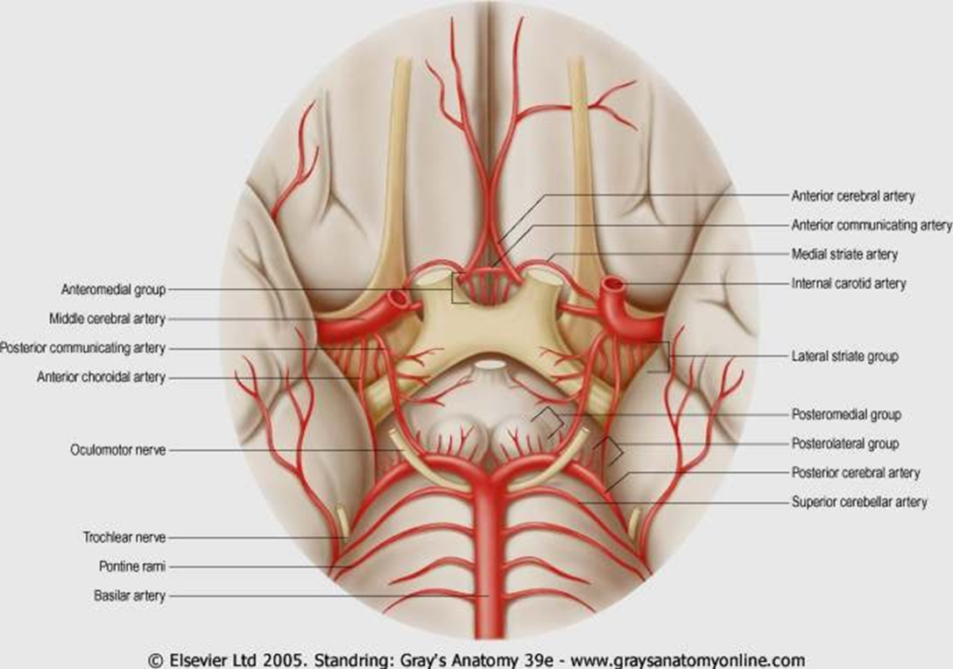
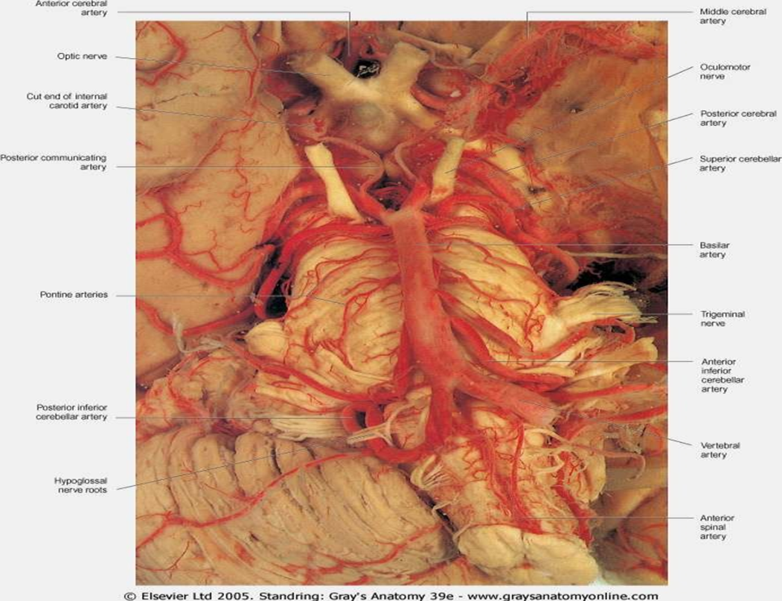
Arterial supply of pons-
  Pontine branches of basilar artery
  Pontine branch of anterior inferior cerebellar artery
  Superior cerebellar artery

Slide 11
Clinical correlations

Slide 12
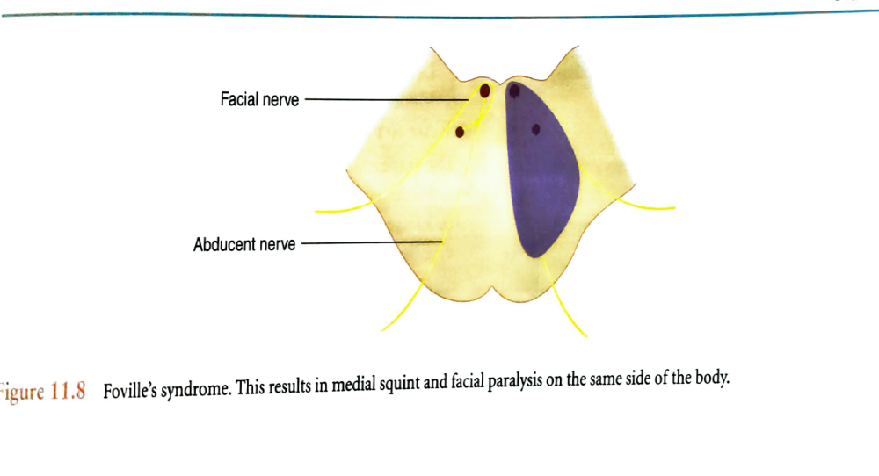

Slide 13
Pontine hemorrhage-
  Due to rapture of artery supplying the pons
  If massive it is invariable fatal
  Patient goes into coma, has pinpoint pupil and hyperpyrexia

Slide 14
THANK YOU

