Slide 1
PERIPHERAL PARASYMPATHETIC GANGLION
SARANGDHAR KUMAR
DEPARTMENTOF ANATOMY
ROHILKHAND MEDICAL COLLEGE, BAREILLY

Slide 2
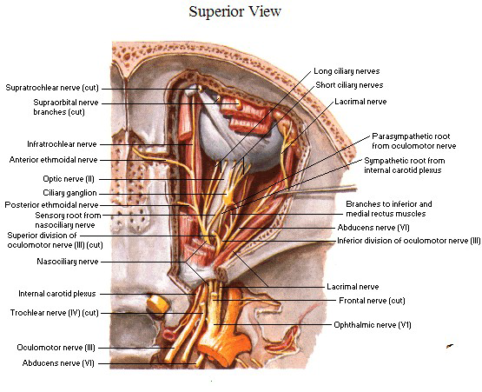
PERIPHERAL PARASYMPATHTIC GANGLION
CILIARY GANGLION
It is a peripheral parasympathetic ganglion
Topographically connected with nasociliary nerve but functionally connected with the oculomotor nerve
Ganglion is about size of pin’s head
Contain cell bodies of multipolar neuron
Situation-
Located near apex of orbit between optic nerve &lateral rectus muscle

Slide 3
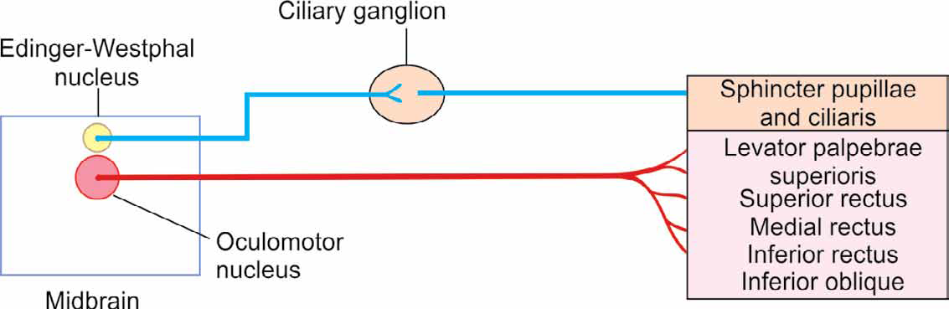
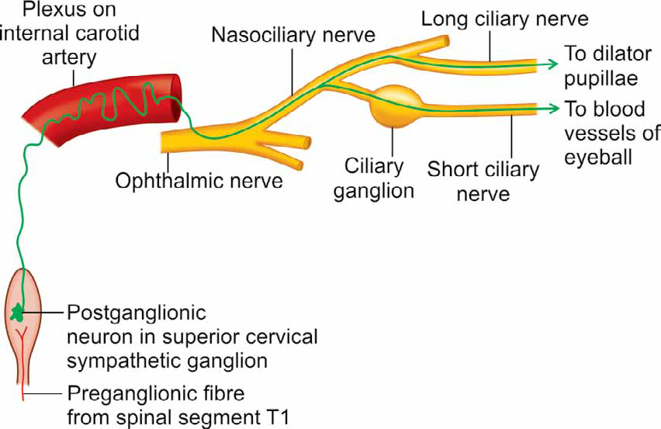
Connections-
  Posterior border of ganglion connected with three roots
Motor (parasympathetic) root-
  Derived from nerve to inferior oblique
  Preganglionic fibers- Edinger-westphal nucleus
  Postganglionic fibers- short ciliary nerve & supply ciliary muscle and sphincter pupillae
Sympathetic root-
  Derived from branches of internal carotid plexus
  It conveys post ganglionic fibers from superior cervical sympathetic ganglion
  It supply blood vessels of eyeball & dilator pupillae
Sensory root-
  Derived from nasociliary nerve
  It carries pain, touch &thermal sensation from eyeball

Slide 4
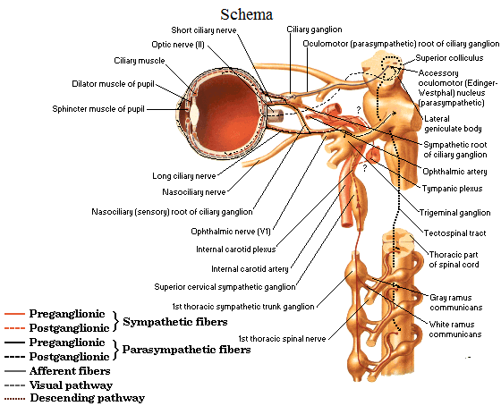
Branches-
8 to 10 short ciliary branches
  Contain fibers of all three roots
  It is peculiar that postganglionic parasympathetic fibers are myelinated

Slide 5
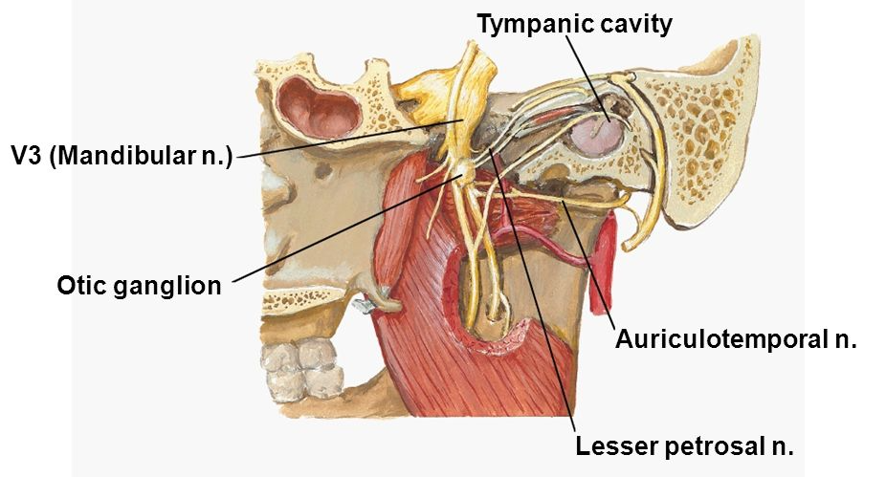
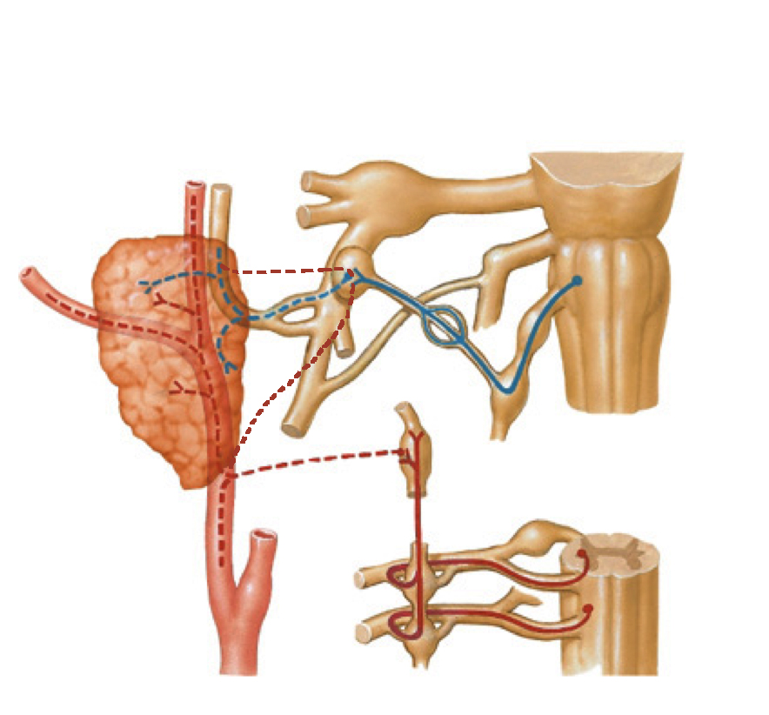
Otic ganglion
It is small, oval parasympathetic ganglion
2-3 mm in size
Situated in infratemporal fossa
Topographically- mandibular nerve
Functionally- glossopharyngeal nerve
Situation-
Below the foramen ovale
Medial to trunk of mandibular nerve
Lateral to tensor veli palatini
In front of middle meningeal artery
Behind the medial pterygoid

Slide 6
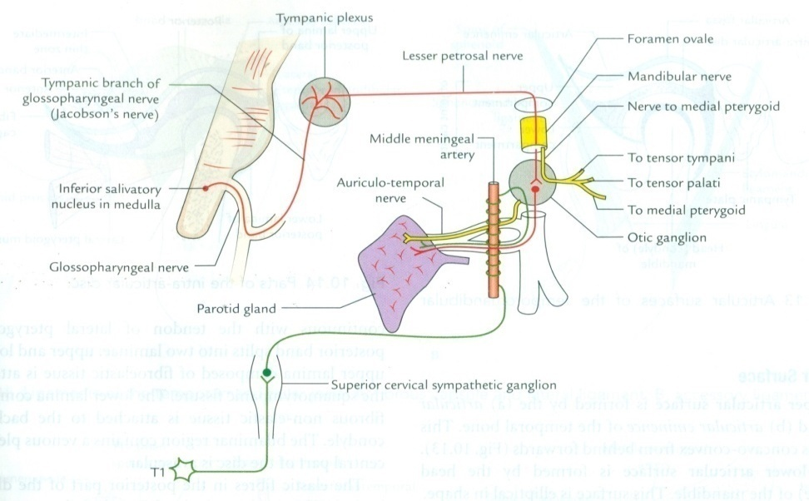
Connections (components)-
  Parasympathetic
    Lesser petrosal nerve (branch of tympanic plexus which is formed by tympanic branch of glossopharyngeal nerve.
    Preganglionic fibers- arises from inferior salivatory nucleus of the medulla. These are the only fibers which synapse in ganglion,
    Post ganglion fibers- run inside auriculotemporal nerve and give secretomotor fibers to parotid gland
  Sympathetic
    Post ganglion fibers forming plexus around middle meningeal artery from superior cervical ganglion
  Sensory
    Auriculotemporal nerve from trigeminal ganglion.

Slide 7
Branches-
Postganglionic parasympathetic – secretomotor to the parotid gland
Postganglionic sympathetic- vasomotor to parotid gland
Fibers from nerve to medial pterygoid – passes through otic ganglion and supply the tensor veli palatini & tensor tympani muscles
Otic ganglion is connected to the Chorda tympani nerve & nerve to pterygoid canal (Alternate root of taste pathway )from ant.2/3rd of the tongue to the geniculate ganglion of facial nerve)

Slide 8
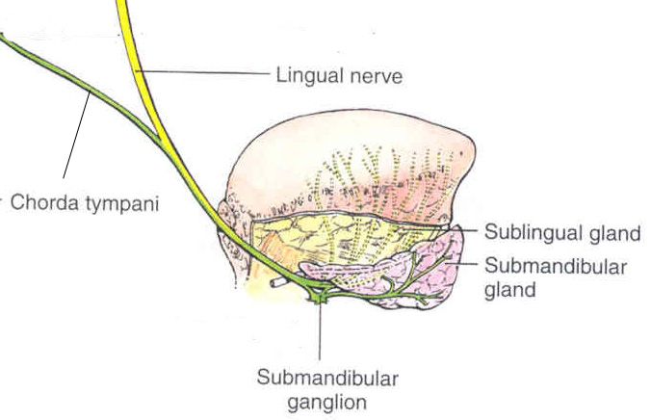
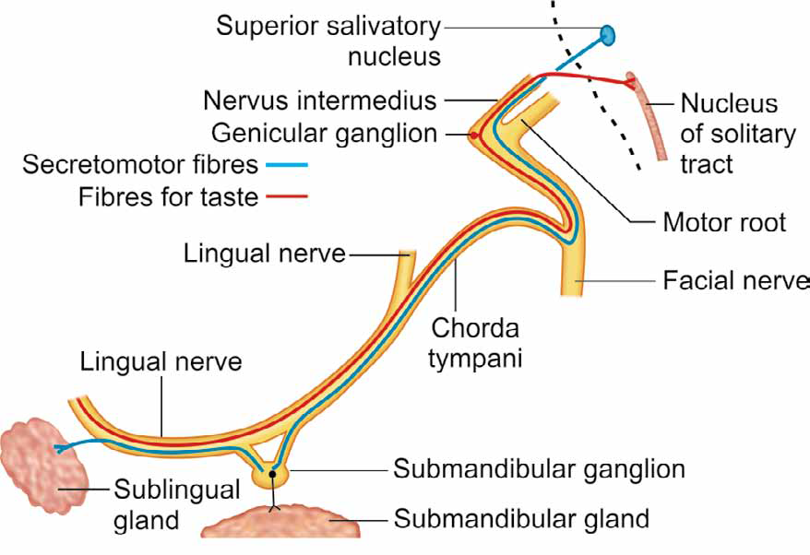
Submandibular ganglion
It is peripheral parasympathetic ganglon
It carries secretomotor fibers to submandibular & sublingual gland
Topographically related to the lingual nerve, but functionally it is connected to Chorda tympani
Location
  Lies on surface of hyoglossus muscle inferior to sub-mandibular duct
Parasympathetic root
  Chorda tympani
Sympathetic root
  Fibers from superior cervical ganglion come from plexus on facial artery
Sensory root
  Lingual nerve
Main distribution
  Sublingual and submandibular glands

Slide 9
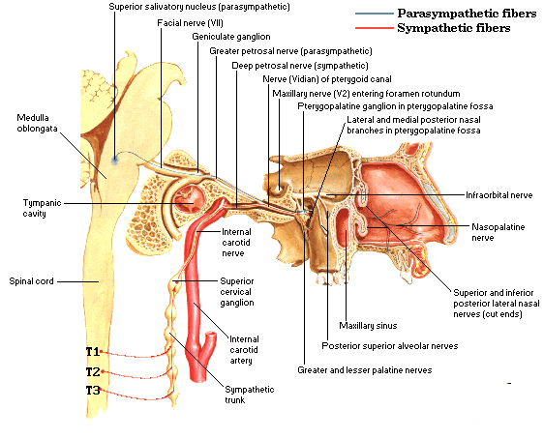
Pterygopalatine ganglion

Slide 10
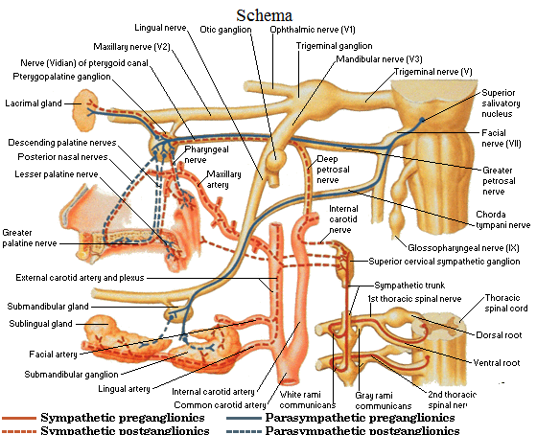
Pterygopalatine ganglion
Largest peripheral parasympathetic ganglion
Also known as hay fever ganglion
Suspended from maxillary nerve via two root in pterygoplatine fossa
Topographically- maxillary nerve
Functionally – facial nerve

Slide 11
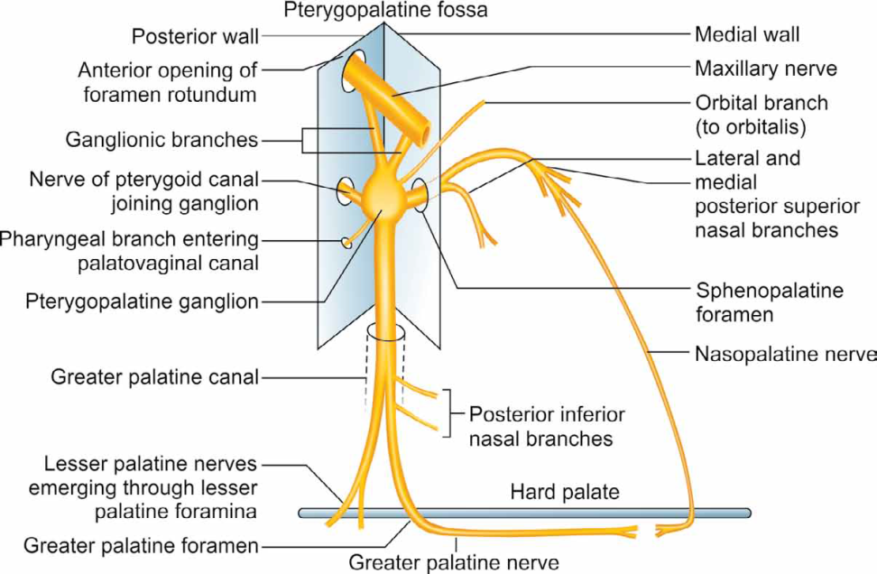
Branches-
  Ganglion provide four sets of branches-
Orbital branch –
  Enter through inferior orbital fissure
  Supply periosteum of orbit,orbitalis muscle, sphenoidal & ethmoidal air sinuses
Palatine branch- (Greater & lesser palatine branch)
  Passes through greater & lesser palatine foramen
  Supply mucous membrane of hard & soft palate & palatine tonsil
Nasal branch-
  Enter nasal cavity through sphenopalatine foramen
  Postero- superior lateral nasal branch
  Postero- superior medial lateral nasal branch
Pharyngeal branch-
  - It passes backward through palato-vaginal canal
  Supply mucous membrane of nasopharynx

Slide 12
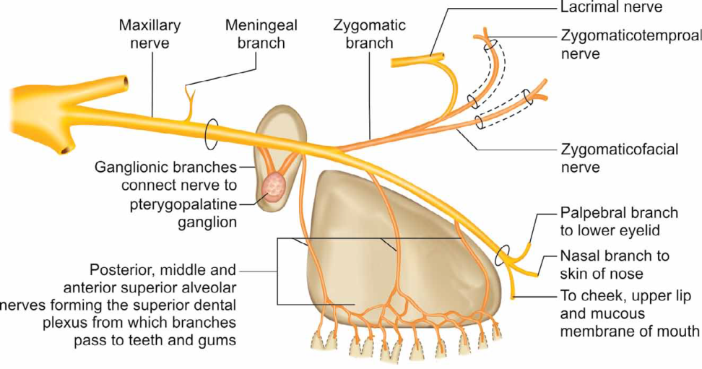

Slide 13
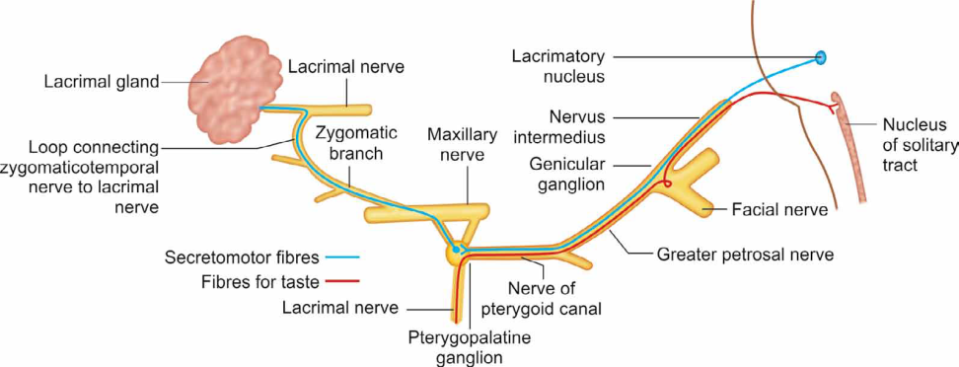
Connections-
  Three roots
Parasympathetic root-
  Secretomotor fibers for lacrimal gland , in addition to nasal & palatine gland
  Derived from nerve of pterygoid canal (vidian nerve)
  (deep petrosal nerve + greater petrosal nerve)
  Preganglionic fiber-
  greater petrosal nerve
  Postganglionic fibers-
  Either by zygotic nerve or orbital branch
Sympathetic root -
  Deep petrosal nerve
  It leaves through its orbital branches for orbitalis muscle in orbit &vasomotor to nasal cavity and palate

Slide 14
Thank you

