Slide 1
MALE EXTERNAL GENITALIA
SARANGDHAR KUMAR
DEPARTMENT OF ANATOMY
ROHILKHAND MEDICAL COLLEGE
BAREILLY

Slide 2
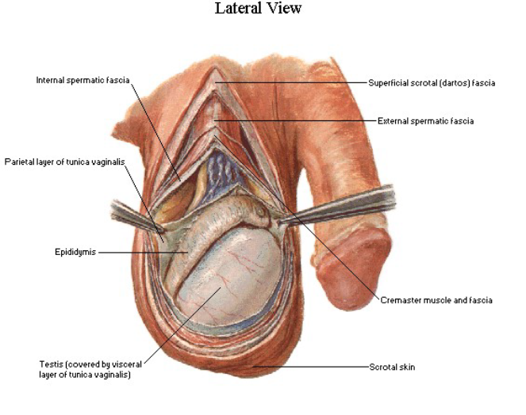
INTRODUCTION
The external genital organ of male consists of
  Penis
    Male copulatory organ
    It gives passes to the urine & semen
  Scrotum
    Pendulous sac of skin
    Houses of both testes & epididymis

Slide 3
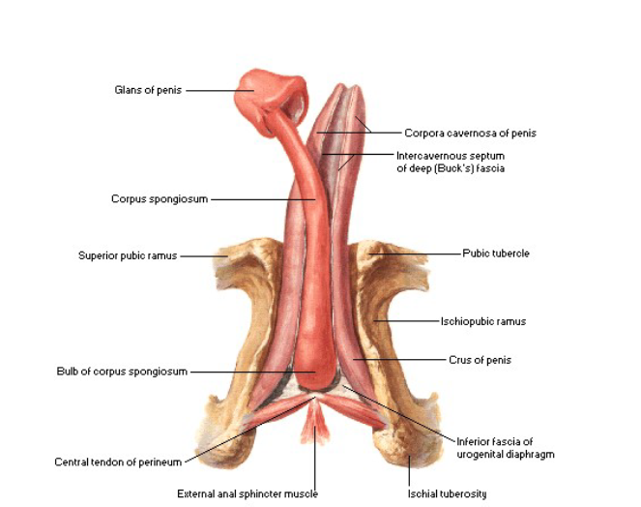
PENIS
It is male copulatory organ
It consists of two parts
  The Root or Fixed part
    Formed by three masses of erectile tissues
    Midline bulb of penis
    Each side of bulb, there is crus
  The Body
    It is elongated & ends in glans penis
    Consists of three elongated masses of erectile tissue whish are continuation of root of penis
    The Crura continue as corpora cavernosa
    The bulb continue as corpus spongiosum

Slide 4
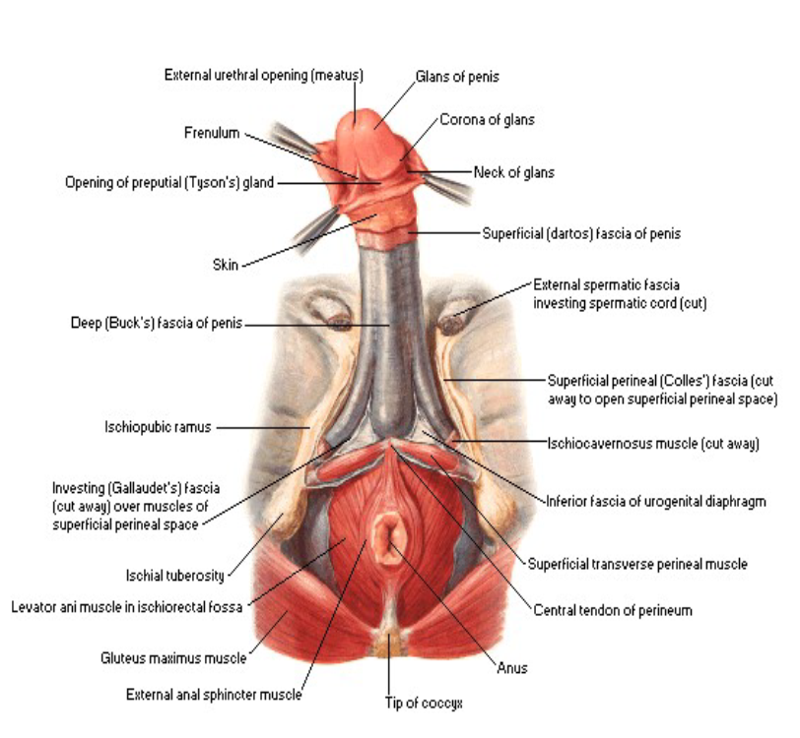
Skin & Fasciae covering the penis
SKIN
  Loose, thin & hairless
  At the neck of the penis skin is reflected upon itself to form prepuce or fore skin(covers the glans)
  Prepuce is attached to ventral surface of glans by fold of skin, frenulum
Phimosis is condition where the prepuce is too tight to retract over glans penis
Smegma – accumulation of secretions under prepuce predisposes to infection & malignanacy
Circumcision is the operation in which redundant part of prepuce is removed

Slide 5
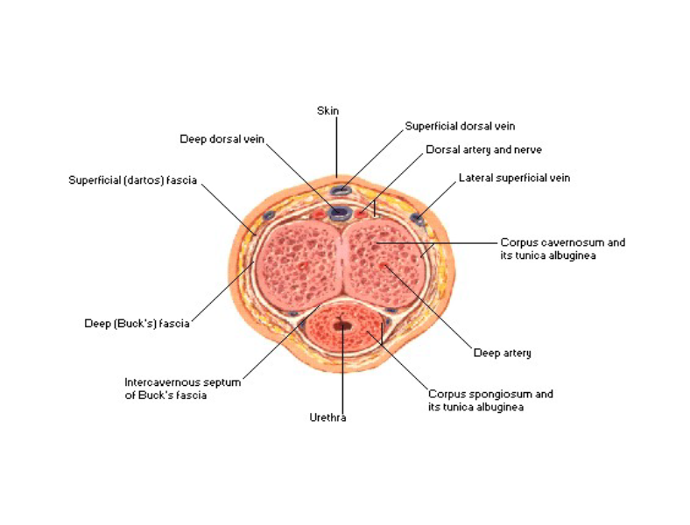
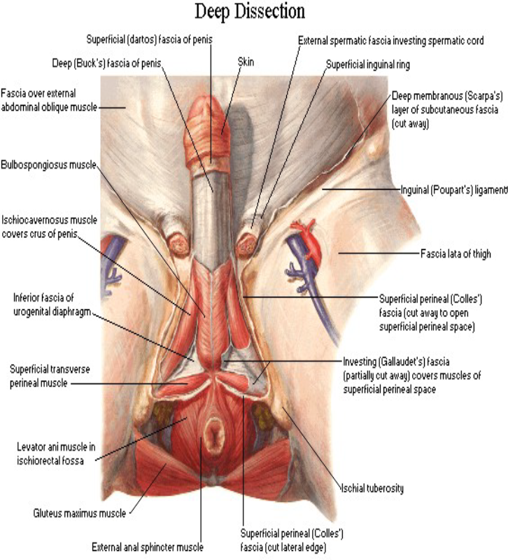
FASCIAE
Superficial fascia of penis contains no fat
The fascia of penis(Buck’s fascia)
  Forms common covering for three erectile masses but it does not cover the glans
  Continuous with fascia scarpa of anterior abdominal wall & dartos muscle of scrotum

Slide 6
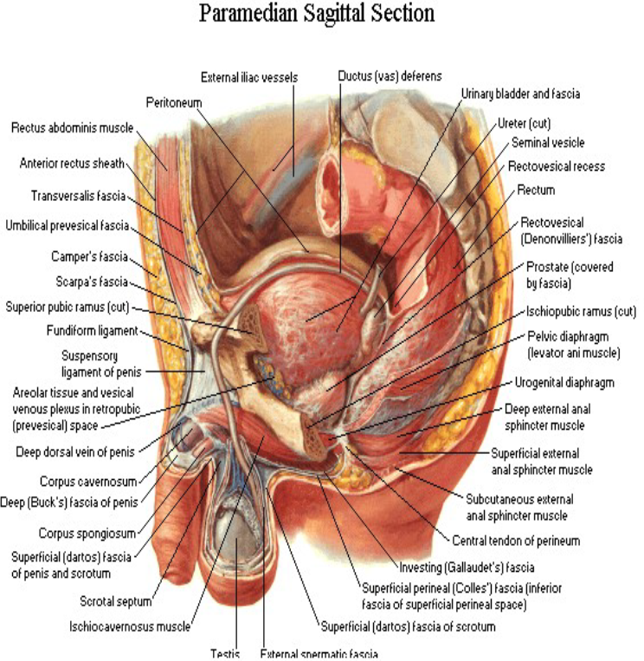
Two ligaments
Fundiform ligament
Suspensory ligament
  Triangular in shape

Slide 7
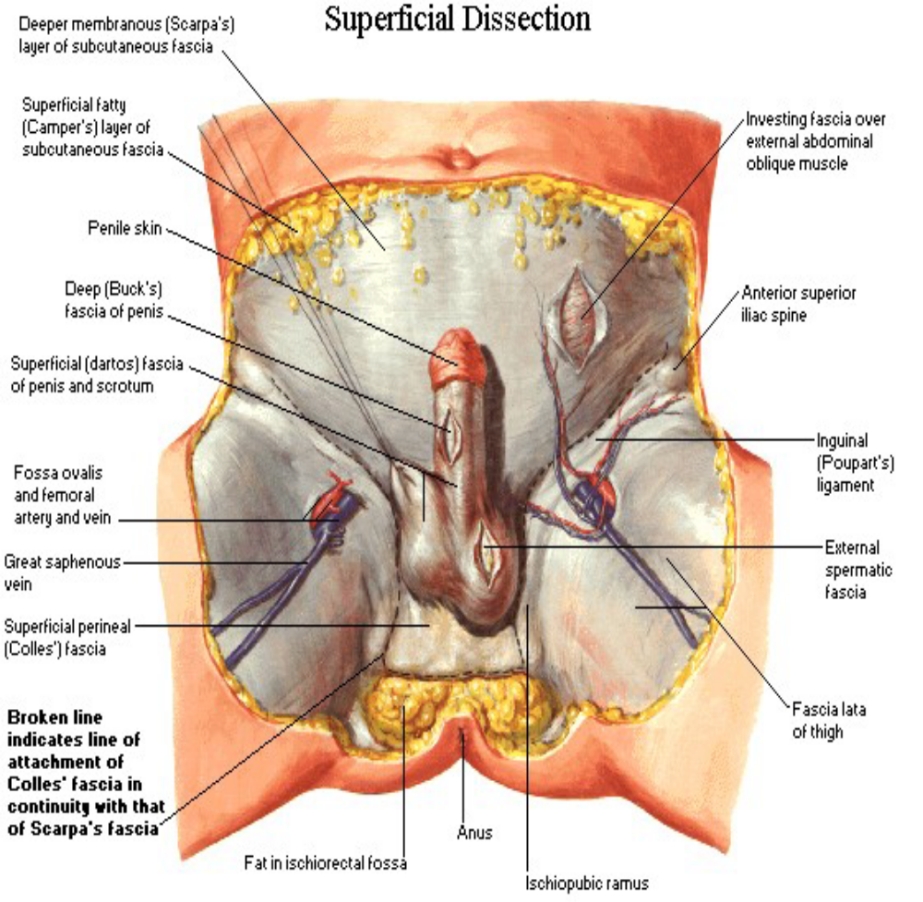
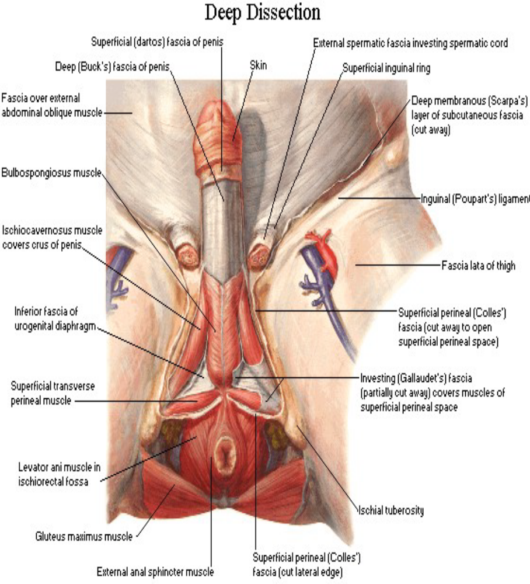

Slide 8
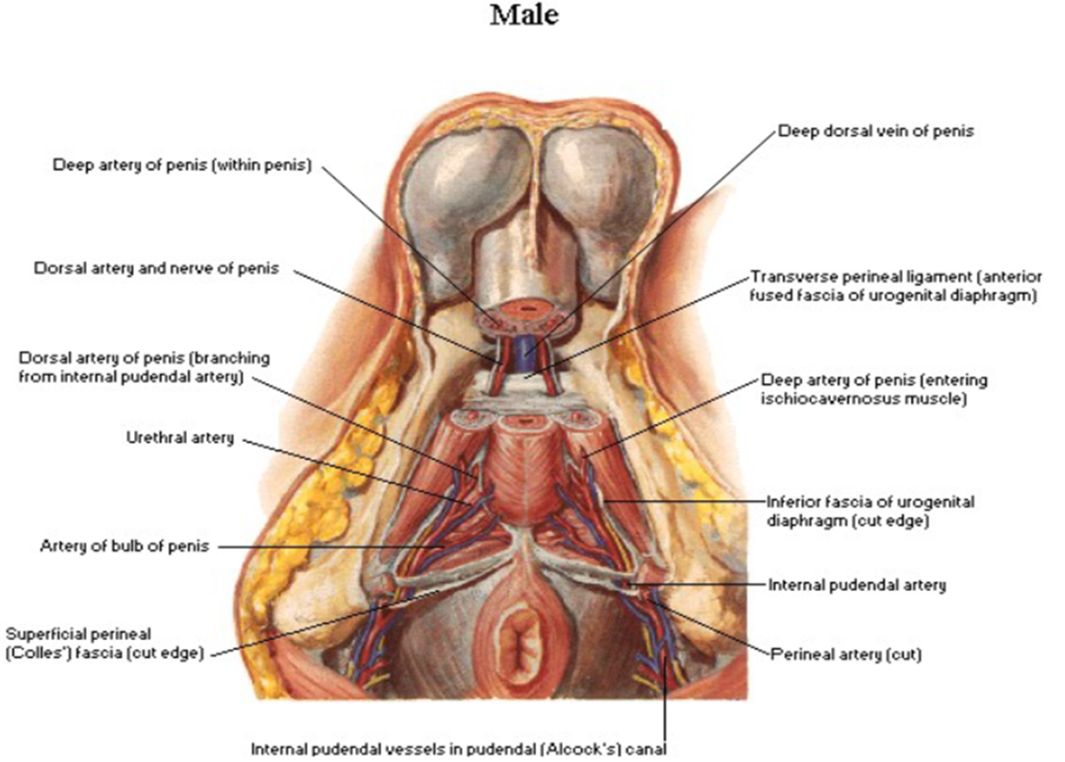
ARTERIAL SUPPLY
Supplied by three paired of arteries which are the terminal branch of internal pudendal artery
  Arteries to Bulb
  Deep artery of penis
  Dorsal artery of penis

Slide 9

VENOUS DRAINAGE
Drained by two sets of unpaired veins
Superficial dorsal vein
  Blood drains from prepuce & the skin of penis
  Finally drains into great saphenous vein
Deep dorsal vein
  Drains blood from glans penis & corpora cavernosa
  Finally drains into prostatic venous plexus

Slide 10
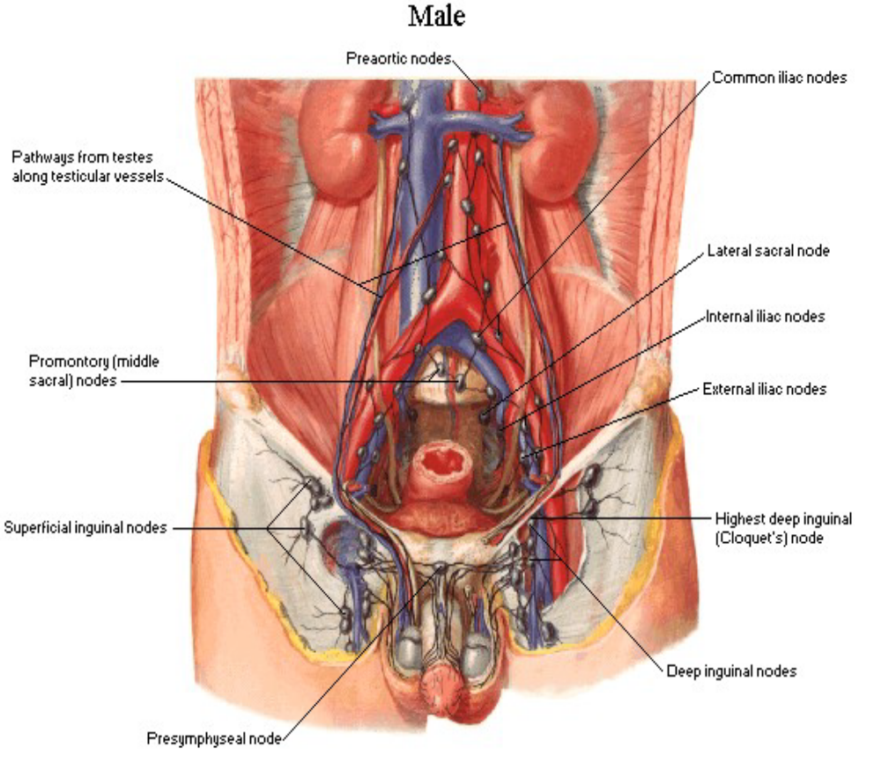
LYMPHATIC DRAINAGE
Skin + prepuce drains into superficial inguinal lymph nodes
Glans penis drains into deep inguinal nodes(gland of Cloquet)
Deeper tissue drain into internal iliac nodes

Slide 11
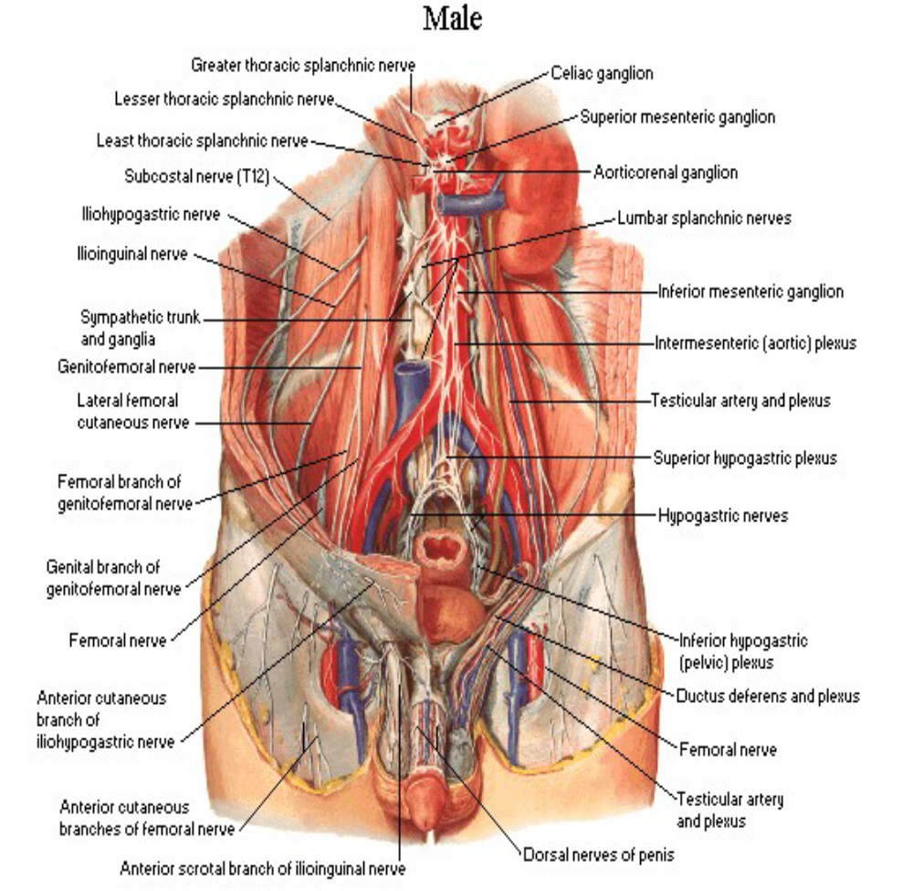
NERVE SUPPLY
Somatic nerve
  Dorsal nerve of penis to skin of the body, prepuce and glans
Autonomic nerve
  Sympathetic nerve
  Derived from superior hypogastric plexus conveying the fibers from L1 segments via pudendal nerve
  vasoconstricter
  Parasympathetic nerve
  Derived from pelvic splanchnic nerve(S2,S3 & S4)
  vasodilator

Slide 12

SCROTUM
Pendulous sac of skin
Hung from medial part of inguinal region of lower abdominal wall
Located between thigh behind the flaccid penis
It houses testes & epididymis along lower part of spermatic cord
It protect the testes from external violence & maintain the temperature which is lower than abdomen

Slide 13
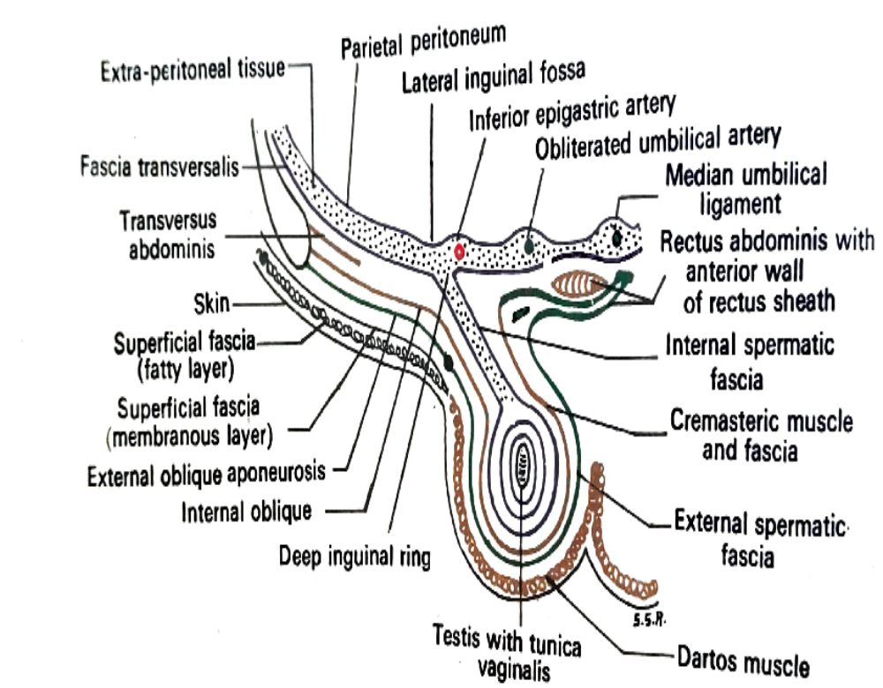
COVERING OF SCROTUM
From outside inwards
Skin
  Thin ,elastic, pigmented & corrugated
  Provided with sebaceous &sweat gland
  After puberty skin present coarse hairs
  Subcutaneous fat is absent
Dartos muscle
  Subcutaneous involuntary muscle
External spermatic fascia
  derived from aponeurosis of external oblique muscle
Cremasteric muscle & fascia
  Derived from internal oblique muscle
Internal spermatic fascia
  Derived from fascia transversalis

Slide 14
BLOOD SUPPLY, NERVE SUPPLY & LYMPHATIC DRAINAGE
BLOOD SUPPLY-
  External pudendal artery
  Posterior scrotal artery
  Cremasteric artery
NERVE SUPPLY-
  Anterior 1/3- by ilioinguinal nerve & genital branch of genitofemoral nerve(L1)
  Posterior 2/3- by posterior scrotal nerve & perineal branch of posterior cutaneous nerve of thigh(S3)
LYMPHATIC DRAINAGE-
  Superfical inguinal lymph nodes

Slide 15
THANK YOU

