Slide 1
MAJOR BLOOD VESSELS
OF
THORAX
Sarangdhar kumar
Assistant professor
Department of Anatomy
Rohilkhand Medical college
Bareilly

Slide 2
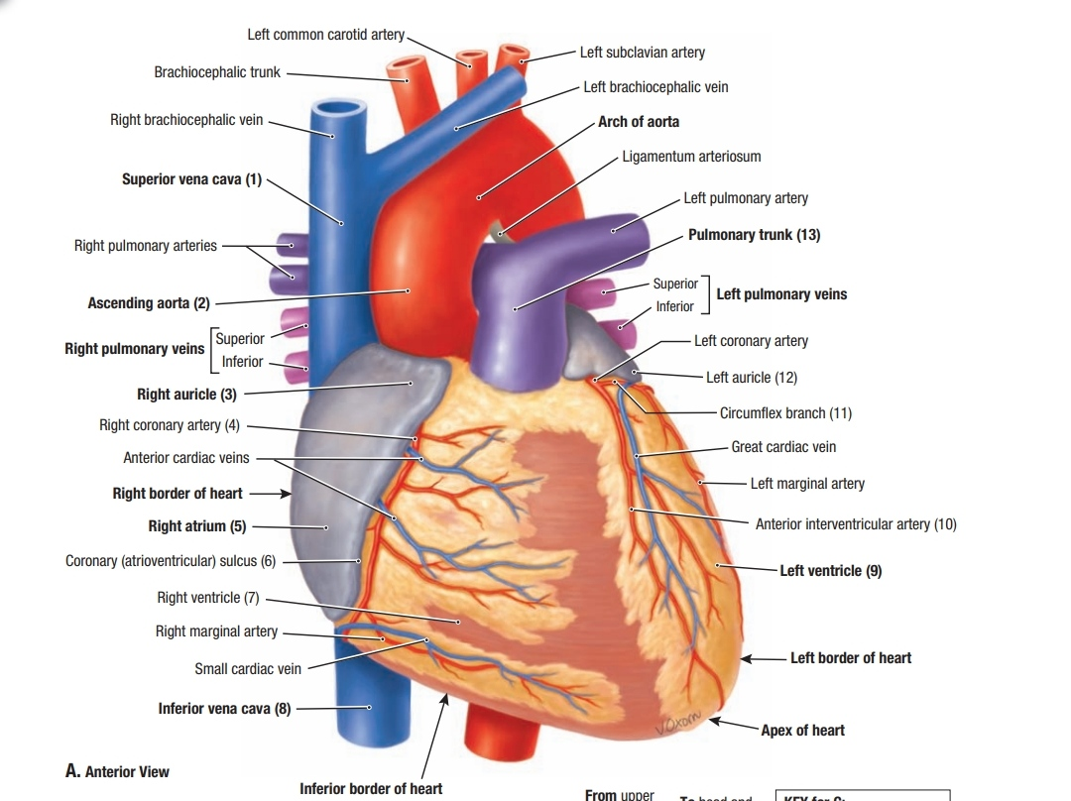
The major blood vessels of thorax are as follows:
    Pulmonary vessels
    Ascending aorta
    Arch of aorta
    Descending aorta
    Superior vena cava
    Azygos system of veins

Slide 3
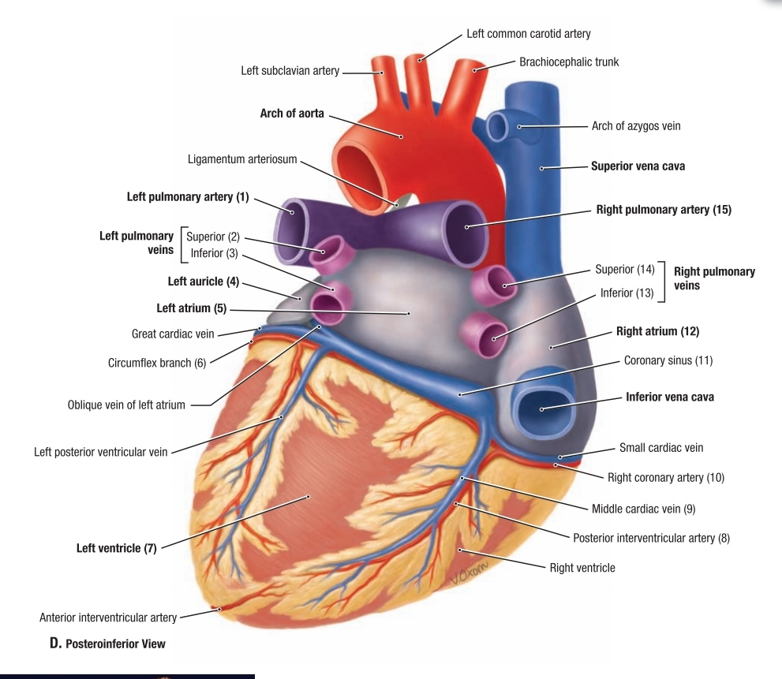
PULMONARY VESSELS
Consists of -
  Pulmonary trunk & its terminal branches
  One pair of pulmonary veins

Slide 4
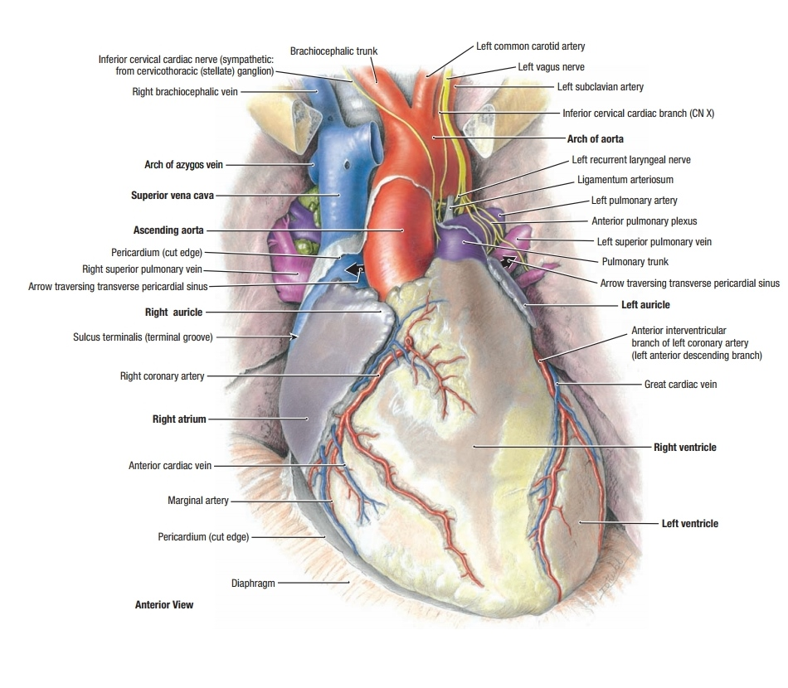
Pulmonary trunk
  Continuation of infundibulum of Rt. Ventricle at pulmonary valve
  5 cm long
  3 cm wide
  Systolic pressure – 15 – 25 mm Hg
  Bifurcation takes place at level of T5

Slide 5

Pulmonary veins –

Slide 6
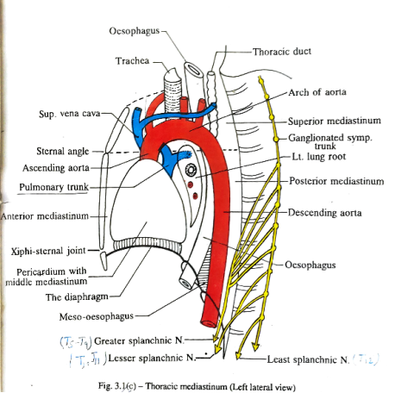
ASCENDING AORTA
Begins from the left ventricle at the level of aortic valve
Continue as arch of aorta at sternal angle
Entirely Intrapericardial
Length – 5 cm
Diameter – 3 cm

Slide 7
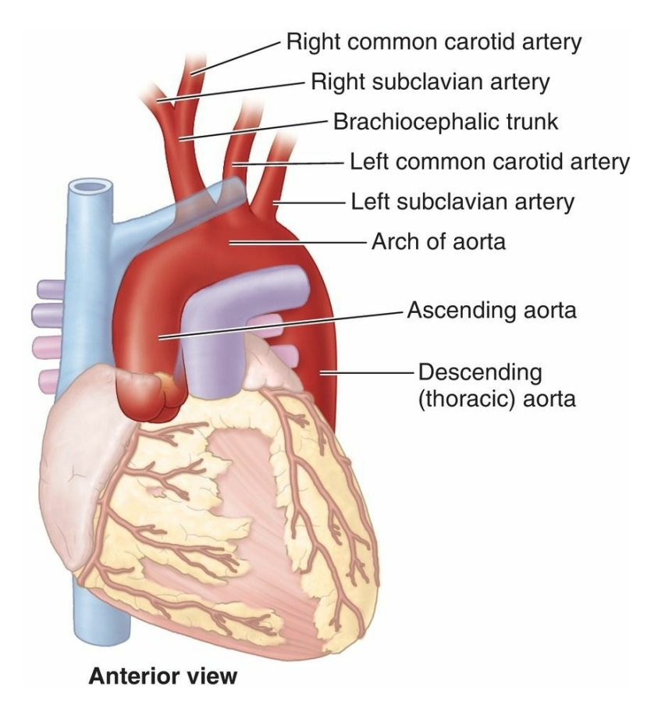
Sinuses of Valsalva –
  Dilatation above the aortic valve in the wall of ascending aorta
  Positions of the dilatation are one anterior & two posterior (right & left)
  Anterior aortic sinus is called right coronary sinus
  Left posterior sinus is called left coronary sinus
  Right posterior sinus is called non coronary sinus

Slide 8
Bulb of ascending aorta
  Dilatation on right side of ascending aorta
  This site is prone to aneurysm

Slide 9
Relations
Anterior –
    Infundibulum
    Right auricle
    Pulmonary trunk
Posterior –
    Transvers sinus of pericardium
Right side –
    SVC
    Right atrium
Left side –
    Pulmonary trunk

Slide 10
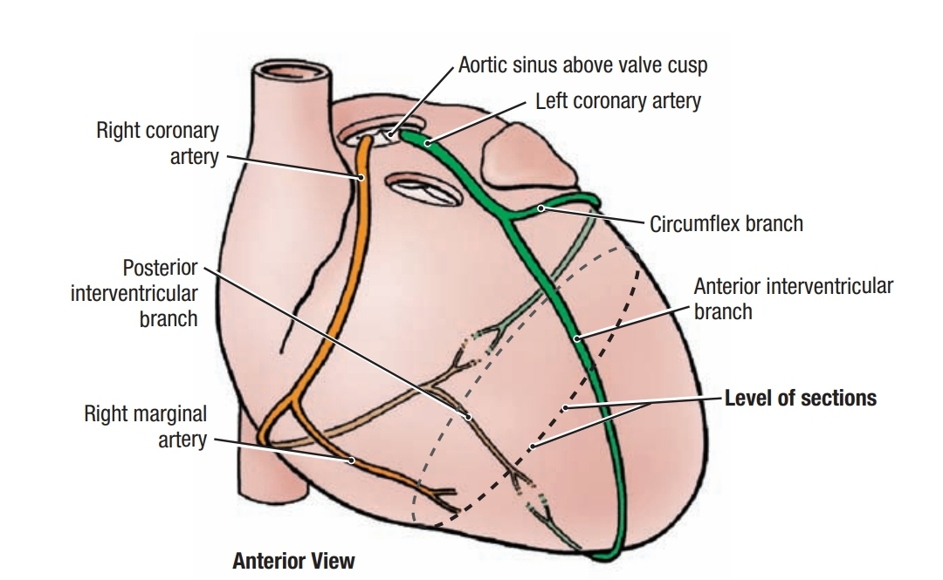
Branches –
  Right coronary artery
  Left coronary artery

Slide 11

ARCH OF AORTA
Begins as continuation of ascending aorta
Terminates as descending thoracic aorta
Both events takes place at sternal angle (T4)
Arch begins anteriorly & it ends posteriorly (very close to left side of 4th thoracic vertebra)
Located in superior mediastinum

Slide 12

Course –
  Begins at the level of upper margin of right 2nd costal cartilage
  Then it turns upwards, backwards & to the left side of trachea
  Then passes downward on the body of T4 & arch over the hilum of left lung
  Continue as descending thoracic aorta

Slide 13
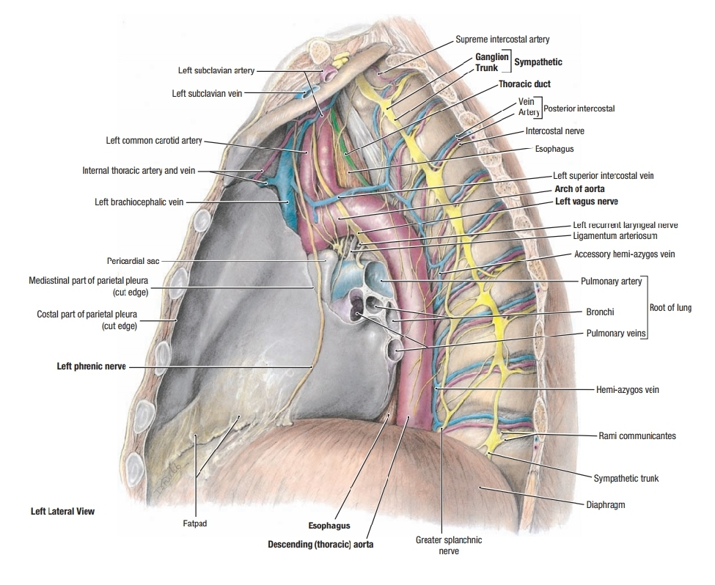
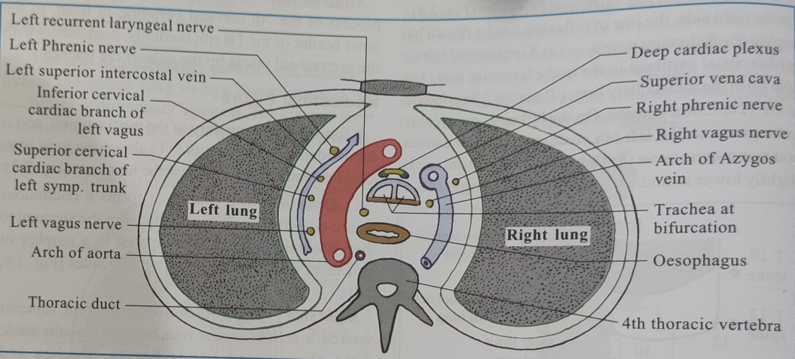
Relations –
Anteriorly & to the left
  4 nerves & 1 vein
    Left phrenic nerve
    Inferior cardiac branch of left vagus
    Superior cardiac branch of left sympathetic chain
    Left vagus
    Left superior intercostal vein
Posteriorly & to the right
    Lower end of trachea
    Left recurrent laryngeal nerve
    Oesophagus
    Thoracic duct
    4th thoracic vertebra
Superiorly
    Branches of arch of aorta
Inferiorly
    Bifurcation of pulmonary trunk
    Left bronchus

Slide 14
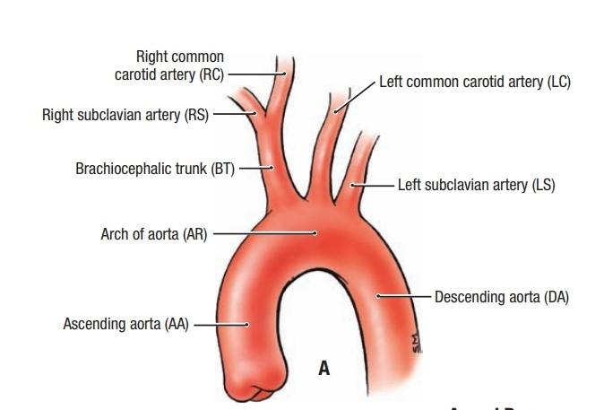
Branches –
    Brachiocephalic trunk
    Left common carotid artery
    Left subclavian artery
    Thyroidea ima artery(occasionally)

Slide 15
Arterial supply –
  Outer part of wall - by vasa vasora
  Inner part of wall – by blood inside the lumen

Slide 16

DESCENDING THORACIC AORTA
Located in posterior mediastinum
Extend – T4 to T12 vertebra
At the T12 it is continue as abdominal aorta by passing through aortic opening of diaphragm

Slide 17
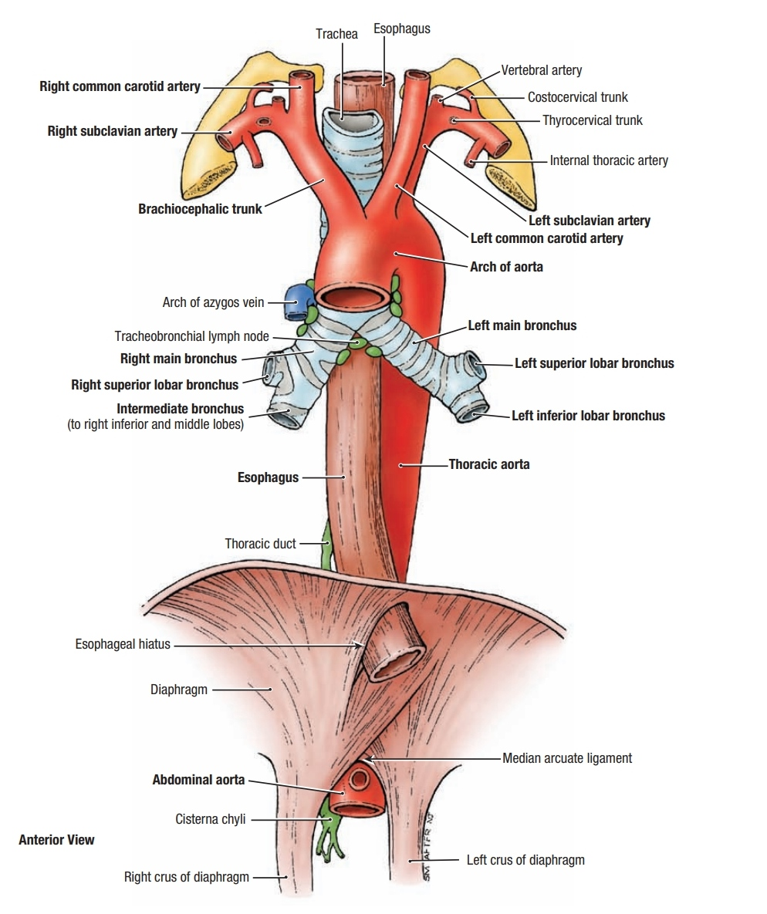
Relations –
Anterior
  Left lung root
  Pericardium
  Oesophagus
  diaphragm
Posterior
  Vertebral column
  Hemiazygos veins
Right side
  In upper part – oesophagus,thoraic duct & azygos vein
  In lower part – right lung & pleura
Left side
  Deep groove on mediastinal surface of left lung

Slide 18
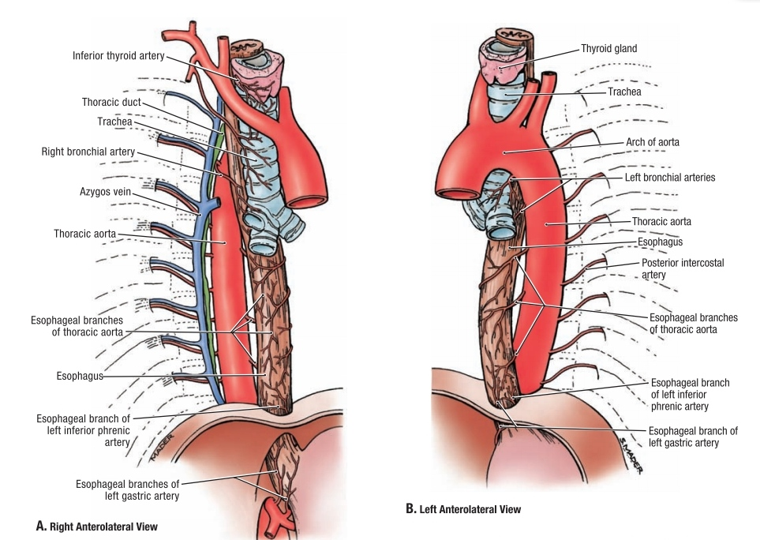

Slide 19
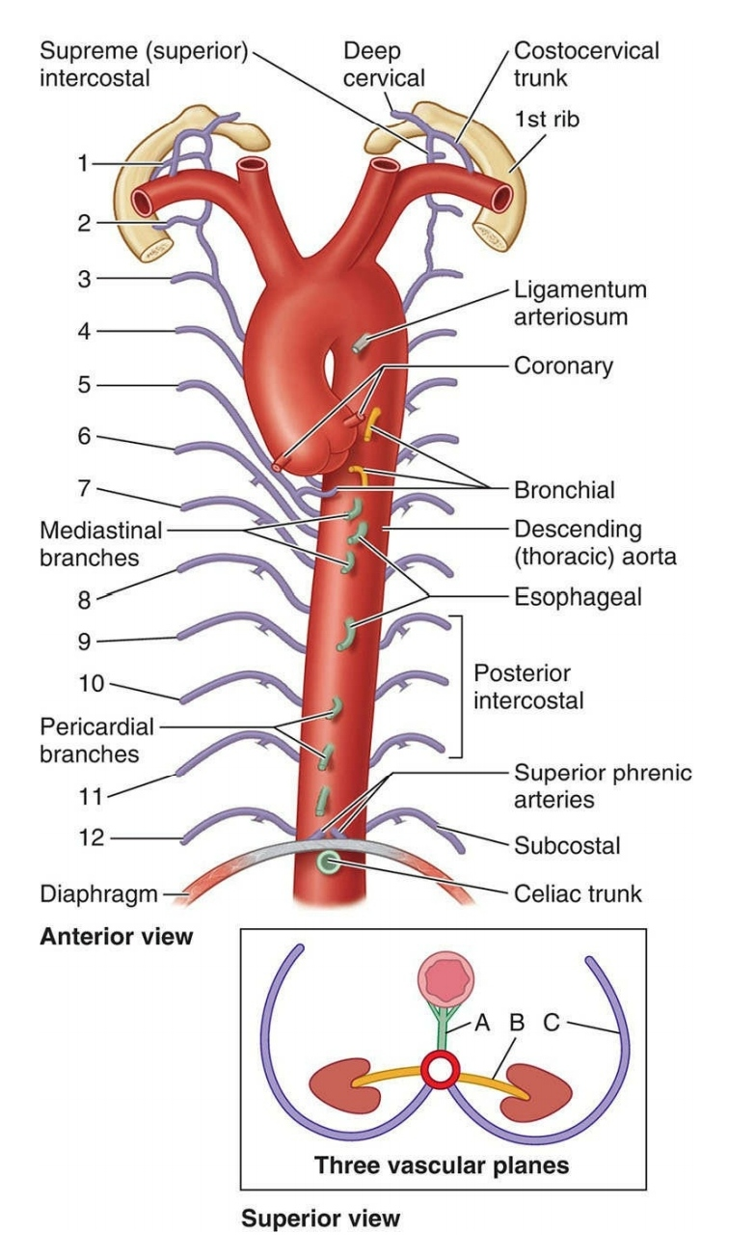
Branches –
Visceral branches
  Pericardial
  Esophageal
  Mediastinal
  Left bronchial
Parietal branches
  Posterior intercostal arteries (3 – 11)
  Subcostal artery
  Superior phrenic artery

Slide 20
SUPERIOR VENA CAVA
Formation
    It is formed by union of right & left brachiocephalic veins
    Behind the lower border of rt. first costal cartilage
It drains the blood from
    Head & neck
    Upper limbs
    Wall of thorax
    Upper abdomen
No valves
Length – 7 cm
Width – 2 cm
Parts –
    Extrapericardial part
    Intrapericardial part

Slide 21
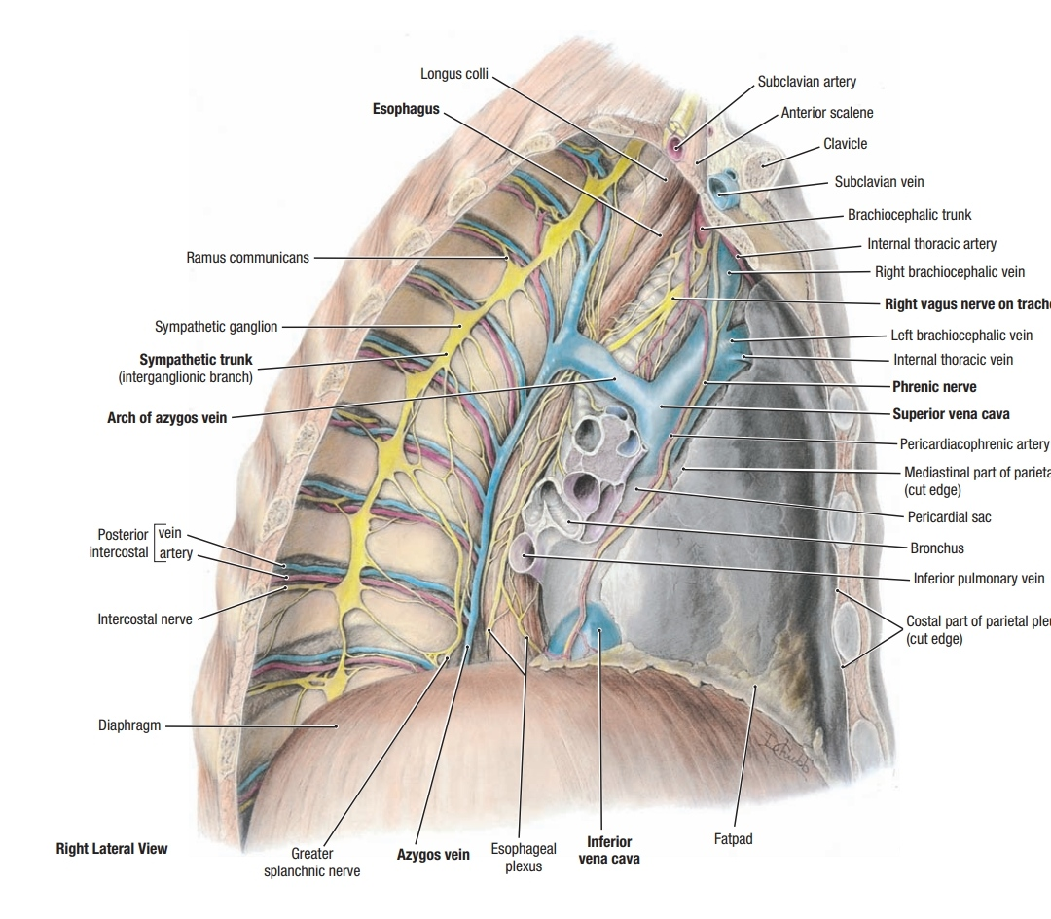
Course –
  It passes vertically downwards
  Behind the rt. 1st & 2nd intercostal spaces
  Pierces the fibrous pericardium to open into rt. Atrium at the level of 3rd costal cartilage
  Azygos vein opens Just before pierces the fibrous pericardium

Slide 22

Relations
Infront
  Right lung & pleura
  Right internal thoracic vessels
  1st & 2nd intercostal space
Behind
  In upper part
    Trachea & right vagus
    Right lung covered by mediastinal pleura
  In lower part
    Root of right lung
Right side
  Right lung & pleura
  Right phrenic nerve
  Pericardiophrenic vessels
Left side
  Brachiocephalic trunk(upper part)
  Ascending aorta (lower part)

Slide 23
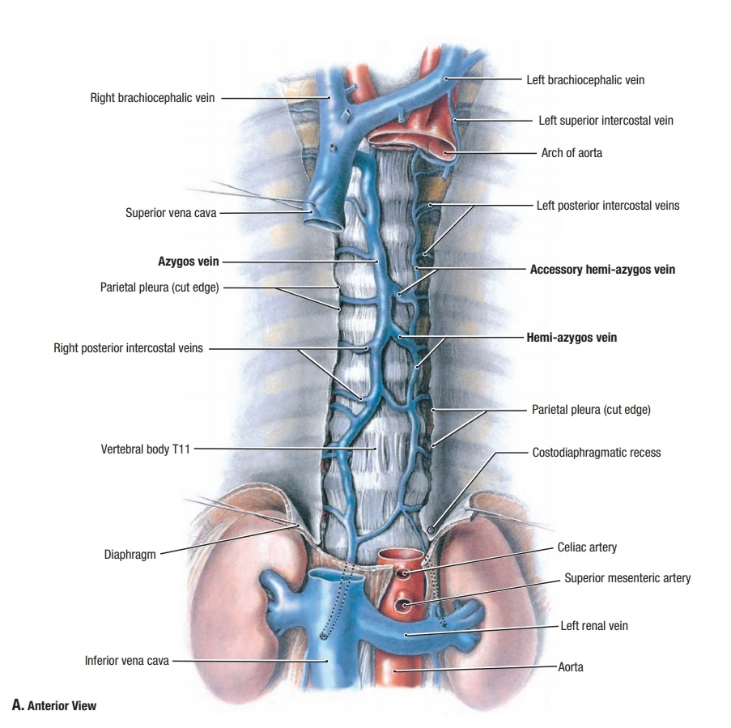
Tributaries
    Right & left brachiocephalic veins
    Azygos vein
    Pericardial veins
    Mediastinal veins

Slide 24

AZYGOS SYSTEM
It consists of –
  Azygos vein
  Inferior Hemiazygos vein
  Superior Hemiazygos vein

Slide 25
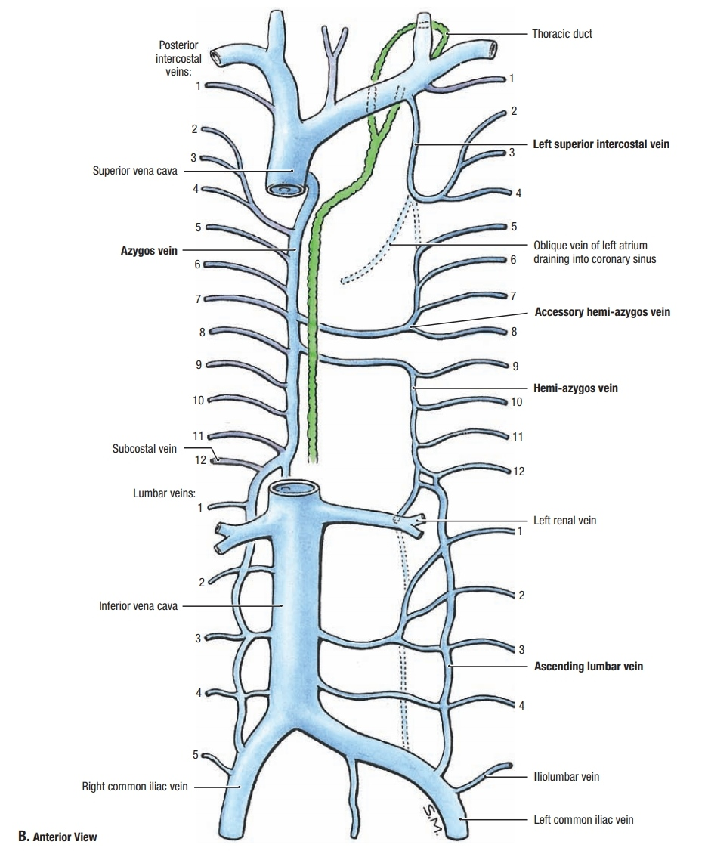
Azygos vein
Means single or without companion
Present on right side only
Provided with the valves
It passes through two regions-
  Posterior abdominal wall
  Posterior mediastinum

Slide 26
Formation –
  It is a continuation of lumbar azygos vein
Or
  Union of right ascending lumbar and right subcostal veins
  Exit from abdomen - aortic opening of diaphragm

Slide 27

Courses –

Slide 28
Relations
Infront
  Diaphragm
  Fibrous pericardium
  Oblique pericardial sinus
  Root of right lung
Behind
  Lower eight thoracic vertebrae
  Right posterior intercostal vessels
Right side
  Greater splanchnic nerve
  Right lung & pleura
Left side
  Thoracic duct
  Descending thoracic aorta
  Right vagus
  Right edge of oesophagus

Slide 30

Tributaries
  Right superior intercostal vein
  Right posterior intercostal vein from 4th space downward
  Right subcostal vein
  Right ascending lumbar vein
  Hemiazygos vein
  Accessory Hemiazygos vein
  Right bronchial vein (usually last tributary)
  Esophageal vein
  Pericardial vein
  Mediastinal vein

Slide 31

HEMIAZYGOS VEIN
ACCESSORY HEMIAZYGOS VEIN

