Slide 1
LUMBAR VERTEBRAE
Sarangdhar kumar
Assistant professor
Department of Anatomy
Rohilkhand Medical College
Bareilly

Slide 2
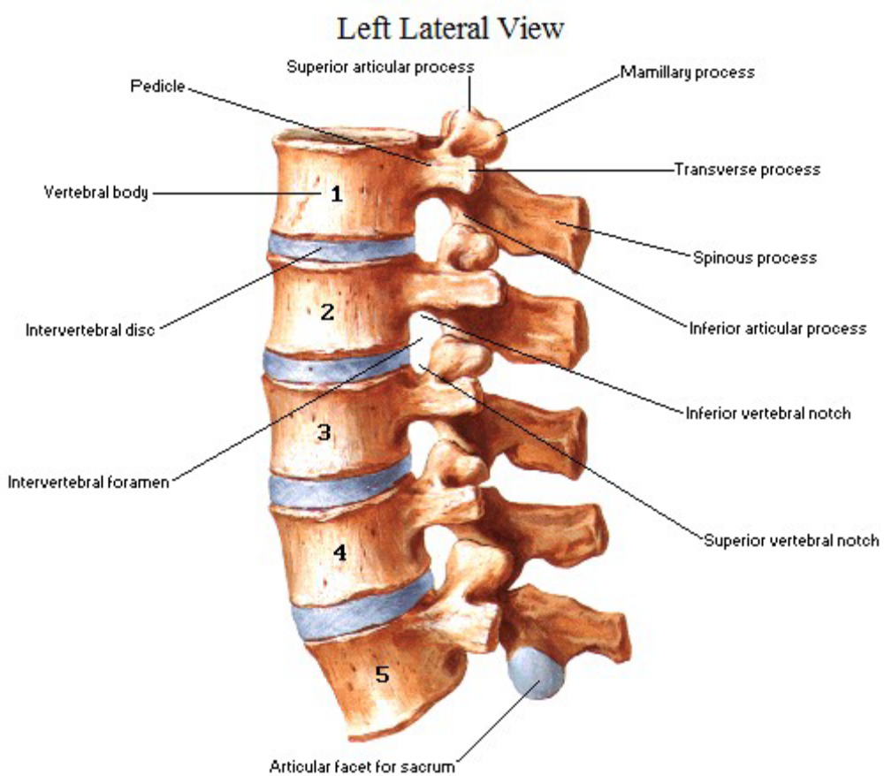
Lumbar vertebrae are identified by-
    Massive body
    Mamillary & accessory tubercle on their vertebral arches
    Absence of costal facets on body
    Absence of foramen transversarium
5 in number
    Typical – L1 to L4
    Atypical – L5

Slide 3
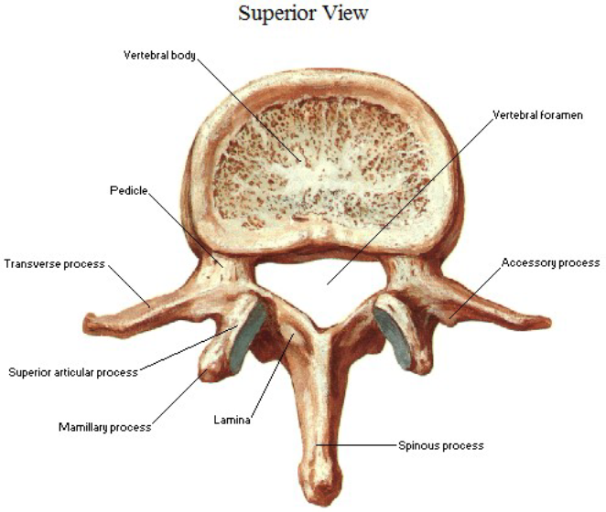
Parts –
  Body
  Vertebral arch
    Consists of –
      pair of pedicles
      Pair of lamina
      Seven processes
  Vertebral foramen
    Large & triangular

Slide 4

Body
  Very large
  Reniform shape
  Transmits the body weight
  Presents four surfaces
    Superior
    Inferior
    Anterior
    Posterior

Slide 5
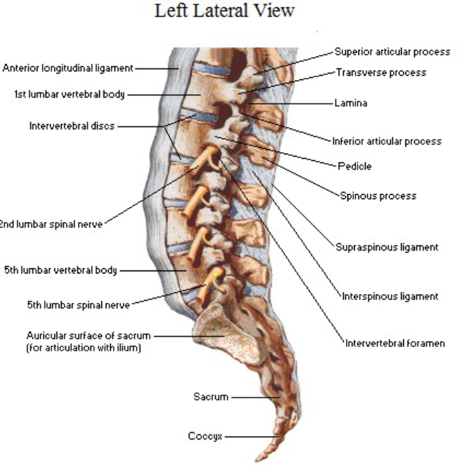
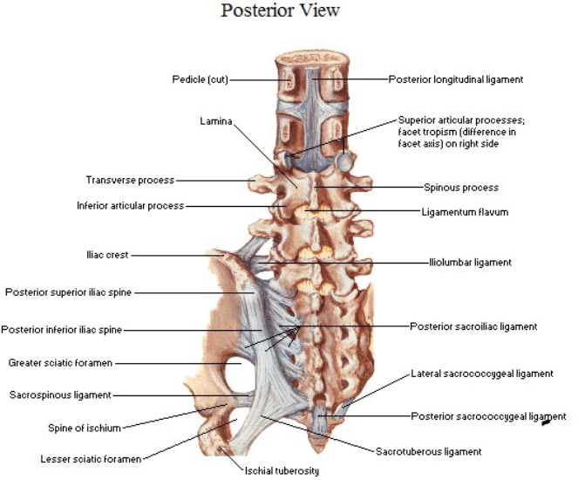

Slide 6
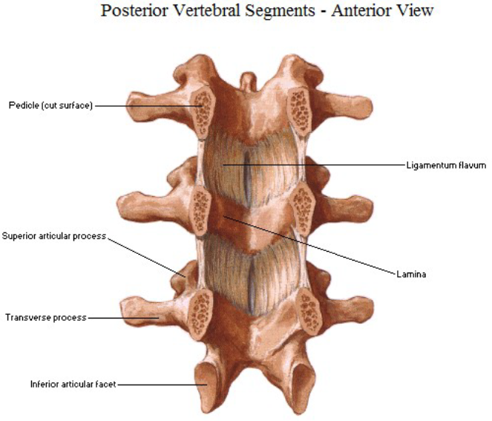
Vertebral arch
Pedicle -
  Arises from posterolateral part of the body
  Presents superior & inferior vertebral notch
Lamina –
  Arises from dorsal end of pedicle
  Passes backward & medially
  Fuse with the opposite side of lamina in mid line

Slide 7
Transverse process –
  Slender except in 5th lumbar vertebra
  Postero- inferior part of root of TP presents elevation , accessory process
  Presents two surfaces & tip
    Anterior surface
      Medial part – psoas major
      Lateral part – quadratus lumborum
      Vertical ridge – anterior layer of thoracolumbar fascia
    Posterior surface
    Tip – middle layer of thoraco- lumbar fascia

Slide 8
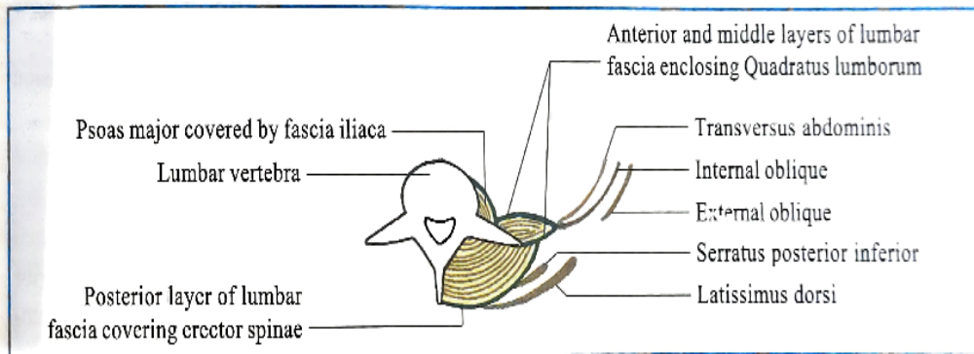

Slide 9
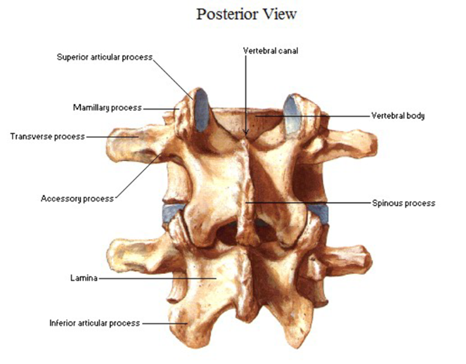

Pair of superior articular process –
  Presents articular facet
    Concave
    Directed backwards & medially
    Posterior margin presents rough elevation, mamillary process
Pair of inferior articular process –
  Presents inferior articular facet
    Convex
    Directed forward & laterally

Slide 10
Unpaired spinous process –
  Broad
  quadrilateral
  Horizontally backward in direction
  Thick along posterior & inferior borders
  Connected to one another by interspinous & supraspinous ligament
  Provide attachment to posterior layer of thoraco-lumbar fascia & deep muscle of back

Slide 11
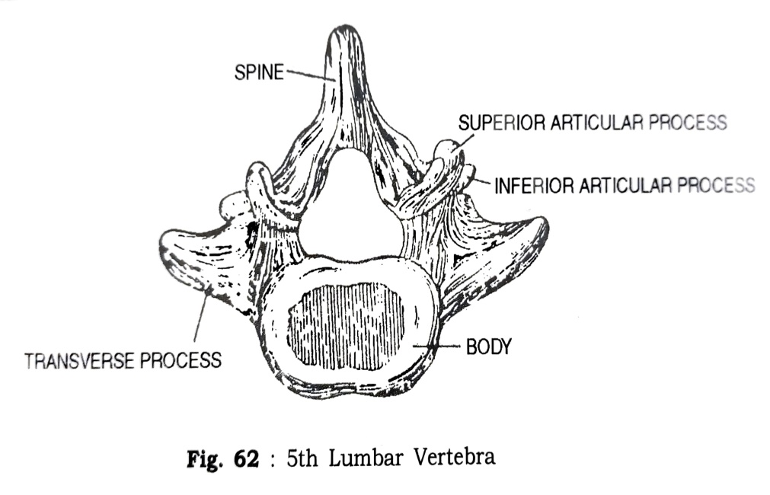
Atypical lumbar vertebra (L5) –
  Anterior surface of body of 5th lumbar is more extensive than posterior surface
    Sacro-vertebral angle – 120 (Normal adult)
  TP are substantial & encroach on side of the body
  Distance b/w two superior articular process is almost equal with inferior articular process
  Tip of TP of L5 vertebra provide attachment to two ligaments
    Iliolumbar ligament
    Lumbosacral ligament

Slide 12
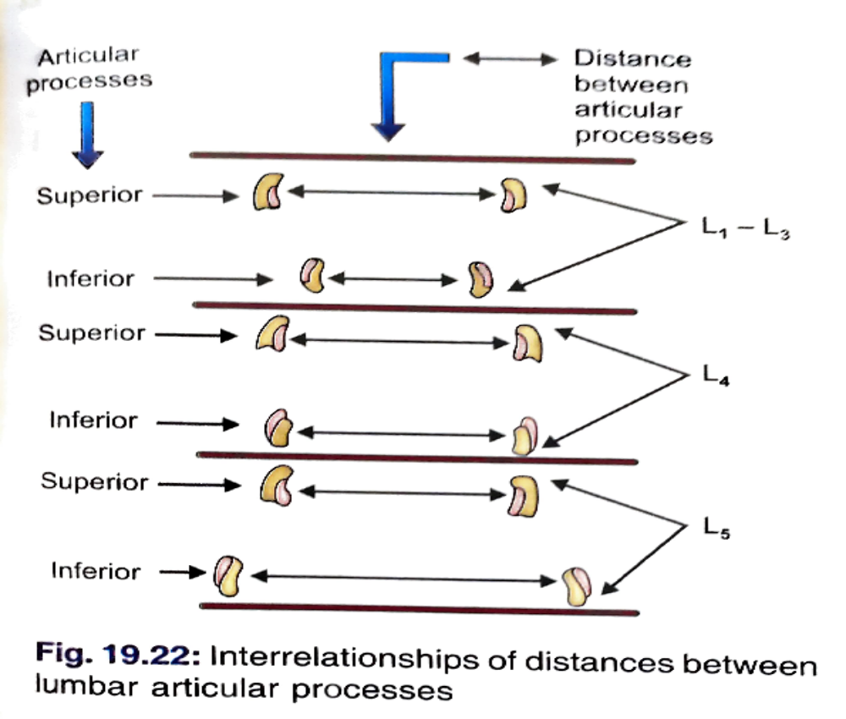

Slide 13
Thank you

Slide 14



Slide 15
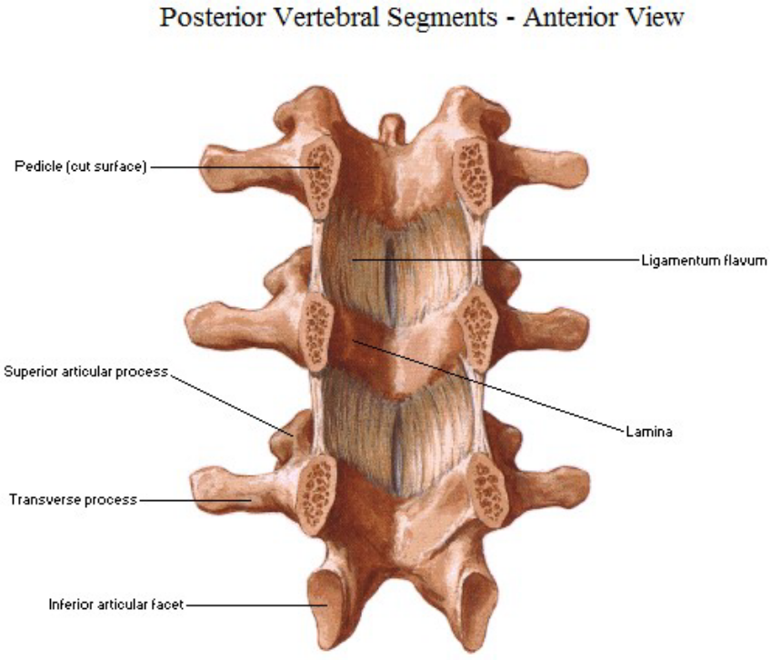
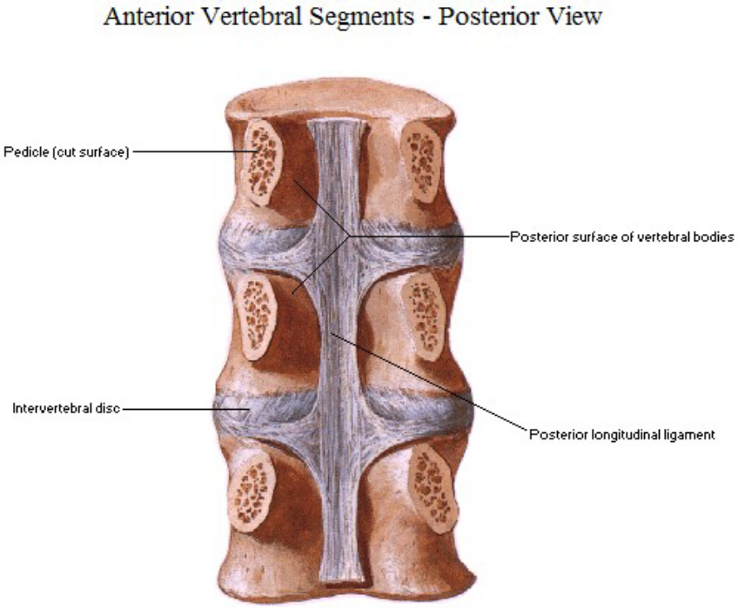

Slide 16


