Slide 1
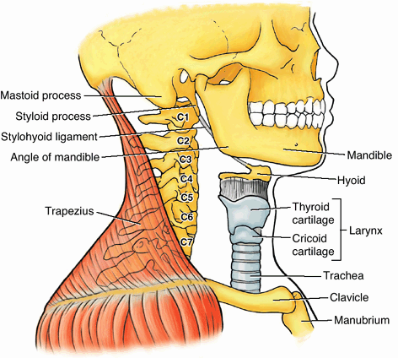
LARYNX
SARANGDHAR KUMAR
DEPARTMENT OF ANATOMY ROHILKHAND MEDICAL COLLEGE BAREILLY

Slide 2
◻ To know about the extent of larynx
◻ To know about the structure of the larynx
◻ To describe the cavity of larynx including Rima vestibuli & Rima glottidis (glottis)
◻ To know about the ligaments, joints & muscles of larynx
◻ To know about nerve supply, blood supply & lymphatic drainage

Slide 3
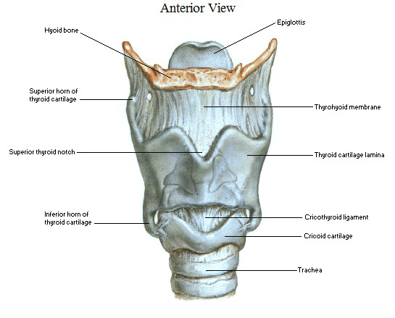
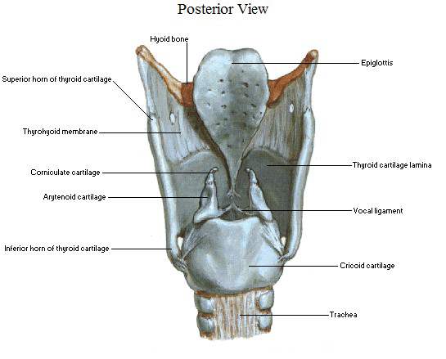
Larynx –
  An organ of respiration & phonation
  It protects the lower respiratory passes
  Acts as a ‘watch-dog’ to prevent entry of any materials other than air
  Above it communicates with laryngo-pharynx & below with trachea
Extent-
  From upper border of epiglottis to lower border of cricoid cartilage
  It lies opposite to
    In adult- C3 to C6 vertebrae
    In children- C1 to C4 vertebrae
C3
C6

Slide 4
Measurements
In male
Vertical- 44 mm
Transverse- 43mm
Antero-posterior- 36mm
In female
Vertical- 36mm
Transverse- 41mm
Antero-posterior- 26mm

Slide 5

Structure of larynx
It composed of nine cartilages
Connected to one another by –
  Ligaments
  Synovial joint,
  Intrinsic muscle,
  Cricovocal & Quadrate membrane
Lined internally by mucous membrane

Slide 6
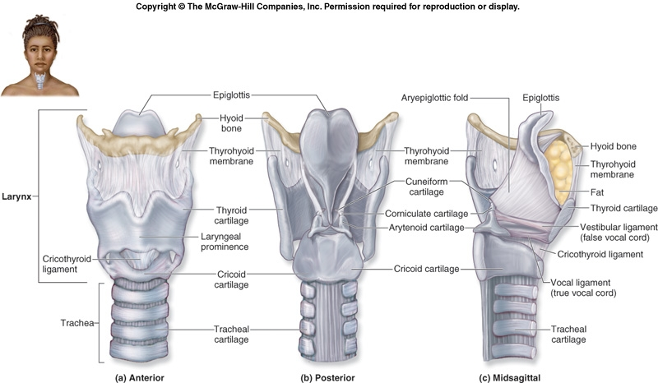
Structure of larynx ….

Slide 7
Cartilage of larynx
All laryngeal cartilages are hyaline in structure, except
  Epiglottis
  Corniculate
  Cuneiform
  Vocal process & apex of arytenoid
9 Cartilages
3
Unpaired
Epiglottis
Thyroid
Cricoid
3
Paired
Arytenoid
Corniculate
Cuneiform

Slide 8
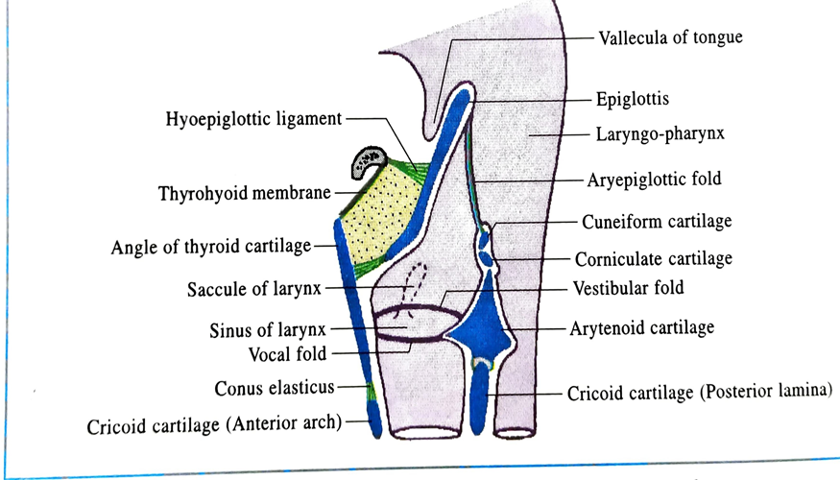
Epiglottis cartilage
  Leaf shaped cartilage
  Placed obliquely behind the hyoid bone in anterior wall of upper part of larynx
  Upper end is broad and free and projects upward behind hyoid bone and tongue
  Lower end is pointed and is attached to back of thyroid cartilage by thyro-epiglottic ligament
  Anterior surface is covered with mucous membrane and connected with base of tongue & hyoid bone by glosso-epiglottic fold & hyo-epiglottic ligament
  Posterior surface covered with mucous membrane
  Lateral border is free in upper part but lower part provide the attachment of aryepiglottic fold

Slide 9
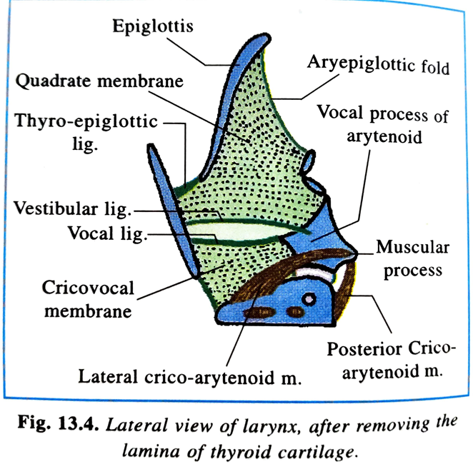
Thyroid cartilage
V shaped ,lies opposite to C4 & C5 vertebrae
Having two lamina- right and left lamina
Anterior border- Lower part of anterior border of right and left lamina fuse and form a median projection called laryngeal prominence
(ADAM’S APPLE)
Upper part of anterior border are separated by thyroid notch
Posterior surface of anterior border gives attachment to following structures -
  Thyro-epiglottic ligament
  Vestibular ligament
  Vocal ligament
  Three intrinsic muscles

Slide 10
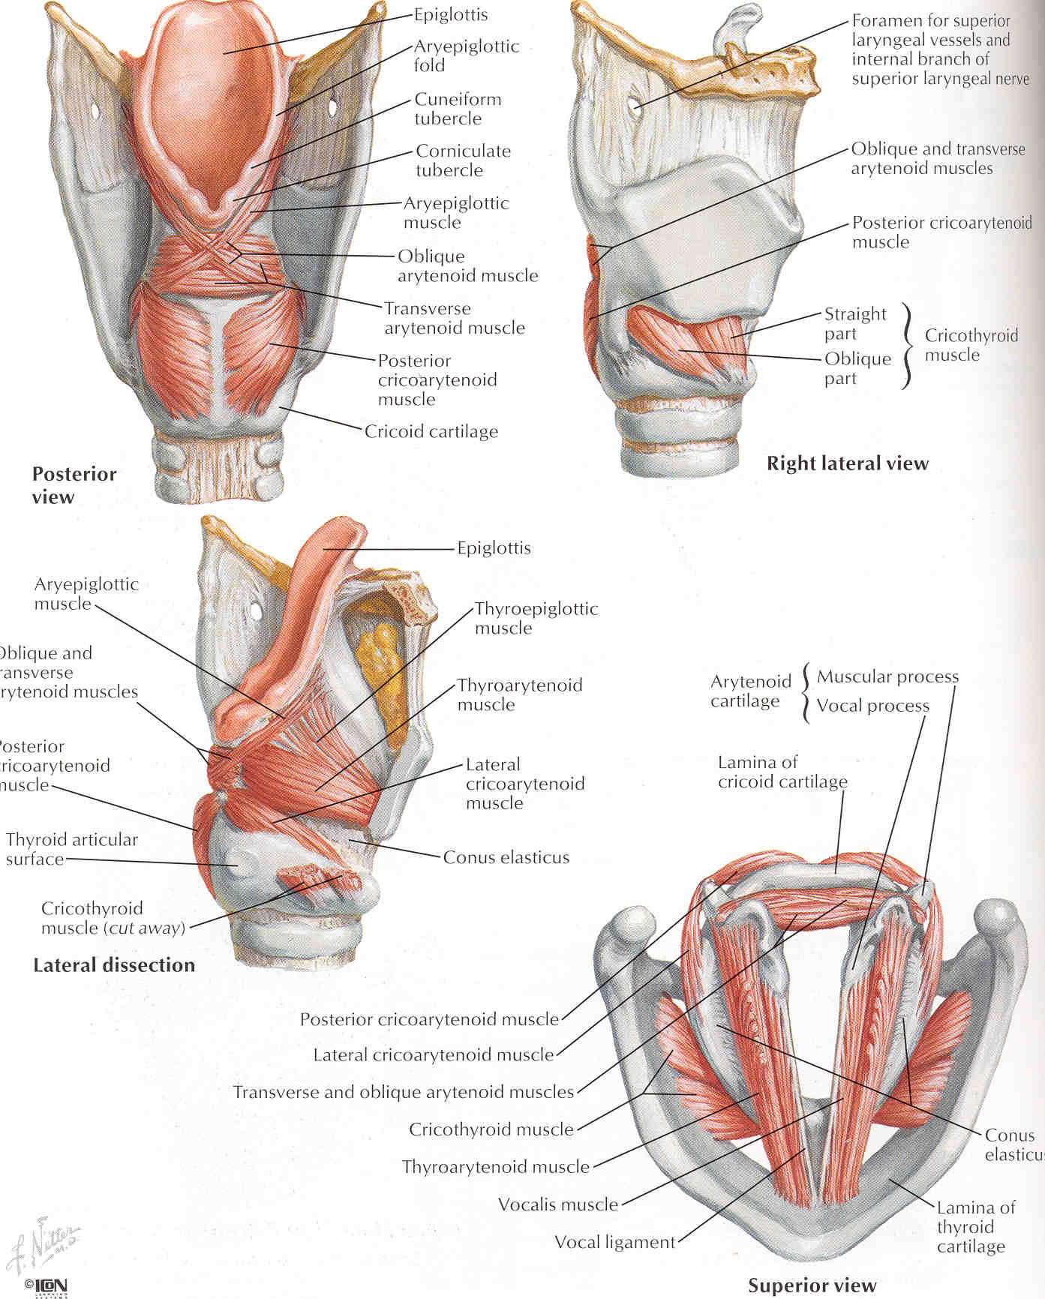
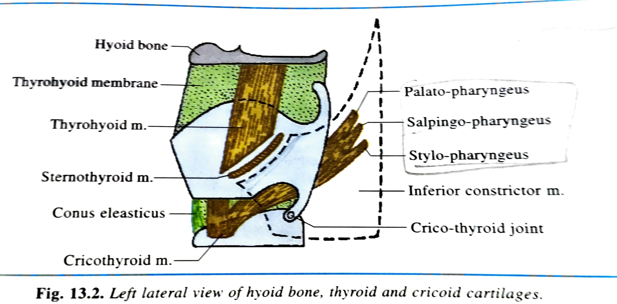
Posterior border - free and prolonged upward and downward as superior and inferior horns
  Superior horn articulate with hyoid bone by lateral thyro-hyoid membrane
  Inferior horn articulate medially with cricoid cartilage and forming synovial crico-thyroid joint
Upper border – convexo- concave from before backward
Lower border – straight in front and concave behind
Outer surface- has an oblique line that gives attachment to sternothyroid, thyrohyoid, inferior constrictor
Inner surface – covered with mucous membrane

Slide 11



Slide 12
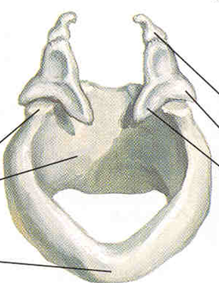
Cricoid cartilage
Shaped like a ring
Lies at the level of C6 vertebrae
Ring has a narrow anterior part called arch and a broad posterior part called lamina
Lamina articulates superiorly with arytenoid cartilage
Arch- presents two borders & two surfaces
  Upper border- Crico-arytenoideus muscle
Crico-vocal membrane
  Lower border- 1st cartilaginous ring of trachea by crico-tracheal ligament
  Inner surface- lined by ciliated columnar epithelium
  Outer surface- Crico- thyroid muscle
Inferior constricter
arytenoid
Lamina
Arch
cricoid

Slide 13
Lamina- quadrilateral, Presents two borders & two surfaces
  Upper border- Articulate with arytenoid cartilage & forming crico-arytenoid joint
  Lower border- Trachealis muscle
  Anterior surface- lined by ciliated columnar epithelium
  Posterior surface-
  Tendon of oesophagus
  Posterior crico-arytenoid muscle
  Lined by stratified squamous epithelium

Slide 14
Arytenoid cartilages
  Pyramid shaped lying on upper border of cricoid lamina
  It presents apex, base, three surfaces & two processes
  Apex articulates with Corniculate cartilage
  Prolonged anteriorly to form vocal process and laterally to form muscular process
Corniculate cartilages
  Two small conical nodules lying on apex of arytenoid cartilage
Cuneiform cartilages
  Two small rod shaped cartilage placed in aryepiglottic fold just ventral to Corniculate cartilage

Slide 15
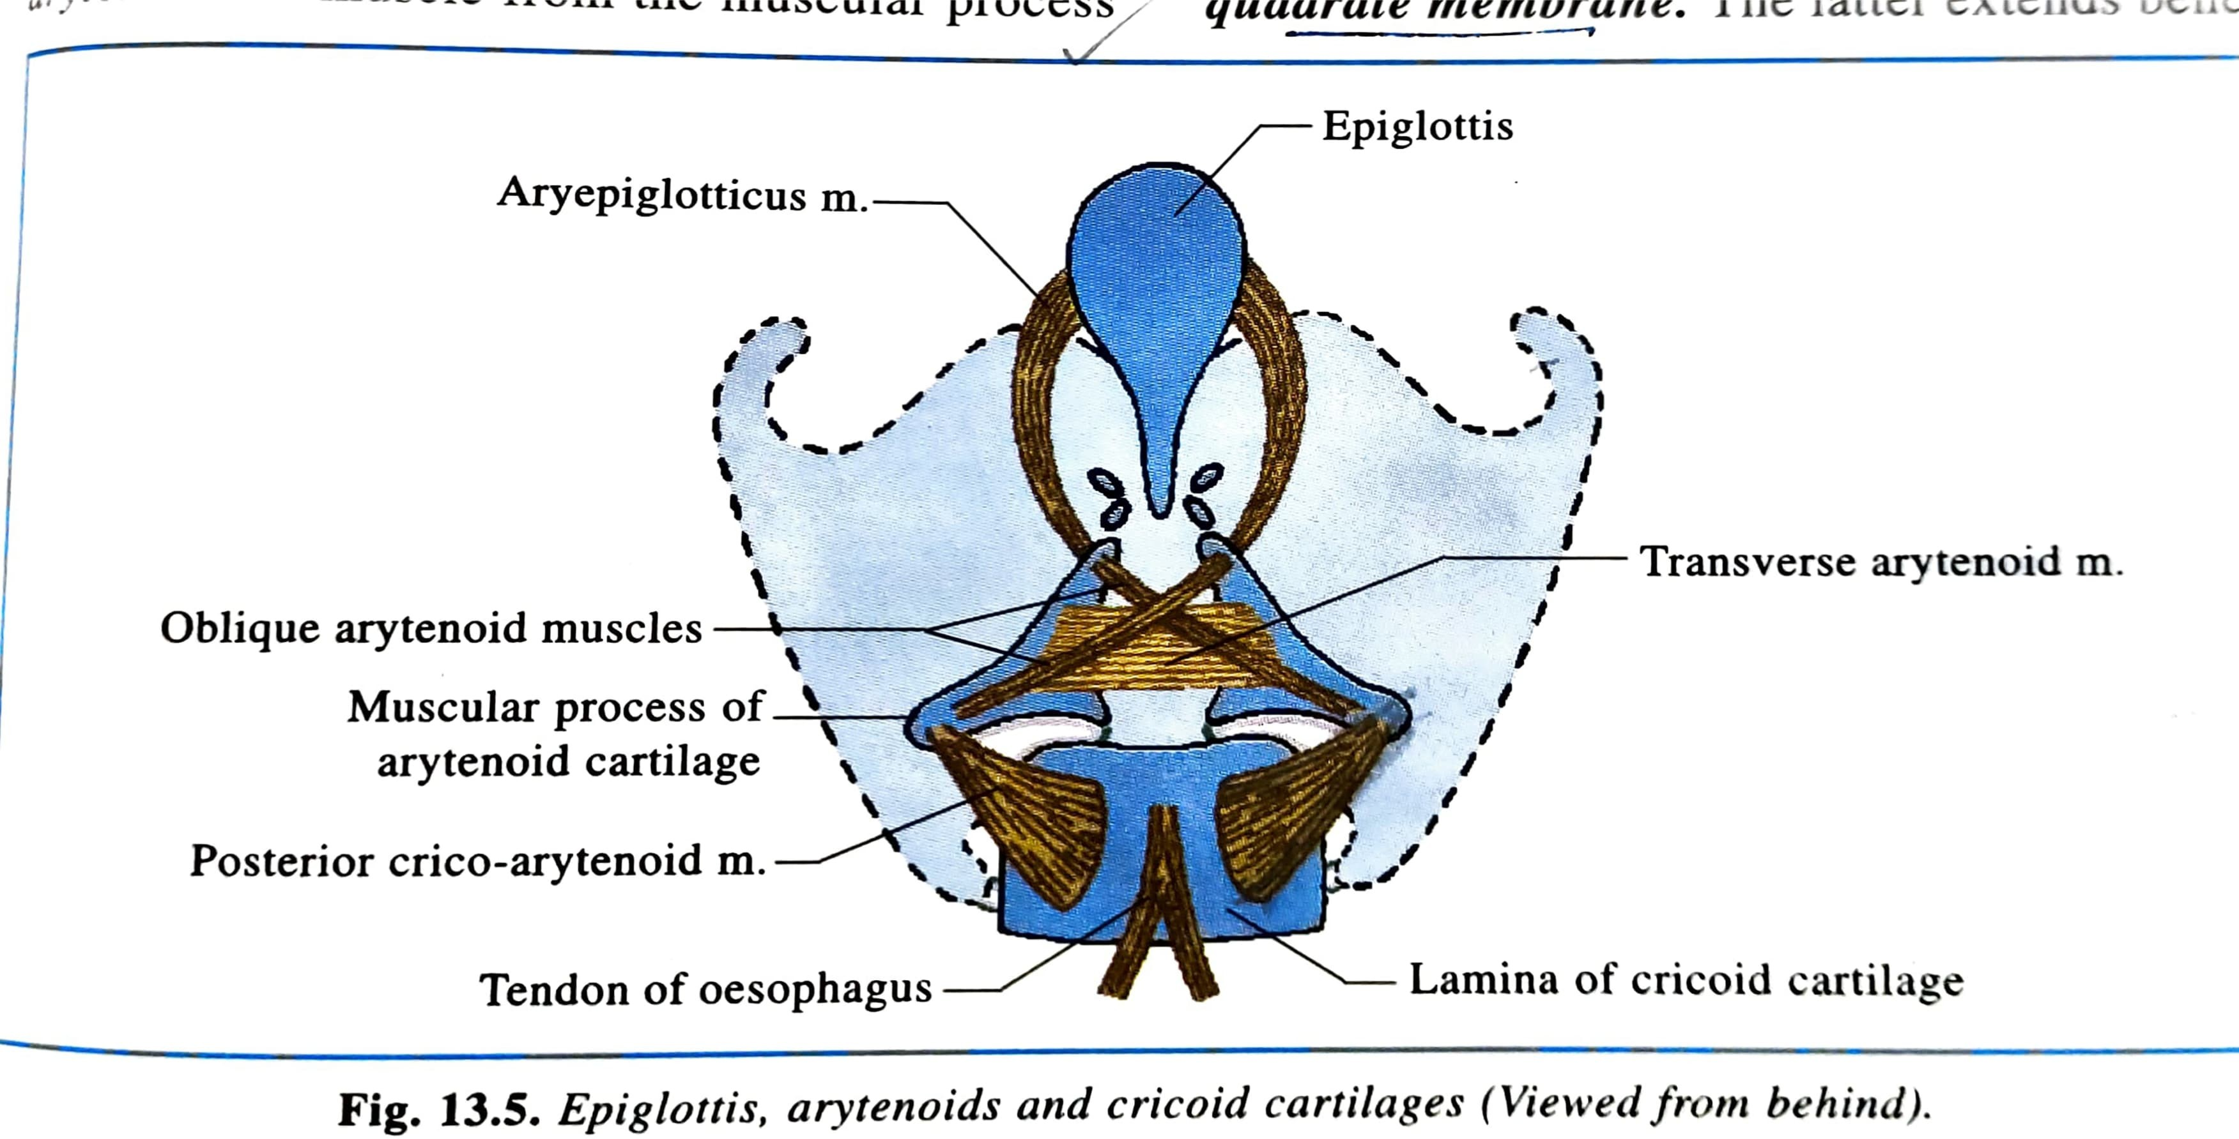

Slide 16
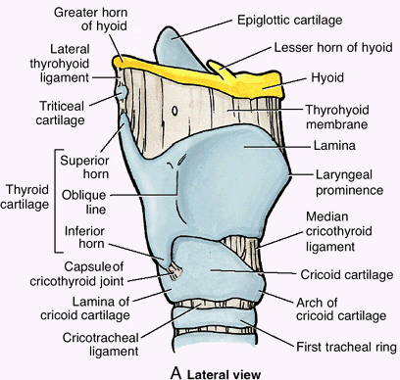
Laryngeal ligaments and membranes
Extrinsic ligament
  Thyrohyoid membrane
  Hyo-epiglotic ligament
  Crico-tracheal ligament
  Median cricothyroid ligament

Slide 17
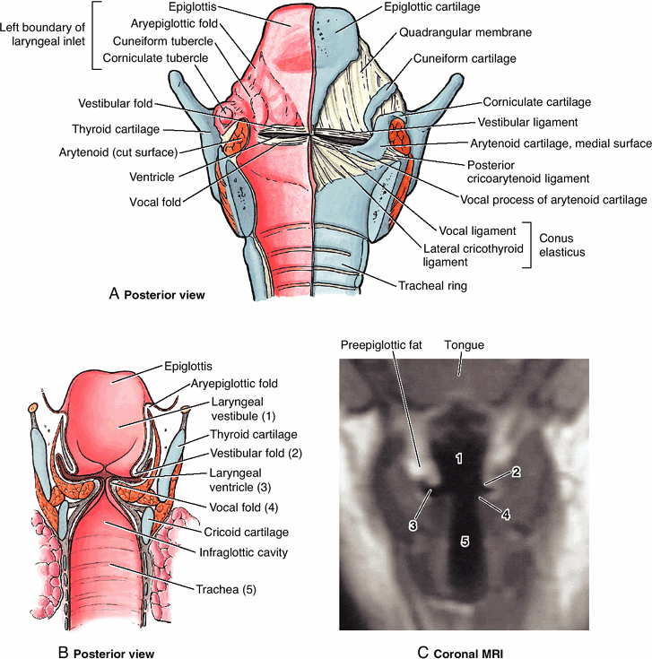

Intrinsic ligament
  Formed by sub mucosal broad sheet of fibro-elastic tissue
  Interrupted on each side by (ventricle) sinus of larynx
  Part of membrane above sinus is known as quadrate membrane, and part below sinus is called crico-vocal membrane
  Lower end of quadrate membrane is called vestibular ligament (fold)
  Upper end of crico-vocal membrane is called vocal ligament (fold)

Slide 18
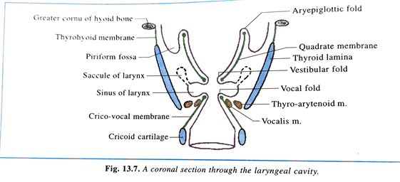
Cavity of the larynx
Space between vestibular fold is called rima vestibuli, whereas space between vocal fold is called rima glottidis
Vestibular and vocal fold divide the cavity of larynx into 3 parts
Part above vestibular fold –vestibule
Part between vestibular and vocal fold -sinus (ventricle) of larynx
Part below vocal fold -infraglottic part
Anterior part of sinus prolonged upward between vestibular fold and lamina of thyroid cartilage called saccule of larynx
Saccule contain mucous gland which help to lubricate vocal fold

Slide 19
Rima vestibulli-
  Space between two vestibular fold
  Lined by ciliated columnar epithelium
  Contains sub -mucous areolar tissue & vestibular ligament
Functions
  It permits air entry in inspiration & prevents air exit in expiration ,it acts as exit valve
  Holding of breadth at the end of inspiration

Slide 20
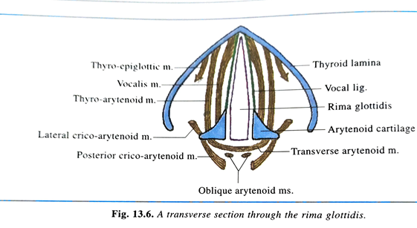
Rima glottidis
  Narrow antero-posterior cleft
  Lined by non keratinized stratified epithelium
  Devoid of sub mucous coat
Sagittal diameter-
  In male- 23 mm
  In female- 17 mm
Boundaries-
  In front- angle of thyroid cartilage
  Behind- inter arytenoid mucous fold
  each side-
    upper 3/5th – vocal fold
    lower 2/5th - vocal process of arytenoid cartilage
Subdivision of Rima glottidis
  Inter membranous part in anterior 3/5th, between vocal fold
  Inter cartilaginous part in posterior 2/5th , between arytenoid cartilage

Slide 21
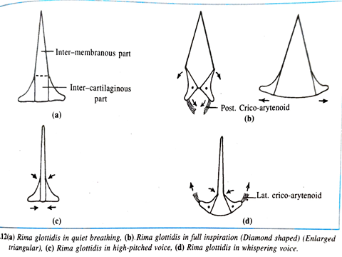
Shape of Rima glottidis
In normal breathing-
  Inter membranous part- triangular shape
  Inter cartilaginous part- rectangular in shape
In full inspiration- diamond shaped
In high pitch sound-
  linear chink
In whispering voice- Inverted funnel shaped

Slide 22
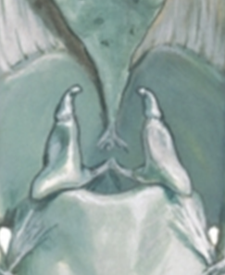
Joints of Larynx
2 Joints both synovial
  Crico-arytenoid joints b/w base of arytenoid and superolateral surface of cricoid lamina
  Movements at joints:
  (i) Sliding of arytenoids towards or away from each other
  (ii) Tilting anteriorly or posteriorly
  (iii) Rotation
  Important –for tensing or relaxing the vocal folds

Slide 23
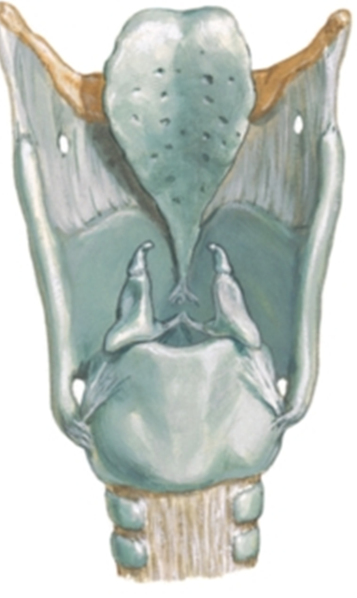
Joints of Larynx…..
Cricothyroid joints b/w Inferior horns of thyroid and articular facet of cricoid
  Rotation + gliding of thyroid cartilage → changes in length of vocal folds
Recurrent laryngeal nerve lies immediately behind this joint

Slide 24
Muscles of larynx
Muscle
Extrinsic
Elevators
-Attached to thyroid cartilage & hyoid bone from above
Depressors
- Attached to thyroid cartilage or hyoid bone from below
Intrinsic
Cricothyroid
Thyroarytenoid
Post.& lat.crico arytenoid
Transverse arytenoid
Vocalis
Aryepiglottic

Slide 25
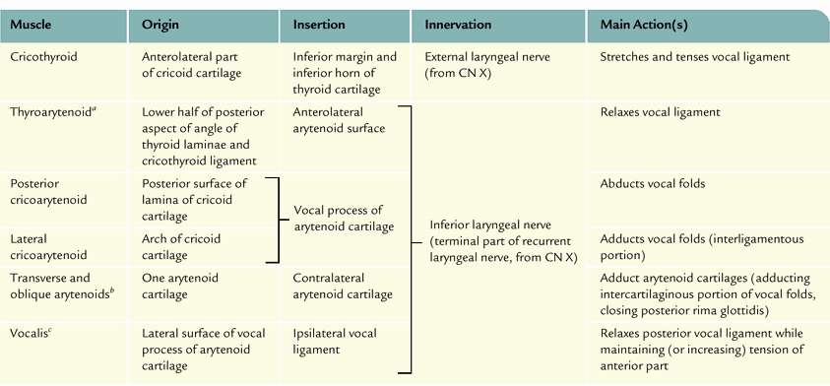
Muscles of larynx

Slide 26
2
3
1
4
3

Slide 27
Actions of muscles
Muscles that open the glottis (Abduction)
    Posterior cricoarytenoid
Muscles which close the glottis (Adduction)
    Lateral cricoaryteniod,
    transverse arytenoid,
    cricothyroid,
    thyroarytenoid
Muscles which tenses the vocal cords (Tension)
    Cricothyroid
Muscles which relax the vocal cord (Relaxation)
    Thyroarytenoid,
    vocalis
Muscles which open the inlet of larynx
    Thyroepiglottic

Slide 28
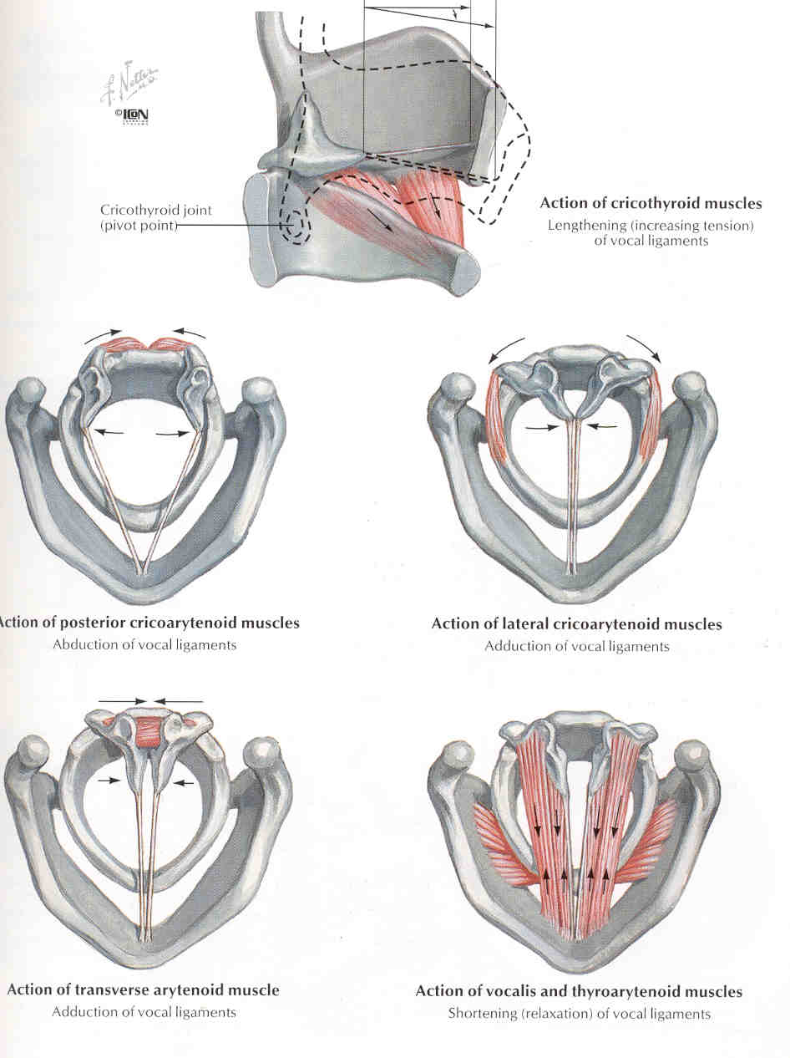

Slide 29
Nerve supply
Motor supply
  All intrinsic muscle of larynx is supplied by recurrent laryngeal nerve except cricothyroid which is supplied by external laryngeal nerve
  Transverse arytenoideus present dual nerve supply (recurrent & internal laryngeal nerve)
  Secretomotor supply mostly by recurrent laryngeal nerve
Sensory supply
  Mucosa above vocal fold by internal laryngeal nerve
  Mucosa below vocal fold by recurrent laryngeal nerve

Slide 30
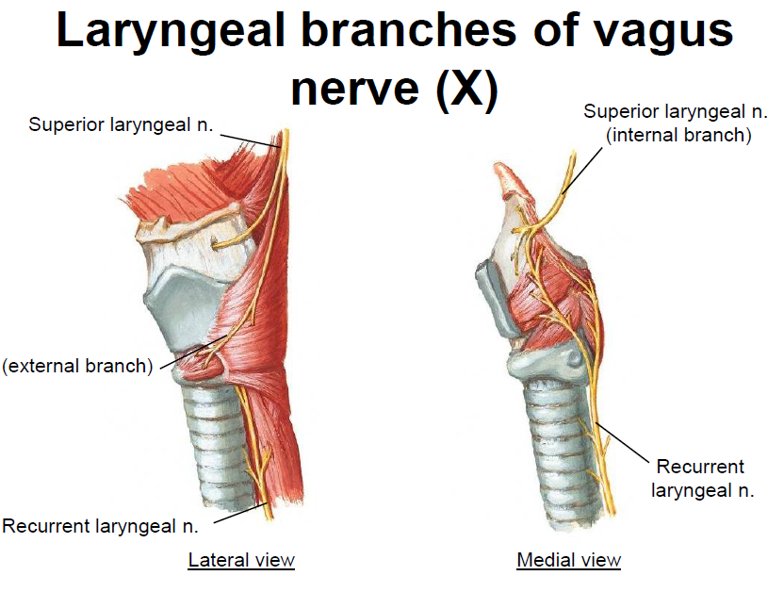

Slide 31
Blood supply
Up to vocal fold
  Superior laryngeal artery branch of superior thyroid artery
  Superior laryngeal vein drains into superior thyroid vein
  Lymphatic goes to superior group of deep cervical lymph node
Below vocal folds
  Inferior laryngeal artery branch of inferior thyroid artery
  Inferior laryngeal vein drains into inferior thyroid vein
  Lymphatic goes to inferior group of deep cervical lymph node

Slide 32
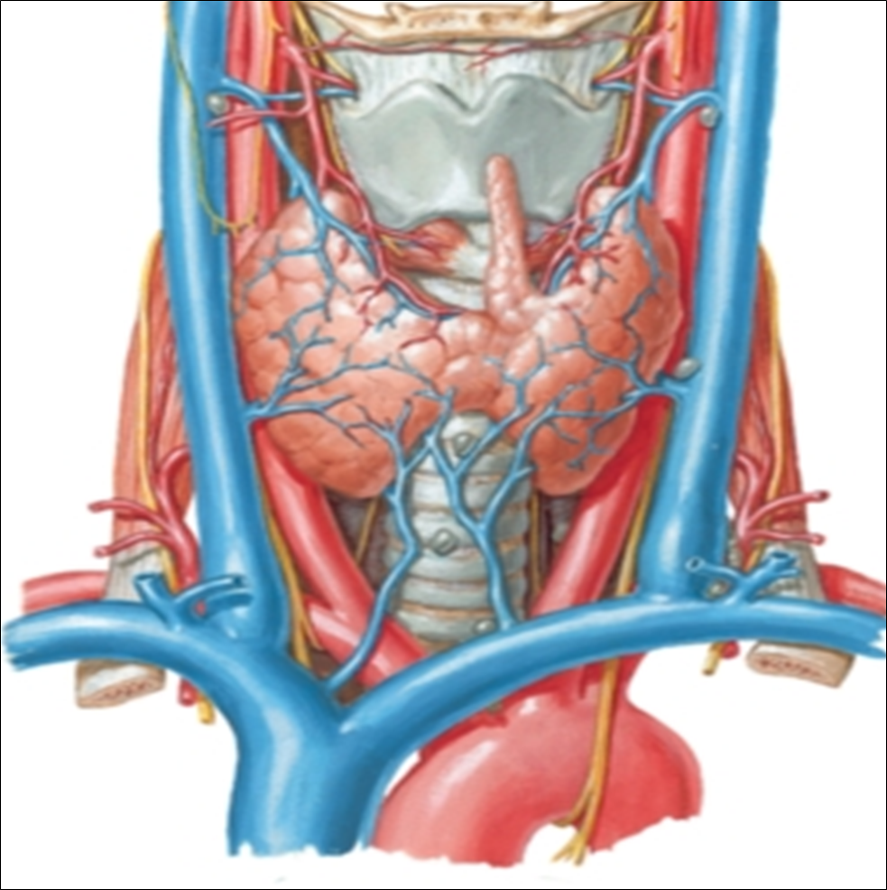
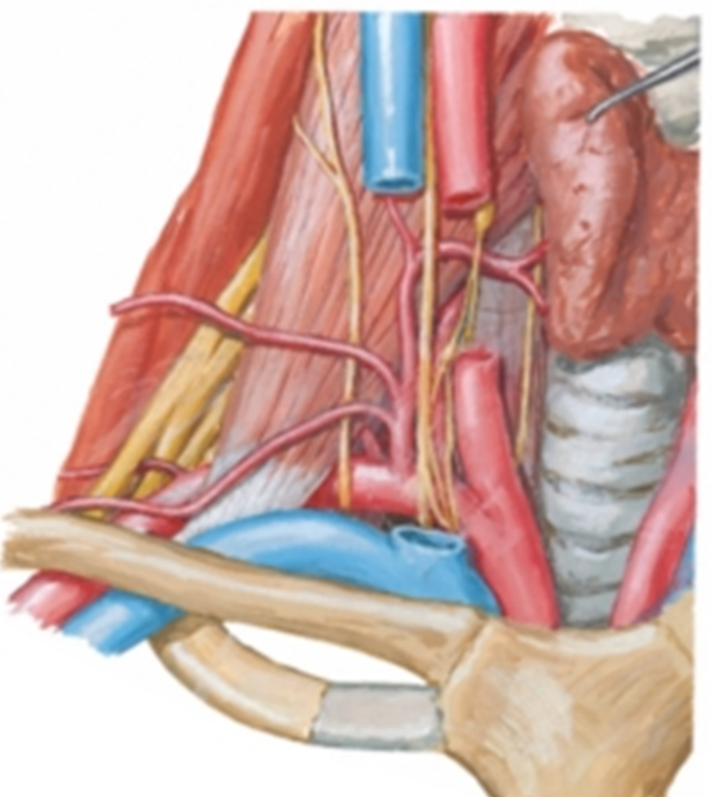
Blood supply
Inferior thyroid artery arches high up and loops down to lower pole of thyroid gland.
Superior Laryngeal artery enters through thyrohyoid membrane (supplies upper half above vocal folds)
Branches:
Ascending cervical ,
Inferior laryngeal,(supplies lower ½ ) Oesophageal,Tracheal and
Terminal branches to thyroid gland

Slide 33
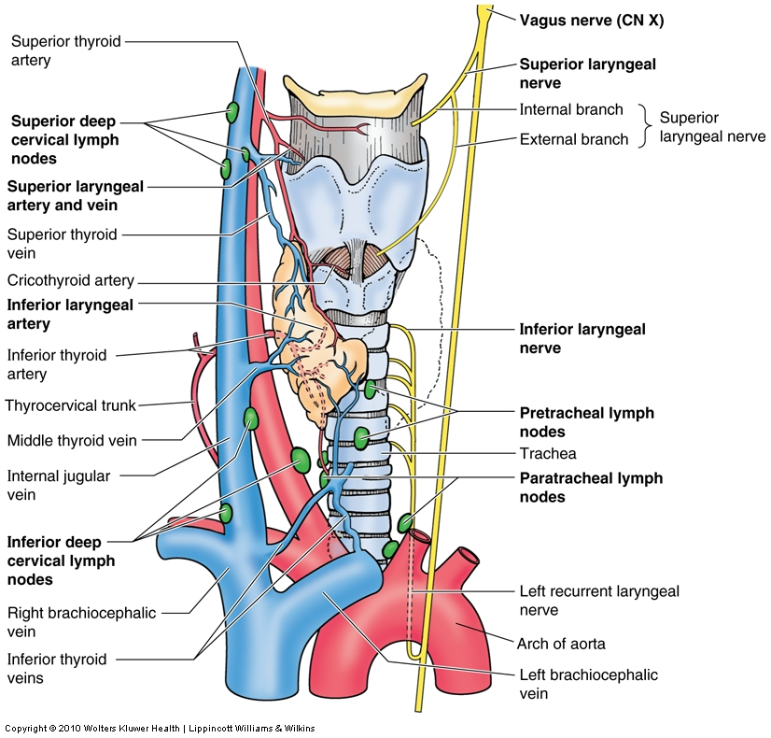
Lymphatic

Slide 34
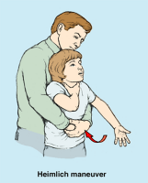
Applied anatomy
Laryngeal obstruction (choking)
  Caused by aspirated food which usually lodged in rima glottidis
  Could be released by compression of abdomen to expel air from lungs and thus dislodge the food (Heimlich maneuver)
Laryngitis
  Inflammation of mucous membrane of larynx

Slide 35
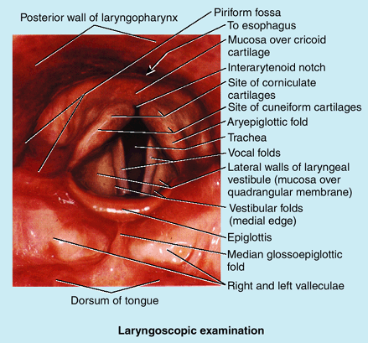
Laryngoscopy
Examination of larynx

Slide 36
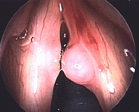
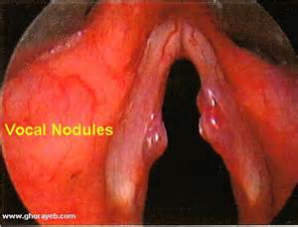
LARYNGEAL NODULE

Slide 37
THANKS

