Slide 1
KNEE JOINT

Slide 2
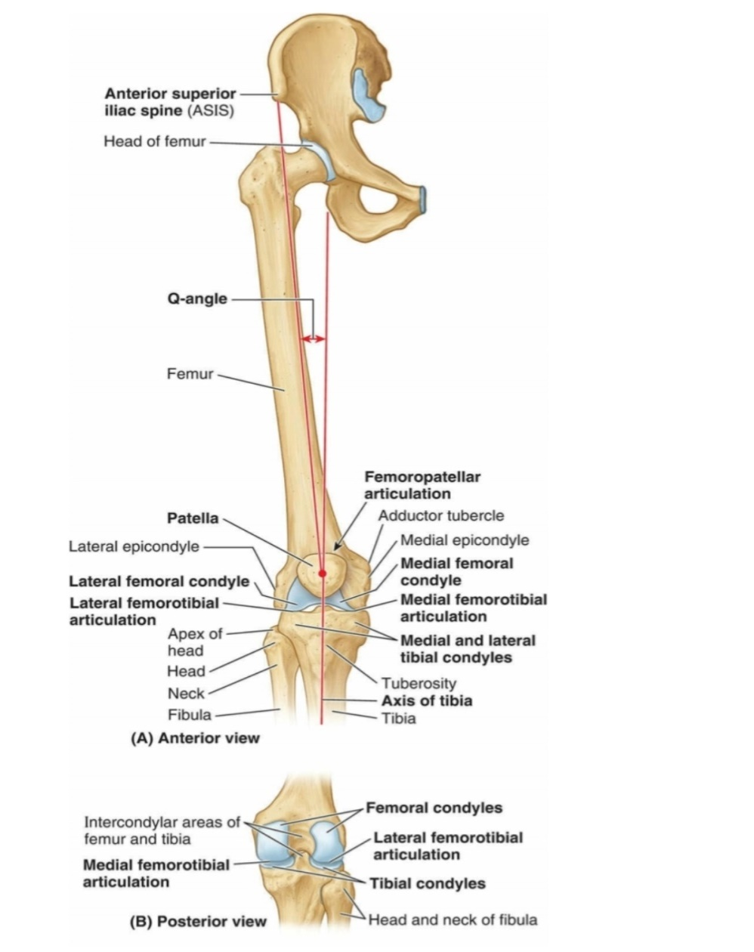
INTRODUCTION
LARGEST & MOST COMPLECATED SYNOVIAL JOINT IN BODY
IT COSISTS IF THREE JOINT
    Medial condylar joint
    Lateral condylar joint
    Patellofemoral joint
FIBULA IS NOT DIRECTLY INVOLVED IN THE JOINT

Slide 3
KNEE JOINT IS A MAJOR WEIGHT WEARING JOINT
STABILITY OF THE JOINT DEPENDS ON PRIMARILY ON QUADRICEPS MECHANISM AND SECONDARILLY ON LIGAMENTS

Slide 4
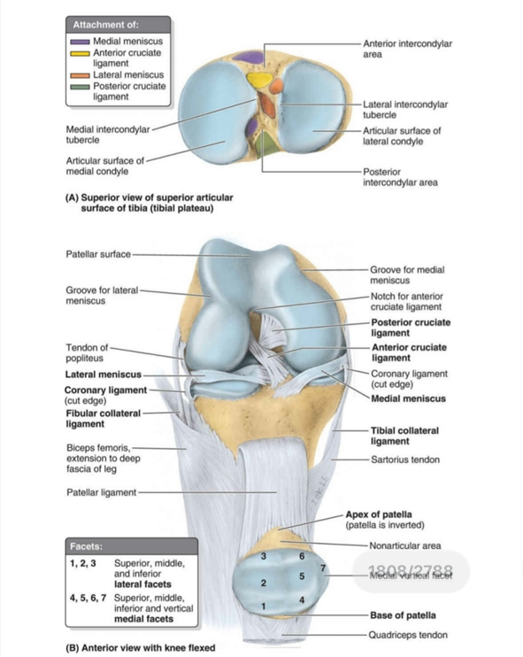
ARTICULAR SURFACES
The articular surface of knee joint are as following
  THE CODYLE OF FEMUR
  PATELLA
  THE CONDYLE OF TIBIA

Slide 5
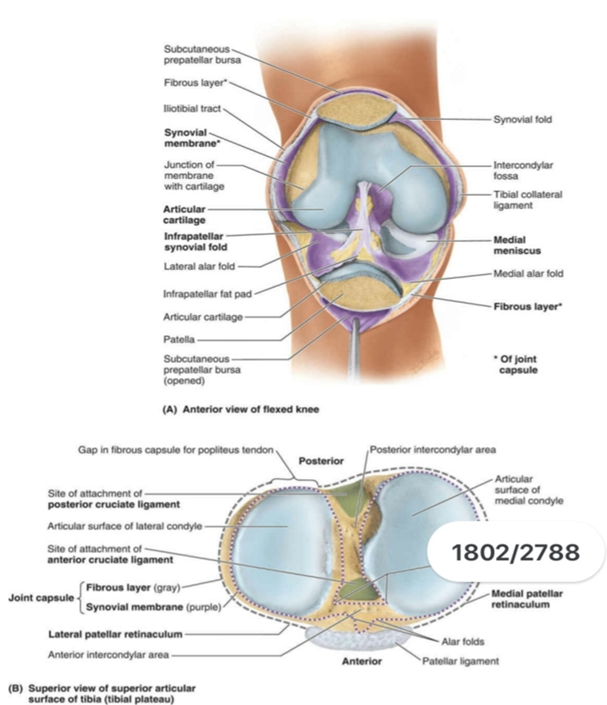
JOINT CAPSULE OF KNEE JOINT
CONSISTS OF EXTERNAL FIBROUS LAYER ( FOBROUS CAPSULE) & INTERNAL SYNOVIAL MEMBRANE
FTIBROUS LAYER HAS FEW THICHENED PART THAT MAKES UP INTRINSIC LIGAMENT

Slide 6
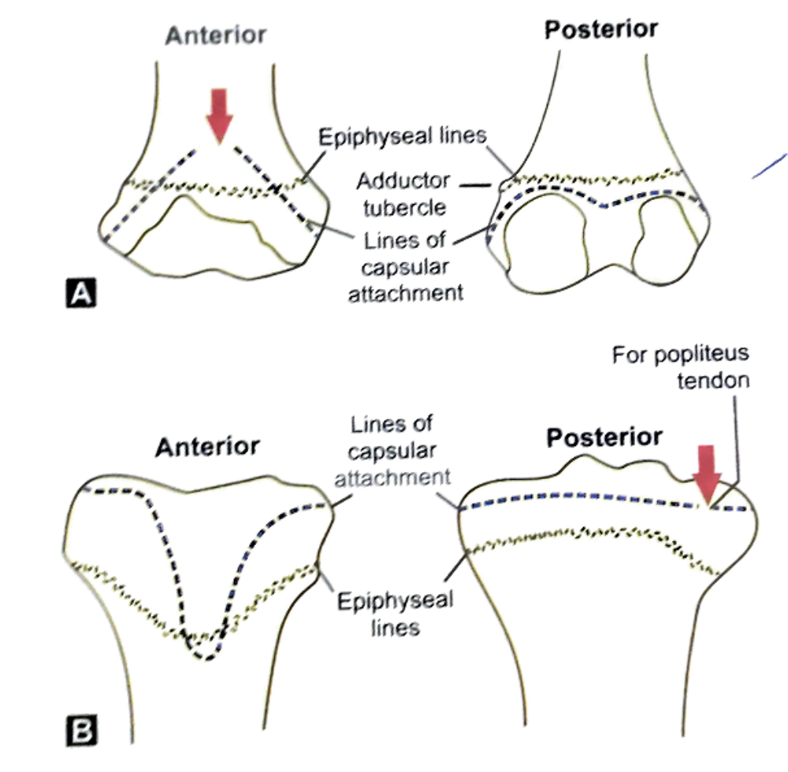

Slide 7

SYNOVIAL MEMBRANE –
  IT ATTACH TO MARGIN OF THE ARTICULAR SURFACE & TO THE SUPERIOR AND INFERIOR OUTER MARGIN OF MENISCI
  IT LINES THE FIBROUS CAPSULE EXCEPT POSTERIORLY WHERE CRUCIATE LIGAMENTS ARE FOUND
  INFRONT IT IS ABSENT FROM PATELLA

Slide 8
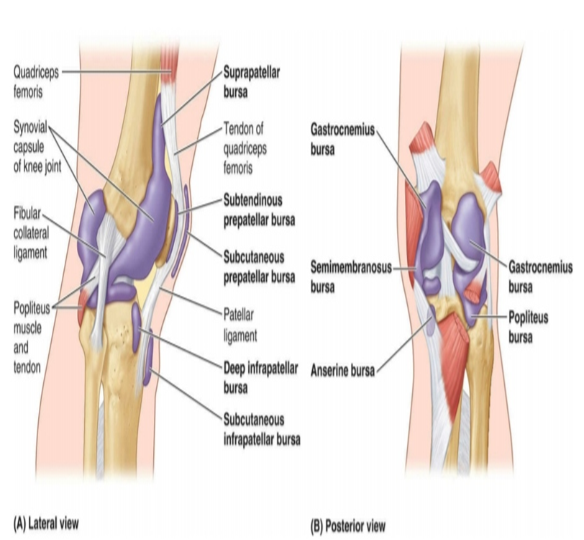
BURSAE OF KNEE JOINT
THERE ARE 13 BURSAE AROUND THE KNEE JOINT
  4 ARE ANTERIOR
  4 ARE LATERAL
  5 ARE MEDIAL

Slide 9


ANTERIOR BURSAE -
  FOUR IN NUMBER
    Subcutaneous prepatellar bursae
    Subcutaneous infrapatellar bursae
    Deep infrapatellar bursae
    Suprapatellar bursae

Slide 10
LATERAL BURASE –
  FOUR IN NUMBER
    A bursae deep to lateral head of gastrocnemius
    A bursae b/w fibular collateral ligament & biceps femoris
    A bursae b/w fibular collateral ligament & tendon of popliteus
    A bursae b/w tendon of popliteus & lateral condyle of tibia

Slide 11

MEDIAL BURSAE –
  FIVE IN NUMBER
    A bursae to the medial head of gastrocnemius
    Anserine bursae
    A bursae deep to tibial collateral ligament
    A bursae deep to semimembranosus
    A bursae b/w semimembranosus & semitendinosus (occasionally)

Slide 12
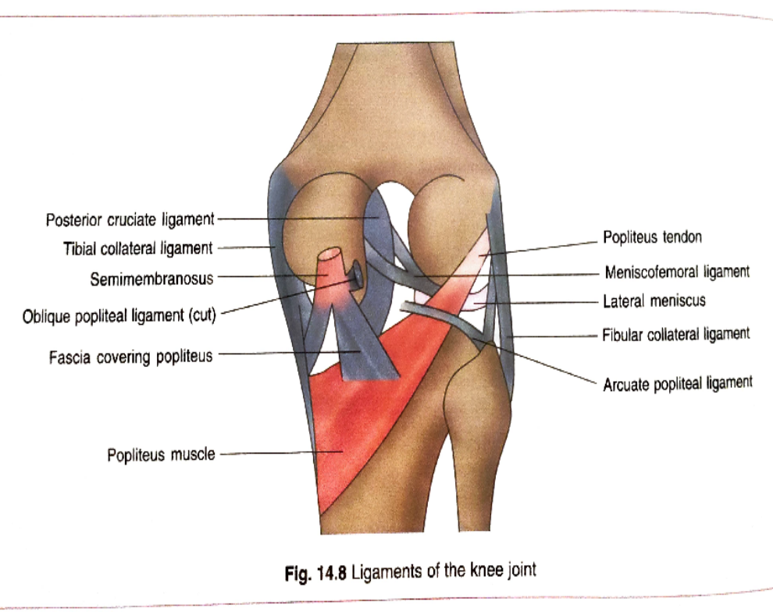
LIGAMENTS OF KNEE JOINT
Are extracapsular and intra- articular ligament
EXTRACAPSULAR LIGAMENTS –
    Ligamentum patellae
    Tibial collateral ligament
    Fibular collateral ligament
    Oblique popliteal ligament
    Arcuate popliteal ligament
    Coronary ligament

Slide 13
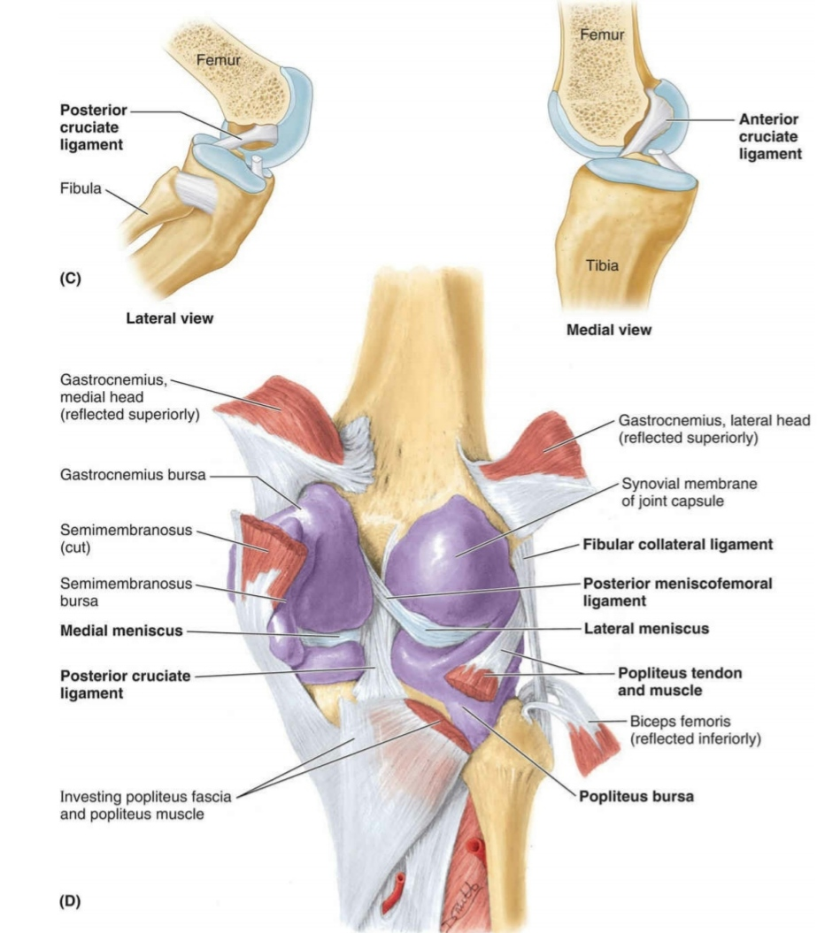
INTRA-ARTICULAR LIGAMENTS
Anterior cruciate ligament
Posterior cruciate ligament
Medial meniscus
Lateral meniscus
Ligaments of Wrisberg & Humphrey

Slide 14
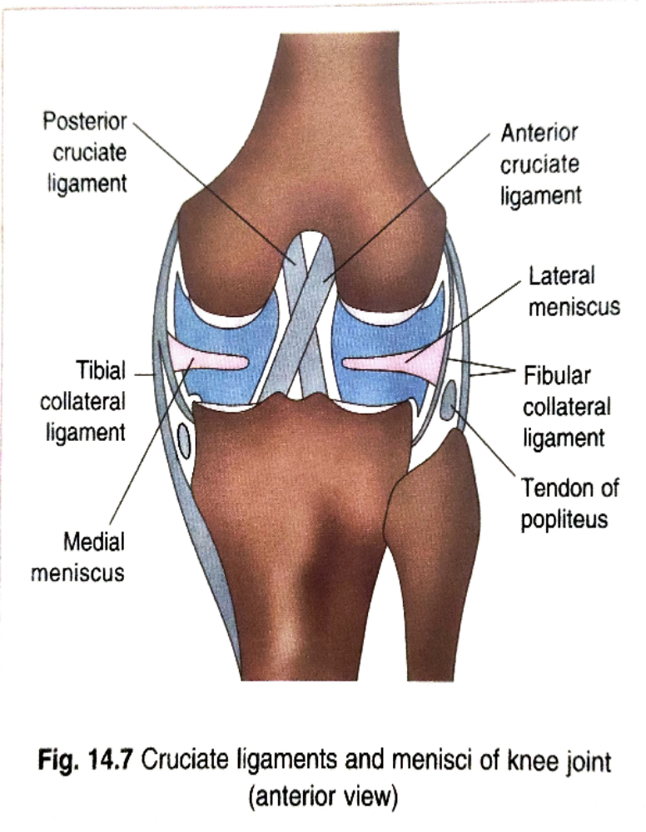
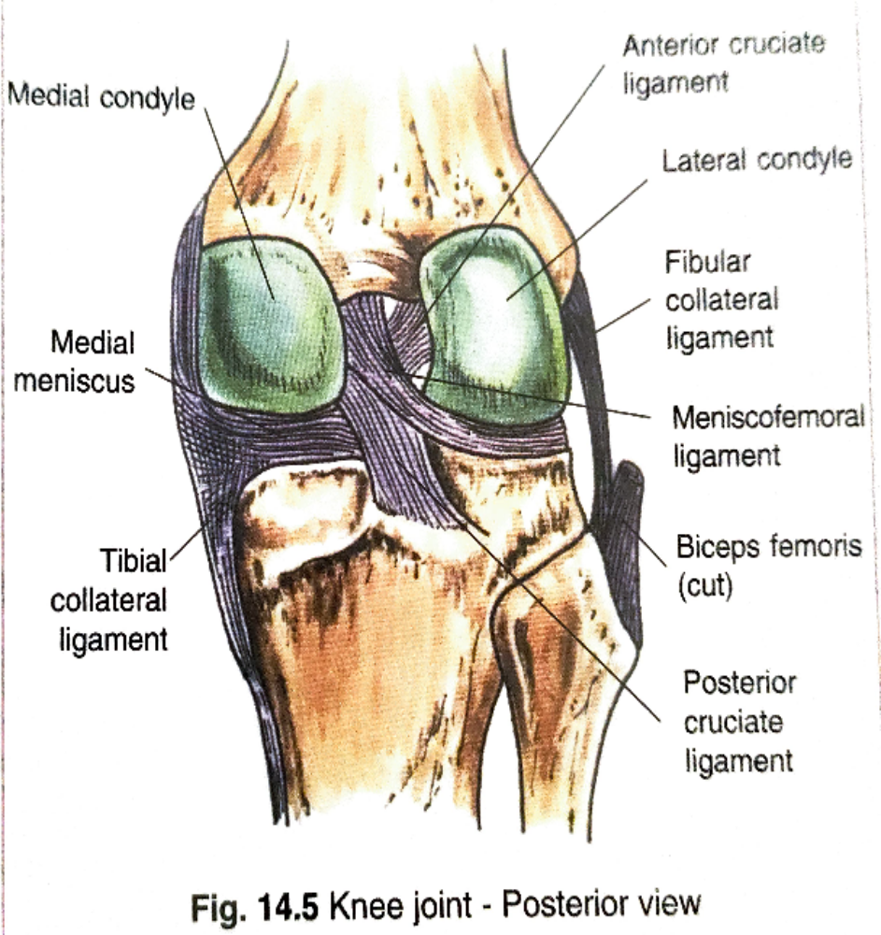

Slide 15
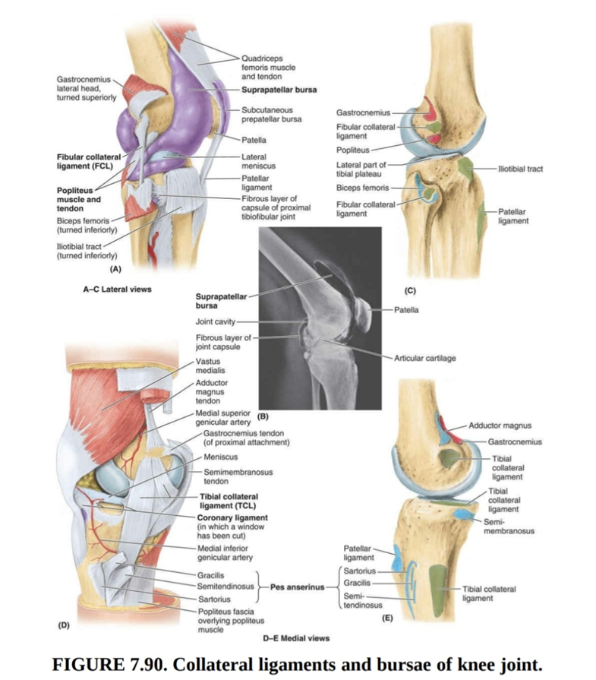

Slide 16
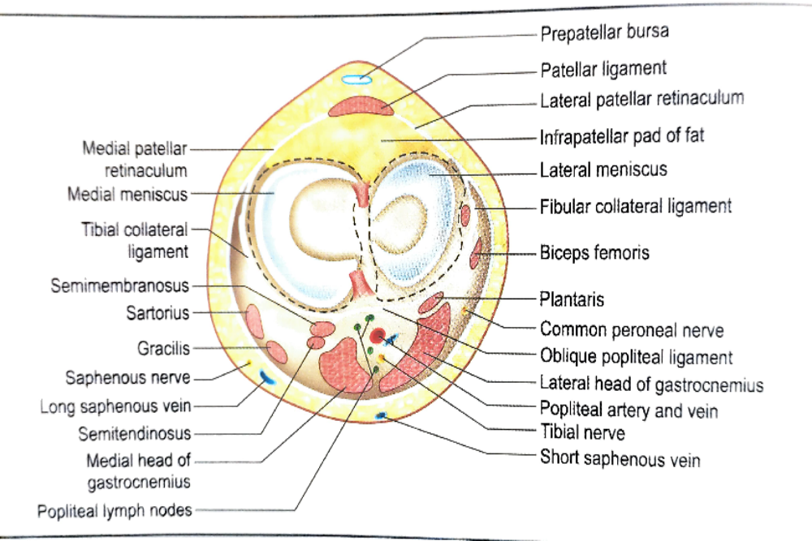
RELATION OF KNEE JOINT
Anteriorly – Quadriceps femoris, Patella & Ligamentum patellae
Posteriorly – Popliteal vessels &Tibial nerve
Posteromedially – Semimembranosus, tendon of Sartorius, Semitendinosus
Posterolaterally - Tendon of biceps femoris, common peroneal nerve

Slide 17
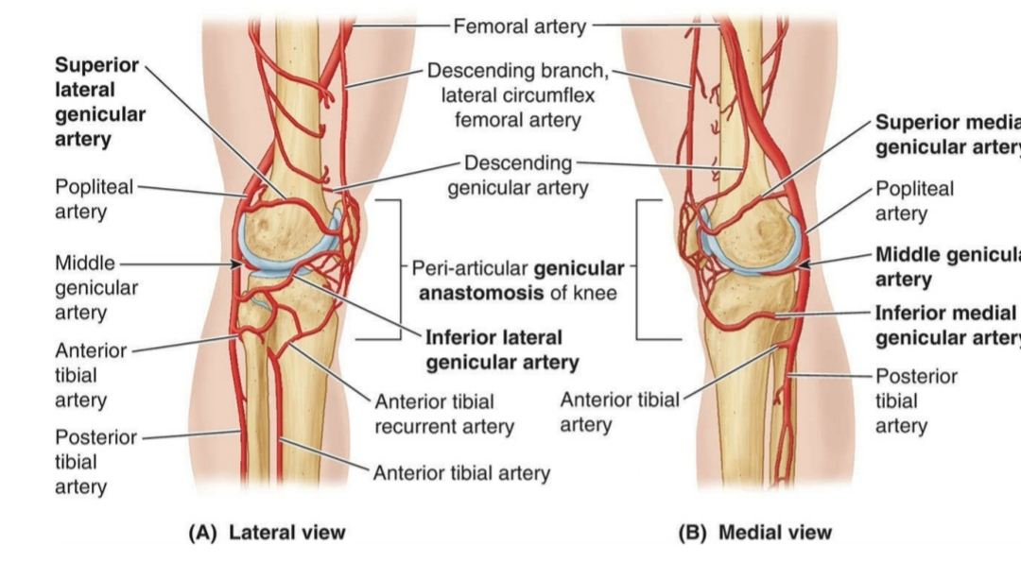
ARTERIAL SUPPLY
Supplied by many genicular artery
These are derived from popliteal, femoral, anterior & posterior tibial arteries

Slide 18
MOVEMENT OF KNEE JOINT
FLEXION – Hamstring muscle
EXTENSION – Quadriceps femoris & tensor fascia latae
ROTATION –
  MEDIAL - Semitendinosus, Semimembranosus & Popliteus
  LATERAL- Biceps femoris

Slide 19
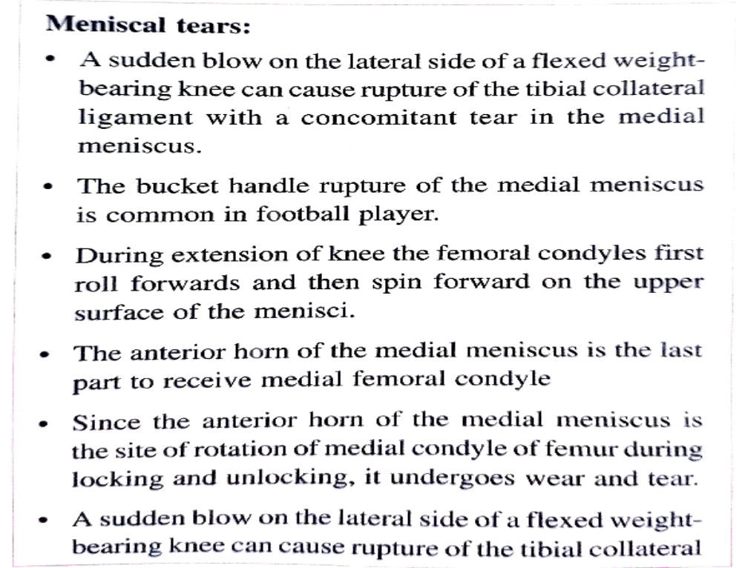

Slide 20
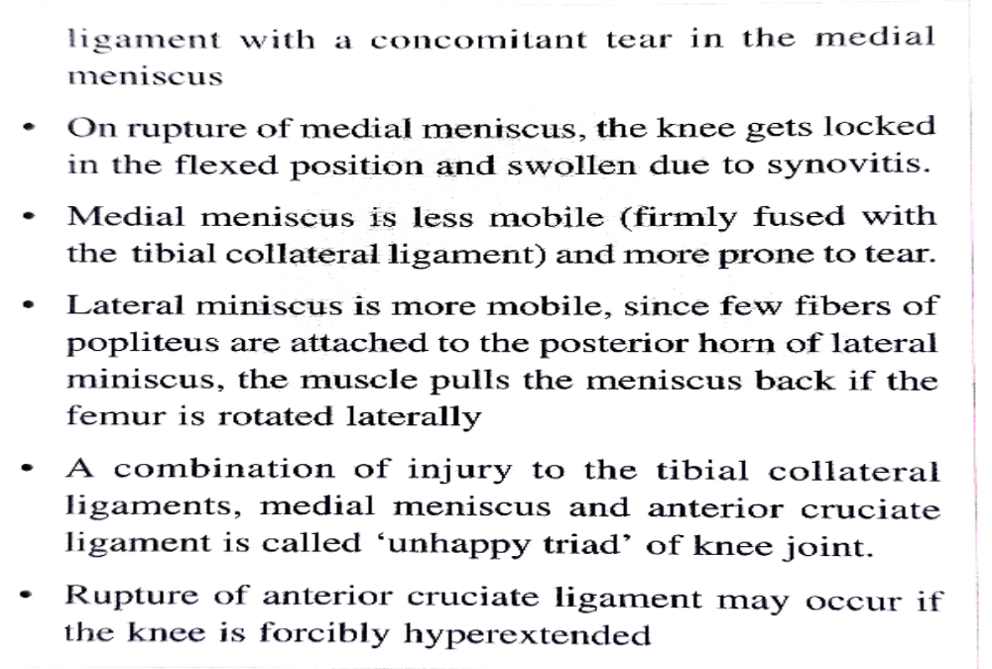

Slide 21
CASE - 1
A 50 year old house made visits hospital with a painful swelling in front of the lower part of the left knee. While taking the history she revealed that her work involves cleaning the floor area bending her knee for most of the time .
  Using your knowledge of anatomy, what is the diagnosis ?

Slide 22
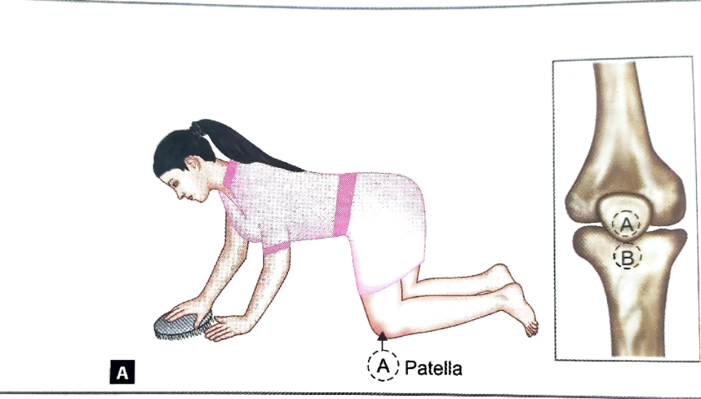
ANSWER CASE -1
On examination , swelling is found infront of her ligamentum patellae on left side
It due to inflammatory response in subcutaneous infrapatellar bursa by repeated unaccustomed trauma

Slide 23
CASE -2
A medical student, while playing football collided with another player and fell to the ground. As he fell, the right knee, which was taking the weight of his body, was partially flexed, the femur was rotated medially and the leg abducted on thigh. A sudden pain was felt in the right knee joint, and he was unable to extend the knee. When examined by physician an hour later, the student was still unable to extend the knee , which was now greatly swollen. Severe local tenderness was felt along the medial side of the joint line.
  What is the diagnosis?
  Why was the knee locked?
  Why was the swelling of the knee so excessive over the front of the joint?

Slide 24
ANSWER CASE -2
As the student fell, medial meniscus was drawn laterally within the knee joint
The sudden movement of knee joint occurred on striking the ground resulted in immobile medial meniscus torn between medial femoral condyle and tibial condyle , and medial meniscus split along part of its length
Knee locked due to detached portion jammed b/w the articular surface, limiting the further extension
Tenderness was experienced over the torn medial meniscus, the trauma stimulated excessive production of synovial fluid which fill the joint cavity & suprapatellar bursa that lead to distension infront of the joint

Slide 25
CASE -3
A 19 year student was hit on the posterolateral side of the right knee by an opponent player while playing a football match . At the time of impact, the student’s right foot was firmly planted. The leg was severely abducted by the blow, and the knee buckled and the student collapsed to the ground in severe pain. A stretcher was required to remove him from play ground. He was then shifted to the hospital where knee was thoroughly examined. Severe pain was localized to medial side of right knee, and drawer test was positive. The student underwent surgery and he was unable to return to the playing field until the following season.
  Based of information given, which ligaments were probably injured?
  What other structure may also be injured?
  What is the drawer test?

Slide 26
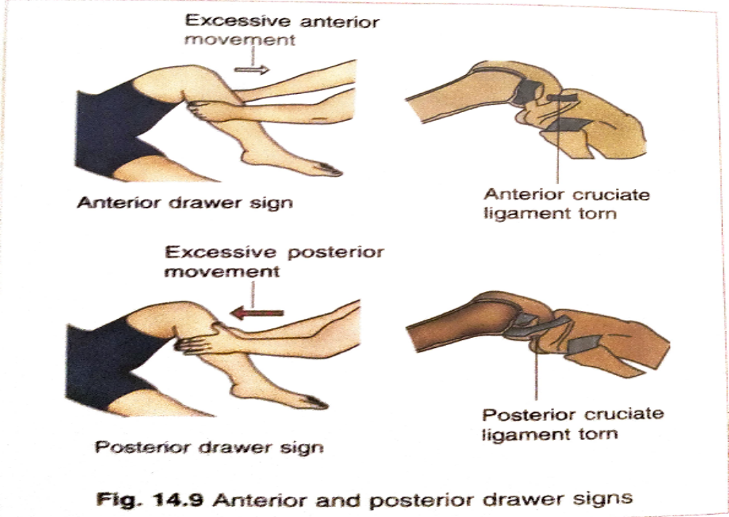
ANSWER CASE -3
Medial collateral ligament & anterior cruciate ligament ,( localized pain suggest medial collateral ligament injury & positive drawer test indicates the rapture of anterior cruciate ligament
medial meniscus is probably damaged, because it attached to the medial collateral ligament

Slide 27
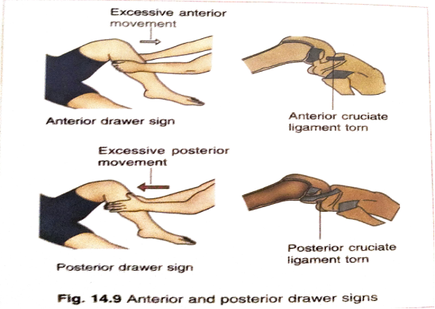
Drawer test –
  Person in supine positon
  Hip & knee are in flex position
  Examiner grasp the leg with both hands with thumb placed on patella
  If excessive forward movement of tibia indicate the injury of anterior cruciate ligament
  If there is excessive backward movement of tibia indicate injury of posterior cruciate ligament

Slide 28
CASE -4
Following a severe automobile accident, a 27 year old female was found to have an unstable right knee joint. On examination under an anesthetic, it was possible to pull the tibia forward excessively on femur. The patient’s knee joint was fixed in plaster for three month and vigorous physiotherapy was carried out on her quadriceps femoris muscle.
  What structured was damaged in the knee joint?
  Why was it necessary to have physiotherapy on the quadriceps femoris muscle?

Slide 29
ANSWER CASE- 4
In this patient the anterior cruciate ligament in the right knee has been raptured
Actually strength of knee joint depends primarily on the tone of quadriceps femoris muscle & secondarily on ligaments so loss this ligament can be compensated by developing tone in quadriceps femoris muscle.

Slide 30
THANK YOU

