Slide 1
THE KIDNEY
Sarangdhar kumar
Assistant professor
Department of anatomy
Rohilkhand medical college
Bareilly

Slide 2
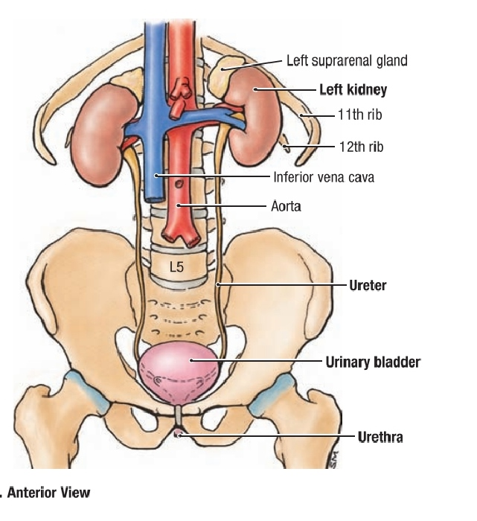
Introduction
Paired excretory organ
Reddish brown in colour
Elaborate urine & eliminate the waste product of protein metabolism
Maintains the electrolyte & water balance of the body
It secretes -
    Renin – for autoregulation of blood flow & blood pressure
    Erythropoietin – for maturation of RBC
    1,25 dihydroxy cholecalciferol - for control of calcium metabolism

Slide 3
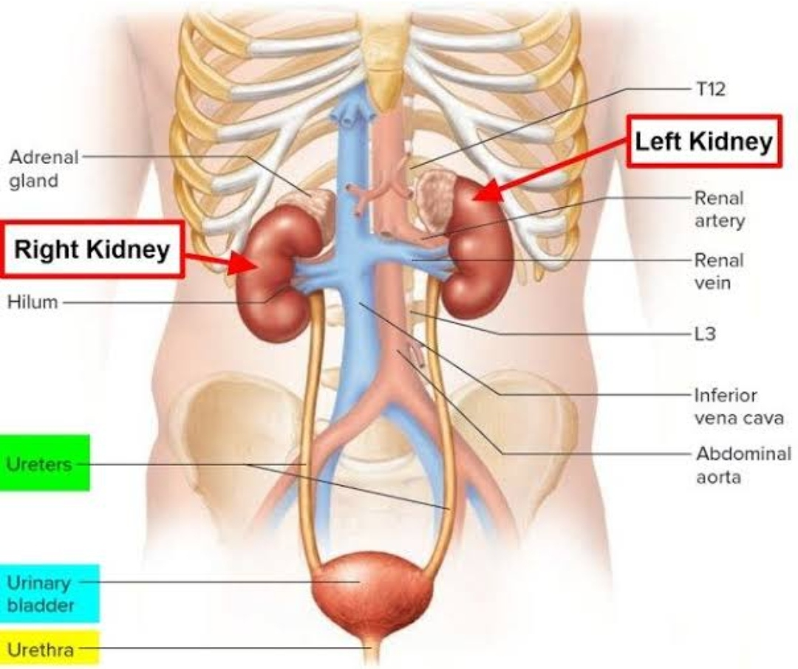
Situation
Situated retroperitoneally in posterior abdominal wall by the side of vertebral column (paravertebral gutter)
Extends –
    T12 – L3 vertebrae
Right kidney is slightly lower than the left one

Slide 4
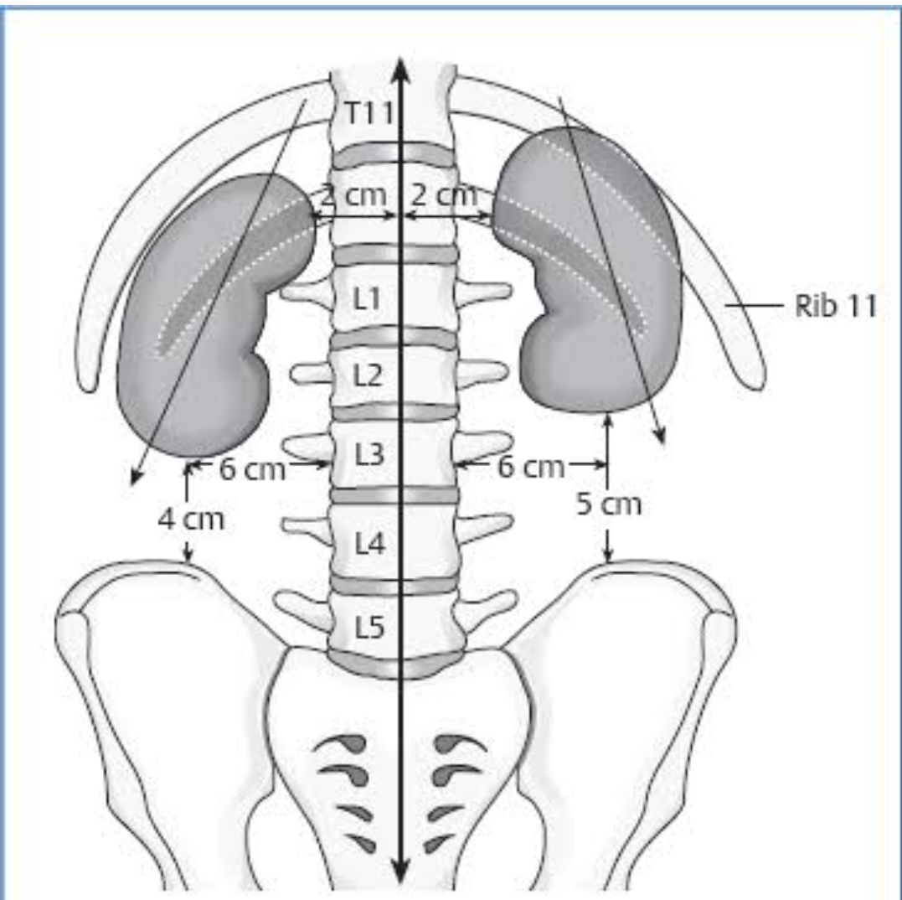
Axis of kidney
Long axis
  Directed downwards & laterally
Transverse axis
  Directed laterally & backwards
  Because kidney rest on muscles of paravertebral gutter
Transpyloric plane passes through upper part of hilum of right kidney & lower part of hilum of left kidney
Left kidney is longer , narrower & near to vertebral column than the right kidney

Slide 5
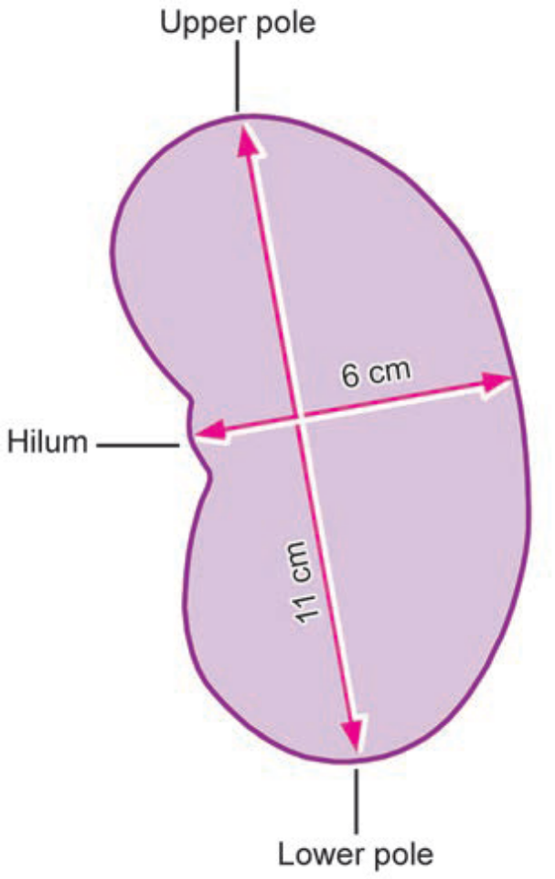
Measurements
Length
    11 cm
Breadth
    6 cm
Thickness
    3 cm
Weight
    In male – 150 gm – 170 gm
    In female – 130gm - 150 gm
    Ranges from 130 gm – 170 gm
Shape
    Bean shaped , hilum directed medially

Slide 6
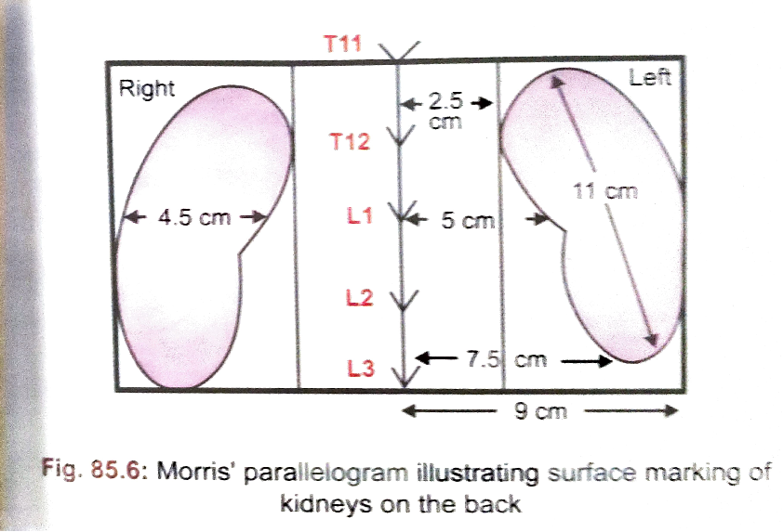
Surface marking of kidney on the back

Slide 7
Factors keeping the kidney in position
Pressure exerted by neighbouring viscera
  This is maintain by the tone of the abdominal muscles
By disposition of renal fascia & distribution of renal fat
Pedicles of kidney (renal vessels & pelvis of ureter ) attached to the hilum

Slide 8
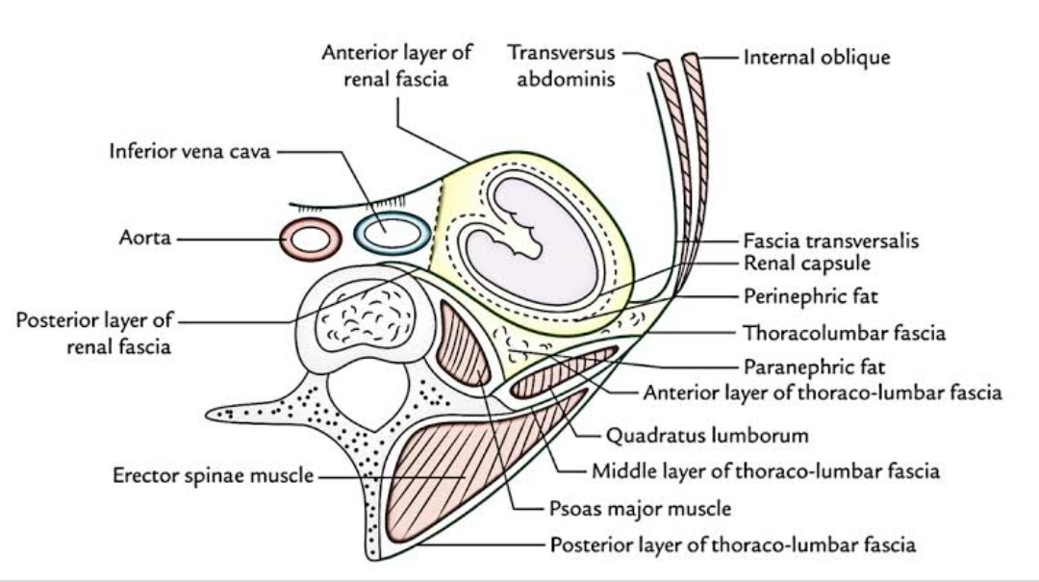
Covering of kidney
Each kidney has four coverings
Within outwards they are –
  Fibrous capsule (True capsule)
  Perinephric fat (Adipose capsule)
  Renal fascia or fascia of Gerota (False capsule)
  Paranephric fat

Slide 9
Fibrous capsule
  Covers the entire organ
  Formed by condensation of stroma of the kidney
  Lines the wall of renal sinus
  Reflected as tubular sheath around minor & major calyces and pelvis of ureter
Perinephric fat
  It occupies between fibrous capsule & renal fascia
  Fat is abundant along borders
  It is a content of renal fascia

Slide 10
Renal fascia
  Formed by condensation of extra peritoneal connective tissue around the kidney
  Continuous laterally with fascia transversalis
  Consists of two layers
    Anterior layer (fascia of Toldt )
    Posterior layer ( fascia of Zuckerkendle )

Slide 11
Tracings of renal fascia
Laterally
  Both layers are fused and forms lateral conal fascia & it is continuous with fascia transversalis
Medially
  Anterior layer – covers the front of kidney & renal vessels & is continuous with similar layer of opposite side of renal fascia
  Posterior layer – covers the back of kidney blends with psoas fascia

Slide 12
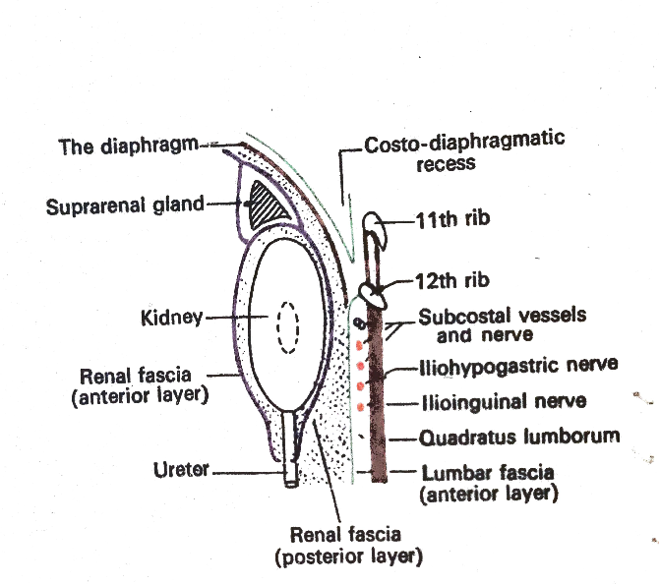
Above
  After covering the suprarenal gland
    On right side
      Anterior layer – continue with coronary ligament at the bare are of liver
      Posterior layer – continue with sub-diaphragmatic fascia
    On left side
      Anterior layer – continue with gastrophrenic ligament
      Posterior layer – continue with sub-diaphragmatic fascia
Below
    On both side - it extend downward along the ureter & blend with fascia iliaca in the iliac fossa

Slide 13

Paranephric fat
  Occupies interval b/w renal fascia & anterior layer of thoraco- lumbar fascia
  Abundant on posterior surface of lower part of kidney

Slide 14
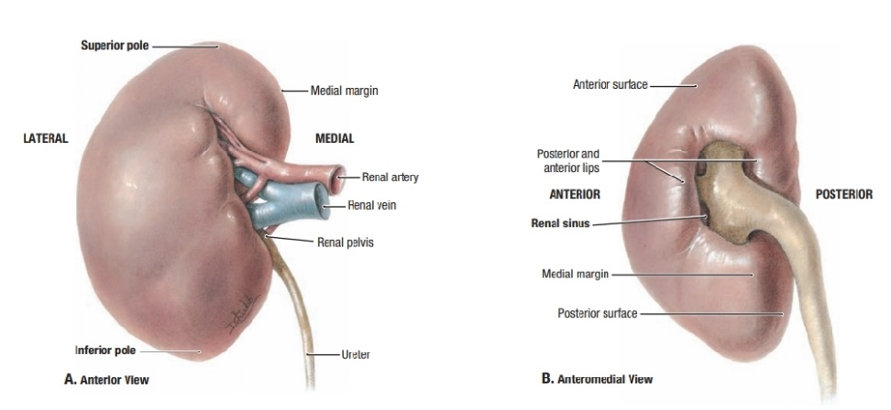
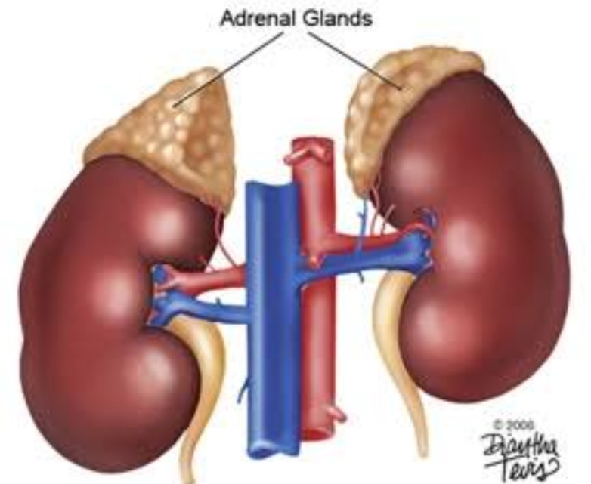
Presenting parts of kidney
Each kidney presents 2 ends, 2 borders & 2 surfaces
Two ends (poles)
  Upper end
    Thicker & rounded than lower end
    Situated about 2.5 cm from median plane opposite T12
    Related with suprarenal gland
  Lower end
    Directed downward & laterally
    Situated about 7.5 cm from median plane opposite to L3

Slide 15

Two borders
  Medial border
    Convex in upper & lower part and concavity at the hilum
    Hilum is situated about 5 cm from middle line opposite to lower border of L1
  Structure passing through the hilum
    (before backwards)
      Renal vein
      Renal artery
      Pelvis of ureter
  Lateral border
    Convex & thick

Slide 16
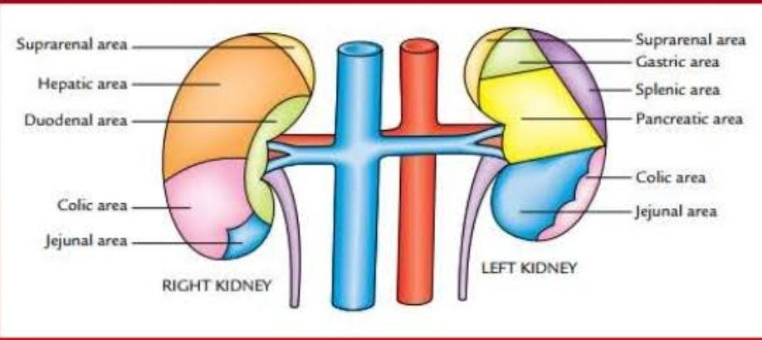
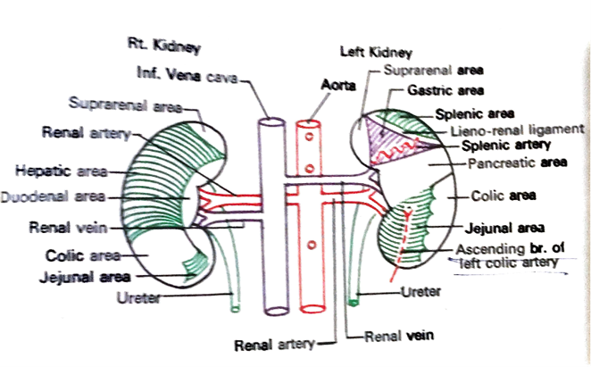
Two surfaces
  Anterior surface
  Convex ,directed forwards & laterally
  Partially covered with peritoneum
  Relations on anterior surface of both kidney
  On the Right kidney –
    Supra renal area
    Duodenal area
    Hepatic area
    Colic area
    Jejunal area

Slide 17


  On Left kidney
    Related with six areas
    Supra renal area
    Splenic area
    Gastric area
    Pancreatic area
    Colic area
    Jejunal area

Slide 18
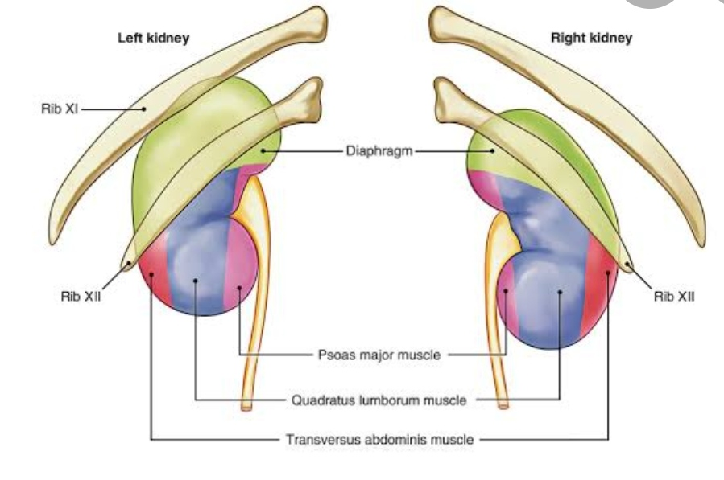
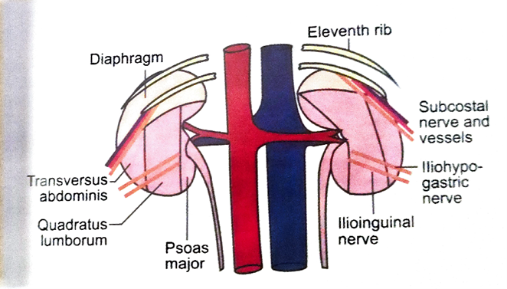
Posterior surface
  Flat ,directed backwards & medially
  Entirely non peritoneal
Relation on posterior surface of both kidney
  Posterior surface presents two parts –
Upper part –
  Diaphragm arising from medial &lateral arcuate ligaments
  11th & 12th ribs on left side & 12th rib on right side
Lower part -
  Medial to lateral
    Psoas major
    Quadratus lumborum
    Transversus abdominis
  The following structures passes downward & laterally from above downwards
    Subcostal nerve & vessels
    Ilio-hypogastric nerve
    Ilio-inguinal nerve

Slide 19
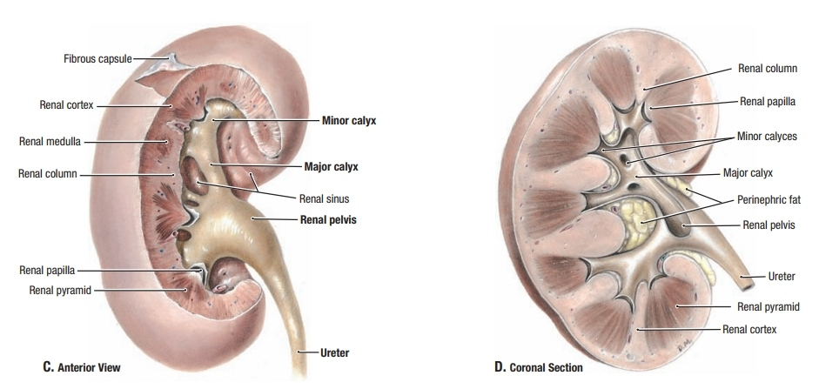
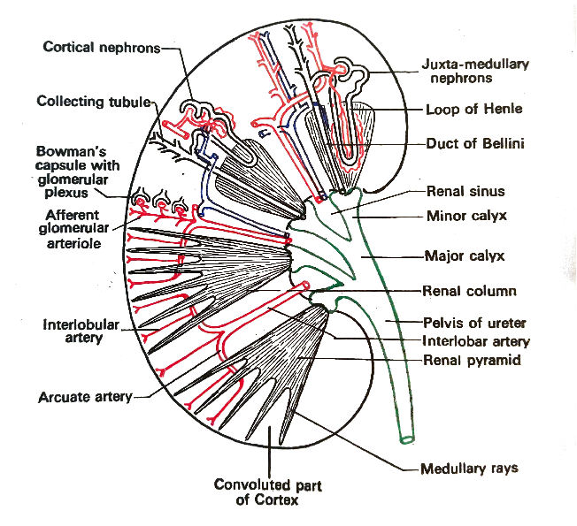
Internal structure of kidney
(Macroscopic)
On Coronal section the specimen presents two parts outer renal substance & inner renal sinus
Renal substance –
  Consists of inner medulla & outer cortex
Medulla-
  Consists of 10 – 15 medullary pyramids
  Base of each pyramid is directed towards the cortex & apex projects into renal sinus

Slide 20

Apex of pyramid is known as renal papilla
Pyramid contains
  The collecting duct
  Loop of Henle
  Vasa recta
Renal papilla is open at the funnel shaped minor calyx

Slide 21
Cortex –
  Surrounding the medulla
  Contains renal corpuscles
    PCT
    DCT
    Medullary rays
      Thin projection of medulla from the base of medullary pyramid into cortex
    Interlobular artery & veins

Slide 22
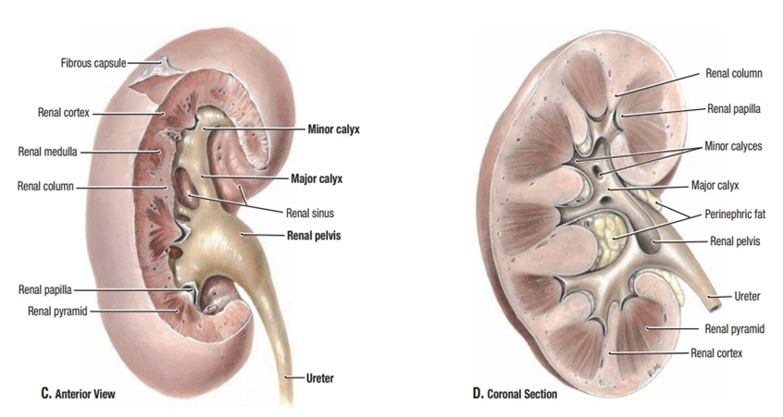

Renal sinus –
  Cavity within the kidney
  Wall of sinus is lined by renal capsule & presents number of renal papillae
  Contents of sinus
    Renal blood vessels , lymph vessels & nerves
    Perinephric fat
    Excretory apparatus which includes minor & major calyces and pelvis of ureter

Slide 23
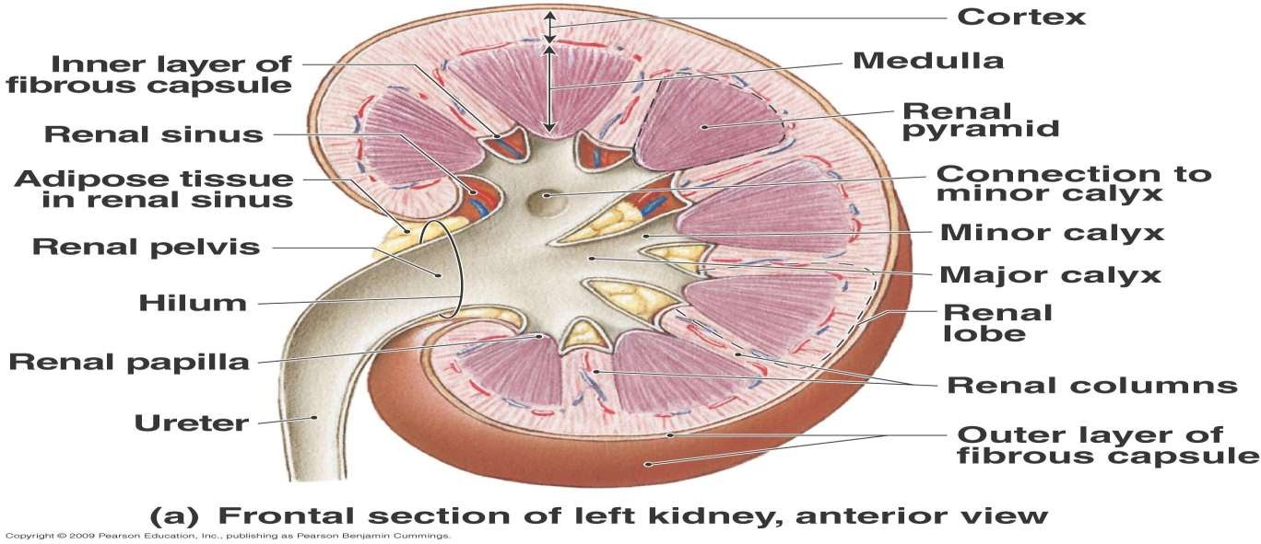

Slide 24
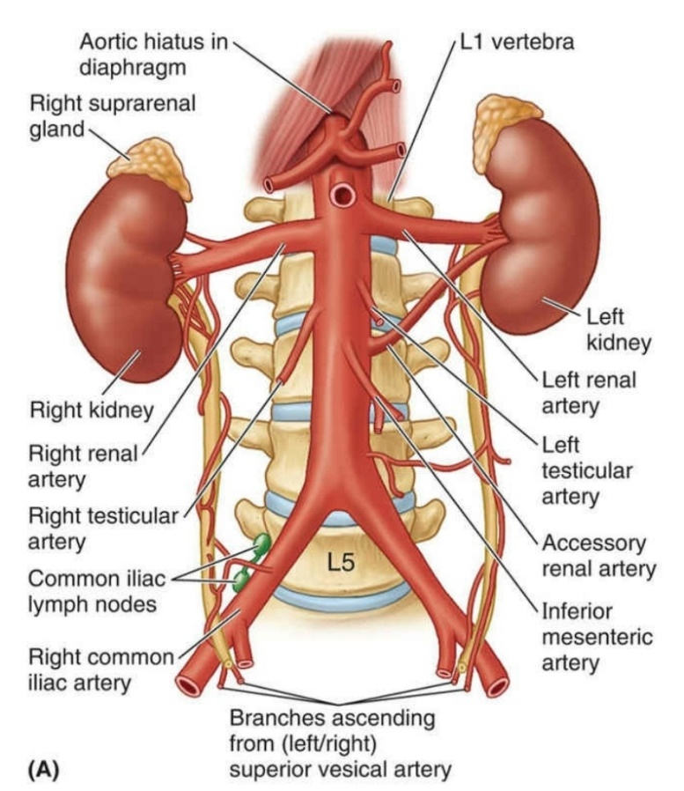
Blood supply of the kidney
Arterial supply
  Each kidney is supplied by
    Renal artery
    Accessory renal artery ( in about 30%individuals)
  Branch of abdominal aorta
Venous drainage
  Renal vein , drains into IVC

Slide 25
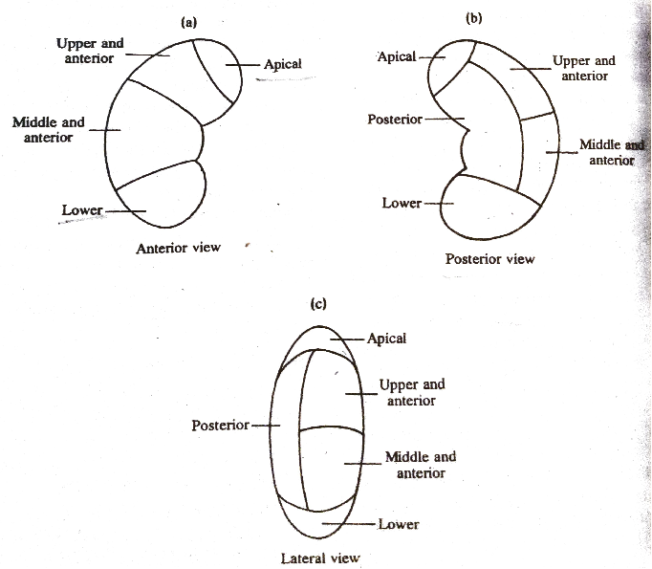
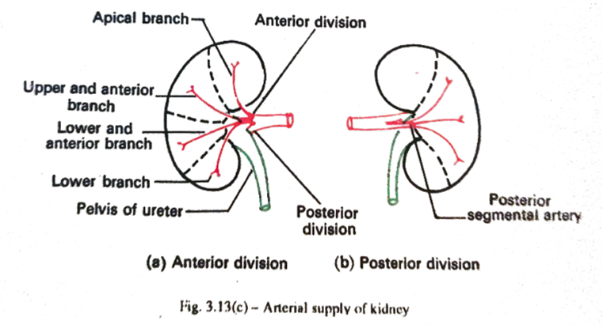
Arterial segments of kidney

Slide 26
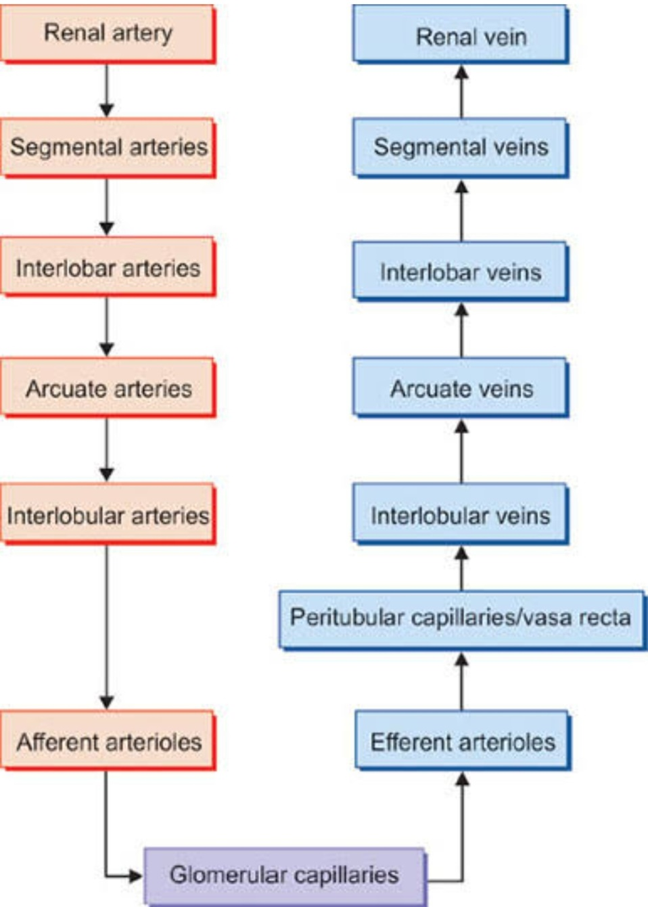
Distributions of blood vessels of kidney

Slide 27
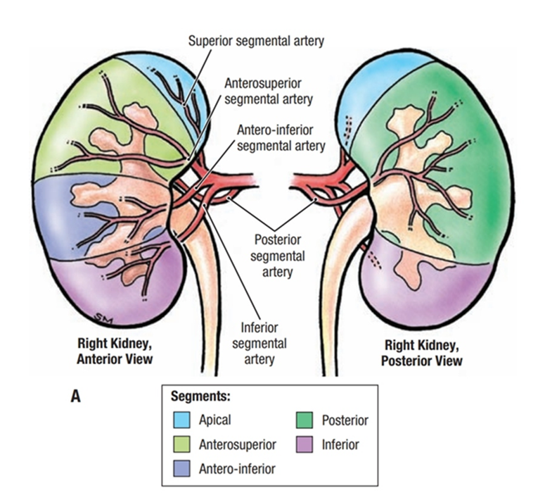
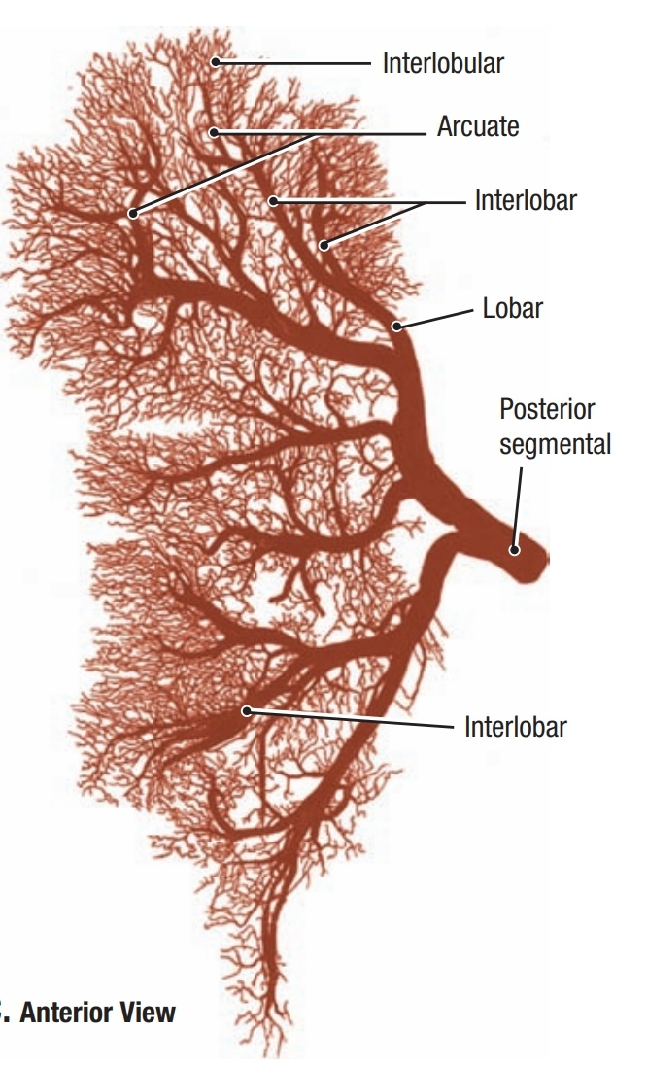

Slide 28
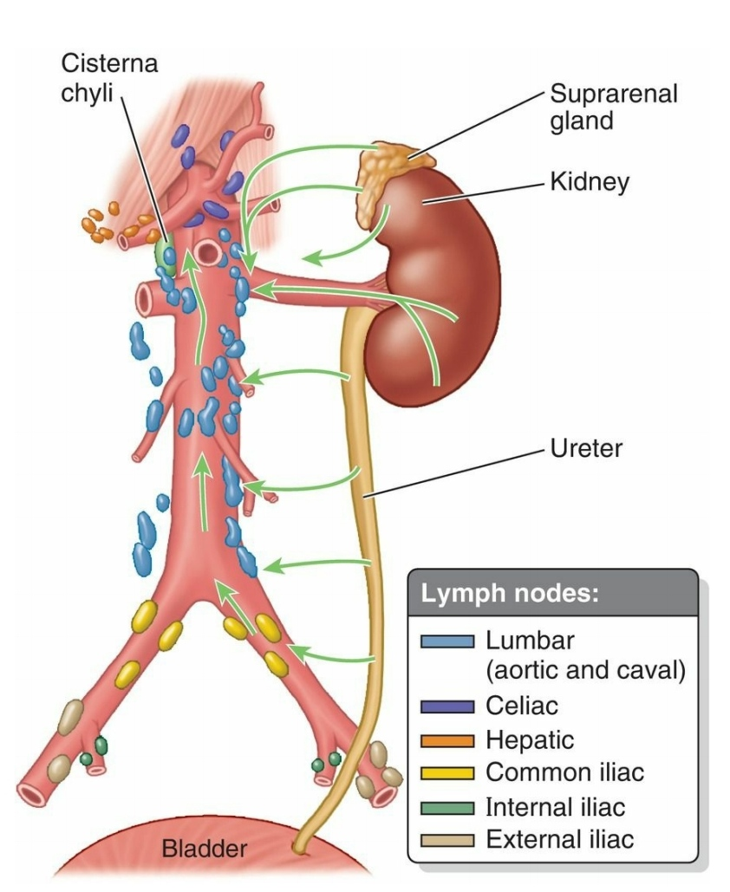
Lymphatic drainage of kidney
Drains into lateral aortic nodes following the course of blood vessels

Slide 29
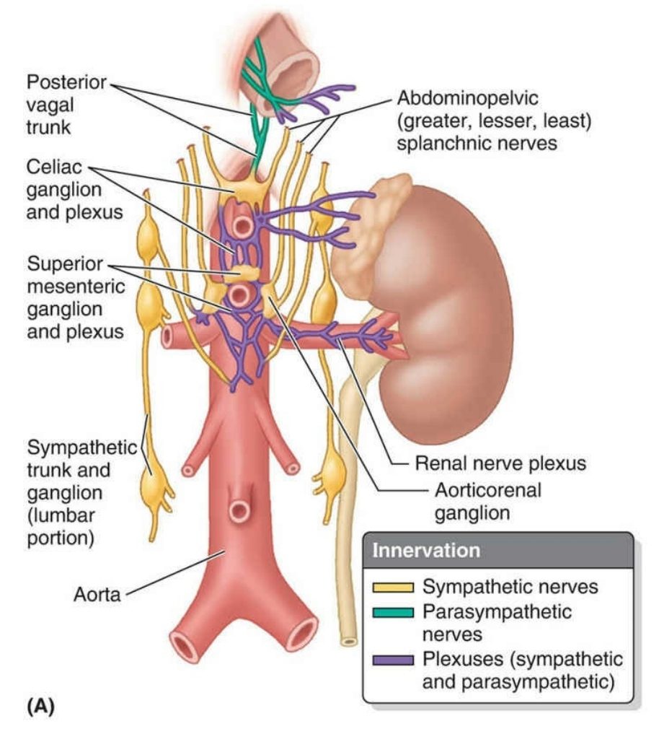
Nerve supply
Sympathetic
  Derived from renal plexus
    T10 – L1
Parasympathetic
  By both vagus

Slide 30
Applied anatomy
Glomerular diseases
  A number of different diseases can result in glomerular diseases
  It may be due to an infection or drug toxic of kidney
              or
  It may result from a disease that affects the entire body such as diabetes or systematic lupus erythematosus
Nephrotic syndrome
  In this condition the glomerular basement membrane becomes leaky
  Which results in
    Proteinuria
    Hypoalbuminaemia
    Oedema
Acute Nephritic syndrome
  In this condition there is a Haematuria, Proteinuria ,Oedema & Hypertension

