Slide 1
Joints, surface anatomy, radiology of head & neck

Slide 2
Joints of head, neck
Skull joints
Joints of neck
  Atlanto-occipital joint
  Atlanto-axial joint
  Intervertebral joint
Joints between ear ossicles
Temporomandibular joint

Slide 3
Skull joints
Most are fibrous joints called sutures
Important sutures of skull
  Metopic suture
  Coronal suture
  Sagittal suture
  Lambdoid suture
  Squamosal suture
  Pterion
  Intermaxillary suture

Slide 4
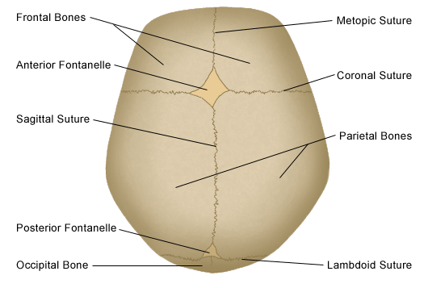
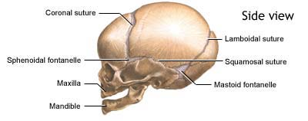
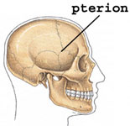
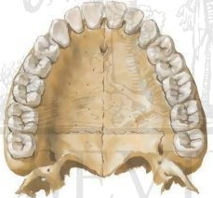
Important sutures of skull
Intermaxillary suture

Slide 5
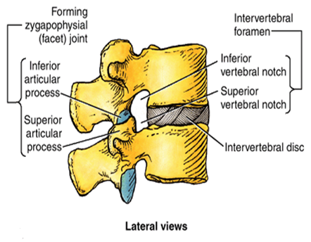
Joints of neck
Joints between two vertebra (intervertebral joints)
  Zygapophysial joint (facet joint)
    Plane synovial joint
    Between superior articular process of one vertebra and inferior articular process of vertebra directly above it
    Prevent one vertebrae from slipping anteriorly on the vertebra below
  Secondary cartilaginous joint
    Between vertebral body

Slide 6
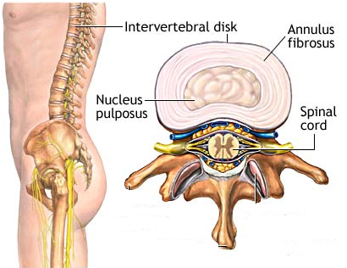
Intervertebral disc
Between bodies of two vertebra
Functions as a shock absorber
Two parts
  Nucleus pulposus
    Jelly like substance, situated in central portion of intervertebral disc
    Remnant of notochord
  Annulus fibrosus
    Consists of concentric layer of fibrous tissue and fibrocartilage

Slide 7
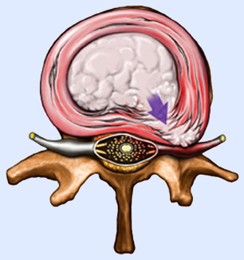
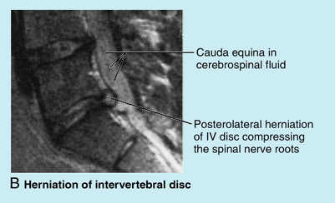
Disc prolapse (herniated intervertebral disc)
In disc prolapse nucleus pulposus herniate posterolaterally, usually rupture annulus fibrosus and compress the root

Slide 8
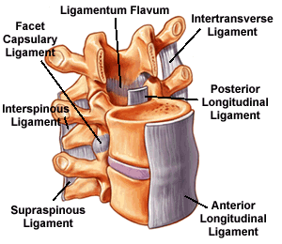
Ligaments of vertebral column
Notes:
Ant. longitudinal lig; post longitudinal lig; ligamentum flavum (connects the lamina of two adjacent vertebra); interspinous lig; supraspinous lig
Anterior longitudinal ligament – all vertebra
Posterior longitudinal ligament - sacrum to axis

Slide 9
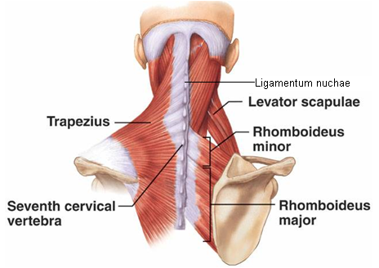
Ligamentum nuchae
Thickened supraspinous and interspinous ligament
Triangular in shape
Apex lies at 7th cervical spine and base at external occipital crest
Anterior border is attached to cervical spines, while posterior border is free and provides attachment to investing layer of deep cervical fascia
Gives origin to splenius, rhomboid and trapezius

Slide 10
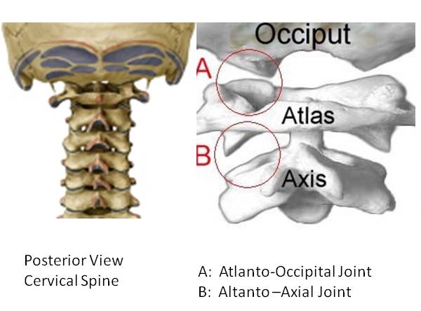
Atlanto-occipital joint
Condylar synovial joint
Articular surface
  Occipital condyle above
  Facets on the superior surfaces of lateral masses of atlas below

Slide 11
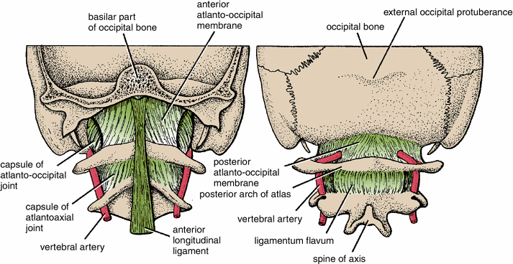
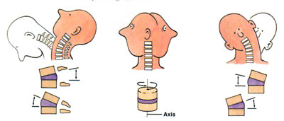
Ligaments and movement
Ligaments
  Fibrous capsule
  Anterior atlanto-occipital membrane
    Continuation of anterior longitudinal ligament
  Posterior atlanto-occipital membrane
    Continuation of ligamentum flavum
Movements
  Flexion, extension
  (“yes” movement), lateral flexion, no rotation
Notes:
Anterior atlanto-occipital membrane
Connect anterior arch of atlas to anterior margin of foramen magnum
Continuation of anterior longitudinal ligament
Posterior atlanto-occipital membrane
Connect posterior arch of atlas to posterior margin of foramen magnum
Similar to ligamentum flavum

Slide 12
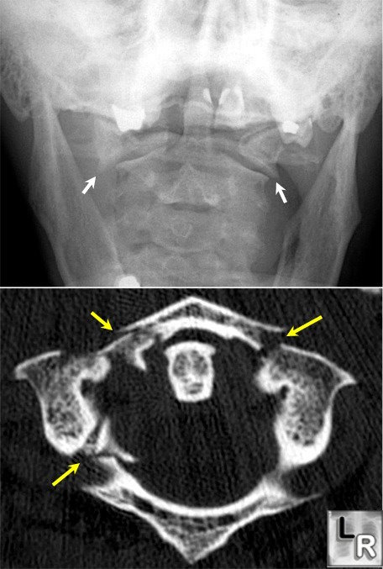
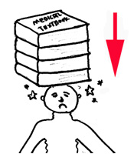
Compression fracture
Jefferson’s fracture( # of C1)
In the cervical region, with the neck straight, an excessive vertical force applied from above will cause ring of atlas to be disrupted

Slide 13
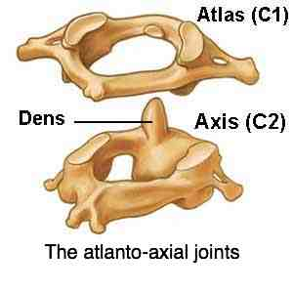
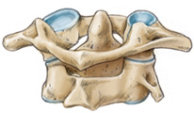
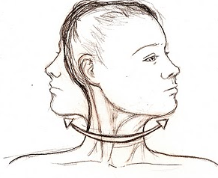
Atlantoaxial joint
3 synovial joint
  One median atlantoaxial joint
    Between odontoid process and anterior arch of atlas
    Pivot synovial joint
  Two right and left lateral atlantoaxial joint
    Between facets of C1 and C2
    Plane synovial joint
Movement
  Side to side
  (called “no” movement)

Slide 14
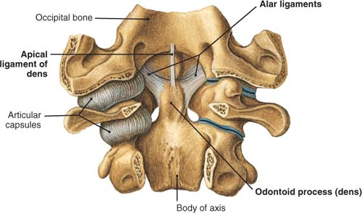
Ligaments
Apical ligament
  Apex of odontoid process to anterior margin of foramen magnum
Alar ligament
  One each side of apical lig.
  Connect odontoid process to the medial sides of occipital condyle
Notes:
Present most anterior

Slide 15
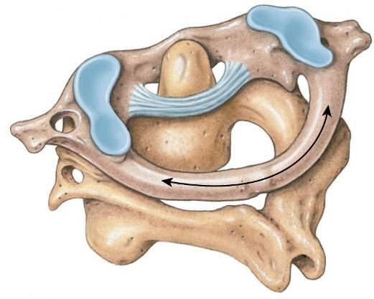
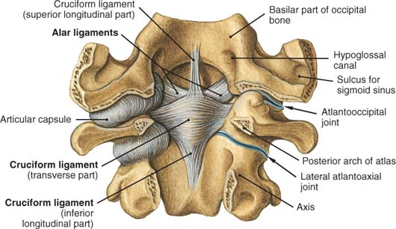
Cruciate ligament
  Transverse part
    Attached on each side of inner aspect of lateral mass of atlas
    Binds odontoid process to anterior arch of atlas
  Longitudinal (vertical) part
    Posterior surface of body of axis to anterior margin of foramen magnum
Notes:
Present in middle

Slide 16
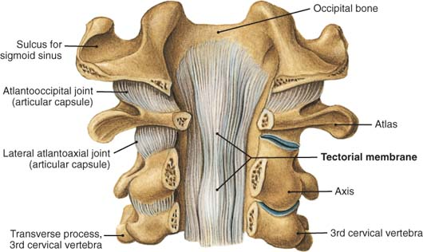
Membrana tectoria
  Upward continuation of posterior longitudinal ligament
  Attached above to occipital bone just within foramen magnum
  Covers the apical, alar, and cruciate ligaments
Notes:
Present most posterior

Slide 17
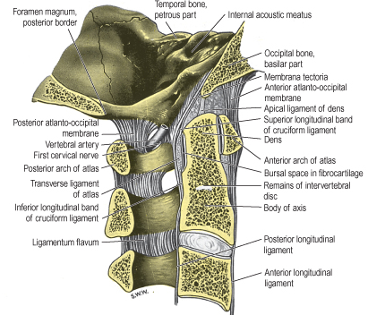
Important ligaments

Slide 18
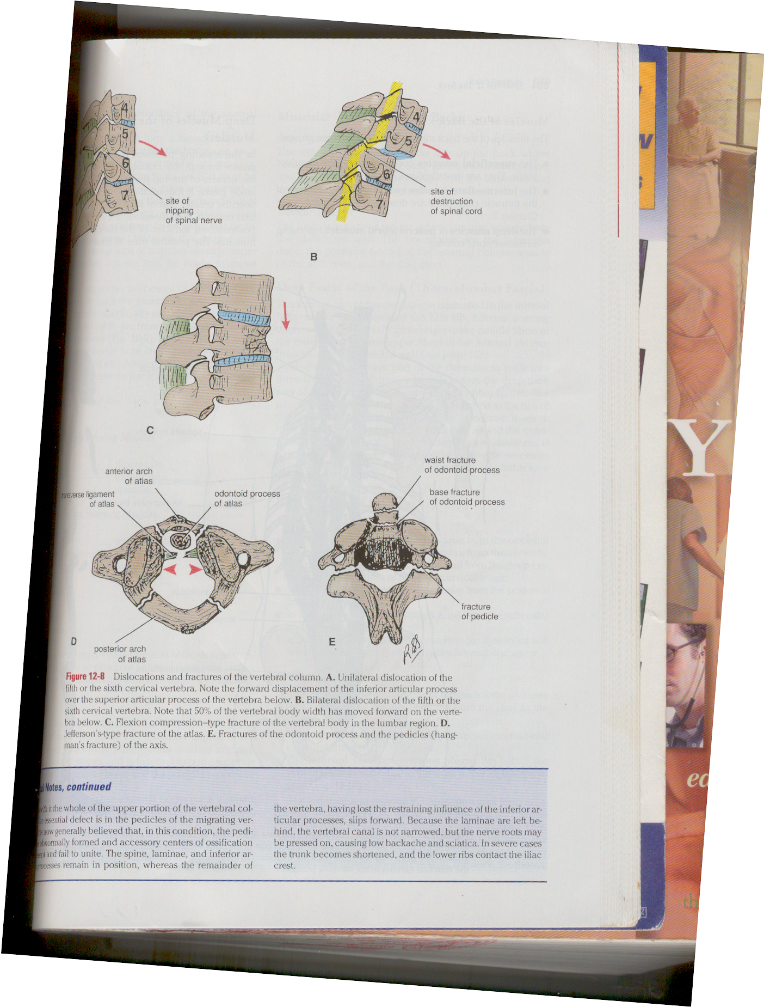
Hangman’s #
Fracture of dens and the pedicles of C2
Occur in hanging

Slide 19
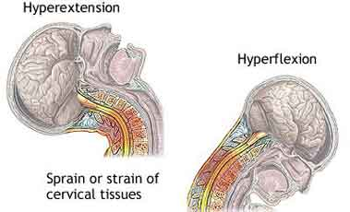
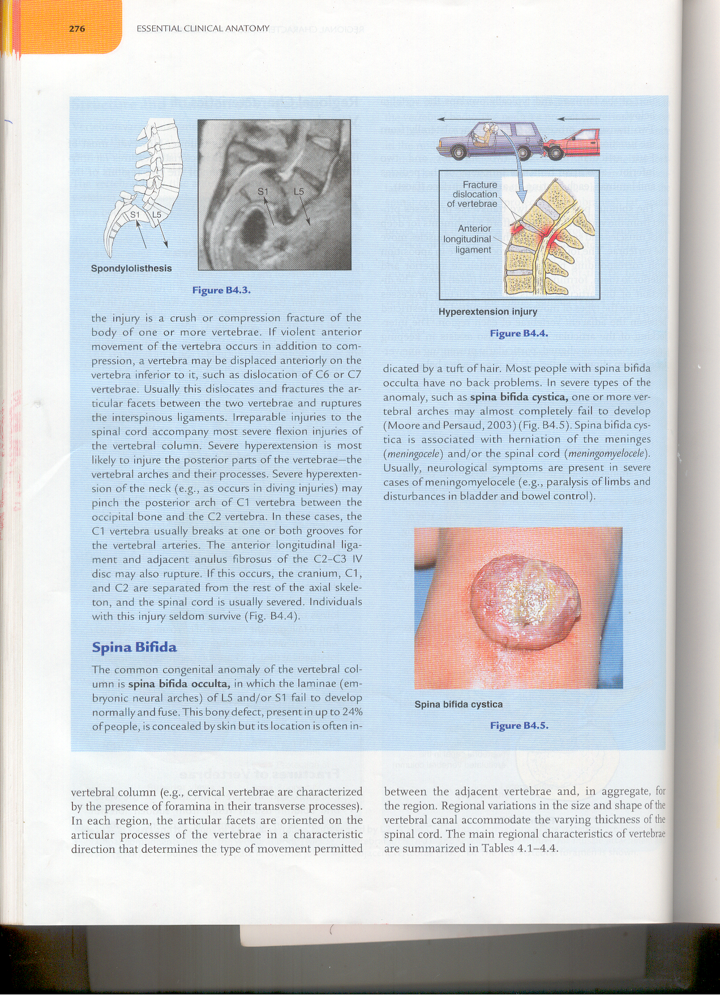
Whiplash injury of neck
Occur due to hyperextension followed by hyperflexion of neck rapidly
Occur in rear-end mobile collision
Occur frequently at the junction of C4&C5, vertebra; C1-C4 act as lash and C5-C7 vertebra act as the handle of whip
Notes:
Produced by a force that drives the trunk forward while the head lags behind, causing the head to hyperextend and neck to hyperflex rapidly

Slide 20
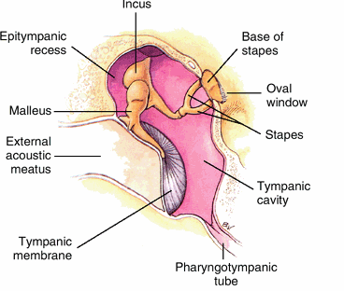
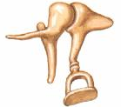
Joints of the ossicles
Between malleus and incus (incudomalleolar joint)
  Saddle joint
Between incus and stapes (incudostapedial joint)
  Ball and socket joint
Both are surrounded by capsular ligament

Slide 21
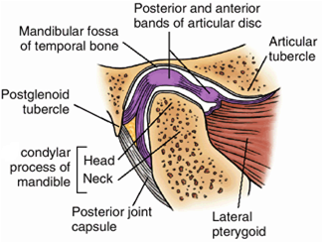
Temporomandibular joint
Type of joint
    Condylar synovial (modified synovial hinge) joint
Articular surfaces
    Articular tubercle & mandibular fossa above and head of mandible below

Slide 22
  Articular surface is covered by a fibrocartilagenous disc which divide joint into upper & lower part
  Forward gliding (protrusion) and backward gliding (Retraction)
    Upper part of joint
  Elevation & depression
    Lower part of joint
Notes:
Peripheral of disc is connected to fibrous capsule
Disc is also connected to lateral pterygoid muscle

Slide 23
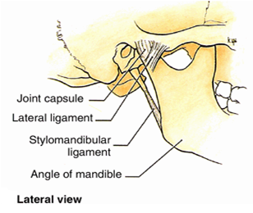
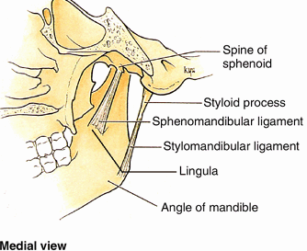
Ligaments
Fibrous capsule
  Attached to margin of articular area on temporal bone and around neck of mandible, lined internally by synovial membrane
Lateral ligament
  Extends from tubercle of zygoma to neck of mandible, strengthens the joint laterally
Sphenomandibular ligament
  Extends from spine of sphenoid to lingula of mandible
Stylomandibular ligament
  Extend from styloid process to angle of mandible

Slide 24
Movements at temporomandibular Joint
Movements of Mandible | Muscles
Elevation (close mouth) | Temporal, masseter, and medial pterygoid
Depression (open mouth) | Lateral pterygoid and suprahyoid and infrahyoid muscles
Protrusion (protrude chin) | Lateral pterygoid, masseter, and medial pterygoid
Retrusion (retrude chin) | Temporal (posterior oblique and near horizontal fibers)
Lateral movements (grinding and chewing) | Temporal of same side, pterygoids of opposite side, and masseter

Slide 25
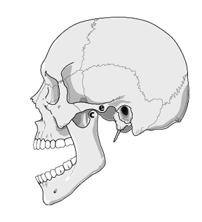
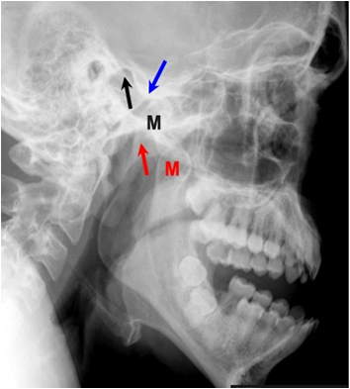
Applied
Dislocation of mandible
Anterior dislocation is common. Occur due to excessive opening of mouth during yawning or taking a large bite. Head comes to lie below articular tubercle
Derangement of articular disc
  Result from injury like over closure or malocclusion. This give rise to clicking and pain during movement of jaw
Notes:
Dislocated mandible. Both mandibular condyles (labeled M) are dislocated anterior to
their respective mandibular fossae (red and black arrows) in the temporal bones. The blue arrow
points to the articular eminence which prevents the mandibular condyle (black M) from relocating
in the mandibular fossa (black arrow).

Slide 26
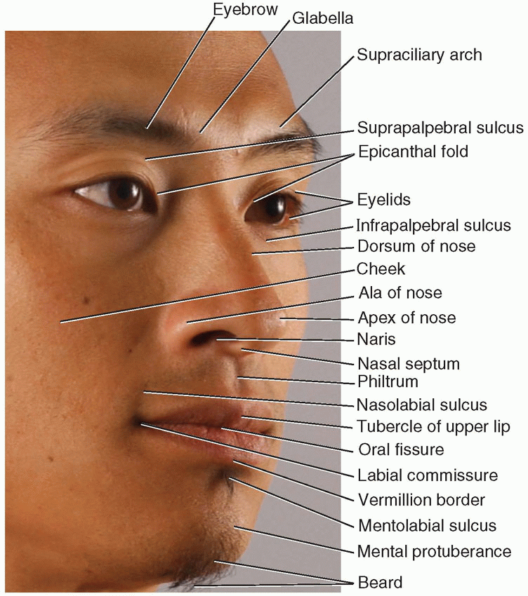
Surface anatomy of head & neck

Slide 27
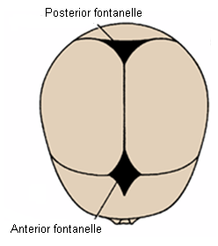
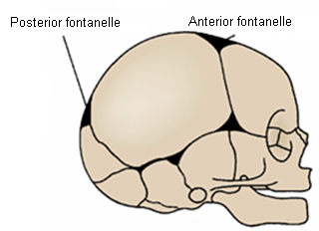
Important surface landmarks of head
Anterior fontanelle
  Between frontal bone infront and two halves of parietal bones behind
  Bregma in adult
Posterior fontanelle
      Between squamous part of occipital bone and posterior border of two parietal bones
      Lambda

Slide 28
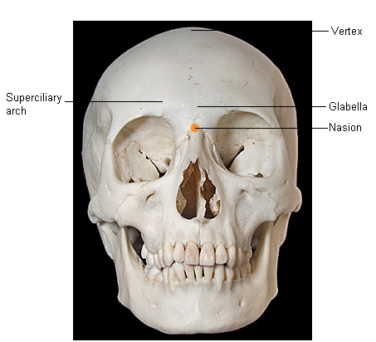
Nasion
  Depression in the midline at root of nose
Glabella
  Meeting point of two superciliary arches
Vertex
  Highest point on skull in the sagittal plane

Slide 29
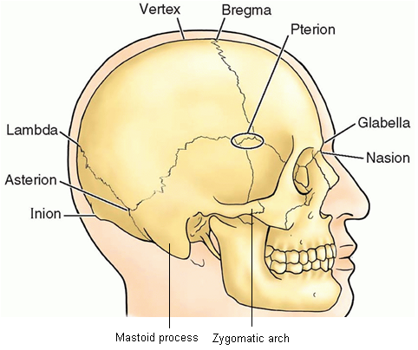
Pterion
  Lie 1.5 inch above midpoint of zygomatic arch
  Beneath it lies anterior branch of MMA
Zygomatic arch
  Extend forward in front of ear
  Above is temporal fossa
  Attached to lower margin is masseter muscle
Mastoid process of temporal bone
  Projects downward and forward behind the ear
  Develop after 2 years
Notes:
MMA – middle meningeal artery

Slide 30
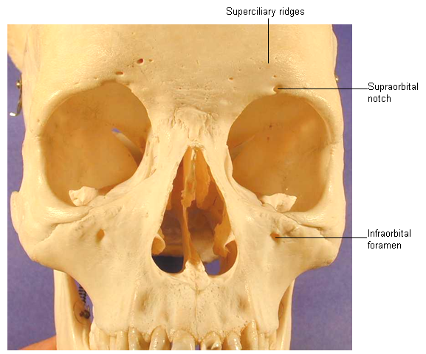
Orbital margin
  Formed by frontal, zygomatic and maxillary bones
Superciliary ridges (arch)
  Two prominent ridges on the frontal bones above the upper margin of orbit
  Deep to these ridges on either side of midline lie frontal air sinuses
Supraorbital notch
  Junction of medial and intermediate third of upper margin of orbit
Infraorbital foramen
  Lie 5mm below lower margin of orbit, on a line drawn from the supraorbital notch
  Transmit infraorbital nerve and vessels
Maxillary air sinus
  Situated within maxilla below infraorbital foramen each side

Slide 31
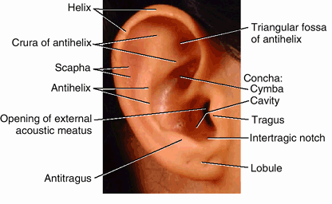
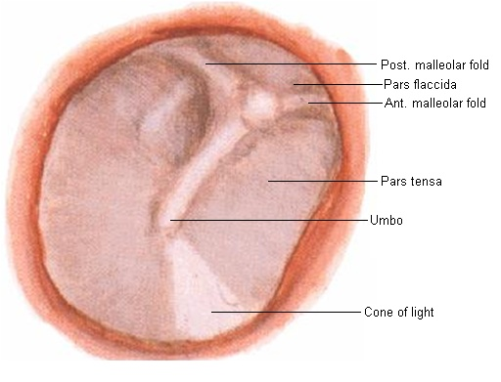
Auricle and external acoustic meatus
  Lie in front of mastoid process
  To examine the tympanic membrane
    In the adult
      Auricle should be pulled upward and backward
    In children
      Slightly downward and backward
Tympanic membrane
  Gray and concave toward the meatus
  Most depressed part is called umbo
  Caused by attachment of handle of malleus on its medial surface

Slide 32
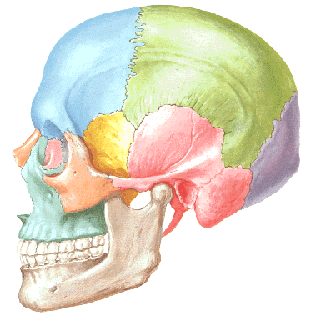
Suprameatal triangle
  Anterior
    Posterior border of the external acoustic meatus
  Superior
    Posterior root of the zygomatic arch
  Posterior
    A line joining the two
Mastoid antrum lie deep to it

Slide 33
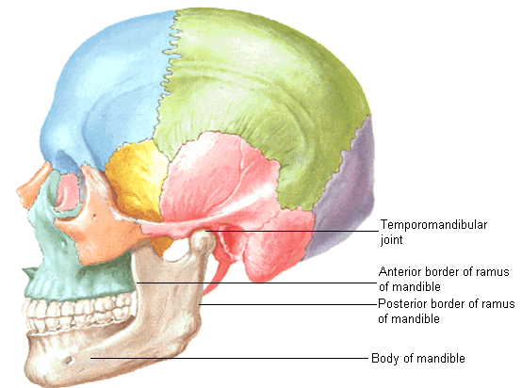
Temporomandibular joint
  Easily palpated in front of auricle while opening the mouth
Anterior border of ramus of mandible
  Felt deep to anterior border of masseter muscle
Posterior border of ramus of mandible
  Felt deep to posterior border of masseter muscle
Body of mandible
  Best examined by having one finger inside the mouth and another on outside

Slide 34
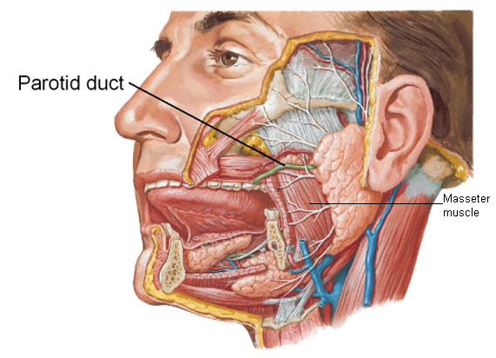
Border of masseter
  Can be easily felt by clenching the teeth
Parotid duct
  Runs forward one finger breadth below zygomatic arch
  It can be rolled beneath the examining finger at the anterior border of masseter as it turns medially and opens into the mouth opposite upper 2nd molar tooth

Slide 35
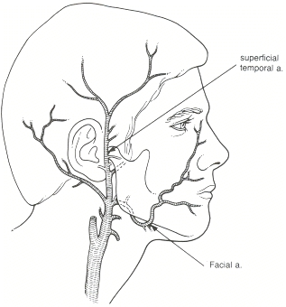
Superficial temporal artery
  Pulsations can be felt in front of auricle
Facial artery
  Pulsation can be felt as it crosses the lower margin of body of mandible, at anterior border of masseter

Slide 36
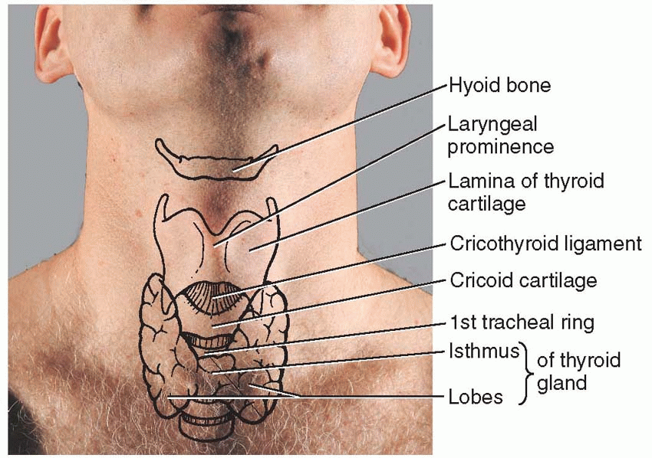
Surface landmarks of neck
Anterior aspect
Symphysis menti
  Junction of two half of mandible
Submental triangle
  Between symphysis menti and body of hyoid bone
Body of hyoid bone
  Opposite 3rd cervical vertebra
Upper border of thyroid cartilage
  Opposite 4th cervical vertebra
Cricoid cartilage
  At level of 6th cervical vertebra
Notes:
Cricoid cartilage level – C6, junction of larynx and trachea, junction of pharynx and esophagus, middle cervical ganglion, inferior thyroid artery enters inside thyroid gland

Slide 37
Thyrohyoid ligament/ membrane
  Between hyoid bone and thyroid cartilage
Cricothyroid ligament
  Between cricoid cartilage and thyroid cartilage
Cricotracheal ligament
  Junction of cricoid cartilage and 1st tracheal ring
1st tracheal ring
  Just below cricoid cartilage
    Isthmus of thyroid gland
      In front of 2nd, 3rd and 4th tracheal ring
Notes:
Thyrohyoid ligament is pierced by the superior laryngeal vessels and the internal branch of the superior laryngeal nerve.

Slide 38
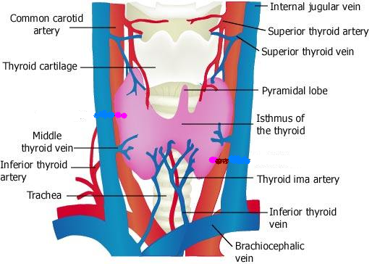
Inferior thyroid vein
  In front of 5, 6 and 7th tracheal ring
Thyroid ima artery
  When present ascends in front of trachea to isthmus of thyroid gland, from brachiocephalic artery
Notes:
Thyroid ima artery usually arises from brachiocephalic trunk or arch of aorta

Slide 39
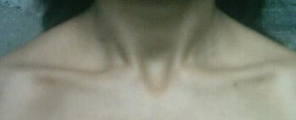
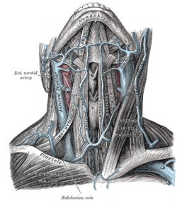
Suprasternal notch (Jugular notch)
  Superior border of manubrium
  Lie opposite the lower border of body of 2nd thoracic vertebra
Jugular venous arch
  Two anterior jugular vein are connected with each other just above suprasternal notch

Slide 40
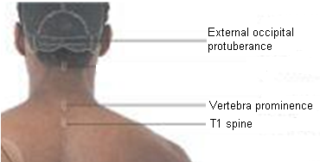
Surface landmarks of neck
(Posterior aspect)
External occipital protuberance
  Bony prominence on back of skull
  Line joining nasion to this protuberance superiorly indicates the position of falx cerebri, superior sagittal sinus
Superior nuchal line
  Curved line extending from external occipital protuberance to mastoid process
  Gives attachment to trapezius and sternocleidomastoid
Vertebra prominence
  Spine of 7th cervical vertebra
Ligamentum nuchae
  From spine of 1st to 7th cervical vertebra

Slide 41

Surface landmarks of neck
(Lateral aspect)
Sternocleidomastoid muscle
  Can be palpated from sternum and clavicle to mastoid process
  Divide neck into anterior and posterior triangle
Trapezius muscle
  Can be felt by asking the patient to shrug his shoulders
Platysma muscle
  Can be seen as a sheet of muscle by asking the patient to clinch the jaw firmly

Slide 42

Anterior triangle of neck
  Carotid sheath
    Marked out by line joining the sternoclavicular joint to a point mid way between tip of mastoid process and angle of mandible
    At the level of upper border of thyroid cartilage CCA divides in ECA and ICA. Pulsation of these arteries can be felt at this level

Slide 43

Posterior triangle of neck
  Nerve point
    Mid point of SCM
  Accessory nerve
    Line from nerve point to trapezius
Notes:
SCM – sternocleidomastoid

Slide 44


Facial nerve
  Stylomastoid foramen
    Situated about 2.5 cm from surface, opposite middle of anterior border of mastoid process
  Horizontal line from this point to ramus of mandible overlies stem of nerve

Slide 45

Subclavian artery
  Indicated by curved line, which passes upward from the sternoclavicular joint for about 0.5 inch and then downward to the middle of clavicle
  Here it lies on upper surface of 1st rib, that is pulsation can be felt
  Subclavian vein lie behind the clavicle

Slide 46

External jugular vein
  Lie in superficial fascia deep to platysma
  Passes downward from the region of angle of mandible to middle of the clavicle
  Perforates the deep fascia just above the clavicle and drains into the subclavian vein

Slide 47

Surface marking of salivary glands
Parotid gland
  Lies below the ear in the interval between mandible and anterior border of SCM
Submandibular gland
  Superficial part
    Lies beneath lower margin of body of mandible
  Deep part, submandibular duct and the sublingual gland
    Can be palpated through the mucous membrane covering the floor of mouth in the interval between the tongue and lower jaw
    Submandibular duct opens into the mouth on the side of the frenulum of the tongue

Slide 48
Radiology of head & neck
Skull x-ray (lateral view)
Skull x-ray (AP view)
Skull x-ray (AP view) with mouth open
MRI of orbit
Neck x-ray (lateral view)
CT of neck

Slide 49

Skull x-ray (lateral view)
F. Frontal sinus
P. Orbital plate of frontal bone
E. Ethmoidal sinus
M. Maxillary sinus
S. Sphenoidal sinus
H. Hypophyseal fossa
N. Nasopharynx
T. Petrous part of temporal bone
Mc. Mastoid air cells
IT. Inner table of bone
D. Diploe
OT. Outer table of bone

Slide 50

Skull x-ray (AP view)

Slide 51

Radiograph of the Odontoid Process and the Atlantoaxial Joints
Notes:
NOTE: This is an anteroposterior projection taken through the oral cavity as shown in the diagram.

Slide 52

Axial (horizontal) magnetic resonance imaging showing the contents of the orbital and cranial cavities
Notes:
Note that the eyeballs, the optic nerves, the optic chiasma, and the extraocular muscles can be identified.

Slide 53

Superior oblique
Lacrimal gland
MRI Orbit

Slide 54

Cervical Spine (lateral View)

Slide 55

CT scan of head, neck

Slide 56
Angiogram of head, neck
Carotid CT angiogram
Vertebral arteriogram (lateral and posterior view)
Cerebral venous sinuses MR (magnetic resonance) venogram
Angiogram circle of Willis

Slide 57

Carotid CT angiogram
Common Carotid Artery.
Internal Carotid Artery.
Ascending pharyngeal Artery.
Occipital Artery.
Superficial Temporal Artery.
Middle cerebral Artery.
Anterior cerebral Artery.
Middle meningeal Artery.
Maxillary artery.
Facial artery.
Lingual artery.
External carotid artery.
Superior thyroid artery.

Slide 58

Internal carotid arteriogram (Lateral View)
1. Internal carotid artery (cervical part)
2. Internal carotid artery (petrous part),
3. Internal carotid artery (cavernous part),
4. Ophthalmic artery,
5. Anterior cerebral artery,
6. Middle cerebral artery

Slide 59

Vertebral arteriogram (Posterior View)
Vertebral artery
Basilar artery
Posterior inferior cerebellar artery
Anterior inferior cerebellar artery
Superior cerebellar artery
Posterior cerebral artery (sometimes referred to as the artery of sight)
Occipital branch of the posterior cerebral artery

Slide 60

Circle of Willis

Slide 61

Angiogram showing Circle of Willis

Slide 62

Cerebral venous sinuses MR (magnetic resonance) venogram

