Slide 1
HISTOLOGY OF URINARY SYSTEM
Sarangdhar kumar
Assistant professor
Department of anatomy
Rohilkhand medical college
Bareilly

Slide 2
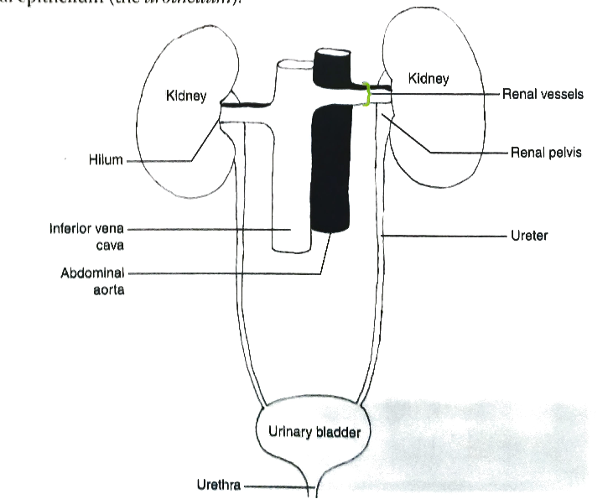
Urinary system consists of
  Pair of kidney
  Pair of ureter
  A Urinary bladder
  A urethra
Main function is to remove metabolic waste product from blood
Also help in regulating fluid & electrolyte

Slide 3
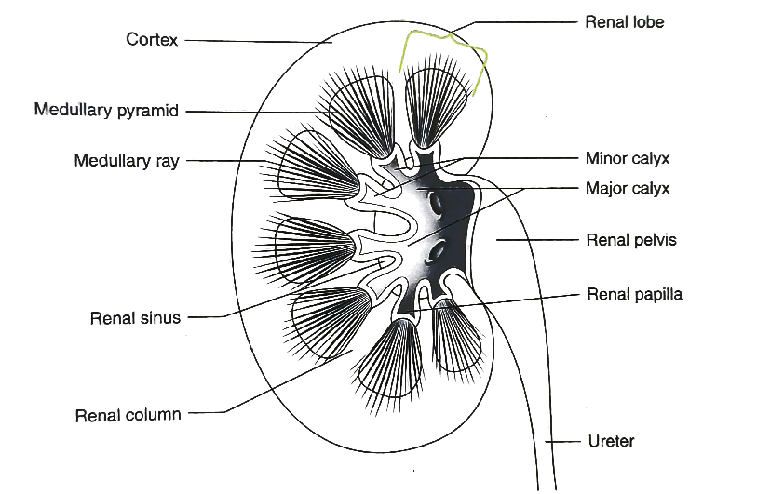
The urine produced by kidney is conveyed outside the body by excretory passages
Excretory passages consists of
  Minor & Major calyces
  Renal pelvis
  Ureter
  urinary bladder
  Urethra
These are hollow tube
Wall of these tube have similar organization & consists of mucosa , muscle layer and adventitia (except urethra)
Mucosal lining of most of these tube is transitional epithelium (Urothelium) , except some parts of urethra

Slide 4
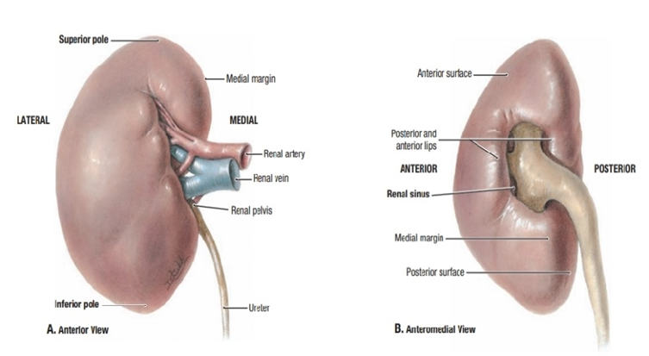
Kidney
Retroperitoneal organ
Located in the posterior abdominal wall at the level of T12 – L3 vertebrae
Bean shaped & medial border has central concavity known as hilum
It secretes -
    Renin – for autoregulation of blood flow & blood pressure
    Erythropoietin – for maturation of RBC
    1,25 dihydroxy cholecalciferol - for control of calcium metabolism

Slide 5
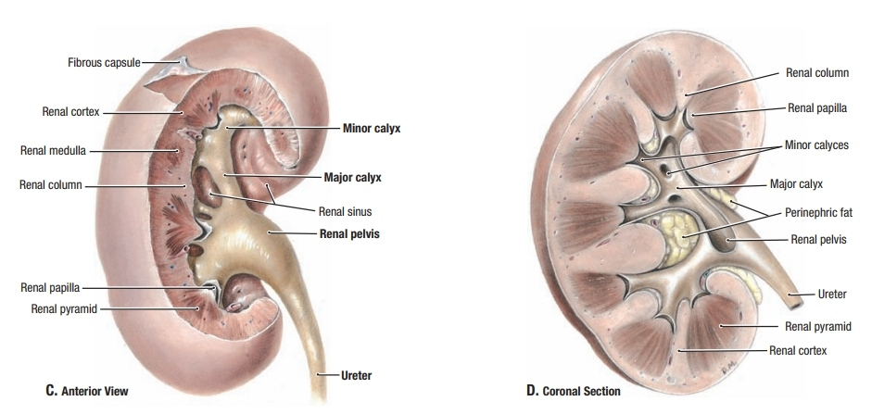
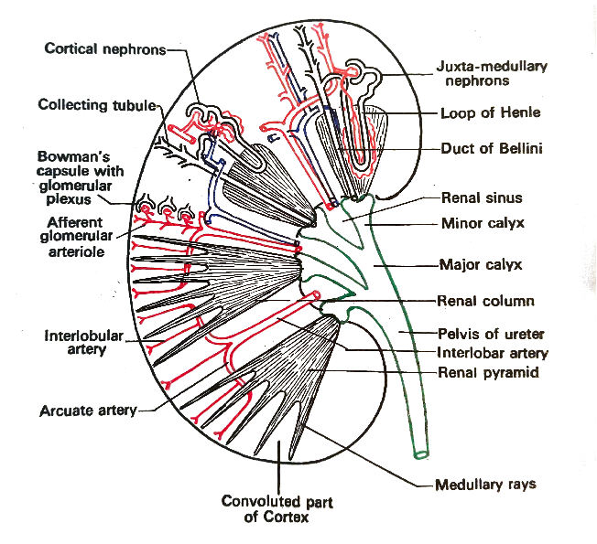
Internal structure of kidney
(Macroscopic)
On Coronal section the specimen presents two parts outer renal substance & inner renal sinus
Renal substance –
  Consists of inner medulla & outer cortex
Medulla-
  Consists of 10 – 15 medullary pyramids
  Base of each pyramid is directed towards the cortex & apex projects into renal sinus

Slide 6

Apex of pyramid is known as renal papilla
Pyramid contains
  The collecting duct
  Loop of Henle
  Vasa recta
Renal papilla is open at the funnel shaped minor calyx

Slide 7
Cortex –
  Surrounding the medulla
  Contains renal corpuscles
    PCT
    DCT
    Medullary rays
      Thin projection of medulla from the base of medullary pyramid into cortex
    Interlobular artery & veins

Slide 8
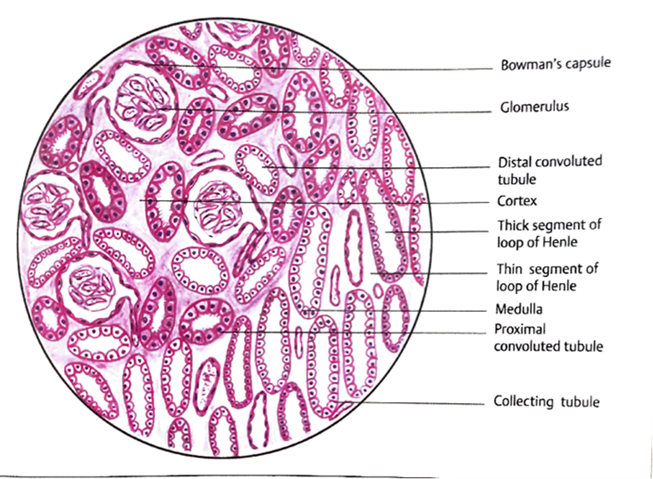
Microscopic structure of kidney
Histologically the kidney consists of three components
Stroma
  The capsule
  Interstitium
    Connective tissue which support the parenchyma
Parenchyma
  Consists of nephrons
Collecting system
  Includes collecting tubules & ducts

Slide 9
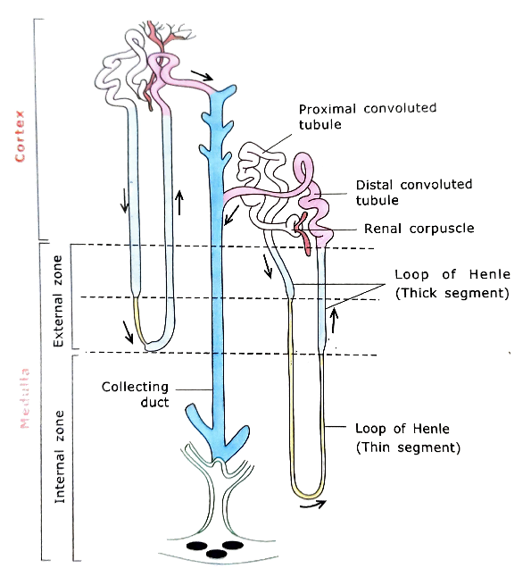
Nephron
  Structural & functional unit of kidney
  Major part of a nephron is located in the cortex & parts of it is present in medulla
  Each nephron consists of –
    Renal corpuscle
      Consists of Bowman’s capsule & glomerulus
    Tubule
      Consists of PCT , loop of Henle & DCT

Slide 10
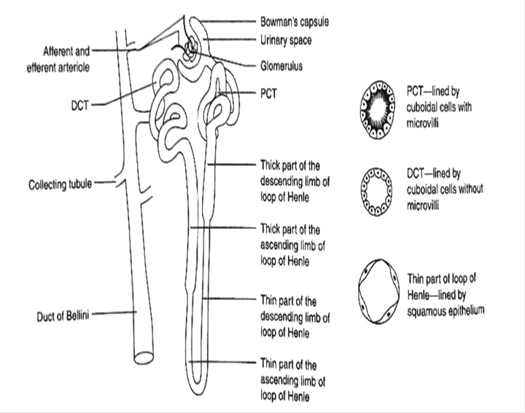

Slide 11
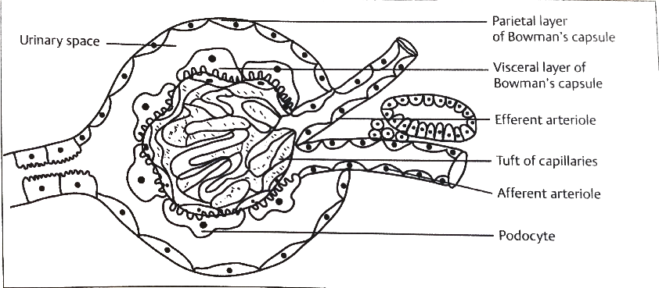
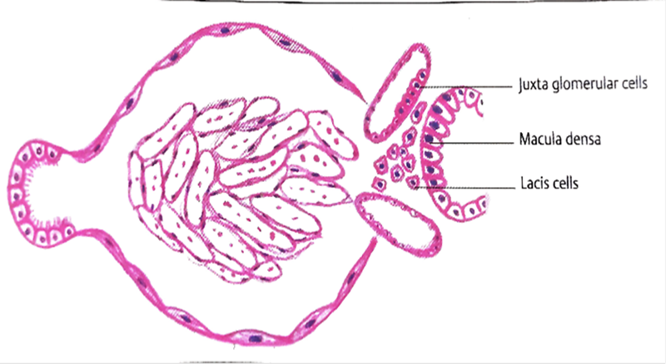
Renal corpuscle
  Present in cortex
  Present two poles
    Vascular pole
    Urinary pole
  Consists of Bowman’s capsule & glomerulus
Bowman’s capsule
  Is blind beginning of nephron
  Invaginated by tufts of capillaries called glomerulus
  Afferent arteriole enters the renal corpuscle through vascular pole which divides into capillaries
  These capillaries join to form efferent arteriole which leaves the glomerulus through vascular pole

Slide 12
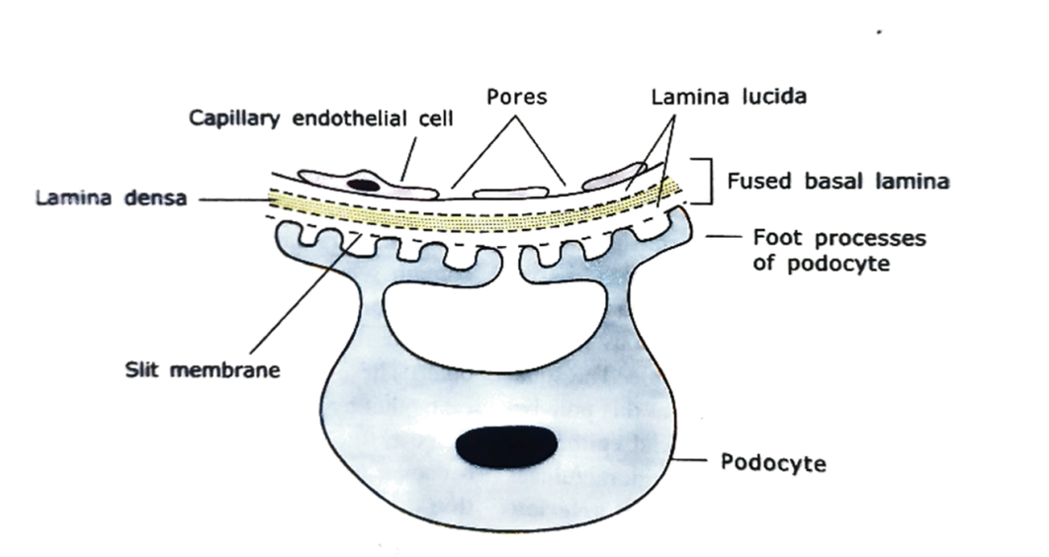
  It consist of two layers
    Parietal layer
      Lined by simple squamous epithelium
    Visceral layer
      Lined by podocytes
  Space b/w two layers is called urinary space (Bowman’s space)
  At vascular pole both layers are continuous with each other
The process of urine formation begins with filtrate of blood plasma at the renal corpuscle

Slide 13
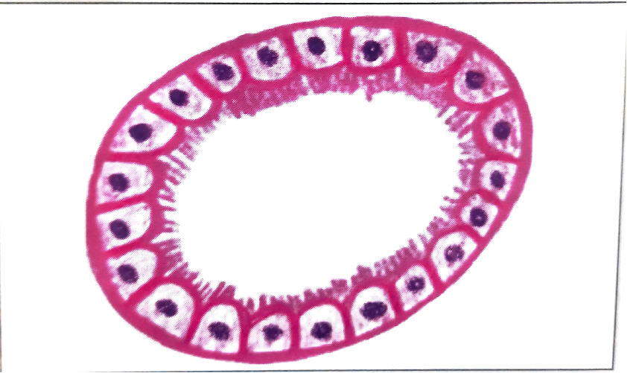
Tubule
Proximal convoluted tubule (PCT)
  Longest part of nephron
  Begins at urinary pole of renal corpuscle
  Lined by simple cuboidal epithelium with microvilli(brush border)
  Nuclei are round & centrally placed
  Reabsorption of various component (about 75%) of glomerular filtration occurs here –
    Na & Cl (80%)
    water (85%)
    Amino acid ,ascorbic & lactic acid (100%)
    Glucose
    Bicarbonate

Slide 14
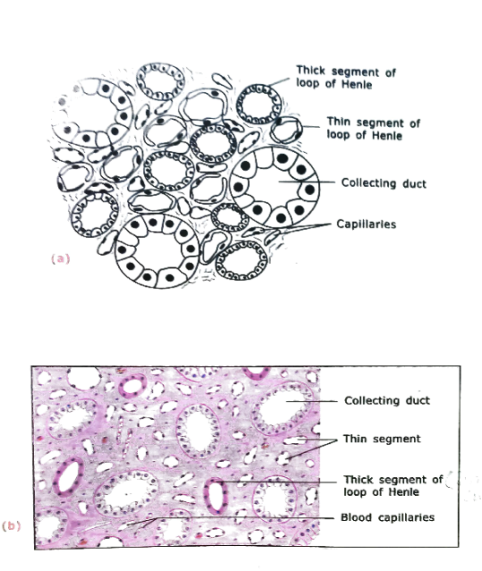
Loop of Henle (LOP)
  It is ‘U’ shape tube arising from PCT
  Descends from cortex into medulla & then return back into the cortex & end into DCT
  It has descending limb & ascending limb
  Each limb has thick & thin parts
    Thick part – lined by cuboidal epithelium
    Thin part – lined by squamous epithelium with few microvilli
  It helps in increasing the osmotic gradient in the medulla
  The gradient allows concentration of urine in the collecting duct

Slide 15
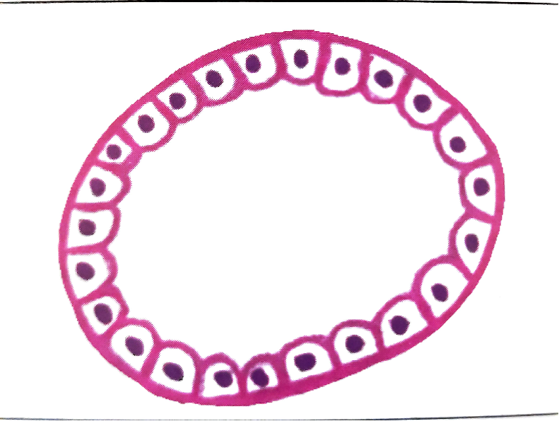
Distal convoluted tubule (DCT)
  Present in cortex
  Continuation of ascending limb of LOH
  Lined by simple cuboidal epithelium
  Do not have microvilli
  Large regular lumen
  Involved in reabsorption of salt, water & bicarbonate
  It is under control of antidiuretic hormone (ADH) which promotes reabsorption

Slide 16

Juxtaglomerular apparatus
  Present in the vascular pole of the kidney
  It has a three components
    Macula densa
    Juxtaglomerular cells
    Lacis cell/ Polkissen cells

Slide 17
Macula densa
  Specialized cells of DCT coming in contact with afferent arteriole
  Cells lining DCT becomes tall & nuclei are aggregated to form macula densa
  Acts as an osmoreceptor ( responding the concentration of sodium in DCT)
Juxtaglomerular cells
  Smooth muscle cells in tunica media of afferent arteriole becomes modified (large & rounded with spherical nucleus)
  It secrets renin,which increases the blood pressure

Slide 18
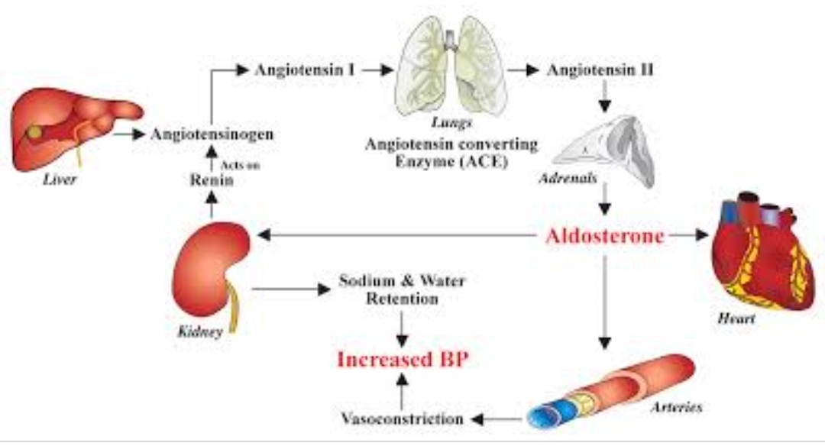
Renin angiotensin mechanism –

Slide 19

Lacis cells/ Polkissen cells
  Extra-glomerular mesangial cell
  Stellate in shape
  Produces a hormone erythropoietin
  It is also contractile ,thus regulate GFR
  Their phagocytic functions also help to remove large protein & maintain the integrity of filtration

Slide 20

Collecting tubule
  Begins in the cortex & proceed to the medullary ray where they join the collecting duct
  Collecting ducts in medulla run towards the apex of pyramid & join each other to form duct of Bellini
  Lined by simple cuboidal or columnar epithelium
  Brush border is not present
  Cells outline is clear
  Cells are lightly stained with eosin
  It play a role in final concentration of urine

Slide 21
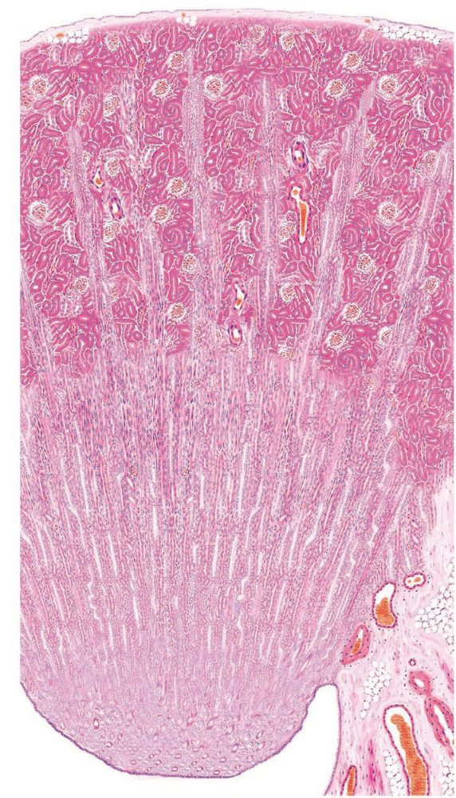


Slide 22
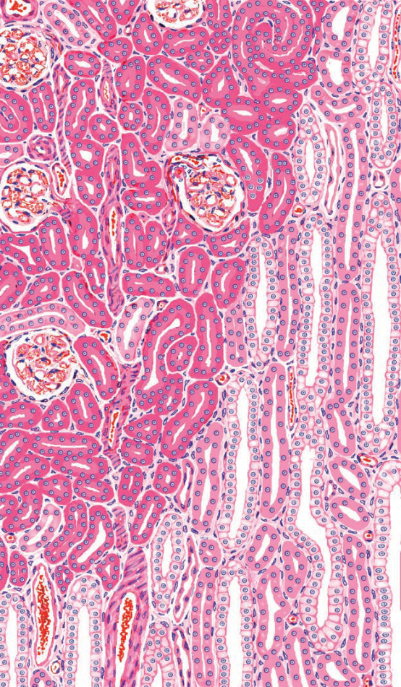

Slide 23

URETER
Muscular tube
Length – 25-30 cm
Convey urine from kidney to urinary bladder
It begins as s continuation of renal pelvis below the lower end of corresponding kidney

Slide 24
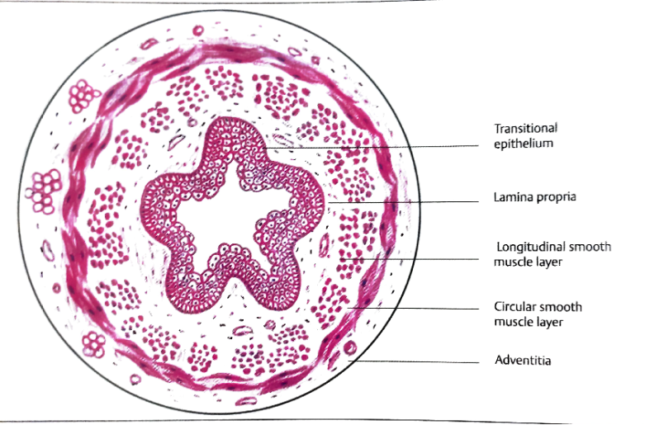
Microscopic structure of ureter
Wall of ureter consists of three layers-
  Mucosa
  Muscle layer
  Adventitia

Slide 25
Mucosa
  Extensively folded & gives lumen a star shaped appearance
  Lined by transitional epithelium
  4-5 cell thick with ill defined basement membrane
  Lamina propria is fibro-elastic connective tissue rich in blood vessels & nerves

Slide 26
Muscle layer
  Smooth muscle cells
  Upper part
    Inner – longitudinal layer
    Outer – circular layer
  Middle & lower part
    Inner – longitudinal
    Middle – circular
    Outer – longitudinal
Adventitia –
  Loose connective tissue
  Contains blood vessels, nerves & adipose tissue

Slide 27
URINARY BLADDER
Distensible reservoir of urine
It stores urine temporarily
Located in the lesser pelvis

Slide 28
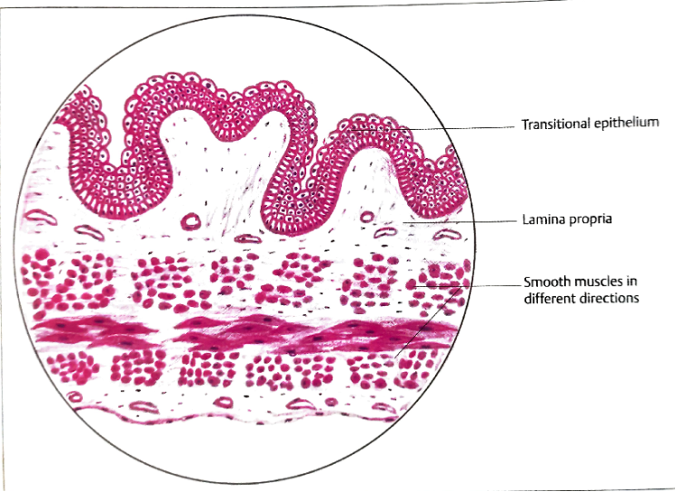
Microscopic structure of urinary bladder
Wall of urinary bladder consists of three layers
  Mucosa
  Muscle layer
  Adventitia/ serosa
Mucosa –
In empty bladder mucosa thrown into folds that disappear when bladder distended

Slide 29
Lined by transitional epithelium
4-7 cells thick in empty bladder
2-3 cells thick in distended bladder
Made of three distinctive layers of cells
    Basal layer – cuboidal , mitotic in nature
    Intermediate layer – polygonal cell, have a capacity to stretch
    Superficial layer – umbrella cells ,large binucleated , protective in function

Slide 30
  Lamina propria
    Made of connective tissue
    Contains blood vessels , lymphatics & nerves
Muscle layer
  it is made up of three indistinctive layers –
    Inner – longitudinal
    Middle – circular
    Outer – longitudinal
Adventitia / serosa
  Superior surface – covered by serosa
  Rest of the part – covered by adventitia

