Slide 1
HISTOLOGY
OF
SMALL INTESTINE
SARANGDHAR KUMAR
ASSISTANT PROFESSOR
DEPARTMENT OF ANATOMY
RMCH,BAREILLY

Slide 2
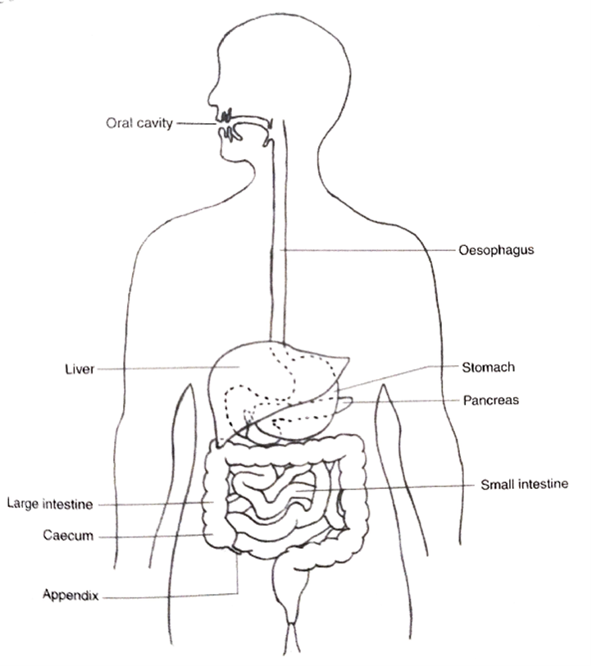
GENERAL FEATURE
6 m long
Divided into three parts
    Duodenum
    Jejunum
    Ileum
Principal site for absorption & digestion
To facilitate absorption, the luminal surface area is increased by presence of following structures
  Plica circularis(valve of Kecking)
  Intestinal villi
  Microvilli

Slide 3
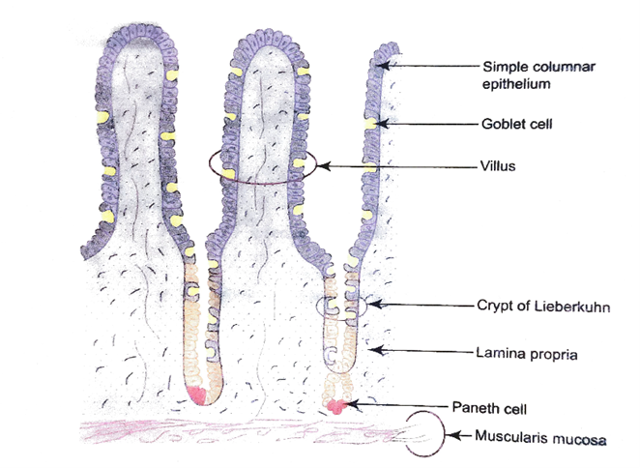
General microscopic structure
Mucosa
Lining epithelium
  Simple columnar epithelium with goblet cells
  Shows intestinal villi
  Crypts of Liberkuhn(intestinal gland)
  Renewed every 3-5 days
Lamina propria
  Connective tissue
  Contains fibroblasts, mast cells , plasma cells, lymphocytes + crypts of Lieberkuhn + lacteals + capillary loops
Muscularis mucosae
  Inner – circular muscle layer
  Outer – longitudinal muscle layer

Slide 4
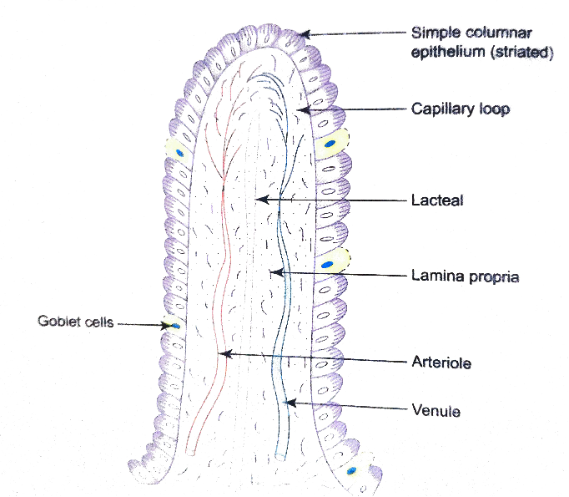
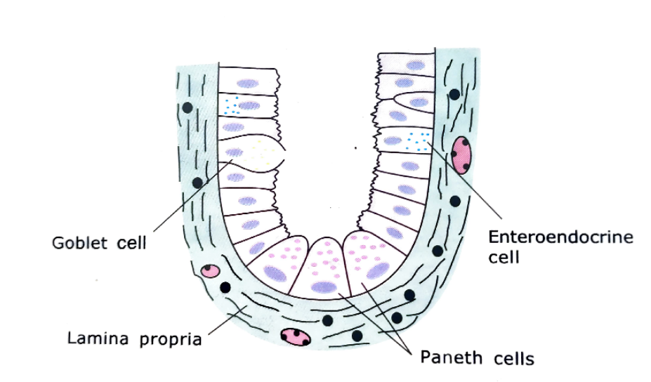

Slide 5
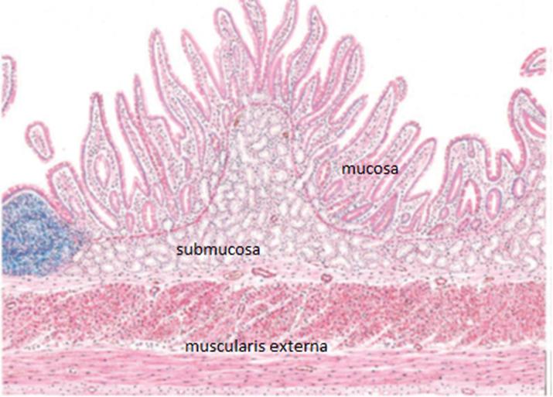
Submucosa
  Brunners gland – in duodenum
  Peyer’s patches – in ileum
  No Brunner’s gland &payer’s patches – in jejunum
Muscularis externa
  Inner – circular muscle layer
  Outer – longitudinal muscle layer
Serosa / Adventitia

Slide 6
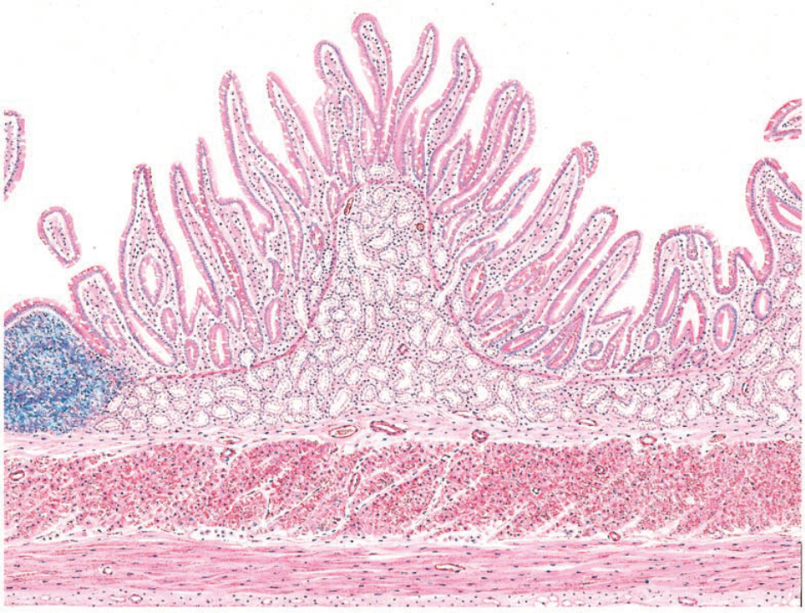
Duodenum
Villi are leaf like
Presence of Brunner gland in submucosa
Muscularis mucosa is disrupted
Enteroendocrine cell secrets hormone like
  Urogastrone - inhibits HCL secretion in stomach
  Secretin
  Cholecystokinin
Brunner gland in submucosa

Slide 7
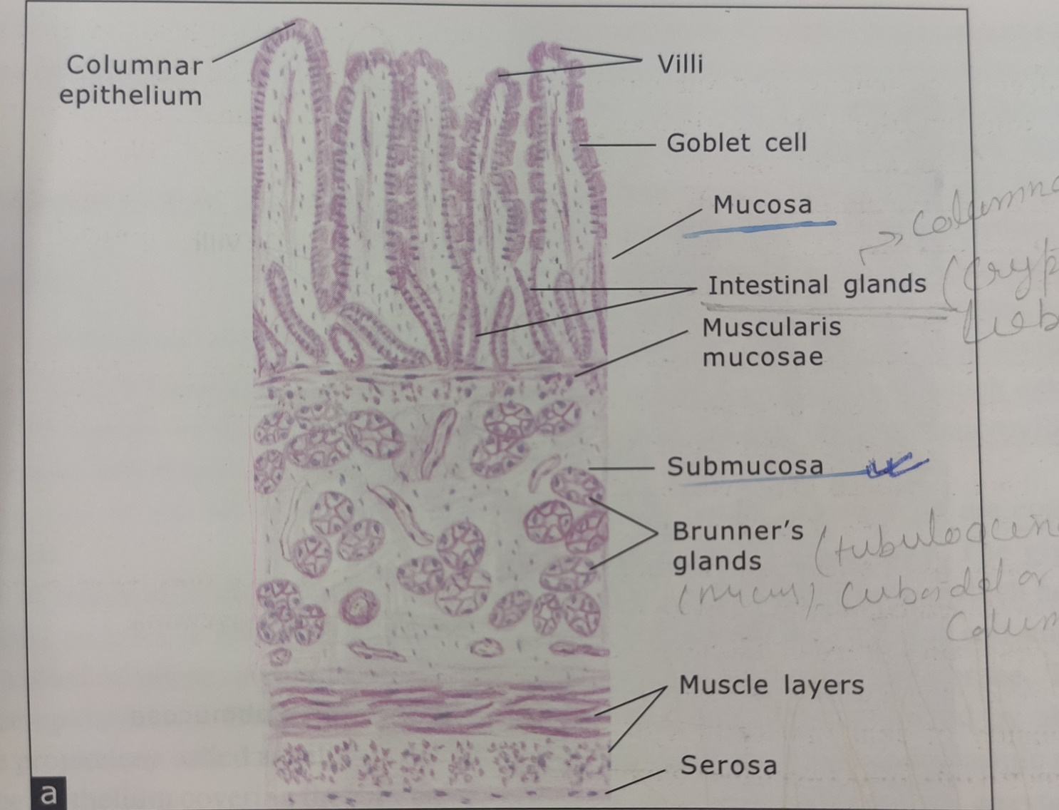

Slide 8
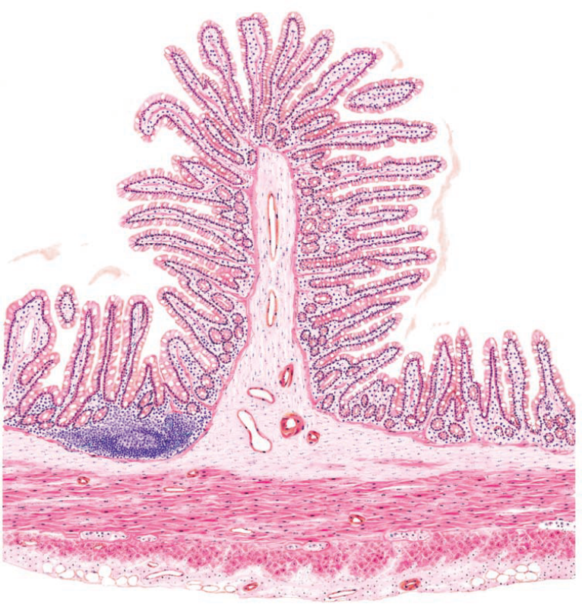
Jejunum
Villi are tongue like
Submucosa lacks Brunner glands & payer’s patches

Slide 9
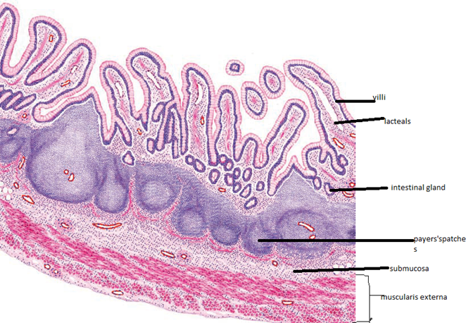
Ileum
Villi are short, thin & slender fingers like
Submucosa contain Peyer’s patches
M cells (antigen presenting cells) are found overlying lymphoid follicle

Slide 10
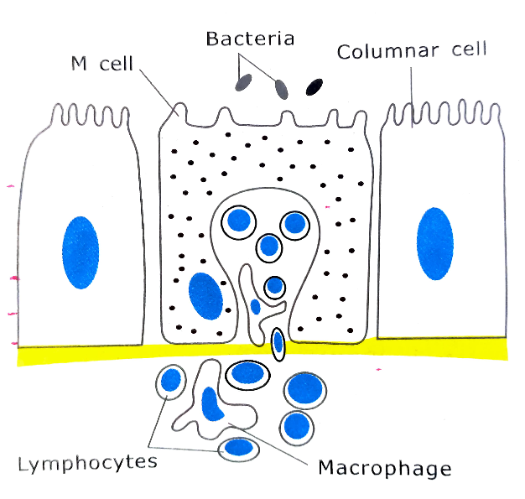

Slide 11
