Slide 1
HISTOLOGY OF SKIN
Sarangdhar kumar
Assistant professor
Department of Anatomy
Rohilkhand Medical College
Bareilly

Slide 2
Introduction
Largest organ of the body
16% of body weight
Covers the entire exterior of the body
Thickness varies from 0.1 to 5 mm
Weight – 4-5 kg
It consists of two layer
  Epidermis
  Dermis

Slide 3
Based on thickness of epidermis it is classified into thin & thick skin
Thick skin present in the palm & sole
Rest of the body is covered by thin skin
Beneath the skin there is layer of loose connective tissue & adipose tissue, hypodermis

Slide 4
Types of skin
FEATURES | THICK SKIN | THIN SKIN
THICKNESS OF EPIDERMIS | THICK (0.5MM) | THIN (0.1MM)
LAYERS OF EPIDERMIS | ALL FIVE | STRATUM LUCIDUM ABSENT
HAIRS | ABSENT | PRESNT
SABECEOUS GLAND | ABSENT | PRESENT
SWEAT GLAND | MORE | LESS
DISTRIBUTION | PALM & SOLE | REST OF THE BODY

Slide 5
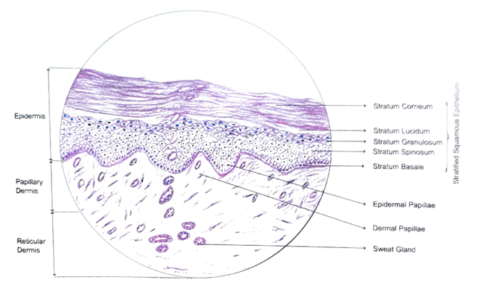
Thick skin

Slide 6
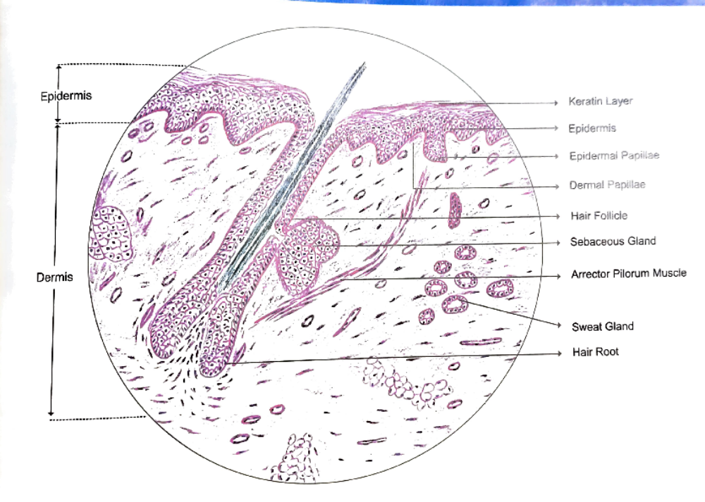
Thin skin

Slide 7
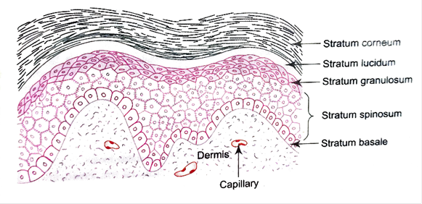
Epidermis
Made up of an epithelium
Lined by stratified squamous epithelium
Ectodermal in origin
An avascular & nourished by diffusion
Thickness varies – 0.1 to 1.4 mm
Renewed every 15-30 days
Consists of five layers
Mainly made up of keratinocytes & non keratinocytes cells are also present
(melanocytes, Langerhans cell & Markel's cell)

Slide 8
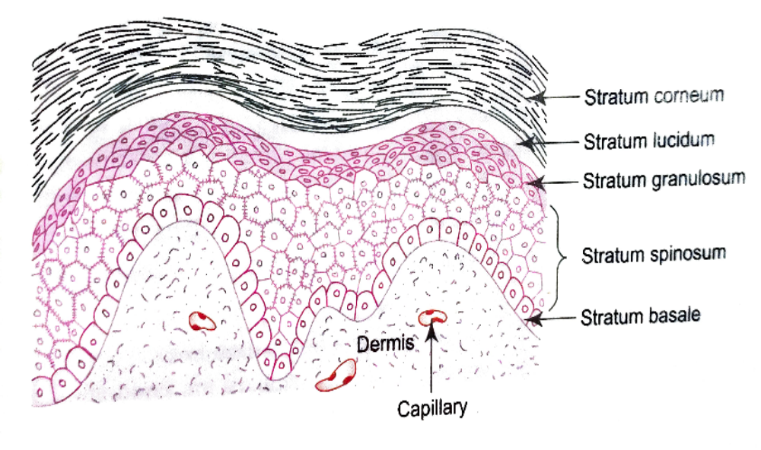
Layers of epidermis
Composed of five layers
  From deep to superficial
    Stratum basale
    Stratum spinosum
    Stratum granulosum
    Stratum lucidum
    Stratum corneum

Slide 9
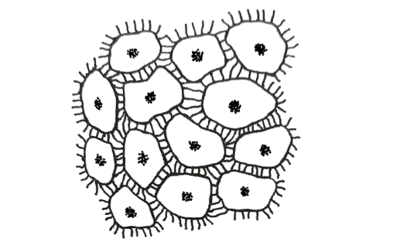
Stratum basale
  Deepest layer
  Single layer of columnar or cuboidal cell
  Resting on basement membrane
Stratum spinosum
  Several layer of polygonal cells which are held together by desmosomes
  Contains tonfilaments & tonofibrils
  These cells have cytoplasmic projection which gives spine like appearance so it is also called prickle cells

Slide 10
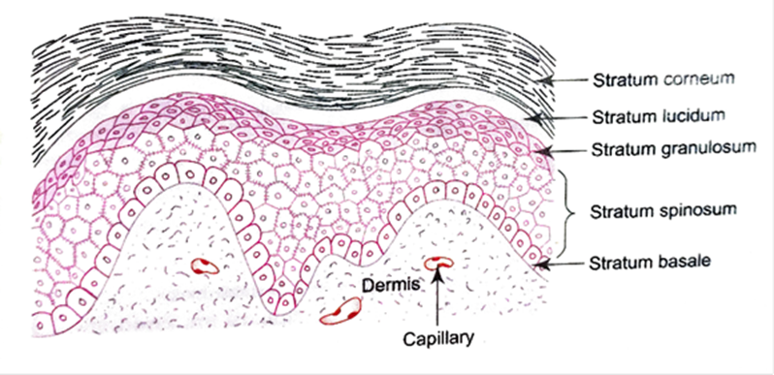
Stratum granulosum
  4 to 5 layers of flattened cell
  Filled with keratohyaline granule
Stratum lucidum
  Seen only in thick skin
  Several layers of flattened dead cell
  It appear as narrow translucent layer
Stratum corneum
  Most superficial layer
  Consists of 15-20 layers of dead keratinized cells
  Cells are very flat without cell organelles
  Cytoplasm has abundant keratin filaments

Slide 11
Cells of epidermis
Keratinocytes
  90% cell in epidermal layer
  Produce tough protein complex scleroprotein known as keratin
  Keratohyalin granule + Tonofibrils = Keratin
  Keratinocyte migrate from stratum basale toward surface
keratinization
Loss of mitotic potential
Keratin synthesis
Thickening of plasma membrane
Disintegration of nuclei & organelles
Cornification & desquamation of cells

Slide 12
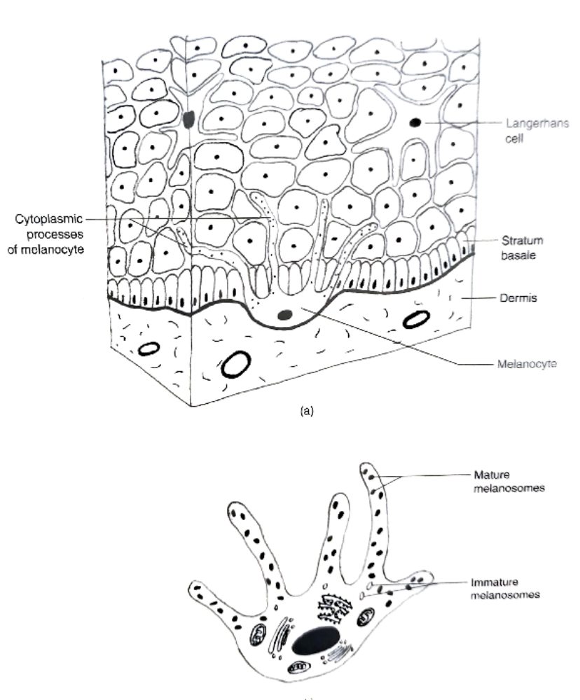
Non keratinocytes
Melanocytes
  Originates from neural crest cell
  Present in stratum basale
  Produce melanin pigment
  Protect from UV radiation

Slide 13
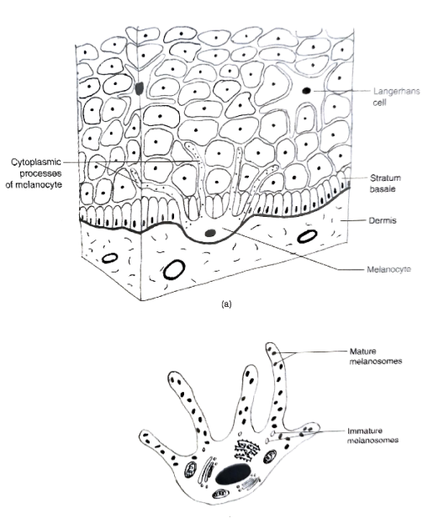
Langerhans cells
  Non pigmented granular dendrocytes
  Present in stratum spinosum
  Not seen in H&E stain
  Derived from bone marrow ( mesodermal in origin)
  Antigen presenting cells & it belong to mononuclear phagocytic system

Slide 14
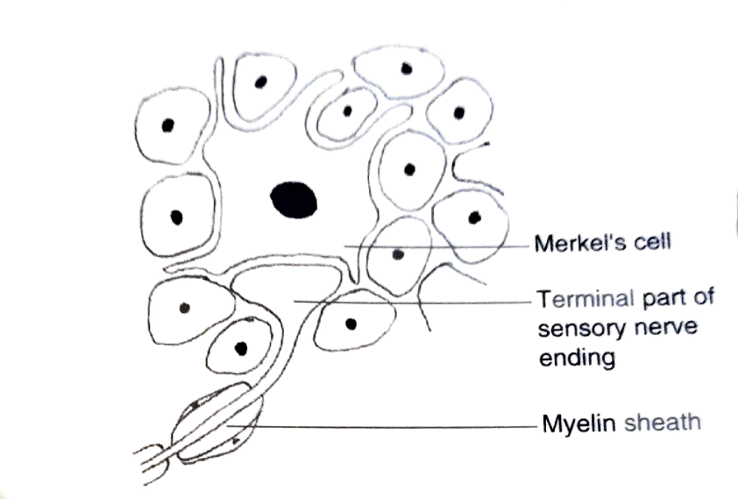
Merkel’s cell
  Sensory cells (mechanoreceptors )
  Present in stratum basale
  Innervated by sensory nerve ending

Slide 15
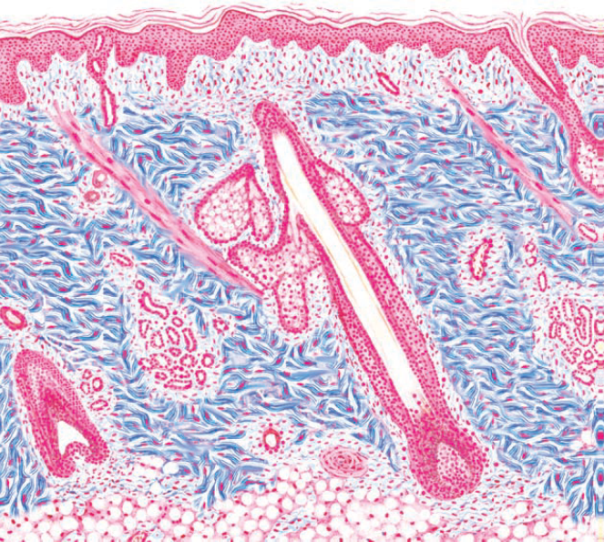
Dermis
Made up of connective tissue
Predominantly made up of collagen bundles
Mesodermal in origin
Vascular
Rich supply of free nerve endings & Pacinian corpuscles
Thickness varies – 0.3 to 4.0 mm
Consists of two layers, papillary & reticular

Slide 16
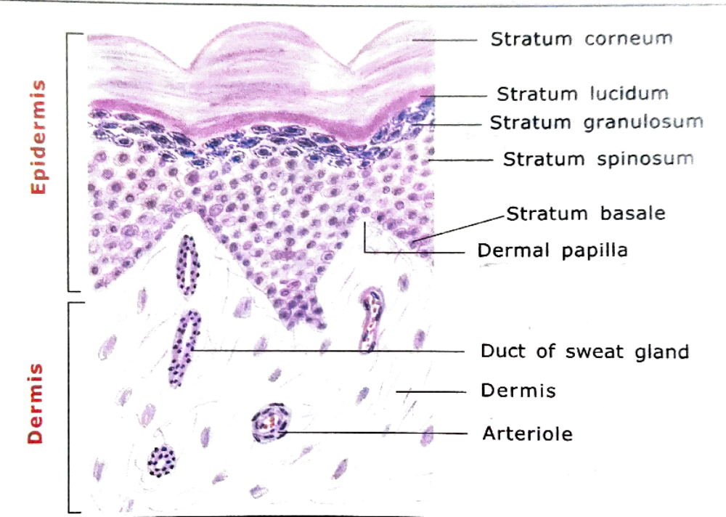

Slide 17
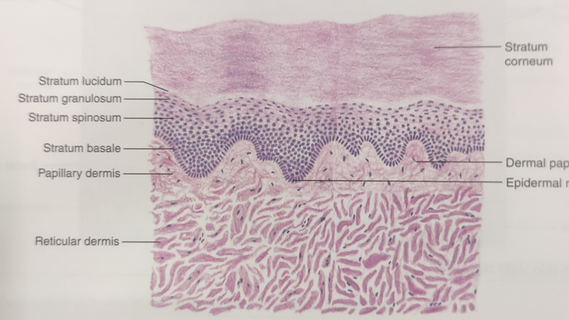
Papillary layer
  Loose connective tissue
  Show finger like projection in to base of epidermis called dermal papillae
  Epidermal ridges
Reticular layer
  Dense connective tissue
  Contains coarse bundle of collagen ,nerves, blood vessels

Slide 18
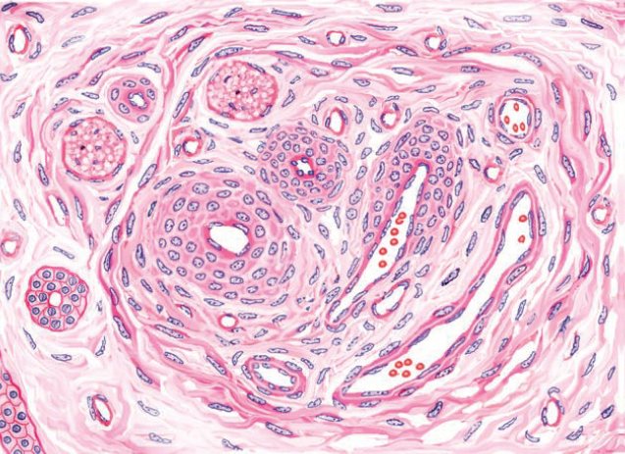
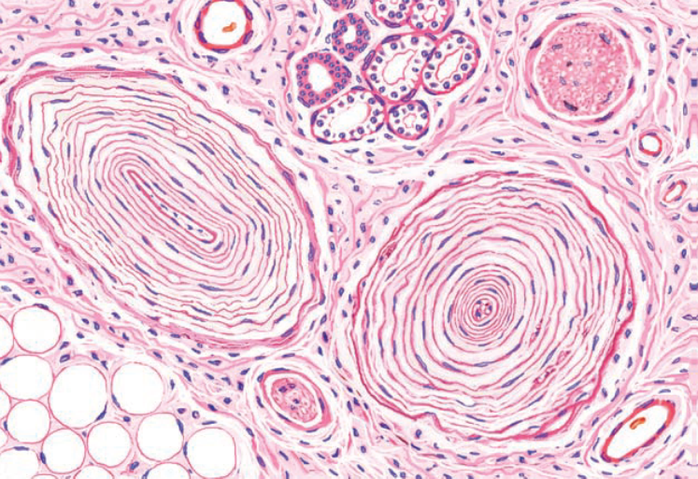
Nerve endings & Pacinian corpuscles

Slide 19
Clinical correlations
Vitiligo –
  degeneration of melanocytes
  Causing depigmentation of skin
  Treatment – phototherapy (UV light)
Acne vulgaris –
  Commonly referred as pimples
  Occurs due to blockage of sebum outflow
Malignant melanoma –
  Cancer arising from melanocytes

Slide 20
THANK YOU

