Slide 1
HISTOLOGY
OF
MALE GENITAL SYSTEM
Sarangdhar kumar
Assistant professor
Department of anatomy
Rohilkhand medical college
Bareilly

Slide 2
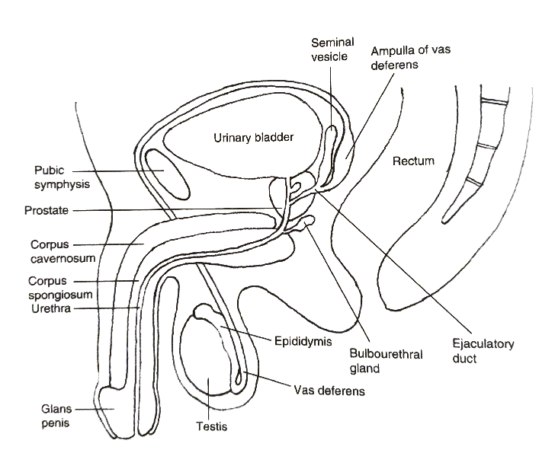
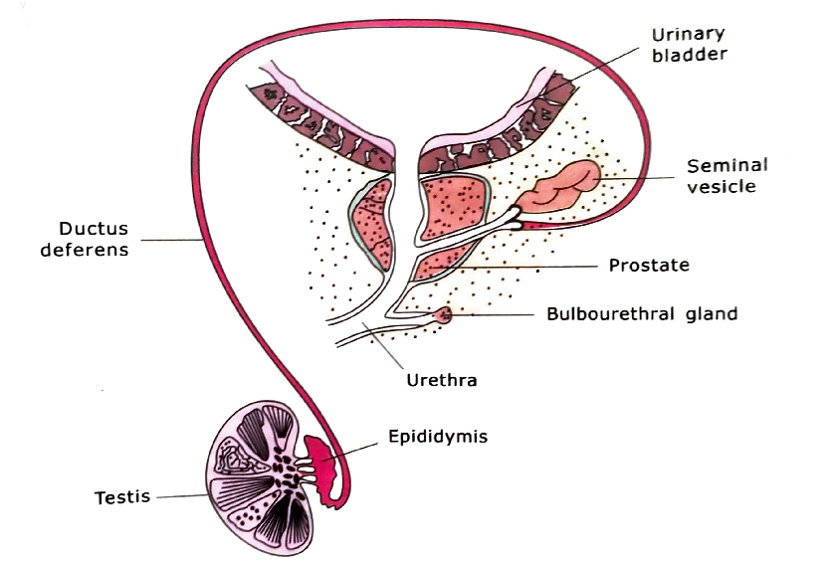
Male genital system includes
Male gonads
  Testes
Duct system
  Straight tubule
  Rete testis
  Efferent ducts
  Epididymis
  Vas deferens
Accessory sex gland
  Seminal vesicle
  Prostate
  Bulbourethral gland
Copulatory organ
  Penis

Slide 3
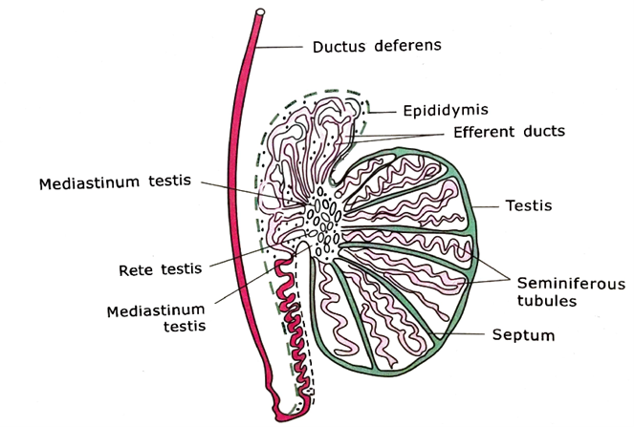
Testis
Paired male gonads
Ovoid in shape
Located in scrotum
It has a two functions:-
  Production of male gametes
  Synthesis & secretion of male sexual hormones testosterone

Slide 4
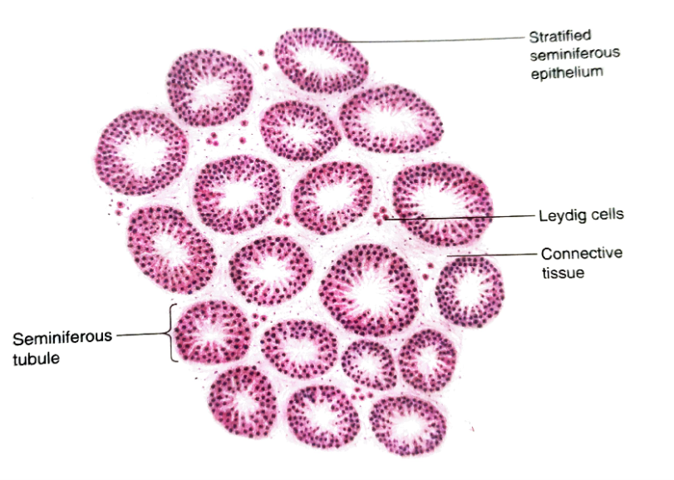
Structural organisation of testis
Coverings of testis
(From outside inwards)
    Tunica vaginalis
      Serous sac
    Tunica albuginea
      Dense connective tissue surrounding the testis
      Mediastinum testis
      About 250 lobules
      Each lobules contains –
        2-4 seminiferous tubules
        Loose connective tissue
        Interstitial cells of Leydig
    Tunica vasculosa
      Vascular layer which lines the lobules of testis

Slide 5
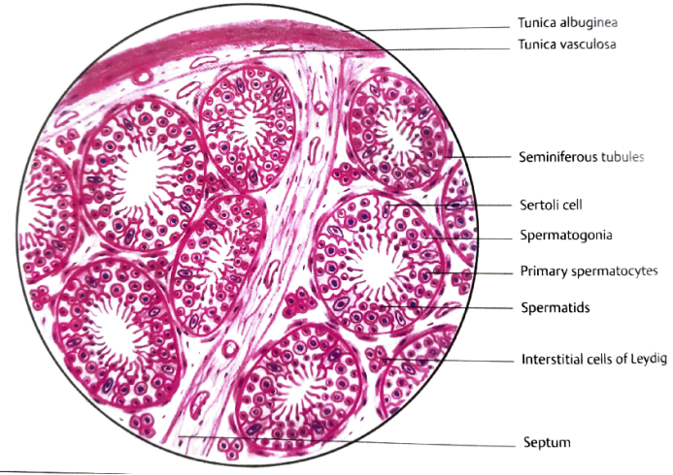

Slide 6
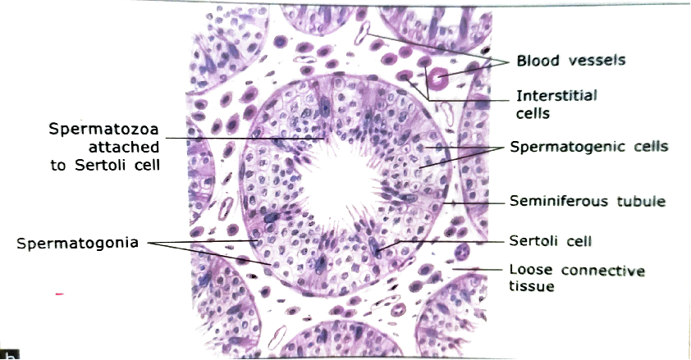
Seminiferous tubules
  Highly convoluted tubules
  Interior of tubules is lined by special type of stratified germinal epithelium(seminiferous epithelium)
  Consist of two types of cells
    Spermatogenic cells
      Differentiate into sperm
    Sertoli cells
      Supporting cell

Slide 7
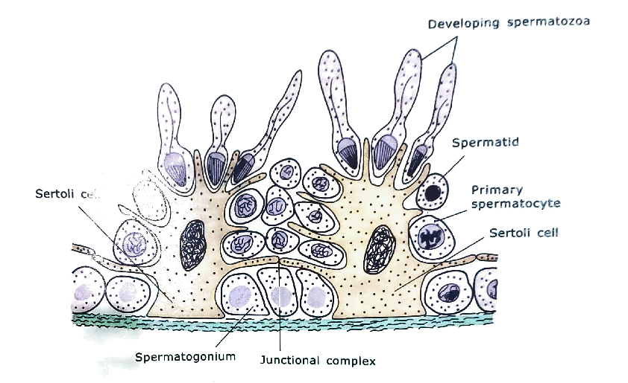
Sertoli cells-
  Pyramid shape cells with ovoid nuclei
  Extends from basement membrane to lumen of seminiferous tubules
  Have a numerous processes on the lateral surface
  Basal lateral process divide the lumen into two compartment
    Basal compartment
    Ad luminal compartment

Slide 8
Functions of Sertoli cell
  Provide nutrition & mechanical support to spermatogenic cells
  Forms blood testis barrier
  Phagocytosis of residual bodies
  It secretes -
    ABP( androgen binding protein)
    Inhibin
    MIS (mullerian inhibiting substances )
    Transferrin (iron transporting molecule)

Slide 9

Interstitial cells of Leydig
  Located in connective tissue b/w seminiferous tubules
  Polygonal cells with round nucleus
  Presents in clusters
  Constitute the endocrine part of testis
  It synthesize & secrets testosterone

Slide 10
EPIDIDYMIS
Comma shaped structure
Located on posterolateral aspect of testis
Single highly coiled tube
Consists of head ,body & tail
6 m long
Continue as vas deferens

Slide 11
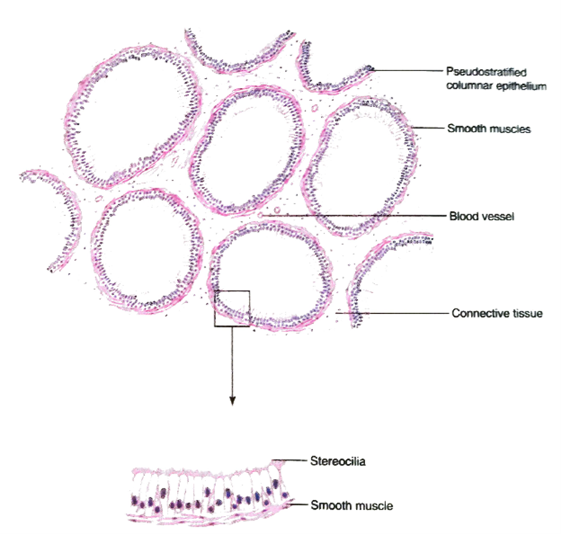
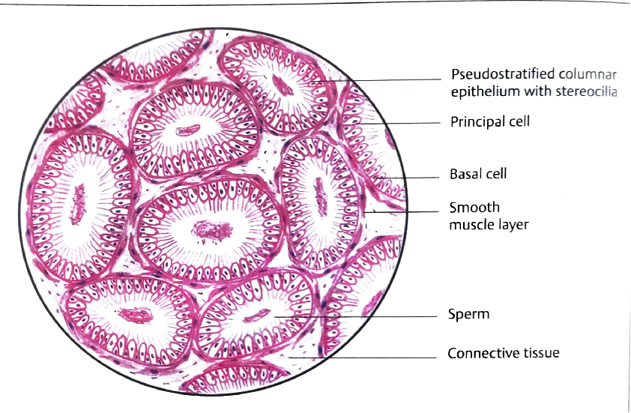
Microscopic structure of epididymis
Lined by pseudostratified epithelium with stereocilia
Consists of two types of cells
  Principal cells
    Columnar & have a stereocilia
  Basal cells
    Small & round
    Acts as precursor of principal cells
Underneath the basement membrane there is a thin layer of circularly arranged smooth muscle cells

Slide 12
Functions –
Spermatozoa are stored & make motility
Cells lining the epithelium performs three functions
  Absorption
  phagocytosis
  Secretions
    Glycerophosphocholine
    Sialic acid
    Glycoproteins

Slide 13
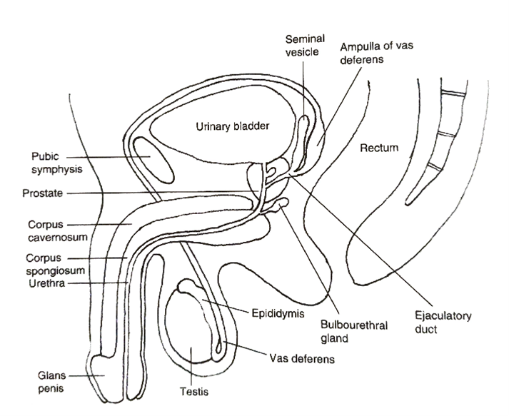
VAS DEFERENS
Thick walled muscular tube
Carries spermatozoa from epididymis to the ejaculatory duct
Begins as a continuations of epididymis & finally joins the duct of seminal vesicle to form ejaculatory duct

Slide 14
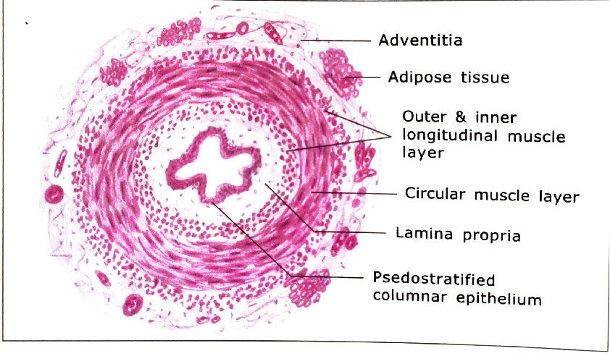
Microscopic structure of vas deferens
Mucosa
  Lining epithelium is pseudostratified columnar epithelium with stereocilia
  Lamina propria contains elastic & collagen fibers
Muscle layers
  Thick
  Arranged in three layers
    Inner – longitudinal
    Middle – circular
    Outer - longitudinal
Adventitia
  Loose areolar tissue
  Contains blood vessels & nerves

Slide 15

SEMINAL VESICLE
Paired elongated sac like gland
Located at the base of urinary bladder
Highly convoluted irregular lumen
Secretions of seminal vesicle constitute 70% of total ejaculate
Secretions contains fructose & prostaglandin
Secretion is yellow ,slightly alkaline & rich in fructose which provide nutrition to sperm

Slide 16
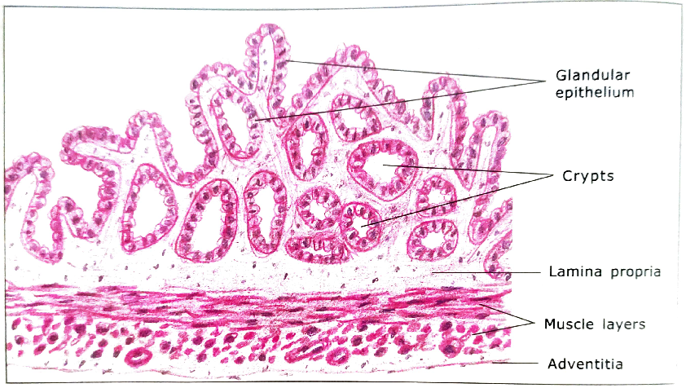
Microscopic structure of seminal vesicle
Consists of three layers
Mucosa
  Highly folded & lined by pseudostratified columnar non ciliated epithelium
  Lamina propria – loose connective tissue
Muscle layer
  Consists of smooth muscle arranged in two layer
    Inner - circular
    Outer- longitudinal
Adventitia
  Connective tissue

Slide 17
PROSTATE
An accessory male sex gland
Present below the neck of urinary bladder
Surrounding the origin of urethra infront of ampulla of rectum
Secrets prostatic fluid
  Thin milky fluid (1/3rd of semen)
  Rich in acid phosphatase
  Fibrinolysin
  Citric acid
  Amylase
  PSA (prostatic specific antigen)

Slide 18
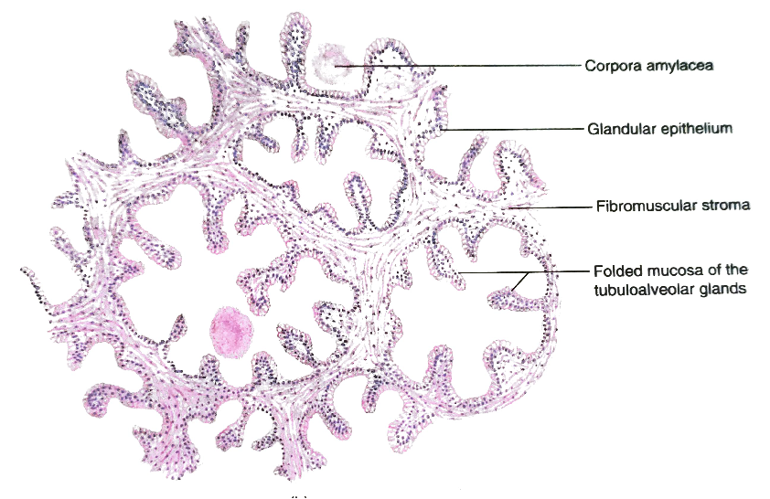
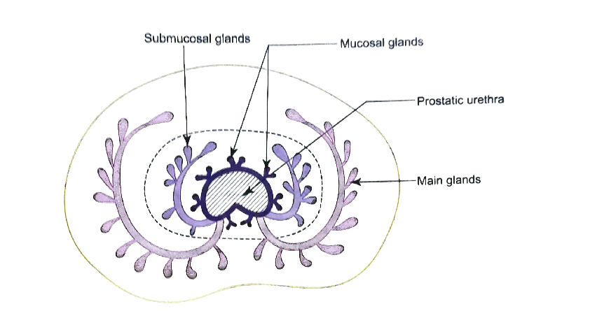
Microscopic feature of prostate
Consists of
Fibromuscular stroma
  Fibrous connective tissue & smooth muscle
Parenchyma
  Consists of 30-50 tubuloalveolar glands
  Arranged in three concentric layers
    Inner – mucosal
    Intermediate - submucosal
    Outer – main glands
  Lining epithelium of gland
    In an active state – pseudostratified columnar
    In an inactive state – simple cuboidal/ columnar
  In old age alveoli of gland show a rounded eosinophilic bodies ( corpora amylacea )

Slide 19
Ducts
  10-12 in number
  Lined by simple columnar epithelium which changes to a transitional epithelium in the terminal part

Slide 20
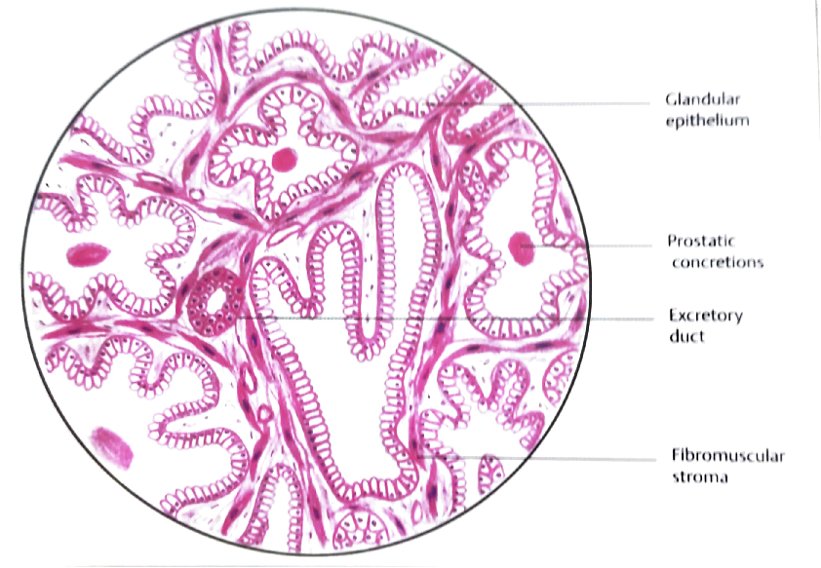

Slide 21
THANK YOU

