Slide 1
HISTOLOGY
OF
LIVER , PANCREAS & GALL BLADDER
Sarangdhar kumar
Assistant professor
Department of anatomy
Rohilkhand medical college
Bareilly

Slide 2
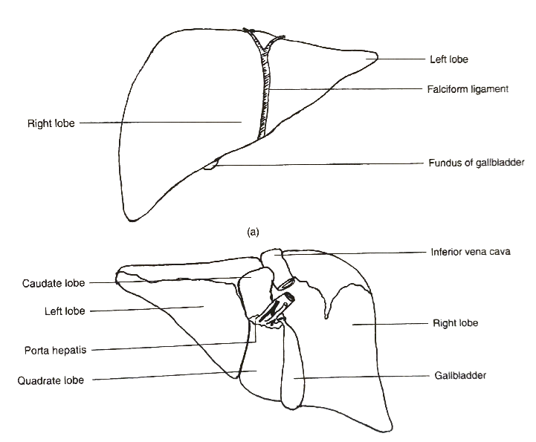
LIVER
Largest gland of body
Present under the diaphragm
Occupies entire right hypochondrium , part of epigastrium & left hypochondrium
Anatomically consists of four lobe – right , left , caudate & quadrate lobes
Hilum or porta hepatis is present b/w caudate & quadrate lobe

Slide 3
Functions
  Maintaining the normal level of blood glucose through synthesis , storage & breakdown of glycogen
  Metabolism & transport of fat
  Excretion of urea as a byproduct of deamination of amino acids
  Synthesis of plasma protein including albumin & globulins and clotting factors such as fibrinogen & prothrombin
  Detoxification of drugs
  Removal of waste from blood
  Excretion of bilirubin which is byproduct of red blood destruction
  Storage of vitamin A & D.
  Gluconeogenesis – conversion of lipids & amino acids into glucose

Slide 4
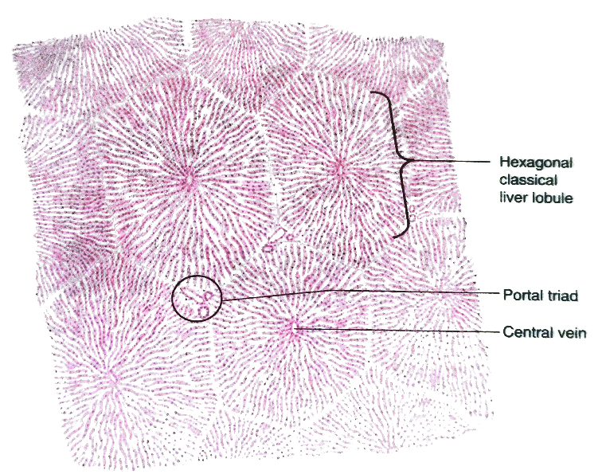
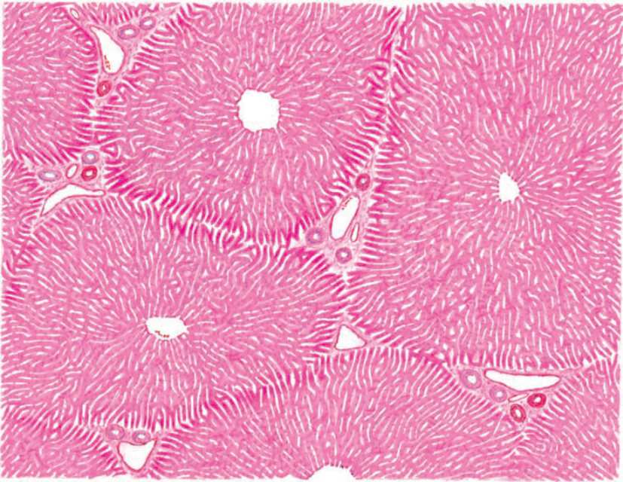
Microscopic structure
Stroma
  Connective tissue covers the liver , Glisson’s capsule
Parenchyma
  Liver lobule
  Hepatic sinusoids
  Hepatocytes (liver cells)

Slide 5
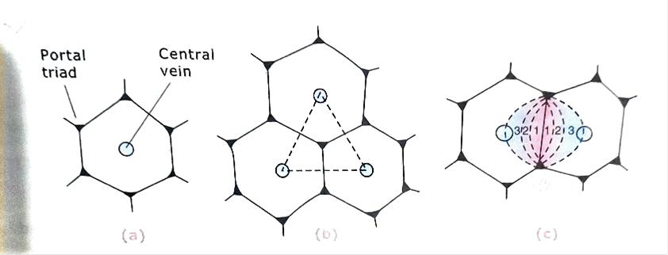
Liver lobule
  Three different type of liver lobule
  Classical lobule
    On structural basis
    It is basic structural unit of the liver
  Portal lobule
    On the basis of biliary flow through liver
  Hepatic acinus
    On the functional basis it is the functional unit of the liver

Slide 6
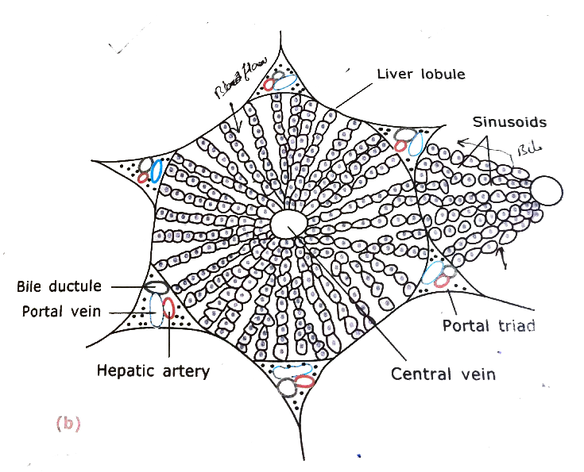
Classical lobule
  Surrounded by connective tissue
  Hexagonal in shape
  At angles of hexagon there are small triangular area of connective tissue , portal triads
  Each Portal triads contain contains branches of portal vein , hepatic artery & interlobular bile duct
  Centre of each lobule is the central vein

Slide 7
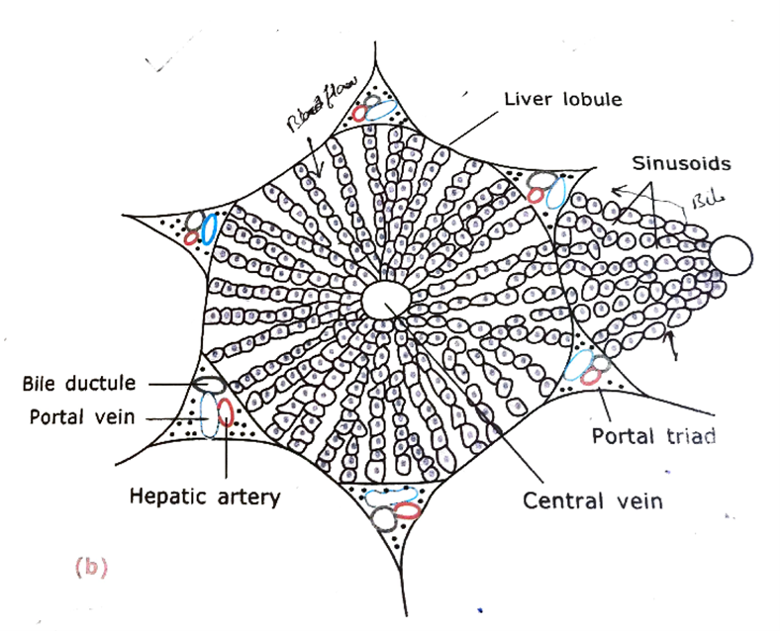
  Inside the hepatic lobule hepatocytes radiate from central vein , which are arranged in one or two cell thick plate
  Between the plate there is space called sinusoids
  Neighbouring plates are anastomose with each other

Slide 8
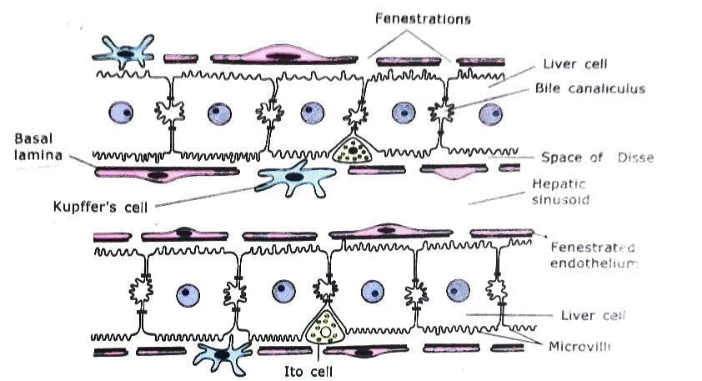
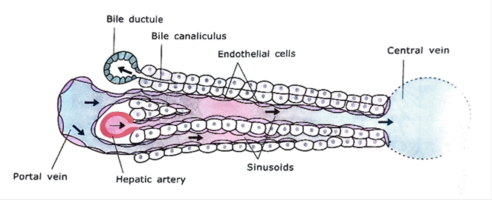
Hepatic sinusoids
  Lies b/w hepatic lamina
  Lined by two kinds of cell endothelial cell & phagocytic cells (Kupffer cells)
  It is fenestrated space
  Narrow space b/w endothelial cells & hepatocytes called space of Disse

Slide 9
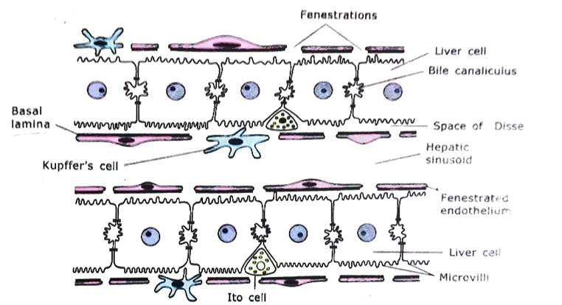
Space of Disse
  Perisinusoidal space
  Exchange of substance b/w hepatocytes & blood vessels takes place
  Ito cells are found in this space
    Involved in storage of vitamin A & lipid

Slide 10

Hepatocytes
  Polygonal in shape
  Have 5 – 12 sides
  Large nucleus (probably binucleated ) & single nucleolus
  Have granular acidophilic cytoplasm
  Constitute about 80% of liver volume
  Life span – 5 month
  Capable of regeneration

Slide 11
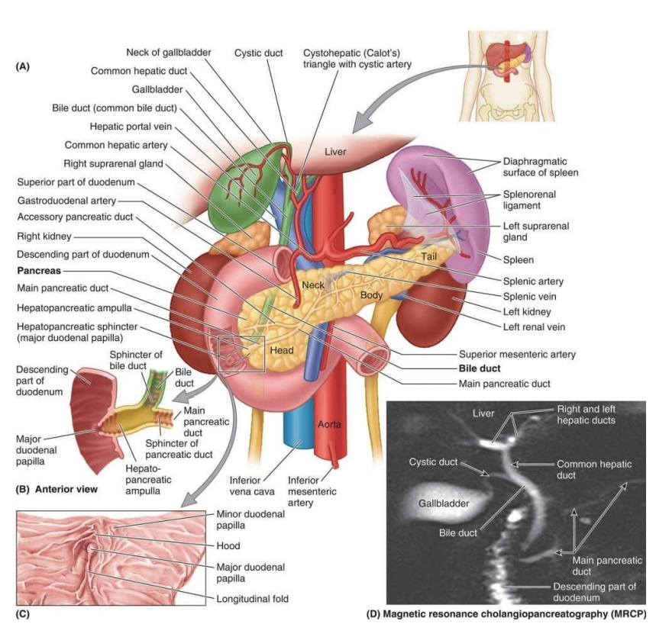
Pancreas
It is retroperitoneal organ
Consists of both endocrine & exocrine part
Extend from concavity of duodenum to the hilum of spleen
It consists of four parts
  Head
    Located within concavity of duodenum
  Neck
    Constricted part
  Body
    Major bulk part of gland
  Tail
    Related to hilum of spleen

Slide 12
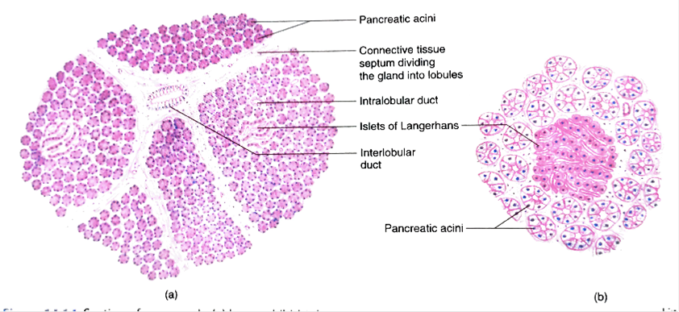
Microscopic features
  It has three component
    Stroma
    Parenchyma
    Duct system
  Carries the secretion of exocrine part into duodenum

Slide 13
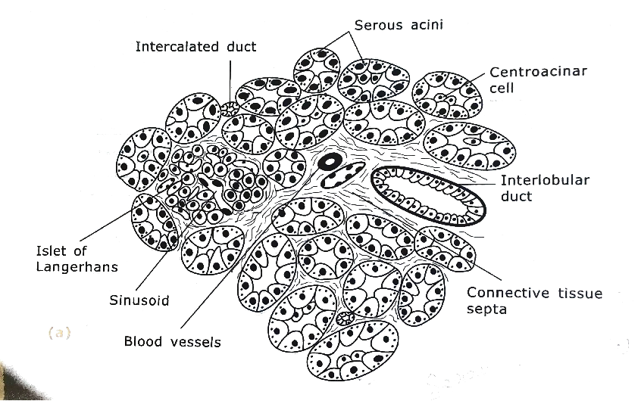
Stroma
  Thin capsule of connective tissue
  Numerous septa arises from the capsule which divide the parenchyma of gland into many lobules

Slide 14

Parenchyma
  Consists of exocrine part & endocrine part
Exocrine part
  Compound acinar gland
  Pancreatic acini
  Group of pyramidal shaped acinar cells arranged around small lumen
  Round nuclei at their base
  Cytoplasm in
    Basal portion – basophilic
    Apical portion – eosinophilic (zymogenic granules)

Slide 15
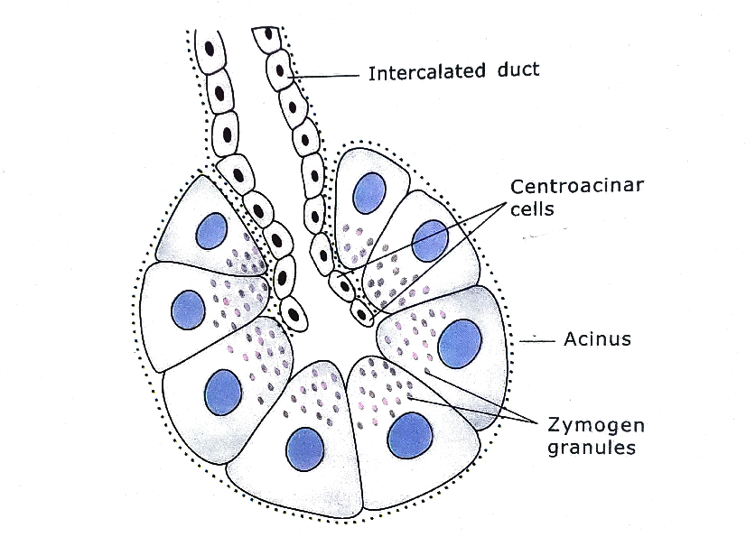
Duct system –
Intercalated duct
    Lies inside the acini & lined by centroacinar cell
Intralobular duct
    Lined by simple cuboidal epithelium
Interlobular duct
    Simple columnar epithelium
Main pancreatic duct

Slide 16

Centroacinar cell
  Seen at centre of acini where duct system begins
  Have a central nucleus & pale cytoplasm
  Add bicarbonate ions to pancreatic juice which neutralize the acidic contents entering the duodenum from stomach

Slide 17
Endocrine part
  Islets of Langerhans
    Most abundantly in tail region
    Consists of polyhedral cells arranged in cord
    Have four types of cells
      Alpha
      Beta
      Delta
      PP cells

Slide 18
Types of cell | % of cell | Secretion | Effects of secretion
Alpha | 20 | Glucagon | Rise in blood glucose level
Beta | 70-75 | Insulin | Decrease in blood glucose level
Delta | 5-8 | Somatostatin | Inhibition of secretion of alpha & beta cell
PP | 1 | Pancreatic peptide | Inhibition of exocrine secretion

Slide 19
Pancreatic secretions
  Exocrine part
    Fluid rich bicarbonate ions & digestive enzymes
    These secretions are under hormonal control secretin & cholecystokinin
  Endocrine part
  Secretes
    Glucagon
    Insulin
    Somatostatin
    Pancreatic peptide

Slide 20
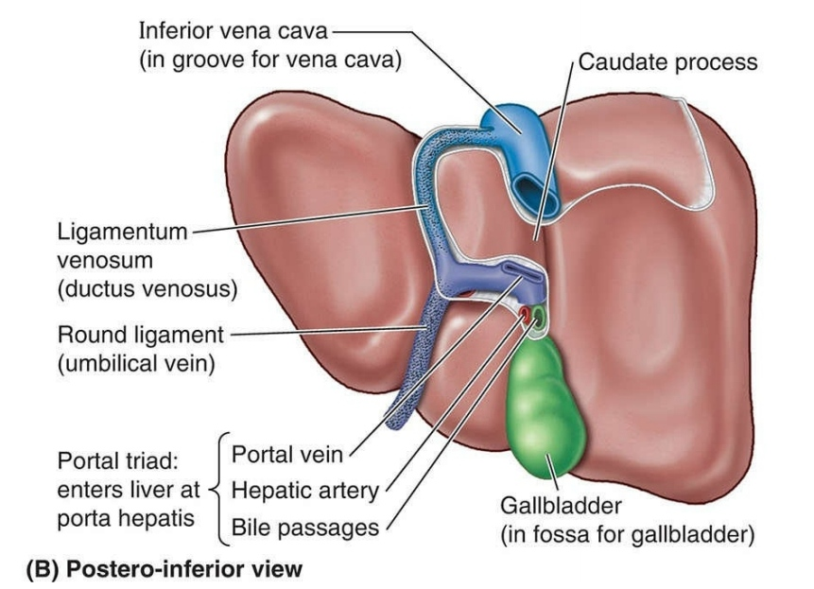
Gall bladder
Blind sac
Present at the inferior surface of liver
It has a three parts
  Neck
    It is continuous with cystic duct
  Body
  Fundus
Stores & concentrates the bile

Slide 21
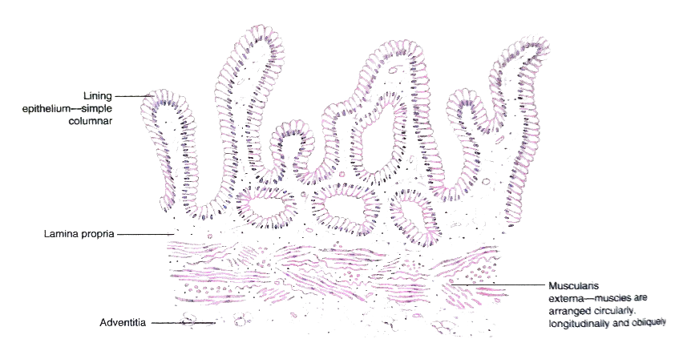
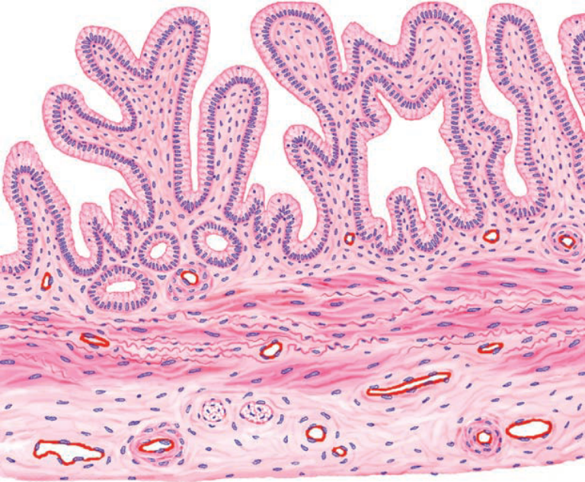
Microscopic features
  Consists of three layers
    Mucosa
    Muscularis externa ( fibromuscular layer )
    Adventitia/ serosa
  No submucosal layer

Slide 22

Mucosa
Lining epithelium
  Simple columnar epithelium with microvilli
  No goblet cells
  Lies over lamina propria
No muscularis mucosa
Muscularis externa
  Bundles of smooth muscles
  Arranged in different planes(circularly , longitudinally & obliquely)
  In between bundles of smooth muscles there are numerous
Adventitia & serosa

