Slide 1
HISTOLOGY OF LARGE INTESTINE
SARANGDHAR KUMAR
ASSISTANT PROFESSOR
DEPARTMENT OF ANATOMY
ROHILKHAND MEDICAL COLLEGE
BAREILLY

Slide 2
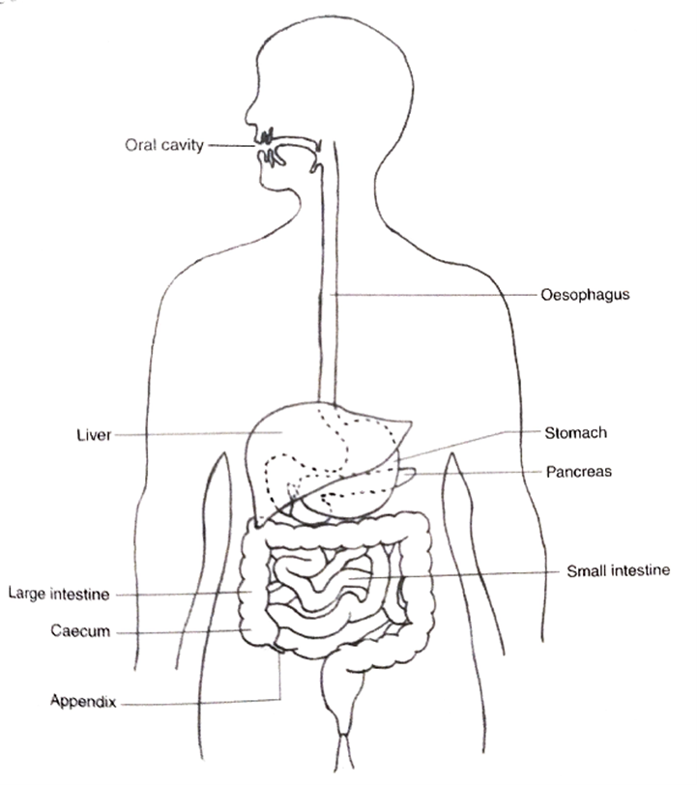
Large intestine consists of
  Caecum
  Colon
  Rectum
  Anal canal
It is house of some nonpathogenic bacteria that produce vit.B12 & vit.K
Diameter is more than that small intestine
Main function are absorption of water and electrolyte & Conversion of liquid
Undigested material into solid faeces

Slide 3
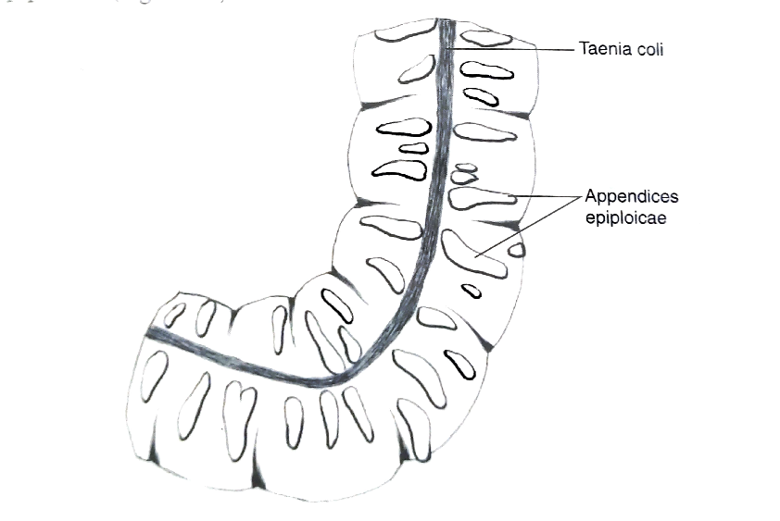
Structure of large intestine remains almost the same throughout except anal canal
It has three important cardinal feature
  Taenia coli
  Sacculations
  Appendices epiloicae
It lacks of intestinal villi

Slide 4
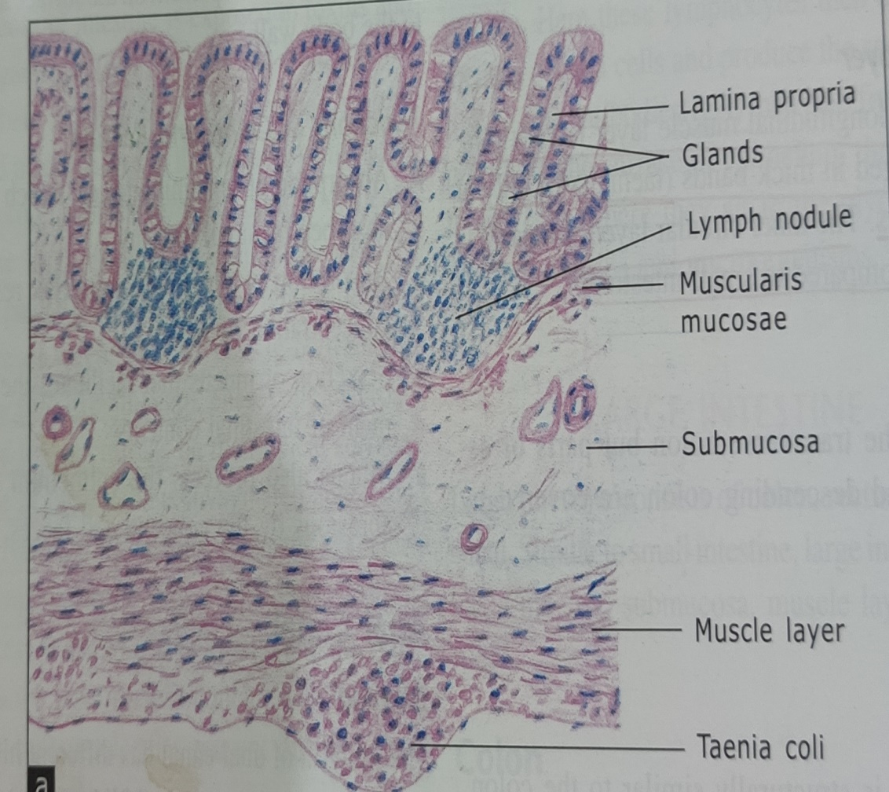
colon
Mucosa
  Mucosal fold (plica circularis) & villi are absent
  Lining Epithelium
    simple columnar with goblet cell
    Absorptive surface have microvilli
  Lamina propria
    Crypt of Leiberkuhn(intestinal gland) & lymphoid follicle
    Contain enteroendocrine cell
      Stem cell
      Goblet cell
      No Paneth cell

Slide 5
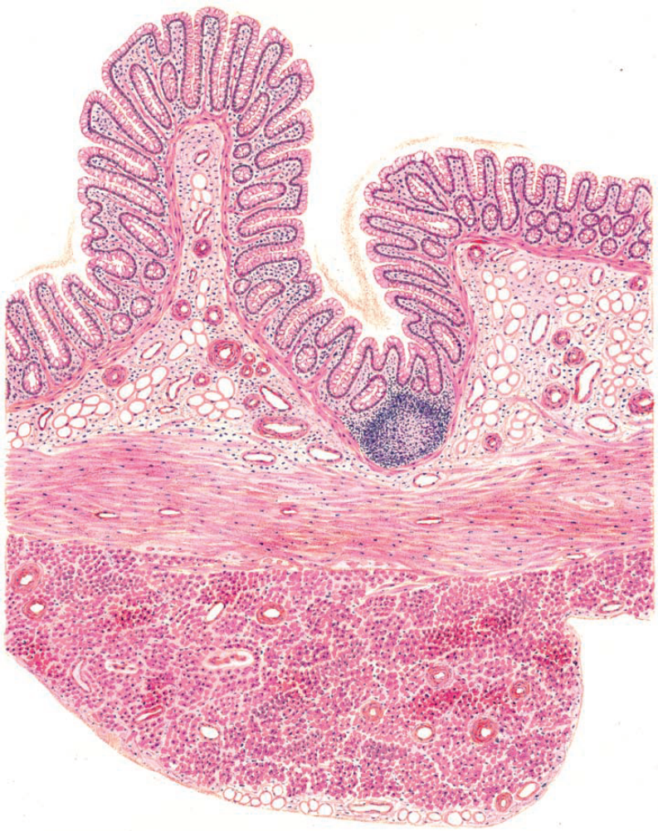
Mucosa
Lining epithelium
Lamina propria
Muscularis mucosae
submucosa
Muscularis externa
Taenia coli

Slide 6

Muscularis externa
  Consists of two layers of smooth muscle-
  Inner circular layer
  Outer longitudinal layer
    Outer longitudinal layer forms three longitudinal band – taenia coli
  Auerbach’s or myenteric plexus
Adventitia/ serosa
  Transvers colon & sigmoid colon have serosa & rest of parts have a adventitia

Slide 7
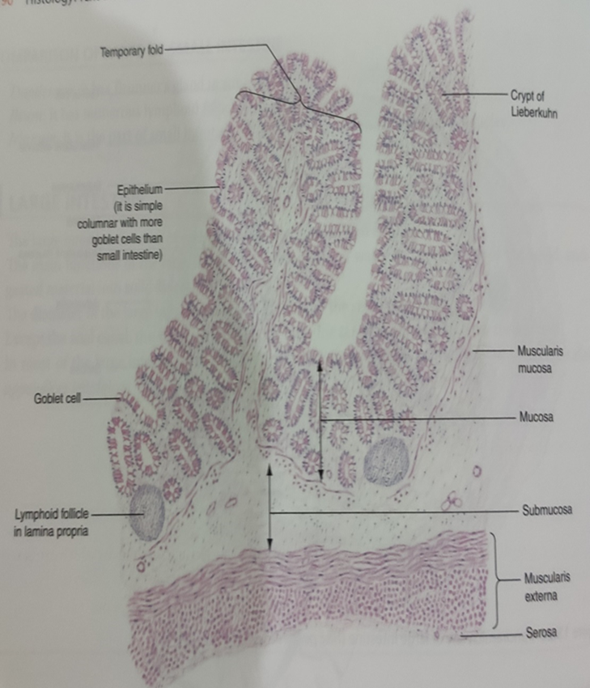

Slide 8
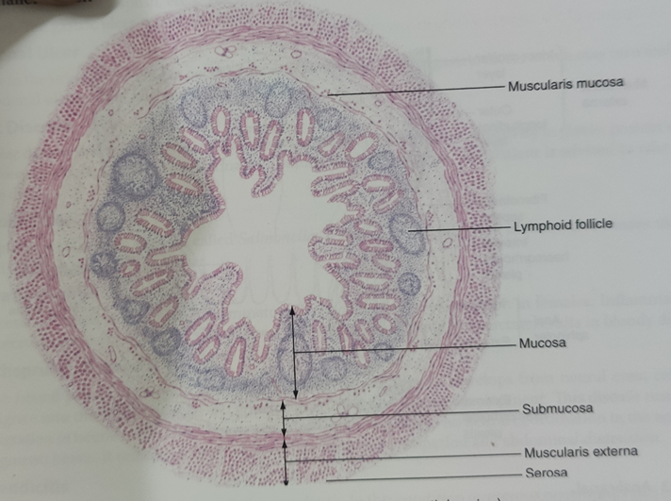
Appendix
Narrowest part of large intestine
Microscopic structure of appendix resembles the colon with few differences
  Lamina propria has numerous lymphoid follicles which extend into submucosa
  No taenia coli
  Small lumen

Slide 9
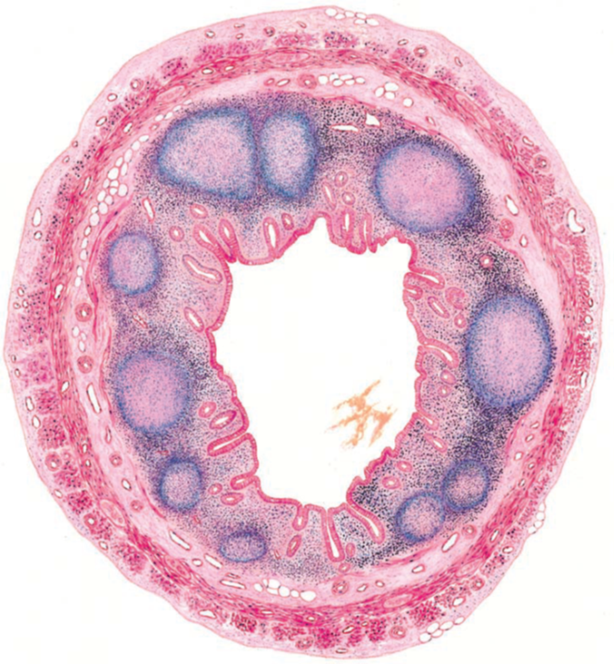
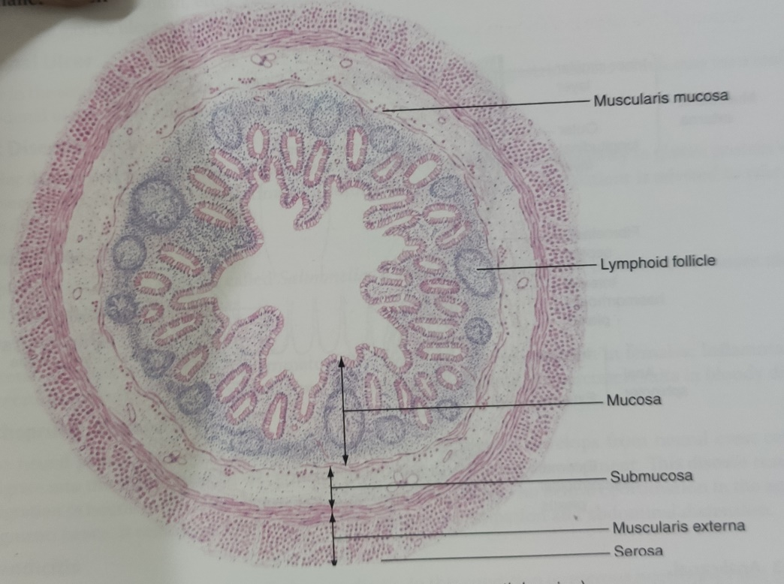

Slide 10
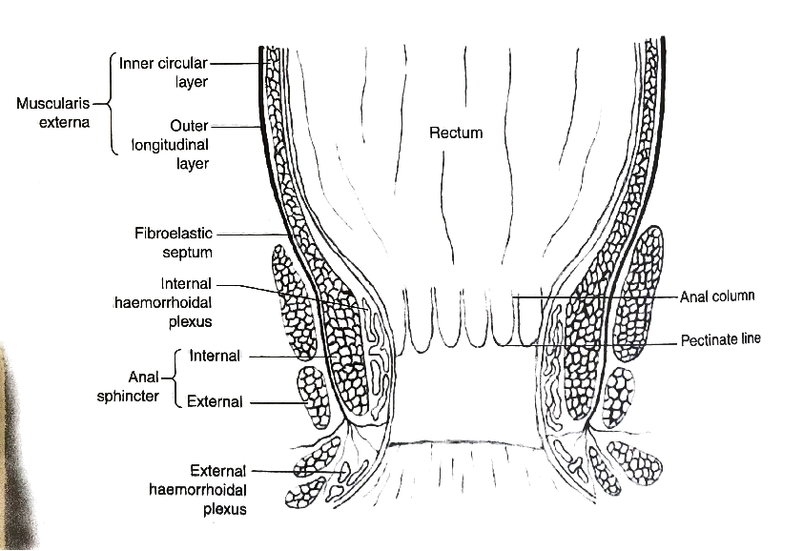
Anal canal
Upper part of anal canal shows 6 -10 permanent longitudinal fold – columns of Morgagni
Lower end of columns are connected with fold of mucosa – anal valves
Pectinate line corresponds to level of the anal valve
Hiltons white line

Slide 11
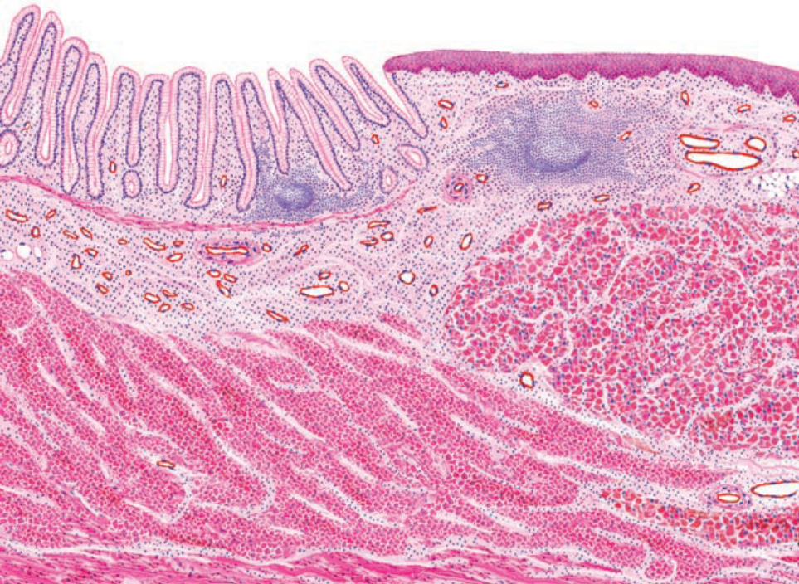
Mucosa
  Lining epithelium
    Upper 1/3rd part – simple columnar epithelium
    Middle 1/3rd part – stratified squamous non keratinized
    Lower 1/3rd part – stratified squamous keratinized
  Lamina propria
    Few short intestinal gland
  Muscularis mucosae
    Disappears at the level of middle part
LE
LP
SM
ME

Slide 12

Submucosa
  Contains numerous venous plexus , haemorrhoidal plexus
Muscularis externa
  Inner - circular muscle layer
  Outer – longitudinal muscle layer
Adventitia

Slide 13
Ulcerative colitis
  Inflammatory bowels diseases
  More common in female
  Inflammation & ulceration occurs in colon & rectum
  Damage of mucosa & submucosa results in bloody diarrhoea
Hirschsprung disease
  Neural plexus of GIT develops from neural crest cells which migrate into the wall of GIT in cephalocaudal direction during development
  This disease results due to migration of neural cells arrests before reaching the anus
  There is no neural coordination in aganglionic segment hence it remain contracted and this lead to constipation & abdominal distension
Appendicitis
  Inflammation of appendix
  In this condition numerous neutrophils & ulceration are seen in mucosa

