Slide 1
HISTOLOGY
OF
GASTROINTESTINAL TRACT
Sarangdhar kumar
Assistant professor
Department of Anatomy
Rohilkhand Medical College
Bareilly

Slide 2
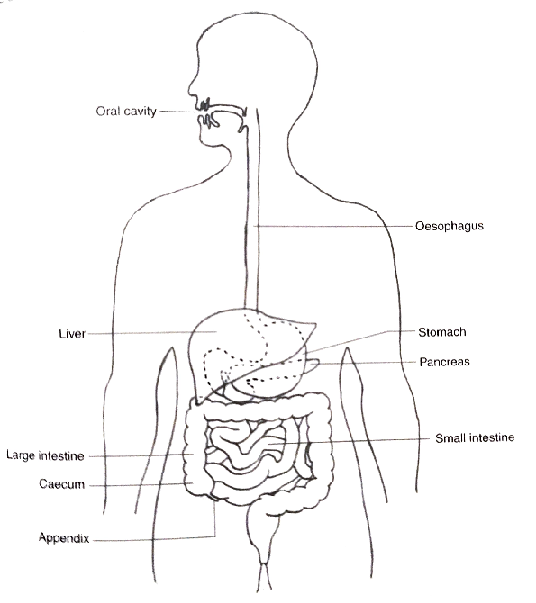
GENERAL PLAN OF GASTROINTESTINAL TRACT
LONG MUSCULAR TUBE
BEGINS WITH ORAL CAVITY & END IN THE ANUS
PARTS –
    ORAL CAVITY
    PHARYNX
    OESOPHAGUS
    STOMACH
    SMALL INTESTINE
    LARGE INTESTINE

Slide 3
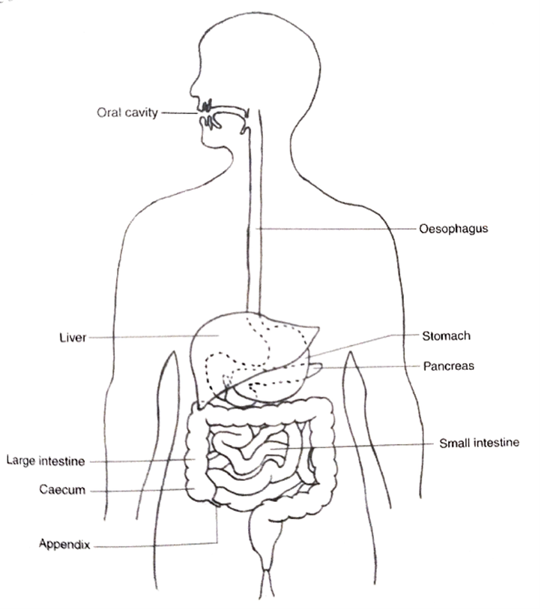
MAIN FUNCTION IS DIGESTION
DIFFERENT PARTS OF TRACT ARE SPECIALISED TO PERFORM DIFFERENT FUNCTION

Slide 4
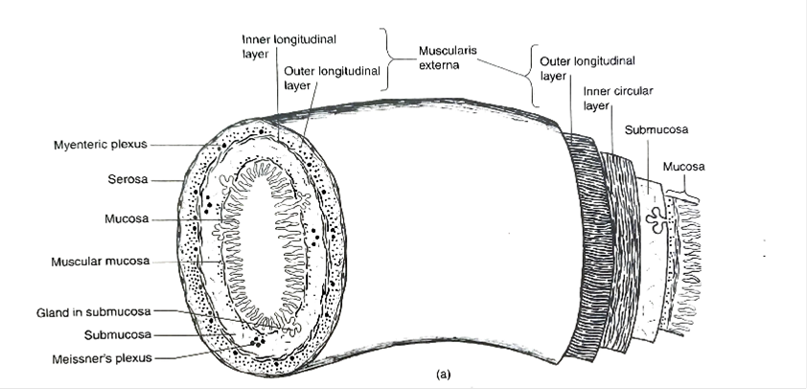
GENERAL MICROSCOPIC FEATURES
  GIT CONSISTS OF FOUR LAYERS
    MUCOSA
    SUBMUCOSA
    MUSCULARIS EXTERNA
    SEROSA OR ADVENTITIA

Slide 5
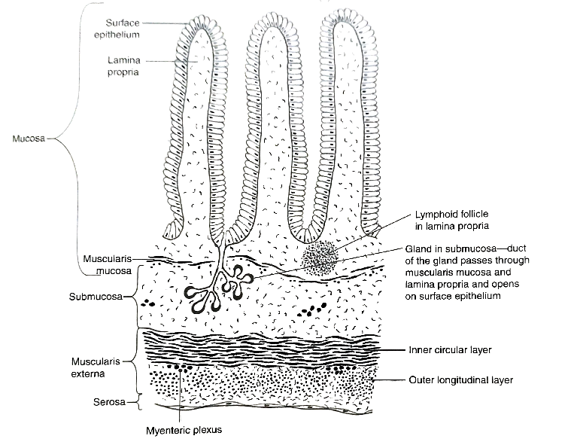
MUCOSA-
Consists of
Lining epithelium
  It gets modified according to the function it has to perform
Lamina propria
  Support epithelium
  Composed of loose connective tissue
  Rich in blood supply & lymphatics
  Digested food enters the blood in this layer
  It also contain gland & lymphoid follicles
Muscularis mucosae
  It separates mucosa from submucosa
  Consists of inner circular & outer longitudinal layers of smooth muscle
  It produces localised movement of mucous membrane

Slide 6
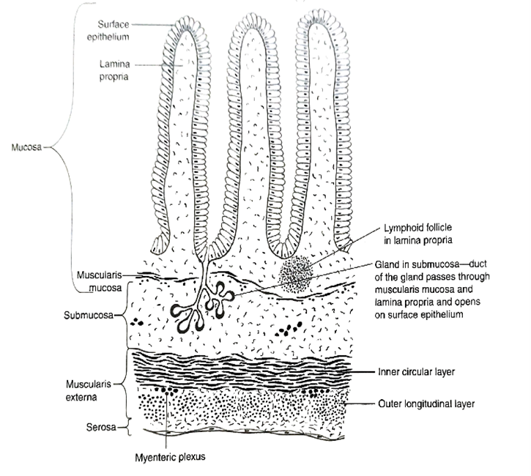
SUBMUCOSA
  Made up of loose connective tissue
  Consists
    Plexus of autonomic nerve (Meissner’s plexus)
    Blood vessels
    Lymphatics
  It may also contain glands

Slide 7
MUSCULARIS EXTERNA
  Consists of two layers of smooth muscle-
    Inner circular layer
    Outer longitudinal layer
  Auerbach’s or myenteric plexus
  Contraction of this layer propels the food contents

Slide 8
SEROSA & ADVENTITIA
  Outermost layer of GIT
  The adventitia consists of loose connective tissue
  In the abdominal part adventitia is covered by simple squamous epithelium (mesothelium)
    Adventitia + mesothelium = serosa

Slide 9
HISTOLOGY OF OESOPHAGUS
25 cm long muscular tube
Proximally it continue with oropharynx & distally it passes through posterior mediastinum and pierces the diaphragm and open into the cardiac end of stomach
It conducts chewed food (bolus)& liquid to stomach

Slide 10
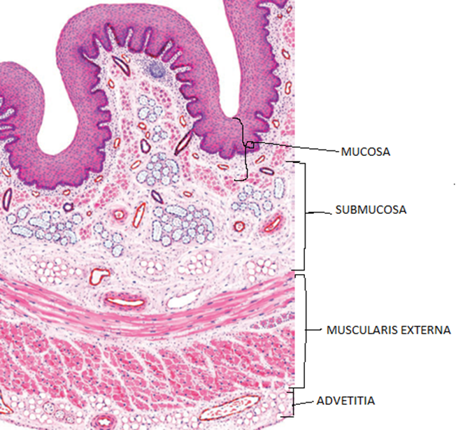

Four basic layers-
MUCOSA
  Lining epithelium – stratified squamous epithelium( non keratinized )
  Lamina propria – few lymphoid follicles, oesophageal cardiac gland
  Muscularis mucosae – single longitudinal layer of smooth muscle
    No circular layer
SUBMUCOSA
  Oesophageal gland
MUSCULARIS EXTERNA
  In upper 1/3rd – skeletal muscle
  In middle 1/3rd – both skeletal & smooth
  In lower 1/3rd – only smooth muscle
ADVENTITIA & SEROSA
  In thoracic part – adventitia
  In abdominal part - serosa

Slide 11
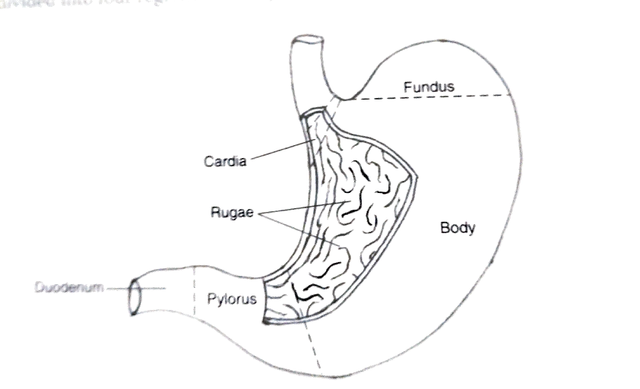
HISTOLOGY OF STOMACH
On the basis of histological structure it is divided into three regions
  Cardiac region
  Fundic region (or body)
  Pyloric region
In empty stomach mucosa & submucosa are thrown into longitudinal folds called rugae
Epithelial lining gastric mucosa contains many depressions called gastric pits
From bottom of each pit several tubular gastric gland extend into lamina propria

Slide 12
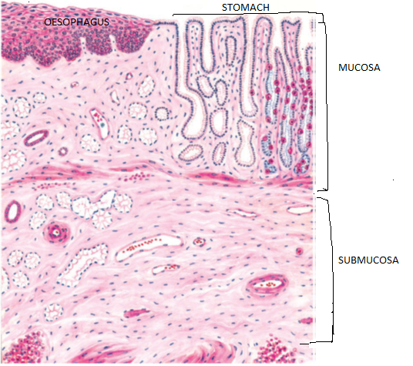
CARDIAC REGION
MUCOSA
  Lining epithelium – simple columnar epithelium
  Goblet cells are not present in epithelium
  Lamina propria – contains small tubular gland (cardiac gland)
  Muscularis mucosae –
    Inner circular layer
    Outer longitudinal layer
SUBMUCOSA
MUSCULARIS EXTERNA
  Consists of three layer of smooth muscle
    Inner – oblique
    Middle – circular
    Outer – longitudinal
SEROSA/ADVENTITIA

Slide 13
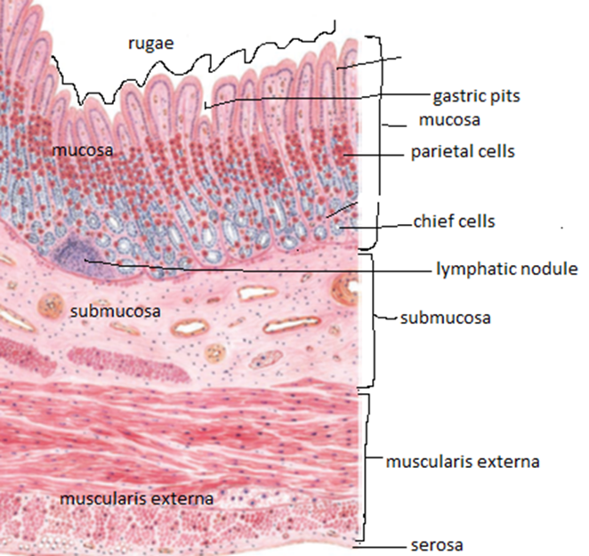
FUNDIC OR BODY REGION
MUCOSA –
  LINING EPITHELIUM
    Simple columnar epithelium
    Secrets mucus
    Invaginates into lamina propria to form gastric pit
  LAMINA PROPRIA
    Contains gastric gland or fundic gland
    Gastric gland –
      Branched tubular gland
      Three parts – isthmus, neck & base
        Isthmus contain – surface epithelium & parietal cells
        Neck – mucous neck cells, stem cell & parietal cells
        Base – zymogen cell enteroendocrine cell

Slide 14
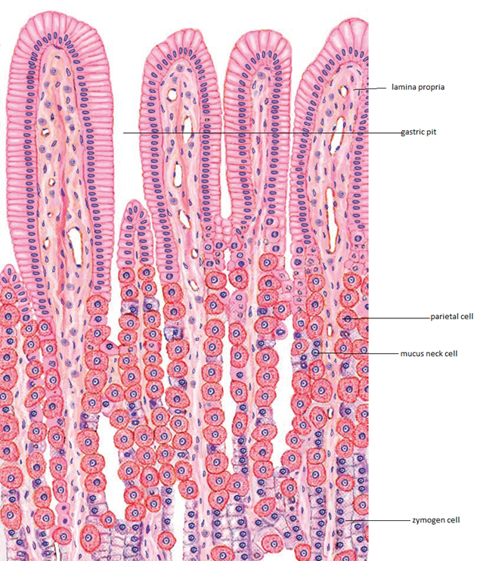
Cells of gastric gland –
Parietal cells
  Also called oxyntic cells
  Secrets gastric acid & intrinsic factor – absorption of vitamin B12
Stem cells
  It differentiate into other types of cells
Mucous neck cells
  Lies b/w the parietal cells of neck region
  Secrets mucus
Zymogen cells
  Also called chief cells
  Present in the base of gland
  Secrets gastric enzyme pepsinogen, rennin & gastric lipase
Enteroendocrine cells
  Mainly present in the base of the gland
  Secrets serotonin, histamin & gastrin

Slide 15
  MUSCULARIS MUCOSAE
    Thin layer of smooth muscle cells
    Arranged in inner circular & outer longitudinal layer
SUBMUCOSA
MUSCULARIS EXTERNA

Slide 16
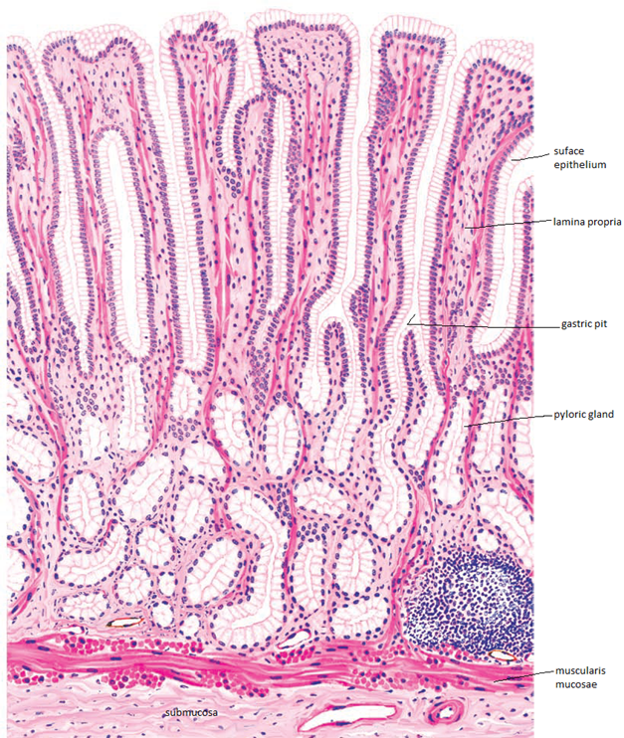
PYLORIC REGION
MUCOSA
  Similar to that of fundus & body
  Points of differences are-
    Gastric pits are longer than body & fundus
    Bases of the glands are more coiled than the glands in the body
    Ratio b/w depth of gastric pit & the gastric gland is 3:1
    No zymogen cells are present in this region

Slide 17
Comparison between fundus & pylorus of the stomach
FEATURES | FUNDUS & BODY | PYLORUS
Depth of gastric pit | Less | More
Coiling of base of gland | Less | More
Parietal cells | Numerous | Very few
Zymogen cells | numerous | Absent

