Slide 1
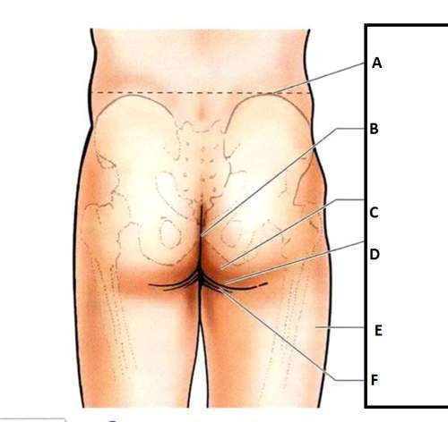
GLUTEAL REGION
SARANGDHAR KUMAR
DEPARTMENT OF ANATOMY
ROHILKHAND MEDICAL COLLEGE
BAREILLY

Slide 2
CHAPTER OUTLINE :-
Introduction of Gluteal region and its extension
Skeletal framework of gluteal region
Cutaneous innervation
Muscles of gluteal region
Arteries of gluteal region
Nerves of gluteal region

Slide 3
PROMINANACE IN THE UPPER POSTERIOR PART OF LOWER LIMB
ANTERO-SUPERIOR PART OF THIS REGION SEEN IN A SIDE VIEW IS CALLED HIP
THE PROMINANACE OF BUTTOCK IS UNIQUE IN MAN DUE TO-
  ADOPTION OF UPRIGHT POSTURE
  BIPEDAL MODE OF LOCOMOTION
THE PROMINANCE IS ACCOUNTED FOR
  MASSIVE DEVELOPMENT OF GLUTEUS MAXIMUS
  ABUNDANT DEPOSITION OF SUBCUTANEOUS FAT

Slide 4
EXTENT OF GLUTEAL REGION
ABOVE – entire length of iliac crest
BELOW – gluteal fold (transverse skin crease for hip joint)
BEHIND – sacral spine
INFRONT – an imaginary vertical line
(extend from anterior superior iliac spine to anterior edge of greater trochanter)

Slide 5
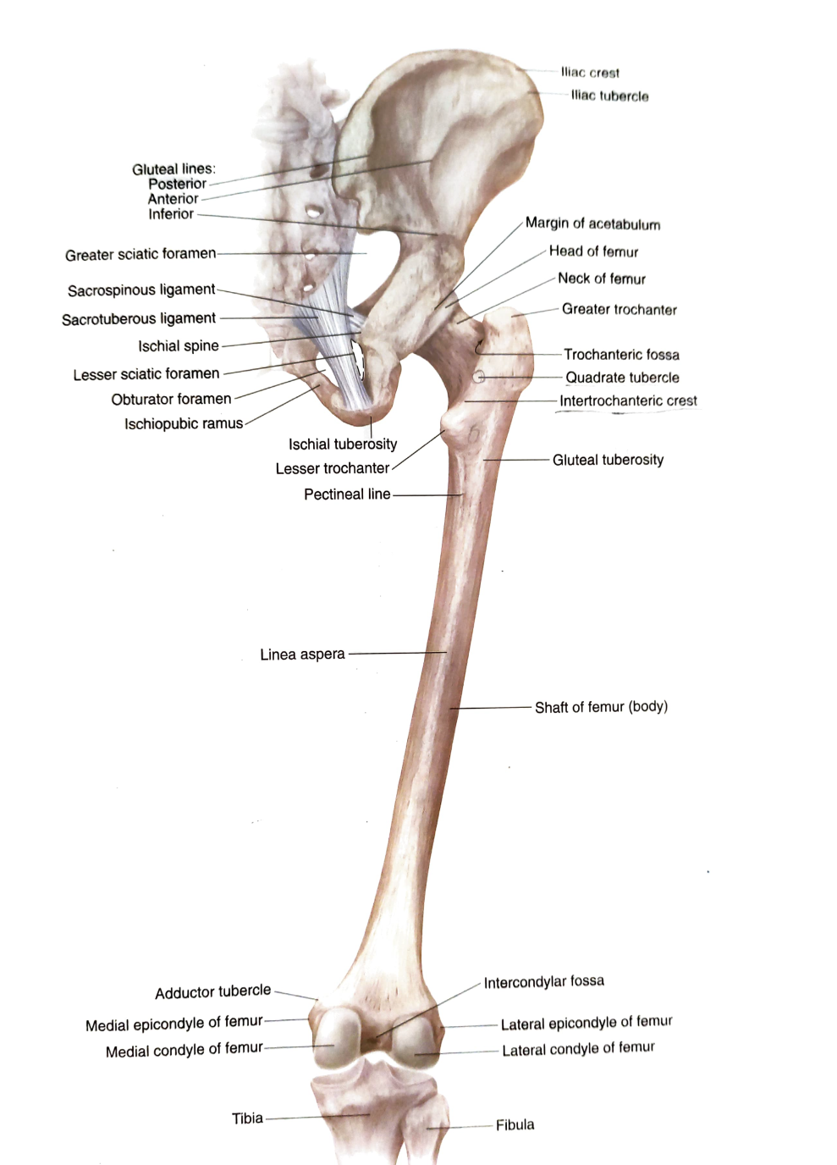
SKELETAL FRAMEWORK
It is contributed by the following bones –
  Dorsal surface of sacrum & coccyx
  Gluteal surface of ilium
  Dorsal surface of ischium with ischial tuberosity , ischial spine , greater & lesser sciatic notch
  Posterior surface of upper part of femur

Slide 6

BONY LANDMARKS
Highest point of iliac crest
Posterior superior iliac spine
Tip of greater trochanter
Ischial tuberosity

Slide 7
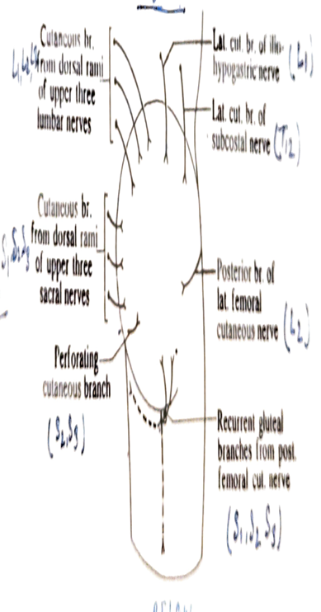
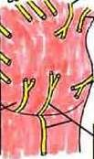
SUPERFICIAL FASCIA
Thick & fatty
Subcutaneous fat is abundant in adult female that makes the rounded contour of the buttock
Consists of
  Cutaneous nerves
  Cutaneous vessels- perforating branch of superior & inferior gluteal vessels
  Lymphatics- lat. group of superficial inguinal lymph node

Slide 8
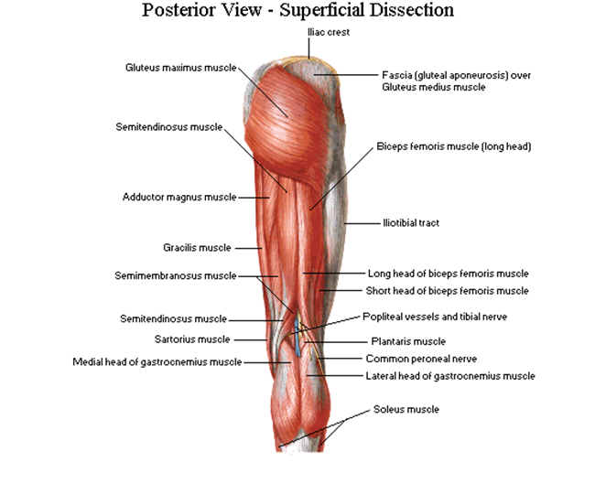
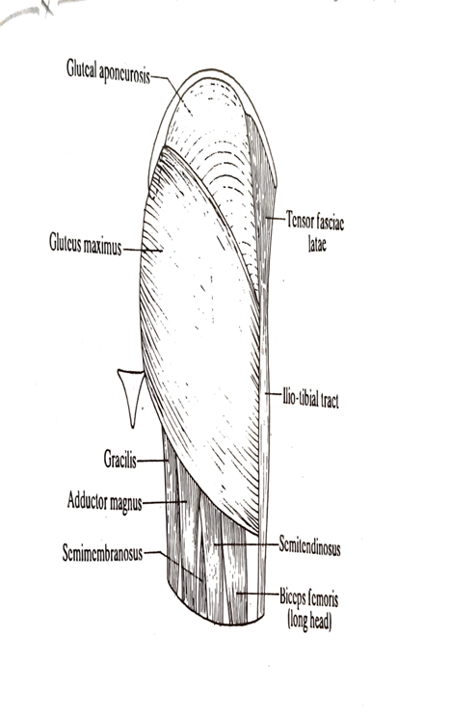
DEEP FASCIA
Attached above to iliac crest & behind to the sacrum
Fascia splits twice along the iliac crest to enclose the gluteus maximus & tensor fascia latae
Forms thick aponeurotic sheath over gluteus medius muscle
Laterally it continue with ilio-tibial tract

Slide 9
MUSCLES OF GLUTEAL REGION
10 IN NUMBER & ARRANGED IN THREE LAYER
THREE LAYER
SUPERFICIAL
GLUTEUS MAXIMUS
TENSOR FASCIA LATAE
INTERMEDIATE
GLUTEUS MEDIUS
PIRIFORMIS
GRMILUS SUPERIOR
GEMILUS INFERIOR
OBTURATOR INTERNUS
QUADRATUS FEMORIS
DEEP LAYER
GLUTEUS MINIMUS
REFLECTED HEAD OF RECTUS FEMORIS
TENDINOUS INSERTION OF OBTURATOR EXTERNUS

Slide 10
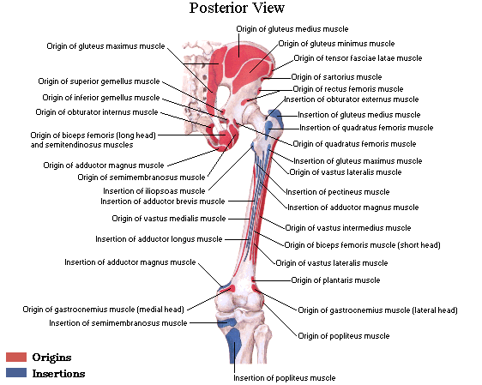
GLUTEUS MAXIMUS
Largest & more superficial muscle
Quadrilateral in outline
  Origin-
  Gluteal surface of ilium above & behind the posterior gluteal line
  Outer sloping area of dorsal segment of iliac crest
  Posterior layer of thoraco-lumber fascia
  Dorsal surface of gluteal aponeurosis
  Sacrotuberous ligament
  Dorsal surface of lower part of sacrum & coccyx

Slide 11
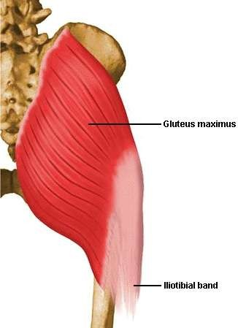

Slide 12

  Insertion –
    1/4th part- gluteal tuberosity
    3/4th part- upper part of ilio-tibial tract
  Nerve supply –
    inferior gluteal nerve (L5,S1, S2)dorsal branch of ventral primary rami
  Arterial supply –
    superior & inferior gluteal artery
  Actions –
    chief extensor of hip joint
    Strong lateral rotator of hip joint
    Powerful abductor of hip joint (upper fibers)

Slide 13
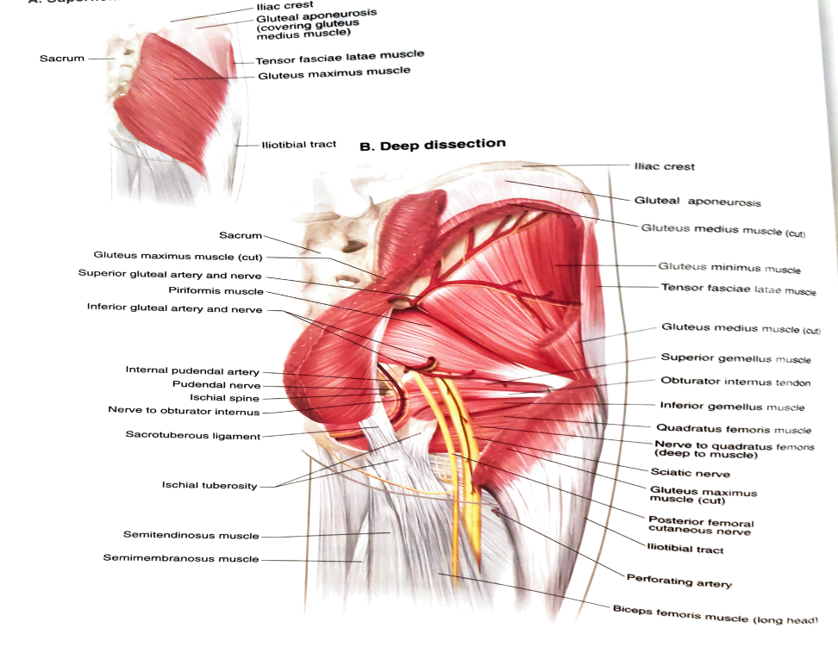
Structures undercover of gluteus maximus
Bones & ligament –
  Ilium
  ischium
  Sacrum
  Coccyx
  Ischial tuberosity
  Greater trochanter
  Sacro-tuberous ligament
  Dorsal sacro-iliac ligament
Bursae –
  Trochanteric bursa
  Gluteo-femoral bursa
  Ischial bursa (occasionally)

Slide 14
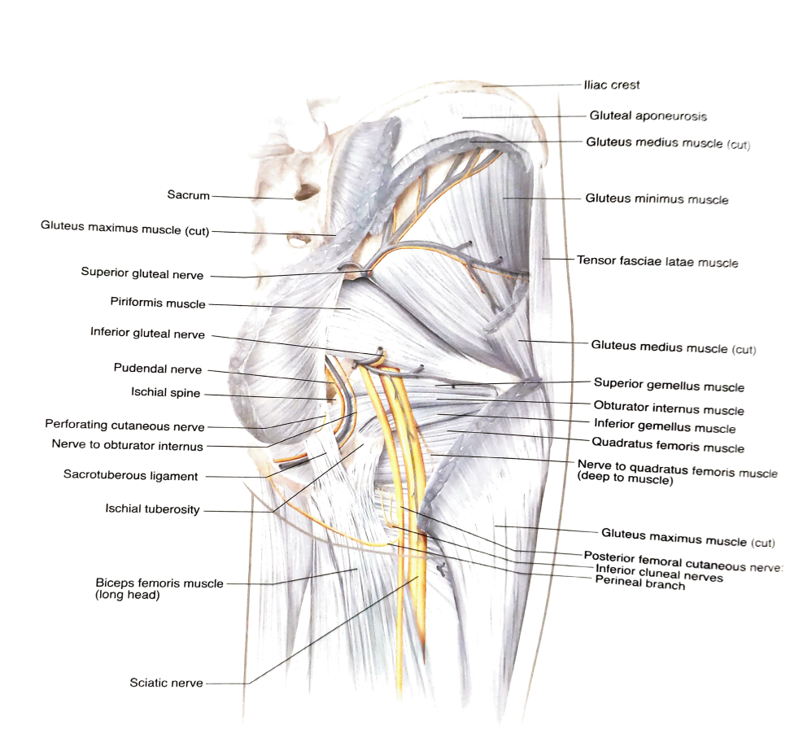
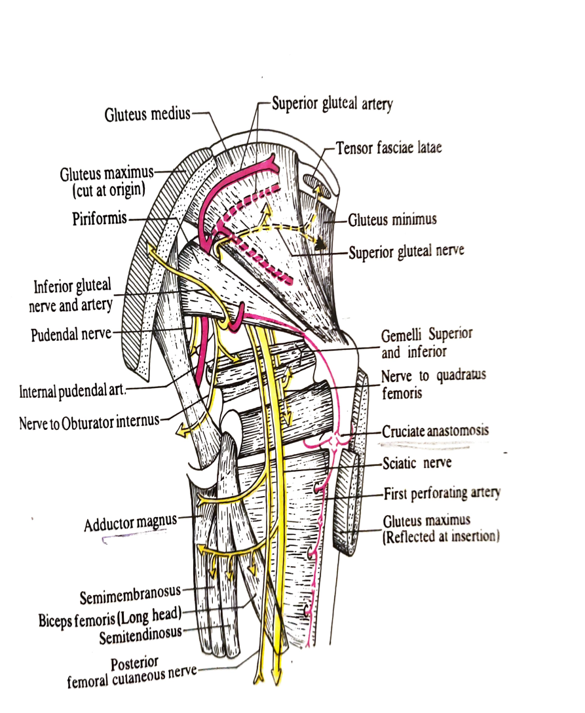

Slide 15
Muscles –
  Gluteus medius,
  Gluteus minimus
  Piriformis,
  Tricipital tendon of obturator internus,
  Quadratus femoris,
  Origin of hamstring group of muscle
Blood vessels & nerves –
  Superior & inferior gluteal artery,
  Internal pudendal vessels,
  Sciatic nerve,
  Posterior cutaneous nerve of thigh,
  Superior & inferior gluteal nerve,
  Nerve to obturator internus,
  Nerve to quadratus femoris
Arterial anastomosis –
  Trochanteric ,
  Cruciate

Slide 16
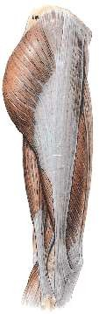
TENSOR FASCIAE LATAE
Tensor fasciae latae
Origin –
  Outer lip of iliac crest b/w anterior superior iliac spine to iliac tubercle
Insertion –
  Ilio-tibial tract
Nerve supply –
  Superior gluteal nerve (L4,L5,S1 dorsal branch)
Action –
  Abductor of hip joint
  Assist the gluteus maximus muscle to keeping knee in extended position
Iliotibial tract

Slide 17
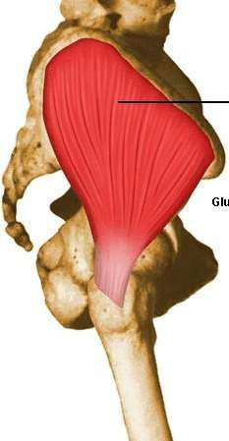
GLUTEUS MEDIUS

Slide 18
Gluteus medius
Origin –
  Area b/w posterior gluteal line and anterior gluteal line of gluteal surface of ilium
Insertion –
  Oblique ridge on lateral surface of greater trochanter
Nerve supply –
  superior gluteal nerve
Actions –
  Gluteus medius + Gluteus minimus = powerful abductor of hip joint
  Anterior fiber medially rotate the thigh
  Holds the opposite side of pelvis horizontally when foot is off the ground

Slide 19
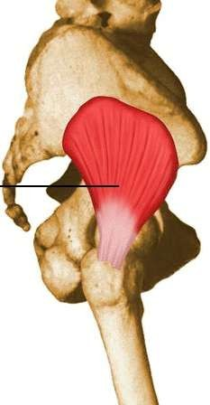
GLUTEUS MINIMUS
It is triangular in outline
Origin –
  Area b/w anterior and inferior gluteal line of gluteal surface of ilium
Insertion –
  Anterior surface of greater trochanter
Nerve supply –
  Superior gluteal nerve
  Action –
    Gluteus medius + Gluteus minimus = powerful abductor of hip joint

Slide 20
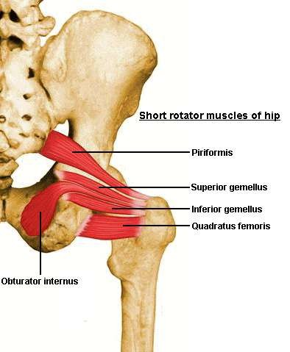
PIRIFORMIS
Key muscle of this region
It lies partly in pelvis region & partly in gluteal region
Origin –
  Bony bar of middle three sacral foramina on pelvic surface of sacrum
  Sacro-tuberous ligament
  Upper margin of greater sciatic notch
Insertion –
  Apex of greater trochanter
Nerve supply –
  Nerve to piriformis (S1,S2 root of sacral plexus)
Actions –
  In extended thigh it acts as lateral rotator
  In flexed thigh it acts as abductor

Slide 21

TRICIPITAL TENDON
Obturator internus –
Origin –
  Inner surface of obturator membrane
  Adjoining ischio-pubis ramus
  Upper part of pelvic surface of body of ischium
Insertion –
  Medial surface of greater trochanter of femur(above & infront of trochanteric fossa)
Nerve supply –
  Nerve to obturator internus(L5,S1,S2 ventral branch)
Gemellus superior –
Origin –
  Upper part of lesser sciatic notch
Insertion –
  Medial surface of greater trochanter of femur
Nerve supply –
  Nerve to obturator internus
Gemellus inferior –
Origin –
  Lower part of lesser sciatic notch
Insertion –
  Medial surface of greater trochanter of femur
Nerve supply –
  Nerve to quadratus femoris(L4,L5,S1ventral branch)

Slide 22

QUDRATUS FEMORIS
Rectangular muscle
Origin –
  femoral surface of ischial tuberosity
Insertion –
  quadrate tubercle (present on intertrochanteric crest of femur)
Nerve supply –
  nerve to quadratus femoris (L4,L5,S1 ventral branch)
Action –
  lateral rotator of thigh

Slide 23

NERVES OF GLUTEAL REGION
SCIATIC NERVE
SUPERIOR GLUTEAL NERVE
INFERIOR GLUTEAL NERVE
POSTERIOR CUTANEOUS NERVE OF THIGH
PUDENDAL NERVE
NERVE TO OBTURATOR INTERNUS
NERVE TO QUADRATUS FEMORIS
These are the branch of sacral plexus

Slide 24
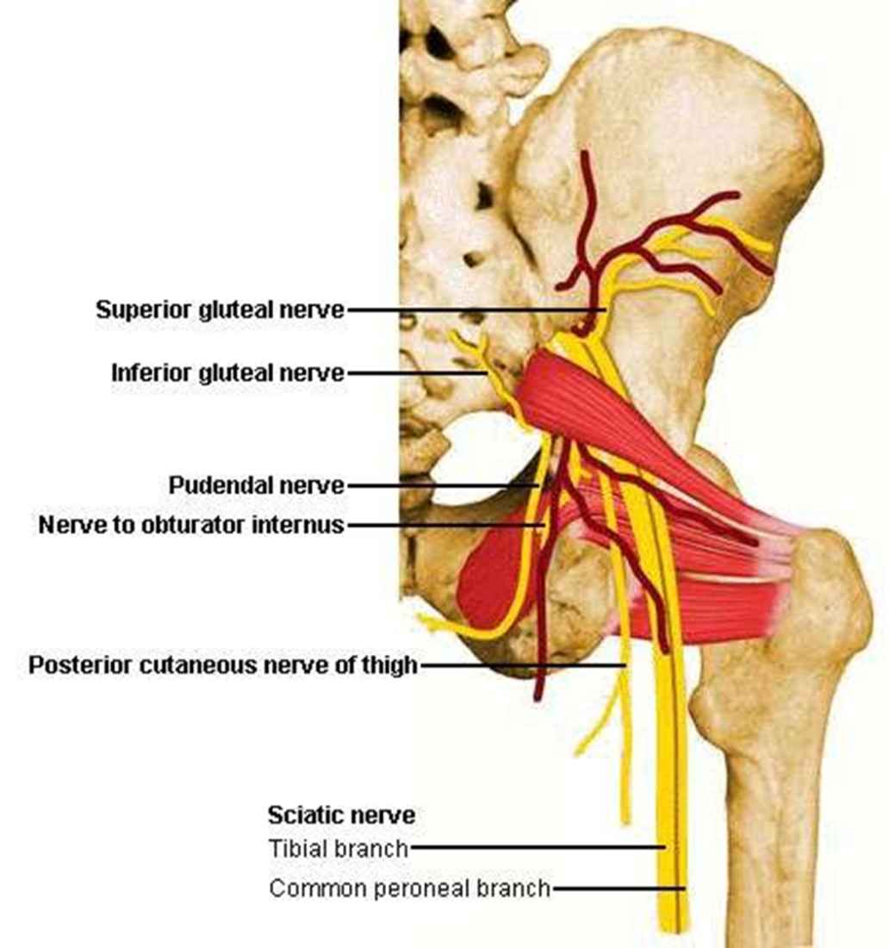
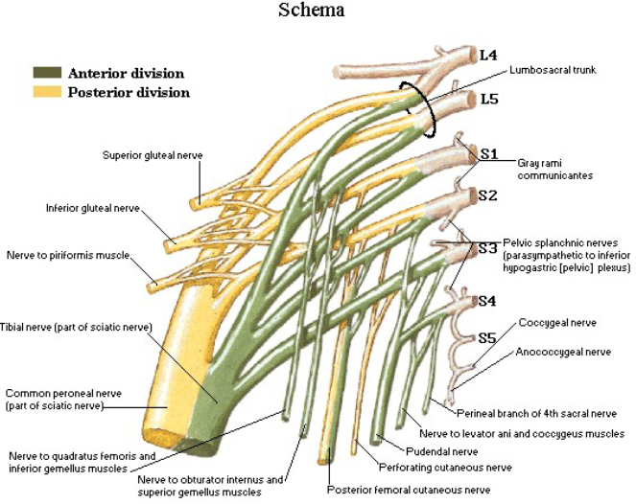

Slide 25

SACRAL PLEXUS
Formed by ventral rami of fourth & fifth lumber and upper four sacral nerves ( L4,L5,S1,S2,S3 & S4)
L4 is called nervi furcalis
All the root of sacral plexus divides into dorsal and ventral branch, except S4
Ventral ramus of S4 divides into upper and lower branch
Lower branch of S4 joins with S5 and forms coccygeal plexus
plexus present two terminal branches, the sciatic & pudendal nerves

Slide 26
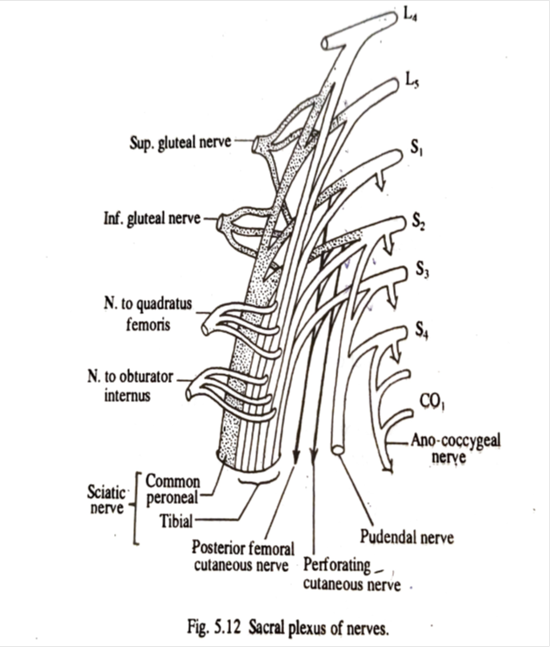

Slide 27
Branches of sciatic nerve –
12 named branches
Sciatic & pudendal nerve is terminal branch
3 sets of nerve arises from root of plexus
  Nerve to piriformis (S1,S2)
  Nerve to levator ani (S3,S4)
  Pelvic splanchnic nerve (S2,S3,S4)
PELVIC REGION (5) | GLUTEAL REGION (7)
Nerve to piriformis (S1,S2) Nerve to levator ani (S3,S4) Pelvic splanchnic nerve (S2,S3,S4) Perineal branch of S4 Pudendal nerve (S2,S3,S4 ventral branch) | Superior gluteal nerve (L4,L5,S1) Inferior gluteal nerve (L5,S1,S2) Perforating cutaneous nerve (S2,S3) Nerve to obturator internus (L5,S1,S2) Nerve to quadratus femoris (L4,L5,S1) Sciatic nerve (L4,L5,S1,S2,S3) Posterior cutaneous nerve of thigh (S1,S2,S3) (S1,S2- dorsal branch & S2,S3- ventral branch)
dorsal

Slide 28
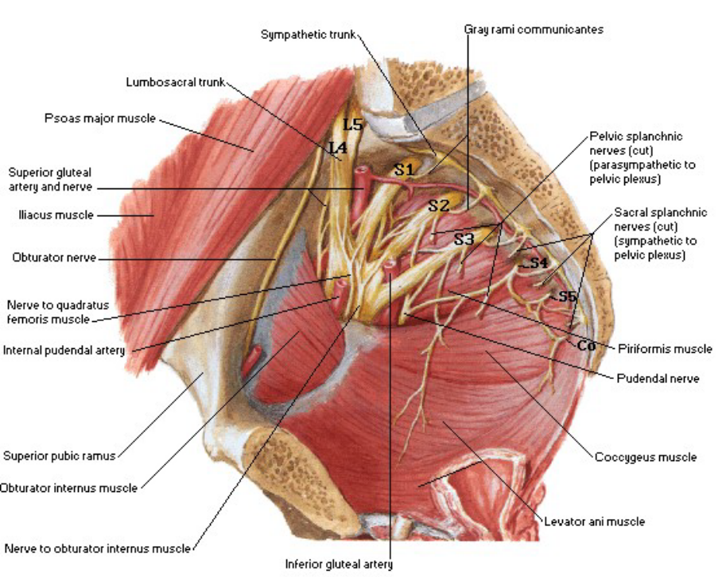
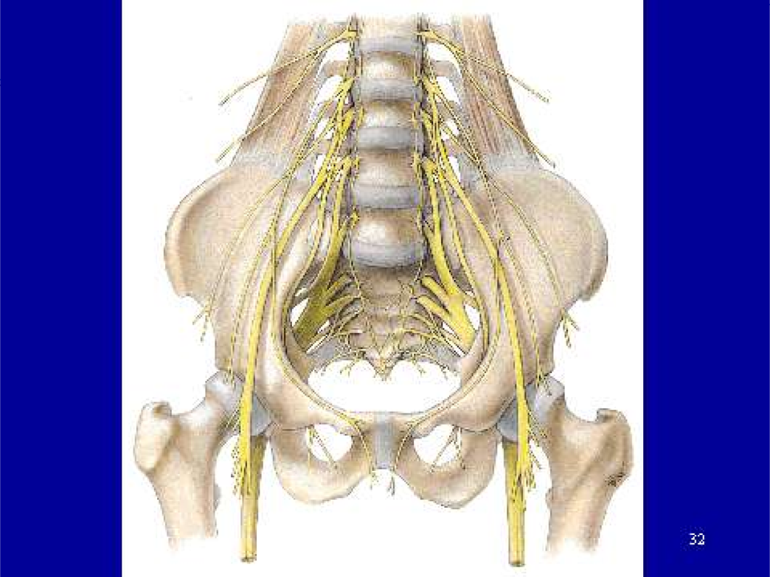

Slide 29

Sciatic nerve –
  Root value - L4, L5, S1, S2, S3
  Is the largest branch of the sacral plexus and the largest nerve in body
  Consists of two component of nerves, the common peroneal nerve (d) and the tibial nerve (v)
  Leaves the pelvis through the greater sciatic foramen below the piriformis muscle

Slide 30

SUPERIOR GLUTEAL NERVE –
  Root value – L4, L5, S1 ventral branch
  Leaves the pelvis through the greater sciatic foramen above the piriformis muscle with the superior gluteal artery and vein
  In the gluteal region supplies –
  Gluteus medius
  Gluteus minimus
  Tensor fasciae latae
  The hip joint

Slide 31
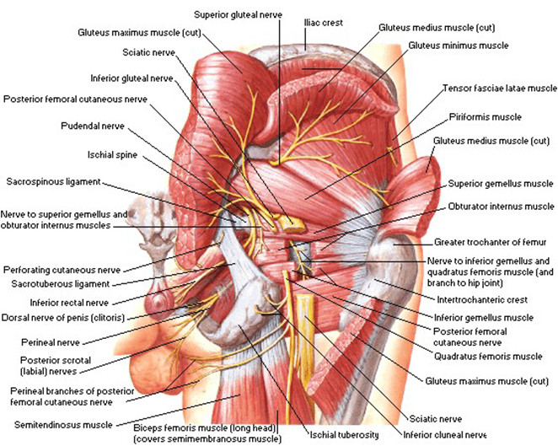
INFERIOR GLUTEAL NERVE –
Root value - L5, S1, S2
Leaves the pelvis through the greater sciatic foramen below the piriformis muscle with the inferior gluteal artery and vein
In the gluteal region supplies the gluteus maximus muscle

Slide 32
POSTERIOR CUTANEOUS NERVE OF THIGH –
Root value – S1, S2 dorsal branch & S2, S3 ventral branch
Leaves the pelvis through the greater sciatic foramen inferior to the piriformis
In the gluteal region descends on the posterior surface of the sciatic nerve
Supplies the skin of the buttocks, posterior thigh, popliteal fossa, and external genitalia

Slide 33
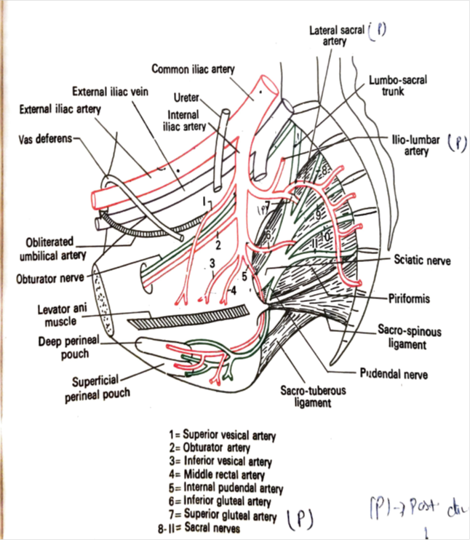
PUDENDAL NERVE –
Root value – S2, S3, S4 ventral branch
Leaves the pelvis through the greater sciatic foramen inferior to the piriformis muscle along with the internal pudendal artery and vein
In the gluteal region descends posterior to the ischial spine and enters the lesser sciatic foramen
Is distributed to the perineum
No branches in the gluteal region

Slide 34

NERVE TO OBTURATOR INTERNUS –
Root value - L5, S1, S2 ventral branch
Leaves the pelvis through the greater sciatic foramen below the piriformis muscle
In the gluteal region descends on the superior gemellus muscle to pass below the ischial spine and enter the lesser sciatic foramen
Supplies the superior gemellus and obturator internus muscles

Slide 35

NERVE TO QUADRATUS FEMORIS –
Root value- L4, L5, S1 ventral branch
Leaves the pelvis through the greater sciatic foramen below the piriformis muscle and deep to the sciatic nerve
In the gluteal region runs anterior to the superior and inferior gemellus and obturator internus muscles
Supplies the inferior gemellus and quadratus femoris muscles

Slide 36
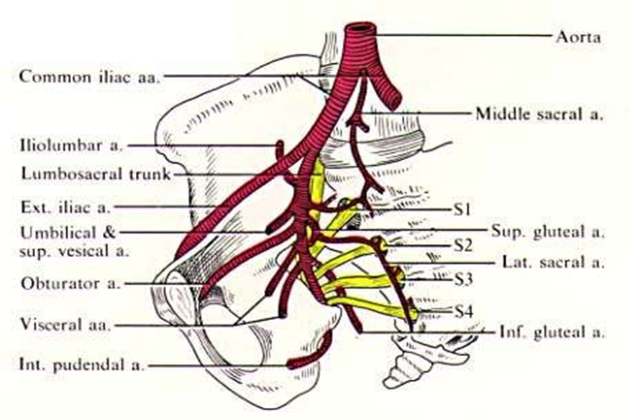

ARTERIES OF GLUTEAL REGION
SUPERIOR GLUTEAL ARTERY
  It is the branch of posterior division of internal iliac artery
  It leaves the pelvis and enters into the gluteal region by passing through greater sciatic foramen above the piriformis muscle
  Divides into superficial & deep branches
  Superficial branch passes b/w G. maximus & G. medius
  Deep branch passes b/w G. medius & G. minimus and divides into upper & lower branch

Slide 37



Slide 38

INFERIOR GLUTEAL ARTERY –
  It is a branch of anterior division of internal iliac artery
  Appears in the gluteal region below the piriformis
  Breaks up mainly into three sets of branches
    Muscular branches
    Anastomotic branches
    Arteria nervi ischiadici (remnant of axis artery of lower limb)
INTERNAL PUDENDAL ARTERY
  It is branch of anterior division of internal iliac artery
  Brief appearance in gluteal region below the piriformis
  then it curve forward through lesser sciatic foramen & enter the pudendal canal
  Supply the str. of perineum

Slide 39
TROCHANTERIC & CRUCIATE ANASTOMOSIS
Descending branch of superior gluteal artery
TROCHANTERIC ANASTOMOSIS
  Site- trochanteric fossa
  Chief source of blood supply of
  neck of femur
Ascending branch of medial circumflex artery
Ascending branch of lateral circumflex femoral artery
TROCHANTERIC ANASTOMOSIS
Inferior gluteal artery

Slide 40
CRUCIATE ANASTOMOSIS
Site- close to greater trochanter
Formed in inter muscular space b/w adductor magnus & quadratus femoris
Descending branch of inferior gluteal artery
Transverse branch of medial circumflex artery
Transverse branch of lateral circumflex femoral artery
CRUCIATE ANASTOMOSIS
Ascending branch of 1st perforator artery

Slide 41
APPLIED ANATOMY
INTRAMUSCULAR INJECTION IN BUTTOCK –
  Must be given in upper lateral quadrant of buttock (gluteus maximus/ medius)
  To avoid injecting into sciatic nerve
  This is one of the most common causes of litigation against medical personnel

Slide 42
TRENDELENBERG TEST

Slide 43
SCIATICA –
Caused by prolapse of intervertebral disc, which compresses the lower lumbar & upper sacral nerve root or pressure on the sacral plexus
Patients experiences radiating pain
  down the posterior aspect of thigh
  posterior & lateral side of leg
  lateral part of foot
Disc prolapsed b/w L4 & L5 involves L5 nerve which is manifested by-
  numbness in medial 3 toes
  difficulty in dorsiflexion
Disc prolapsed b/w L5 & S1 involves S1 nerve which is manifested by –
  numbness in lateral border of foot
  difficulty in plantar flexion
SLEEPING FOOT –
  Due to temporary compression of sciatic nerve against the femur at the lower border of gluteus maximus muscle

Slide 44
THANK YOU

