Slide 1
FOURTH VENTRICLE
SARANGDHAR KUMAR
DEPARTMENT OF ANATOMY
ROHILKHAND MEDICAL COLLEGE
BAREILLY

Slide 2
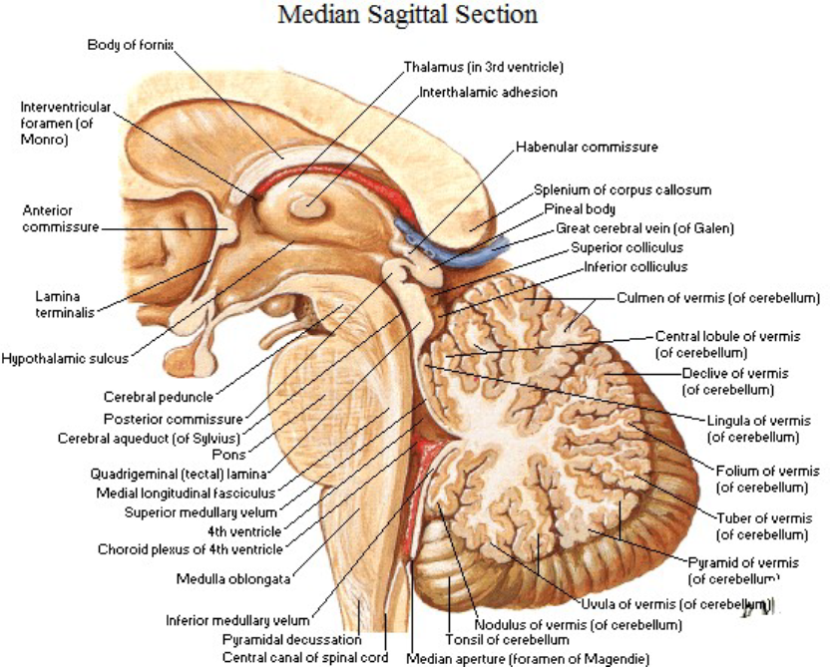
The 4th ventricle is tent like cavity of the hind brain
Situated in the posterior cranial fossa
Behind the pons and the upper part of medulla oblongata
In front of the cerebellum
Triangular outline in sagittal section and appears rhomboidal in shape in horizontal section

Slide 3
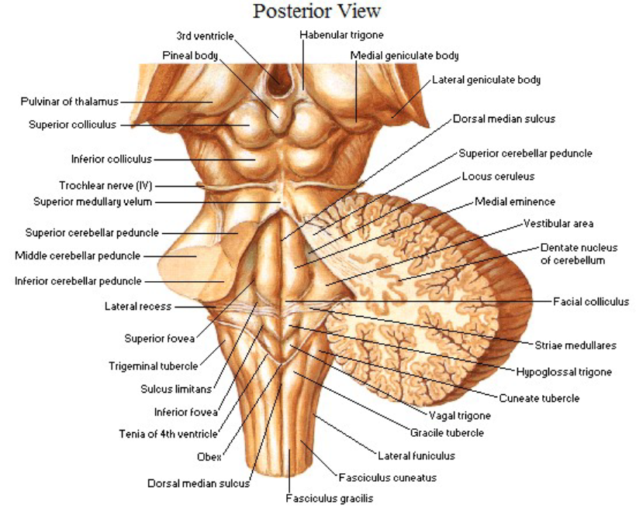
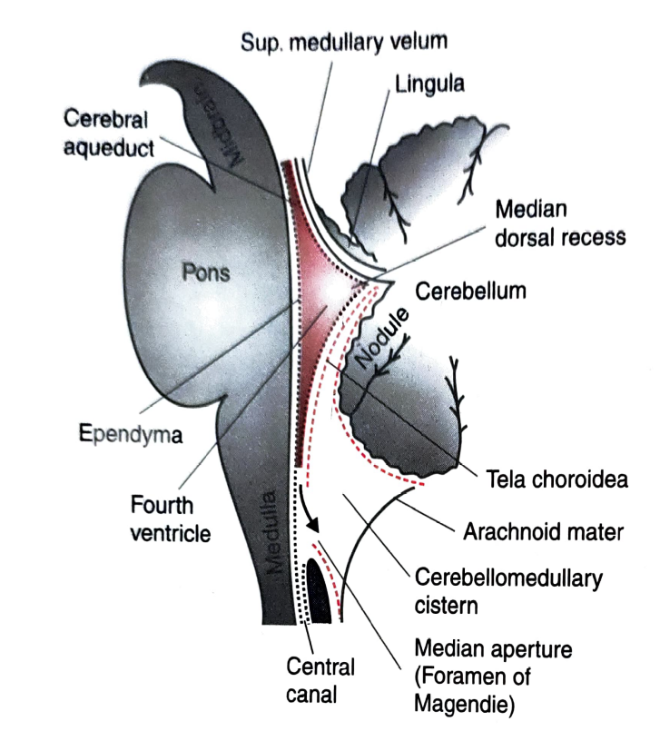
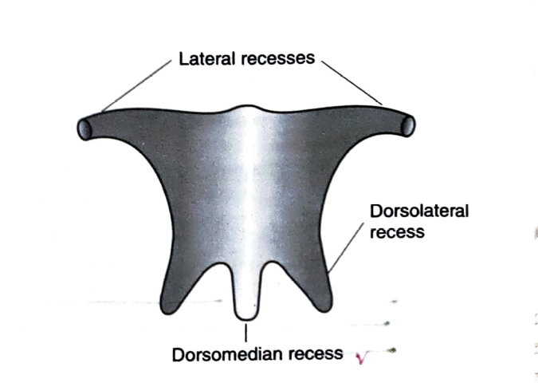
Features of the 4th ventricle
Cavity of 4th ventricle-
Recesses-
  Five in number
  Two lateral recesses
  A median dorsal recess
  Two lateral dorsal recesses
Openings –
Three openings in the roof –
  One median (foramen Magendie)
  Two lateral (foramina of Luscka)

Slide 4
Angles of the 4th ventricle
  Four angles
  Superior angle
  Inferior angle
  - Two lateral angles

Slide 5

Boundaries of 4th ventricle
  Lateral wall-
  Infero-laterally- inferior cerebellar peduncle & gracille and cuneate tubercles
  - Supero-laterally- superior cerebellar peduncle
  Roof (posterior wall)-
  Upper part- formed by superior cerebellar peduncle & thin sheet of white matter superior medullary velum
  Lower part - mainly formed by tela choroidea of 4th ventricle & thin sheet of non nervous tissue (inferior medullary velum)

Slide 6
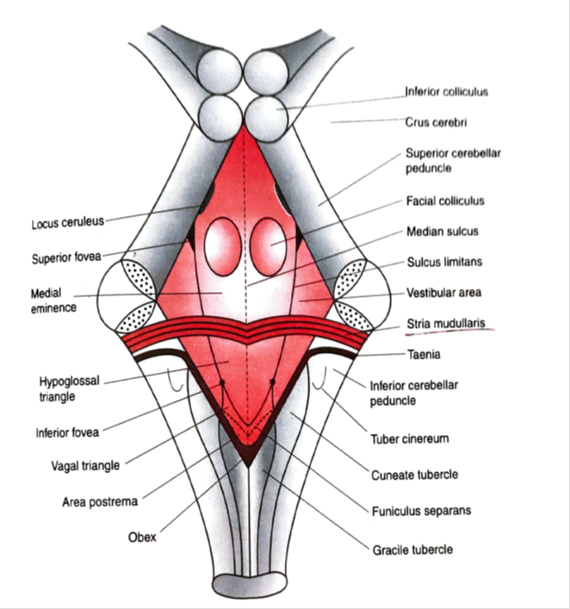
Floor (Rhomboid fossa)-
Shape of floor is diamond shaped
Formed by posterior surfaces of the pons and the upper part of the medulla
Three parts:
Upper triangular part - The posterior surface of the pons.
The lower triangular part - the upper part of the posterior surface of the medulla.
The intermediate part- at the junction of the medulla and pons.

Slide 7


Features of the floor-
Right and left halves
  Median sulcus- divides the floor into right & left half
  Median eminence- longitudinal elevation on either side of median sulcus
  Sulcus limitans- limits the median eminence
  Vestibular area- lateral to the sulcus limitans
Upper part
  Facial colliculus
  Superior fovea
  Locus coeruleus- pigmented neurons of pontine reticular formation (bluish in colour), substantia ferruginea.
Lower part
  Hypoglossal triangle- hypoglossal nerve nucleus lies deep to hypoglossal triangle
  Vagal triangle- dorsal nucleus of vagus & solitary nucleus lies deep to vagal triangle
  Inferior fovea-

Slide 8
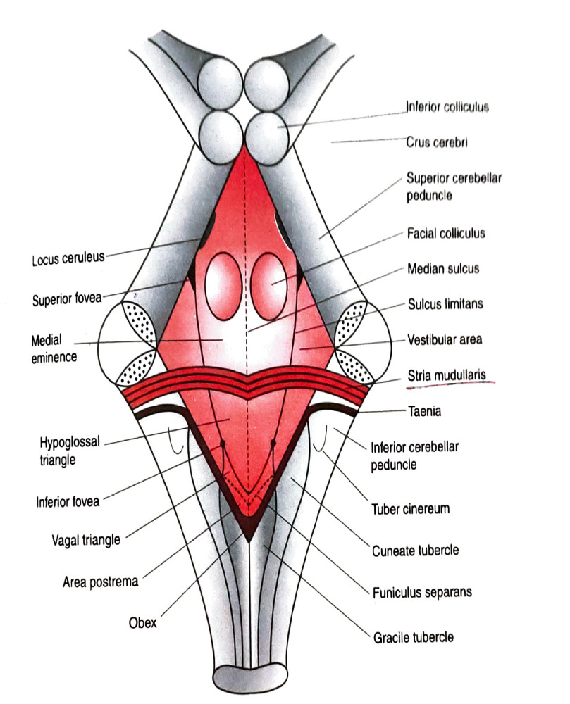
  Area postrema- consists of highly vascular mass of neuroglial tissue
  It is devoid of BBB
  Vomiting center is located
  Taenia- The inferolateral margins marked by a narrow white ridge
  Obex - The two taenia meet at the inferior angle of the ventricle
The features of the lower part of the floor of fourth ventricle resemble with that of a pen-nib, hence it is called calamus scriptorius

Slide 9
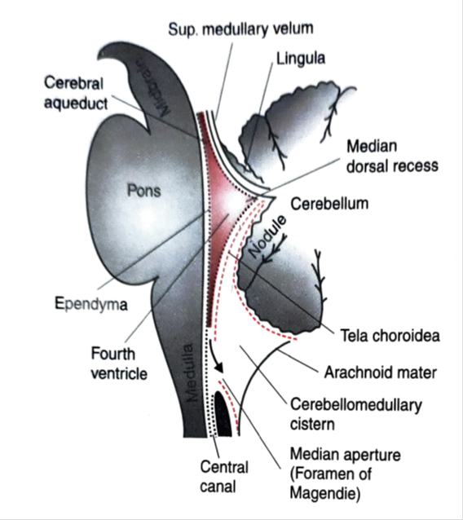
Tela choroidea & choroid plexus of 4th ventricle
Tela choroidea- double layer of pia mater (dorsal & ventral layer)
Choroid plexus- lies within the tela choroidea
  It is formed by choroidal branch of posterior cerebellar artery

Slide 10
Clinical correlation-
Ependymoma
  Tumor arising from ependymal lining of 4th ventricle
  It causes obstruction to flow of CSF leads to internal hydrocephalus
Medulloblastoma
  Highly malignant tumor
  Arising from cerebellar vermis,
  When the tumor enlarges it projects into 4th ventricle and compress the vital centre in the floor of 4th ventricle

Slide 11
Thank you

