Slide 1
FEMORAL HERNIA
SARANGDHAR KUMAR
DEPARTMENT OF ANATOMY
ROHILKHAND MEDICAL COLLEGE
BAREILLY

Slide 2
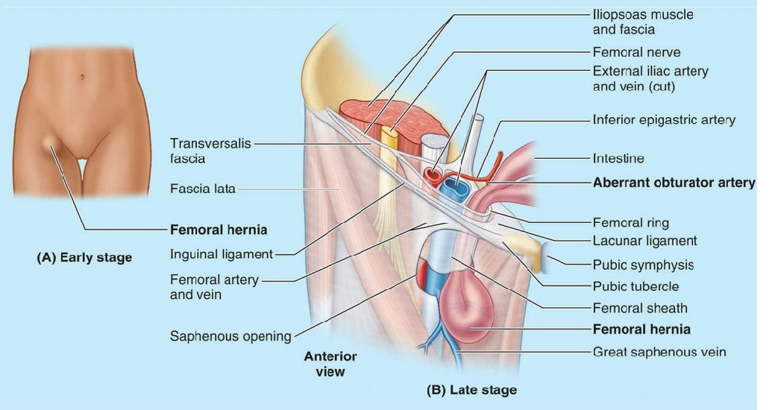
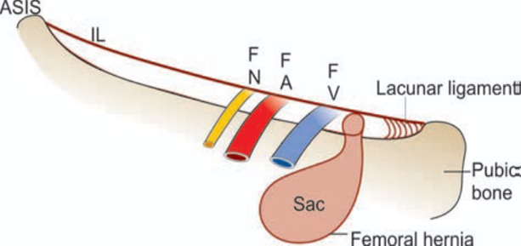
A femoral hernia is the protrusion of abdominal contents through femoral ring into the femoral canal
Usual originating site - femoral ring (weak area in the anterior abdominal wall)
It is 3rd most common hernia (17%)
  Inguinal hernia (73%)
  Incisional hernia
Appears as a mass in the femoral triangle inferolateral to pubic tubercle
It bounded by femoral vein laterally & lacunar ligament medially
It is covered by parietal peritoneum (Hernia sac)

Slide 3
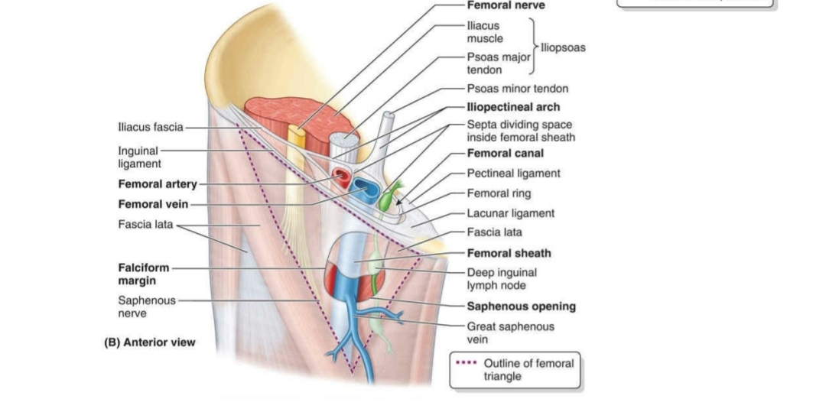
Anatomy of Femoral Canal
  It is the medial most compartment of the femoral sheath
  which extends from femoral ring above to saphenous opening below.
  It contains fat, lymphatics, lymph node of Cloquet
  It is 1.25 cm long and 1.25 cm wide at the base
  Below it is closed by cribriform fascia.

Slide 4

Anatomy of Femoral ring
It is bounded –
  Anteriorly - Inguinal ligament
  Posteriorly - Ilio pectineal ligament of Cooper ,Pubic bone & Fascia covering the pectineus muscle
  Medially - Concave sharp margin of lacunar (Gimbernat’s) ligament
  Laterally - A thin septum separating from femoral vein.

Slide 5
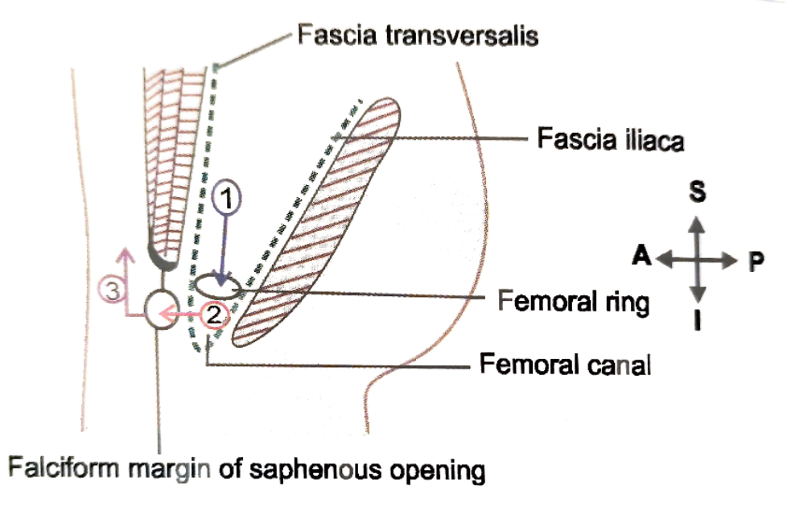
Path of Femoral hernia –
  At first downward then anterior and then upward
  Located inferolateral to pubic tubercle
  It is useful for surgeon to know the path of hernia in order to reverse the path during reducing the hernia

Slide 6
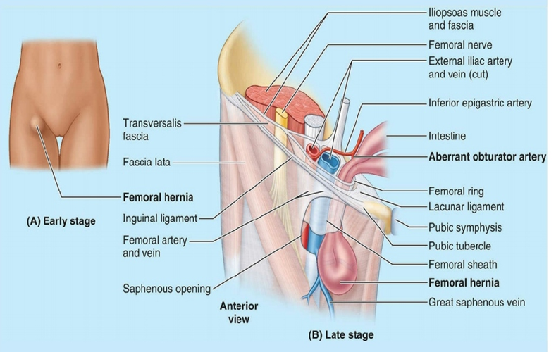

PARTS OF HERNIA -
  Hernia comprises of –
    Covering
    Sac
    Content
  Sac is a diverticulum of peritoneum with mouth, neck, body and fundus.

Slide 7
Etiology of Femoral hernia –
  More common in female due to Wider pelvis & Smaller inguinal canal
  It also occurs after multiple pregnancies due to enlargement of femoral ring over time from increased intra- abdominal pressure forcing fat into femoral canal
    Lifting of heavy weight
    Chronic cough
    Chronic constipation
    Obesity
    Smoking
    Ascites

Slide 8
Clinical Features
  Common in females(2:1) ratio , Rare in the male
  Common in multiparous female , rare before puberty
  20% occurs bilaterally , more common on right side
  Presents as a swelling in the groin below and lateral to the pubic tubercle (Inguinal hernia is above and medial to the pubic tubercle)
  Often femoral hernia can be associated with inguinal hernia also
  When obstruction and strangulation occurs which is more common (40%)
  Present hip or abdominal pain , tenderness, abdominal distension, vomiting and features of toxicity

Slide 9
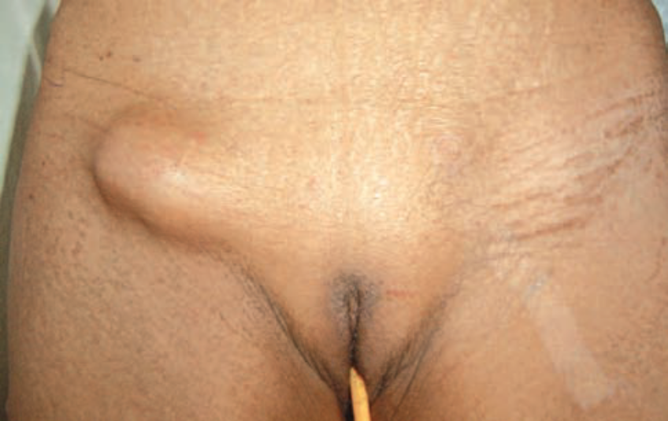
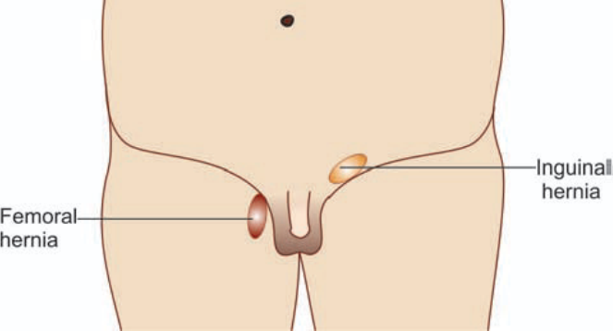
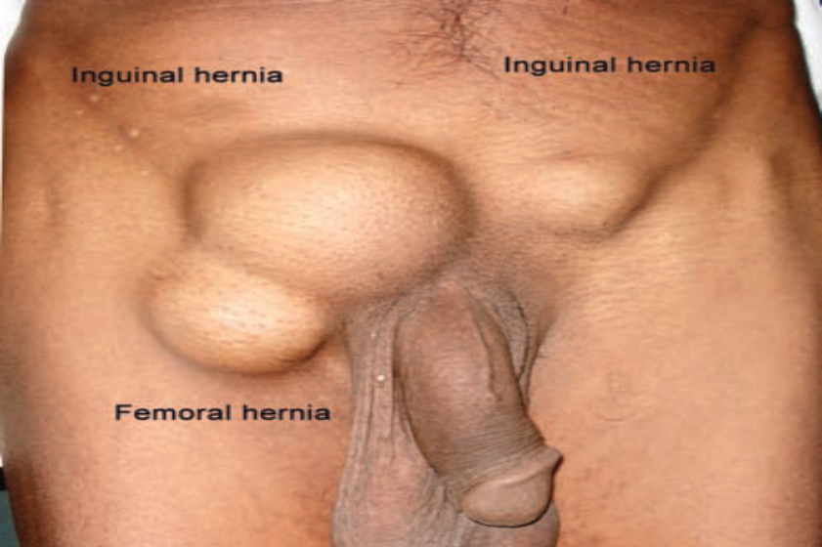
Femoral hernia on right side
Note the location below the inguinal ligament
Femoral hernia is common on right side
It is common in females
Right side femoral hernia in a male patient
Patient is also having bilateral inguinal hernia.
Femoral hernia is rare in males.

Slide 10
APROACHES OF FEMORAL HERNIA
  LOCKWOOD LOW OPERATION
  MC’ EVEDY HIGH OPERATION
  LOTHEISSEN’S OPERATION

Slide 11
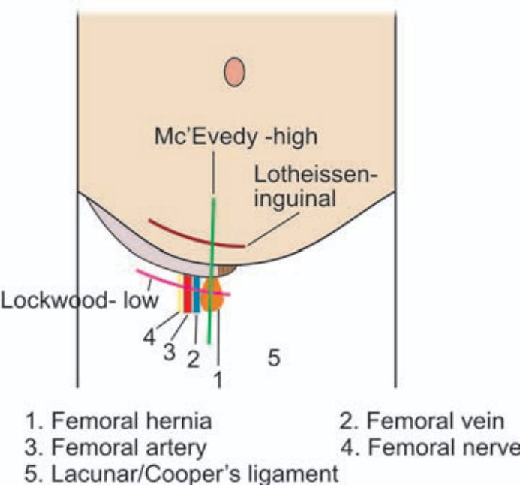
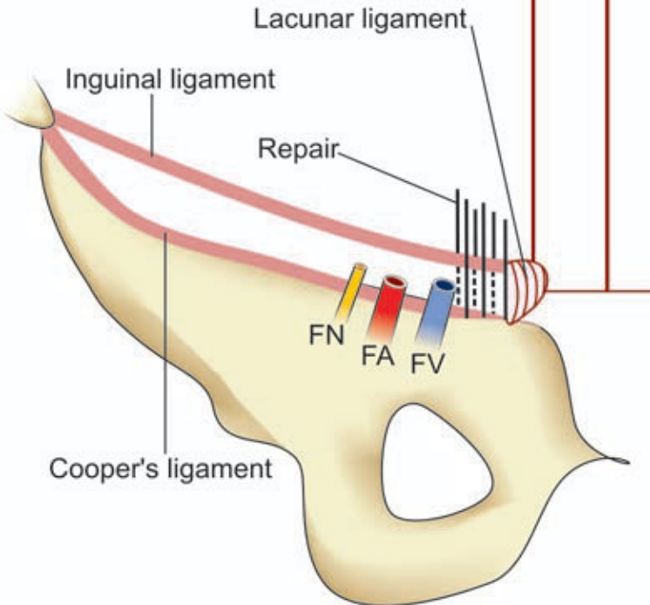
Lockwood low operation –
  Sac is approached below the inguinal ligament through groin crease incision (or over the swelling
  So that fundus of sac is dissected by direct vision
  Repair is done from below Here inguinal ligament is sutured to Cooper’s ligament

Slide 12
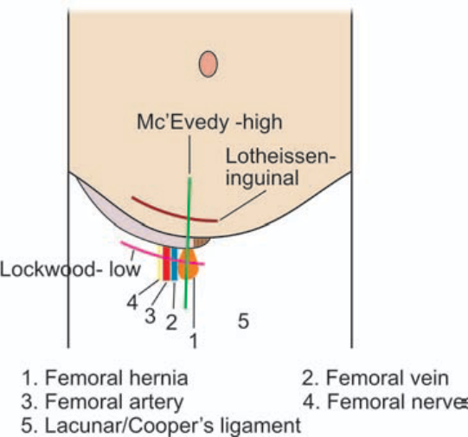
Mc’Evedy-High operation –
  A incision is made over the femoral canal extending vertically above the inguinal ligament
  Sac is dissected from below & neck from above
  Repair is done from above
  It gives a very good exposure of both neck, fundus of sac
  Repair is easier
  It is done in strangulated femoral hernia.

Slide 13

Lotheissen’s operation –
It is through inguinal canal approach (like for inguinal hernia)
Transversalis fascia is opened and neck of the sac is identified in the femoral ring
Sac is dissected from above, neck is ligated and repair is done
Lotheissen’s repair –
After herniotomy, conjoined tendon is sutured to ilio-pectineal line (ligament) by interrupted sutures (2 or 3), using non-absorbable monofilament sutures
Care should be taken to avoid injury to femoral vein, pubic branch of obturator artery, bladder
Complications - Bleeding haematoma, abscess formation.

Slide 14
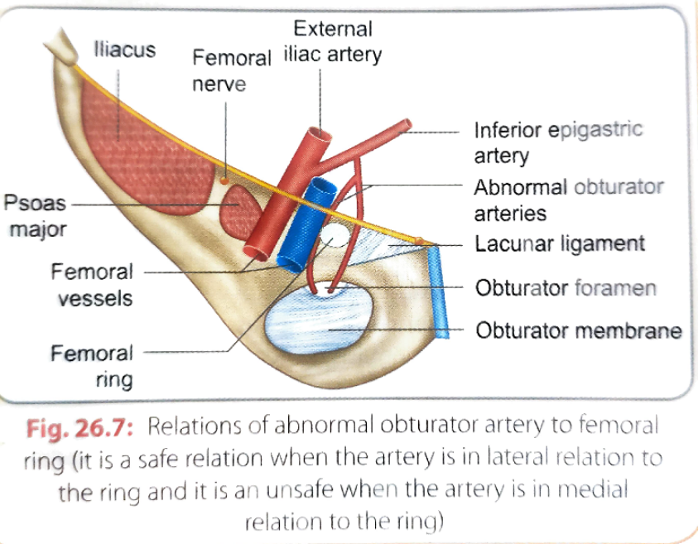
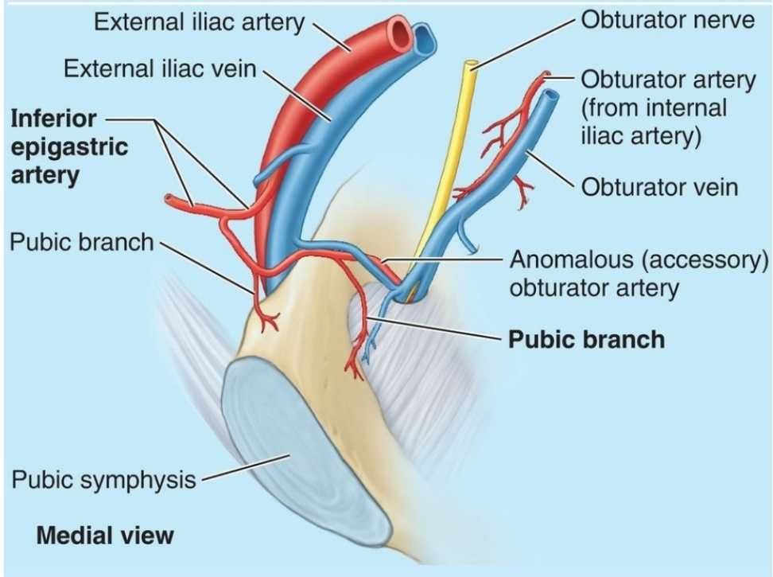
The relief of strangulated loop is obtained by cutting the lacunar ligament , so as to enlarge the femoral ring
The surgeon must be familiar with the anatomical relation of abnormal obturator artery to the femoral ring while incising the lacunar ligament

Slide 15
CASE -
A 50 year old woman come to the hospital, when she noticed lemon sized swelling in the upper thigh. On examination , the swelling was found to be inferior and lateral to the pubic tubercle and it was seen to push in to the saphenous opening

Slide 16
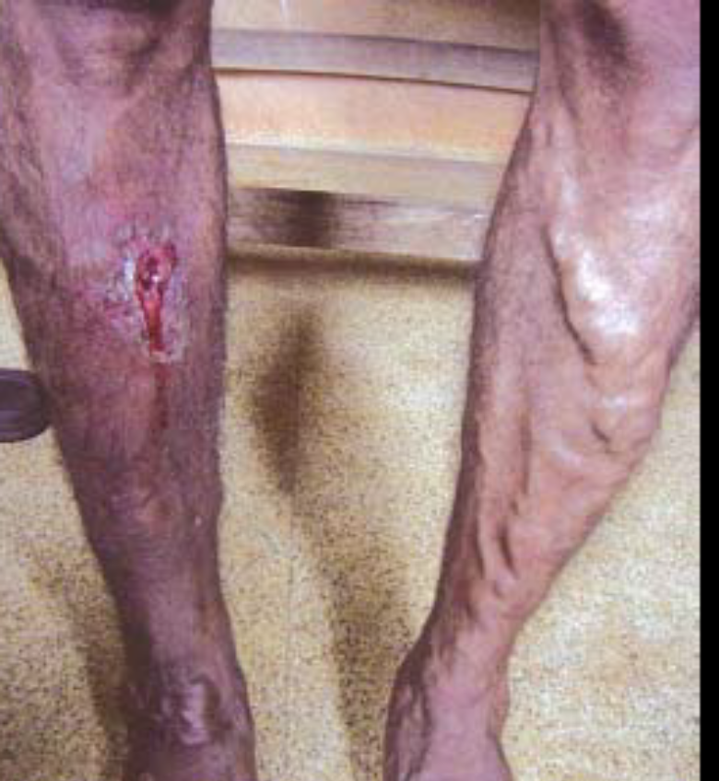
VARICOSE VEIN

Slide 17
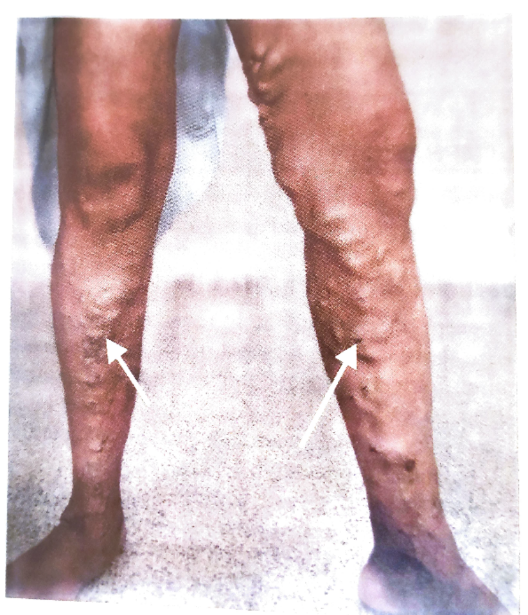
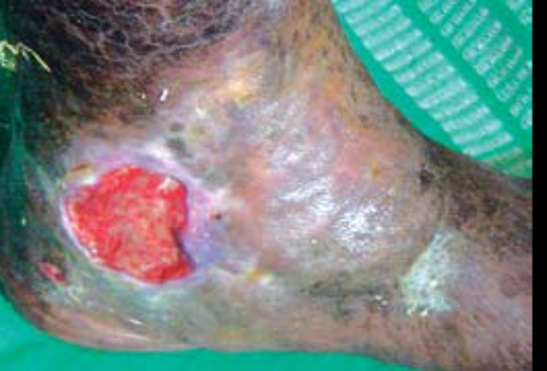
VERICOSE VEIN
Superficial veins of lower limb are dilated & tortuous and become varicose vein
The area over varicosity skin becomes pigmented
Suffers lack of nutrition culminates in varicose ulcer
Such ulcer bleeds profusely & warrants immediate surgical attention

Slide 18
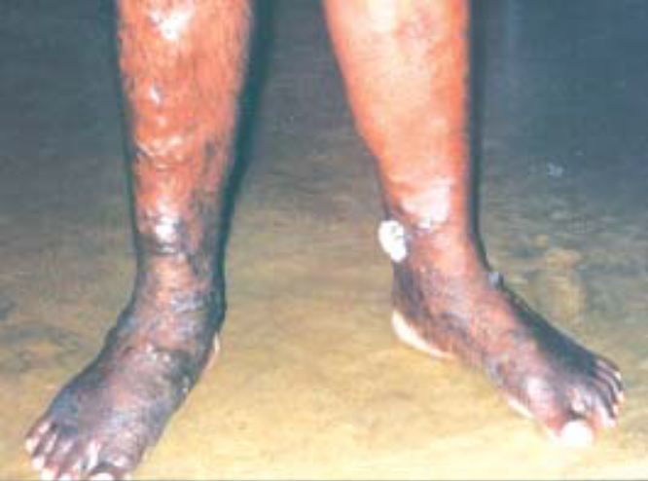
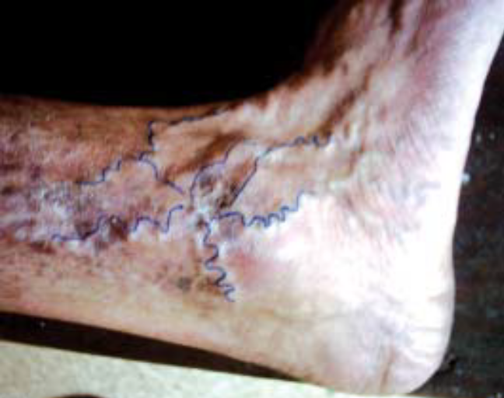

Slide 19
SITES WHERE VARICOSITIES CAN OCCURS –
  Lower limb
  Pampiniform plexus of veins
  Vulva
  Sites of portosystemic anastomosis

Slide 20
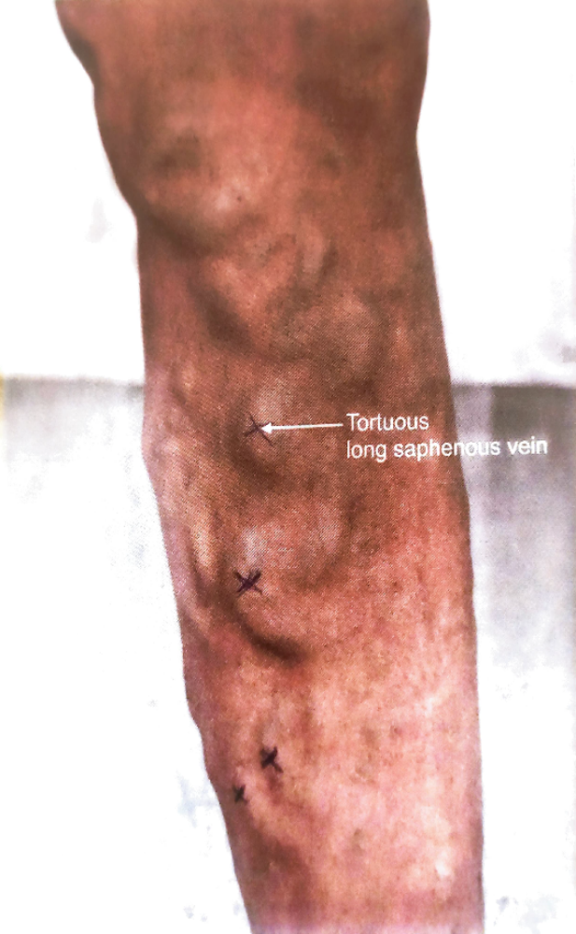
TYPES –
1. Long saphenous vein varicosity
2. Short saphenous vein varicosity
3. Varicose veins due to perforator incompetence
4. Thread veins are small varices in the skin usually around ankle
5. Reticular varices (1-3 mm in size): are slightly larger than thread veins located in subcutaneous region
6. Combinations of any of above
Small varicose vein is < 3 mm in diameter
Large varicose vein is > 3 mm in diameter

Slide 21
ETIOLOGY -
The principles cause of varicosities are –
  Thrombosis in deep vein (DVT)
  Persistent elevation of intra-abdominal pressure due to abdominal tumours or multiple pregnancies
  Incompetency of valve in perforating veins or superficial veins or both (commonest cause)
    Family history
    Ageing
    Oral contraceptive
    Obesity
    Long hour of standing

Slide 22
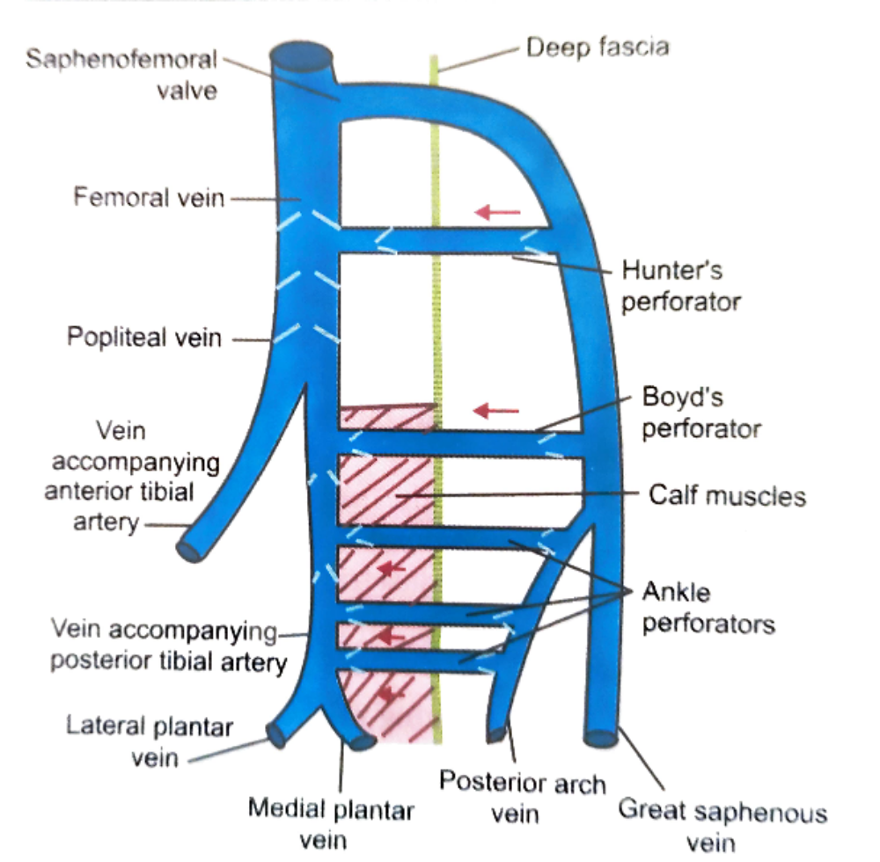

Slide 23
PATHOGENESIS
TWO THEROIES
FIBRIN CUFF THEORY
WHITE CELL TRAPPING THEORY

Slide 24
FIBRIN CUFF THEORY -
Incompetence of venous valves
↓
Stasis of blood
↓
Chronic ambulatory venous hypertension
↓
Defective microcirculation
↓
RBC diffuses into tissue planes
↓
Lysis of RBC’s
↓
Release of haemosiderin
↓
Pigmentation
↓
Dermatitis
↓
Capillary endothelial damage
↓
Prevention of diffusion and exchange of nutrients
↓
Severe anoxia
↓
Chronic venous ulceration

Slide 25
WHITE CELL TRAPPING THEORY –
  Inappropriate activation of trapped leucocytes release proteolytic enzymes which cause cell destruction and ulceration

Slide 26
CLINICAL FEATURES –
  Symptoms in varicose veins
    Dragging pain
    Heaviness in the legs
    Night time cramps – usually late night
    Oedema feet
    Discolouration/ulceration in the feet/painful walk

Slide 27
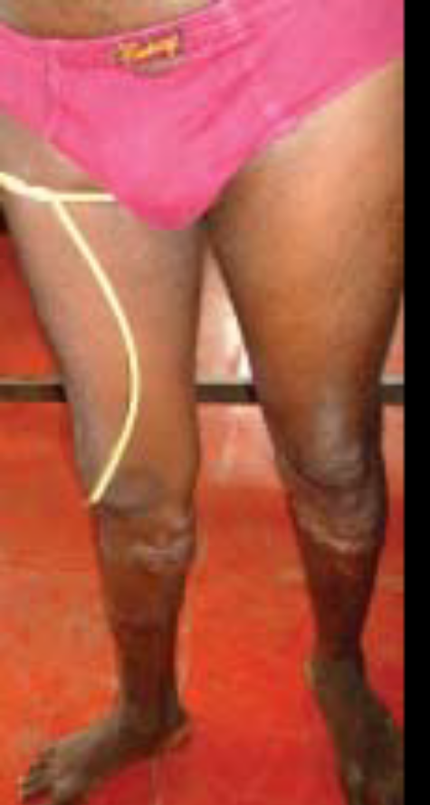
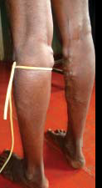
TRENDELENBURG TEST
  To find out the incompetency of valve ( Spheno-femoral valve or valve of perforators)
  The patient lies down in supine position
  Then asked to raise the leg above the heart to empty the superficial vein
  Then Spheno- femoral junction is closed by thumb (or tourniquet is tied)
  Then asked the patient to stand up
  Immediate filling of great saphenous vein from above after removing of thumb indicates the incompetent of Spheno-femoral valve(Positve Trendelenburg test)
  If slow felling from below without removing the thumb indicates incompetent of valve of perforators

Slide 28
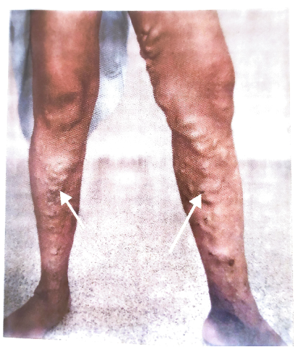
CASE
A 55- year- old policeman with a history of chronic dull ache in both legs came to the hospital, when he noticed dilated and tortuous veins on the medial side of both legs. The skin on the medial malleolus was found to be discolored , dry , and scaly.

Slide 29
THANK YOU

