Slide 1
FACIAL NERVE
SARANGDHAR KUMAR
DEPARTMENT OF ANATOMY
ROHILKHANAD MEDICAL COLLEGE
BAREILLY

Slide 2
It is the seventh cranial nerve
It is the nerve of 2nd pharyngeal arch therefore it supplies all the muscles that develop from mesoderm of that arch
Mixed nerve (large motor root & small sensory root)
Sensory root (nervous intermedius)-
  Taste sensation of ant.2/3rd of tongue
  Cutaneous sensation from external ear
  Also carries secretomotor fiber from superior salivatory & lacrimatory nuclei in pons
Sensory ganglion of facial nerve is called geniculate ganglion
Submandibular & Sphenopalatine ganglia are functionally associated with this nerve

Slide 3
NUCLEI OF ORIGIN
Motor nucleus of facial nerve(facial nucleus)- lies in the reticular formation in lower part of pons
Superior salivatory nucleus
  salivatory nucleus- for submandibular ganglion
  Lacrimatory nucleus- for Sphenopalatine ganglion
Nucleus of tractus solitarius- sensory nucleus &receives taste fibers from ant. 2/3rd of tongue
Nucleus of spinal tract of trigeminal nerve receives few cutaneous fibers from external ear

Slide 4
FUNCTIONAL COMPONENTS-
Special visceral efferent (SVE)
  facial nucleus- muscle derived from 2nd pharyngeal arch
General visceral efferent(GVE)
  superior salivatory nucleus- secretomotor to submandibular, sublingual & lacrimal gland
Special visceral afferent (SVA)
  taste sensation from ant. 2/3rd of tongue to nucleus tractus solitarius
General somatic afferent (GSA)
  general sensation from external ear to nucleus of spinal tract of trigeminal

Slide 5
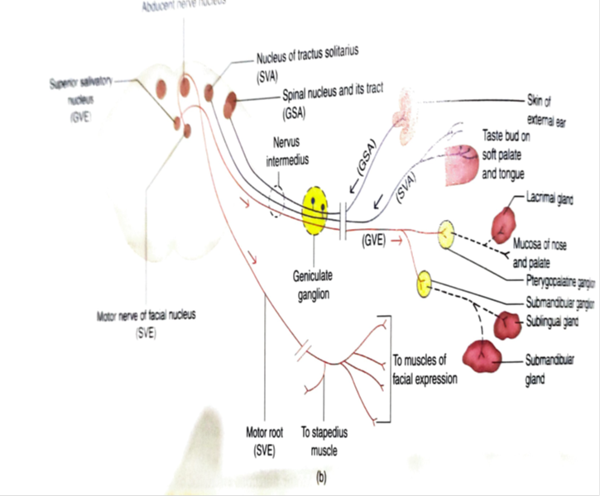

Slide 6
Course of 7th CN
Intrapontine course
Meatal part
Facial canal part
Extracranial course
Intrapetrous course
Facial part
1st segment
( labyrinthine)
2nd segment
(tympanic )
3rd segment
(mastoid)

Slide 7
COURSE
Intrapontine course
Intrapetrous course
  Meatal part
  Facial canal
  Facial canal part is divided into three segments
    1st segment
    2nd segment
    3rd segment
Geniculate ganglion
  Sensory ganglion
  Located on external genu
  Contains pseudounipolar neurons
Exit of cranium
  Through stylomastoid foramen
Extracranial course

Slide 9
BRANCHES OF FACIAL NERVE-
  Greater petrosal nerve
  Communicating branch to vagus nerve ( Alderman’s nerve)
  Nerve to stapedius
  Chorda tympani nerve
  Posterior auricular nerve
  Nerve to posterior belly of digastric & stylohyoid muscle
  Terminal branches (temporal, zygomatic, upper & lower buccal, marginal mandibular and cervical)

Slide 10
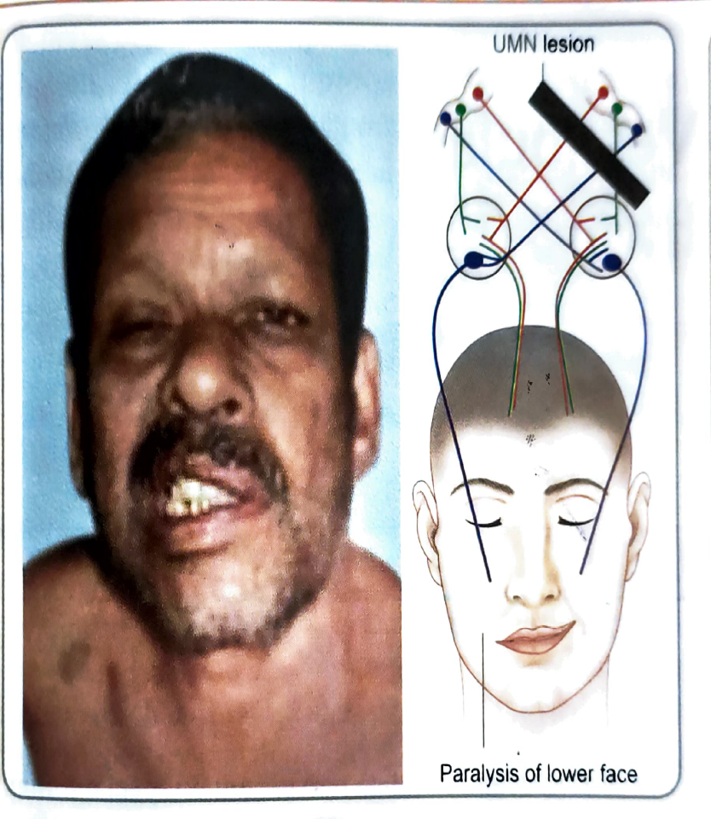
APPLIED ANATOMY-
Facial paralysis – may result due to supranuclear, nuclear & infranuclear lesions
Supra nuclear lesion(upper motor neuron paralysis)-
  Most common cause of supranuclear lesion is hemorrhage in internal capsule involving Corticonuclear & Corticospinal fibers
  Results in contralateral paralysis of lower face and contralateral hemiplegia
Nuclear lesions-
  Most common cause of nuclear lesion is vascular accident in pons
  Results in ipsilateral lower motor neuron facial paralysis involving the entire face
  When the pontine lesion includes Corticospinal fibers & facial nucleus it gives rise to Millard-Gubler syndrome
    Ipsilateral LMN facial paralysis and UMN hemiplegia

Slide 11
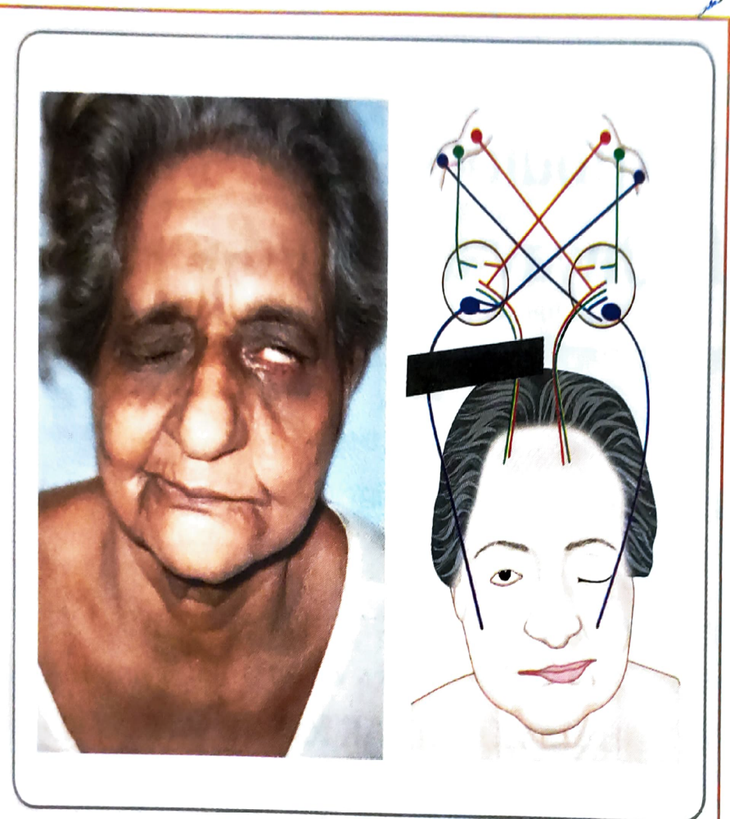
Infranuclear lesion
  Lesion involves the facial nerve beyond its attchment to brain stem
  This causes ipsilateral lower motor neuron facial palsy involving entire face
Site of infranuclear lesion-
Lesion in internal acoustic meatus
  produces facial paralysis with tinnitus & imbalance
Lesion at external genu-
  ipsilataral facial paralysis associated with
    Reduced lacrimation
    Decrease salivary secretion
    Loss of taste sensation on ant.2/3rd of tongue
    Hyperacusis on ipsilateral side
    Herpes zoster infection of geniculate ganglion causes Ramsey-Hunt syndrome( facial paralysis & eruption of painful vesicles on external ear

Slide 12
Lesion in medial wall-
  ipsilateral facial paralysis + loss of taste sensation
Lesion in vertical part of facial canal-
  loss of taste on ipsilateral side
Lesion at Stylomastoid foramen-
  Ipsilateral facial paralysis only (Bell’s palsy)
  Loss of horizontal wrinkles on fore head
    Inability to close the eye
    Epiphora
    Loss of corneal reflex
    Absence of nasolabial fold
    Inability to show the teeth
    While smiling the angle of mouth on affected side remains motionless & normal side moves upward and laterally

Slide 13
THANK YOU

