Slide 1
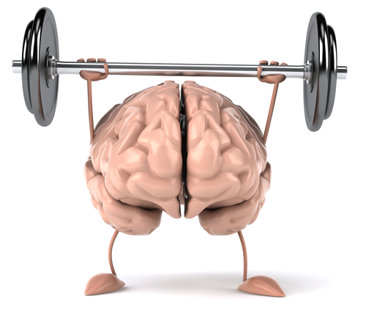
Development of nervous system

Slide 2
Three main parts
Central nervous system
  Brain and spinal cord
Peripheral nervous system
  Cranial and spinal nerves
Autonomic nervous system
  Sympathetic and parasympathetic nervous system

Slide 3
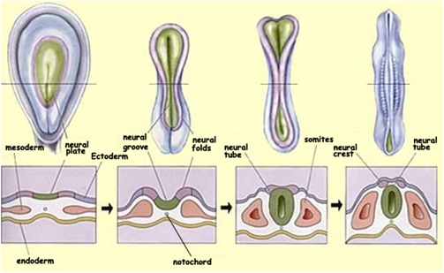
Formation of neural tube
At the beginning of 3rd week ectoderm above notochord thicken and form neural plate
Lateral edges soon elevate to form neural folds
Margin of neural folds fuse together and form neural tube
3rd week

Slide 4
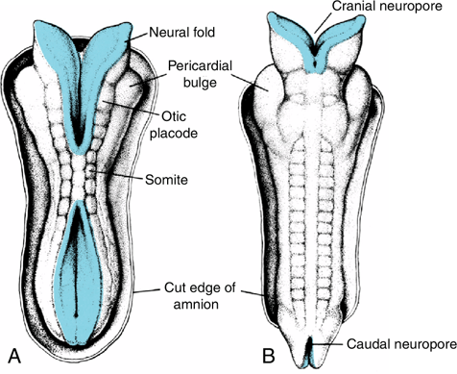
Fusion of neural groove begins in cervical region, extends both cranially and caudally and "zips up" neural groove
Initially has 2 openings at either end- cranial and caudal neuropores
Cranial neuropore closes approximately on 25th day (18-20 somite stage), caudal on 27th day (25 somite stage)

Slide 5
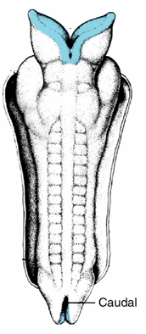
Somites
Cephalic part – brain, caudal part – spinal cord

Slide 6
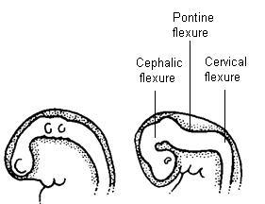
Development of neural tube flexures
During 4th week neural tube bends ventrally at two places
Cervical flexure at the junction of brain (hindbrain) and spinal cord, cephalic (midbrain) flexure in midbrain region
Later, unequal growth of brain between these flexures produces pontine flexure
4th week neural tube bends ventrally
Notes:
Caudal part of neural tube form spinal cord whereas cephalic part form brain

Slide 7
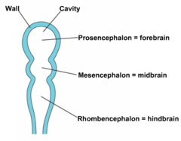
Cephalic end of neural tube shows three dilations (vesicles)
3 dilations (primary brain vesicles)
Prosencephalon, or forebrain
Mesencephalon, or midbrain
Rhombencephalon, or hindbrain

Slide 8
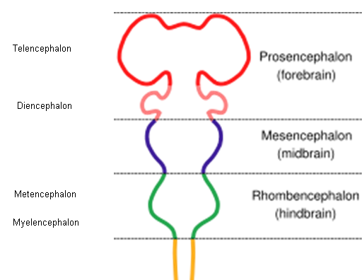
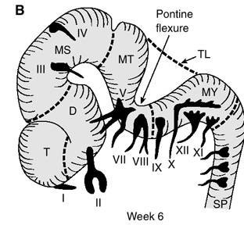
Further division of brain vesicle
Forebrain
Telencephalon
Diencephalon
Midbrain does not divide
Hindbrain
Metencephalon
Myelencephalon

Slide 9
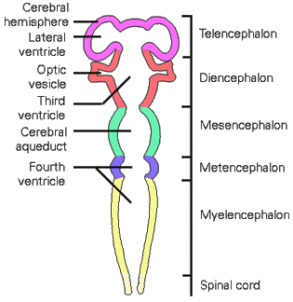
Development of ventricle
Each subdivision encloses a part of original cavity of neural tube
Cavity of each telencephalon
Lateral ventricle
Diencephalon
3rd ventricle
Mesencephalon
Cerebral aqueduct of Sylvius
Rhombencephalon
4th ventricle
Notes:
4th ventricle is continuous with central canal of spinal cord.

Slide 10
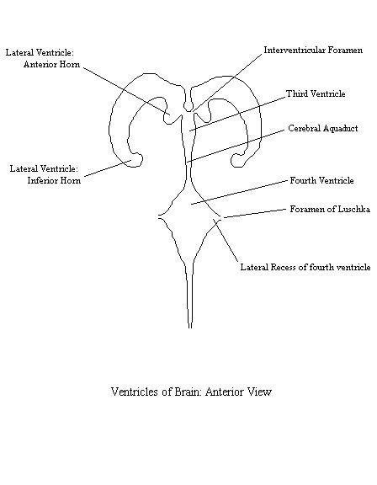
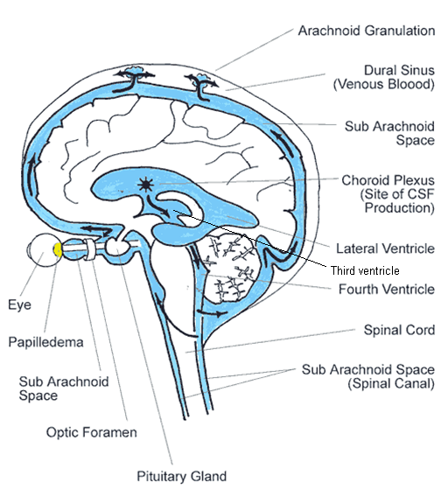
Circulation of cerebrospinal fluid
Lateral ventricle
3rd ventricle
4th ventricle
Subarachnoid space
Foramina of Monro
Cerebral aqueduct
Foramina of
Magendie and Luschka

Slide 11
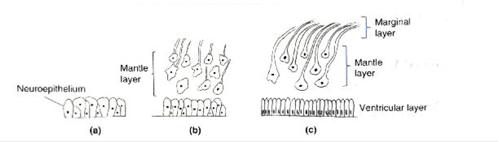
Histological differentiation of neural tube
Neuroepithelium - Cells lining the neural tube
These cells gives rise to most of the cells of CNS
It divides, differentiate & organize into three layers-
  Inner – ventricular layer
  Middle – mantle layer
  Outer – marginal layer

Slide 12
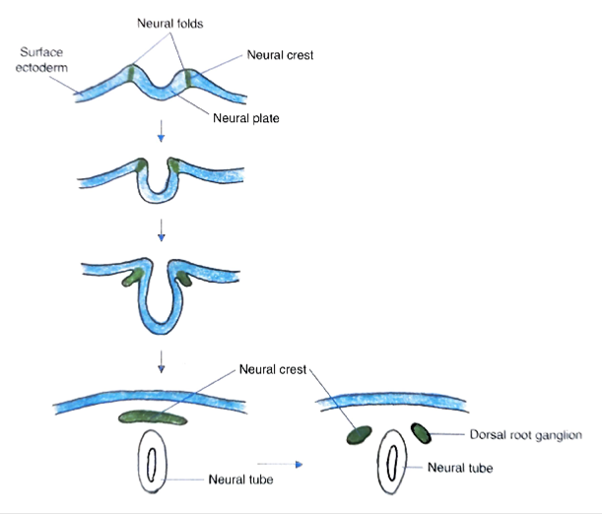
Neural crest cells –
In trunk region –
  Melanocytes
  Dorsal root ganglion,
  Sympathetic chain ganglion,
  Schwann cell,
  Merkel cell,
  Parasympathetic ganglion of gut
  Adrenal medulla
In Head region –
  Most of bone of skull,
  Sensory ganglion of cranial nerve(V, VII,VIII, IX &X)
  Parafollicular cell of thyroid gland

Slide 13
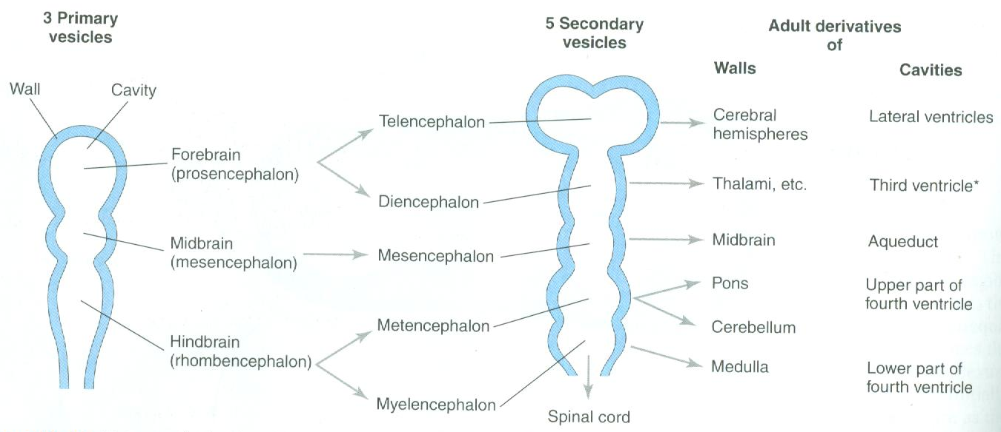
Development of brain
Develop from cephalic part of the neural tube
Notes:
Cerebellum develop from rhombic lip that develop from metencephalon

Slide 14
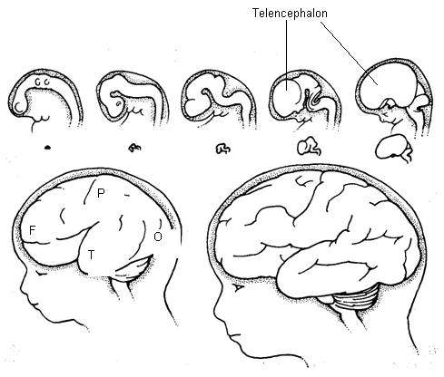
Telencephalon grow over diencephalon superiorly, anteriorly, posteriorly, anterolaterally and form different lobes of cerebrum
Completely covers the lateral surface of diencephalon

Slide 15
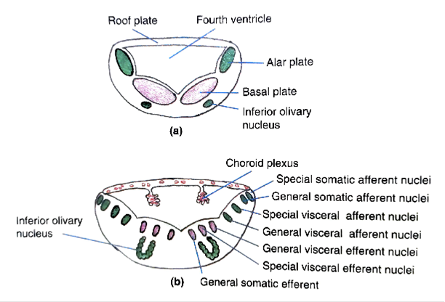
Myelencephalon
Medulla oblongata
  Cell organization is same as spinal cord
  Alar plate –
    SSA- Cochlear & vestibular groups of nuclei
    GSA- spinal nucleus of trigeminal(pain & temp.from H&N)
    SVA- solitary nucleus(taste from tongue)
    GVA- general sensation fro viscera
  Basal plate –
    GVE-inf.salivatory nucleus & dorsal nucleus of vagus
    SVE-nucleus ambiguus
    GSE- hypoglossal nuclei

Slide 16
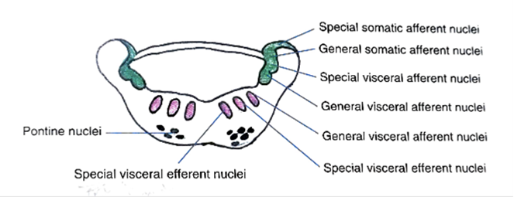
Metencephalon
Gives rise to pons & cerebellum
Organization of cells are same as to myelencephalon
Alar plate
  SSA-
  GSA-principal nucleus of trigeminal(touch, pressure & vibration from H&N)
  SVA-
  GVA-
Basal plate
  GVE-superior salivatory nucleus(submandibulargland)
  SVE- trigeminal& facial nuclei
  GSE- nucleus of Abducent

Slide 17
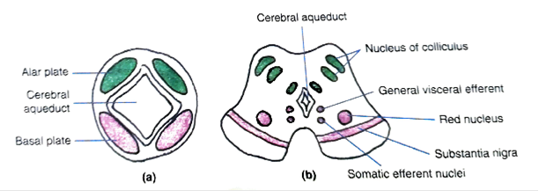
Mesencephalon
Wall forms the midbrain & cavity cerebral aqueduct
  Alar plate –
    Forms tectum of midbrain
    Neuroblasts in this region form two pairs of swelling(colliculus)
Basal plate –
    Forms tegmentum of midbrain
    GSE- Oculomotor & Trochlear nuclei
    GVE- EWN (Edinger-Westphal Nucleus)
  It also gives rise to red nucleus & substantia nigra
  Descending fiber from Cerebrum to Pons & spinal cord forms crus cerebri

Slide 19
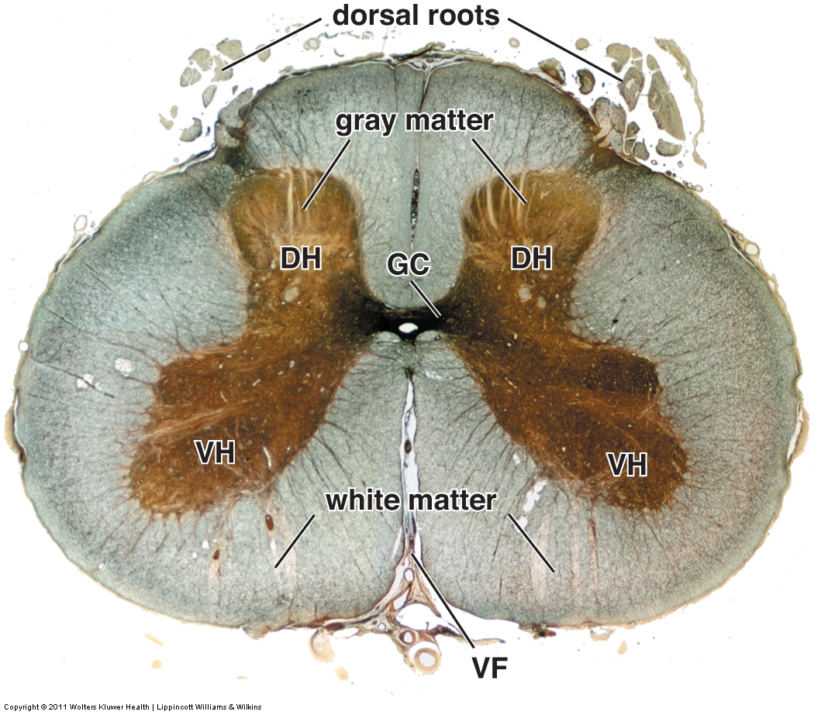
Development of spinal cord

Slide 20
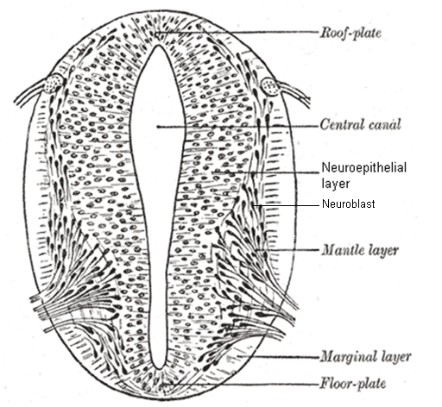
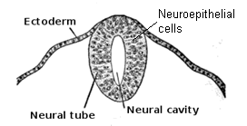
Development of spinal cord
(histogenesis)
Neural tube is lined by pseudostratified columnar epithelium – neuroepithelial cells
Neuroepithelial cells divide, become multilayered
Outermost neuroepithelial cells differentiate into neuroblast
Cell body of neuroblast form a layer around inner neuroepithelial cell – mantle layer (zone), process coming out from neuroblast form marginal layer (zone)

Slide 21
Marginal layer myelinate later on and form white matter of spinal cord
Mantle layer - gray matter of spinal cord
Remaining neuroepithelial cells form ependymal layer
Cavity – central canal

Slide 22
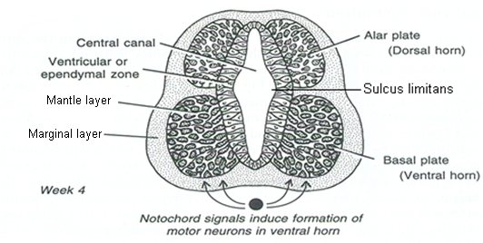
Development of basal plate and alar plate
Mantle layer shows a ventral and a dorsal thickening separated by a groove called sulcus limitans
Ventral thickening is known as basal plate, contain ventral motor neurons
Dorsal thickening is
known as alar plate, form sensory neurons

Slide 23
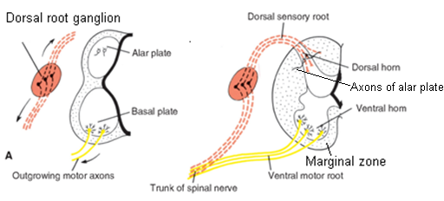
Axons in basal plate break through marginal zone and form ventral motor root of spinal nerves
Axons in alar plate penetrate into marginal zone, where they ascend to either higher or lower levels to form association fibers

Slide 24
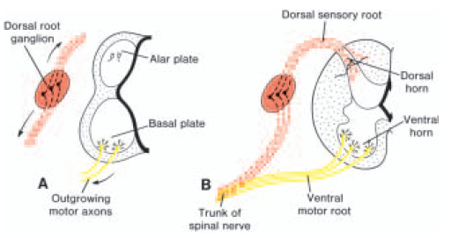
Development of spinal nerves
Ventral root
  Axons of basal plate neuroblasts
Dorsal root
  Axon (central process) of dorsal root ganglion
Peripheral process of dorsal root ganglia join ventral nerve root and form spinal nerve

Slide 25
Development of neuroglial (glial) cells
Astrocytes
Oligodendrocyte
Ependymal cells
Microglial cells
Neuroepithelial cells
Mesenchyme (monocytes –
macrophage)
Notes:
They differentiate into astrocytes in mantle layer and oligodendrocyte in marginal layer

Slide 26
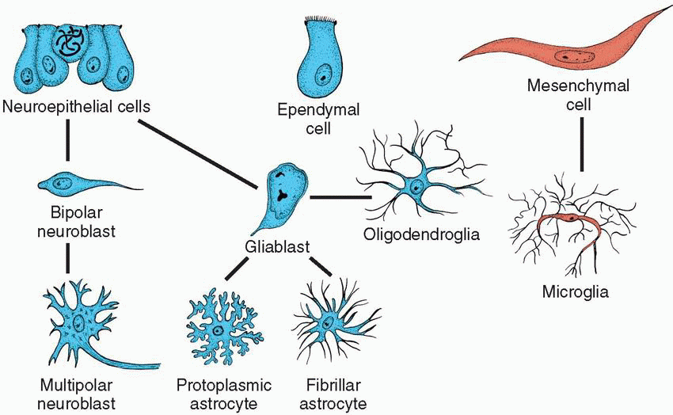
Development of neurons and glial cells
Notes:
All cells develop from neuroepithelial cells except microglia which develop from mesenchymal cells of monocyte- macrophage lineage

Slide 27
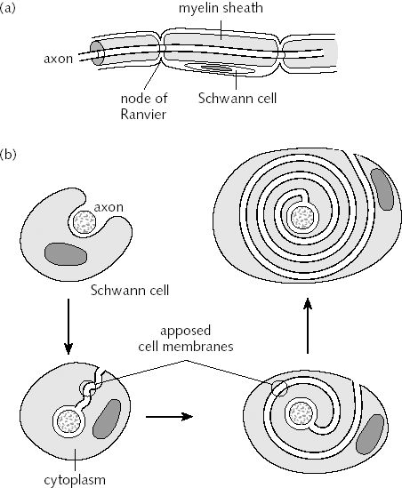
Myelination
(Begins in 4th month of development)
Done by Schwann cells and oligodendrocyte
Wrap themselves around axons and form myelin sheath
Begin in 4th month of development and goes on until puberty

Slide 28
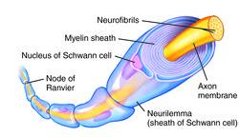
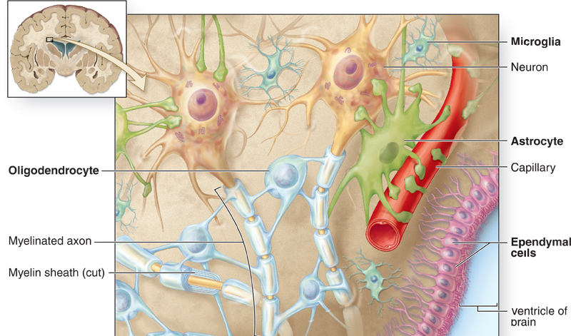
Difference between myelination of Schwann cells and oligodendrocyte
Schwann cells | Oligodendrocyte
Myelinate peripheral nerves | Myelinate central nervous system
Myelinate only a single axon | Myelinate up to 50 axons
Develop from neural crest cells | Develop from neuroepithelial cells

Slide 29
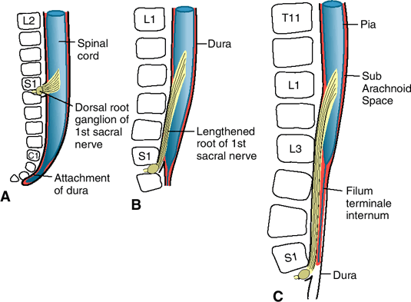
Positional changes of the spinal cord
In 3rd month of development
  Cord extends entire length of embryo
  Roots of spinal nerves pass through intervertebral foramina at their level of origin
Vertebral column and dura lengthen more rapidly than neural tube, and terminal end of spinal cord gradually shifts to a higher level
At birth, lower end is at the level of 3rd lumbar vertebra

Slide 30
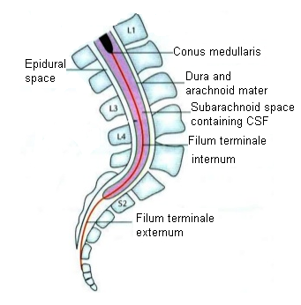
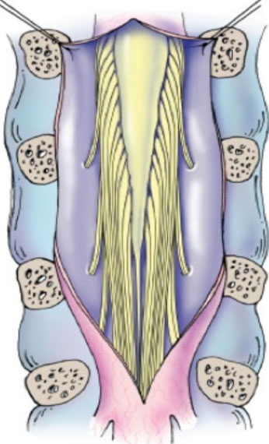
In adult, spinal cord terminates at the level of L1 – L2
Dural sac and subarachnoid space extend to S2
Nerve fibers below the terminal end of the cord collectively constitute the cauda equina

Slide 31
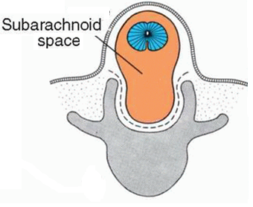
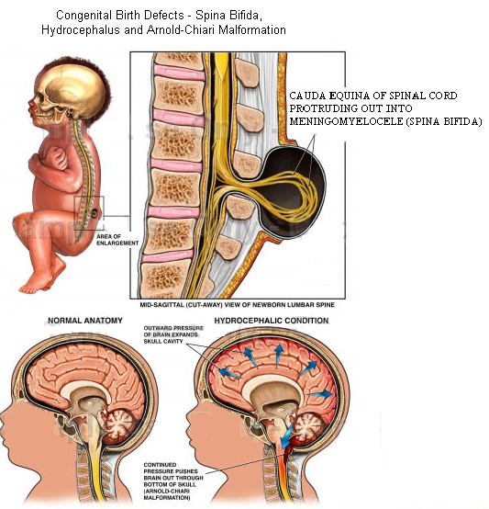
Clinical correlates
Type II arnold chiari syndrome
Complication of meningomyelocele
    Meninges, neural tissues/spinal cord/ cauda equina comes out through gap
Spinal cord is tethered to the vertebral column
As vertebral column lengthens, tethering pulls medulla and cerebellum into foramen magnum, cutting off flow of cerebrospinal fluid resulting in hydrocephalus
Notes:
Type I : A congenital malformation, generally asymptomatic during childhood, but often manifests with headaches and cerebellar symptoms. Herniation of cerebellar tonsils. The most common form. Syndrome of occipitoatlantoaxial hypermobility. An acquired Chiari I Malformation in patients with hereditary disorders of connective tissue. Patients who exhibit extreme joint hypermobility and connective tissue weakness as a result of Ehlers-Danlos syndrome or Marfan Syndrome are susceptible to instabilities of the craniocervical junction and thus acquiring a Chiari Malformation. This type is difficult to diagnose and treat.
Spinal cord trapped btw two vertebrae. Pulls brain down. Blockage of CSF leads to hydrocephalus.
Type II : Usually accompanied by a lumbar myelomeningocele leading to partial or complete paralysis below the spinal defect. As opposed to the less pronounced tonsillar herniation seen with Chiari I, there is a larger cerebellar vermian displacement. Low lying torcular herophili, tectal beaking, and hydrocephalus with consequent clival hypoplasia are classic anatomic associations. The position of the torcular herophili is important for distinction from Dandy Walker syndrome in which it is classically upturned. This is important because the hypoplastic cerebellum of Dandy Walker may be difficult to distinguish from a Chiari malformation that has herniated or is ectopic on imaging. Colpocephaly may be seen due to the associated neural tube defect.
Type III: Causes severe neurological defects. It is associated with an occipital encephalocele.
Type IV: Characterized by a lack of cerebellar development.
Other conditions sometimes associated with Chiari Malformation include hydrocephalus, syringomyelia, spinal curvature, tethered spinal cord syndrome, and connective tissue disorders such as Ehlers-Danlos syndrome and Marfan Syndrome

Slide 32
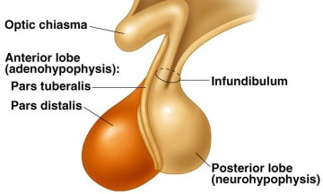
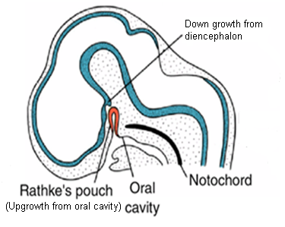
Pituitary gland
2 parts
  Adenohypophysis, neurohypophysis
Ectodermal in origin
Develop from 2 sources
  An upgrowth from ectodermal roof of oral cavity (stomodeum), Rathke’s pouch
    Adenohypophysis
  A down growth from diencephalon
    Neurohypophysis
Notes:
Rathke’s pouch is a diverticulum from the roof of the oral cavity (stomodeum)

Slide 33
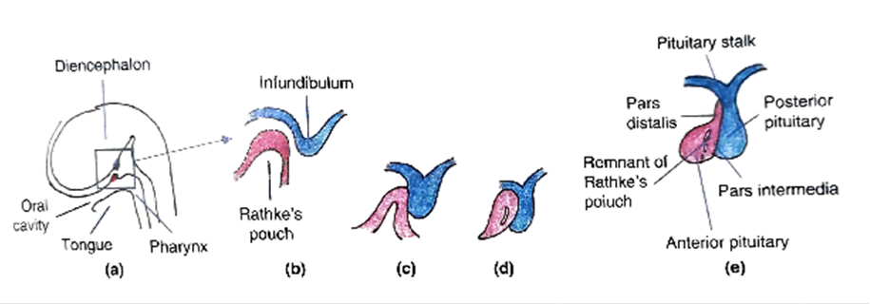

Slide 34
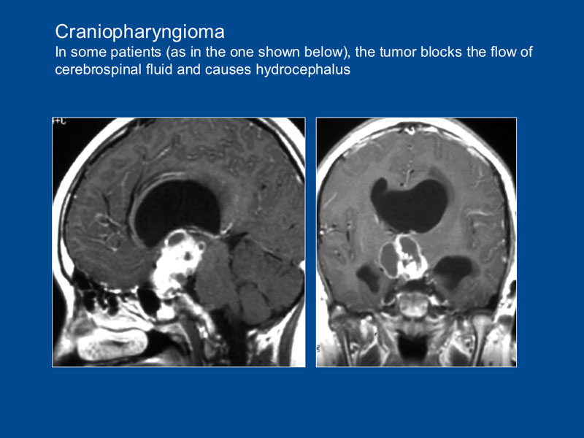
Clinical correlates
Hypophyseal defects
Occasionally, a small portion of Rathke's pouch persists in roof of pharynx as a pharyngeal hypophysis
Craniopharyngiomas arise from remnants of Rathke's pouch
  They may form within the sella turcica or along the stalk of the pituitary

Slide 35
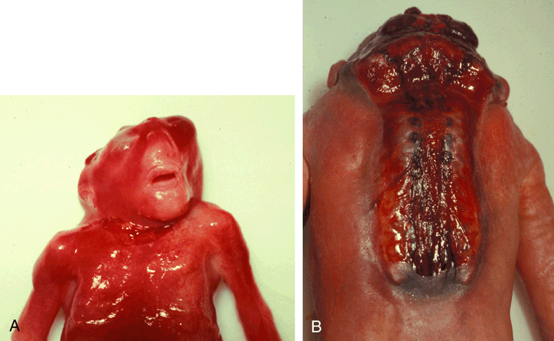
Anencephaly
Due to failure of the cranial neuropore to close
As a result, vault of skull does not form, leaving malformed brain exposed
Later, this tissue degenerates, leaving a mass of necrotic tissue→ this defect is called anencephaly

Slide 36
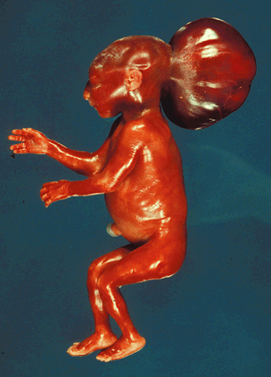
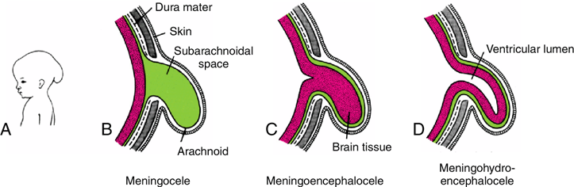
Ossification defect in bones of skull, mainly squamous part of occipital bone gives rise to
Meningocele
  Only meninges bulge through the gap
Meningoencephalocele
  Part of brain bulges along with meninges
Meningohydroencephalocel
  Part of meninges, part of brain, part of ventricle

Slide 37
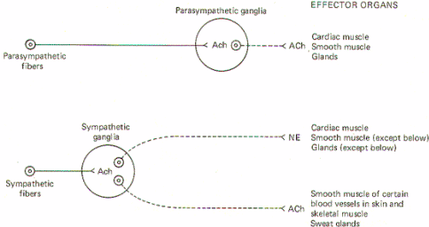
Development of sympathetic and parasympathetic nervous system
Both originates from basal plate of neural tube and neural crest cells
Basal plate of neural tube (neuroblast cells) - preganglionic fibers
Neural crest cells - ganglion and post ganglionic fibers
Notes:
Neural crest cells give rise to ganglion and post ganglionic fibers

Slide 38
Development of cranial nerves
CN I
  Nasal placodes
CN II
  Ganglion cells of retina (which is a diverticulum of diencephalon). CN II is not a true cranial nerve, but a tract of diencephalon
CN VIII
  Otic placode
CN III
  Basal plate of midbrain
CN IV
  Basal plate of midbrain
CN VI
  Basal plates of pons
CN XI
  Basal plate of spinal segment C1-C6
CN XII
  Basal plate of medulla

Slide 39
CN V
  Motor division from basal plate of pons
  Sensory division from neural crest cells
CN VII
  Motor division from basal plate of pons
  Sensory division from neural crest cells
CN IX
  Motor division from basal plate of medulla
  Sensory division from neural crest cells
CN X
  Motor division from basal plate of medulla
  Sensory division from neural crest cells

Slide 40
Learning objectives
Describe the development of the neural tube and neural crest
Describe the process of cell division within the neuroepithelium (ventricular zone), and the formation of the intermediate (mantle) zone, marginal zone, and ependymal layer
Distinguish between alar and basal plates
Describe the embryonic origins of the nervous and non‑nervous cells in the central nervous system and peripheral nervous system including the autonomic nervous system
List the derivatives of neural crest cells
Describe the process of myelination of nerve fibers within the CNS and PNS When does myelination occur?
Explain the relative positional changes that occur between the caudal end of the spinal cord and vertebral column
List the major adult derivatives of each of the five secondary brain vesicles
Describe the location and orientation of the three brain flexures
Characterize briefly the following brain abnormalities: anencephaly, Arnold‑Chiari malformation, Meningocele , Meningoencephalocele, Meningohydroencephalocel
Notes:
CNS- central nervous system, PNS- peripheral nervous system

