Slide 1
DEVELOPMENT OF CVS
Sarangdhar kumar
Assistant professor
Department of anatomy
Rohilkhand medical college
Bareilly

Slide 2
The nutritional supply of embryo changes according to development-
1st week before implantation – duetoplasm( accumulated cytoplasmic nutrients)
2nd week – breakdown products of endometrium by
simple diffusion
After 3rd week – maternal blood through uteroplacental circulation
Then increasing nutritional demand of growing embryo initiates development of CVS

Slide 3
Components of CVS
  Development of heart
  Development of blood vessels
All the components of CVS develop from mesoderm

Slide 4
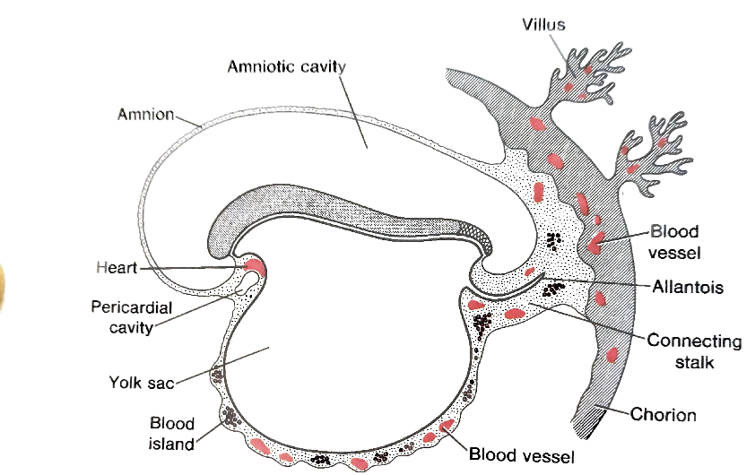
DEVEOPMENT OF EXTRAEMBRYONIC BLOOD VASCULAR SYSTEM
EARLY PART OF 3RD WEEK
DEVELOPMENT OF VASCULATURE IS SEEN IN
    CHORION
    CONNECTIVE STALK
    YOLK SAC

Slide 5
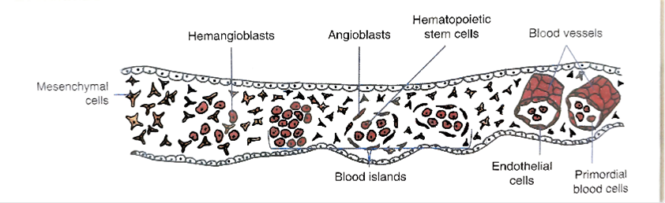
MESENCHYME IN THIS REGION DIFFERENTIATE INTO HEMANGIOBLASTS
HEMANGIOBLASTS – COMMON PRECURSOR OF ENDOTHELIAL & BLOOD VESSELS

Slide 6

HEMANGIOBLASTS
BLOOD ISLANDS
ANGIOBLASTS
ENDOTHELIAL CELL
BLOOD VESSELS

Slide 7
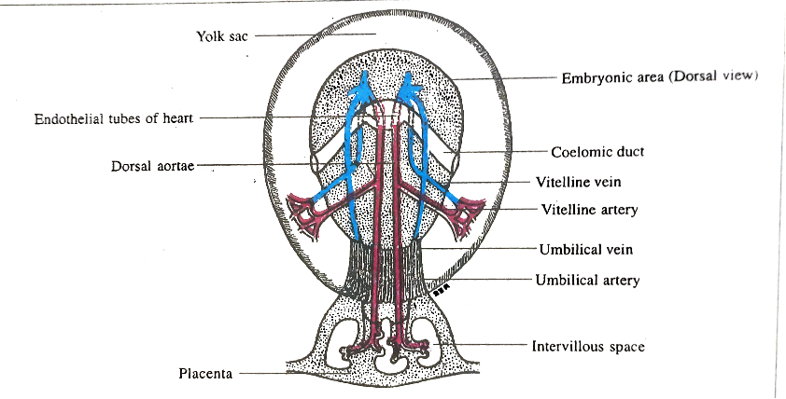
DEVELOPMENT OF INTRAEMBRYONIC BLOOD VESSELS
&
PRIMITIVE HEART
IN LATER PART OF 3RD WEEK
INTRAEMBRYONIC BLOOD VESSELS DIFFERNTIATE FROM THE ANGIOBLAST CELL PRESENT IN THE INTRAEMBRYONIC MESODERM
ESTABLISH SECONDARY CONNECTION WITH EXTRAEMBRYONIC BLOOD VESSELS
TWO LONGITUDINAL VESSELS APPEARS AS A DORSAL AORTAE ON EACH SIDE OF NOTOCHORD

Slide 8
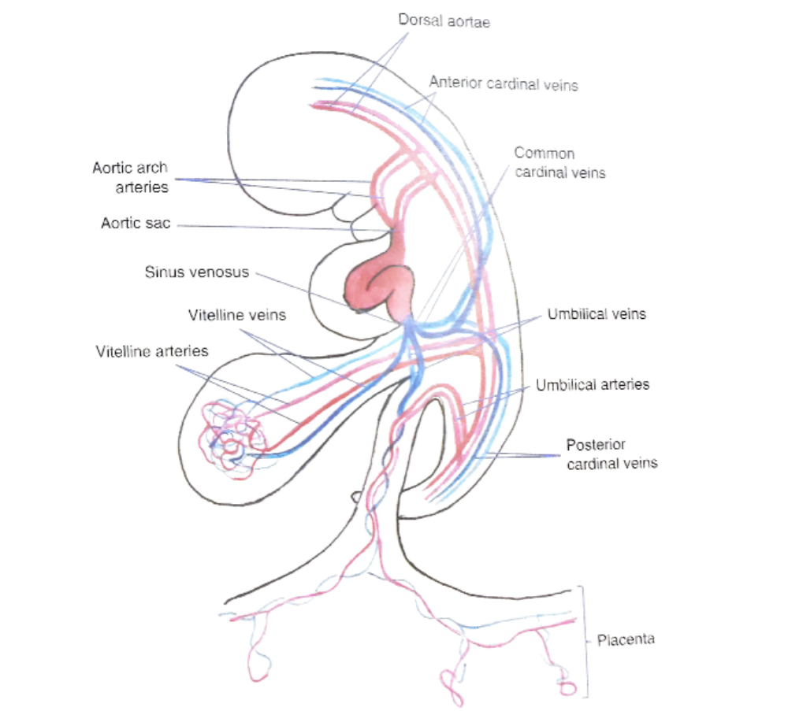

Slide 9
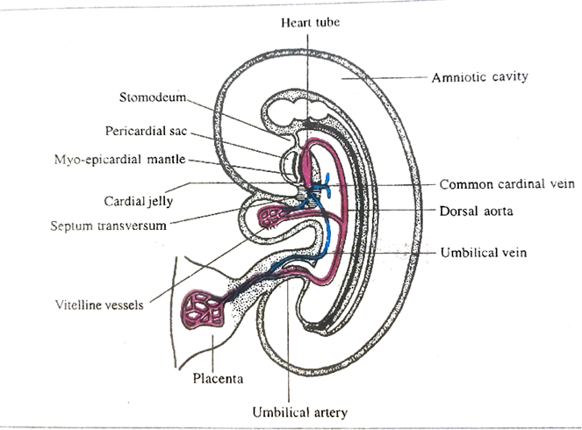
DEVELOPMENT OF DEFINITIVE HEART
Establishment of cardiogenic area
Development of heart tubes
Fate of heart tube
Folding of heart tube
Development of atria
Developments of ventricle

Slide 10
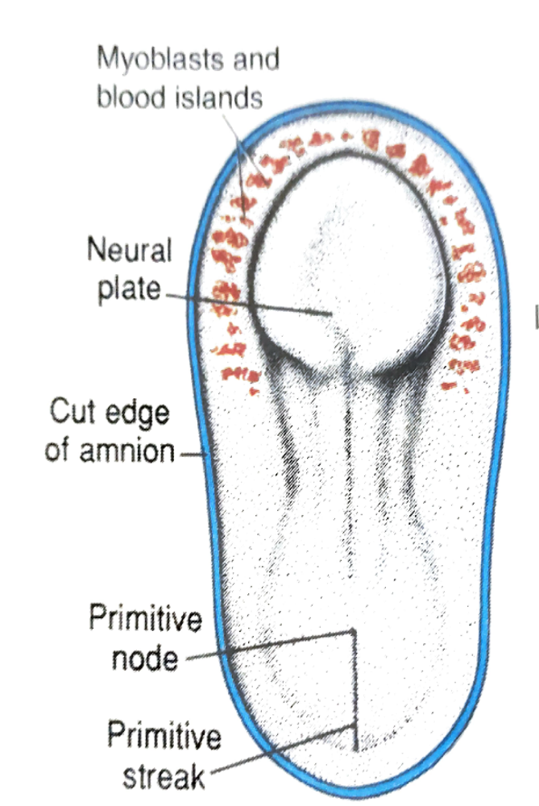
Cardiogenic area –
  During 3rd wk cardiac progenitor cell develop just lateral to primitive streak
  These cells migrate through primitive streak & forms horseshoe shaped primitive heart field in splanchnopleuric mesoderm
  On the formation of head fold primitive heart field come to lie on dorsal side of pericardial sac
  Vasculogenesis in the primitive heart field (induced by endoderm of primitive pharynx )
  Small vessels joins to form two (right & left) endothelial heart tube

Slide 11
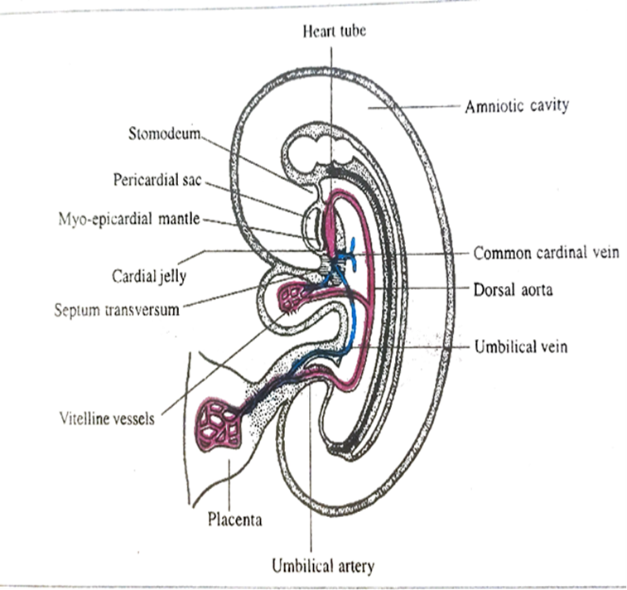
Myo-epicardial mantle –
The two heart tube are separated from the floor of pericardial sac by thickened plate of mesodermal tissue
It Forms –
    Myocardium
    Epicardium
  Primitive hearts starts beating - 22nd day(IUL)
  Blood circulates within the embryo – 24th day(IUL)

Slide 12
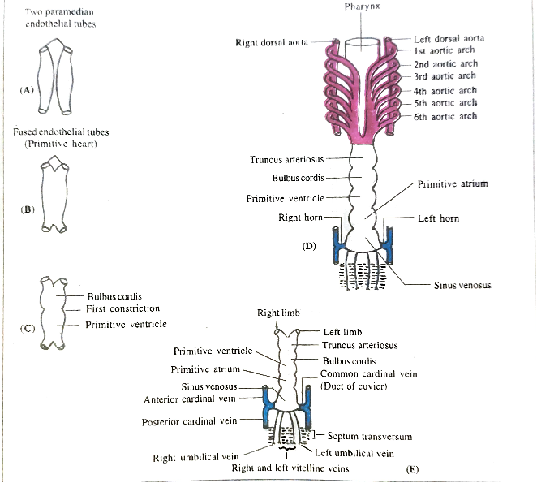
Heart tube –
  In 3rd wk two heart tube fuse to form single tube
  End of the tube remain bifurcated
    Cranial end – arterial end
    Caudal end – venous end
  Soon after fusion it show five dilatations

Slide 13
FIVE DILATATION & ITS FATE -
COMPONENTS OF HEART TUBE | FATE OR DERIVATIVES
TRUNCUS ARTERIOSUS | ASCENDING AORTA PULMONARY TRUNK
BULBUS CORDIS | CONUS ARTERIOSUS AORTIC VESTIBULE
PRIMITIVE VENTRICLE | TRABECULATED PART OF RIGT & LEFT VENTRICLE
PRIMITIVE ATRIUM | TRABECULATED PART OF RIGHT & LEFT ATRIUM
SINUS VENOSUS | RIGHT HORN- SINUS VENARUM LEFT HORN – CORONARY SINUS & OBLIQUE VEIN OF ATRIUM

Slide 15
Fate of tributaries of sinus venosus –
    Right common cardinal vein – part of SVC
    Right vitelline vein – terminal part of IVC
    Left horn & left common cardinal vein – coronary sinus
    Left common cardinal vein – oblique vein of left atrium
    Cephalic part of right posterior cardinal vein – arch of azygos vein
    Right umbilical vein & left vitelline vein – obliterated by 5th week
    Left common cardinal vein – obliterated by the 10th week

Slide 16
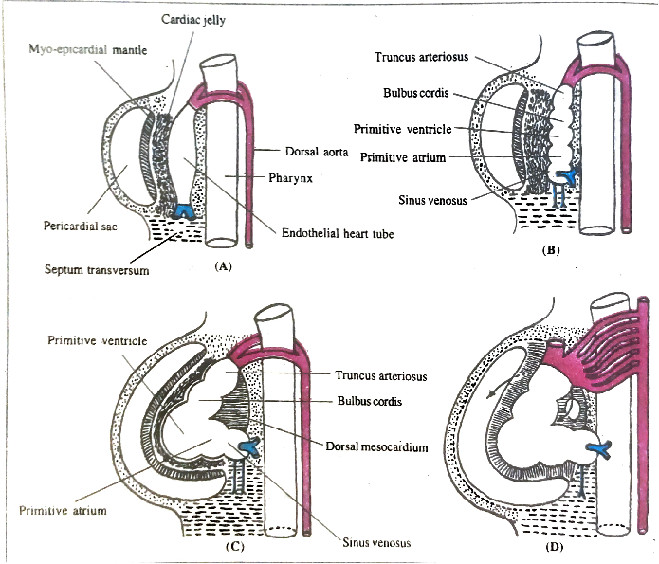
FOLDING OF HEART TUBE-

Slide 17
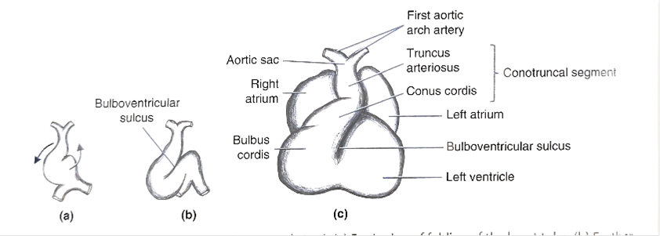

Slide 18

DEVELOPMENT OF ATRIA
  RIGHT ATRIUM
    ROUGH PART – right half of primitive atrium
    SMOOTH PART - by sinus venosus
  LEFT ATRIUM
    ANTERIOR ROUGH PART- left half of primitive atrium
    POSTERIOR SMOOTH PART – absorption of pulmonary veins
  INTER ATRIAL SEPTUM
    By two sources –
      Septum primum
      Septum secundum

Slide 19
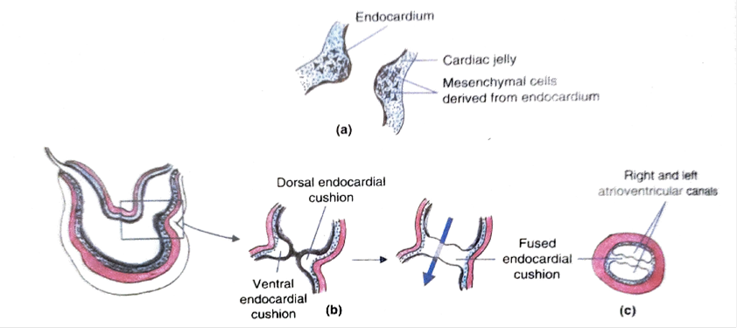
PARTIONING OF ATRIOVENTRICULAR CANAL
Results in partial separation of atria from ventricles & formation of atrioventricular orifice
Begins with formation of endocardial cushions in dorsal & ventral wall of atrioventricular canal
Endocardial cushions develop from two sources-
  Cardiac jelly
  Cells of endocardium
Endocardial cushion increase in size & fuse with each other to form septum intermedium
And divide the canal into two atrioventricular orifice

Slide 20
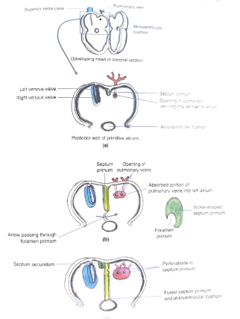
PARTIONING OF ATRIUM
Development of interatrial septum
As endocardial cushion is formed
Septa formation begins in primitive atrium (5th week)
  Septum primum
    Foramen primum (ostium primum)
    Foramen secundum(ostium secundum)
  Septum secundum
    Foramen ovale

Slide 21
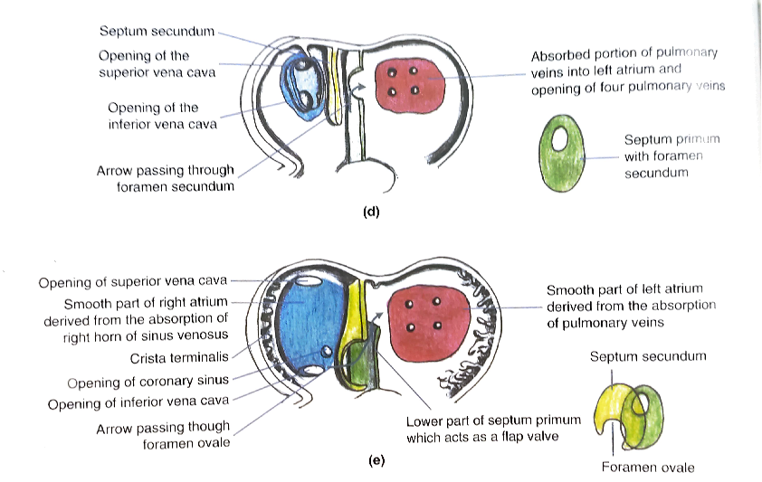
STAGES OF DEVELOPMENT –
  SEPTUM PRIMUM
  FORAMEN PRIMUM
  FORAMEN SECUNDUM
  SEPTUM SECUNDUM
  FORAMEN OVALE
  OBLITERATION OF FORAMEN OVALE
    FOSSA OVALIS
    ANNULUS OVALIS

Slide 22
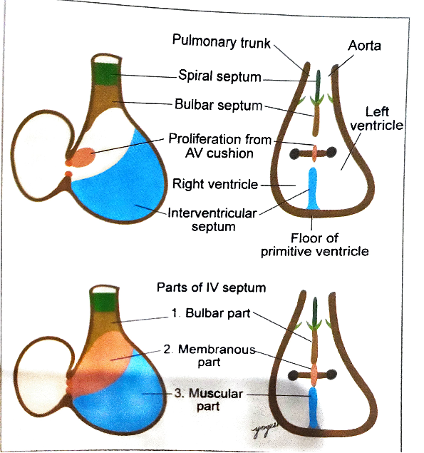
PARTIONING OF VENTRICLE
Development of interventricular septum
It consists of three part
    Muscular part
      Develops from muscular ridge arising from floor of the primitive ventricle
    Bulbar part
      It develops from right & left bulbar ridge
    Membranous part
      It develops from proliferation of AV cushion

Slide 23
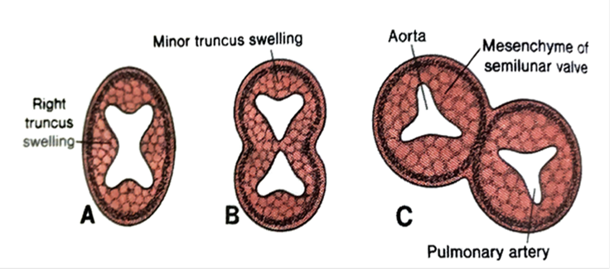
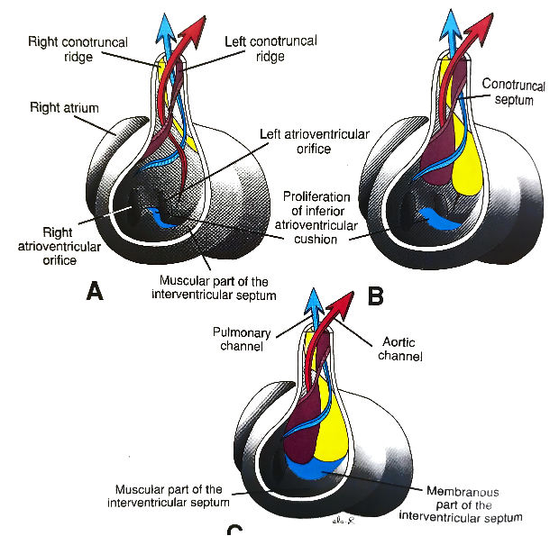
PARTIONING OF OUTFLOW TRACT
In the truncus arteriosus
Appearance of spiral septum(aorticopulmonary septum)
Septum divides the truncus arteriosus into aorta & pulmonary trunk
STEPS –
Truncal ridge
Fusion of bulbar septum
Spiralling of septum

Slide 24
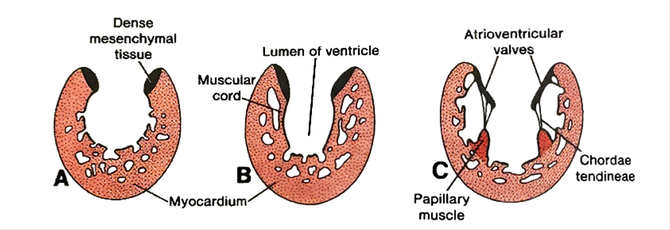
FORMATION OF HEART VALVE
ATRIOVENTRICULAR VALVE
  Right AV valve(tricuspid)
  Left AV valve(bicuspid)
    Proliferation of subendocardial mesenchyme that forms subendocardial cushions around AV canal
    Excavation of these cushions forms cusps of AV valves
    Right side – three cushions
    Left side – two cushions

Slide 25

PULMONARY & AORTIC VALVE-
In truncus arteriosus, two endocardial cushions appear (right &left)
Soon two more anterior & posterior cushions also appear
On separation of pulmonary trunk & aorta by spiral septum right & left cushions divides into two part
Excavation of these cushions forms the cusps of aortic & pulmonary valve
  In aortic valve – one anterior & two posterior
  In pulmonary valve – one posterior & two anterior

Slide 26
FORMATION OF CONDUCTING SYSTEM OF HEART
Derived from cardiomyocytes
Initially impulse is generated in sinus venosus and spread towards the arterial end of heart tube
As sinus venosus gets absorbed into right atrium pacemaker of heart SA node is located closed to opening of SVC
AV node develops near AV canal
Simultaneously all the conducting system develops in their anatomic locations

Slide 27
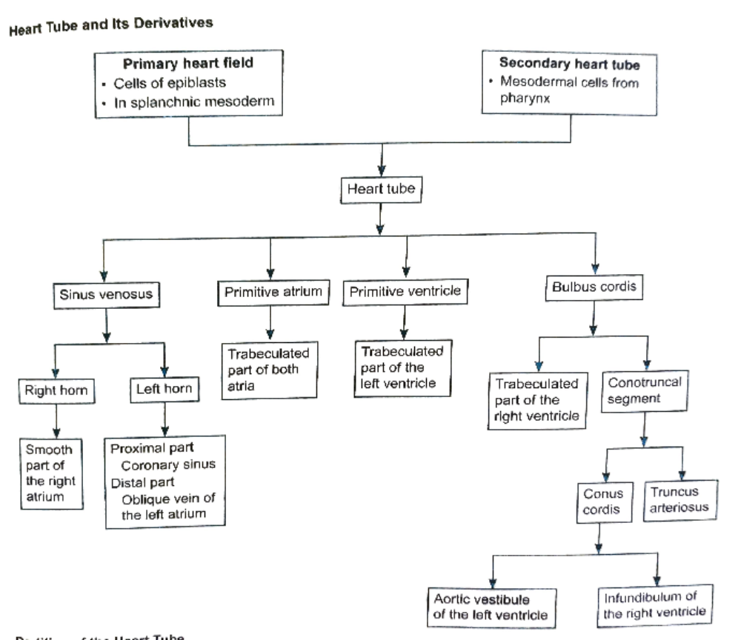
Summary

Slide 28
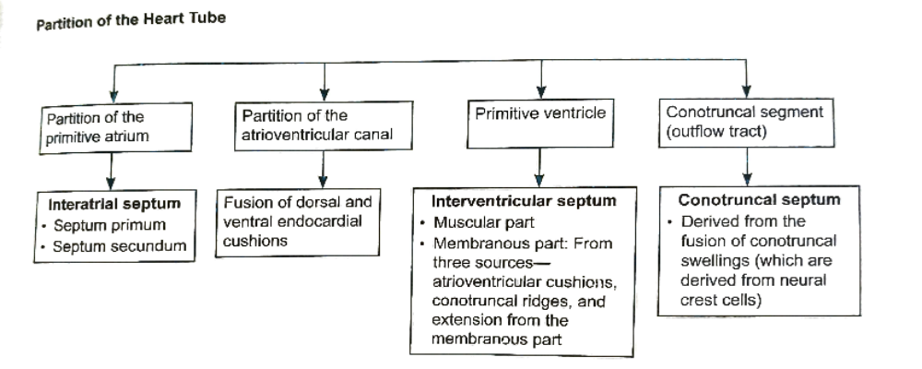

Slide 29
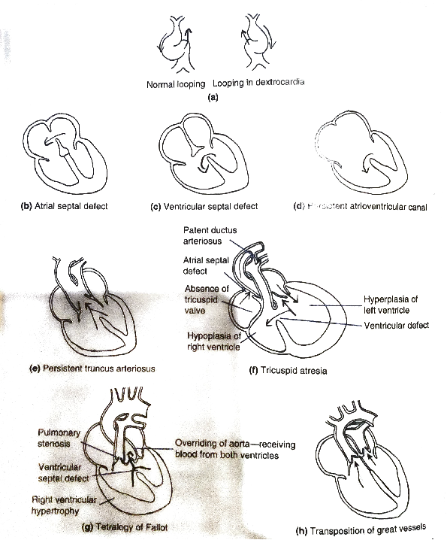
CLINICAL CORRELATES

