Slide 1
Caecum & Appendix
Sarangdhar kumar
Assistant professor
Rohilkhand Medical College
Bareilly

Slide 2
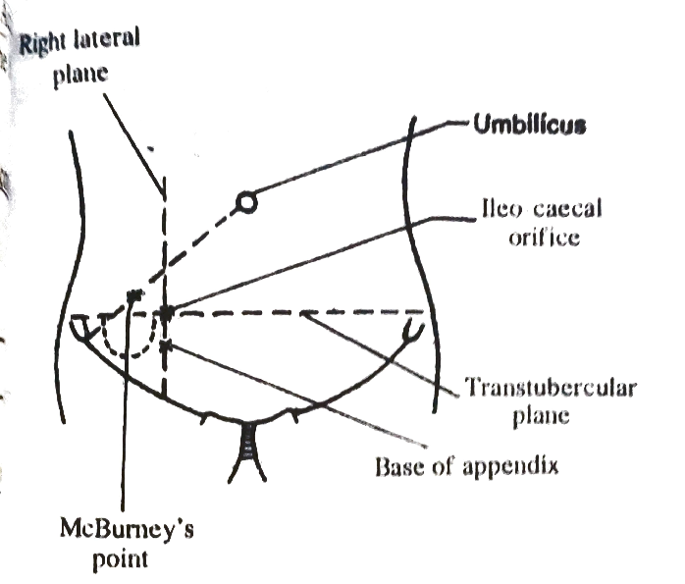
CAECUM
The word ‘Caecum’ = blind (in latin)
Blind end of large intestine
Below the opening of ilium
Lies in right iliac fossa, just above the lateral half of inguinal ligament

Slide 3
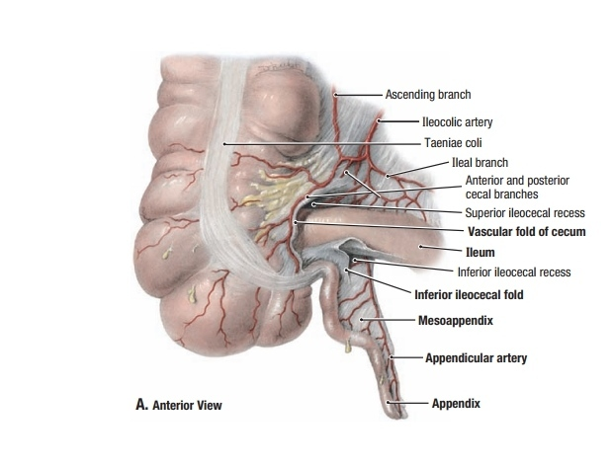
Size
  Length – 6 cm
  Breadth – 7.5 cm
Shape
  Asymmetrical cul-de- sac .
  But shape varies & it is classified under following heading
    Foetal type (2%)
    Infantile type (3%)
    Adult (normal) type (90%)
    Exaggerated type (4-5%)

Slide 4
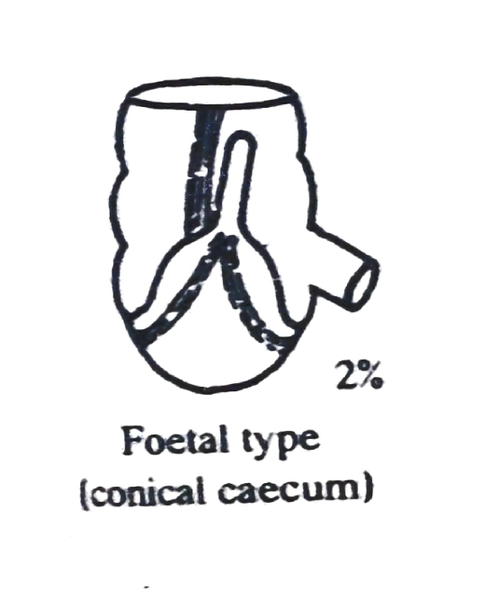
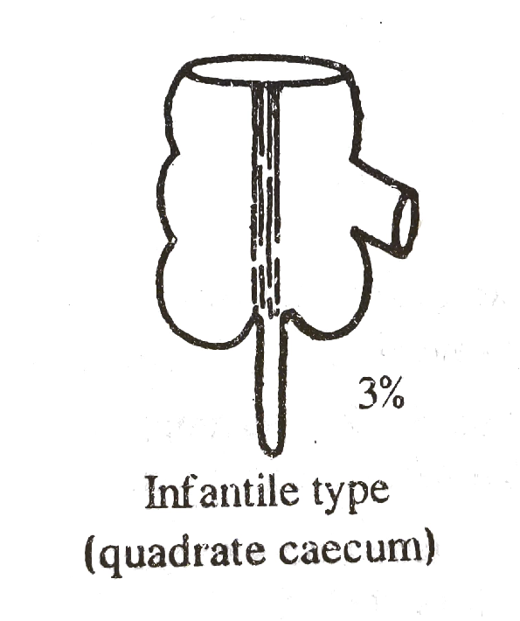
Foetal type
  Caecum is conical
  Appendix arises as a straight tube from its apex
Infantile type
  Caecum is quadrate
  Appendix attached to depressed bottom

Slide 5
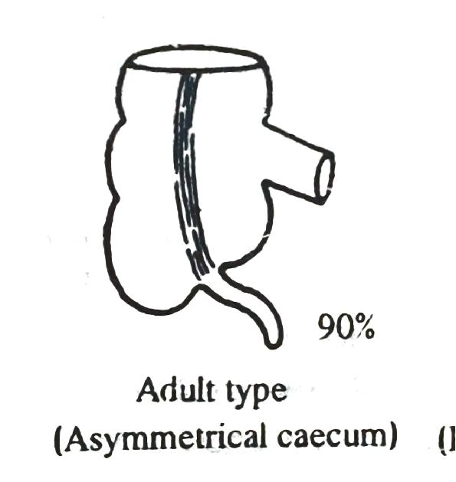
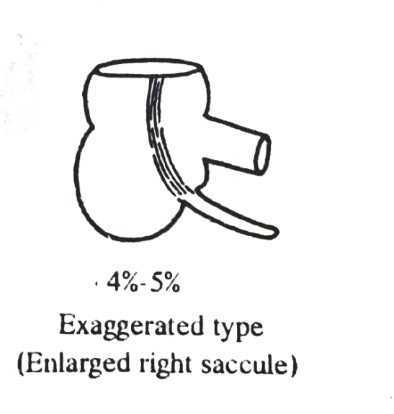
Adult type
  Rt saccule enlarges more than left one
  Appendix situated 2 cm below than ileocecal junction
Exaggerated type
  Rt saccule hugely enlarges
  Left one is get atrophies

Slide 6
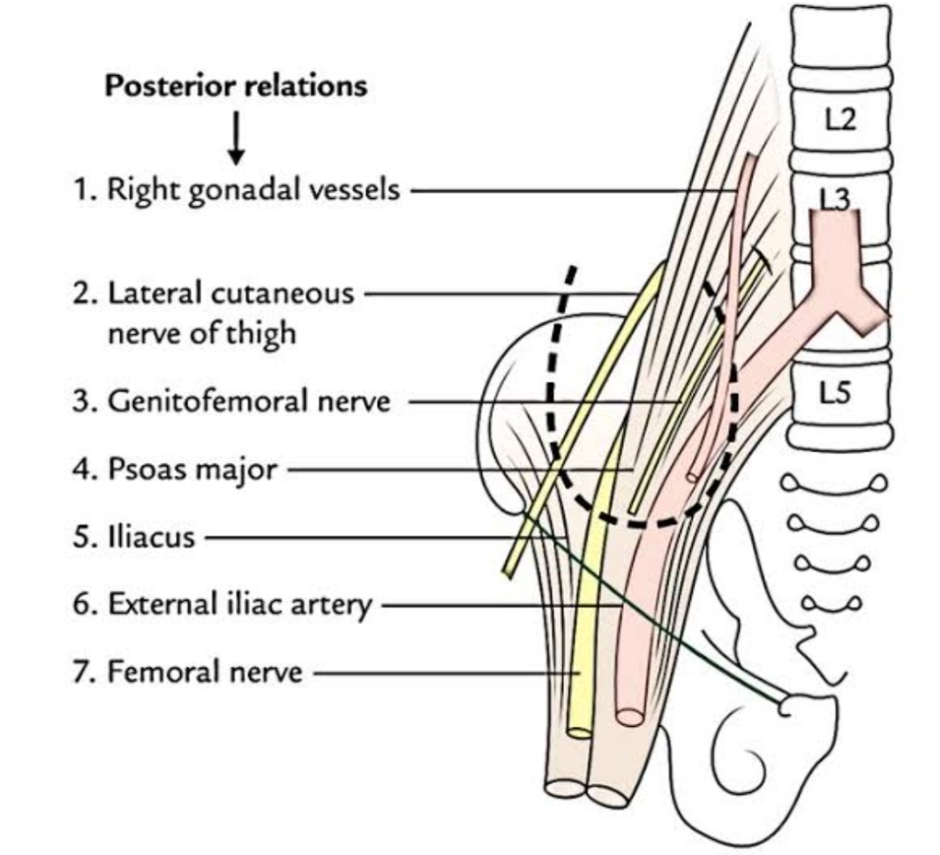
Relation
  Covered by peritoneum on all sides
  In 5% cases only upper part of its posterior surface is non- peritoneal & related with fascia iliaca
Infront –
  Ant. Abdominal wall
  Coils of jejunum
  Sometimes lower margin of greater omentum
Behind –
  Rt iliopsoas muscle
  Lat. Femoral cutaneous nerve of thigh
  Trunk of femoral nerve(deep to fascia iliaca)
  Retrocaecal recess of peritoneum
  Sometimes genitofemoral nerve

Slide 7

Relation (cont….)
Above
  Continue with ascending colon at the level of transverse tubercle plane
Medially –
  Terminal part of ileum
  Vermiform appendix
  Inferior ileo caecal recess which is bounded by non vascular fold (bloodless fold of Treves)

Slide 8
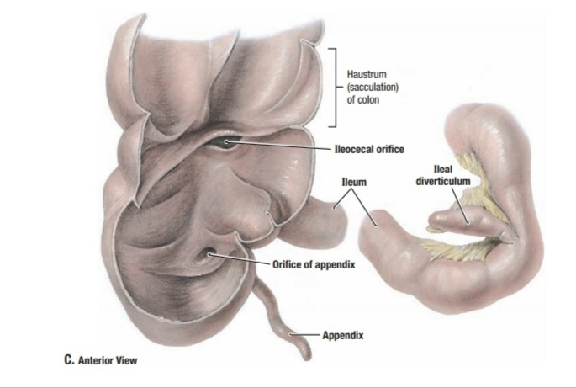
Interior of caecum
1. Ileo-caecal orifice
  Situated in posteromedial wall at the junction of caecum & ascending colon
  Guarded by valve
    Valve consists of two lip
      Upper lip
      Lower lip
    Frenula – meeting point of end of both lip
2. Appendicular orifice
  Small circular opening
  2 cm below & slightly behind the ileo-caecal orifice
  Guarded by semilunar mucous fold (valve of Gerlach)

Slide 9
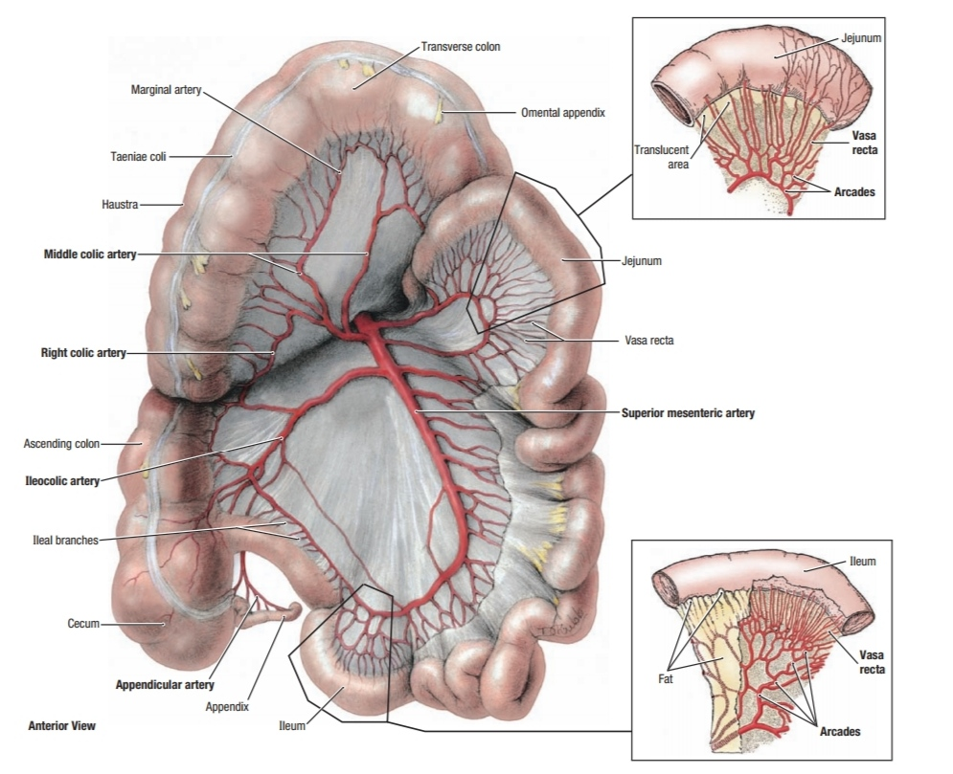
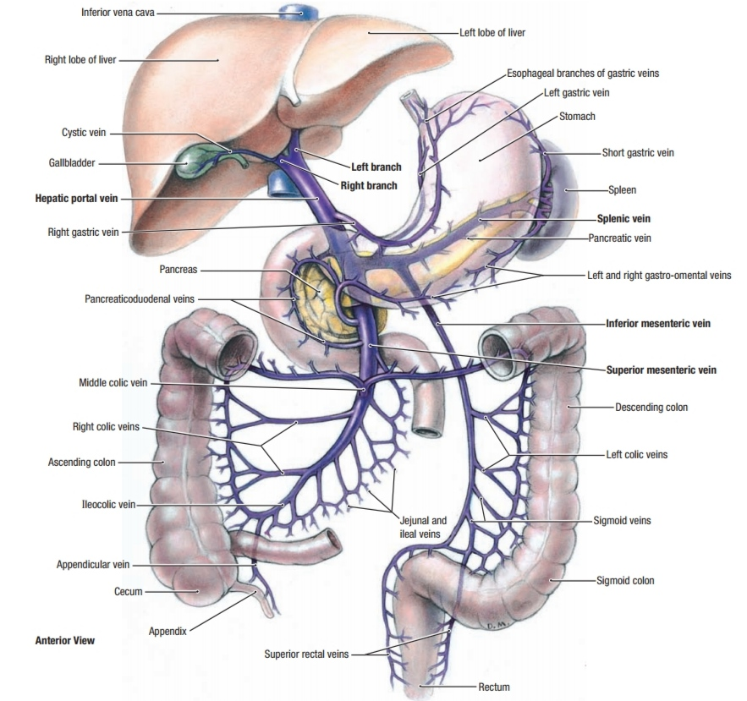
Arterial supply
  Ant.& post. Caecal branch of inferior division of ileo-colic artery
Venous drainage
  Ileo-colic vein
Lymphatic
  ileo colic lymph node
Nerve
  Superior mesenteric plexus (T10 – L1)
  Parasympathetic – vagus (rt & lt)

Slide 10
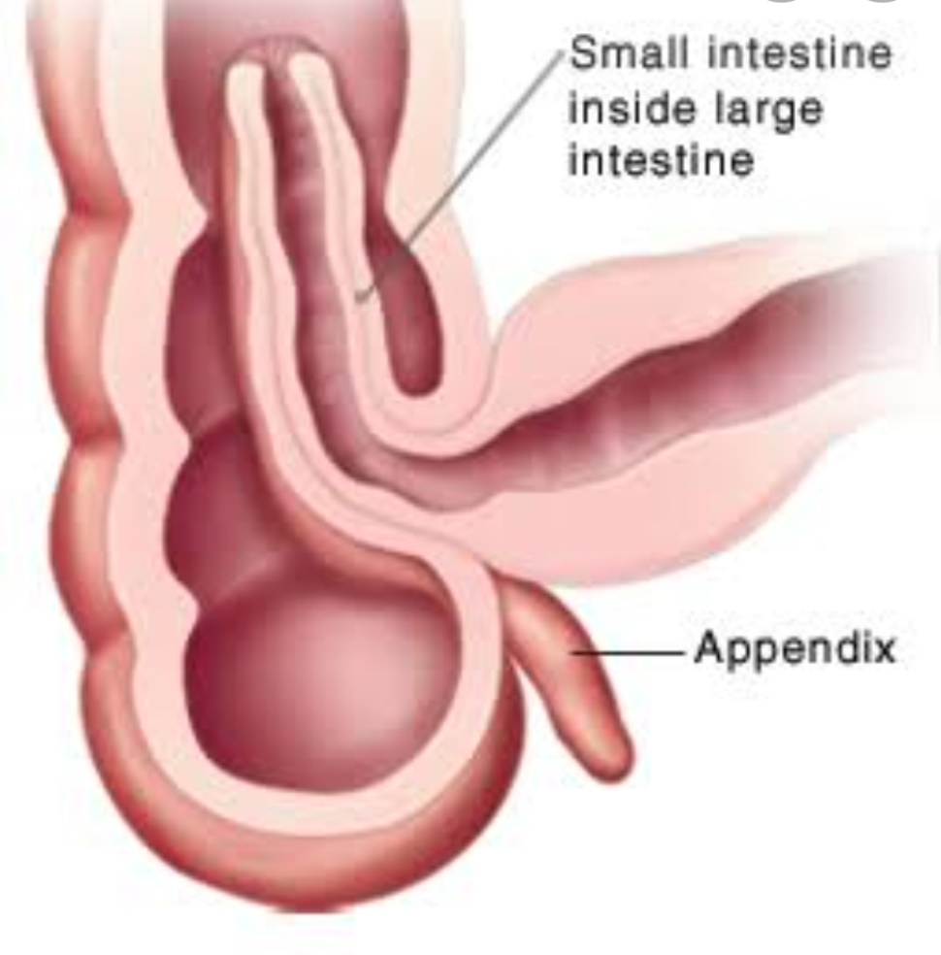
Applied
The caecum acts as a guide in operation of intestinal obstruction
  If caecum is distended, obstruction occurs in large intestine
  If it is empty , the obstruction is of small intestine
Intussusception –
  Sometimes terminal part of ileum is telescopically invaginate into the caecum & ascending colon at ileocaecal junction
  Produces intestinal obstruction

Slide 11
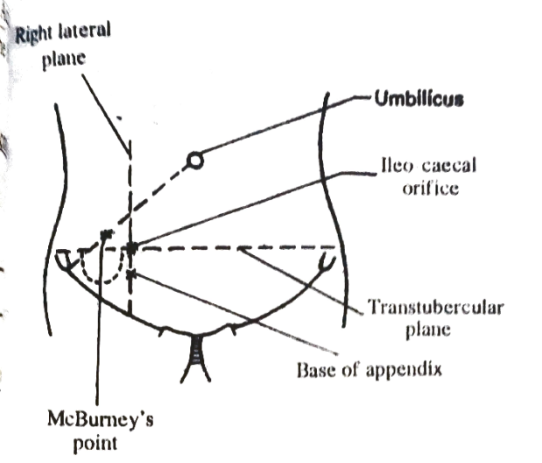

Vermiform appendix
Narrow worm like tubular diverticulum
Aries from posteromedial wall of caecum
About 2 cm below the ileo-caecal junction
Suspended by fold of peritoneum , Mesoappendix
It is devoid of three cardinal features of large intestine
  Taenia coli
  Sacculations
  Appendices epiploicae

Slide 12

Measurement
  Length
    2 cm – 20 cm
  Average length
    9 cm
  Length increases in young adults & diminishes after mid- adult life

Slide 13

Parts
  It presents Base , Body , Tip & Mesoappendix
Base –
  It attached to posteromedial wall of caecum
  2cm below the ileo-caecal orifice
  All taenia are converge at the base

Slide 14
Body
  Narrow , tubular
  Contains canal which is open into caecum
  Opening is guarded by a mucous fold (valve of Gerlach)
Tip
  Least vascular
  Directed in various in various positions

Slide 15
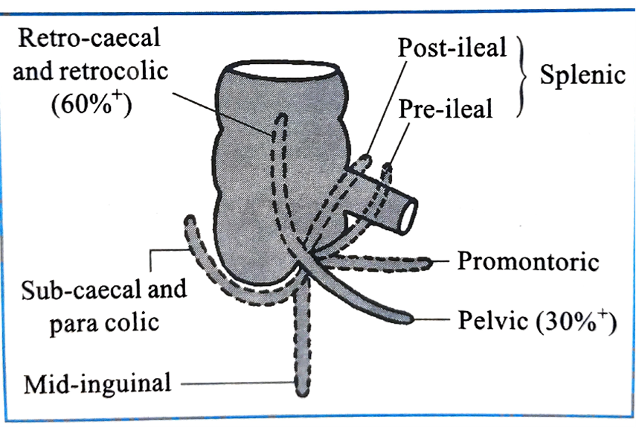
Types
According to its position it is classified into following types
  Sub-caecal(paracolic)
    11`O clock position
    Tip ascend by side of ascending colon
  Retrocaecal
    12`O clock position
    Commonest type (60%)
  Splenic
    2`O clock position
    Pre ileal (most dangerous)
    Post ileal

Slide 16
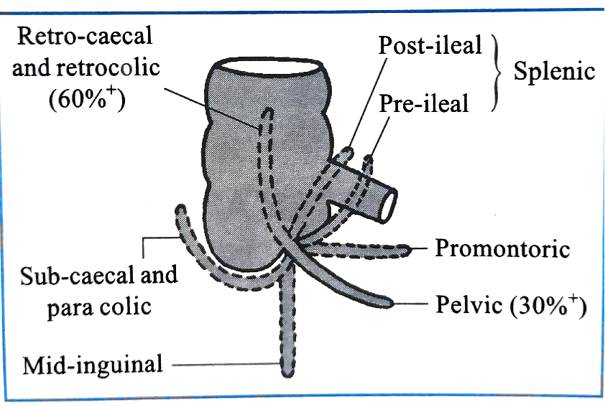
  Promontory
    3`O clock position
    Very rare
  Pelvic
    4`O clock position
    2nd commonest (30%)
  Mid inguinal
    6`O clock position
    Very rare type

Slide 17

Mesoappendix
  Triangular peritoneal fold
  Invest entire appendix
  Derived from posterior layer of mesentery of ileum
  Appendicular vessels passes within the free margin of Mesoappendix

Slide 18

Arterial supply
  Appendicular vessels ,branch of inferior division of ileocolic artery
  An end artery
Venous drainage
  Corresponds to artery & drain into superior mesenteric vein
Nerve supply
  Sympathetic
    Derived from superior mesenteric plexus
    T10 spinal segment
  Parasympathetic
    Both right & left vagus
Lymphatic drainage
    Ileocolic lymph node

Slide 19
Applied
Appendicitis
  Inflammation of appendix
  It manifested by
    Pain (felt in umbilical region)
    Vomiting
    Temperature
    Tenderness & rigidity
  In retrocaecal appendix typical clinical feature may not be observed
    But patient experiences pain on extension of right hip joint (psoas test)
  The anatomical factors producing inflammation
    Faecolith may obstruct the lumen
    Presence of hiatus muscularis
    Supplied by an end artery

Slide 20
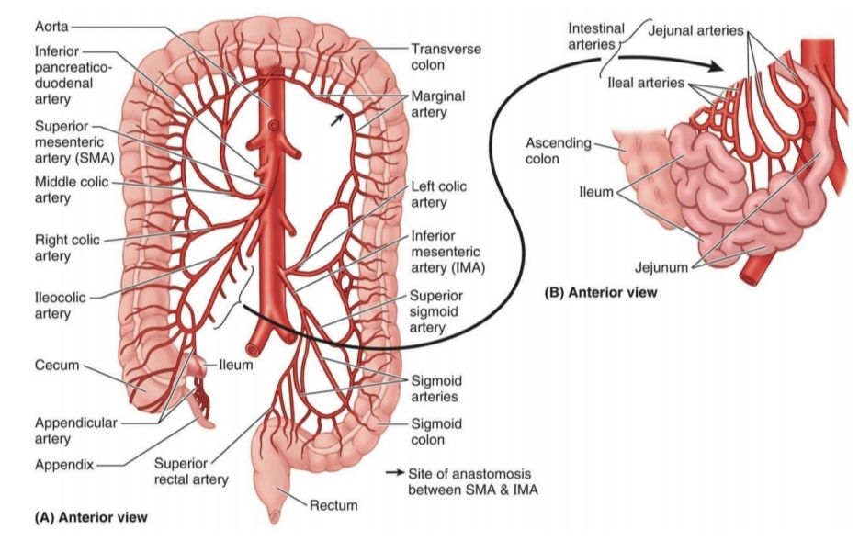
Inferior mesenteric artery

Slide 21

One of the ventral branch of abdominal aorta
Arises 4 cm above to the bifurcation of abd. aorta
At level of L3 vertebra
It passes retroperitoneally downward & to the left side of aorta & enter the lesser pelvis after crossing the left common iliac artery
Continue as superior rectal artery

Slide 22

Branches
  Left colic artery
  Sigmoid artery (2 to 4 in number)
  Superior rectal artery

Slide 23
Critical point of Sudek
  occasionally Lowest sigmoidal artery fails to anastomose with superior rectal artery
Arc of Riolan
  In few cases middle colic artery & left colic artery does not exist
  In this condition trunk of superior mesenteric & inferior mesenteric artery anastomose with arc artery

