Slide 1
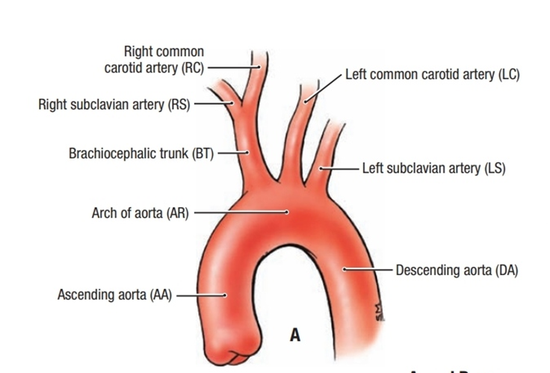
Blood vessels of the Neck
DR.SARANGDHAR KUMAR
DEPARTMENT OF ANATOMY
RMCH,BAREILLY

Slide 2
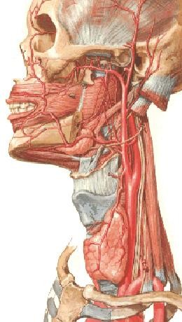
common carotid artery
On the right side it arises from the right brachiocephalic behind the right sternoclavicular joint
On the left arises from the arch of aorta in the superior mediastinum
In the neck extends from the sternoclavicular joint to the upper border of the thyroid cartilage (level of C3&C4)
Where it divides into internal carotid artery & external carotid artery
Lies deep to the anterior border of the SCM lies within the carotid sheath Medial to the IJV Anterior to the vagus nerve

Slide 3
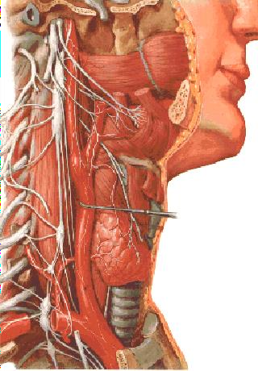
◻ Carotid Sinus
CS
localized dilatation at bifurcation of common carotid artery
Innervated by carotid sinus branch of glossopharyngeal n.
Function as a baroreceptor
(a rise in blood pressure - a slowing of the HR vasodilatation of the arterioles)
◻ Carotid Body
A small neurovascular structure
Lies close to post. wall of carotid sinus
Innervated by the carotid sinus branch of the glossopharyngeal n
Function as a chemoreceptor
(sensitive to excess CO2 and reduced O2 tension in the blood → rise in BP & HR and
increase in RR )

Slide 4
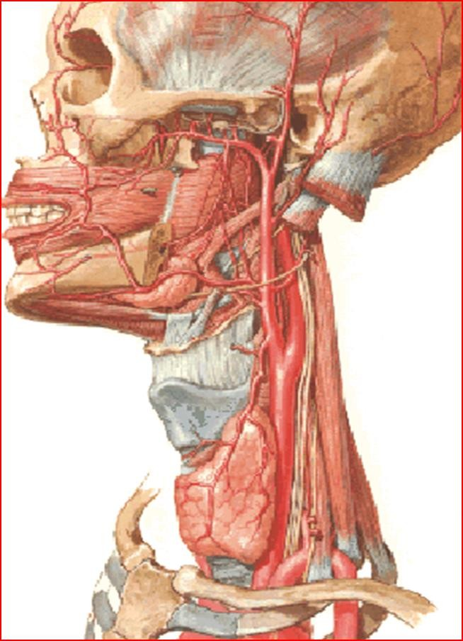
◻ External carotid artery terminal branches of CCA
◻ -begins at the upper border of the thyroid cartilage
◻ -terminates in the substance of the parotid gland behind the neck of mandible
External carotid artery
◻ divides into superficial temporal & maxillary arteries
◻ At first it lies medial to the ICA
then behind to it
Is crossed by the post. Belly of the digastric stylohyoid m.

Slide 5
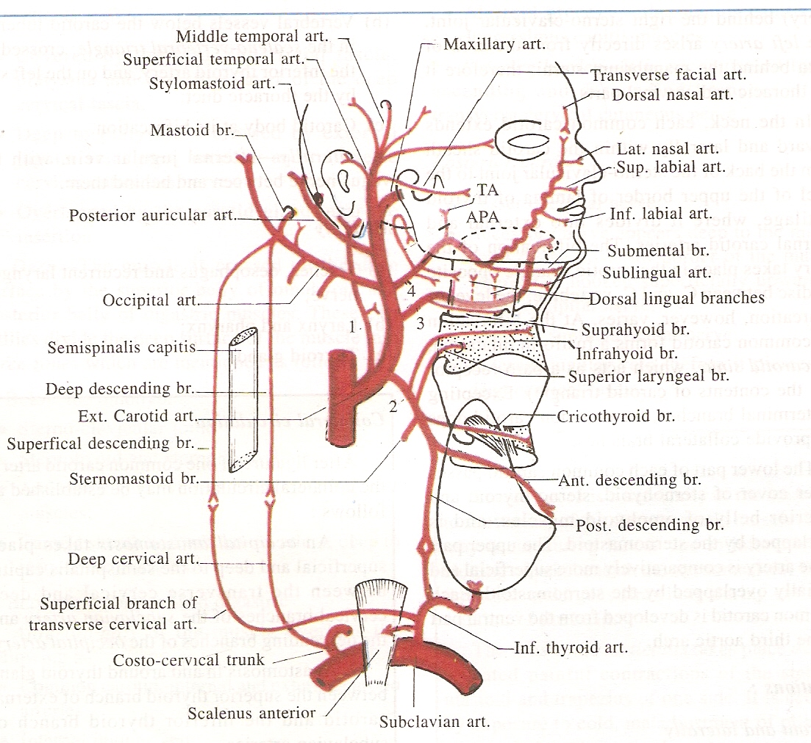

Slide 6
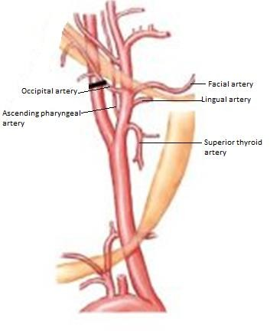
1- superior thyroid artery
Arises near origin of ECC
Upper pole of the thyroid gland
Accompanies the external laryngeal nerve
Branches
Infra- hyoid branch
Crico thyroid branch
Sterno thyroid branch
superior laryngeal artery –
pierces the thyrohyoid membrane with the superior laryngeal nerve
-
Supplies - larynx, infrahyoid m, and thyroid
g
-
-
-

Slide 7
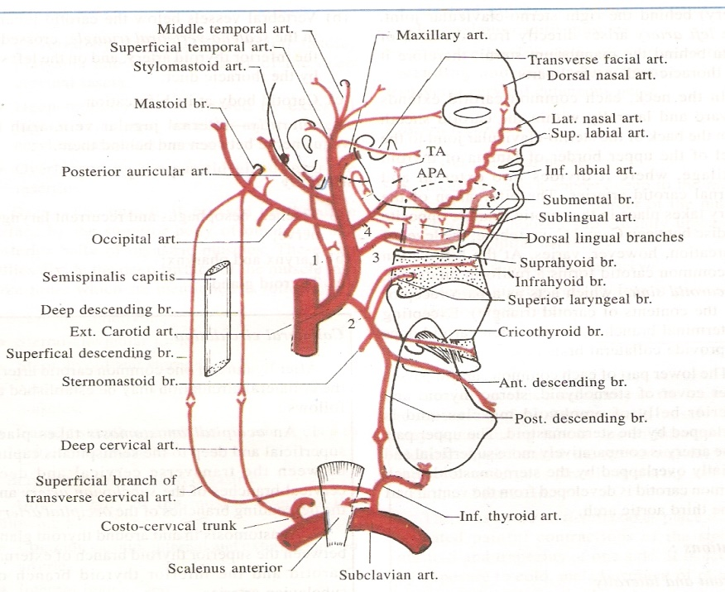
2. Ascending pharyngeal artery
Supplies the pharynx
Arising from the medial side of the ECA
Ascends b/w the ICA and the wall of pharynx
Branches
pharyngeal
meningeal
palatine tonsil
inferior tympanic artery

Slide 8

Lingual artery
  Opposite the tip of the greater cornu of the hyoid bone deep to hyoglossus muscle,
  Reach the tongue accompanies by the deep inguinal vein
  Near its origin is crossed superficially by the hypoglossal n
Branches
    Suprahyoid
    Dorsal lingual artery
    Deep lingual
Subligual artery

Slide 9
4- Facial artery
Arises just distal to the lingual artery
deep to post. Belly of dig m and stylohyoid m
winds around the lower border of the mandible to enter the face at the anterior margin of massseter muscle
passes upward and medially to end at
medial angle of the eye
Branches in neck
1- ascending palatine artery 2- tonsillar artery
glandular branches
submental artery
-
-
-
-
-
-
-
-

Slide 10
5- Occipital artery
opposite the facial artery, back of the scalp passes posteriorly and superiorly
Crosses lateral to the ICA, IJV, CN (X, XI, and XII)
Grooves the temporal bone medial to the
mastoid process
Branches
Sterno-mastoid branch
Meningeal branch
Descending branch

Slide 11
6- Posterior auricular artery
Arises from posterior aspect of ECA
Passes backward & upward along the posterior belly of digastric muscle
Then artery lies under cover of parotid gland
Branches
Stylomastoid branch
Auricular branch
Occipital branch

Slide 12
7- Superficial temporal artery
Smaller terminal branch of ECA
Arises within the parotid gland behind the neck of mandible & divides into anterior & posterior branch
Branches
Transverse facial artery
Anterior Auricular branch
Zygomatico-orbital branch
Middle temporal artery
Anterior branch (Frontal branch)
Posterior branch (Parietal branch)

Slide 13
8- Maxillary artery
larger terminal branch of ECA
Arises within the parotid gland behind the neck of mandible & divides into anterior & posterior branch

Slide 14
INTERNAL CAROTID ARTERY

Slide 15
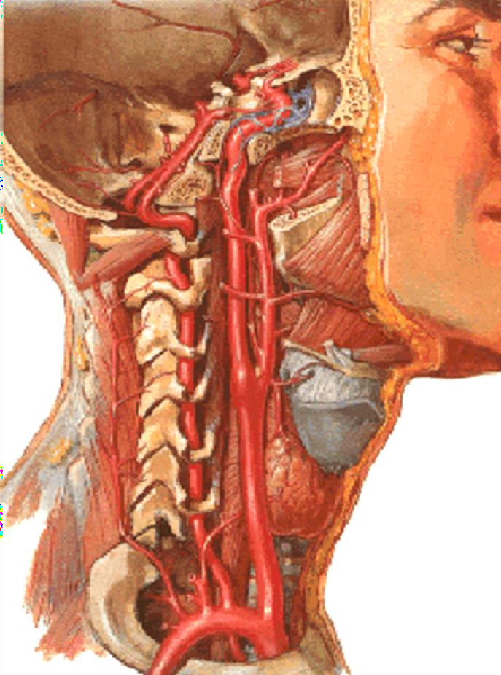
Internal Carotid Artery
One of the terminal branches of the Common Carotid Aretry
Enters the cranial cavity through the carotid canal
Ascends deep to the parotid gland
Gives off NO branches in the neck
Supplies the
brain,
the eyes,
the forehead,
part of the nose

Slide 16
INTERNAL CAROTID ARTRY
It has a four part
Cervical part – no give any branch in neck
Petrous part –
  Carotico- tympanic branch
  Branch to ptrygoid canal
Cavernous part -
  Inferior hypophysial artery
  Meningeal branch
Cerebral part –
  Superior hypophysial artery
  Ophthalmic artery
  Posterior communicating artery
  Anterior choroidal artery
  Anterior cerbral artery
  Middle cerebral artery
Branches
Transverse facial artery
Anterior Auricular branch
Zygomatico-orbital branch
Middle temporal artery
Anterior branch (Frontal branch)
Posterior branch (Parietal branch)

Slide 17
SUBCLAVIAL ARTERY

Slide 18
Subclavian artery:-
Both Rt. & Lt. arteries carry the blood to the upper limbs.
Its territorial supply extend to the Brain, Abdominal wall & Fingers.
Origins:-
-
Rt. Subclavian artery arises from the brachiocephalic trunk.
  Developed from three sources – right 4th aortic arch, right dorsal aorta & right 7th intersegmental artery
-
Lt. subclavian artery arises from the arch of aorta.
    Developed from left 7th intersegmental artery

Slide 19
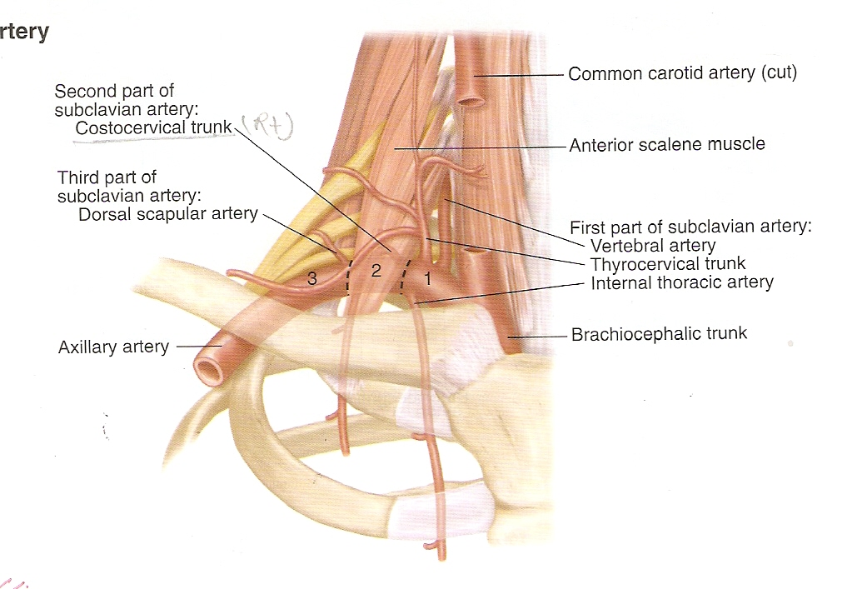

Slide 20
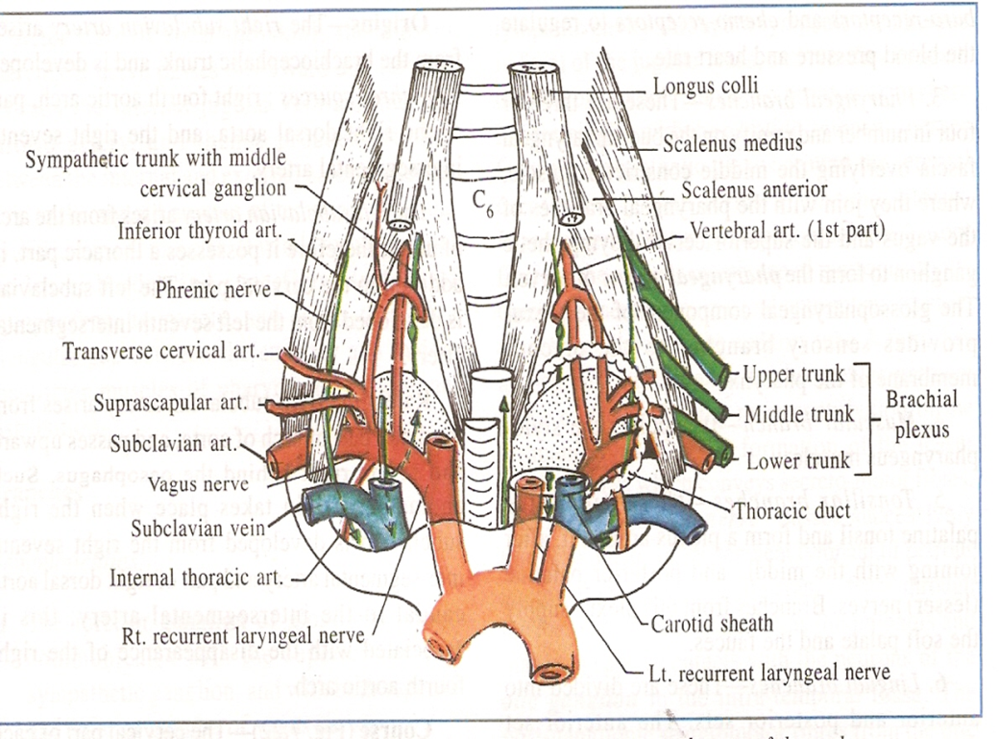
Branches –
From 1st part :-
V- vertebral artery
I – internal thoracic artery
T – thyro-cervical trunk (on left side)
From 2nd part :-
Costo- cervical trunk ( on right side)
From 3rd part :-
Dorsal scapular artery

Slide 21
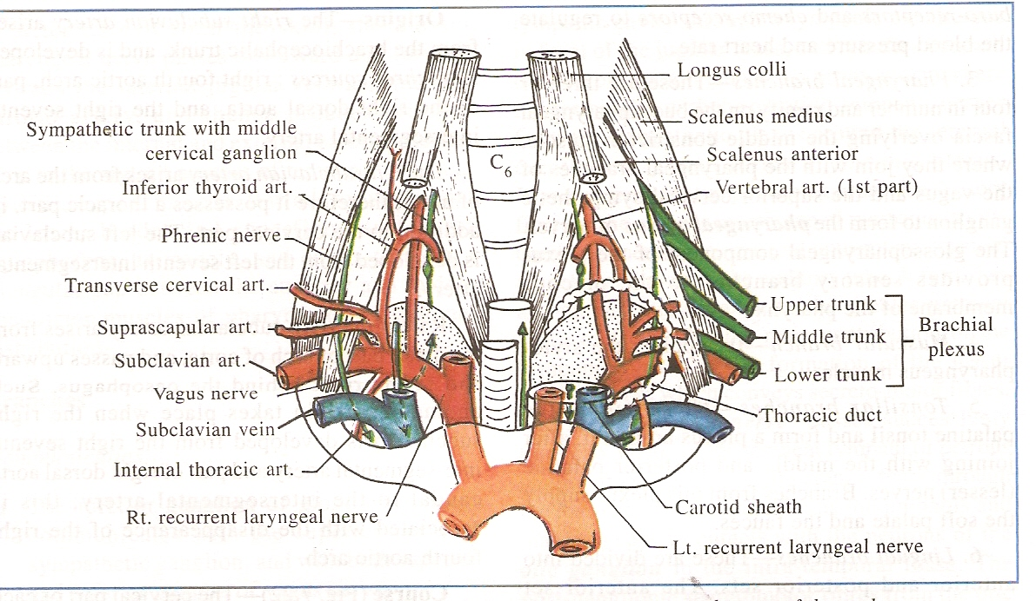

Slide 22
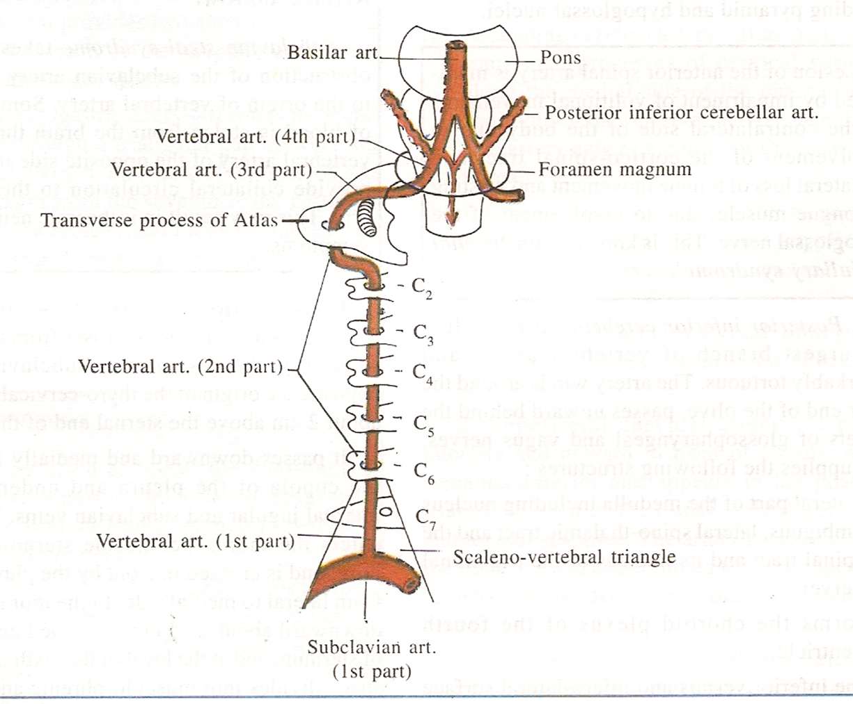
Vertebral Artery
  Vertebral artery
  Branch of 1st part of subclavian artery
  Ascends in the foramina transversaria of upper six cervical vertebrae
  It winds backwards & medially around the lateral mass of atlas and pierces posterior atlanto-occipital membrane

Slide 23
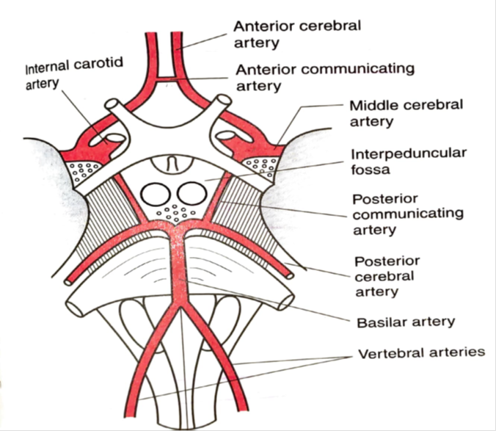
  Then enters the posterior cranial fossa through foramen magnum
  At the lower border of pons both artery unite and form basilar artery
  Branches of intracranial part of vertebral artery-
    Anterior spinal artery
    Posterior spinal artery
    Postero inferior cerebellar artery
    Medullary artery

Slide 24
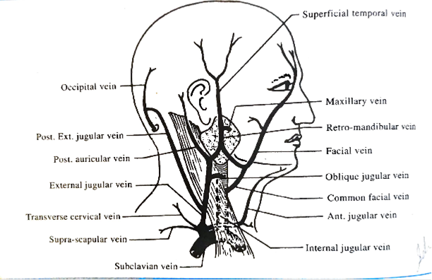
VEINS OF NECK
Veins of neck are –
    Subclavian vein
    Jugular veins
      External jugular vein
      Internal jugular vein
      Anterior jugular vein

Slide 25
Subclavian vein-
Begins as the continuation of axillary vein at the outer border of 1st rib
In the posterior triangle of neck it lies anterior & inferior to the subclavian artery
It ends by joining the internal jugular vein to form brachiocephalic vein

Slide 26
Relations –
Infront – clavicle & subclavius muscle
Behind – subclavian artery
Below – first rib & cervical pleura
Tributaries –
    External jugular vein
    Dorsal scapular vein
    Anterior jugular vein (occasionally)

Slide 27
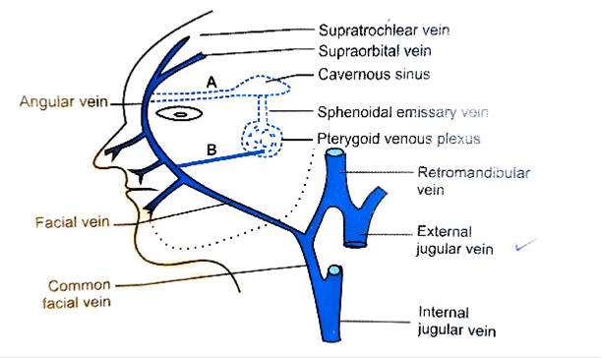
External jugular vein
Drains the blood from greater part of face & scalp
Formed by the union of post. auricular vein & post. division of retromandibular vein
Tributaries –
    Transverse cervical vein
    Suprascapular vein
    Anterior jugular vein
    Formative tributaries

Slide 28
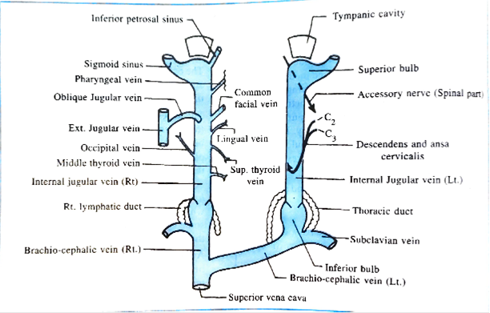
Internal jugular vein
Major deep vein of neck
It lies inside the carotid sheath
It begins as a continuation of sigmoid sinus at posterior part of jugular foramen at the base of skull
At its origin it exhibits superior bulb(closely related to floor of middle ear)
It terminates by joining subclavian vein & forms brachiocephalic vein

Slide 29
Tributaries –
  Inferior petrosal sinus (1st tributary )
  Pharyngeal vein
  Common facial vein
  Lingual vein
  Superior thyroid vein
  Middle thyroid vein

Slide 30
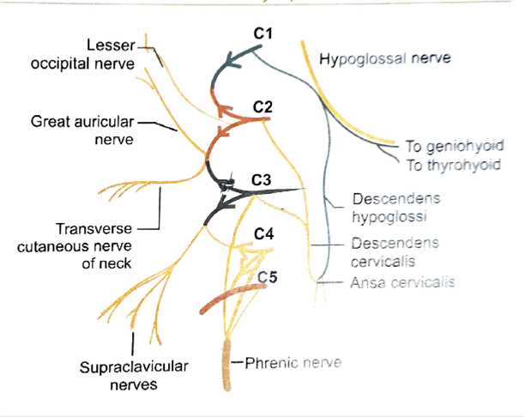
CERVICAL PLEXUS
Located in the upper part of neck behind the prevertebral fascia
Infront of scalenus medius & levator scapulae
It is formed by the ventral primary rami of upper four cervical nerves(C1to C4)
Most important branch is the phrenic nerve

Slide 31

Formation
Form by the upper four cervical nerves
There are three loops in cervical plexus
Each ramus is divides into ascending & descending branch( except 1st )
  1st loop between C2 & C3
  2nd loop between C3 & C4
  3rd loop between C4 & C5

Slide 32
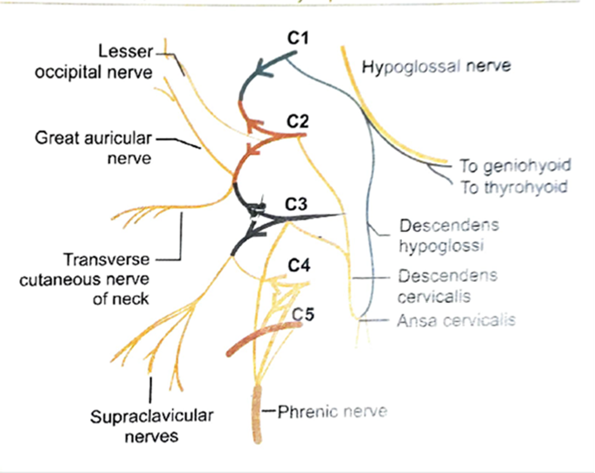
Branches –
Deep or Muscular branches
  Medial branch –
    Rectus capitis lateralis & anterior,
    Longus capitis & colli ,
    descending cervicalis , phrenic nerve (C3, C4 & C5 )
  Lateral branch –
    scalene muscles,
    levator scapulae ,
    proprioceptive to the SCM & trapezius
Superficial branches
  Ascending branch –
    lesser occipital nerve (C2),
    Greater occipital nerve(C2,C3),
    transverse cutaneous (C2,C3)
  Descending branch –
    supraclavicular nerve (C3,C4)

Slide 33
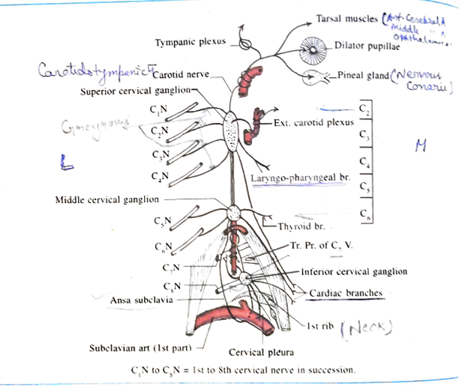
Cervical sympathetic trunk
Extend from base of skull to neck of 1st rib
Paravertebral in position
Situated behind the carotid sheath & infront of longus capitis
Cranial continuation of sympathetic chain is called internal carotid nerve

Slide 34
cervical sympathetic trunk presents three cervical ganglia
Superior cervical ganglia
  Largest of cervical ganglia
  Fusiform in shape
  Form by fusion of upper four cervical ganglia (C1- C4)
  Situated opposite to C2 & C3 vertebrae
  preganglionic fibres mostly from upper three thoracic segments of spinal cord
Branches –
    Laryngo pharyngeal branch
    Cardiac branch
      right cardiac branch – deep cardiac plexus ,
      left cardiac branch – superficial cardiac plexus
    Carotido-tympanic nerve
    Deep petrosal nerve

Slide 35
Middle cervical ganglia
  Formed by union of C5 & C6 nerves
  Lies infront of T.P. of 6th cervical vertebra
  Between CCA infront & inf. thyroid artery behind
Branches
    Grey rami to 5th & 6th cervical nerves
    Thyroid branch
    Cardiac branch – deep cardiac plexus
    Ansa subclavia

Slide 36
Inferior cervical ganglia
  Formed by the fusion of C7&C8 cervical ganglia
  Irregular in shape
  Located in scalenovertebral triangle
  Related to front of neck of first rib
Branches
    Gray rami to C7 & C8 nerves
    Cardiac branch – deep cardiac plexus
    Vascular branch to subclavian artery
    Vertebral branch –vertebral plexus around vertebral artery

