Slide 1
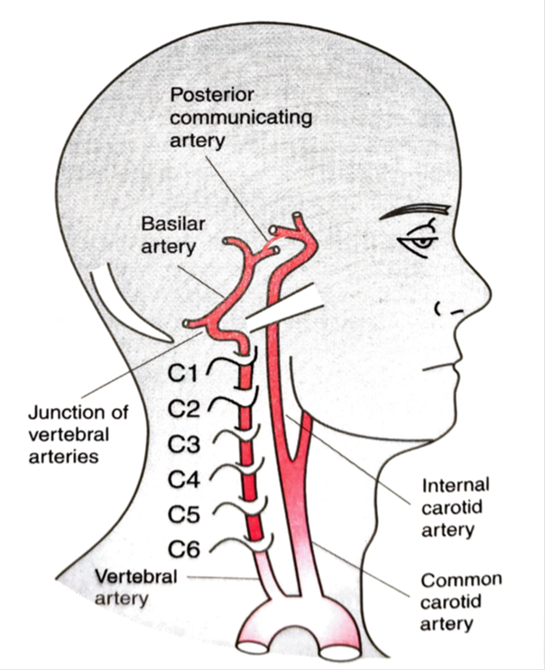
BLOOD SUPPLY OF BRAIN
  SARANGDHAR KUMAR
  DEPARTMENT OF ANATOMY
  ROHILKHAND MEDICAL COLLEGE
  BAREILLY

Slide 2
INTRODUCTION-
  Brain is most metabolic active organ of the body
  Depends upon aerobic metabolism of glucose
  Brain constitute only 2% of the total body weight but it receives 20% of total cardiac output
  O2 consumption is also very high about 20% of total breath
  So acute arrest of blood circulation produces-
    Loss of consciousness – 7 to 10 sec.
    Brain starts damaging – up to 4 minutes
    Completely damage – within 10 minutes

Slide 3
The brain is supplied by branches of two arterial system
  Vertebrobasilar system
  Carotid system
  At the base of the brain, branches of these two system forms an arterial circle called circulus arteriosus (Circle of Willis)

Slide 4
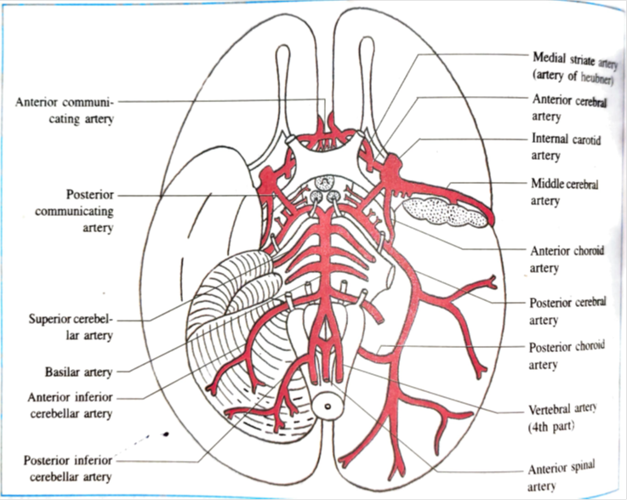
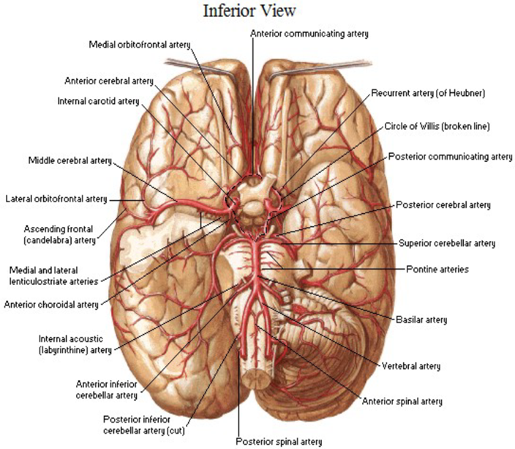

Slide 5
TWO ARTERIAL SYSTEM
VERTEBROBASILAR SYSTEM
PAIRED VERTEBRAL ARTERY
BASILAR ARTERY
CAROID SYSTEM
PAIRED INTERNAL CAROTID ARTERY

Slide 6
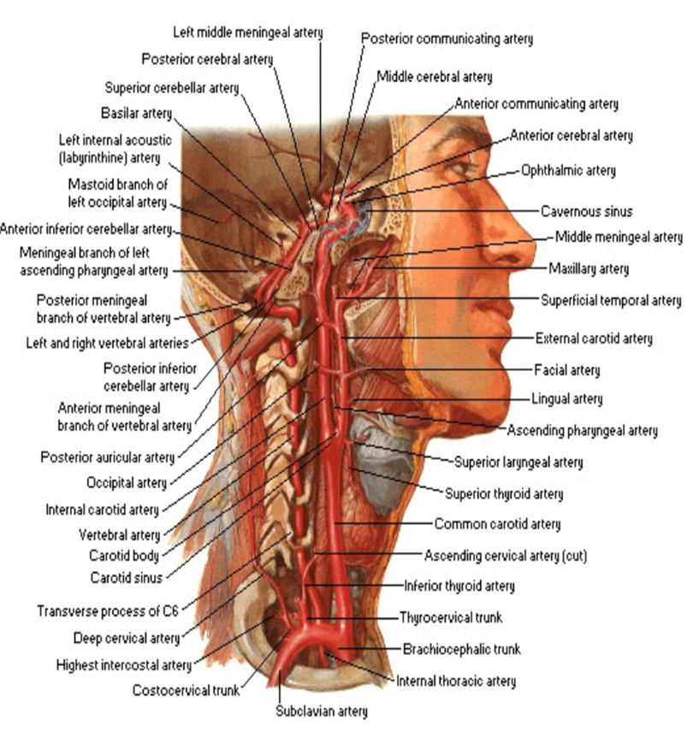
VERTRBROBASILAR SYSTEM
  Include intracranial part of Vertebral artery & basilar artery
  It supply not only the hindbrain but also the spinal cord
  Vertebral artery
  Branch of 1st part of subclavian artery
  Ascends in the foramina transversaria of upper six cervical vertebrae
  It winds backwards & medially around the lateral mass of atlas and pierces posterior atlanto-occipital membrane

Slide 7
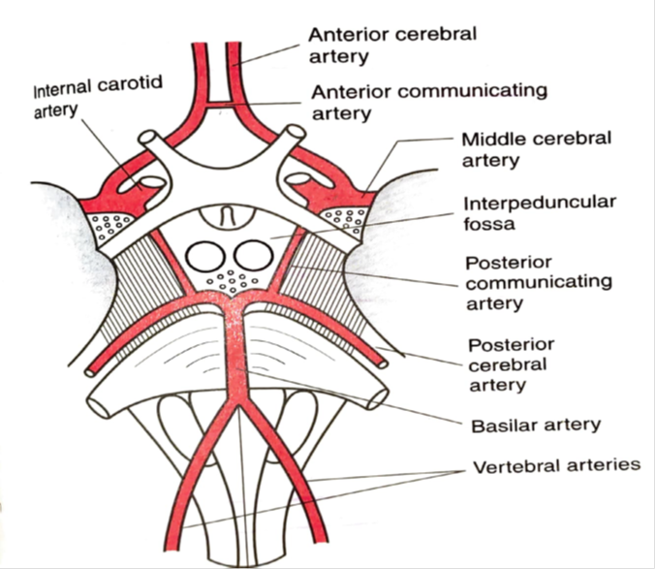
  Then enters the posterior cranial fossa through foramen magnum
  At the lower border of pons both artery unite and form basilar artery
  Branches of intracranial part of vertebral artery-
    Anterior spinal artery
    Posterior spinal artery
    Postero inferior cerebellar artery
    Medullary artery

Slide 8
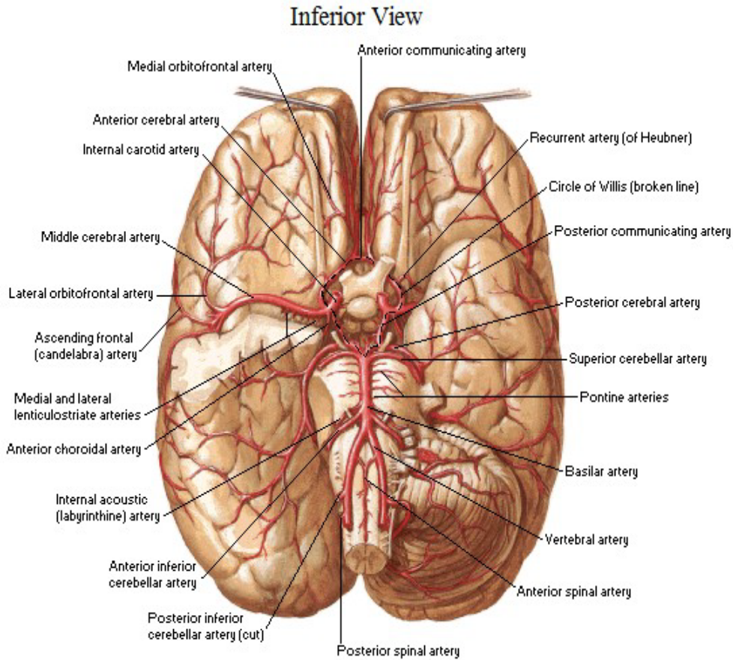
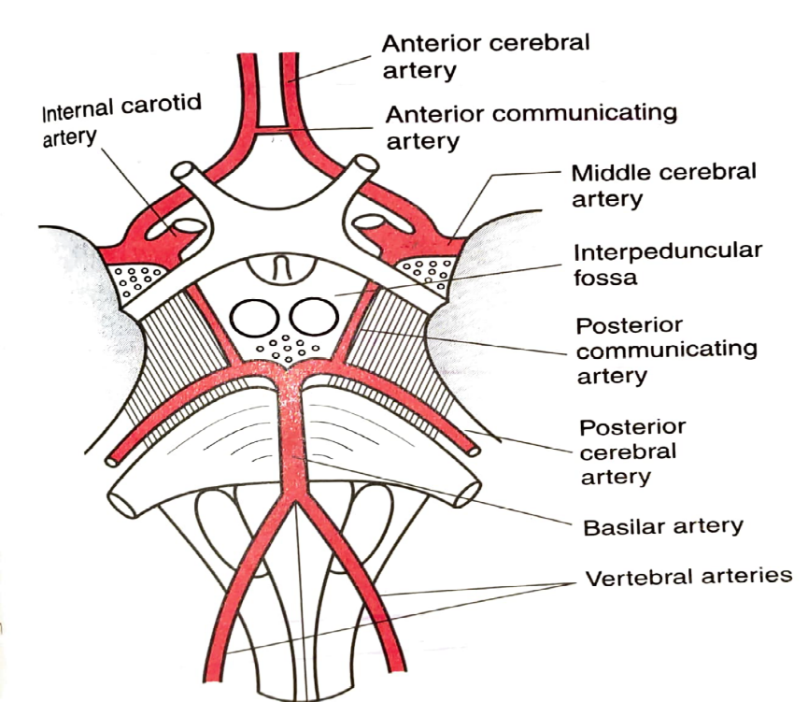
Basilar artery-
  Formed by union of right & left vertebral artery at the lower border of pons
  It runs on basilar groove present on ventral surface pons
  And it ends by dividing into two terminal branch posterior cerebral artery at upper border of pons
  Branches of basilar artery-
    Anterior inferior cerebellar artery
    Labyrinthine artery
    Pontine artery
    Superior cerebellar artery
    Posterior cerebral artery

Slide 10
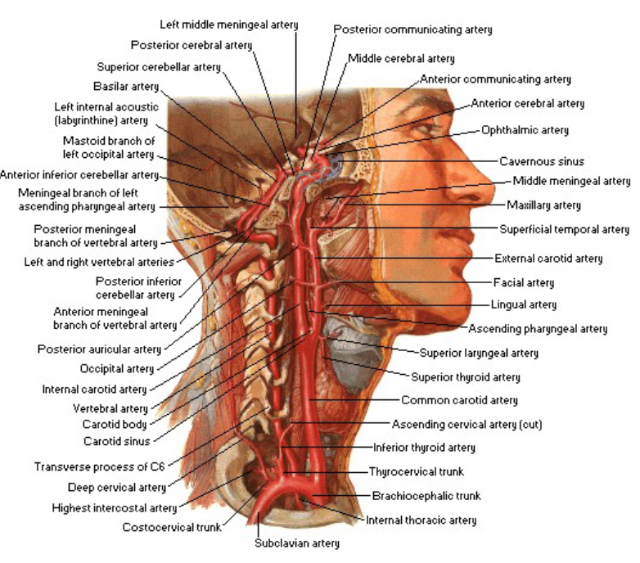
CAROTID SYSTEM
Paired internal carotid artery
Terminal branch of common carotid artery
Passes straight upward & reach to base of skull
Enter into lower opening of carotid canal & traverse the canal and Then reach to the middle cranial fossa
Runs horizontally forward along the floor & medial wall of cavernous sinus

Slide 11
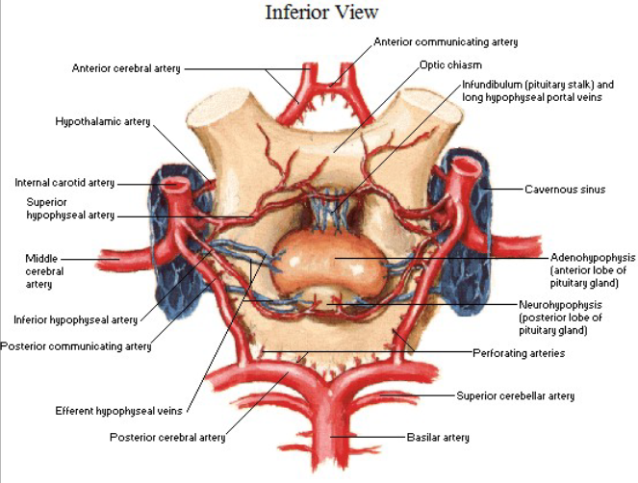
Then turns upward & pierces the floor of and lies medial to anterior clinoid process
Then turns backward and upward lateral to optic chiasma and reaches to anterior perforated substance, where it divide into anterior & middle cerebral artery
During the course internal carotid artery is divided into four parts
Cervical part- does not give any significance branch
Petrous part- it gives two branches-
  Superior cortico-tympanic
  Inferior cortico tympanic

Slide 12

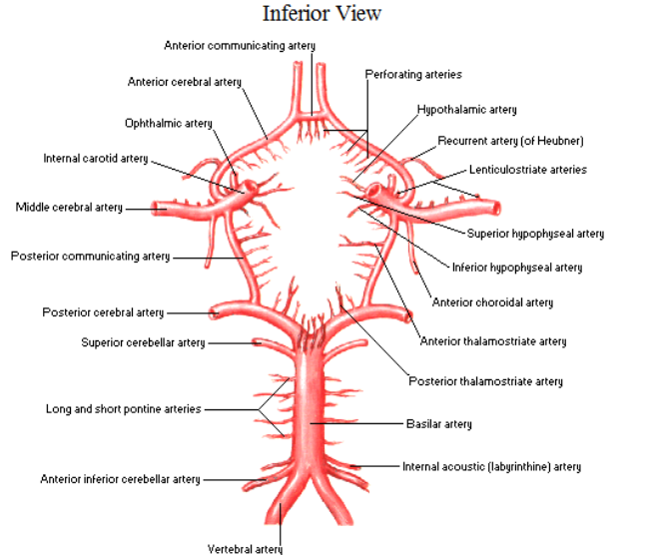
Cavernous part-
  Superior hypophysial artery
  Inferior hypophysial artery
  Branch to trigeminal ganglion & dura mater
Cerebral part-
  Ophthalmic artery
  Anterior cerebral artery
  Middle cerebral artery
  Anterior choroidal artery
  Posterior communicating artery

Slide 13
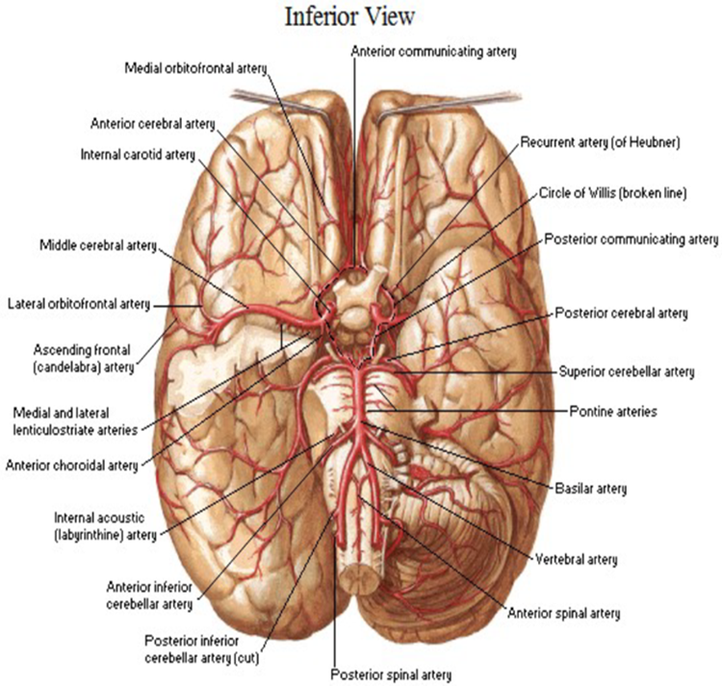
CIRCULUS ARTERIOSUS
It is an arterial circle at the base of the brain
Forms by the anastomosis between the branches of two arterial system ( vertebrobasilar + carotid system)
Polygonal in shape
Located in the interpeduncular fossa

Slide 14

Boundaries-
  Anteriorly- by anterior communicating artery
  Antero laterally- by anterior cerebral artery
  Laterally- by internal carotid artery
  Postero-laterally- by posterior communicating artery
  Posteriorly- by posterior cerebral artery

Slide 15
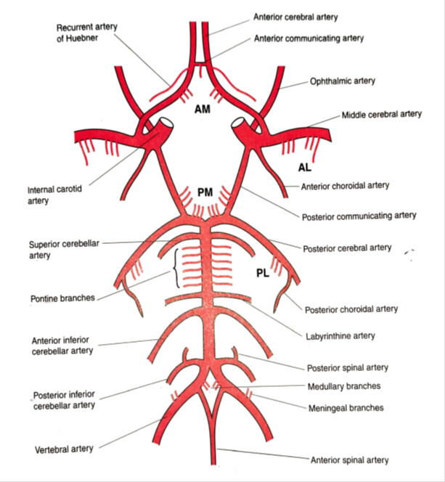
Functional significance
Equalizes the pressure of blood flow to two sides of brain
It is main collateral channel
Branches –
It provide number of central branches which penetrate the base of the brain
Supply diencephalon, corpus striatum & internal capsule

Slide 16
Branches are arranged in the following groups
  Antero-medial group-
  - Internal capsule (Anterior limb)
  -Pre optic & Supra optic region of Hypothalamus
  Paired Antero-lateral group ( striate branch)-
  -Corpus striatum
  -most of Internal capsule
  (Recurrent artery of Heubner)
  (Charcot Artery of cerebral hemorrhage)
  (Deep optic artery)
  Postero-medial group-
  -Anterior & medial part of Thalamus
  -Mammillary region of Hypothalamus
  -Subthalamus
  Paired Postero-lateral group- -Caudal part of Thalamus (Pulvinar & Geniculate body)
    -Lateral Thalamic nuclei

Slide 17
Circle of Willis
AM
group
Paired AL
group
Paired PL
group
PM
group
CLINICAL ANATOMY-
Occlusion of lenticulo striate artery
  Loss of blood supply of internal capsule
  Spastic hemiplegia
  Paralysis of lower half of face
Charcot Bouchard aneurysm-
  Micro aneurysm of lenticulostriate artery
  In presence of long standing hypertension
  Result in cerebral hemorrhage
Berry aneurysm-
  localized dilatation on one of the artery of circle of Willis
  Due to congenital muscular weakness
  Most common site are junction of anterior cerebral artery & anterior communicating artery , bifurcation of ICA
  Rapture leads to life threatening subarachnoid hemorrhage
Medial striate artery
Lateral striate artery
Striate artery

Slide 18
BRANCHING PATERN OF CEREBRAL ARTERY
CEREBRAL ARTERY
CORTICAL BRANCH
-ANTERIOR CEREBRAL ARTERY
-MIDDLE CEREBRAL ARTERY
-POSTERIOR CEREBRAL ARTERY
CENTRAL BRANCH
-A M GROUP
-PAIRED A L GROUP
-P M GROUP
-PAIRED P L GROUP
CHOROIDAL BRANCH
-ANTERIOR CHORIDAL ARTERY
-POSTERIOR CHOROIDAL ARTERY

Slide 19
BLOOD SUPPLY OF CEREBRAL CORTEX
  Supplied by cortical branches
    Anterior cerebral artery-
    Middle cerebral artery
    Posterior cerebral artery

Slide 20
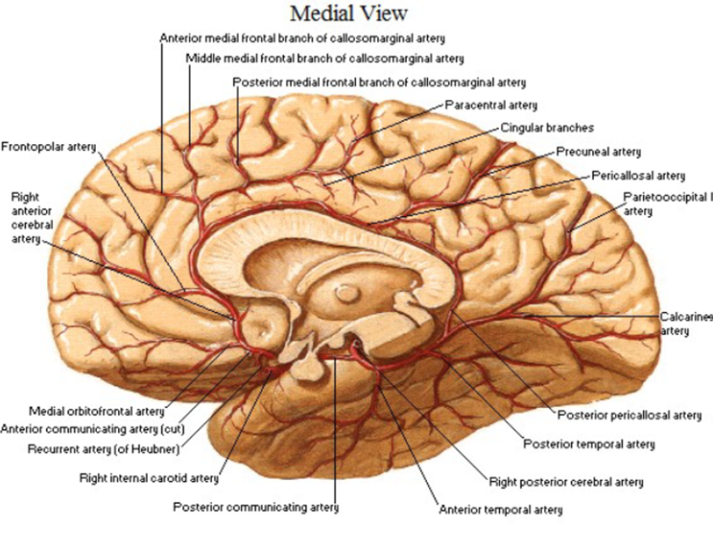

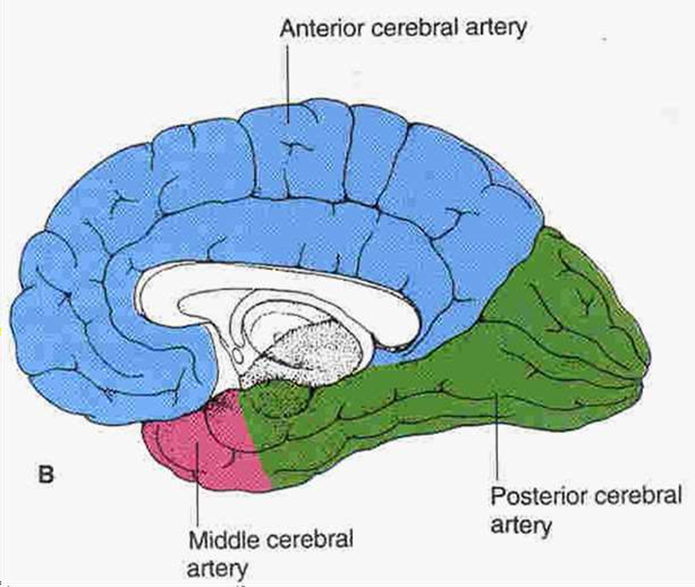

Slide 21
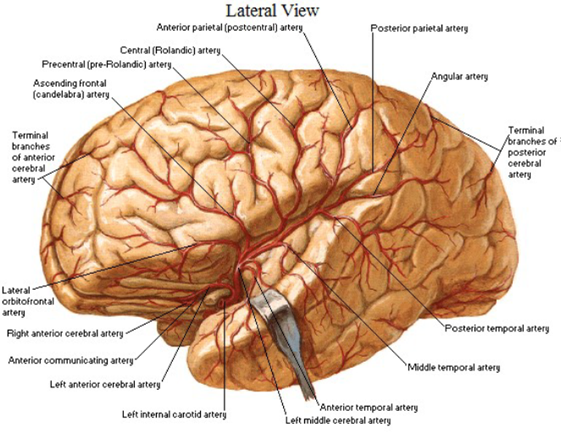

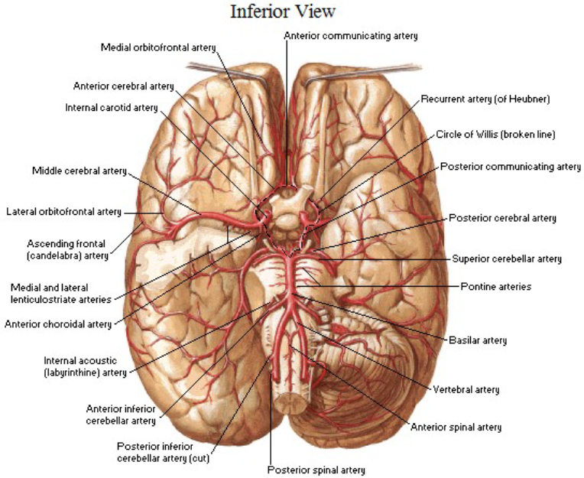
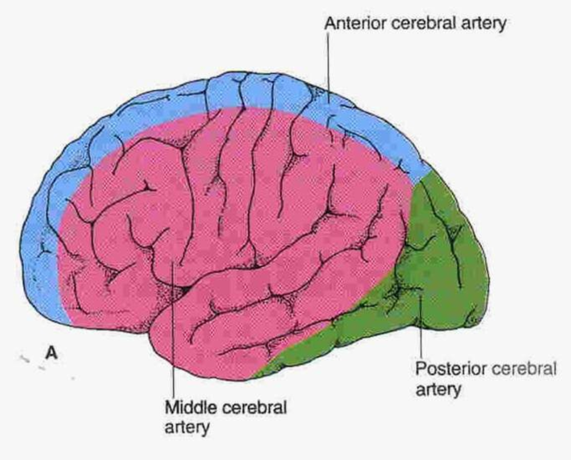

Slide 22


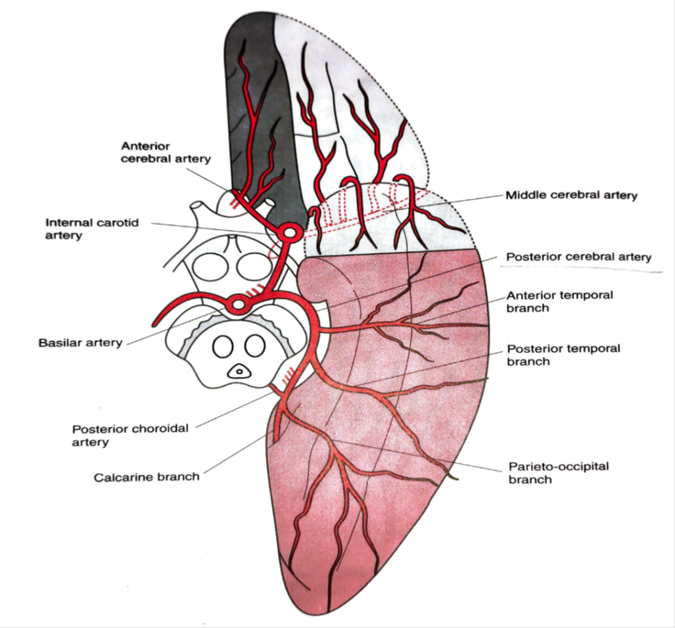

Slide 23
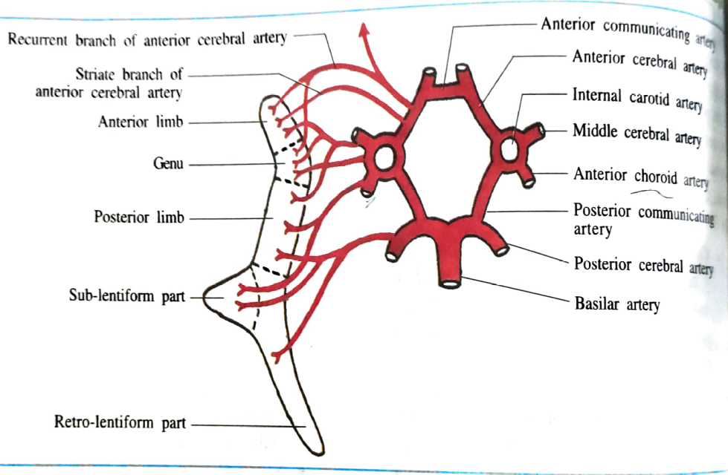
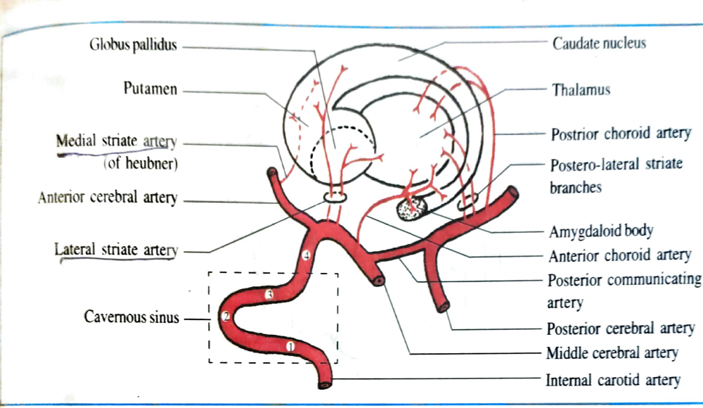
BLOOD SUPPLY OF OTHER PARTS OF BRAIN
CORPUS STRIATUM and INTERNAL CAPSULE
  Striate branch of middle cerebral artery
THALAMUS-
  Central branch of posterior communicating & posterior cerebral artery

Slide 24
MIDBRAIN-
  Posterior cerebral artery,
  Superior cerebellar artery,
  Basilar artery
PONS –
  Pontine branch,
  Superior cerebellar,
  Anterior inferior cerebellar
MEDULLA OBLONGATA
  Branches of vertebral artery
CEREBELLUM-
  Superior cerebellar artery,
  Anterior inferior cerebellar artery,
  Posterior inferior cerebellar artery

Slide 25
VENOUS DRAINAGE OF THE BRAIN
VEINS OF BRAIN
CEREBRAL VEINS
CEREBELLAR VEINS
VEINS OF BRAIN STEM
Veins of the brain are thin walled
Devoid of valve
Most of them drains into dural venous sinuses
Arranged in three sets of vein

Slide 26
CEREBRAL VEINS-
CEREBRAL VEINS
SUPERFICIAL VEINS
SUPERIOR CEREBRAL VEINS
SUPERFICIAL MIDDLE CEREBRAL VEINS
DEEP VEINS
PAIRED INTERNAL CEREBRAL VEINS
INFERIOR CEREBRAL VEIN
PAIRED
BASAL VEINS
GREAT CEREBRAL VEIN

Slide 27
SUPERFICIAL CEREBRAL VEINS
Superior cerebral vein
  - 8-10 in number
  - Collect blood from superolateral surface of hemisphere
  - Drains into superior sagittal sinus
Superficial middle cerebral vein
  Drains blood from lateral surface
  Empties into cavernous sinus
Inferior cerebral vein-
  Drains the inferior surface & ventral part of lateral surface
  Orbital surface- Spheno-parietal + cavernous sinus
  Tentorial surface- superior petrosal+ transvers sinus+ cavernous sinus

Slide 28
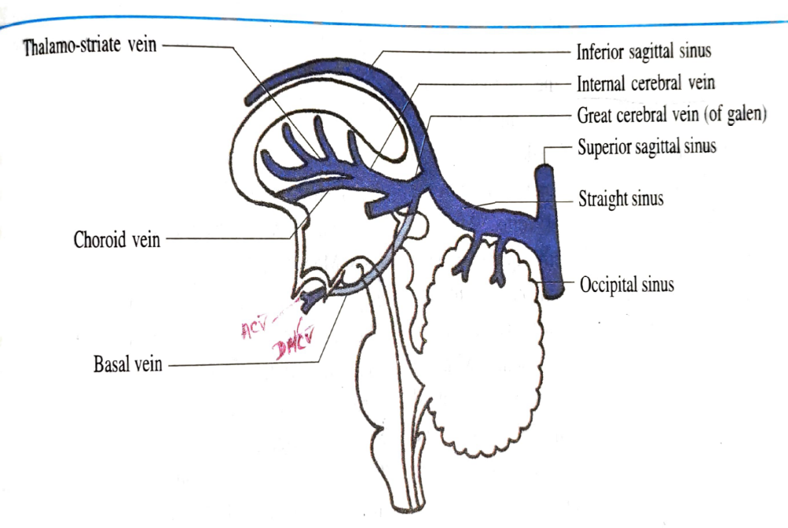
DEEP VEINS
  Paired internal cerebral veins
  Located within the tela choroidea of 3rd ventricle
  Formed by the union of thalmo-striate + choroid veins
  Paired basal veins
  Formed in the region of anterior perforated substance
  By union of anterior cerebral vein + deep middle cerebral vein+ striate veins

Slide 29
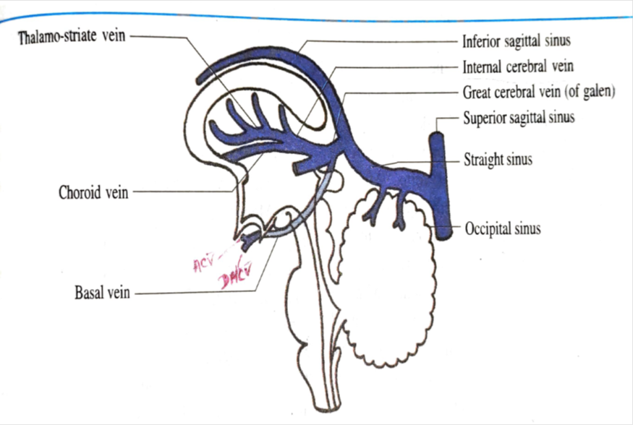
Unpaired great cerebral vein of Galen
  Median venous trunk
  Length- 2cm
  Formed by union of two internal cerebral veins
  It passes upward below & behind the splenium of corpus callosum and terminate at the anterior end of straight sinus
Tributaries –
  Internal cerebral vein
  Basal veins
  Veins from colliculi(tectum of midbrain)
  Veins from cerebellum

Slide 30
VEINS OF BRAIN STEM
  veins of MIDBRAIN- drains into basal veins or great cerebral vein
  Veins of PONS- drains into basal vein , petrosal & transvers sinus
  Veins of MEDULLA- joins the basilar venous plexus & continue with veins of spinal cord
CEREBELLAR VEINS-
  Arranged into superior cerebellar veins & inferior cerebellar veins
  Superior cerebellar veins- drains partly into straight sinus & great cerebral vein partly into transverse & petrosal sinus
  Inferior cerebellar veins- terminate into sigmoid, occipital & inferior petrosal sinus

Slide 31
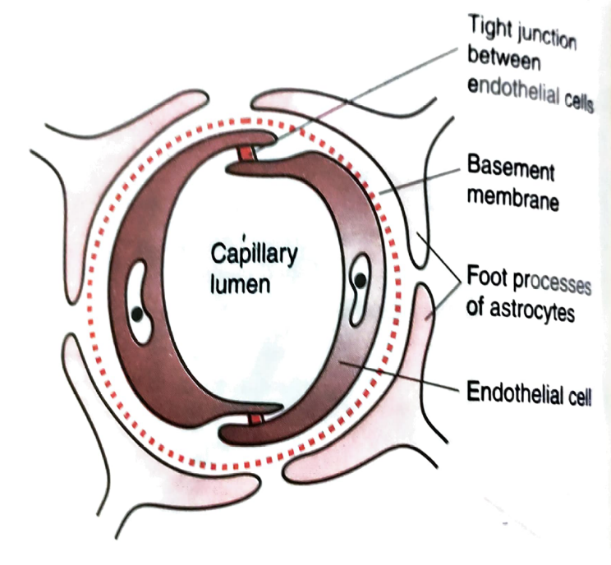
BLOOD BRAIN BARRIER
It protects the neural tissue of brain & spinal cord from circulating toxic substance
It allow selective transport of substance to provides the optimal microenvironment for neurons
In new born BBB is not well developed, so in neonatal jaundice is more common because bile pigments pass through the barrier and damage the basal ganglia producing kernicterus
BBB consist of-
  Non fenestrated Endothelium of blood capillaries
  Basement membrane
  Perivascular foot of astrocytes
  Intercellular space between astrocytes & neuron

Slide 32
BBB is absent in the following areas of brain-
  Pineal body
  Posterior lobe of pituitary gland
  Area postrema
  OVLT (organun vasculosum lamina terminalis)
  Intercolumnar tubercle
  Tuber cinerium of hypothalamus

Slide 33
Thank You

