Slide 1
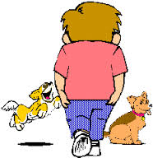
Back sarangdhar kumar department of anatomy rmch,bareilly

Slide 2
Learning objectives
List the major features of vertebrae, sacrum and coccyx
Describe the joints found between typical vertebrae
Describe the structure of the intervertebral disc
Describe the movements between typical vertebrae
Describe the normal curvatures of the vertebral column and their development
Describe scoliosis, kyphosis and lordosis
  Describe the nerve impingements, and their consequences, resulting from disc herniations in the cervical, thoracic and lumbar regions
Describe spondylolysis and spondylolisthesis

Slide 3
Learning objectives
Describe muscles of the back
Describe the extent, attachments and spaces of the spinal meninges
Describe the extent and the contents of the dural sac (lumbar cistern)
Describe the extent and the attachments of filum terminale and denticulate ligaments
Describe between which vertebrae a lumbar puncture (spinal tap) should be performed in an infant and in an adult, and why
List the structures the needle would pierce in a lumbar puncture (spinal tap)
List the arterial supply and venous drainage of spinal cord

Slide 4
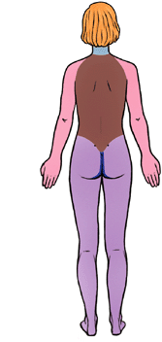
Introduction
Posterior aspect of trunk
  Inferior to neck and superior to buttocks
Consists of
  Skin
  Superficial fascia
  Deep fascia
  Muscles & ligaments
  Vertebral column
  Ribs
  Spinal cord and meninges
Neck
Gluteal
region

Slide 5
Skin & fascia of back
Skin
  Thick and fixed to underlying fascia
Superficial fascia
  Variable amount of fat
Deep fascia
  Dense and membranous

Slide 6
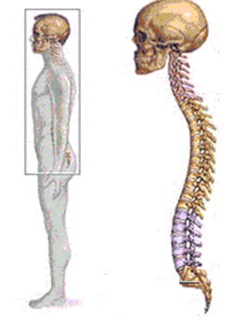
Vertebral column
(spine, spinal column, back bone)

Slide 7
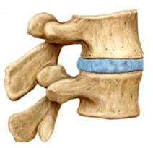
Vertebral column
Central axis of body
Extends from base of skull to apex of coccyx
Length –
  Adult male- 70cm
  Adult female- 60cm
Composition
  Vertebra (3/4)+ intervertebral disc (1/4)
Functions
  Protects the spinal cord
  Supports body weight and transmit it to ground through lower limbs

Slide 8
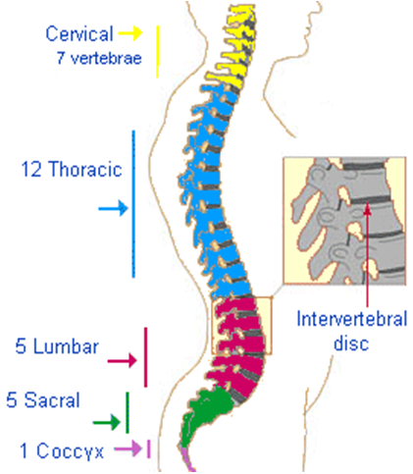
33 vertebrae
Vertebral column consists of 33 vertebrae:
  7 cervical
  12 thoracic
  5 lumbar
  5 sacral
  4 coccygeal
5 sacral vertebrae fused to form one sacrum
4 coccygeal fused to form one coccyx vertebrae

Slide 9
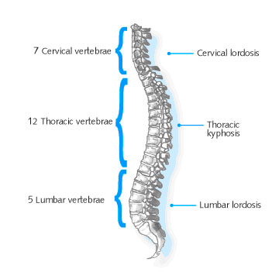
Curvatures of vertebral column
4 curvatures in adult
  Cervical
    Convex anteriorly
  Thoracic
    Concave anteriorly
  Lumbar
    Convex anteriorly
  Sacral
    Concave anteriorly

Slide 10
Primary and secondary curvatures of vertebral column
Primary curvature
  Present since birth
  Thoracic and sacral
  Maintained by difference in height between anterior and posterior part of vertebrae
Secondary curvature
  Develop after birth
  Cervical and lumbar curvature
  Maintained primarily by differences in thickness between anterior and posterior part of intervertebral disc
  Cervical curve develops when child start supporting their head(4-9 month after birth). Lumbar curve appear when child assumes upright posture(12-18 month) after birth/ walking

Slide 11
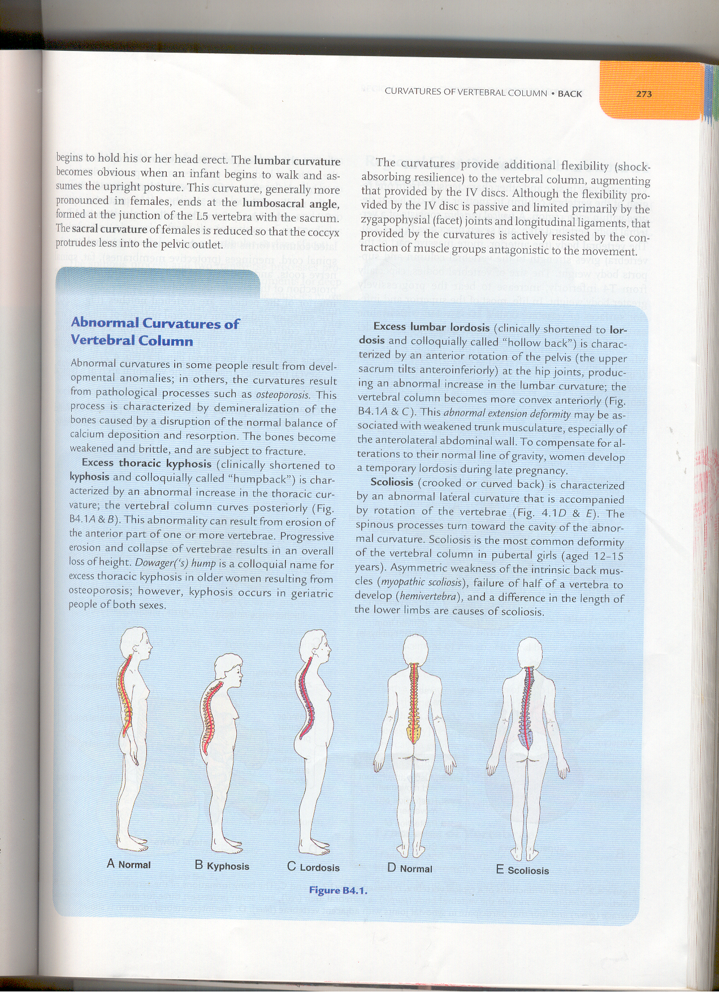
Abnormal curvature of vertebral column
Kyphosis – forward bending, due to exaggeration of thoracic curvature
Lordosis - due to exaggeration of lumbar curvature
Scoliosis- lateral deviation, most commonly in thoracic region

Slide 12
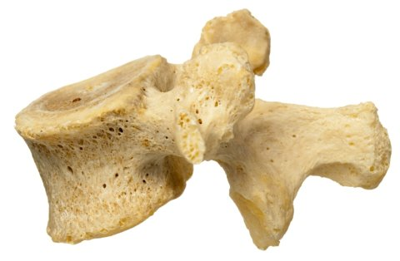
vertebra

Slide 13
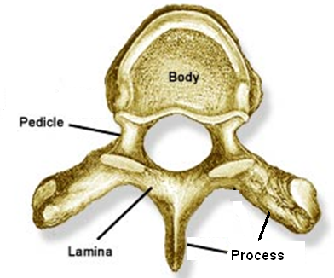
Structure of vertebra
Body
Pedicle
Lamina
Process
Foramina
vertebral arch

Slide 14
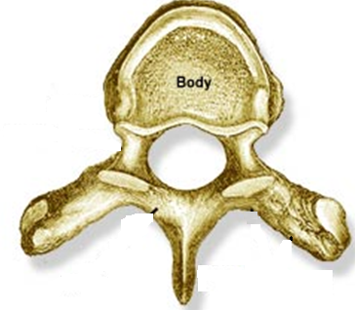
Body
  Rounded from side to side
  Flat upper and lower surfaces
  Upper and lower surfaces are attached to adjoining vertebra by intervertebral disc

Slide 15
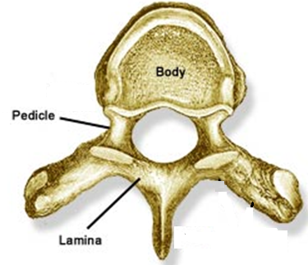
Pedicles
  Short, stout cylindrical processes
  Project posteriorly from vertebral body
  2 - right and left
Lamina
  Flat plates of bone
  2 - right and left

Slide 16
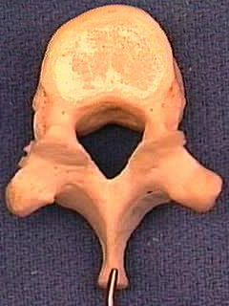
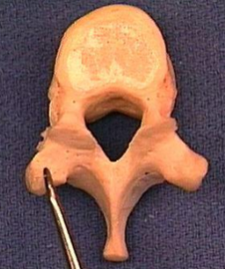
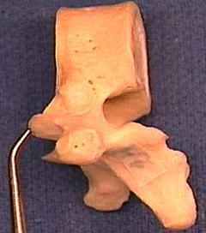
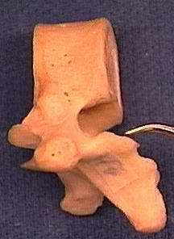
Process of vertebra (7)
1 spinous process
2 transverse process
2 superior articular process
2 inferior articular
process
Arise from vertebral arch of a typical vertebra

Slide 17
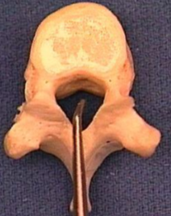
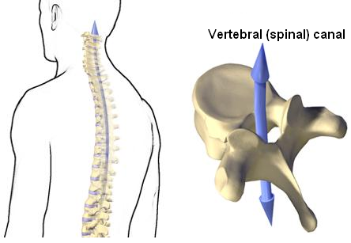
Vertebral foramen / canal
Between body and vertebral arch
      A series of vertebral foramina - vertebral canal which contain spinal cord, its meninges,
      associated vessels and nerve roots

Slide 18
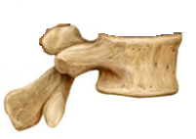
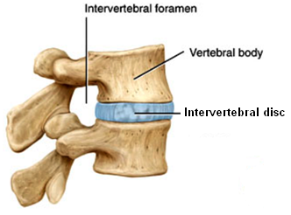
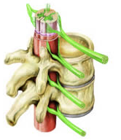
Vertebral notches and intervertebral foramina
Superior vertebral notch
Pedicle
Inferior vertebral notch
Intervertebral foramina-located between inferior and superior surfaces of pedicles of adjacent vertebrae
    Transmit roots of spinal nerve, accompanying vessels and contain dorsal root ganglia

Slide 19
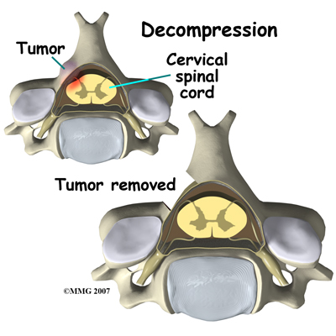
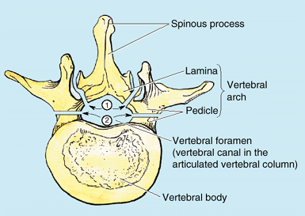
Laminectomy
Surgical excision of one or more lamina
Relieve pressure on the spinal cord or nerve roots
  Commonly caused by tumor, herniated IV disc, or bony hypertrophy (excess growth)

Slide 20
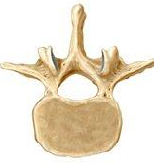
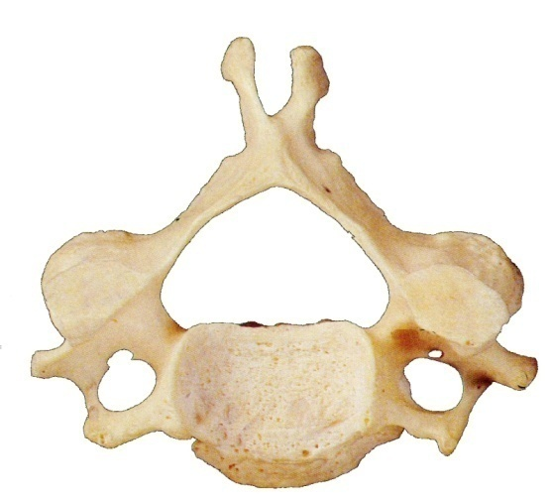
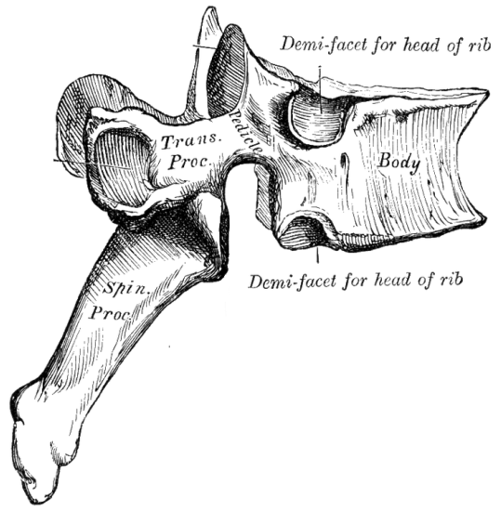
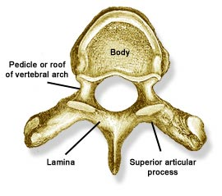
Regional characteristic of vertebrae
Lumbar
Cervical
Thoracic
Costal facets on side of vertebral bodies
Heart shaped body
Circular vertebral foramen
Large kidney shaped body
A small tubercle on transverse process (accessory process)
Mamillary process (rough elevation on posterior border of superior articular process)
Foramen transversarium
Spine is short and bifid
Vertebral foramen is larger than the body

Slide 21
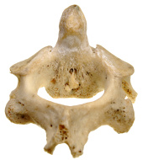
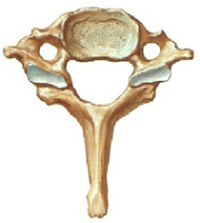
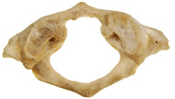
Atypical cervical vertebra
(C1, C2, C7)
Anterior tubercle
Posterior arch
Dens
Lateral
mass
Anterior arch
Posterior tubercle
C2
Dens (odontoid process)
articulates anteriorly with ant. arch of C1 and posteriorly with transverse ligament of C1
C7
Long spinous process
usually not bifid
C1
No body
No spinous process
Consists of two lateral masses connected by ant. and post. arches

Slide 22

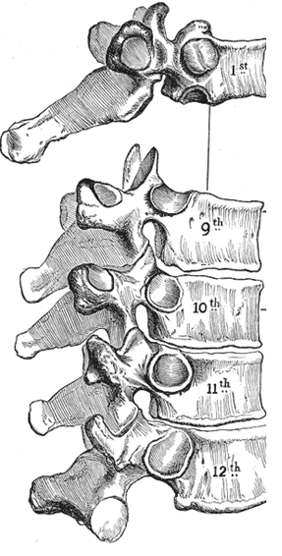
Atypical thoracic vertebrae
(T1, T9, T10, T11, T12)
Typical
T1
  Superior costal facet is complete, inferior is demi
T9
  Superior costal facet is demi, inferior is absent
T10
  Single complete superior costal facet on each side
T11
  Single complete superior costal facet on each side extending on the upper part of pedicle
T12
  Single complete superior costal facet on each side extending on the lower part of pedicle

Slide 23
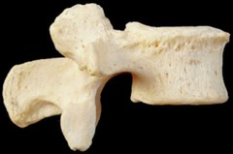
Atypical lumbar vertebrae
(L5)
L5 is atypical lumbar vertebra
  Base of transverse process is attached to whole thickness of pedicle

Slide 24
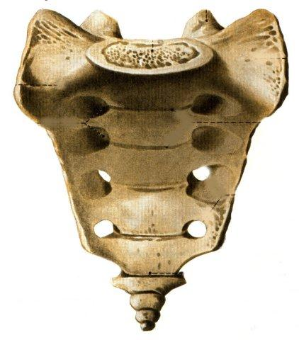
Sacrum
Promontory
Large, triangular bone
Composed of 5 fused sacral vertebra
Base
  Directed upward
  Body and transverse process of S1
  Projecting anterior margin of body - promontory
  Transverse process - ala
Apex
  Directed downward
Ala
Ala

Slide 25
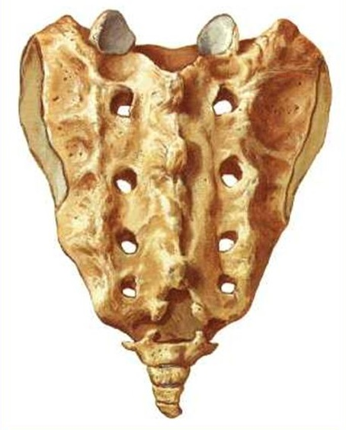
Sacrum
(anterior and posterior surface)
Promontory
Ala
Ala
Pelvic (anterior) surface
    4 anterior sacral foramina
    Anterior rami exit
Dorsal (posterior) surface
    4 posterior sacral foramina
    Posterior rami exit
    Median, intermediate (medial) and lateral sacral crest
    Inferior to median sacral crest there is an inverted U shaped sacral hiatus
Median sacral crest - fused rudimentary spinous processes, Intermediate sacral crests - fused articular processes
Lateral sacral crests – fused transverse processes

Slide 26
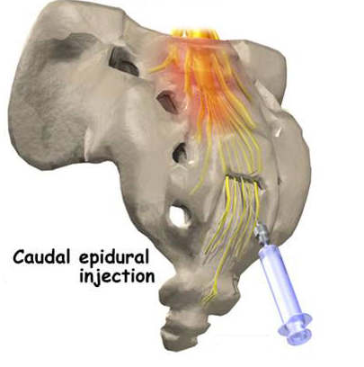
Sacrum hiatus and cornua
Results from absence of lamina + spinous process of S5
Margin of sacral hiatus – sacral cornua
Structures passing through sacral hiatus
  5th sacral nerve
  Coccygeal nerve
  Filum terminale
Caudal epidural anesthesia is given through sacral hiatus
Sacral cornua
Caudal (epidural) anesthesia during labor and child birth is used to block the spinal nerves in the epidural space by injecting local anesthetic agents via the sacral hiatus located between the sacral cornua

Slide 27
Coccyx
    Small triangular bone
    Formed by union of 4 coccygeal vertebrae
Coccyx

Slide 28
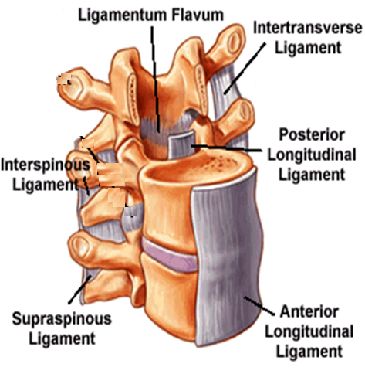
Ligaments of vertebral column
Ant. Longitudinal lig
Post longitudinal lig;
Ligamentum flavum (connects the lamina of two adjacent vertebra)
Interspinous lig
Supraspinous lig
Ligamentum nuchae – triangular median fibrous septum extending from external occipital protuberance to C7
Thickened supraspinous ligament

Slide 29
Joints of vertebral column

Slide 30
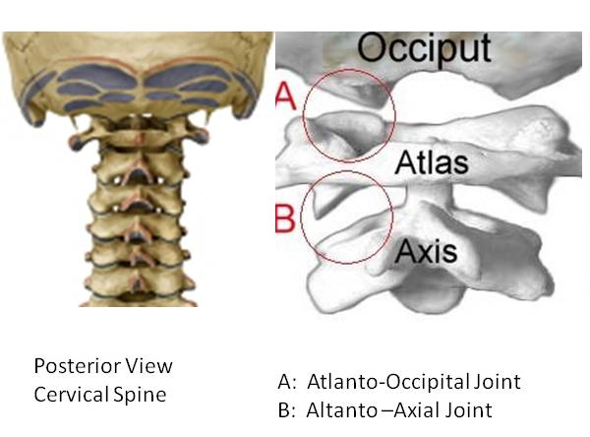
Atlanto-occipital joint
Condylar synovial joint
Articular surface
  Occipital condyle above
  Facets on the superior surfaces of lateral masses of atlas below

Slide 31
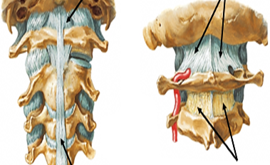
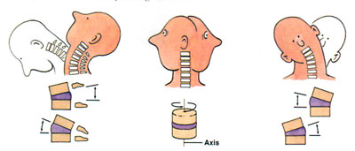
Ligaments and movement
Ligaments
  Fibrous capsule
  Anterior atlanto-occipital membrane (lig.)
    Continuation of anterior longitudinal ligament
    Connects anterior arch of atlas to anterior margin of foramen magnum
  Posterior atlanto-occipital membrane (lig.)
    Continuation of ligamentum flavum
    Connects posterior arch of atlas to posterior margin of foramen magnum
Movements
  Flexion, extension
  (“yes” movement), lateral flexion, no rotation
Anterior atlanto-occipital membrane
Posterior atlanto-occipital membrane
Occipital bone
Anterior longitudinal ligament
Ligamentum flavum

Slide 32
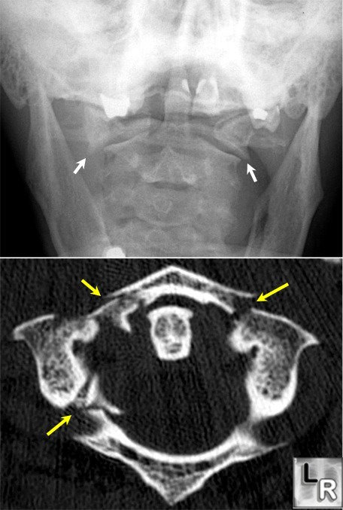
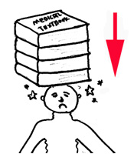
Compression fracture
Jefferson’s fracture( # of C1)
In the cervical region, with the neck straight, an excessive vertical force applied from above will cause ring of atlas to be disrupted

Slide 33
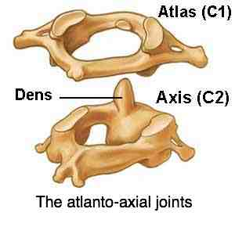
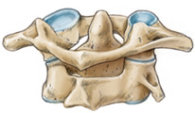
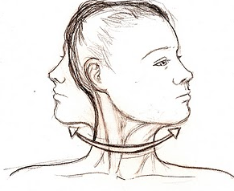
Atlantoaxial joint
3 synovial joint
  One median atlantoaxial joint
    Between dens (odontoid process) and anterior arch of atlas
    Pivot synovial joint
  Two right and left lateral atlantoaxial joint
    Between facets of C1 and C2
    Plane synovial joint
Movement
  Side to side
  (called “no” movement)

Slide 34
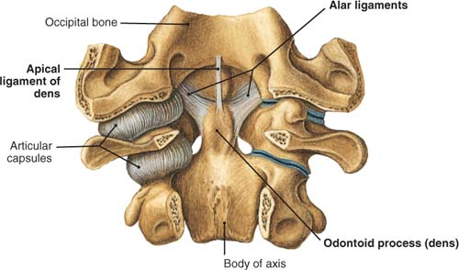
Ligaments
Apical ligament
  Apex of dens to anterior margin of foramen magnum
Alar ligament
  One each side of apical lig.
  Connect odontoid process to the margin of foramen magnum
Notes:
Present most anterior

Slide 35
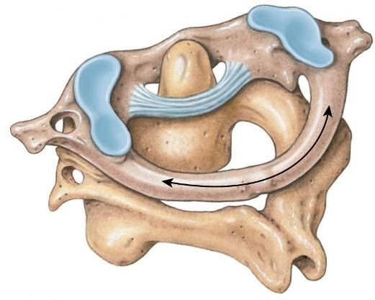
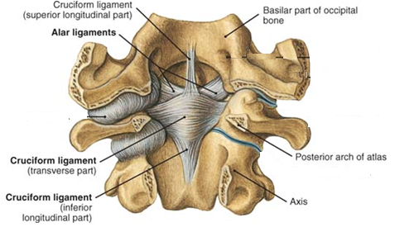
Cruciate ligament
  Transverse part
    Connect inner margin of lateral mass
    Pass posterior to odontoid process
    Binds odontoid process to anterior arch of atlas
  Longitudinal (vertical) part
    Posterior surface of body of axis to anterior margin of foramen magnum

Slide 36
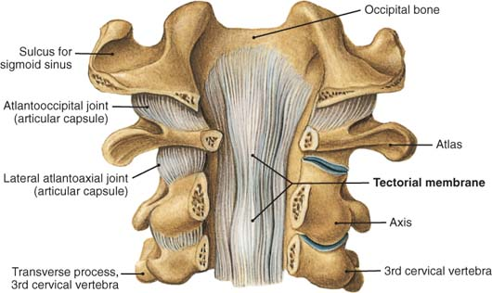
Membrana tectoria
  Upward continuation of posterior longitudinal ligament
  Attached above to occipital bone just within foramen magnum
  Covers the apical, alar, and cruciate ligaments
Notes:
Present most posterior

Slide 37
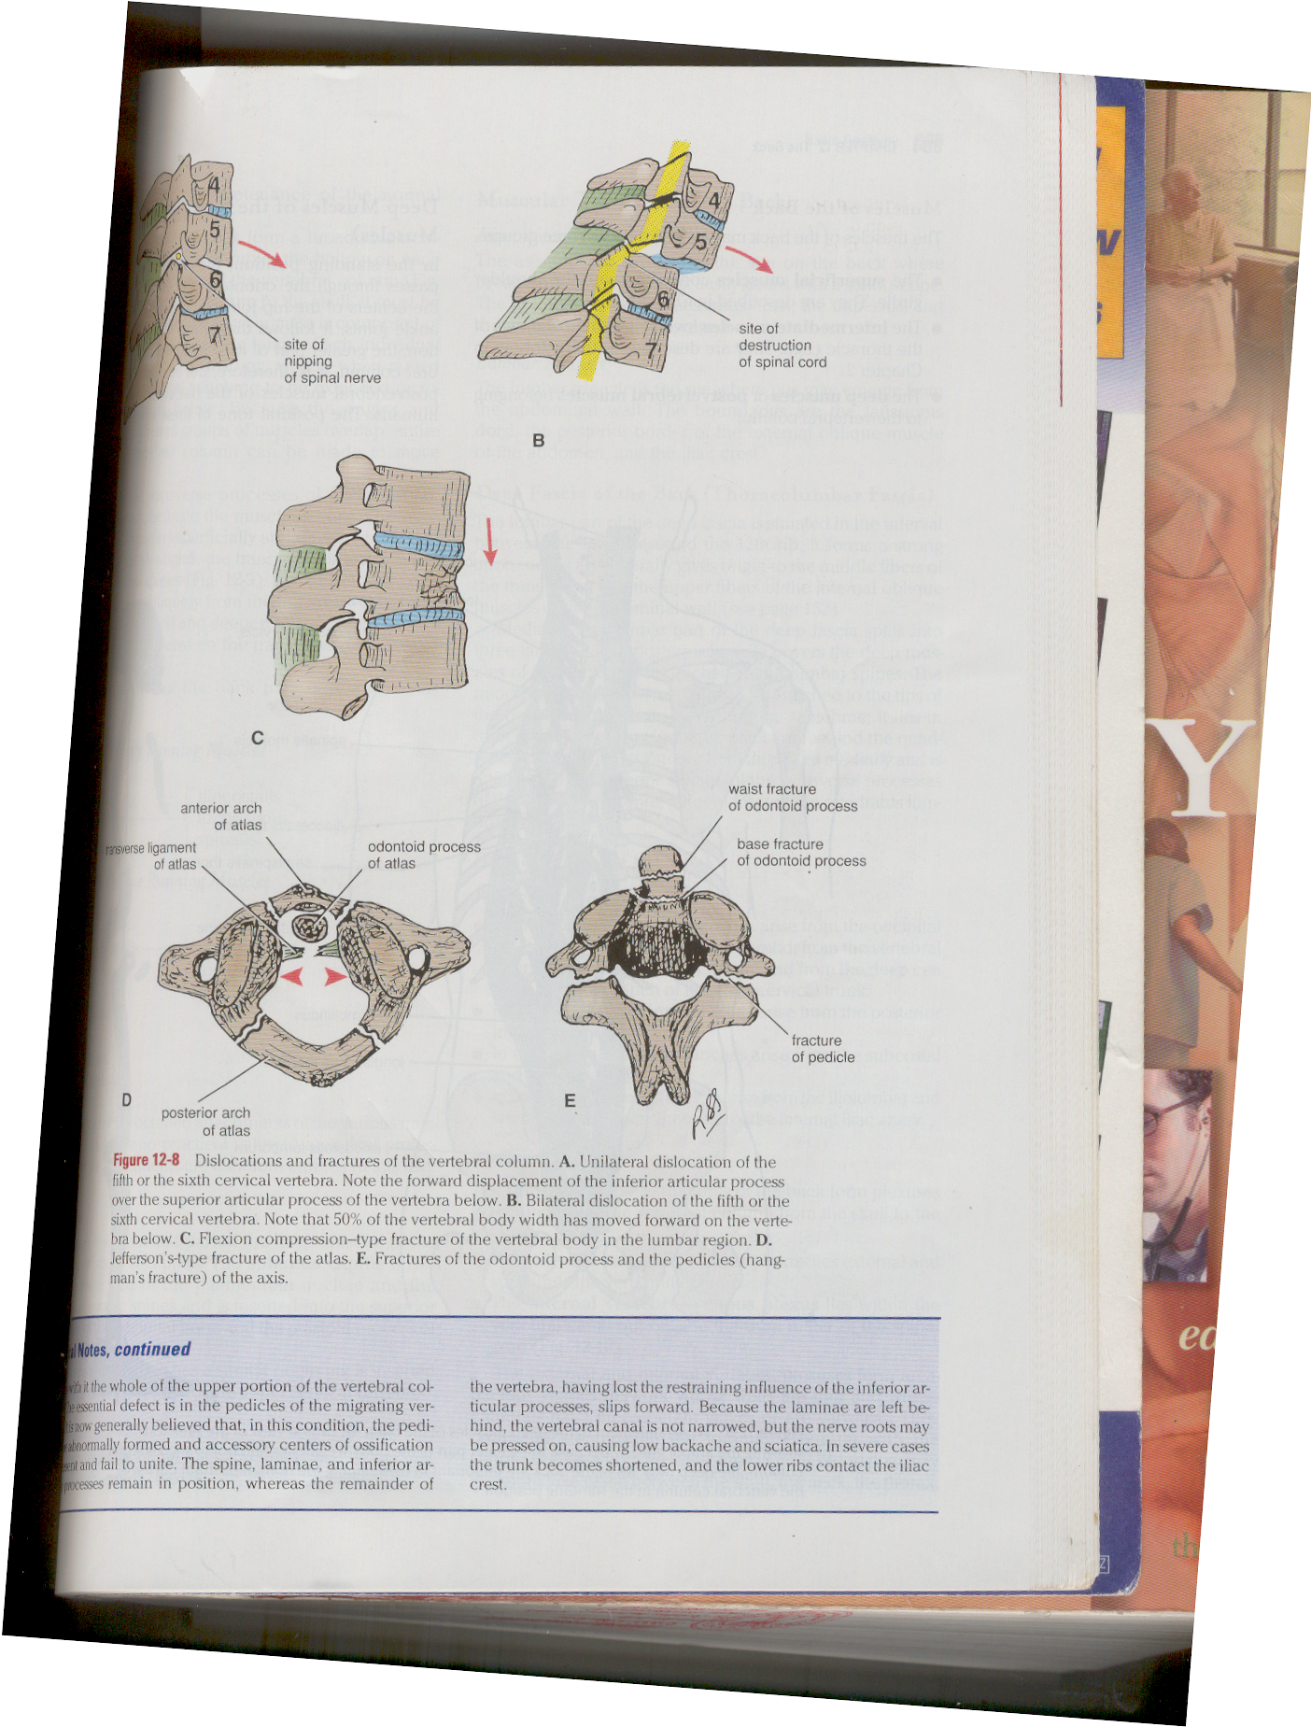
Hangman’s #
Fracture of dens and the pedicles of C2
Occur in hanging

Slide 38
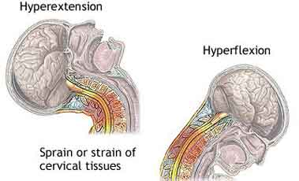
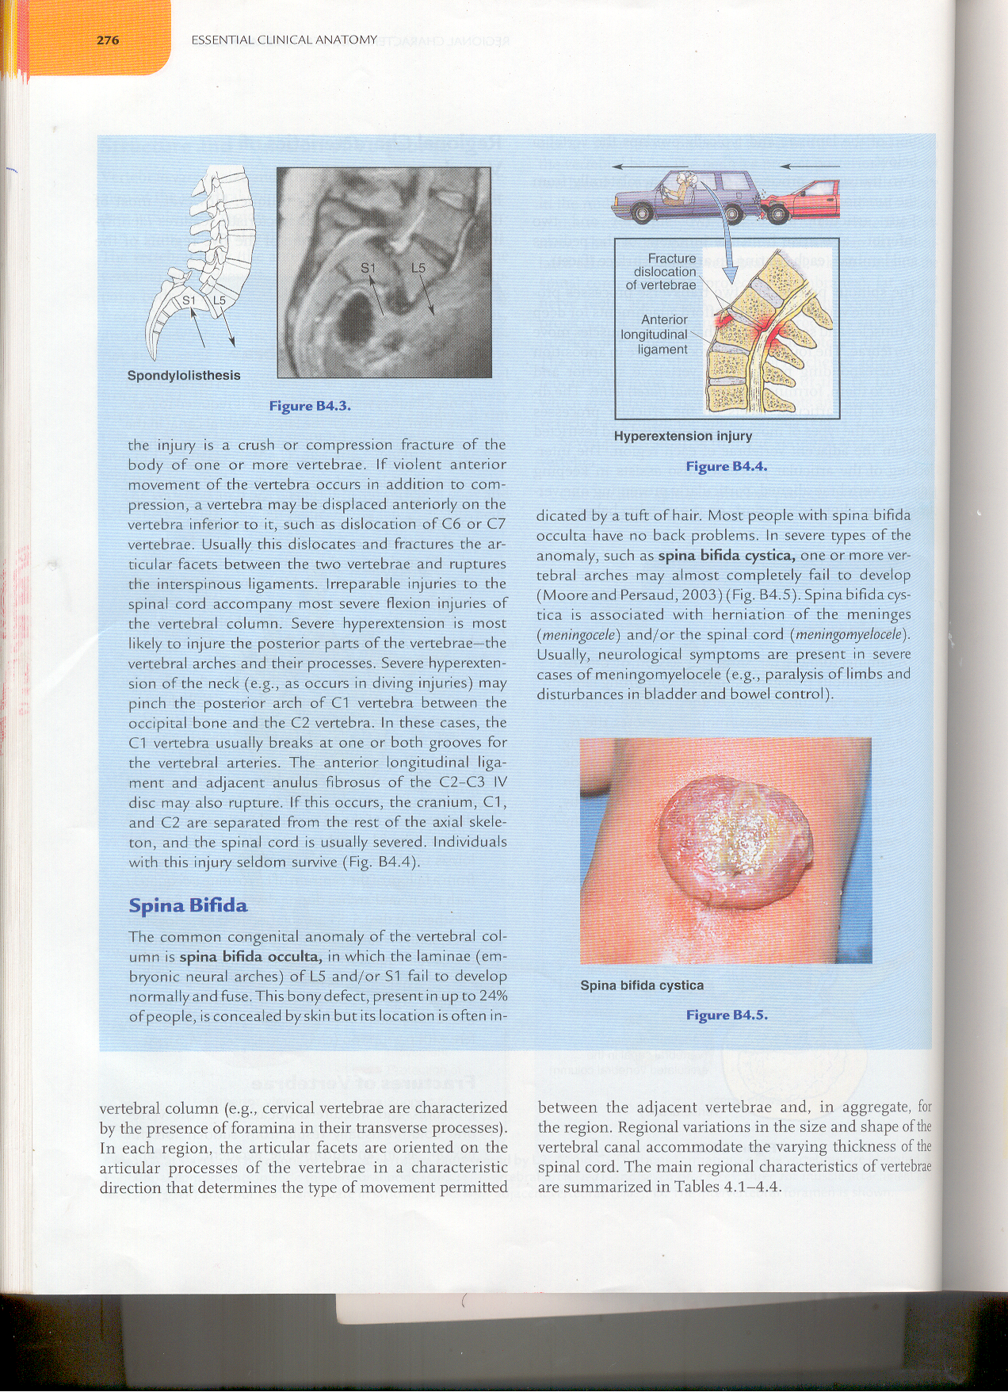
Whiplash injury of neck
Produced by a force that drives the trunk forward while the head lags behind, causing the head to hyperextend and neck to hyperflex rapidly
Occur due to hyperextension followed by hyperflexion of neck rapidly
Occur in rear-end mobile collision
Occur frequently at the junction of C4&C5 vertebra; C1-C4 act as lash and C5-C7 vertebra act as the handle of whip

Slide 39

Some other joints between two vertebra
Zygapophysial joint (facet joint)
  Plane synovial joint
  Superior articular process of one vertebra and inferior articular process of vertebra directly above it
  Prevent one vertebrae from slipping anteriorly on the vertebra below
Secondary cartilaginous joint
  Between vertebral body

Slide 40


Intervertebral disc
Fibrocartilagenous disc between bodies of two vertebra
Functions as a shock absorber
2 parts
  Nucleus pulposus
    Gel like substance situated in the central portion of intervertebral disc
  Annulus fibrosus
    Consists of concentric layer of fibrous tissue and fibrocartilage

Slide 41


Disc prolapse
(herniated intervertebral disc)
In disc prolapse, nucleus pulposus herniate posterolaterally, usually rupture annulus fibrosus and compress the root

Slide 42
Spina bifida
Due to imperfect fusion or nonunion of the vertebral arches
Spina bifida occulta
  Involve only the bony vertebral arches, leaving the spinal cord intact
  Bony defect is covered by skin with plenty of hairs
  No neurological deficits occur
Spina bifida cystica (meningocele)
  Meninges comes out through the gap, but spinal cord lie at its normal position
Meningomyelocele
  Meninges and spinal cord both comes out through the gap

Slide 43




Meningocele

Slide 44

Spondylitis
(ankylosing spondylitis)
Inflammation of a vertebra
Cause back pain and stiffness
May grow or fuse together resulting in a rigid spine
Severe disease may lead to poor posture and deformities
Zygapophysial joint

Slide 45



Spondylolysis and Spondylolisthesis
Fracture of interarticular part of vertebral lamina
Fracture dislocation

Slide 46

Arterial supply of vertebrae
Segmental arteries
  Vertebral
  Ascending cervical arteries in neck
  Posterior intercostal arteries
  Subcostal
  Lumbar arteries
  Iliolumbar
  Lateral & medial sacral arteries
Notes:
Vertebrae is supplied by periosteal and equatorial branches of major cervical and segmental arteries and their spinal branches. Spinal branches originate from vertebral and ascending cervical artery in neck, posterior intercostal artery in thorax, subcostal and lumbar artery in abdomen, iliolumbar, lateral & medial sacral in pelvis

Slide 47

Venous drainage
Internal vertebral venous plexus
External vertebral venous plexus
These plexuses communicate through intervertebral foramina and drain into segmental veins – vertebral, intercostal, lumbar & sacral veins
Basivertebral veins form within vertebral bodies → drain into external & internal vertebral venous plexuses
Internal vertebral
venous plexus
Segmental vein
Basivertebral vein
External vertebral
venous plexus

Slide 48

Nerve supply
Zygapophysial joints and posterior part
  Posterior rami of spinal nerves
Rest of vertebral column
  Recurrent meningeal branch of anterior rami of spinal nerves
  Recurrent meningeal branches of anterior rami of spinal nerves - as spinal nerves exit IV foramina, most of meningeal branches run back through foramina into vertebral canal

Slide 49
Soft tissues of back
(muscles of back)
3 groups
Superficial, intermediate , deep

Slide 50

Superficial muscles
(Superficial extrinsic back muscles)
Part of upper limb
  Trapezius
  Latissimus dorsi
  Rhomboid major
  Rhomboid minor
  Levator scapulae

Slide 51


Intermediate muscle
(Intermediate extrinsic back muscles)
Serratus posterior superior
  Origin
    Spine of C7 – T3
  Insertion
    2,3,4,5 ribs near angles
  Function
    Elevate ribs during deep inspiration
Serratus posterior inferior
  Origin
    Spine of T11 - L2
  Insertion
    9,10, 11, 12 ribs near angles
  Function
    Depress ribs during deep during forced expiration
Serratus posterior
superior
Serratus posterior
inferior
These muscles are respiratory muscle and are innervated by intercostal nerves

Slide 52
Deep muscles
(intrinsic muscles of back)
Splenius-capitis, cervicis
Erector spinae-3 column
  Spinalis
  Longissimus
  Iliocostalis
  All 3 column extend vertebral column when both side work together. If only one side is active they cause lateral bending
Transversospinal group of muscle-lie deep to erector spinae
  Produce rotational and lateral bending between adjacent vertebra, also stabilize vertebral column
  Include semispinalis, multifidus, rotators
Supplied by dorsal rami

Slide 53


Splenius muscles
Erector spinae muscle
Iliocostalis
Longissimus
Spinalis
Arise from midline & extend superolaterally
Splenius cervicis - cervical vertebrae
Splenius capitis - cranium
Lie in a “groove” on each side of vertebral column between spinous processes centrally & angles of ribs laterally

Slide 54

Transversospinal group of muscle
Occupy “gutter” between spinous & transverse processes
Originate from transverse processes of vertebrae & pass to spinous processes of more superior vertebrae
  Group consists of:
    Semispinalis (capitis, cervicis & thoracis) - run parallel to long axis of neck
    Multifidus
    Rotatores

Slide 55

Minor deep muscles
Interspinales
Intertransversarii
Levatores costarum - arise from the ends of the transverse processes of the seventh cervical and upper eleven thoracic vertebrae, insert into the outer surface of the rib immediately below the vertebra from which it takes origin, between the tubercle and the angle.

Slide 56

Contents of vertebral canal
Spinal cord
Spinal nerve roots
Spinal meninges
Neurovascular structures that supply them

Slide 57

Spinal cord
Downward continuation of medulla oblongata
In adults: 42 – 45cm in length
Extends from foramen magnum to the level of L1 - L2 vertebra in adult
Lie in upper 2/3 of vertebral column
Notes:
Ends at L3 vertebra in new born

Slide 58


Conus medularis, filum terminale, cauda equina
Tapering lower end of spinal cord - conus medullaris
Below conus medullaris pia mater continue downward as filum terminale
Dura and arachnoid extend up to S2
Filum terminale surrounded by roots of lumbar, sacral, coccygeal spinal nerve roots - cauda equina

Slide 59

Enlargements
Cervical enlargement
  C4 -T1/2 segments of spinal cord
  Anterior rami of spinal nerves arising from it form brachial plexus
Lumbosacral (lumbar) enlargement
  T11 - S1/2 segments of spinal cord
  Anterior rami of spinal nerves arising from this enlargement make up lumbar & sacral plexuses

Slide 60

Spinal nerves
Anterior root/lets + posterior root/lets (spinal ganglion) → trunk of spinal nerve → ventral + dorsal rami
Spinal cord segment
  Portion of spinal cord giving rise to rootlets & roots that ultimately form one bilateral pair of spinal nerves

Slide 61

31 pairs of spinal nerve
  8 – cervical
  12 – thoracic
  5 – lumbar
  5- sacral
  3-4 coccygeal which unit to from one coccygeal nerve)
All cervical spinal nerves exit through the intervertebral foramina above corresponding vertebra, except 8th
All other spinal nerves exit below corresponding vertebra

Slide 62

Meninges
Dura mater
Arachnoid mater
Pia mater
  Denticulate ligament is lateral extension of pia through arachnoid, attaching to inner surface of duramater
  21 pair in number, help to suspend spinal cord

Slide 63
Spaces
Epidural space
  Space outside dura
  Contain fat, internal vertebral venous plexus
Subdural space
  Space between dura and arachnoid
Subarachnoid space
  Space between arachnoid and pia
  Contain CSF

Slide 64

Lumbar puncture
Usually done between L3&L4 or L4&L5
Done for measurement of CSF pressure and taking out CSF for bacteriological and biochemical examinations
Allows introduction of anesthesia, drugs or radiopaque material into the subarachnoid space
  The needle pass through skin, superficial fascia, supraspinous ligament, interspinous ligament, ligamentum flavum, areolar tissue, duramater and arachnoid mater

Slide 65

Epidural block
  Anesthetic agent is introduced in extradural space
  Blocks the spinal roots after they exit the dural sac
  Patients loss sensation below level of block
  An anesthetic agent can also introduced through sacral hiatus in sacral canal -caudal epidural block.
  It is used in operations in sacral region, including anorectal surgery and culdoscopy .Obstetrician used it to relive pain during delivery

Slide 66

Blood supply of spinal cord
Arterial supply
  3 longitudinal arteries
    1 anterior spinal artery
    2 posterior spinal arteries
  Segmental (radicular) arteries
    Branches of vertebral, ascending cervical, deep cervical, intercostal, lumbar & lateral sacral arteries
Venous drainage
  Follow the arteries
  Anterior and posterior spinal arteries run longitudinally from medulla of brainstem to conus medullaris of spinal cord
  Anterior spinal artery - formed by union of branches of vertebral arteries, runs inferiorly in anterior median fissure and supply approximately 2/3rd of cross-sectional area of spinal cord
  Posterior spinal artery - Branch of either vertebral artery or posteroinferior cerebellar artery

Slide 67

Artery of adamkiewicz
(arteria radicularis magna)
Typically arises from a left posterior intercostal artery at the level of the 9th to 12th posterior intercostal artery , and supplies the lower two thirds of the spinal cord (lumbar and sacral cord)
When damaged or obstructed, it can result in anterior spinal artery syndrome with loss of urinary and fecal continence and impaired motor function of the legs

Slide 68
THANK YOU

