Slide 1
AUTONOMIC NERVOUS SYSTEM
DR. SARANGDHAR KUMAR
DEPARTMENT OF ANATOMY
RMCH, BAREILLY

Slide 2
Deals with any changes in internal enviornment
Controls the automatic (involuntary) functions of the body (glands, cardiac and smooth muscle)
Autonomic Nervous System is divided into:
  Sympathetic
  Parasympathetic
  Enteric (gastrointestinal tract)

Slide 3
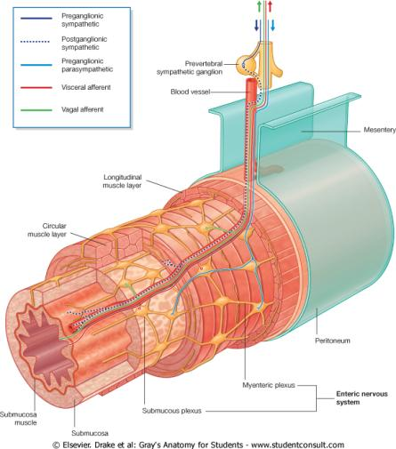
Enteric Nervous system
Collection of neurons embedded within the wall of the entire gastrointestinal tract and its derivatives
Contained within 2 plexus : Myenteric (Auerbach’s) + Submucosal (Meissner’s)
This system controls gastrointestinal motility + secretions

Slide 4
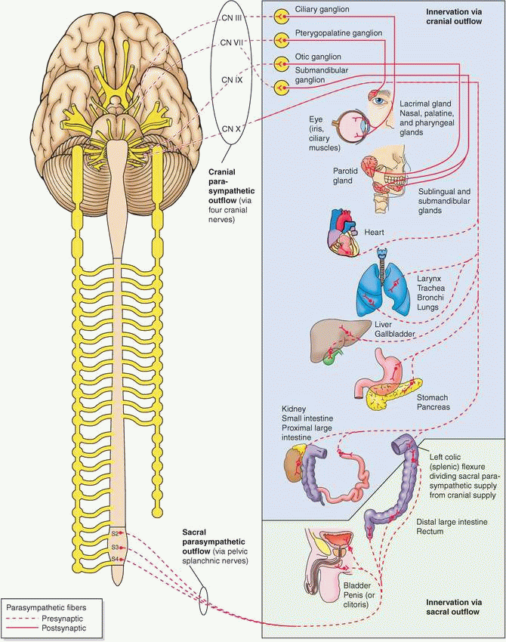
Divisions of ANS
Sympathetic
  Thoracolumbar
  Originate from the lateral horn of T1 to L2 (L3) segments of spinal cord
Parasympathetic
  Craniosacral
    III, VII, IX, and X have parasympathetic fibers
    S2, 3, 4, segments of spinal cord
Each division possesses motor & sensory components

Slide 5
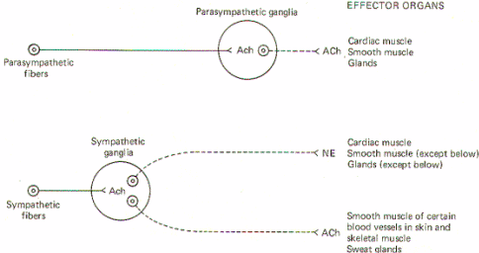
Structure of autonomic neurons (Preganglionic/postganglionic neurons)
Mostly 2 neuron pathway
1. Preganglionic nerve fibers 2. Post ganglionic nerve fibers

Slide 6
SYMPATHETIC NERVOUS SYSTEM
PREGANGLIONIC FIBERS
GANGLIA
POSTGANGLIONIC FIBERS

Slide 7
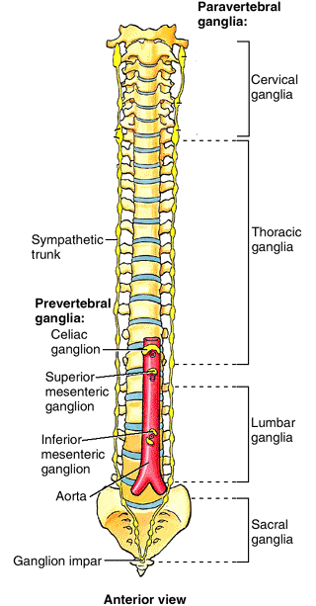
Ganglia of sympathetic nervous system
Two
  Paravertebral (lateral )
  Prevertebral (collateral)

Slide 8
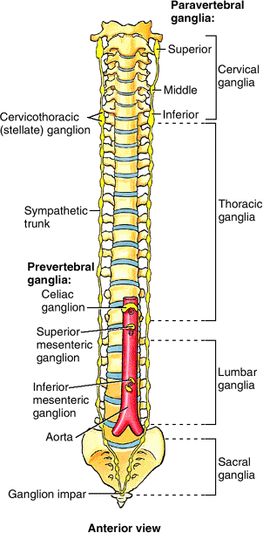
Paravertebral ganglia
Extend from base of skull (superior cervical) to tip of coccyx
Form right and left sympathetic trunk (chains)
At the tip of coccyx right and left chain unite and form a large ganglia -ganglion impar
In early fetal life their number correspond to spinal nerve
Adult
  Cervical ganglia - 3 ganglia
  Thoracic ganglia – 11- 12 ganglia
  Lumbar ganglia - 4 -5 ganglia
  Sacral ganglia - 4 ganglia

Slide 9
Prevertebral ganglia
Around main branches of abdominal aorta
  Celiac ganglia
  Superior mesenteric ganglia
  Inferior mesenteric ganglia

Slide 10
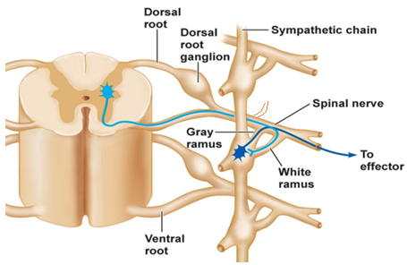
Course of a sympathetic fibers
Lateral grey horn
Ventral root → trunk → ventral ramus of spinal nerves
White rami communicans [preganglionic fibers]
Grey rami communicans [Postganglionic fibers]
Ventral ramus & dorsal ramus
Enter and synapse immediately with a postsynaptic neuron of the paravertebral ganglion at that level

Slide 11
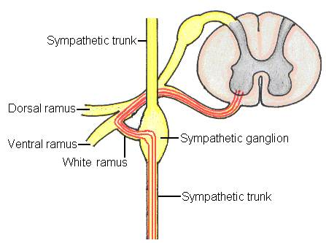
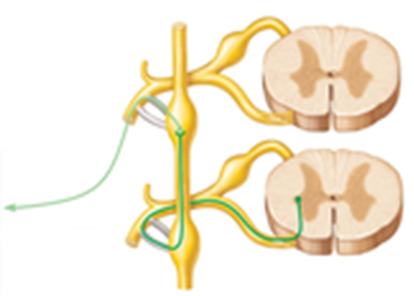
Fibers ascend or descend in the sympathetic trunk to synapse with a postsynaptic neuron of a higher or lower paravertebral ganglion
Target organs

Slide 12
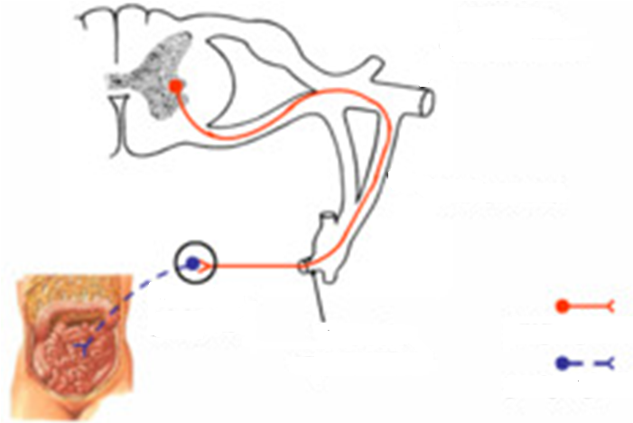
Pass through the sympathetic trunk without synapsing, continuing as splanchnic nerve to reach the prevertebral (preaortic )ganglia
Paravertebral
gangla
Prevertebral
ganglia
Splanchnic
nerve
Preganglionic fibers
Postganglionic fibers

Slide 13
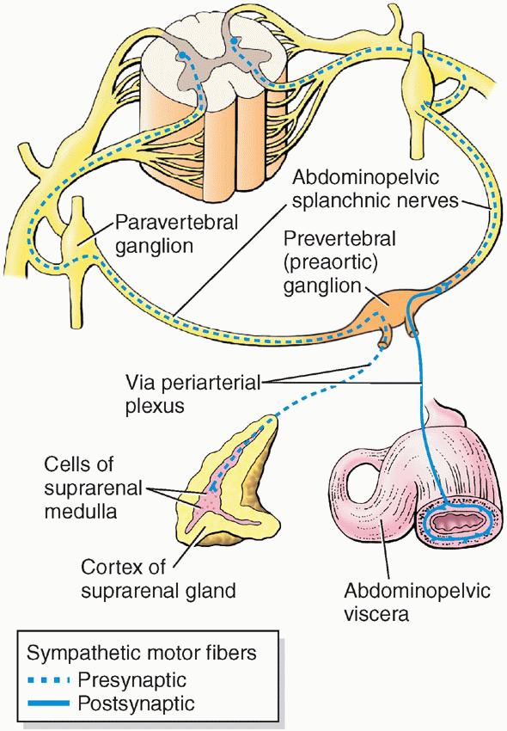
Exception
Fibers going to supply suprarenal medulla pass through celiac prevertebral ganglia without synapsing
Terminate directly on cells of medulla

Slide 14
Parasympathetic nervous system
Notes:
Cranial outflow supply viscera of head, thorax, most of abdomen (upto left colic flexure)
Sacral outflow supply descending colon, sigmoid colon, rectum and other pelvic visceras

Slide 15
Cranial outflow supply viscera of head, thorax, most of abdomen (upto left colic flexure)
Sacral outflow supply descending colon, sigmoid colon, rectum and other pelvic visceras

Slide 16
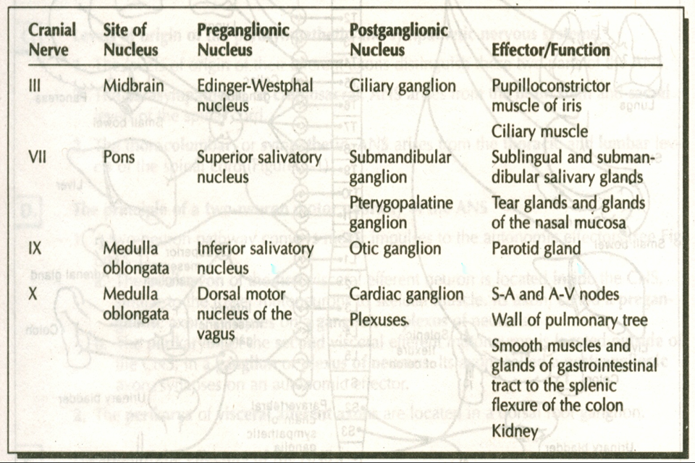
Parasympathetic nervous system

Slide 17
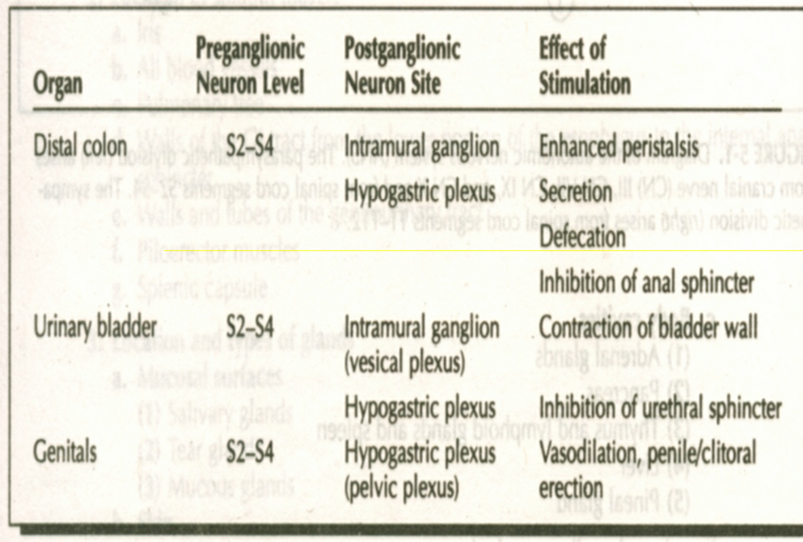
Parasympathetic nervous system

Slide 18
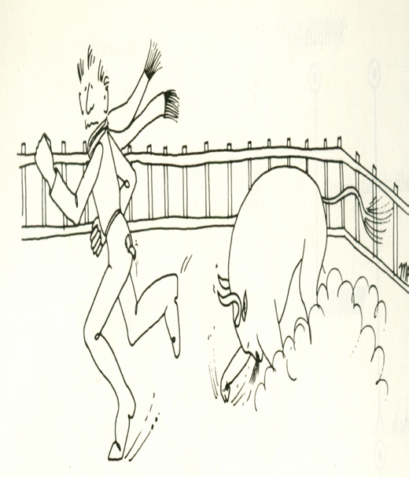
#∗Ω↑ RUN
Hair raised.
Pupils dilated.
Heart rate ↑.
Blood pressure ↑.
Bronchodilatation
Adrenal : ADR + NADR ↑.
Liver: Glycogenolysis → energy.
Skeletal muscle : ↑ blood flow.
••
Bull
SYMPATHETIC SYSTEM
FRIGHT – FLIGHT– FIGHT
Sphincters closed.

Slide 19
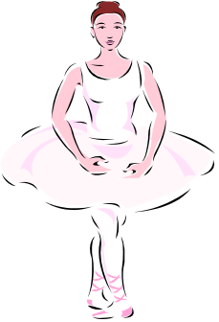
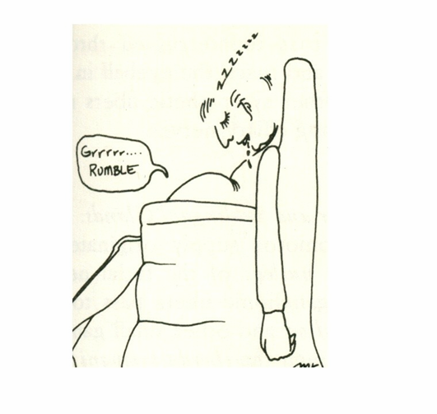
PARASYMPATHETIC ACTION:
Heart rate & blood pressure ↓
Gastric & intestinal glands: secretions ↑
Peristalsis ↑
Conserving & restoring energy!!

Slide 20
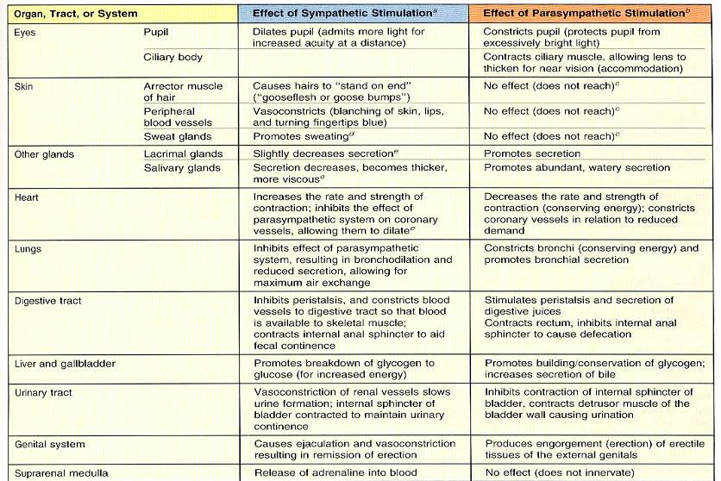
FUNCTION of SYMPATHETIC + PARASYMPSTHETIC SYSTEM

Slide 21
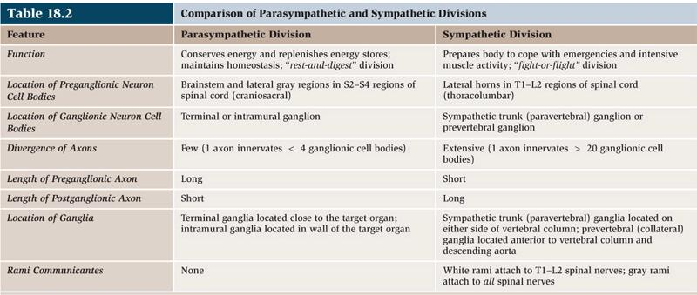
Differences between parasympathetic & sympathetic nervous system

Slide 22
THANK YOU

