Slide 1
ATYPICAL RIBS
Sarangdhar kumar
Department of anatomy
Rohilkhand medical college
Bareilly

Slide 2
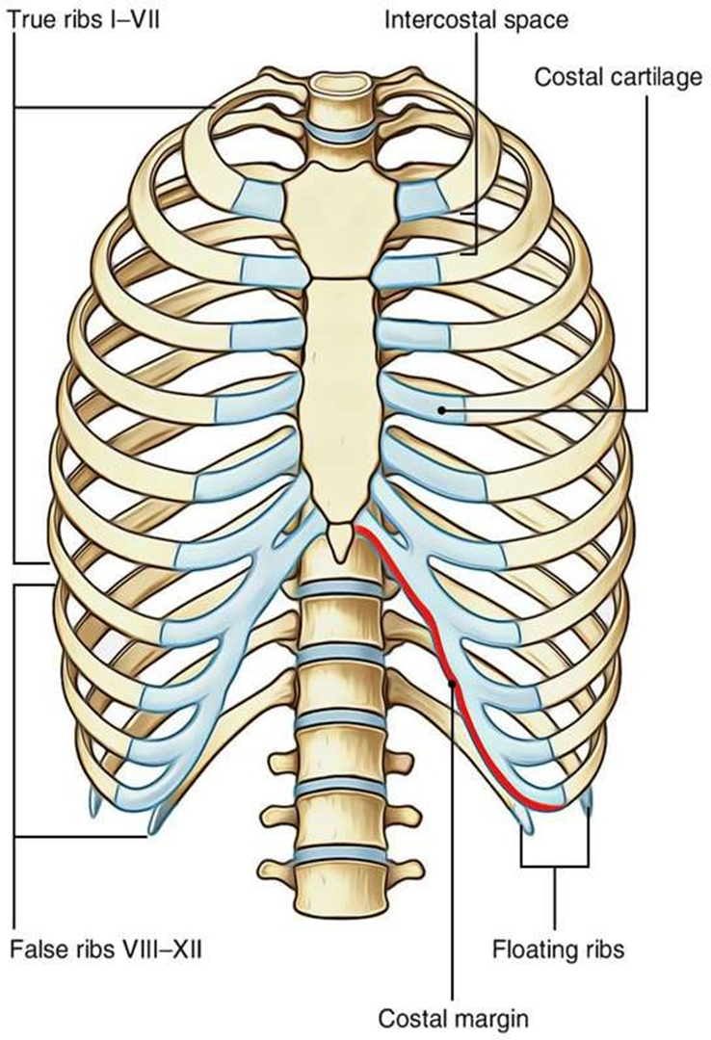
RIBS OR COSTAE
The ribs are –
    Elongated
    curved
    Flat
That forms the largest part of thoracic cage
It represent the detached costal elements of thoracic vertebrae
Arranged in 12 pairs
It extends thoracic vertebrae (posteriorly) to lateral margin of sternum (anteriorly) ,except last two
Length of ribs increases from 1st to 7th and decreases from 7th to 12th , therefore 7th rib is the longest

Slide 3

Classification of ribs
Depending on articulation with sternum
RIBS
Depending on articulation with sternum
True ribs
(1st to 7th)
False ribs
(8th to 12th)

Slide 4
Depending on anterior attachment
RIBS
Depending on anterior attachment
Vertebrosternal
(1-7)
Vertebrochondral
(8-10)
Vertebral
(11&12)

Slide 5
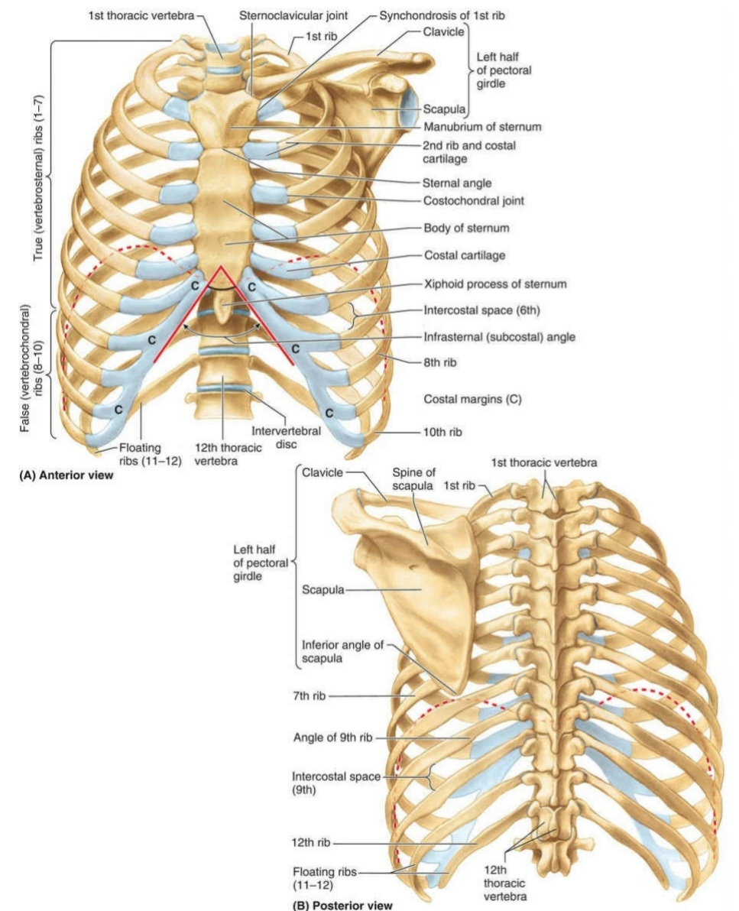

Slide 6
Depending on morphological features
RIBS
Depending on morphological feature
Typical
(3rd to 9th )
Atypical
1st,2nd ,10th ,11th & 12th

Slide 7
GENERAL OBSERVATION
  The ribs are arranged one below the other and the gaps between the adjacent ribs are termed intercostal spaces
  The length of ribs increases from 1st to 7th rib and after that slowly falls; therefore, seventh rib is the longest rib
  The transverse diameter of thorax increases progressively from 1st to 8th rib, thus 8th rib has the best lateral projection
  The ribs are arranged obliquely, i.e., their anterior ends be located at lower level than their posterior ends
  The obliquity of ribs rises progressively from 1st to 9th rib, for this reason 9th rib is most obliquely set
  The width of ribs slowly reduced from above downward

Slide 8
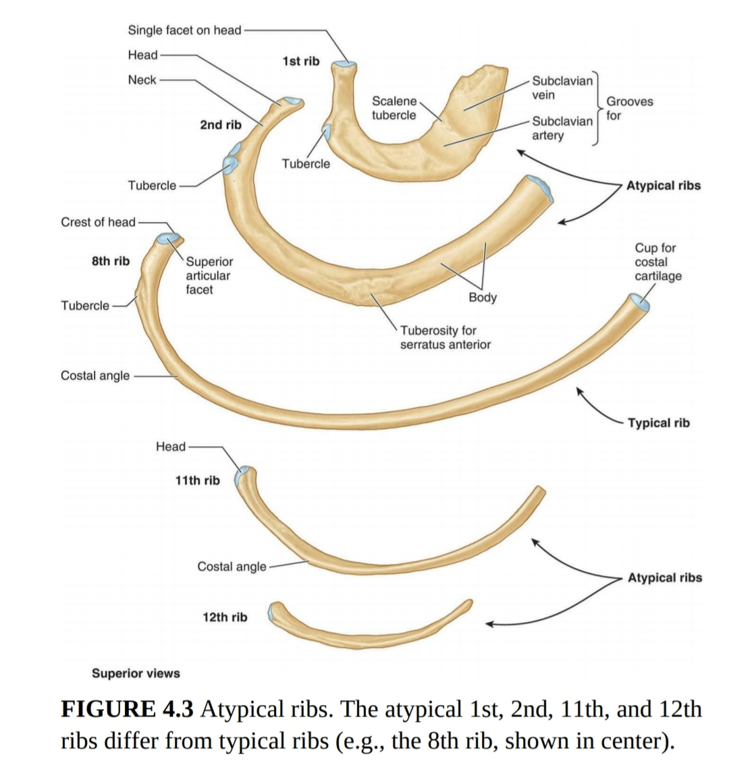

Slide 9
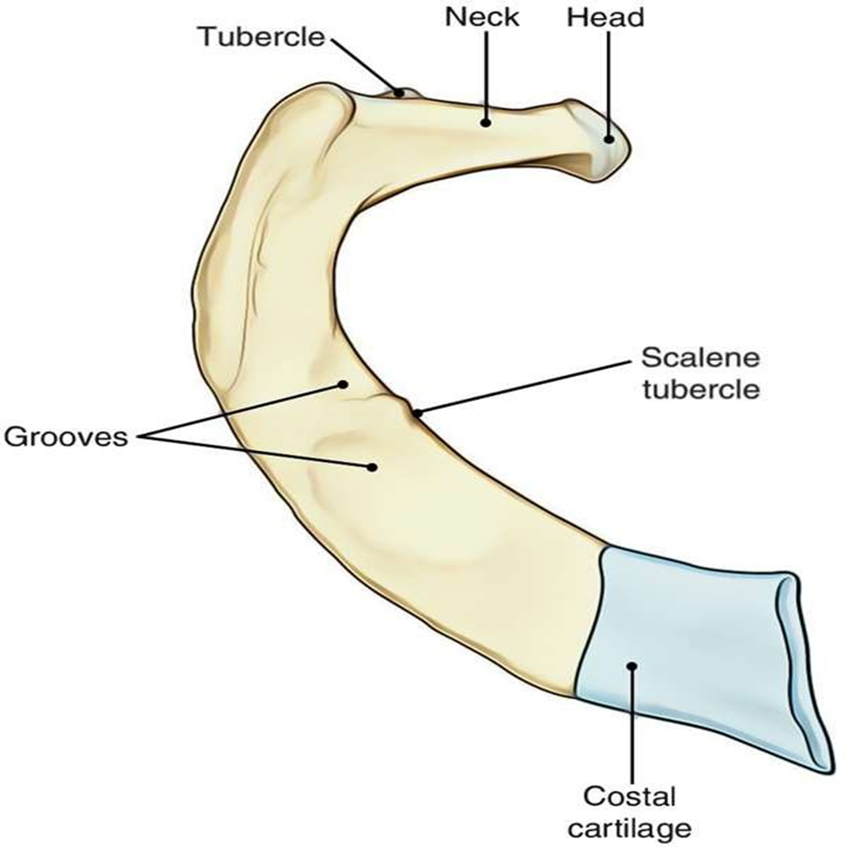
ATYPICAL RIBS
1ST RIB –
It is shortest ,strongest , flattest & most curved
It slops downward & forward, so that its sternal end lies 3-4 cm below than the vertebral end
Head is small & it bear a circular facet that articulate with corresponding vertebrae
Neck is rounded
Tubercle is broad & prominent , projects backward, upward & medially
It has no angle
There is no costal groove

Slide 10

Shaft is flat, present upper and lower surfaces & outer and inner border
Upper surface presents two grooves (anterior & posterior) separated by a faint ridge
Scalene tubercle are present close to inner border on upper surface
Anterior groove – subclavian vein
Posterior groove – subclavian artery
Scalene tubercle – scalenus anterior muscle

Slide 11
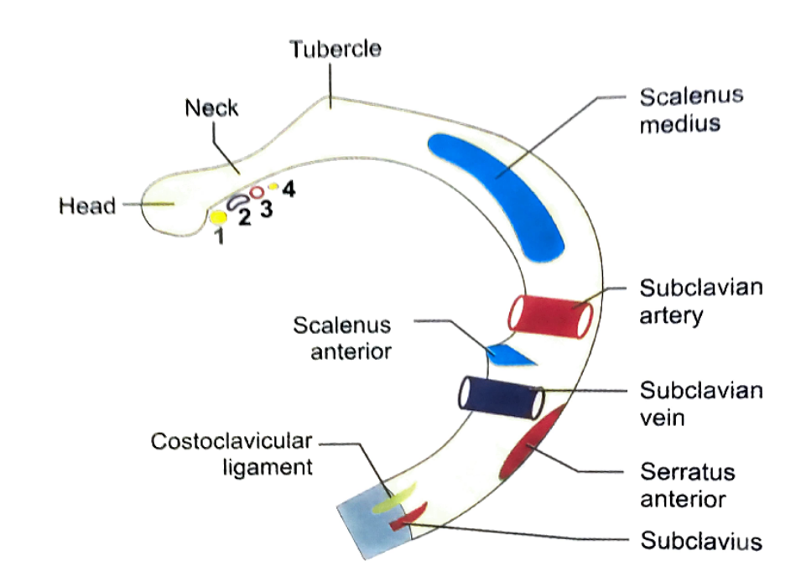
Anterior surface of neck is related with following structure –
  Medial to lateral
    Sympathetic chain
    1st posterior intercostal vein
    Superior intercostal artery
    1st thoracic nerve (ventral ramus)

Slide 12
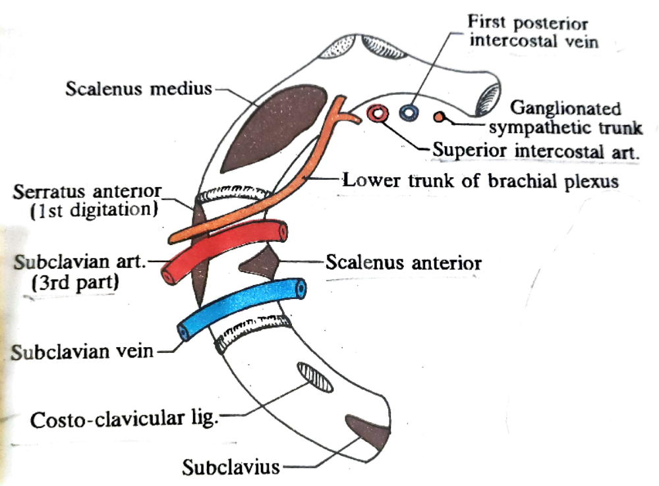
Inner border –
  Concave & thin
  Gives attachment to suprapleural membrane(Sibson’s fascia)
Outer border –
  Convex & thick in posterior part
  Gives attachment to 1st digitation of serratus anterior muscle ( behind the groove for subclavian artery

Slide 13
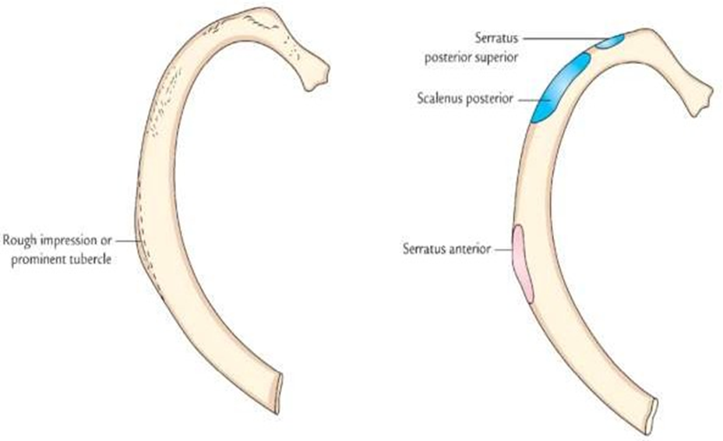
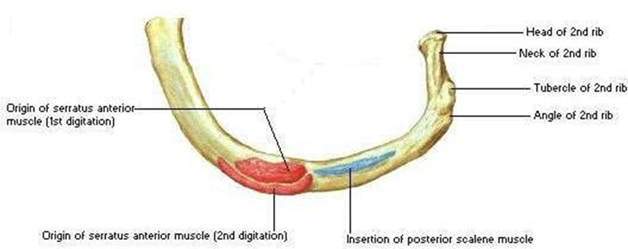
2ND RIB –
It possesses similar curvature to the 1st rib
It is thinner & twice the length of 1st rib
Its shaft is sharply bent not twisted; thus both the ends of rib touch the table top when put on it
Near its middle, the outer convex surface of shaft presents a rough impression or tubercle, which gives connection to the serratus anterior muscle (lower part of first and whole of 2nd digitation)
Posterior part of internal surface presents a short costal groove poorly developed
The upper border and adjoining part of upper surface supply connection to the scalenus posterior and serratus posterior superior muscles

Slide 14
10th RIB –
  It present single facet on its head & articulate fully with body of tenth thoracic vertebrae

Slide 15
11th RIB –
  Single large facet on its head
  No neck
  No tubercle
  Shaft presents slight angle & shallow costal groove
  Pointed anterior end fitted with costal cartilage

Slide 16
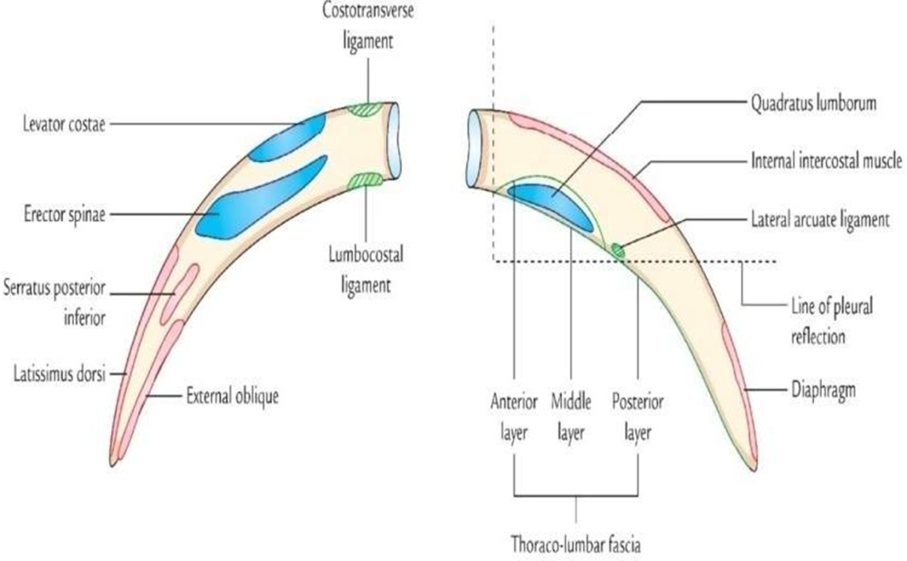
12TH RIB –
  It slope downwards , forwards & laterally
  It is shorter than 11th rib
  Single facet on head
  No neck
  No tubercle
  No angle
  No costal groove

Slide 17
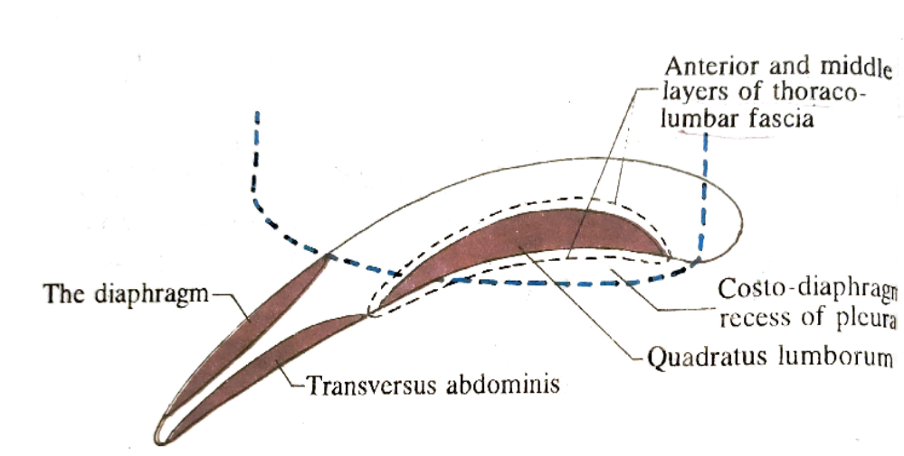
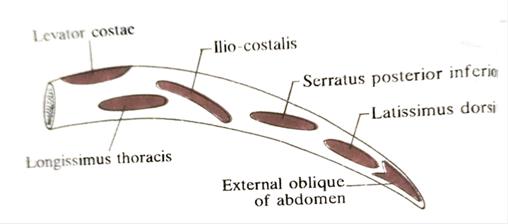
It presents anterior & posterior surface and upper & lower border
Anterior surface faces slightly upward
Anterior surface-
  Medial half -
    quadratus lumborum( lower part)
    Costodiaphragmatic recess (upper part)
  Lateral half -
    Diaphragm (Upper part)
    Transversus abdominis (lower part)
Posterior surface - convex & rough
  Medial half – levator costae, longissimus thoracis, iliocostalis
  Lateral half - serratus posterior inferior, latissimus dorsi , external oblique muscle

Slide 18

Upper border –
    External & internal intercostal muscle
Lower border -
    Middle layer of thoracolumbar fascia
    Close to head , lumbocostal ligament
    Lateral arcuate ligament just outside the quadratus lumborum

Slide 19
