Slide 1
ASCENDING & DESCENDING TRACT OF
SPINAL CORD
SARANGDHAR KUMAR
DEPARTMENT OF ANATOMY
ROHILKHAND MEDICAL COLLEGE
BAREILLY

Slide 2
Ascending & Descending fibers of spinal cord are organized in the form of tracts of fasciculus
Tract is defined as bundle of fibers having the same origin, course, termination & function
Ascending & Descending tracts are distributed in column of white matter of spinal cord
Ascending tracts carry somatic sensation (pain, touch, temperature, vibration & pressure) & visceral sensation (stretch &pain)

Slide 3
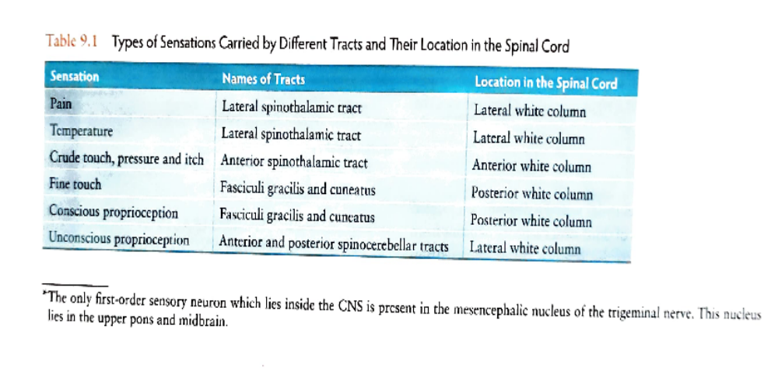
Ascending tract –
  It is sensory in nature
  Ascending tracts carry somatic sensation (pain, touch, temperature, vibration & pressure) & visceral sensation (stretch &pain)
  It forms a part of the sensory pathway

Slide 4
Arrangement of Ascending tracts
Ascending tract
Dorsal funiculus
-Funiculus gracilis
-Funiculus cuneatus
Ventral funiculus
-Anterior spinothalamic
Lateral funiculus
-Posterior spinocerebellar
-Anterior spinocerebellar
-Lateral spinothalamic
-Spinotectal
-Spino-olivary
-Dorsolateral tract of Lissaur

Slide 5
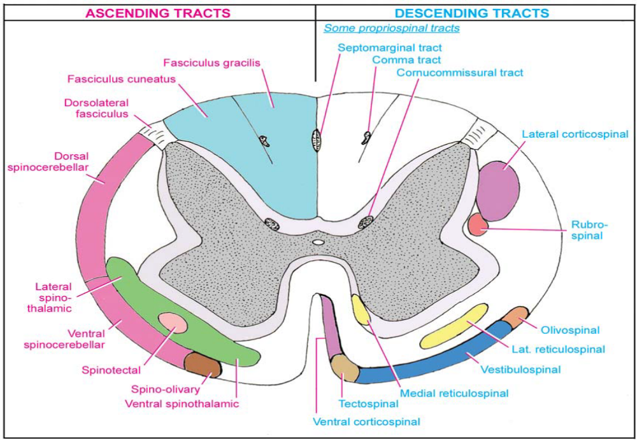

Slide 6
Funiculus gracilis & Funiculus cuneatus

Slide 7
Posterior spinocerebellar

Slide 9
Anterior spinocerebellar

Slide 10
Ventral & lateral spinothalamic

Slide 11
Spino-olivary & spinotectal

Slide 12
Summary of Ascending tracts

Slide 13
Descending tract-
Descending tracts of spinal cord begin from brain and terminate at different levels of spinal cord
It is motor in nature
Descending tracts are grouped into pyramidal and extra- pyramidal tracts
Pyramidal tract is originate in cerebral cortex and play a major role in controlling precise voluntary muscular movement
Extrapyramidal tract is originate mainly from subcortical regions of the brain and play an important role in integration for regulation of muscular movement & muscular tone

Slide 14
Arrangement of Descending tract
Descending tract
Pyramidal tracts
Corticonuclear
Corticospinal
Extrapyramidal tracts
Tectospinal
Rubrospinal
Vetibulospinal
Olivospinal
Reticulospinal

Slide 15
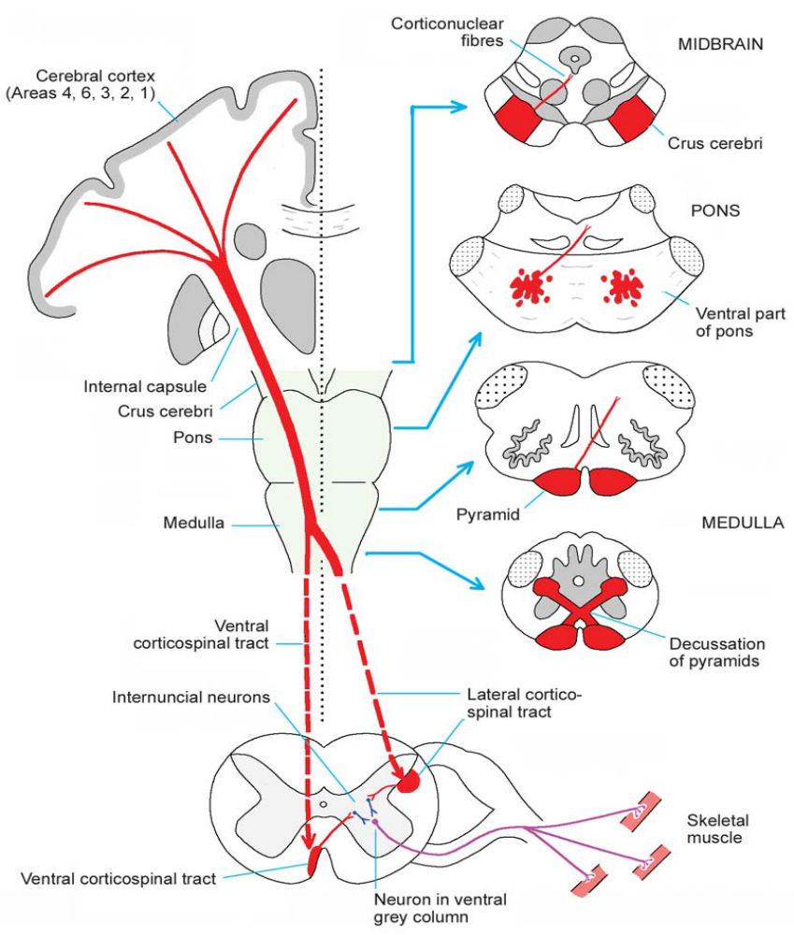
Pyramidal tract
  corticonuclear
  Corticospinal

Slide 16
Thank you

