Slide 1



SARANGDHAR KUMAR DEPATMENT OF ANATOMY RMCH,BAREILLY

Slide 2
◻ To describe the boundary of Anterior triangle
◻ To describe the subdivision of Anterior triangle
◻ To describe the boundaries & content of Submental triangle, Digastric triangle, Carotid triangle and Muscular triangle
◻ To know about the muscles of anterior cervical region
◻ To know about Ansa cervicalis

Slide 3
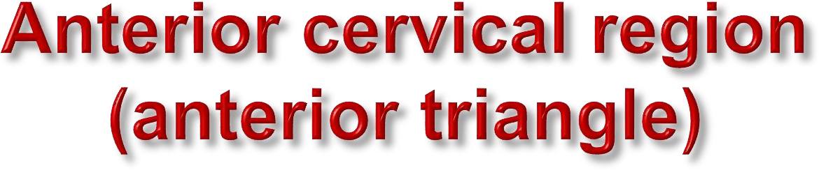
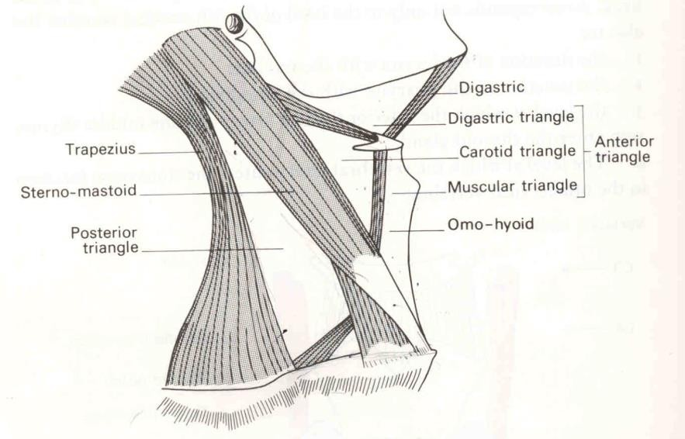
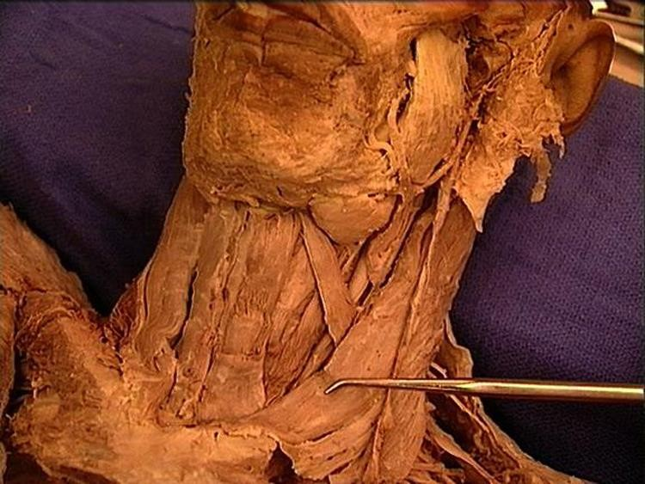
Boundary
  Anterior
    Median line of the neck
  Posterior
    Anterior border of the SCM
  Superior
    Base of mandible
  Apex
    Jugular notch of manubrium
  Roof
    Skin, superficial and deep fascia of
neck
  Floor
    Pharynx, larynx, and thyroid gland

Slide 4
◻ Superior
belly of
omohyoid and two bellies
of digastric
muscle divides anterior triangle
into four sub triangle
Submental
Digastric
Carotid
Muscular triangle

Slide 5

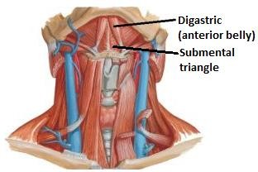
Boundaries
  On each side
    Anterior belly of digastric
  Base
    Body of hyoid bone
  Apex
    Chin
  Floor
    Two mylohyoid muscles wit their median raphe
Contents
  Submental nodes
  Small veins that unite to form the anterior jugular vein
h

Slide 6
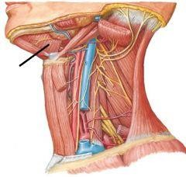
Boundaries
  Anteroinferior
    Anterior belly of digastric
  Posteroinferior
    Posterior belly of digastric and stylohyoid muscle
Apex
Digastric triangle
Intermediate tendon of digastric muscle at hyoid bone
SH
Base
  Lower border of mandible
ST
Floor
Mylohyoid, hyoglossus, middle
constrictor

Slide 7
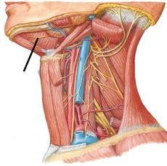
Facial vessels
Submandibular gland and Submandibular lymph nodes
Submandibular gland
Facial vessels
Nerve to mylohyoid and
mylohyoid vessels
Hypoglossal nerve and accompanying it
12th CN
Nerve to mylohyoid
veins

Slide 8

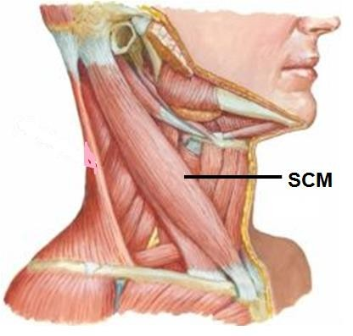
Boundaries -
Anterosuperior
  Posterior belly of digastric and stylohyoid muscles
Diagstric (posterior belly)
Anteroinferior
  Superior belly of omohyoid
SH
Sup. belly
Omohyoid
Posteroinferior
  Anterior border
SCM
of lower

Slide 9
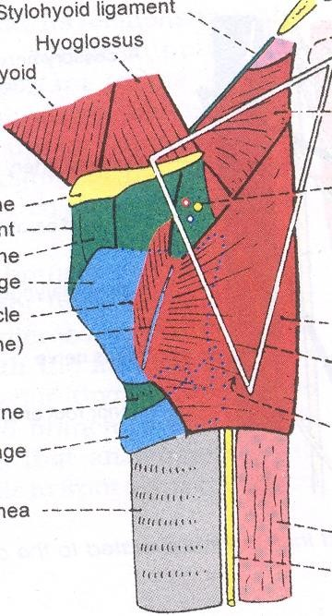
Floor
  Thyrohyoid,
  Hyoglossus,
  Inferior constrictor &
  Middle constrictor muscle of
Pharynx
Roof -
  Skin,
  Superficial fascia & Deep
fascia

Slide 10
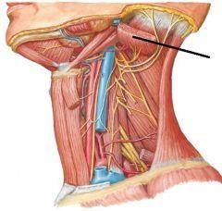
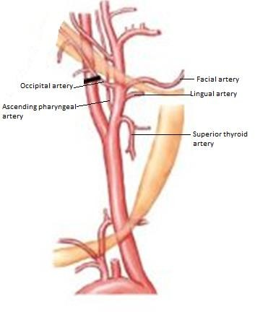
Carotid sheath containing common carotid artery, internal jugular vein, vagus nerve
Ansa cervicalis lie anterior to carotid
SCM
CT
sheath; cervical part of sympathetic trunk lies posterior to the sheath
External carotid artery and 5 out of
its 8 branches
  Ascending pharyngeal artery
  Superior thyroid artery
  Lingual artery
  Facial artery
  Occipital artery

Slide 11
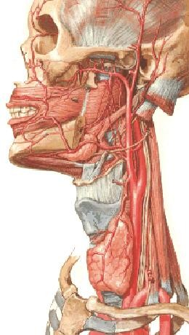
◻ The vessels in the carotid triangle
common carotid artery
On the right side it arises from the right brachiocephalic behind the right sternoclavicular joint
On the left arises from the arch of aorta in the superior mediastinum
In the neck extends from the sternoclavicular joint to the upper border of the thyroid cartilage (level of C4)
Where it divides into internal carotid artery & external carotid artery
Lies deep to the anterior border of the SCM lies within the carotid sheath Medial to the IJV Anterior to the vagus nerve

Slide 12
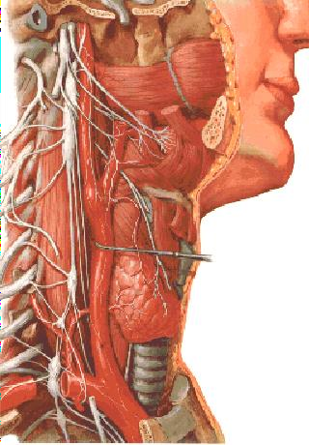
◻ Carotid Sinus
CS
localized dilatation at bifurcation of common carotid artery
Innervated by carotid sinus branch of glossopharyngeal n.
Function as a baroreceptor
(a rise in blood pressure - a slowing of the HR vasodilatation of the arterioles)
◻ Carotid Body
A small neurovascular structure
Lies close to post. wall of carotid sinus
Innervated by the carotid sinus branch of the glossopharyngeal n
Function as a chemoreceptor
(sensitive to excess CO2 and reduced O2 tension in the blood → rise in BP & HR and
increase in RR )

Slide 13
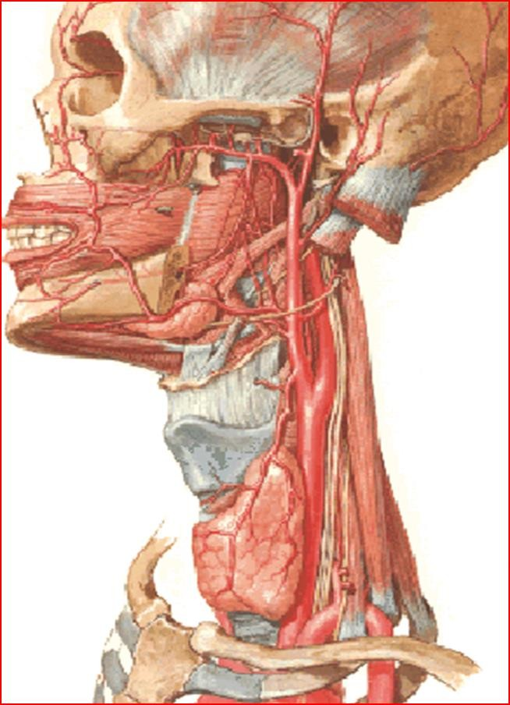
◻ External carotid artery
◻ terminal branches of CCA
◻ -begins at the upper border of the thyroid cartilage
◻ -terminates in the substance of the parotid gland behind the neck of mandible
External carotid artery
◻ divides into superficial temporal & maxillary arteries
◻ At first it lies medial to the ICA
then behind to it
Is crossed by the post. Belly of the digastric stylohyoid m.

Slide 14
1- superior thyroid artery
-arises near origin of ECC
-upper pole of the thyroid gland
-accompanies the external laryngeal nerve
Branches
superior laryngeal artery - pierces the thyrohyoid membrane with the superior laryngeal nerve
- Supplies - larynx, infrahyoid m, and thyroid
g
2- Ascending pharyngeal artery
-
-
supplies the pharynx
arising from the medial surface of the origin of the ECA
Ascends b/w the ICA and the wall of pharynx Branches
pharyngeal
meningeal
palatine tonsil
inferior tympanic artery
-
lingual artery
  Opposite the tip of the greater cornu of the hyoid bone deep to hyoglossus muscle,
  Reach the tongue accompanies by the deep inguinal vein
  Near its origin is crossed superficially by the
hypoglossal n
Branches
    Suprahyoid
    Dorsal lingual artery 3-Deep lingual
4-Subligual artery

Slide 15
4- Facial artery
arises just distal to the lingual artery
deep to post. Belly of dig m and stylohyoid m
winds around the lower border of the mandible to enter the face at the anterior margin of massseter muscle
passes upward and medially to end at
medial angle of the eye
Branches in neck
1- ascending palatine artery 2- tonsillar artery
glandular branches
submental artery
◻ 5- occipital artery
opposite the facial artery, back of the scalp passes posteriorly and superiorly
Crosses lateral to the ICA, IJV, CN (X, XI, and XII)
Grooves the temporal bone medial to the
mastoid process
Branches
1-Sternomastoid branch 2-Meningeal branch
3-Descending branch
-
-
-
-
-
-
-
-

Slide 16
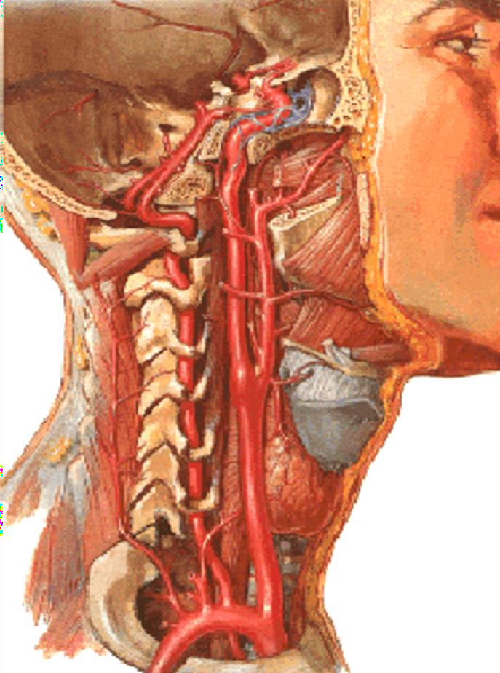
Internal Carotid Artery
-one of the terminal branches of the Common Carotid Aretry
-enters the cranial cavity through the carotid canal
-ascends deep to the parotid gland
-gives off NO branches in the neck
supplies the
brain,
the eyes,
the forehead,
part of the nose

Slide 17
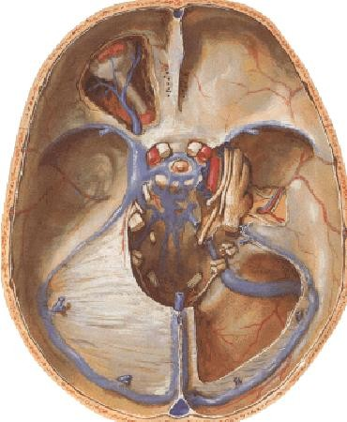
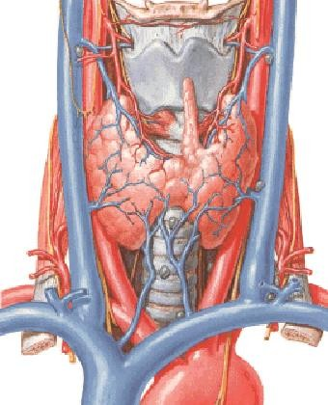
Internal jugular vein
◻ -Receives blood from
1-brain 2- face 3-neck
Begins at jugular foramen
As a continuation of the segmoid venous sinus
-Descends within the carotid sheath Lateral to the ICA and CCA
-Ends behind the medial end of the clavicle by joining the subclavian vein to form the brachiocephalic vein
Usually has a single valve located just above the inferior bulb

Slide 18
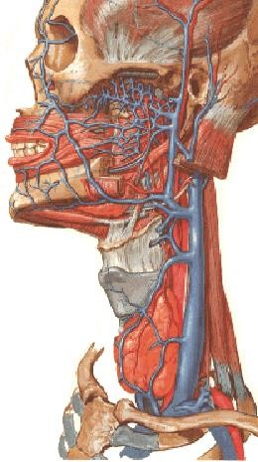
◻ Tributaries
Inferior petrosal sinus-drains the cavernous sinus
Facial vein
pharyngeal vein- drain the pharyngeal plexus
Lingual vein
Superior thyroid vein
Middle thyroid vein
Occipital vein
18

Slide 19
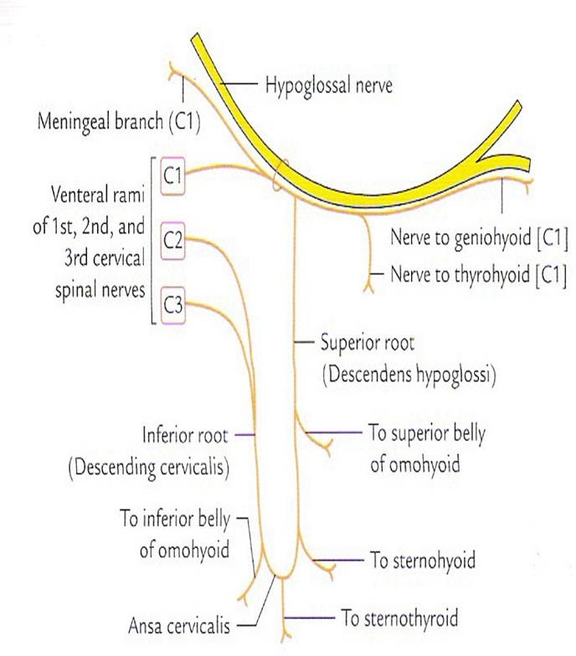
The Ansa Cervicalis (ansa= loop)
◻ It is a loop which is lies in front of
the carotid sheath
◻ it is formed by the union of two descending nerves and it supplies three infrahyoid muscles
1- The first descending nerve (descendens hypoglossi ( superior root))
appears to arise as a branch from the hypoglossal nerve,but comes originally from C1
loop upward to join and travel with the hypoglossal nerve
2- The second descending nerve (descendens cervicalis (inferior root)
arises from primary rami of C2 & C3
is formed behind the IJV within the carotid sheath

Slide 20
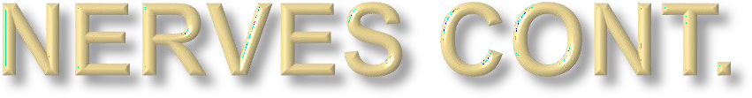
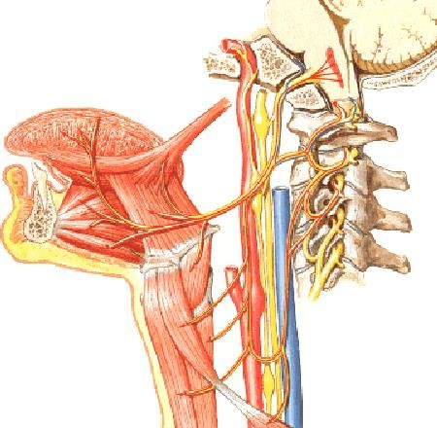
◻ Vagus nerve
◻ Spinal accessory nerve
◻ Cervical part of sympathetic chain
◻ Glossopharyngeal nerve
◻ Hypoglossal nerve

Slide 21
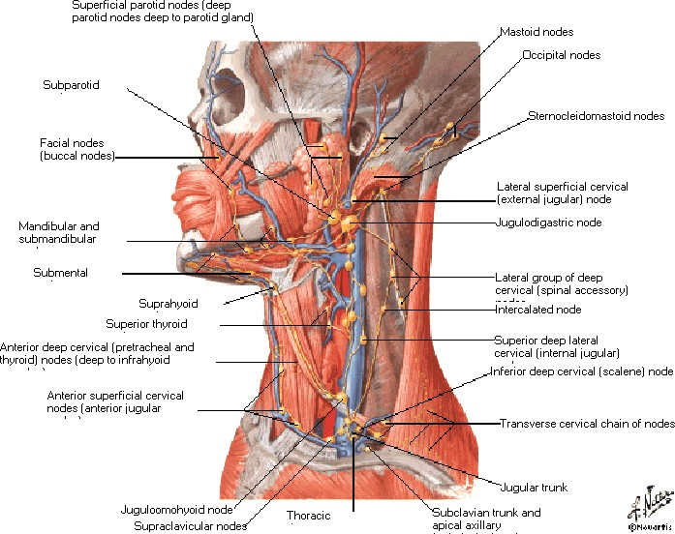

Slide 22

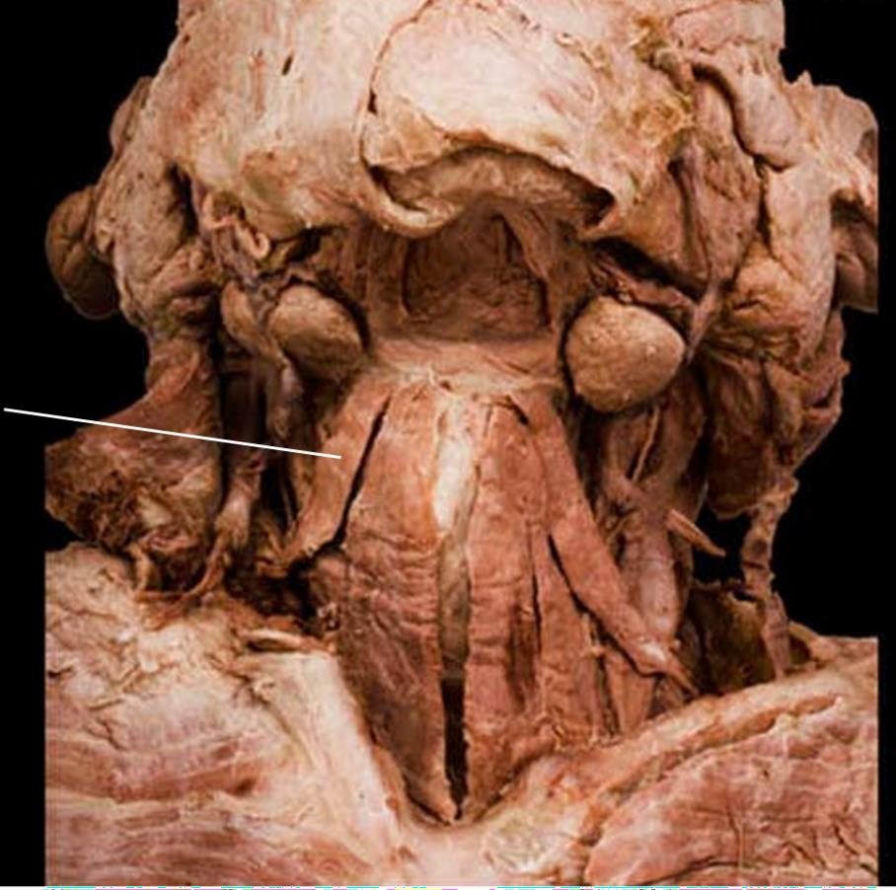
Posterosuperior
  Superior belly of omohyoid
Posteroinferior
  Sternocleidomastoid
Omohyoid
Anterior
  Midline of neck
MT
Contents
SCM
Infrahyoid muscles; thyroid and parathyroid glands

Slide 23
Suprahyoid muscles
  Superior to hyoid bone
Infrahyoid muscles
  Inferior to hyoid bone
These hyoid muscles steady or move the hyoid and larynx

Slide 24
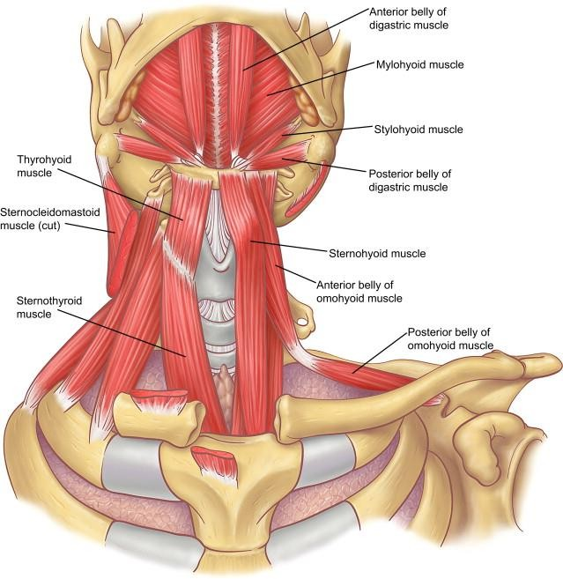
◻ The Infrahyoid muscles
◻ They lie over
the thyroid gland
the trachea
and the larynx
◻ Consist of 4 muscles arranged
into 2 layers
1-The superficial layer
2-The deep layer

Slide 25
◻ The superficial layer
The Sternohyoid
lies near the middle line
  covers the other 2 muscles
  back of manubrium
  lower border of body of
hyoid
The Omohyoid
  sup. Belly lies on its lateral side
◻ The deep layer
a sheet of longitudinal muscle
fibers extend b/w the
upper part of the sternum and the lower border of the hyoid bone
oblique line of the thyroid cartilage divides this sheet into
Suprahyoid
muscles
The Sternothyroid
The Thyrohyoid

Slide 26
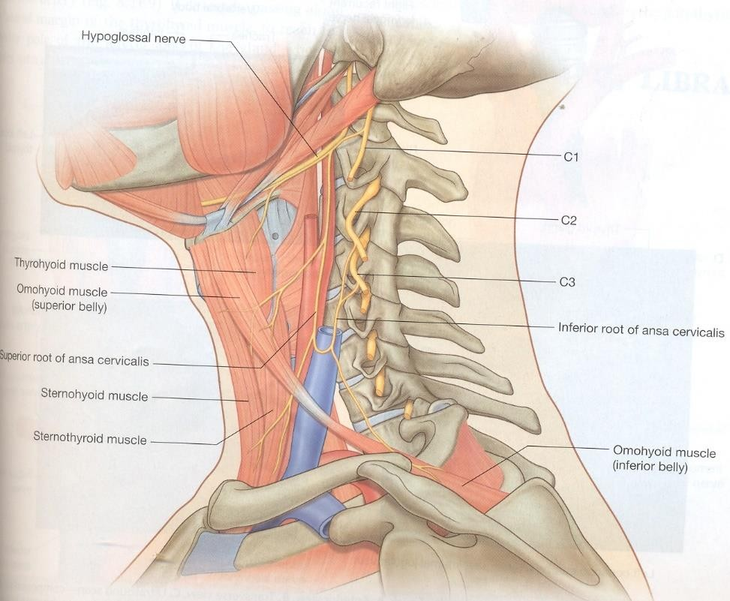
All the infrahyoid muscles except the thyrohyoid are supplied by branches of ansa cervicalis
Thyrohyoid muscle is supplied by.thyrohyoid branch from C1 (appears to arise from CN12)

Slide 27
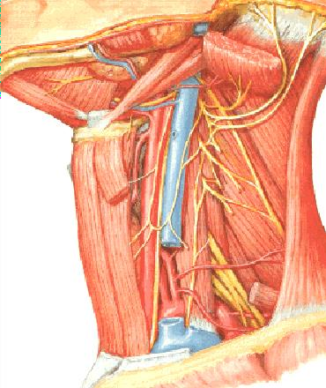
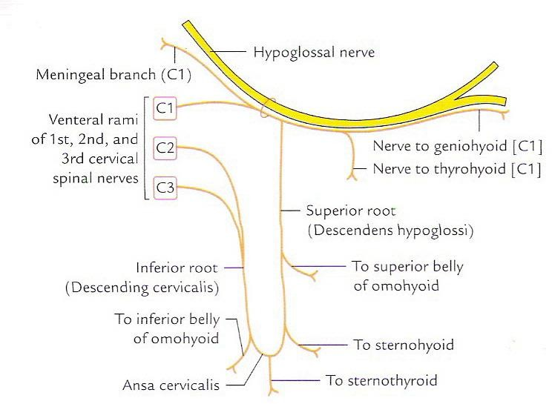

Slide 28
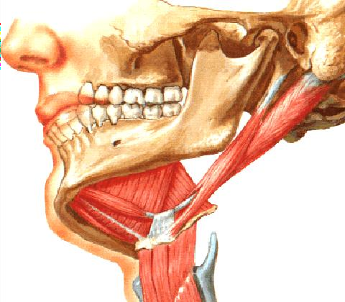
Suprahyoid muscle
Stylohyoid muscle
  Origin- Styloid process
  Insertion –Body of hyoid bone
  Nerve supply- facial nerve
  Action- Elevates the hyoid bone
Digastric muscle
  Origin-
  Ant. Belly- from digastric fossa
of
mandible
  Post. Belly- from mastoid notch of
temporal bone
  Insertion- Both belly forms an
intermerdiate tendon &
attached on hyoid bone
  Nerve supply-
  ant. Belly –mylohyoid nerve
  Post. Belly- facial nerve
  Action - A-depresses the mandible
B-elevate the hyoid bone

Slide 29
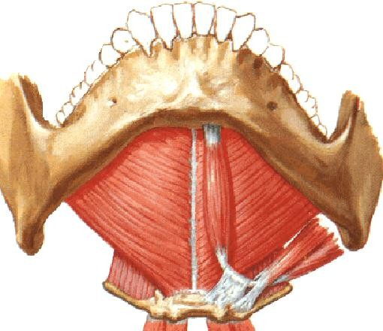
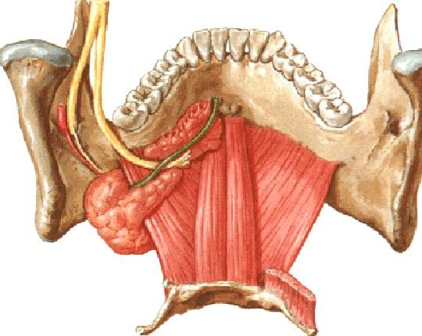
◻ Mylohyoid muscle
Origin - body of the mandible (mylohyoid line)
Insertion - hyoid bone
Nerve supply- nerve to mylohyoid (br.of inferior alveolar nerve of mandibular nerve)
Action- Elevates floor of the mouth and hyoid bone, depresses the mandible
◻ Geniohyoid muscle-
Origin – inferior genial tubercle (on the back of symphysis menti)
Insertion – body of hyoid bone
Nerve supply – C1 fibers (branch
from CN12)
Action – elevate the hyoid bone
MH
GH
29

Slide 30
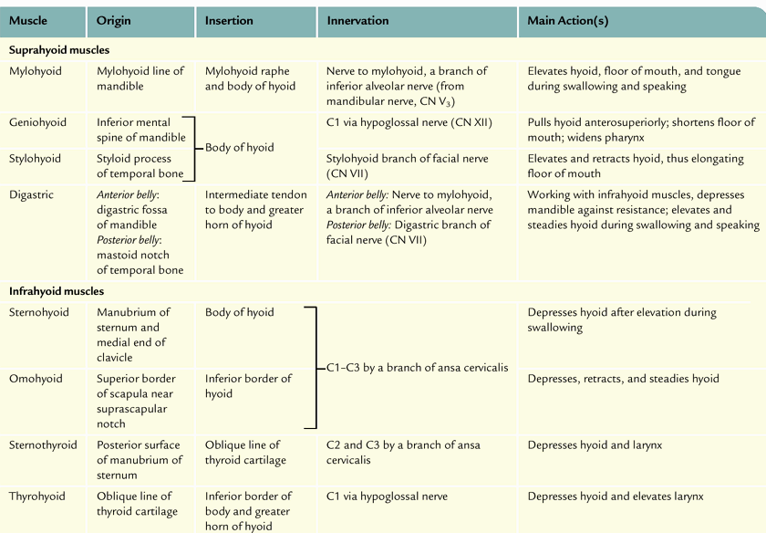

Slide 32
THANK YOU

