Slide 1
OCULOMOTOR , TROCHLEAR & ABDUCENT NERVE
DR.SARANGDHAR KUMAR DEPARTMENT OF ANATOMY
ROHILKHAND MEDICAL COLLEGE, BAREILLY

Slide 2
OCULOMOTOR NERVE
It is the 3rd cranial nerve
Purely motor
Responsible for
  movement of eyeball,
  constriction of pupil &
  accommodation
It is also known as Nerve of accommodation

Slide 3
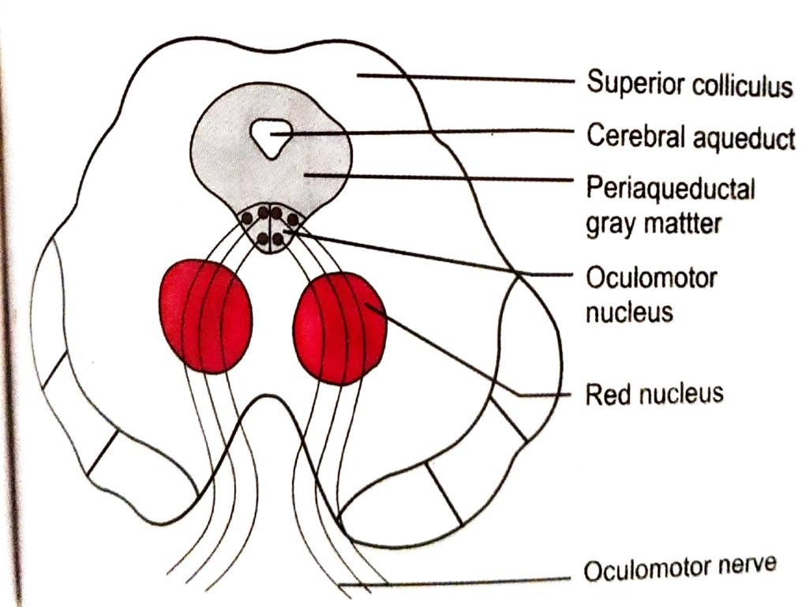
NUCLEI OF ORIGIN
  Oculomotor nerve nucleus is located in the periaqueductal area in the midbrain at the level of superior colliculi
  Consists of
    Somatic part (main oculomotor nucleus)
      It supply intraorbital muscles (except SO4 & LR6)
      levator palpebrae superioris
    Autonomic part ( Edinger- Westphal nucleus
      It gives parasympathetic
supply to
      ciliaris
      sphincter pupillae

Slide 4
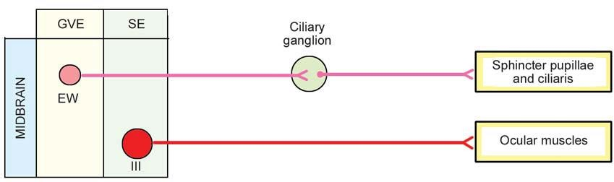
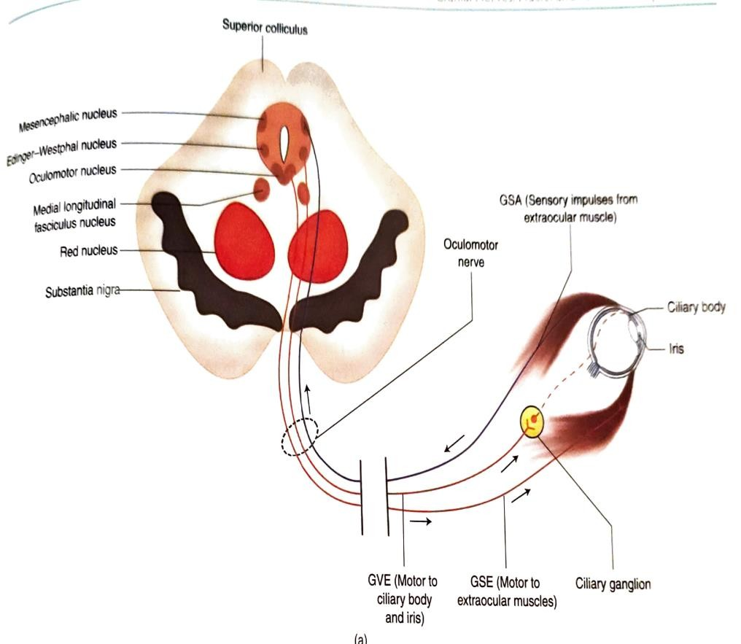
FUNCTIONAL COMPONENT
Two functional components-
Somatic efferent (SE) fibers
  Arises from main oculomotor nucleus
  Supply muscles develops from preotic somites
General visceral efferent (GVE) fibers
  Arises from Edinger-Westphal
nucleus
  It relay in ciliary ganglion & supply ciliaris and sphincter pupillae muscles

Slide 5
CONNECTIONS-
It receives connection from
Cortico-nuclear fibers-
  Arising from motor area (area no.4 & 6)
Medial longitudinal fasciculus(MLF)-
  through which 3rd nerve is connected with 4th, 6th & 8th cranial nerve for
co-ordination of eye movements
Tecto-bulbar tract-
  connected to visual cortex through superior colliculus for visuo-protective reflex
Pretectal nuclei of both sides – for pupillary light reflex

Slide 6
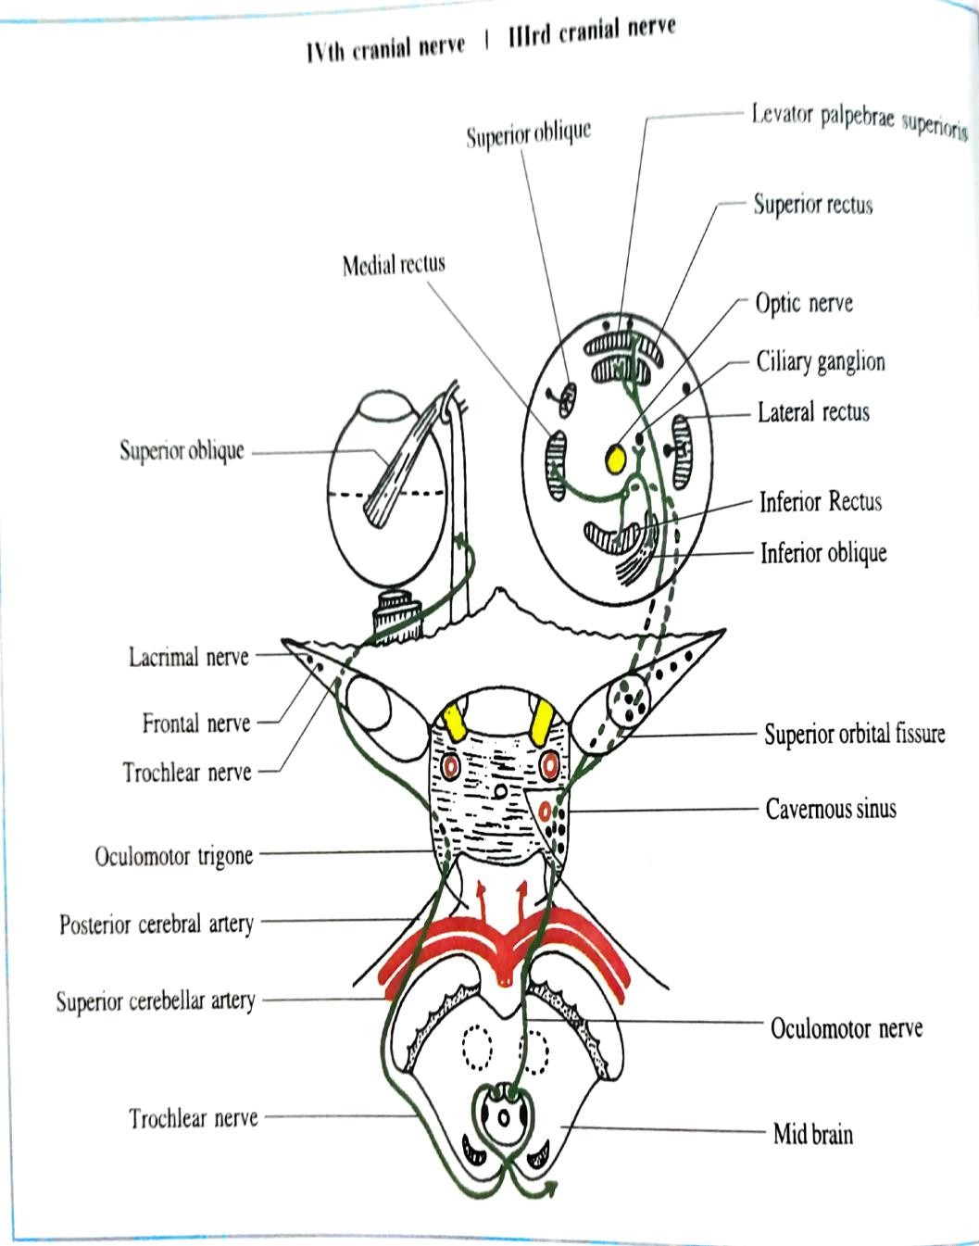
COURSE
Intraneural course-
Point of emergence-
ventral aspect of midbrain & it pierces medial aspect of cerebral peduncle
Intracranial course-
Intraorbital course-

Slide 7
APPLIED ANATOMY-
  Lesion of oculomotor nerve
    Ptosis – due to paralysis of levator palpebrae superioris
    External strabismus- due to unopposed action of LR & SO as the rest of muscles are paralyzed
    Diplopia- on looking medially, inferiorly & superiorly
    Dilated &fixed pupil is due to loss of parasympathetic supply to sphincter pupillae and ciliaris muscles

Slide 8
TROCHLEAR NERVE
UNIQUE FEATURE OF TROCHLEAR NERVE (4TH CN)
  Most slender nerve among the cranial nerve
  It is the only nerve emerge from dorsal aspect of brain stem
  It is the only nerve that shows decussation of fibers before emerging

Slide 9
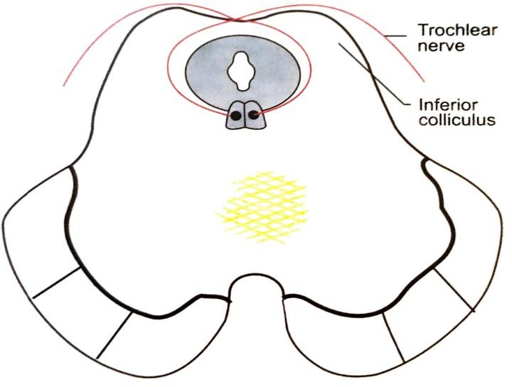
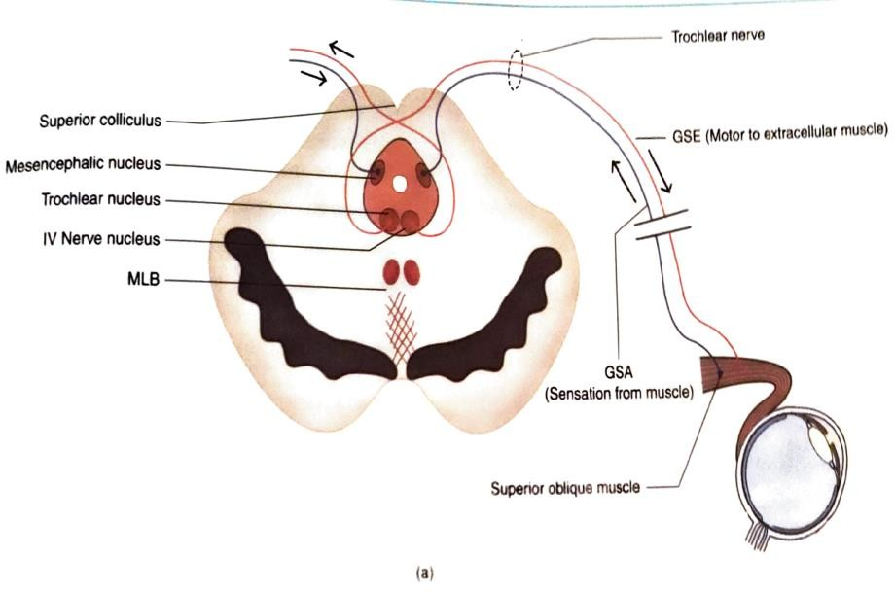
NUCLEUS OF ORIGIN
Trochlear nucleus lies immediately caudal to oculomotor nucleus
In periaqueductal area of midbrain at the level of inferior colliculus
FUNCTIONAL COMPONENT
General somatic efferent (GSE) fibers
–supply superior oblique muscle

Slide 10

COURSE
  Intraneural course
  Point of emergence- posterior aspect of midbrain at the inferior colliculus
  Intracranial course
  Exit of cranium
  Intraorbital course

Slide 11
APPLIED ANATOMY-
Lesion of trochlear nerve-
  Leads paralysis of superior oblique muscle
    Medial deviation of eyeball
    Diplopia on looking laterally (attempting to look below)

Slide 12
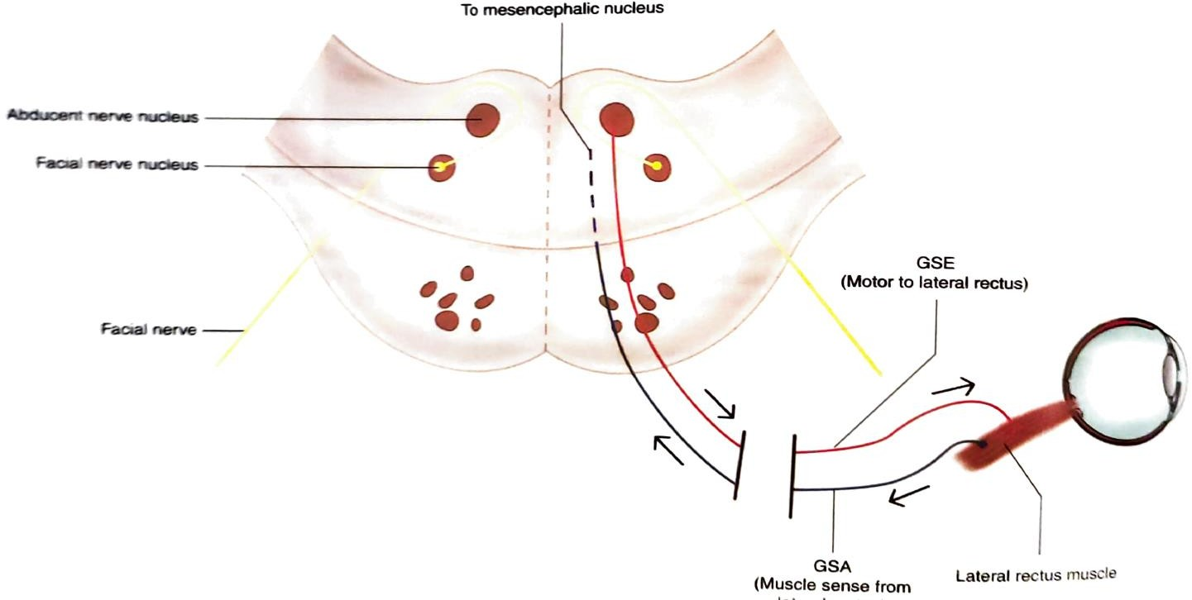
ABDUCENT NERVE
It is the 6th cranial nerve
Motor nerve
It supply single extraocular muscle , lateral rectus
NUCLEUS OF ORIGIN
  Located in the lower part of pons
  Deep to facial colliculus in floor
of 4th ventricle

Slide 13
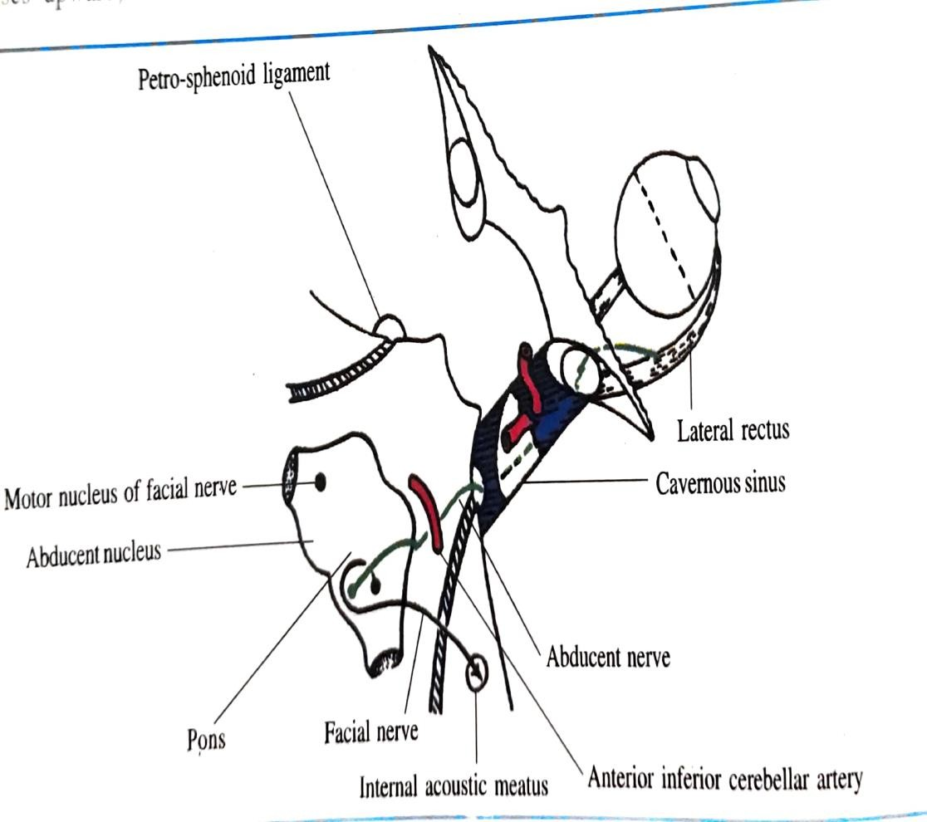
FUNCTIONAL
COMPONENT
General somatic efferent(GSE) –
supply the lateral ractus muscle
COURSE
Intrapontine course-
Point of emergence- ponto- medullary junction cranial to pyramid
Intracranial course-
  Dorello’s canal- fibro-osseous canal
  Formed by apex of petrous temporal bone+petrosphenoid ligament
Intraorbital course-
13

Slide 14
APPLIED ANATOMY
Unilateral lesion of Abducent nerve in pons-
  Affected eye is adducted due to paralysis of LR
Medial longitudinal fasciculus syndrome (internuclear ophthalamoplegia)-
  Due to lesion of MLF
  It causes ipsilateral medial rectus weakness
  On attempted abduction towards normal side, there is nystagmus in abducting eye &weak adduction in adducting eye (eye on the side of lesion in MLF)

Slide 15
THANK YOU

