Slide 1
GENETICS
THE TERM GENETICS WAS FIRST COINED BY WILLIAM BATESON (1906)
IT IS A BRANCH OF BIOLOGY THAT DEALS WITH HEREDITY AND VARIATION.
HEREDITY IS THE INHERITANCE OF CHARACTER TRAITS FROM PARENTS TO OFFSPRING.
VARIATION INDICATES THE DIFFERENCES AMONG THE OFFSPRING AND ALSO FROM PARENTS.
GENETICS INVOLVES THE STUDY OF THE MECHANISMS OF HEREDITY BY WHICH CHARACTER ARE TRANSMITTED OR INHERITED FROM GENERATION TO GENERATION.

Slide 2
CONT.
GREGOR MENDOL PROPOSED LAW OF INHERITANCE(FATHER OF GENETICS).
BRANCHES OF GENETICS-
CYTOGENETICS
MOLECULAR GENETICS
BIOCHEMICAL GENETICS
CANCER GENETICS
DEVELOPMENTAL GENETICS
IMMUNOGENETICS
CLINICAL GENETICS

Slide 3
CHROMOSOMES
CHROMOSOMES IN NONDIVIDING CELLS(INTERPHASE) ARE NOT VISIBLE UNDER MICROSCOPE BECAUSE THEY ARE PRESENT IN THE FORM OF LONG THREAD-LIKE MATERIAL CALLED CHROMATIN.
DURING CELL DIVISION,CHROMATIN CONDENSES TO FORM CHROMOSOMES (VISIBLE UNDER LIGHT MICROSCOPE).
CHROMATIN CONSISTS OF DNA AND PRESENT IN THE NUCLEI OF CELLS.
MORPHOLOGY OF THE CHROMOSOMES CAN BE BEST STUDIED DURING METAPHASE OF CELL DIVISION.IN OTHER PHASES CHROMOSOMES ARE EITHER NOT COMPLETELY CONDENSED OR OVER CONDENSED.

Slide 4
CONT.
THE NUMBER OF CHROMOSOMES IN THE GIVEN SPECIES IS CONSTANT.
DIPLOID NUMBER:THE NUMBER OF CHROMOSOME IN EACH OF THE SOMATIC CELLS(46).
HAPLOID NUMBER:THE NUMBER OF CHROMOSOMES IN EACH OF THE GAMETES(23).
SHAPE OF THE CHROMOSOME VARIES ACCORDING TO THE PHASE OF CELL DIVISION.

Slide 5
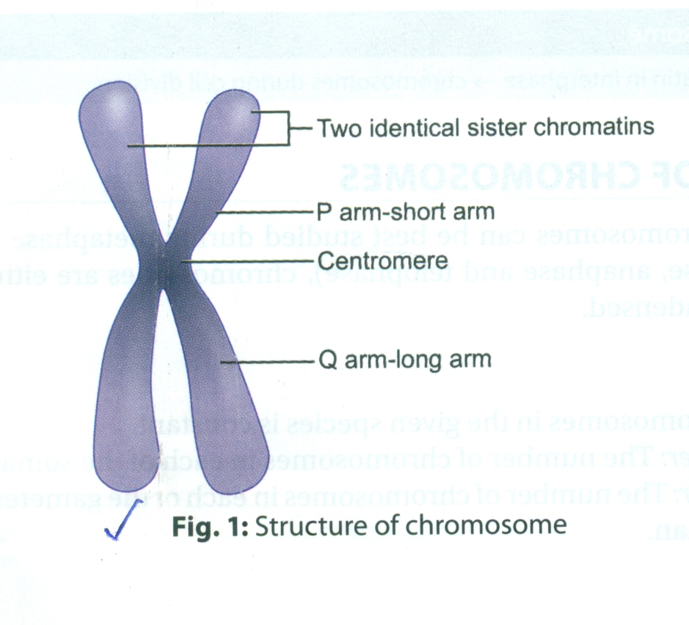
STRUCTURE OF CHROMOSOME
AT MITOTIC METAPHASE, EACH CHROMOSOME SHOWS TWO SYMMETRICAL STRUCTURES CALLED SISTER CHROMATIDS.
BOTH CHROMATIDS ARE ATTACHED TO EACH OTHER AT THE CENTROMERE.
SISTER CHROMATIDS GET SEPARATED AT CENTROMERE IN ANAPHASE AND MIGRATE TO THE OPPOSITE POLES.
CENTROMERE-REGION OF THE CHROMOSOME TO WHICH SISTER CHROMATIDS ARE ATTACHED.
HUMAN CHROMOSOMES ARE MONOCENTRIC AS THEY CONTAIN ONLY ONE CENTROMERE.
DUE TO X-RAY EXPOSURE,CHROMOSOME BREAKS AND MAY FORM ABNORMAL CHROMOSOMES(ACENTRIC OR DICENTRIC).

Slide 6
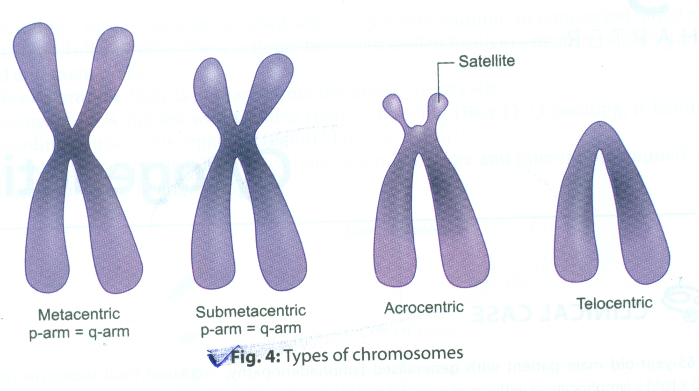
TELOMERE
FREE ENDS OF SISTER CHROMATIDS ARE CALLED TELOMERES.
TELOMERES PREVENT FUSION OF CHROMOSOMES WITH EACH OTHER.
DELETION OF TELOMERE MAKES THE END STICKY.
TELOMERASE IS THE ENZYME RESPONSIBLE FOR TELOMERE SYNTHESIS AND MAINTENANCE OF LENGTH OF THE TELOMERES.TELOMERASE IS RNA-DEPENDENT DNA POLYMERASE.
TELOMERASE ACTIVITY IS PRESENT IN GERM CELLS AND STEM CELLS BUT ABSENT IN SOMATIC CELLS.INCREASED TELOMERASE ACTIVITY FAVOURS CANCER CELLS.

Slide 7
SECONDARY CONSTRICTION
A NARROWED PORTION OF CHROMOSOME OTHER THAN CENTROMERE IS CALLED AS SECONDARY CONSTRICTION.
SECONDARY CONSTRICTION HELPS IN THE IDENTIFICATION OF CHROMOSOMES.
SATELLITE-SATELLITE IS ROUND,ELONGATED KNOB-LIKE APPANDAGE OF CHROMOSOMES.ONLY ACROCENTRIC CHROMOSOMES(13,14,15,21 AND 22) SHOW SATELLITE BODIES.
DEPENDING ON THE SHADE OF STAINING,CHROMATIN IS CLASSIFIED AS LIGHTLY STAINED EUCHROMATIN AND DARKLY STAINED HETEROCHROMATIN.
EUCHROMATIN IS LESS COILED AND ACTIVE CHROMATIN THAN HETEROCHROMATIN.

Slide 8
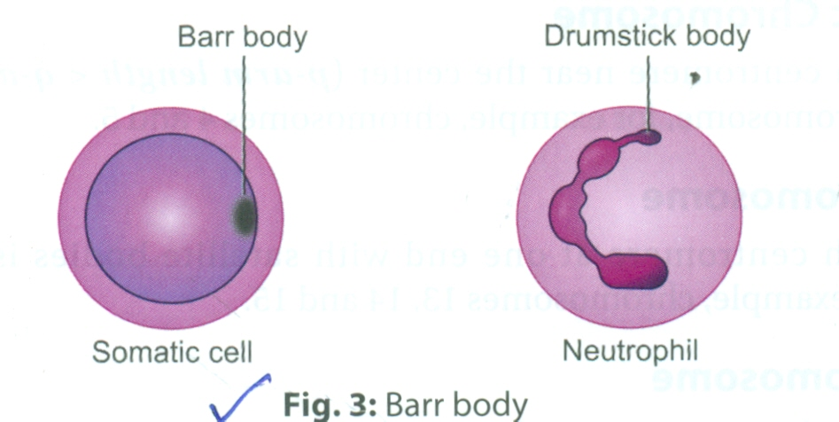
BARR BODIES
ONE X-CHROMOSOME REMAINS ACTIVE AT CERTAIN PHASE OF CELL CYCLE OR LIFE OF AN ORGANISM.
INACTIVE X-CHROMOSOME FORM BARR BODY.
NUCLEUS OF DIPLOID CELLS SHOWS PRESENCE OF DENSE DARK STAINING SPOT AT THE PERIPHERY OF THE NUCLEUS THAT REPRESENT INACTIVE CHROMOSOMES.THIS DARKLY STAINED ZONE IS CALLED AS BARR BODY.IN 3% OF NEUTROPHIL,INACTIVE X-CHROMOSOME APPEARS AS DRUMSTIC.
NO.OF BARR BODIES=NO OF X-CHROMOSOME-1

Slide 9
CHEMICAL COMPOSITION OF CHROMOSOME
CHROMOSOME IS MADE UP OF DNA,HISTONE PROTEIN AND NONHISTONE PROTEIN.
HISTONE PROTEIN HELPS IN PACKAGING OF THE DNA IN CHROMOSOMES.
NONHISTONE PROTEIN HELPS IN CHROMOSOME CONDENSATION,DNA REPLICATION,AND TRANSCRIPTION.

Slide 10
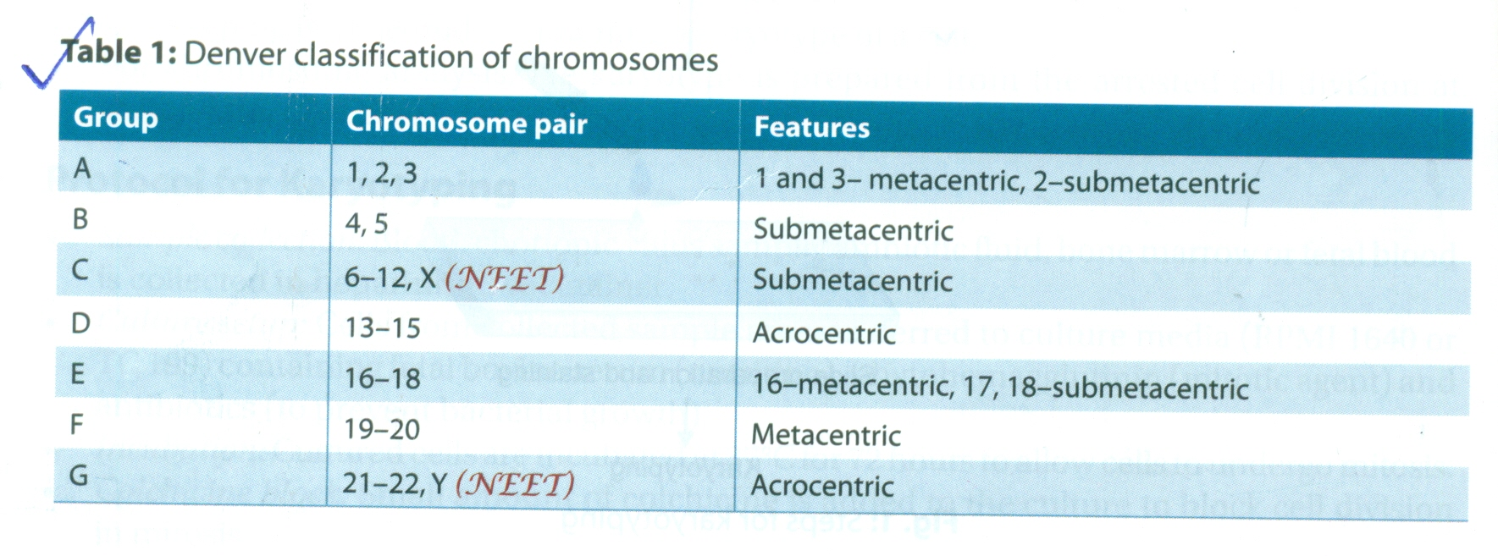
STRUCTURAL CLASSIFICATION OF CHROMOSOMES
EACH CHROMOSOME HAS TWO ARMS SHORT ARM OR p-ARM AND LONG ARM OR q-ARM.
BOTH THE ARMS AE CONNECTED WITH EACH OTHER BY CENTROMERE.ACCORDING TO THE POSITION OF CENTROMERE,CHROMOSOMES ARE CLASSIFIED AS UNDER.
METACENTRIC-CENTRAL CENTROMERE,(p=q) CHROMOSOME 1&3.
SUBMETACENTRIC-CENTROMERE NEAR CENTER(p<q) CHR,4&5.
ACROCENTRIC-CENTROMERE AT ONE END WITH SATELLITE BODIES.eg CHR.13,14,15.
TELOCENTRIC-CENTROMERE AT ONE END,ONLY ONE ARM.IN HUMAN TELOCENTRIC CHROMOSOMES ARE ABSENT.

Slide 11
CYTOGENETICS
CYTOGENETICS IS A BRANCH OF GENETICS THAT STUDIES THE NUMBER AND STRUCTURE OF THE CELL.
KARYOTYPING-KARYOTYPE IS COMPLETE CHROMOSOME SET OF A CELL. KARYOTYPING IS A METHOD OF OBTAINING A KARYOTYPE OF A CELL.FOR CHROMOSOME ANALYSIS,THE KARYOTYPE IS PREPARED FROM ARRESTED CELL DIVISION AT METAPHASE.
WHILE ARRANGING KARYOTYPE,ALL CHROMOSOMES ARE ARRANGED IN PAIRS IN THEIR CORRESPONDING GROUP,EXCEPT X AND Y THAT ARE ARRANGED AT THE END.

Slide 12
USES OF KARYOTYPING
IN CLINICAL DIAGNOSIS OF CHROMOSOMAL ABERRATIONS,CANCER,CHROMOSOMAL DEFECTS IN INFERTILITY.

Slide 13
CHROMOSOMAL ABERRATION
CHROMOSOMAL ABERRATION IS A CHROMOSOMAL ABNORMALITY THAT INVOLVES A MISSING,EXTRA OR IRREGULAR PORTION OF A CHROMOSOME.
CHROMOSOMAL ABERRATIONS ARE STUDIED WITH THE HELP OF KARYOTYPE.KARYOTYPE IS A FULL SET OF CHROMOSOME FROM A PATIENT.
ABNORMAL CHROMOSOME PRODUCES INHERITED ABNORMALITES.
CHROMOSOMAL ABERREATIONS ARE CLASSIFIED IN TO TWO GROUPS.
A. STRUCTURAL ABERRATIONS B. NUMERICAL ABERRATIONS

Slide 14
CLASSIFICATION OF STRUCTURAL CHROMOSOMAL ABERRATIONS.
DELETION-TERMINAL,INTERSTITIAL,MICRODELETION
TRANSLOCATION-ROBERTSONIAN,RECIPROCAL
INSERTION
INVERSION-PERICENTRIC,PARA CENTRIC
ISOCHROMOSOME
RING CHROMOSOME
DUPLICATION

Slide 15
FACTORS CAUSING CHROMOSOMAL ABERRATIONS
ADVANCED MATERNAL AGE
RADIATION
PARENTAL CHROMOSOMAL ABNORMALITIES
AUTOIMMUNE DISORDERS
NUTRITIONAL DEFICIENCIES
ALCOHOL,TOBACCO,DRUG EXPOSURE
INFECTION(VIRUS,BACTEREA)

Slide 16
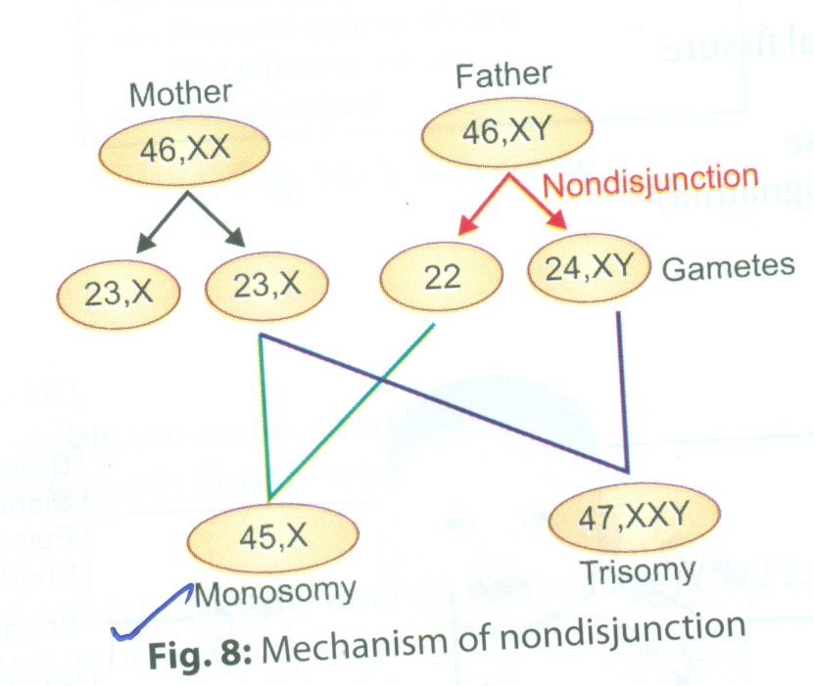
NUMERICAL CHROMOSOMAL ABERRATION
NONDISJUNCTION-IT IS THE FAILURE OF SEPARATION OF HOMOLOGOUS CHROMOSOMES OR SISTER CHROMATIDS DURING CELL DIVISION.

Slide 17
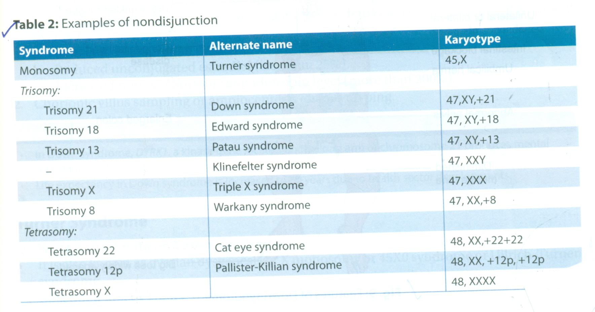
EXAMPLES OF NON DISJUNCTION

Slide 18
DOWN SYNDROME
IT IS ALSO KNOWN AS TRISOMY21 OR MONGOLISM
FIRST PATIENT WAS IDENTIFIED BY JOHN L.DOWN(1866)
KARYOTYPE:47,XY;+21OR 47,XX;+21
DERMATOGLYPHICS-SINGLE TRANSVERSE PALMAR CREASE,KNOWN AS SIMIAN CREASE.
INCIDENCE-1 IN 800 NEW BORN

Slide 19
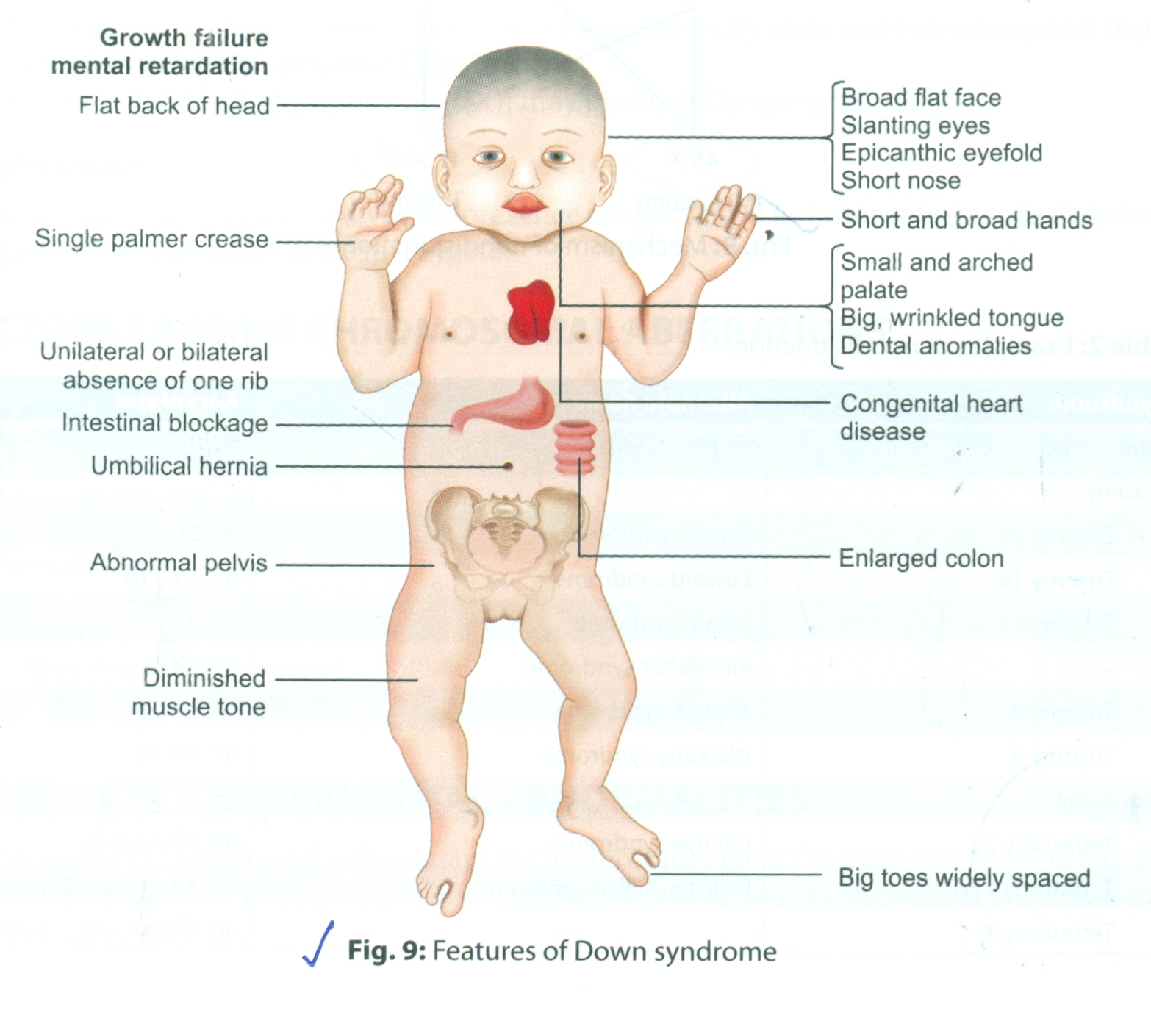
CLINICAL FEATURES

Slide 20
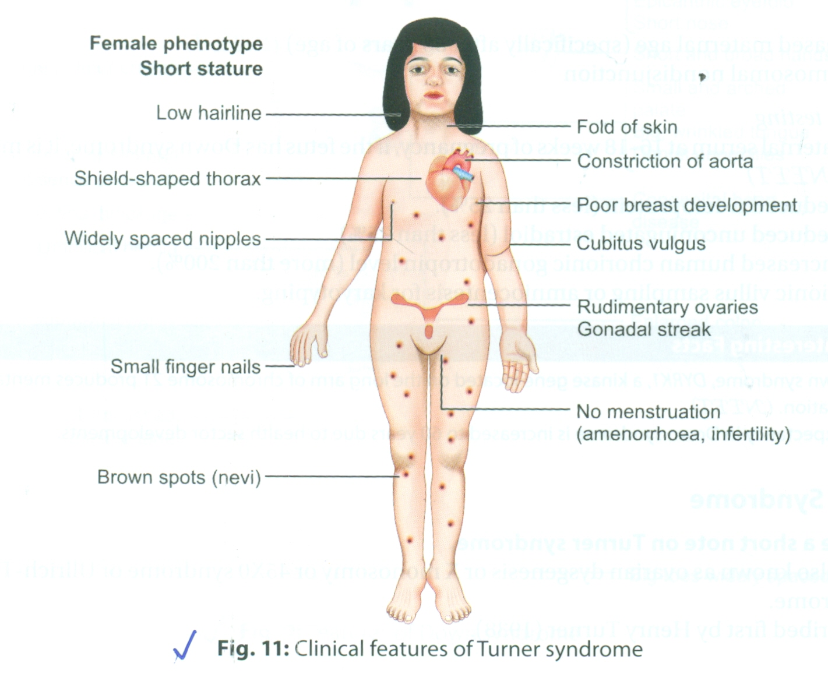
TURNER SYNDROME
IT IS ALSO KNOWN AS OVARIAN DYSGENESIS OR X MONOSOMY OR 45 XO SYNDROME.
DESCRIBED FIRST BY HENRY TURNER(1938).
KARYOTYPE: 45, X
PHENOTYPE: ABSENCE OF Y CHROMOSOME,FEMALE WITH OVARIAN DYSGENESIS.
INCIDENCE: 1 IN 2500-3000 NEW BORN GIRLS

Slide 21
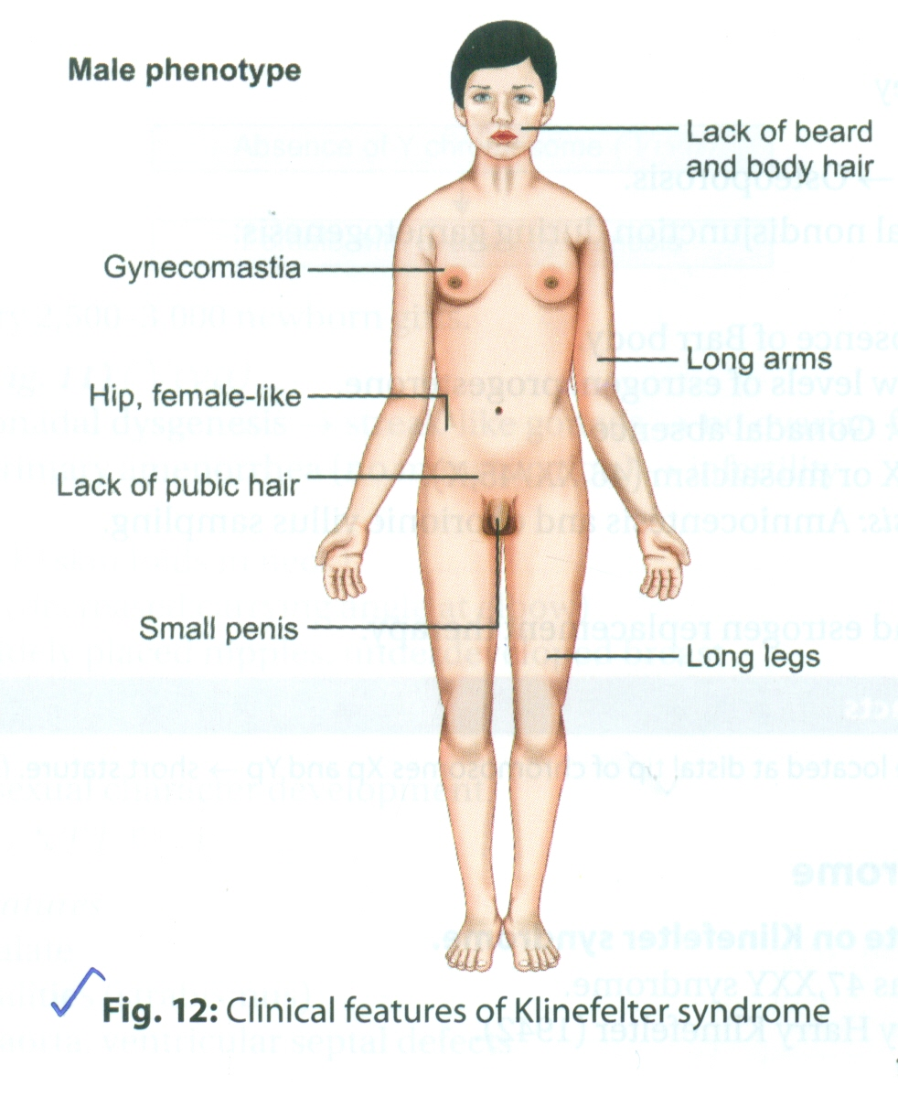
KLINEFELTER SYNDROME
IT IS ALSO KNOWN AS 47,XXY SYNDROME
FIRST DESCRIBED BY HARRY KLINEFELTER
PHENOTYPE-MALE
1 IN 1000 NEW BORN BOYS

Slide 22
TRANSCRIPTION-PROCESS OF mRNA SYNTHESIS FROM DNA
TRANSLATION-THE PROCESS OF PROTEIN SYNTHESIS FROM mRNA
GENE- GENES ARE DEFINED AS WORKING SUBUNITS OF DNA THAT ARE COMPOSED OF A SPECIFIC SEQUENCE OF CODONS AND MAY GET EXPRESSED IN THE PHENOTYPIC FORM(PROTEIN).
GENE IS A REGION OF DNA THAT ENCODES SPECIFIC FUNCTION.
GENE= EXONS+INTRONS
EXON-PART OF GENE THAT ENCODES IN TO MATURED mRNA.
INTRON-PART OF GENE THAT IS REMOVED BY RNA SPLICING DURING mRNA MATURATION.

Slide 23
HUMAN CHROMOSOMES HAVE 30,000 GENES
GENES ARE EITHER STRUCTURAL GENES(PRODUCES PROTEINS) OR REGULATORY GENES(PROMOTE OR INHIBIT ACTIVITY OF OTHER GENES).
GENOTYPE- GENES MADE UP OF DIFFERENT DNA SEQUENCES(TOTAL GENES OF A CELL) ARE CALLED GENOTYPE.
GENOTYPE+ENVIRONMENTAL FACTOR+DEVELOPMENTAL FACTORS=PHNOTYPE

Slide 24
LAWS OF INHERITANCE
MENDELS LAW-MENDEL STATED THREE LAWS,LAW OF DOMINANCE,LAW OF INCOMPLETE DOMINANCE AND LAW OF SEGREGATION.
LAW OF DOMINANCE- CROSSING BETWEEN ORGANISMS FOR CONTRASTING CHARACTERS OF A PAIR,ONLY ONE CHARACTER(DOMINANT) APPEARS IN THE FIRST GENERATION AND ANOTHER DOES NOT APPEAR(RECESSIVE).
EVERY CHARACTER IS CONTROLLED BY A PAIR OF THE GENES.
GENOTYPE- IT IS THE GENETIC CONSTITUTION OF AN ORGANISM WITH RESPECT TO A CHARACTER.
PHENOTYPE- THE PHENOTYPE IS THE EXTERNAL APPEARANCE(OR EXPRESSED PROTEINS) OF AN ORGANISMS WITH RESPECT TO A CHRRACTER.

Slide 25
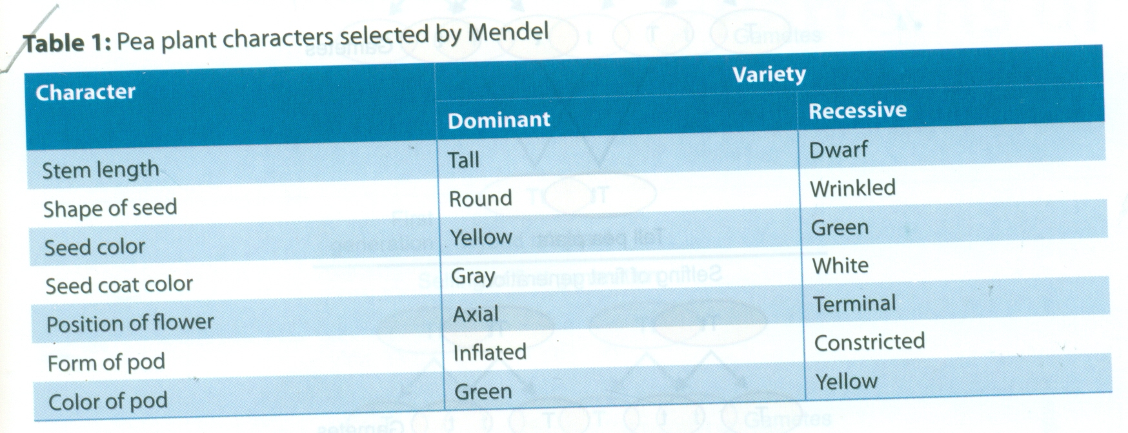
CHARACTERS STUDIED BY MENDEL

Slide 26
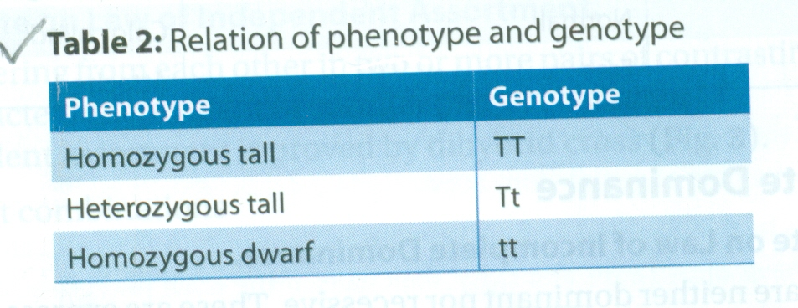
RELATION OF PHENOTYPE AND GENOTYPE

Slide 27
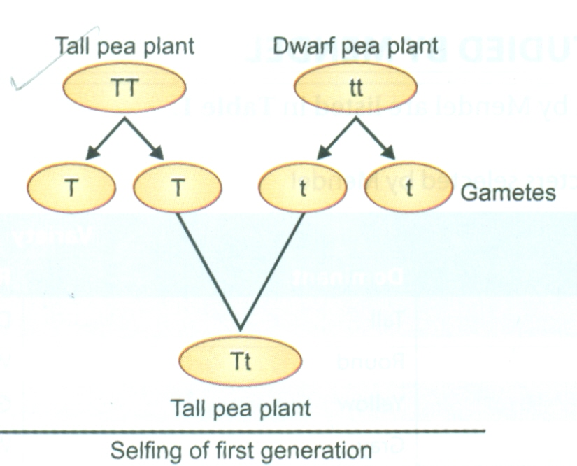
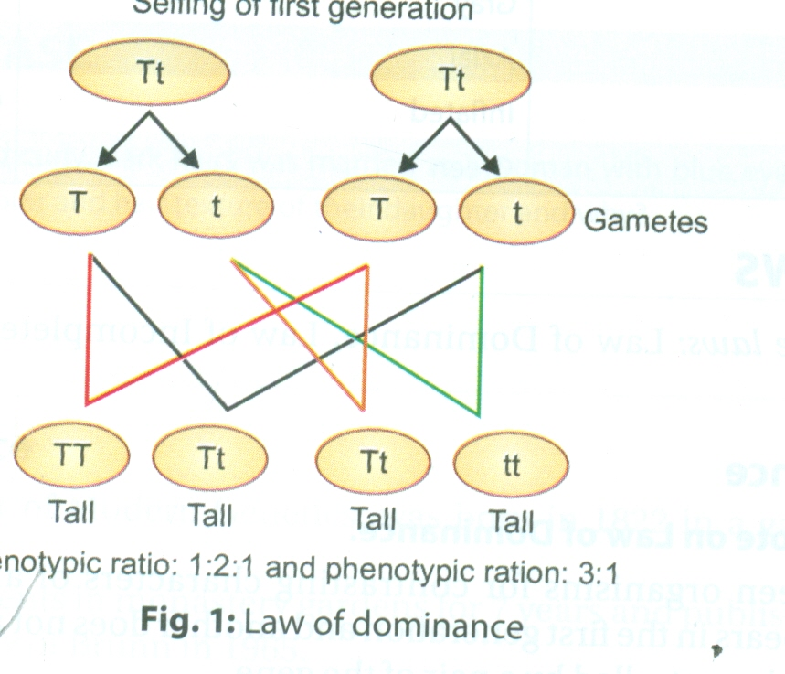
LAW OF DOMINANCE

Slide 28
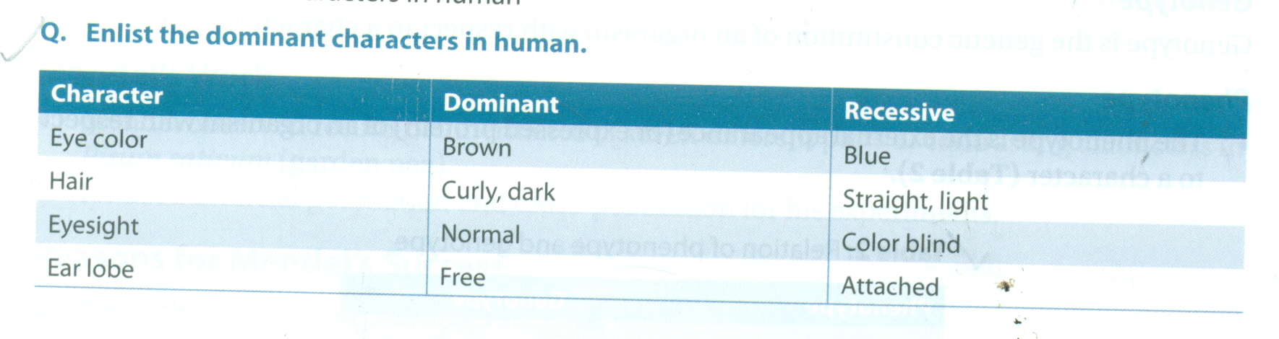
DOMINANT CHARACTERS IN HUMAN

Slide 29
LAW OF INCOMPLETE DOMINANCE
SOME CHARACTERS ARE NEITHER DOMINANT NOR RECESSIVE.THESE ARE EXPRESSED MID WAY BETWEEN TWO PARENTS.
FOR EXAMPLE,PLANT CROSSED WITH RED FLOWERS(RR) AND WHITE FLOWER(rr), FIRST GENERATION PLANTS BEAR PINK FLOWERS(Rr).

Slide 30
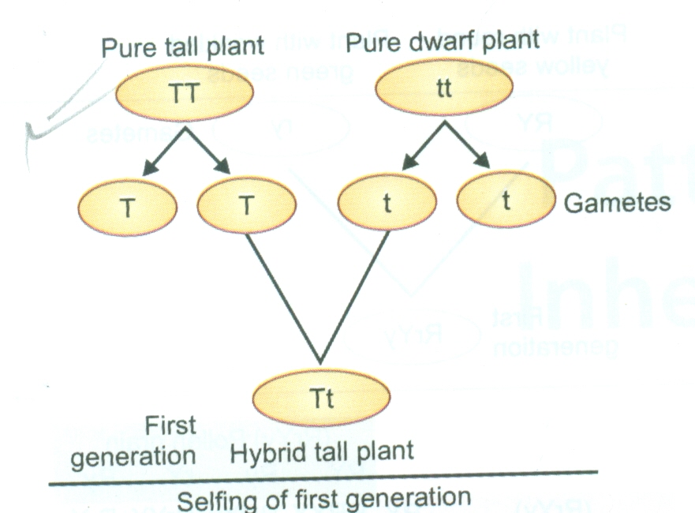
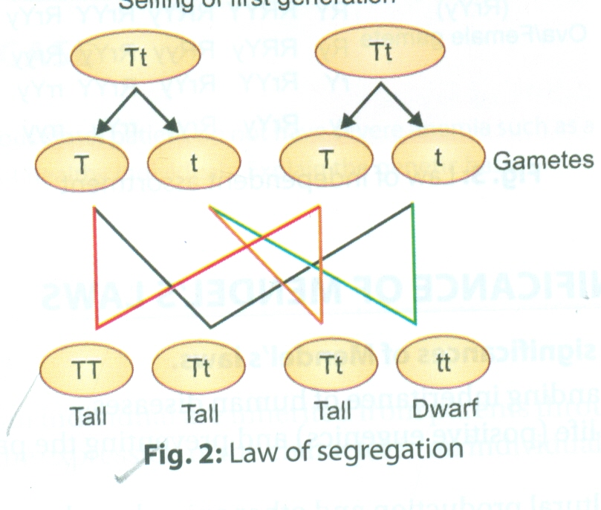
LAW OF SEGREGATION
A PAIR OF CONTRASTING CHARACTER IN A HYBRID FORM REMAINS TOGETHER WITHOUT MIXING WITH EACH OTHER AND SEGREGATES DURING FORMATION OF GAMETES.

Slide 31
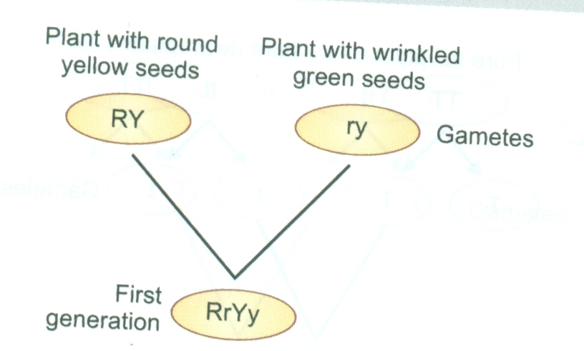
LAW OF INDEPENDENT ASSORTMENT
TWO PARENTS DIFFERING FROM EACH OTHER IN TWO OR MORE PAIRS OF CONTRASTING CHARACTERS INHERIT ONE PAIR OF CHARACTER INDEPENDENT OF ANOTHER PAIR OF CHARACTER.
LAW OF INDEPENDENT ASSORTMENT IS PROVED BY DIHYBRID CROSS.
GENOTYPE-9 DIFFERENT COMBINATIONS.
PHENOTYPE-9:3:3:1

Slide 32
BIOLOGICAL SIGNIFICANCE OF MENDELS LAW
USEFUL IN THE UNDERSTANDING INHERITANCE OF HUMAN DISEASES.
USEFUL FOR IMPROVING LIFE(POSITIVE EUGENICS) AND PREVENTING THE PASSAGE OF THE DISEASES TO NEXT GENERATIONS.
FOR INCREASING THE AGRICULTURE PRODUCTION AND OTHER ANIMAL PRODUCT.
FOR ELIMINATING RECESSIVE DISORDERS WITH THE HELP OF GENETIC COUNSELLING.

Slide 33
PATTERNS OF INHERITANCE
INHERITANCE- ALL THE CHARACTERS OF OF AN INDIVIDUAL ARE INHERITED FROM PARENTS THROUGH GENETIC COMPONENTS.
IN GENETIC DISORDER,THE EXPRESSION OF THE CHARACTER IN AN INDIVIDUAL DEPENDS ON THE CATEGORY OF THE DISEASE.
ALLELE- AN ALLELE IS A VARIANT FROM A GENE.
ALLELE OF THE SAME GENE IS LOCATED AT THE SAME POSITION ON THE CHROMOSOME
IN HUMAN,EACH GENE HAS TWO ALLELES,ONE INHERITED FROM THE MOTHER AND OTHER FROM THE FATHER.

Slide 34
HOMOZYGOUS AND HETEROZYGOUS
AN INDIVIDUAL IS CALLED HOMOZYGOUS FOR THE GENE IF HE HAS TWO IDENTICAL COPIES OF THE SAME ALLELE FOR THAT GENE(AA OR aa).
IF AN INDIVIDUAL HAS NON IDENTICAL COPIES OF THE SAME ALLELE(Aa),THE INDIVIDUAL IS CALLED HETEROZYGOUS FOR THAT GENE.
DOMINANT AND RECESSIVE- ALLELES CAN BE EITHER DOMINANT OR RECESSIVE. EACH ALLELE MAY HAVE A PHENOTYPE.IN HETEROZYGOUS CONDITION, IF ONE ALLELE IS EXPRESSED AND ANOTHER ALLELE IS MASKED,THEN THE EXPRESSED ALLELE IS CALLED DOMINANT AND MASKED ALLELE IS CALLED RECESSIVE.
CODOMINANT- IS THE CONDITION WHERE BOTH THE ALLELES ARE EXPRESSED SIMULTANEOUSLY TO GENERATE A MIXED PHENOTYPIC RESULT,eg.BLOOD GROUP CELLS

Slide 35
MULTIPLE ALLELES- MOST OF THE GENES EXIST IN THE FORM OF TWO ALLELES. SOME GENES HAVE MULTIPLE ALLELES FOR A PARTICULAR CHARACTER. FOR EXAMPLE,ABO BLOOD GROUP TYPE.
POLYGENIC TRAIT- IS A CHARACTER THAT IS DETERMINED BY MORE THAN ONE GENE.EXAMPLES ARE HEIGHT, WEIGHT,SKIN COLOUR.
PHENOTYPE- THE PHENOTYPE IS AN OUTWARD PHYSICAL CHARACTERSTIC MANIFESTATION OF THE ORGANISM. IT ALSO INCLUDES EXPRESSED PROTEINS,MACROMOLECULES,CELL ORGANELLES,CELL STRUCTURE OR FUNCTION AND BEHAVIOUR OF THE ORGANISM.
GENOTYPE- IT IS TOTAL GENETIC MAKE UP OF AN INDIVIDUAL THAT DETERMINES THE PHENOTYPE.
GENETIC DISORDER- A GENETIC DISORDER IS A CONDITION CAUSED DUE TO AN ABNORMALITY IN THE GENOME OF AN INDIVIDUAL.

Slide 36
THERE ARE THREE BASIC GENETIC DISORDERS:
1. SINGLE GENE DISORDER(MENDELIAN DISORDERS)-DEFECT IN A SINGLE GENE.
2. CHROMOSOMAL DISORDERS- DEFECT IN THE NUMBER OR STRUCTURE OF CHROMOSOMES.
3.MULTIFACTORIAL DISORDER- DEFECTIVE INTERACTION BETWEEN GENES AND ENVIRONMENTAL FACTORS(VIRUSES,DRUGS,FOOD)

Slide 37
SINGLE GENE INHERITANCE
MUTATION IN SINGLE GENE-MONOGENIC DISORDER-SHOWS SINGLE GENE INHERITANCE OR MENDELIAN INHERITANCE.
SINGLE GENE DISORDERS ARE GROUPED AS FOLLOWS
1. AUTOSOMAL DOMINANT
2. X-LINKED DOMINANT
3. X-LINKED RECESSIVE
4. Y-LINKED DISORDERS
AS Y-LINKED DISORDERS ARE CARRIED ONLY FROM FATHER TO SON,SEX LINKED DISORDER TERM IS CONFINED FOR X-LINKED DISORDERS.

Slide 38
AUTOSOMAL DOMINANT INHERITANCE
IN AUTOSOMAL DOMINANT DISORDER,EVEN IF A SINGLE GENE(ALLELE) IS PRESENT,IT IS EXPRESSED PHENOTYPICALLY AND PRODUCES A DISORDER.
FOR AUTOSOMAL DOMINANT STATE:
HETEROZYGOTIC STATE-MILD DISEASE
HOMOZYGOTIC STATE-SEVERE DISEASE(DUE TO BOTH ABNORMAL GENES).
COMMON FEATURES- AFFECTS IRRESPECTIVE OF SEX OF THE INDIVIDUAL.
-AFFECTS ALL GENERATIONS(VERTICAL PATTERN OF TRANSMISSION).

Slide 39
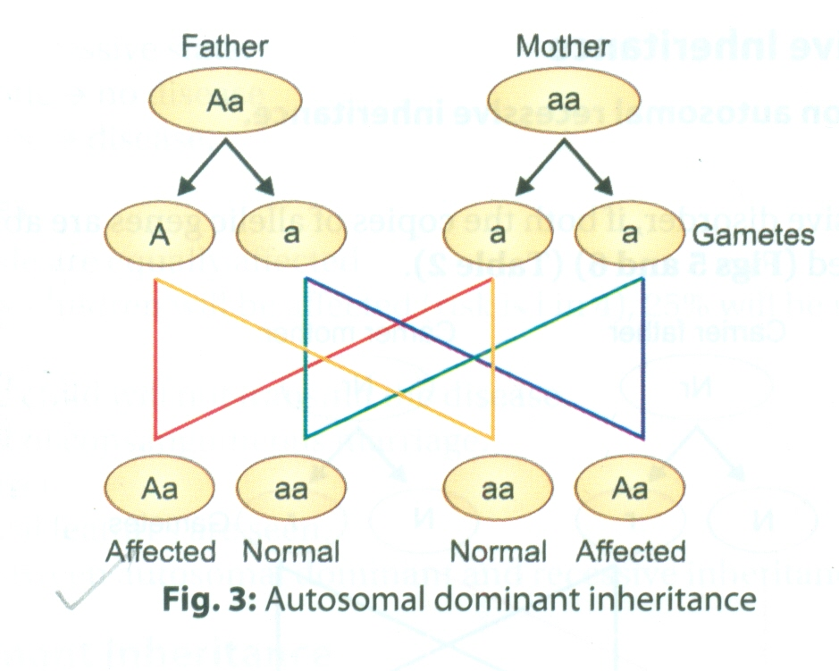
CONT.
50% OFFSPRING OF AFFECTED INDIVIDUAL WILL BE NORMAL AND 50% WILL BE AFFECTED.
NORMAL CHILD IS NOT CARRIER(DO NOT TRANSMIT THE DISEASE).
AFFECTED GENE MAY BE TRANSMITTED FROM OR BY NEW MUTATION DURING GAMETOGENESIS.
VARIABLE CLINICAL EXPRESSION.

Slide 40
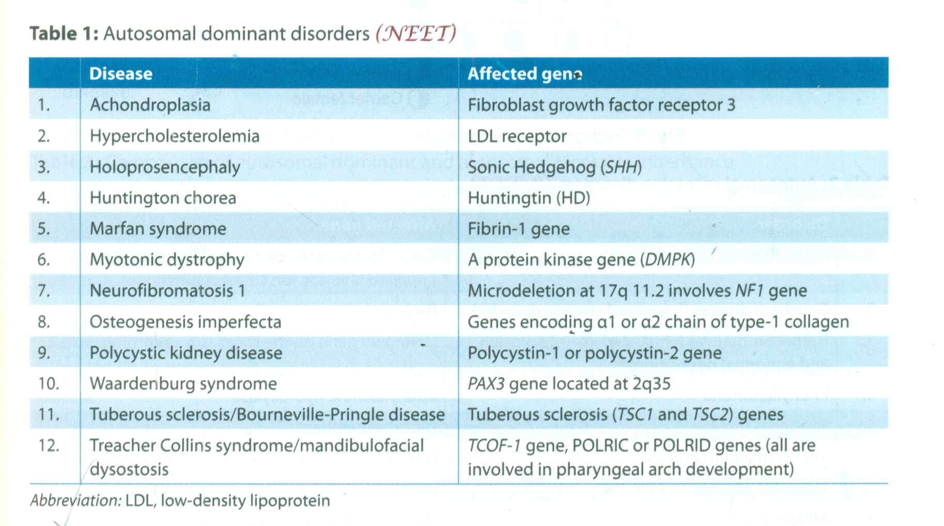
CONTD.
AUTOSOMAL DOMINANT INHERITANCE IS NOT RELATED TO CONSANGUINOUS MARRIAGE.
AFFECTED INDIVIDUAL MAY BE HOMOZYGOUS OR HETEROZYGOUS.

Slide 41
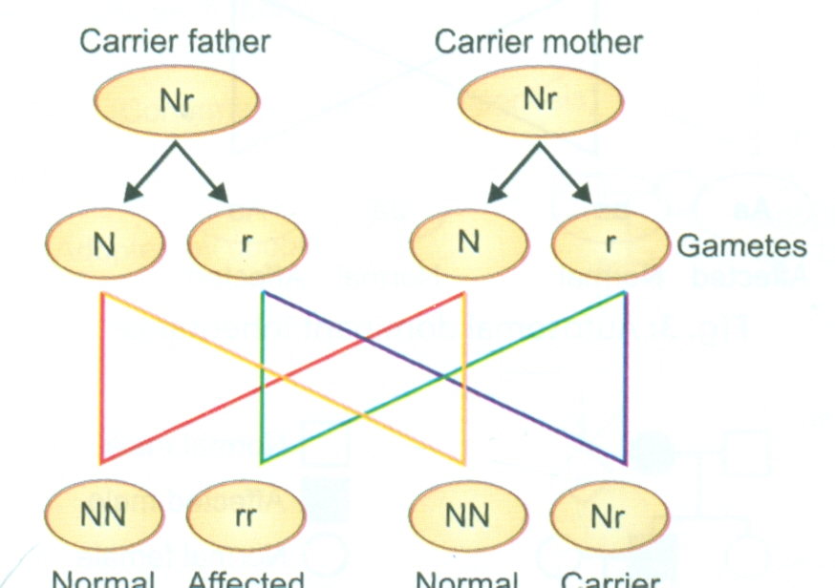
AUTOSOMAL RECESSIVE INHERITANCE
IN AUTOSOMAL RECESSIVE DISORDER,IF BOTH THE COPIES OF ALLELIC GENES ARE ABNORMAL THEN ONLY A DISEASE IS EXPRESSED.
FOR AUTOSOMAL RECESSIVE STATE:
HETEROZYGOTIC STATE- NO DISEASE
HOMOZYGOTIC- DISEASE

Slide 42
COMMON FEATURES
MALE AND FEMALE ARE EQUALLY AFFECTED
PREDICTION: 25% CHILDREN WILL BE AFFECTED,25% WILL BE NORMAL AND 50% WILL BE CARRIER.
THE UNAFFECTED CHILD WILL NOT TRANSMIT THE DISEASE.
MAY BE A RESULT OF CONSANGUINOUS MARRIAGE.
EARLY AGE OF ONSET.
CONSTANT CLINICAL FEATURES ARE SEEN.

Slide 43
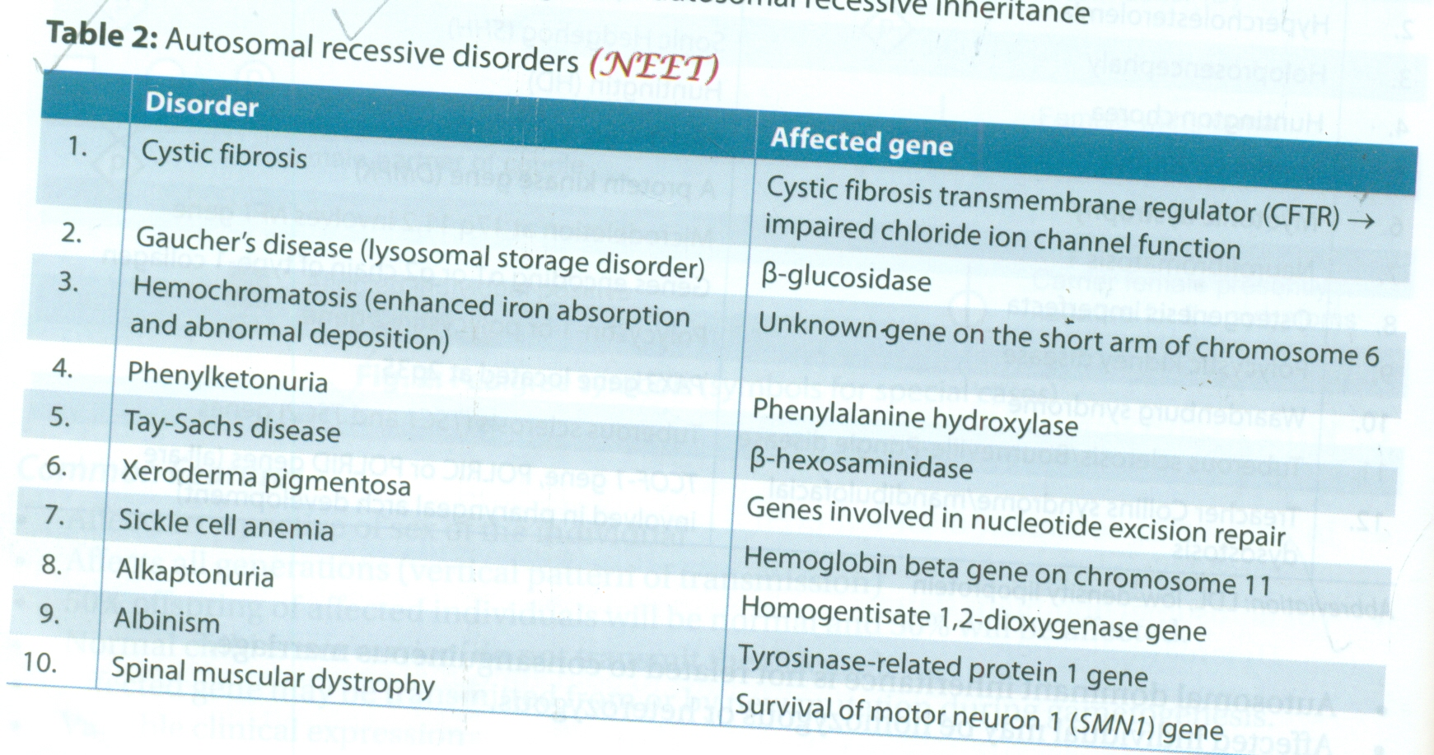
AUTOSOMAL RECESSIVE DISORDER

Slide 44
X-LINKED DOMINANT INHERITANCE
X-LINKED DOMINANT INHERITANCE IS A PATTERN OF INHERITANCE THAT INVOLVES MUTATED DOMINANT GENE OF X-CHROMOSOMES.
ONLY ONE EFFECTED GENE CAN PRODUCE DISEASE.
NO MALE PREPONDERANCE SUCH AS X-LINKED RECESSIVE DISORDERS.
ALL THE DAUGHTERS OF AFFECTED MALE WILL ALSO BE AFFECTED AND ALL SONS OF AFFECTED MOTHER WILL ALSO BE AFFECTED.
MALES HAVE ONLY ONE X-CHROMOSOME,THAT,IS HEMIZYGOUS MALES ALWAYS SHOW AGGRAVATED DISEASE.

Slide 45
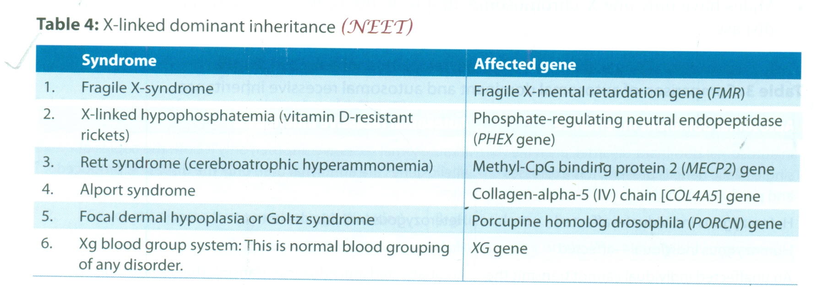
CONTD.

Slide 46
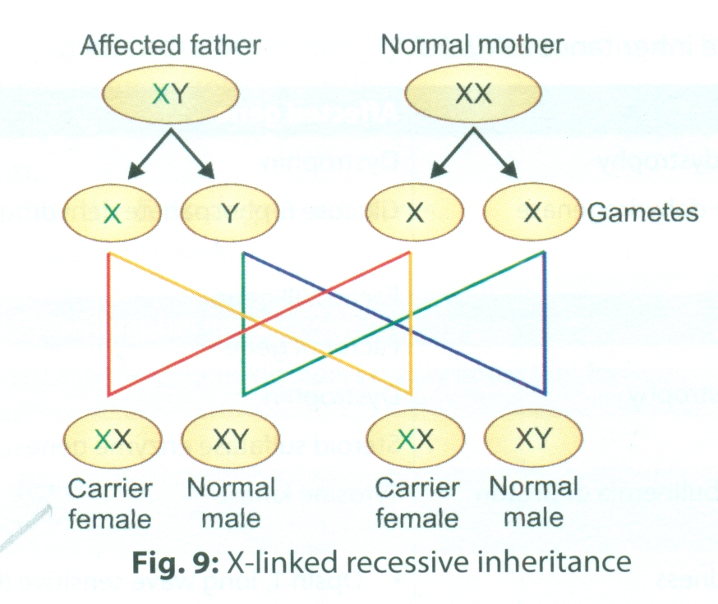
X-LINKED RECESSIVE INHERITANCE
X-LINKED RECESSIVE INHERITANCE IS A PATTERN OF INHERITANCE THAT INVOLVES MUTATED RECESSIVE GENE OF X-CHROMOSOME.
EXPRESSION- HOMOZYGOUS FEMALE-AFFECTED CASE
HETEROZYGOUS FEMALE-CARRIER
HEMIZYGOUS MALE-AFFECTED CASE
COMMON CHARACTERISTICS- THE HETEROZYGOUS FEMALE IS A CARRIER AND THE HOMOZYGOUS FEMALE IS AFFECTED CASE.
AS MALES CARRY ONLY ONE X-CHROMOSOME(HENCE HEMIZYGOUS),THEY HAVE THE DISEASE.

Slide 47
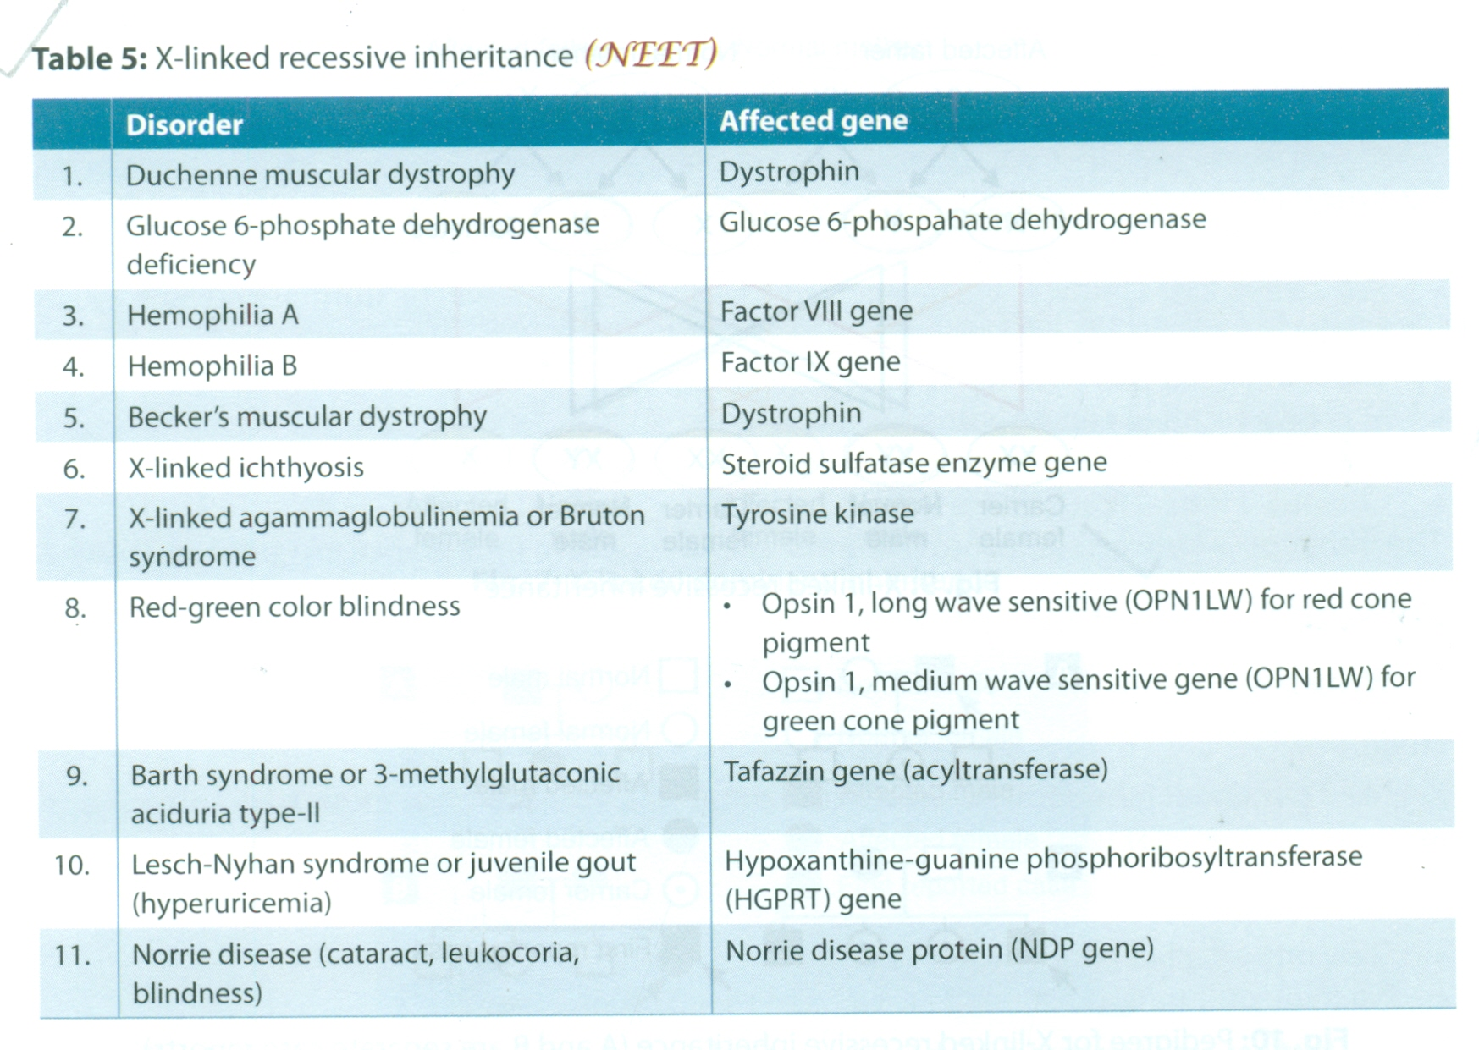
CONTD.
SONS OF AFFECTED MOTHER ARE ALWAYS AFFECTED.
DAUGHTER OF THE AFFECTED FATHER IS A CARRIER,IF THE MOTHER IS NORMAL.
SONS OF THE AFFECTED FATHER ARE NORMAL.
MORE COMMON IN MALES.

Slide 48
Y-LINKED INHERITANCE/HOLANDRIC INHERITANCE
THE PATTERN OF INHERITANCE OF MUTATED Y-CHROMOSOME GENE FROM FATHER TO SON IS CALLED Y-LINKED INHERITANCE.
COMMON FEATURES- AFFECTS ONLY THE MALE
ALL SONS OF AFFECTED MALES ARE ALSO AFFECTED
FEMALES ARE NEITHER AFFECTED NOR A CARRIER.

