Slide 1
EARLY CLINICAL EXPOSURE
DR RAKESH GUPTA
PROFESSOR & HEAD
DEPARTMENT OF ANATOMY
RMCH

Slide 2
LEARNING OBJECTIVES
  Understand the rationale of early clinical exposure
  Plan teaching - learning methods around clinical scenarios
  Use ECE to orient students to basic clinical methods and soft clinical skills ( communication, professionalism,ethics etc.)

Slide 3
Clinical exposure:-
  “Authentic human contact in a social or clinical context that enhances learning of health, illness and/or disease, and the role of a health professional”
Early:-
  The pre-clinical phase, usually the first two years

Slide 4
What is early clinical exposure?
A teaching learning methodolgy, which exposes the medical students to the patients as early as the first phase of medical college

Slide 5
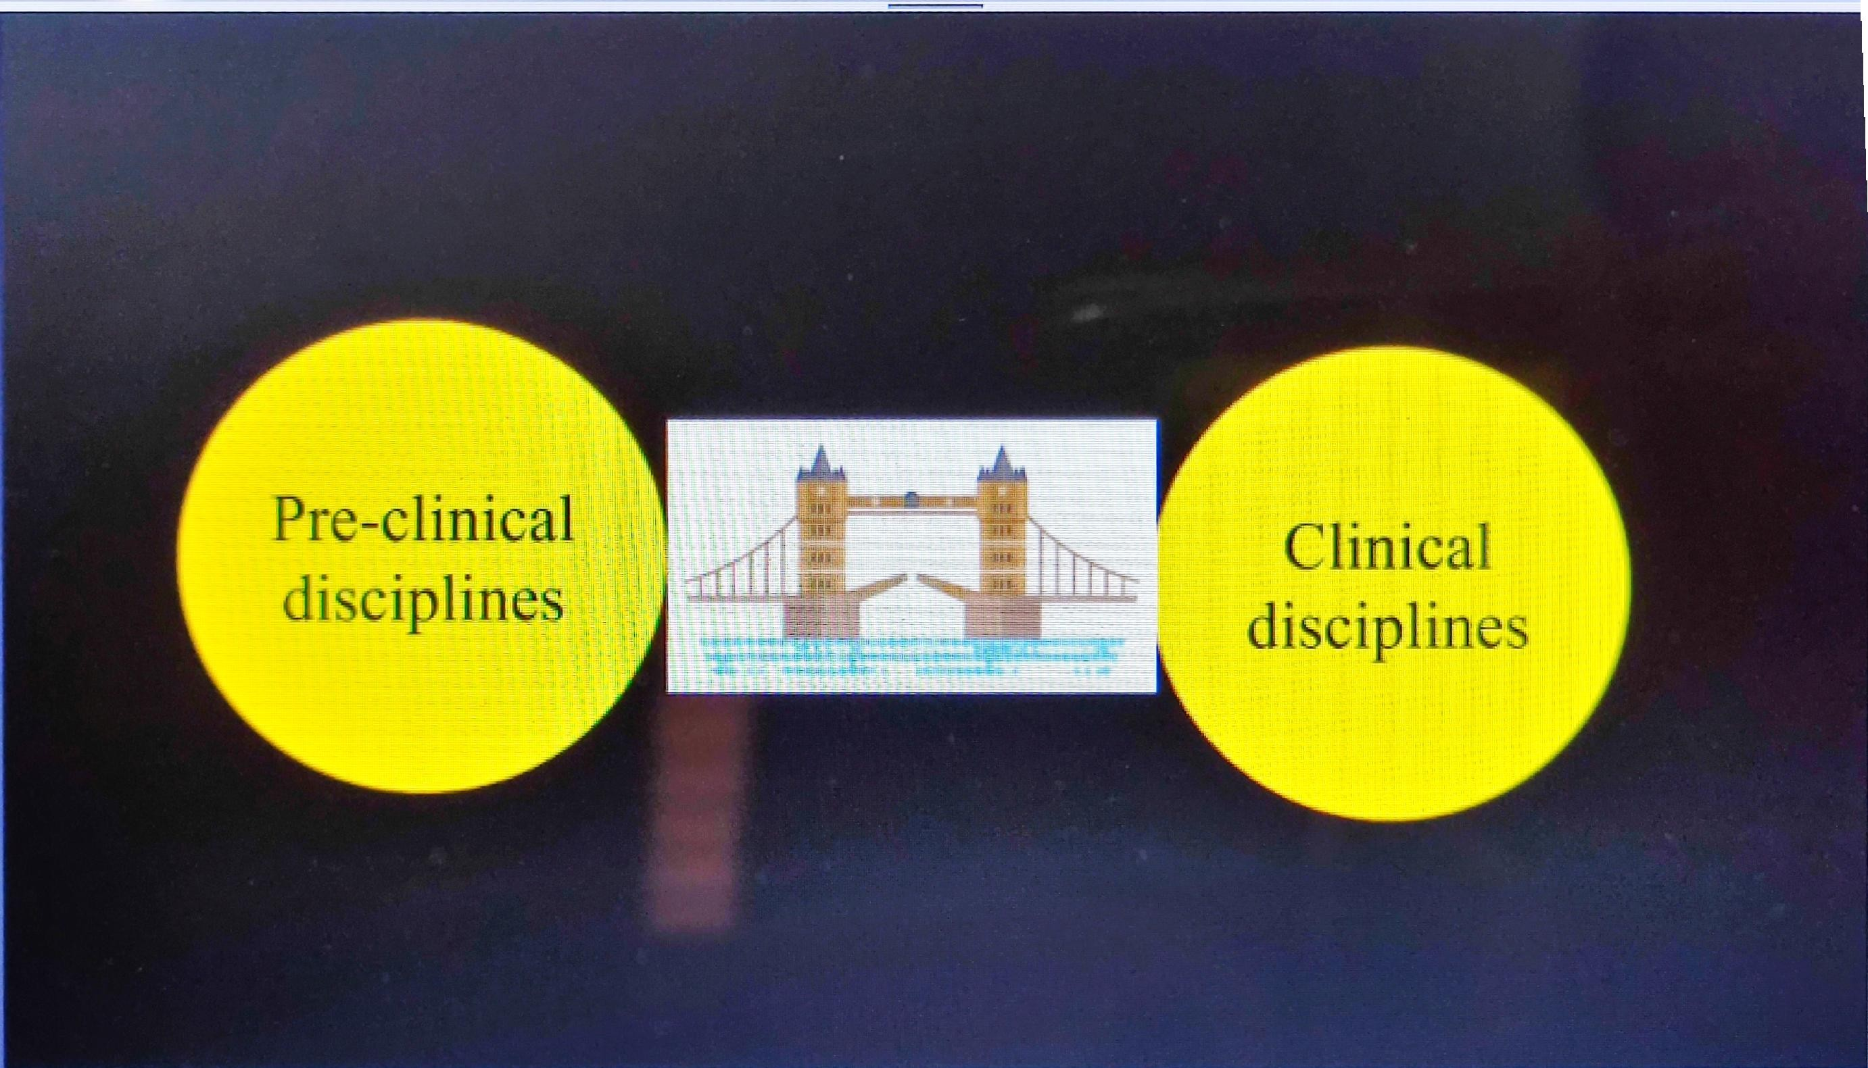

Slide 6
OBJECTIVES OF EARLY CLINICAL EXPOSURE
Recognize the relevence of basic sciences in diagnosis, patient care & treatment
Relate to experience of patients as a motivation to learn
Recognize attitude, ethics & professionalism as integral to doctor patient relationship

Slide 7
TIME ALLOTTED
90 hrs. in phase 1
30 hrs. each with Anatomy, Physiology & Biochemistry

Slide 8
ELEMENTS OF ECE
Three elements:-
  Basic science correlation
  Clinical skills
  Humanites

Slide 9
STRUCTURE OF THE PROGRAM
Basic science correlation:
  (18hrs.: one 3hr session/month x 6 months)
Clinical skills:
  (12 hrs: one 3 hrs session/month x 4 months)
Humanites:
  Merged with AETCOM

Slide 10
A. ECE FOR BASIC SCIENCES CORRELATION
(18 hrs : one 3 hrs session/month x6 months)

Slide 11
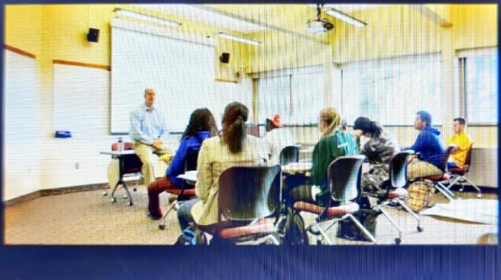
1.CLASSROOM SETTING

Slide 12

What to take to the classroom ?
Paper cases
Photographs, Charts, Videos
X-rays, Laboratory reports,ECG
Patient(actual/simulated)
Role plays

Slide 13
Creating cases
Planning the case
Constructing the case
Formatting the case
Preparing the use of case

Slide 14
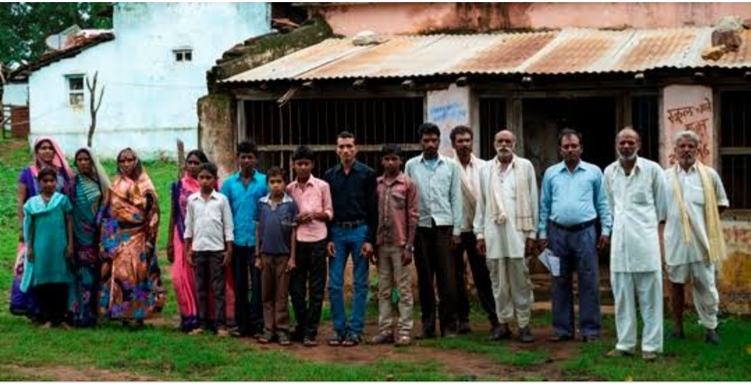
2.COMMUNITY SETTING
community visit

Slide 15
B. ECE FOR CLINICAL SKILLS
(12hrs : one 3hr session/month X 4 months)

Slide 16
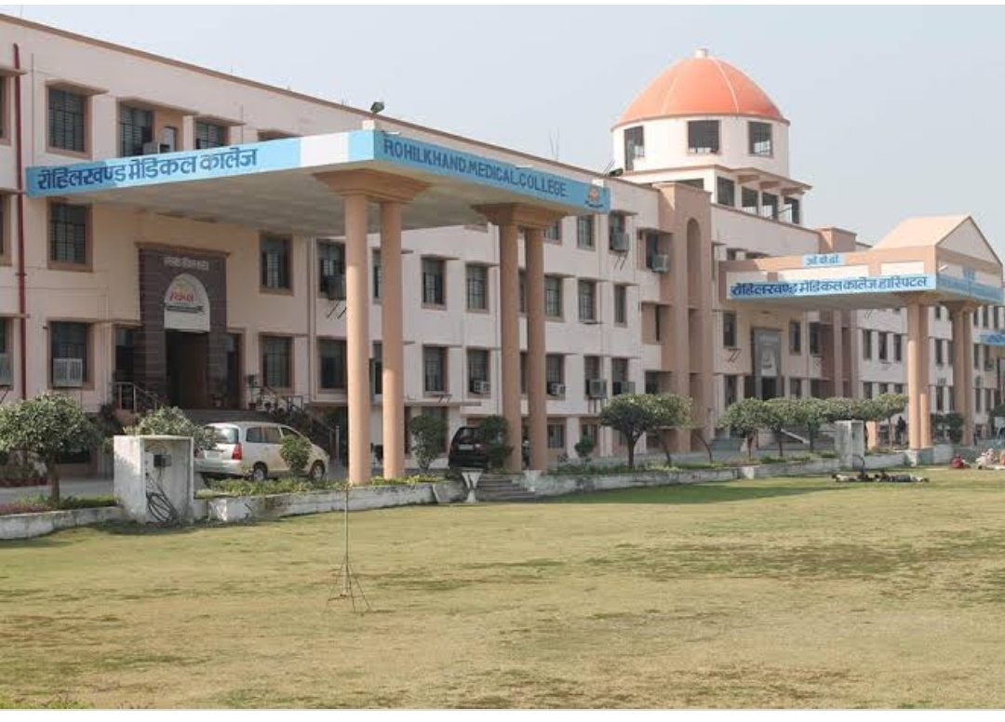
Hospital setting
Hospital visit

Slide 17
Who will demonstrate & where ?
Preclinical faculty or clinicians
In OPDs, Wards, Demo rooms as feasible in small groups

Slide 18
Break up of clinical sessions
1. Introduction & Instruction:- 30 minutes
2. Actual clinical experience:- 1 hr 30 minutes
3. Summary & conclusion:- 30 minutes
4. Reflection:- 30 minutes

Slide 19
What to take along for the actual clinical experience?

Slide 20
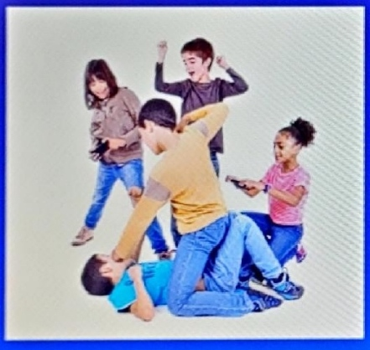
Observe & comment......
                Observation Guide

Slide 21
Actual process
A group of students are posted to the OPD
Instruction to students:
  During the consultation with a post myocardial infarction patient, observe the interaction carefully

Slide 22
Observation guide 1
(for group 1)
Note down the lifestyle & dietary modifications adviced by the doctor to prevent reoccurence of MI

Slide 23
Observation guide 2
(for group 2)
Observe the communication between the doctor & patient.
List all the points in the communication that helped the patient understand
Also list a few points that could have helped more

Slide 24
How can we use guides???
Can be used in a variety of ways:-
    Students observing same aspect &comparing notes
    Students observing different aspects and sharing notes
    All summarise & conclude
    Reflection writing

Slide 25
DESIGNING ECE MODULE
What is setting?
State the expected competency & learning objectives
Plan learning experiences(oservation guides)
How will you implement it? What are the challenges/ How will you overcome them?
Plan evaluation of the ECE curriculum/ module

Slide 26
ASSESSMENT
Formative as well as summative examinations
Two questions in each paper in all assessments must be from ECE(PBQs, SAQs, MCQs,OSPE)
Formative assessment: logbook entries

Slide 27
FACULTY DEVELOPMENT
Preclinical & clinical faculty need to coordinate with each other
Clinical faculty must be involved in planning of the sessions

Slide 28
THANK YOU

