Slide 1
OCULOMOTOR NERVE
The oculomotor nerve has two motor nuclei (1) the main motor nucleus (2) the accessory parasympathetic nucleus
The main oculomotor nucleus is situated in the anterior part of the gray matter that surrounds the cerebral aqueduct of the mid brain.
It lies at the level of the superior colliculus.
The nucleus consists of groups of nerve cells that supply all the extrinsic muscles of the eye except the superior oblique and lateral rectus.
The outgoing nerve fibres pass anteriorly through the red nucleus and emerge on the anterior surface of the midbrain in the interpeduncular fossa.

Slide 2
CONT.
The main oculomotor nucleus receives corticonuclear fibres from both cerebral hemisphere.
It receives tectobulbar fibres from the superior colliculus and,through this route,receives information from the visual cortex.
It also receives fibres from the medial longitudinal fasciculus,by which it is connected to the nuclei of the fourth,sixth,and eighth cranial nerve.
The accessory parasympathetic nucleus(Edinger-Westphal nucleus)-is situated posterior to the main oculomotor nucleus.
The axons of the nerve cells,which are preganglionic,accompany the other oculomotor fibres to the orbit.here they synapse in the ciliary ganglion,and postganglionic fibres pass through the short ciliary nerves to the constictor pupillae of the iris and the ciliary muscles.

Slide 3
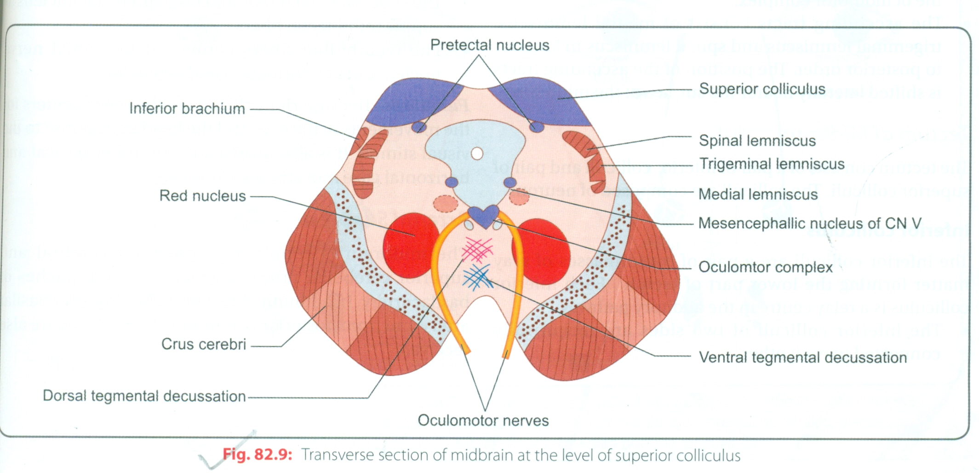
CONT.
The accessory parasympathetic nucleus receives corticonuclear fibres for the accomodation reflex and fibres from the pretectal nucleus for the direct and consensual light reflex.

Slide 4
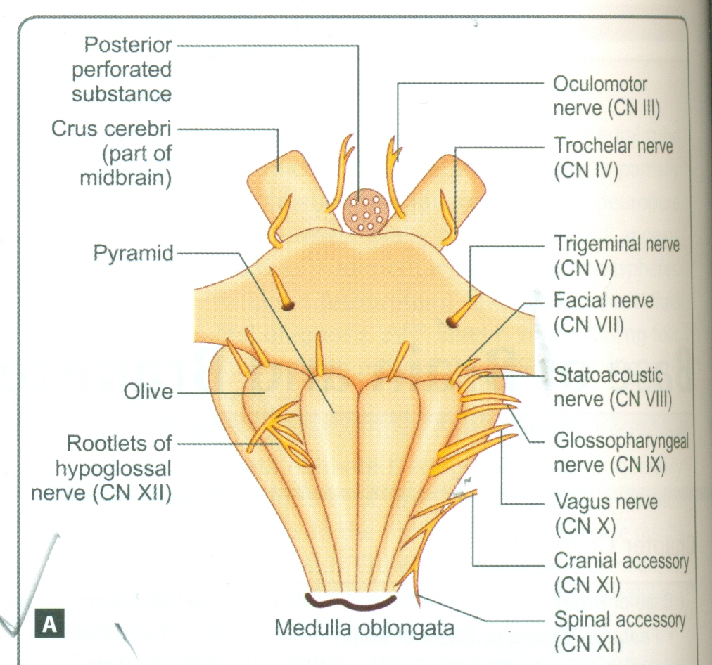
COURSE OF THE OCULOMOTOR NERVE
The oculomotor nerve emerges on the anterior surface of the mid brain.
It passes forward between the posterior cerebral artery and superior cerebellar artery,
It then continues in to the middle cranial fossa in the lateral wall of the cavernous sinus.here, it divides in to a superior and an inferior ramus,which enter the orbital cavity through the superior orbital fissure.
The oculomotor nerve supplies the following extrinsic muscles of the eye :the levator palpebrae superioris,superior rectus,medial rectus,inferior rectus and inferior oblique.

Slide 5
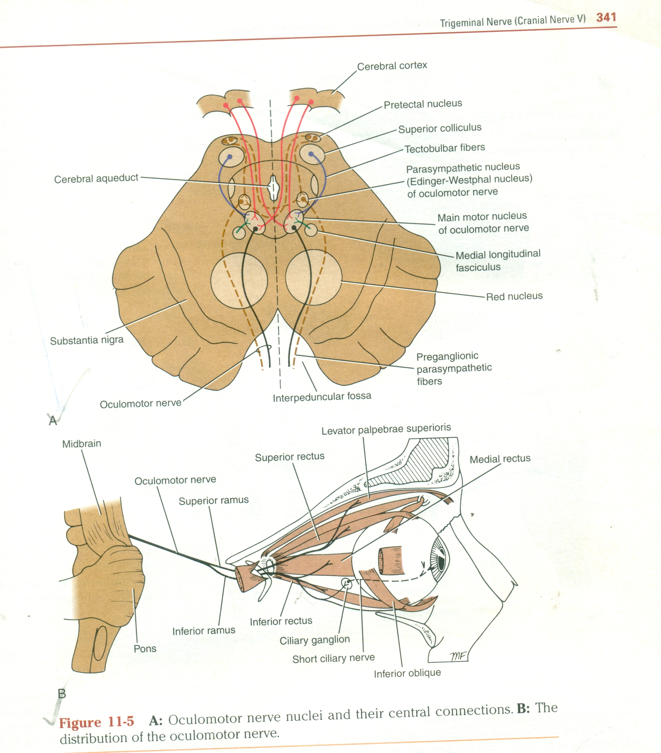
CONT.
It also supplies,through its branch to the ciliary ganglion and short ciliary nerves.
Prasympathetic nerve fibres to the following intrinsic muscles: the constrictor pupillae of the iris and ciliary muscles.
Therefore,the oculomotor nerve is entirely motor and is responsible for lifting the upper eye lid;turning the eye upward ,and medially;constricting the pupil,and accomodating the eye.

Slide 6
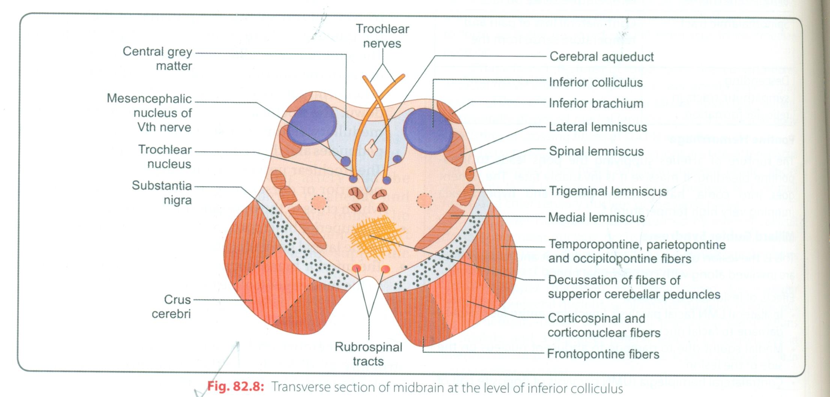
TROCHLEAR NERVE
The trochlear nerve is entirely motor in function.
Trochlear nerve nucleus-the trochlear nucleus is situated in the anterior part of the gray matter that surrounds the cerebral aqueduct of the mid brain.
It lies inferior to the oculomotor nucleus at the level of the inferior colliculus.
The nerve fibres,after leaving the nucleus,pass posteriorly around the central gray matter to reach the posterior surface of the mid brain .
The trochlear nucleus receives corticonuclear fibres fom both cerebral hemisphere.

Slide 7
CONT.
It receives the tectobulbar fibres, which connects it to the visual cortex through the superior colliculus .
It also receives fibres from the medial longitudinal fasciculus ,by which it is connected to the nuclei of the third,sixth and eighth cranial nerves.

Slide 8
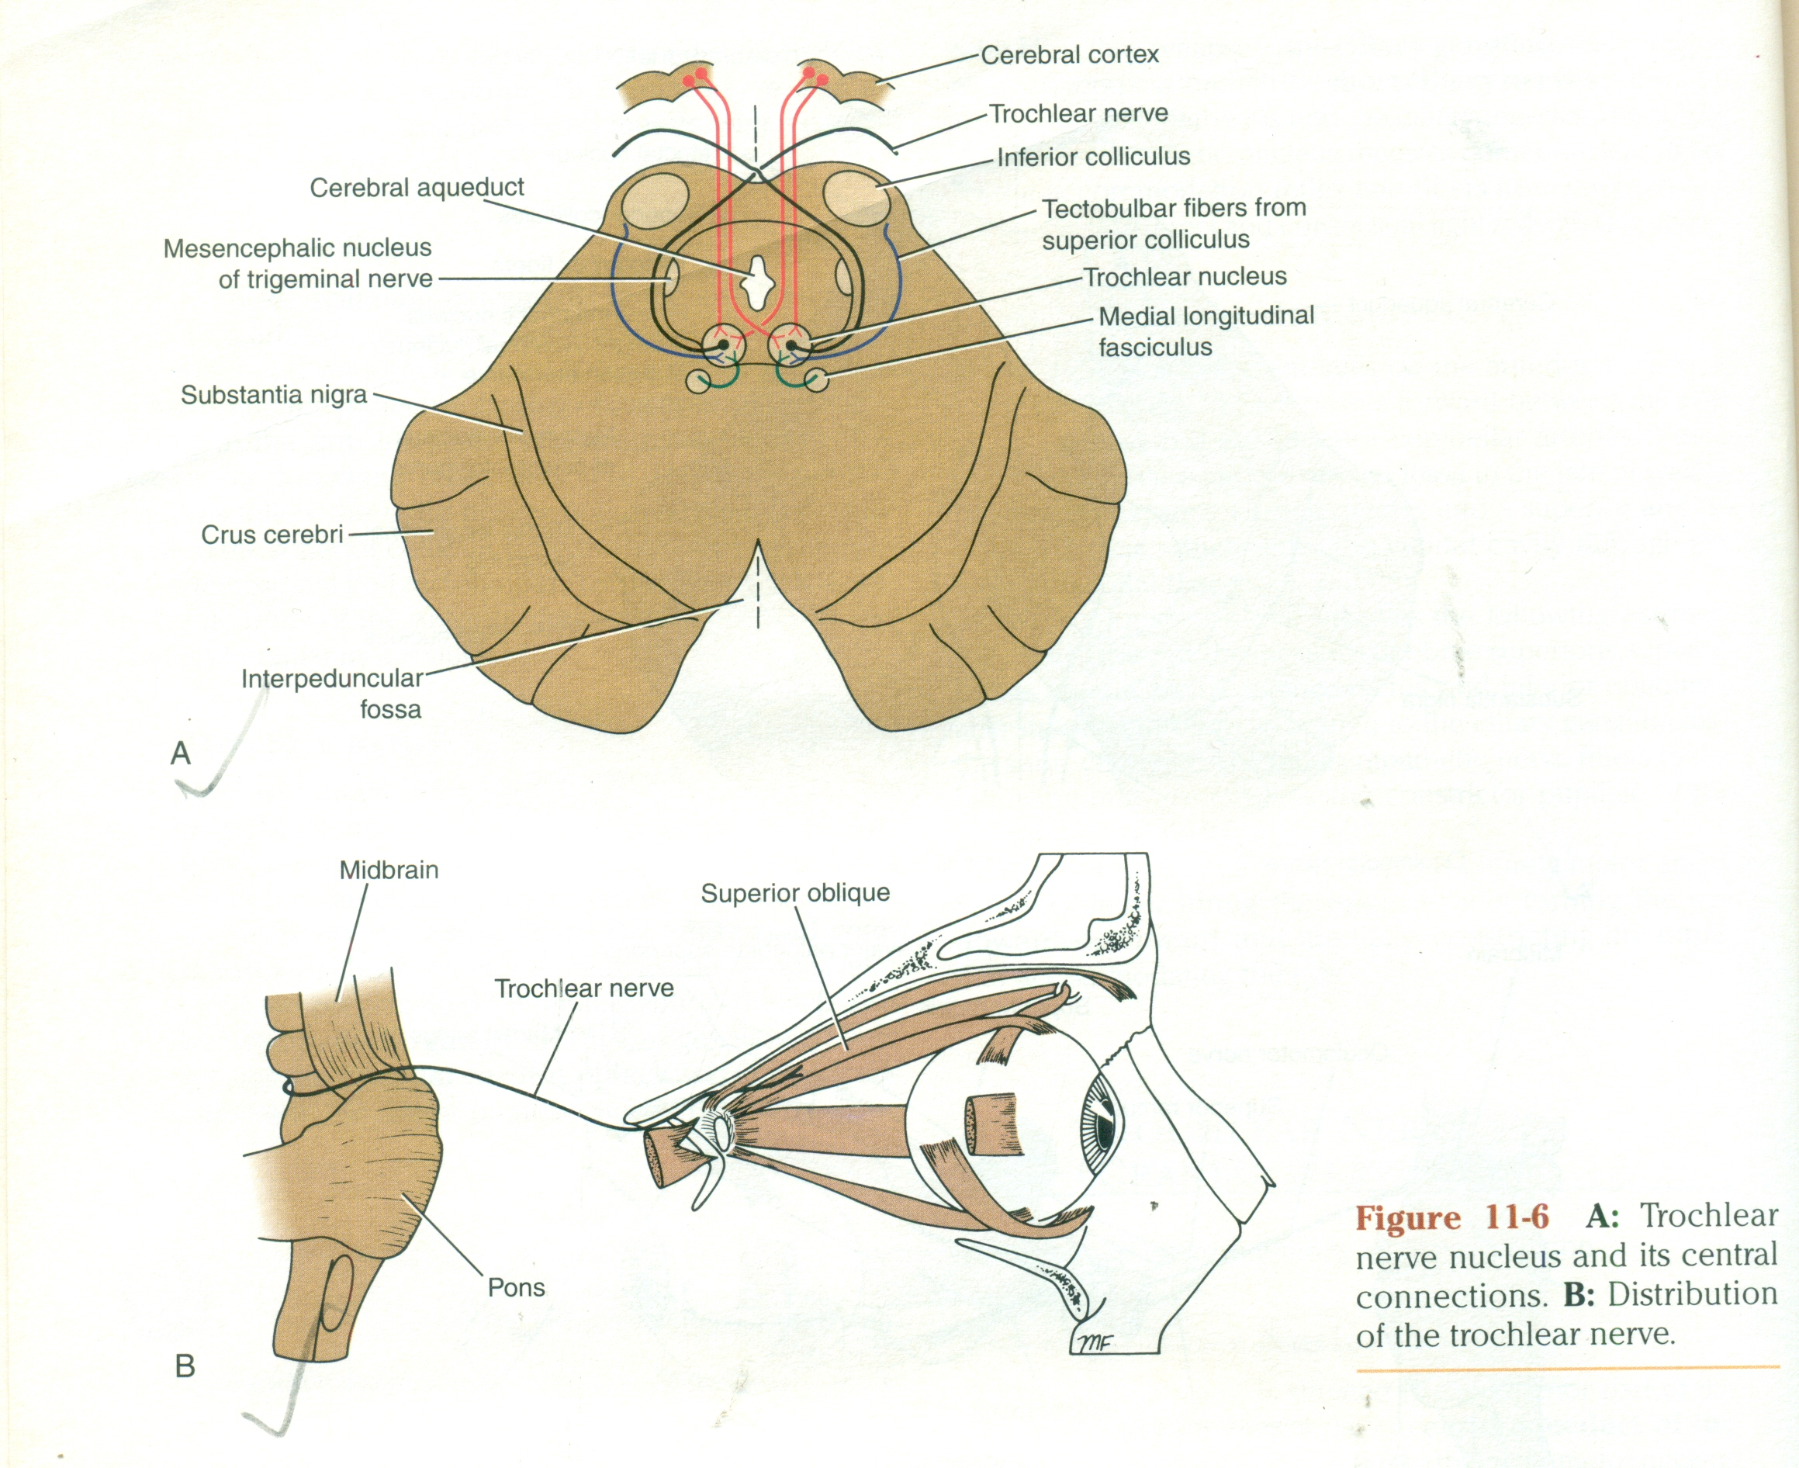
COURSE OF THE TROCHLEAR NERVE
The trochlear nerve,the most slender of the cranial nerves and the only one to leave the posterior surface of the brain stem.
Emerges from the mid brain and immediately decussates with the nerve of the opposite side.
The trochlear nerve passes forward through the middle cranial fossa in the lateral wall of cavernous sinus and enters the orbit through the superior orbital fissure.
The nerve supplies the superior oblique muscle of the eye ball.
The trochlear nerve is entirely motor and assists in turning the eye downward and laterally.

Slide 9
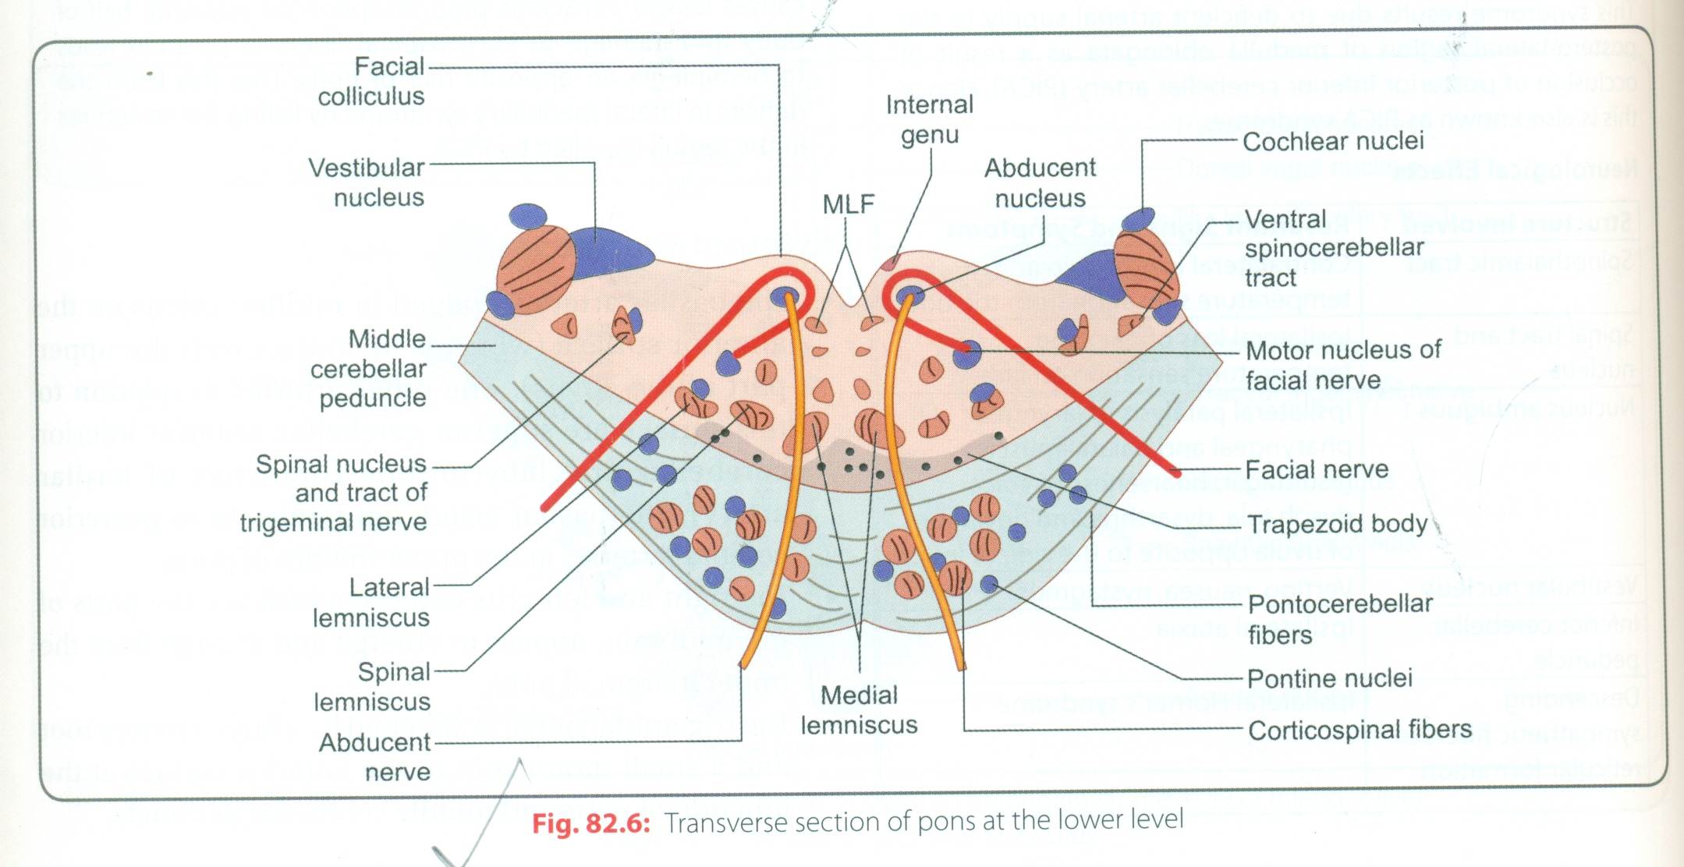
ABDUCENT NERVE
The abducent nerve is a small motor nerve that supplies the lateral rectus muscle of the eye wall.
Abducent nerve nucleus is small motor nucleus situated beneath the floor of the upper part of the fourth ventricle,close to the midline and beneath the facial colliculus.
The nucleus receives afferent corticonuclear fibres from both cerebral hemisphere.
It receives the tectobulbar tract from the superior colliculus,by which the visual cortex is connected to the nucleus.
It also receives fibres from the medial longitudinal fasciculus ,by which it is connected to the nuclei of the third,fourth,and eighth cranial nerves.

Slide 10
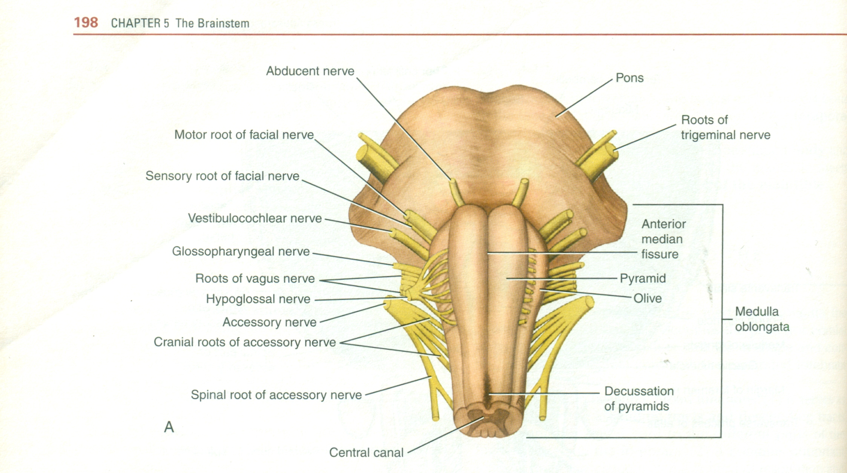
COURSE OF THE ABDUCENT NERVE
The fibres of The abducent nerve pass anteriorly through the pons and emerge in the groove between the lower border of the pons and the medulla oblongata.
It passes forward through the cavernous sinus lying below and lateral to the internal carotid artery.
The nerve then enters the orbit through the superior orbital fissure.
The abducent nerve is entirely a motor nerve and supplies the lateral rectus muscle and,therefore ,is responsible for turning the eye laterally.

