Slide 1
CEREBELLUM
The cerebellum plays a very important role in the control of posture and voluntary movements.
It unconsciously influences the smooth contraction of voluntary muscles and carefully coordinates their actions.
Each cerebellar hemisphere controls muscular movements on the same side of the body and that the cerebellum has no direct pathway to the lower motor neurons but exerts its controls via the cerebral cortex and the brain stem.

Slide 2
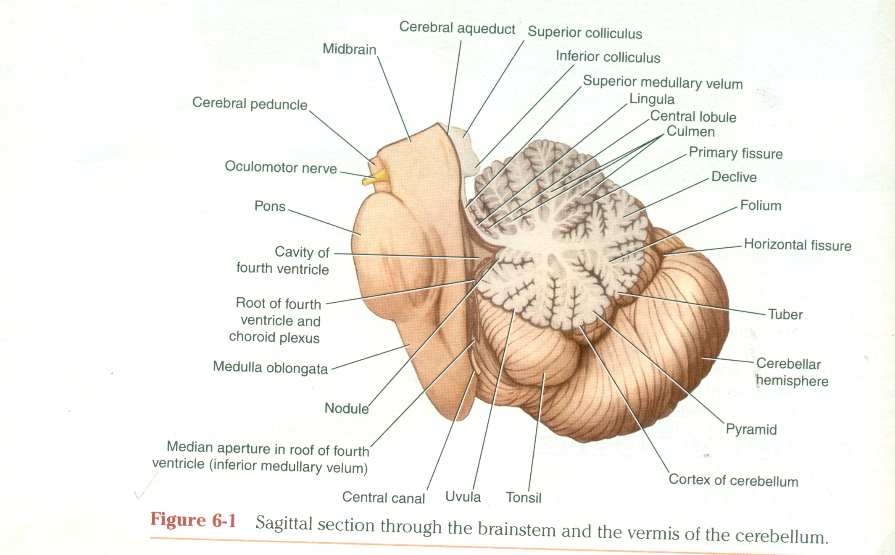
GROSS FEATURES OF CEREBELLUM
The cerebellum is situated in posterior cranial fossa and is covered superiorly by the tentorium cerebelli.
It is the largest part of the hind brain and lies posterior to the fourth ventricle,the pons,and the medulla.
The cerebellum is some what ovoid in shape and constricted in its median part.
It consists of two cerebellar hemispheres joined by a narrow median vermis.
The cerebellum is connected t the posterior aspect of the brain stem by three symmetrical bundles of nerve fibres called the superior,middle,and inferior cerebellar peduncles.

Slide 3
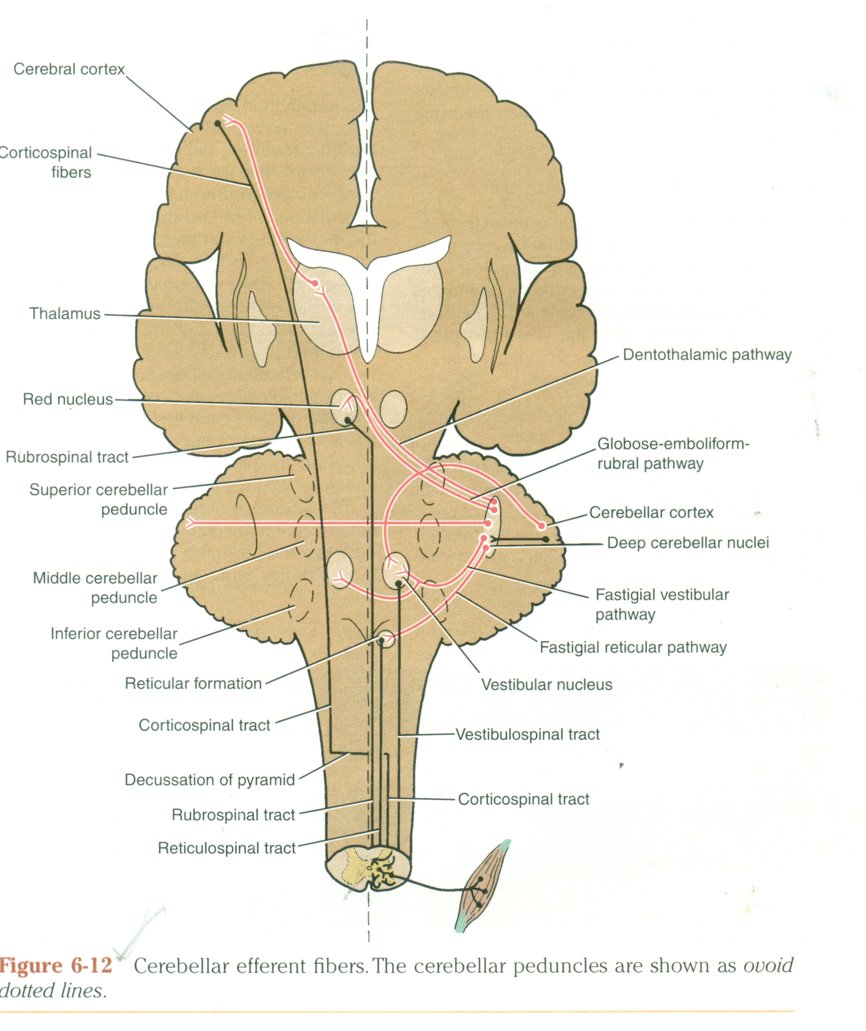

Slide 4
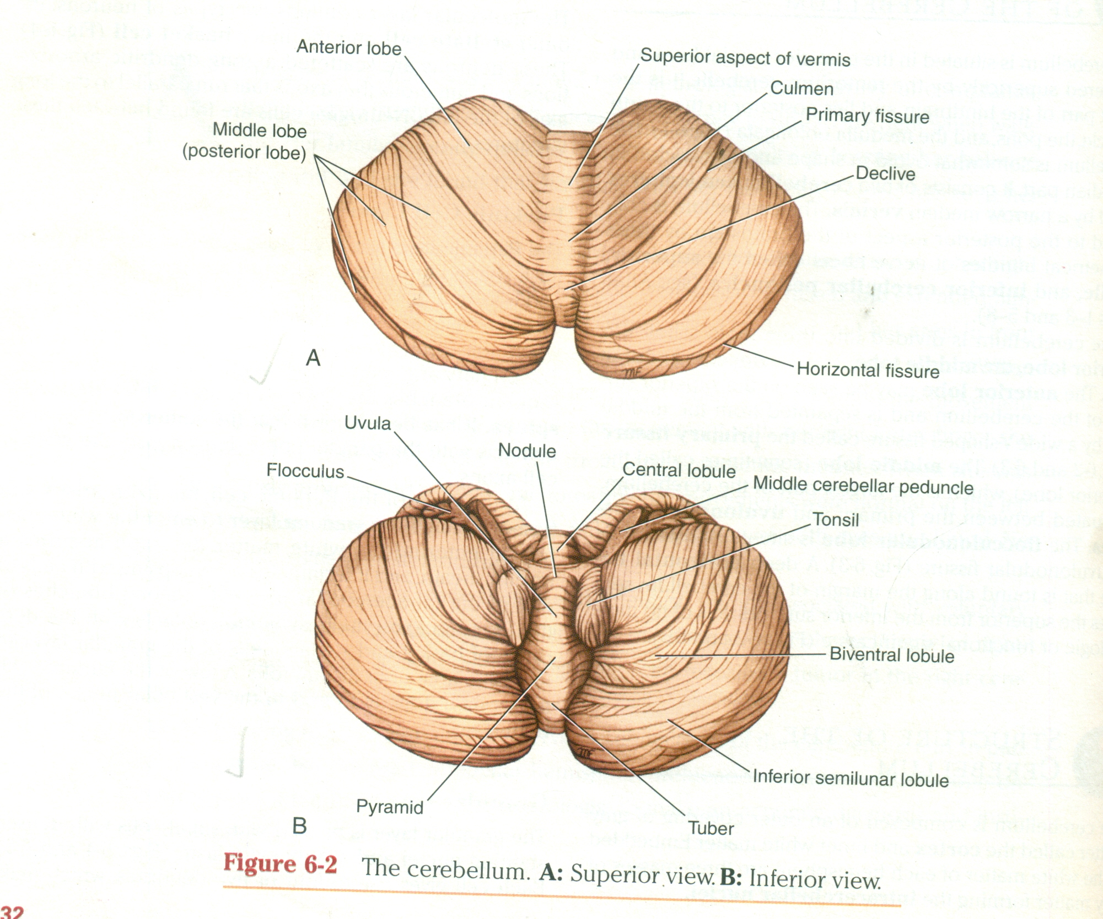
cont.
The cerebellum is divided in to three main lobes :the anterior lobe,the middle lobe and the flocculonodular lobe.
The anterior lobe may be seen on the superior surface of the crebellum and is separated from the middle lobe by a wide V-shaped fissure called the primary fssure.
The middle lobe,which is the largest part of the cerebellum,is situated between the pramary and uvulonodular fissures.
The flocculonodular lobe is situated posterior to the uvulonodular fissure.
A deep horizontal fissure i.e found along margin of the cerebellum separates the superior from the inferior surface:it is of no morphologic or functional significans.

Slide 5
STRUCTURE OF THE CEREBELLUM
The cerebellum is composed of an outer covering of gray matter called the cortex and inner white matter.
Embeded in the white matter of each hemisphere are three masses of gray matter forming the intracerebellar nuclei.
Structure of cerebellar cortex-the cerebellar cortex can be regarded as a large sheet with folds lying in the coronal or transverse plane.
Each fold or folium contains a core of white matter covered superficially by gray matter.
A section made through the cerebellum parallel with the median plane divides the folia at right angles,and cut surface has a branched appearence called the arbor vitae.
The gray matter of the cortex throught its extent has a uniform structure.

Slide 6
CONT.
It may be divided in to three layers
External, molecular layer
Middle, purkinje cell layer
Internal,granular layer

Slide 7
FUNCTIONAL AREAS OF CEREBELLAR CORTEX
The cortex of the vermis influences the movements of the long axis of the body,namely,the neck,the shoulders,the thorax,the abdomen,and the hips.
Immediately lateral to the vermis is a so called intermediate zone of the cerebellar hemisphere.
This area controls the muscles of the distal parts of limb,especially hands and feet.
The lateral zone of each cerebellar hemisphere is concerned with the planning of sequential movements of the entire body and is involved with the conscious assessment of movement errors.

Slide 8
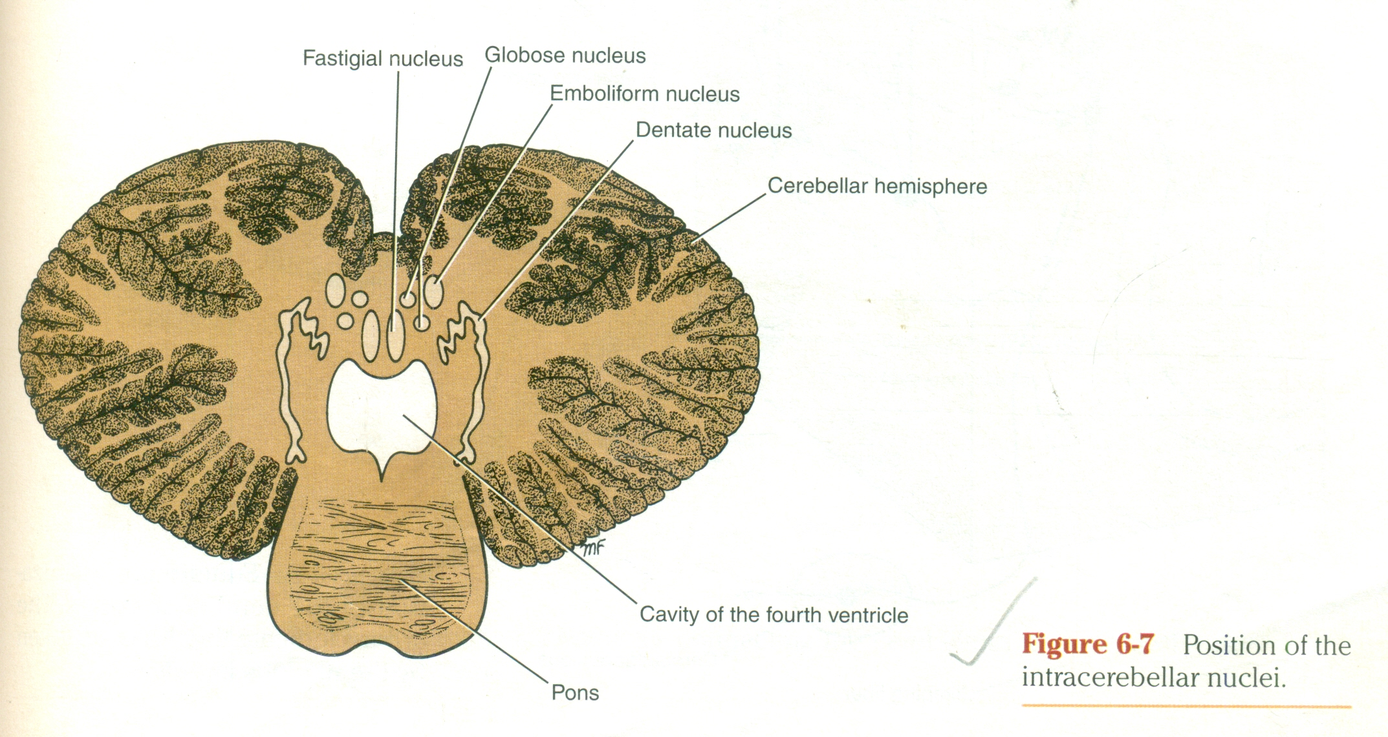
INTRA CEREBELLAR NUCLEI
Four masses of gray matter are embeded in the white matter of the cerebellum on each side of the midline.
From lateral to medial these are the dentate,the emboliform,the globose,and the fastigial.
Dentate nucleus-is the largest of the cerebellar nuclei.it has a shape of crumpled bag with the opening facing medially.the interior of the bag is filled with the white matter made up of efferent fibres that leave the nucleus through the opening to form a large part of the superior cerebellar peduncle.
Emboliform nucleus-is ovoid and is situated medial to the dentate nucleus,partially covering its hilus.

Slide 9
CONT.
Globose nucleus-consists of one or more rounded cell groups that lie medial to the emboliform nucleus.
The fastigial nucleus-lies near the midline in the vermis and close to the roof of the fourth ventricle;it is larger than the globose nucleus.
The intra cerebellar nuclei are composed of large,multipolar neurons with simple branching dendrites.the axons form the cerebellar outflow in the superior and inferior cerebellar peduncles.

Slide 10
WHITE MATTER OF CEREBELLUM
There is a small amount of white matter in the vermis;it closely resembles the trunk and branches of a tree and thus is termed the arbor vitae.there is large amount of white matter in each cerebellar hemisphere.
The white matter is made up of three groups of fibres.
Intrinsic fibres
Afferent fibres
Efferent fibres
Intrinsic fibres do not leave the cerebellum but connect the different regions of the organ.some interconnect folia of the cerebllar cortex and vermis on the same side;others connect the two cerebellar hemisphere together.

Slide 11
CONT.
The afferent fibres form the greater part of the white matter and proceed to the cerebellar cortex.they enter the cerebellum mainly through the inferior and middle cerebellar peduncle.
Efferent fibres constitute the out put of the cerebellum and commence as the axons of the purkinje cells of the cerebellar cortex.
The great majority of the purkinje cell axons pass to and synapse with the neurons of the cerebellar nuclei.
The axons of the neurons then leave the cerebellum.a few purkinje cell axons in the flocculonodular lobe and in parts of vermis bypass the cerebellar nuclei and leave the cerbellum without synapsing.

Slide 12
CONT.
Fibres from the dentate,emboliform,and globose nuclei leave the cerebellum through the superior cerebellar peduncle.
Fibres from fastigial nucleus leave through the inferior cerebellar peduncle.

Slide 13
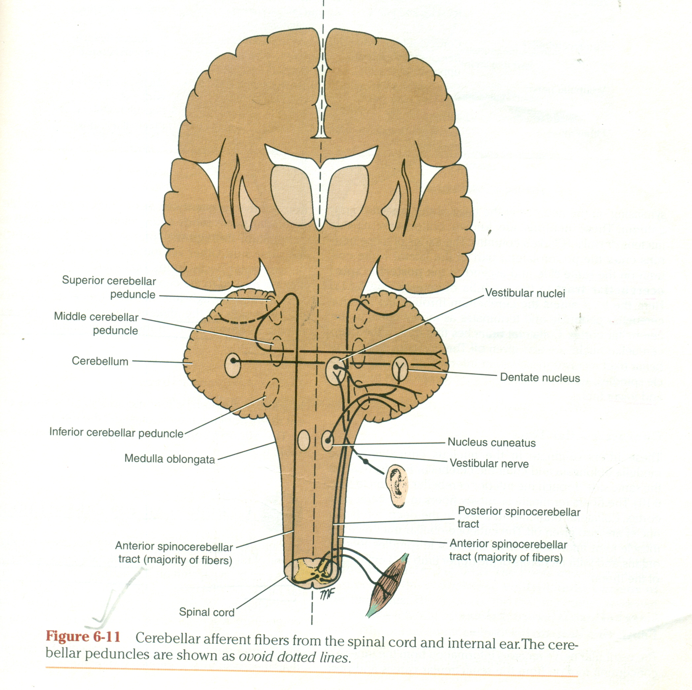
CEREBELLAR AFFERENT FIBRES
FR0M CEREBRUM-sends information to the cerebellum by three pathways.
cortico ponto cerebellar pathway
cerebro-olivo cerebellar pathway
cerebro reticulo cerebellar pathway
This connection between the cerebrum and the cerebellum is important in the control of voluntary movements.
FROM SPINAL CORD-The spinal cord sends information to the cerebellum from somatosensory receptors by three pathways

Slide 14
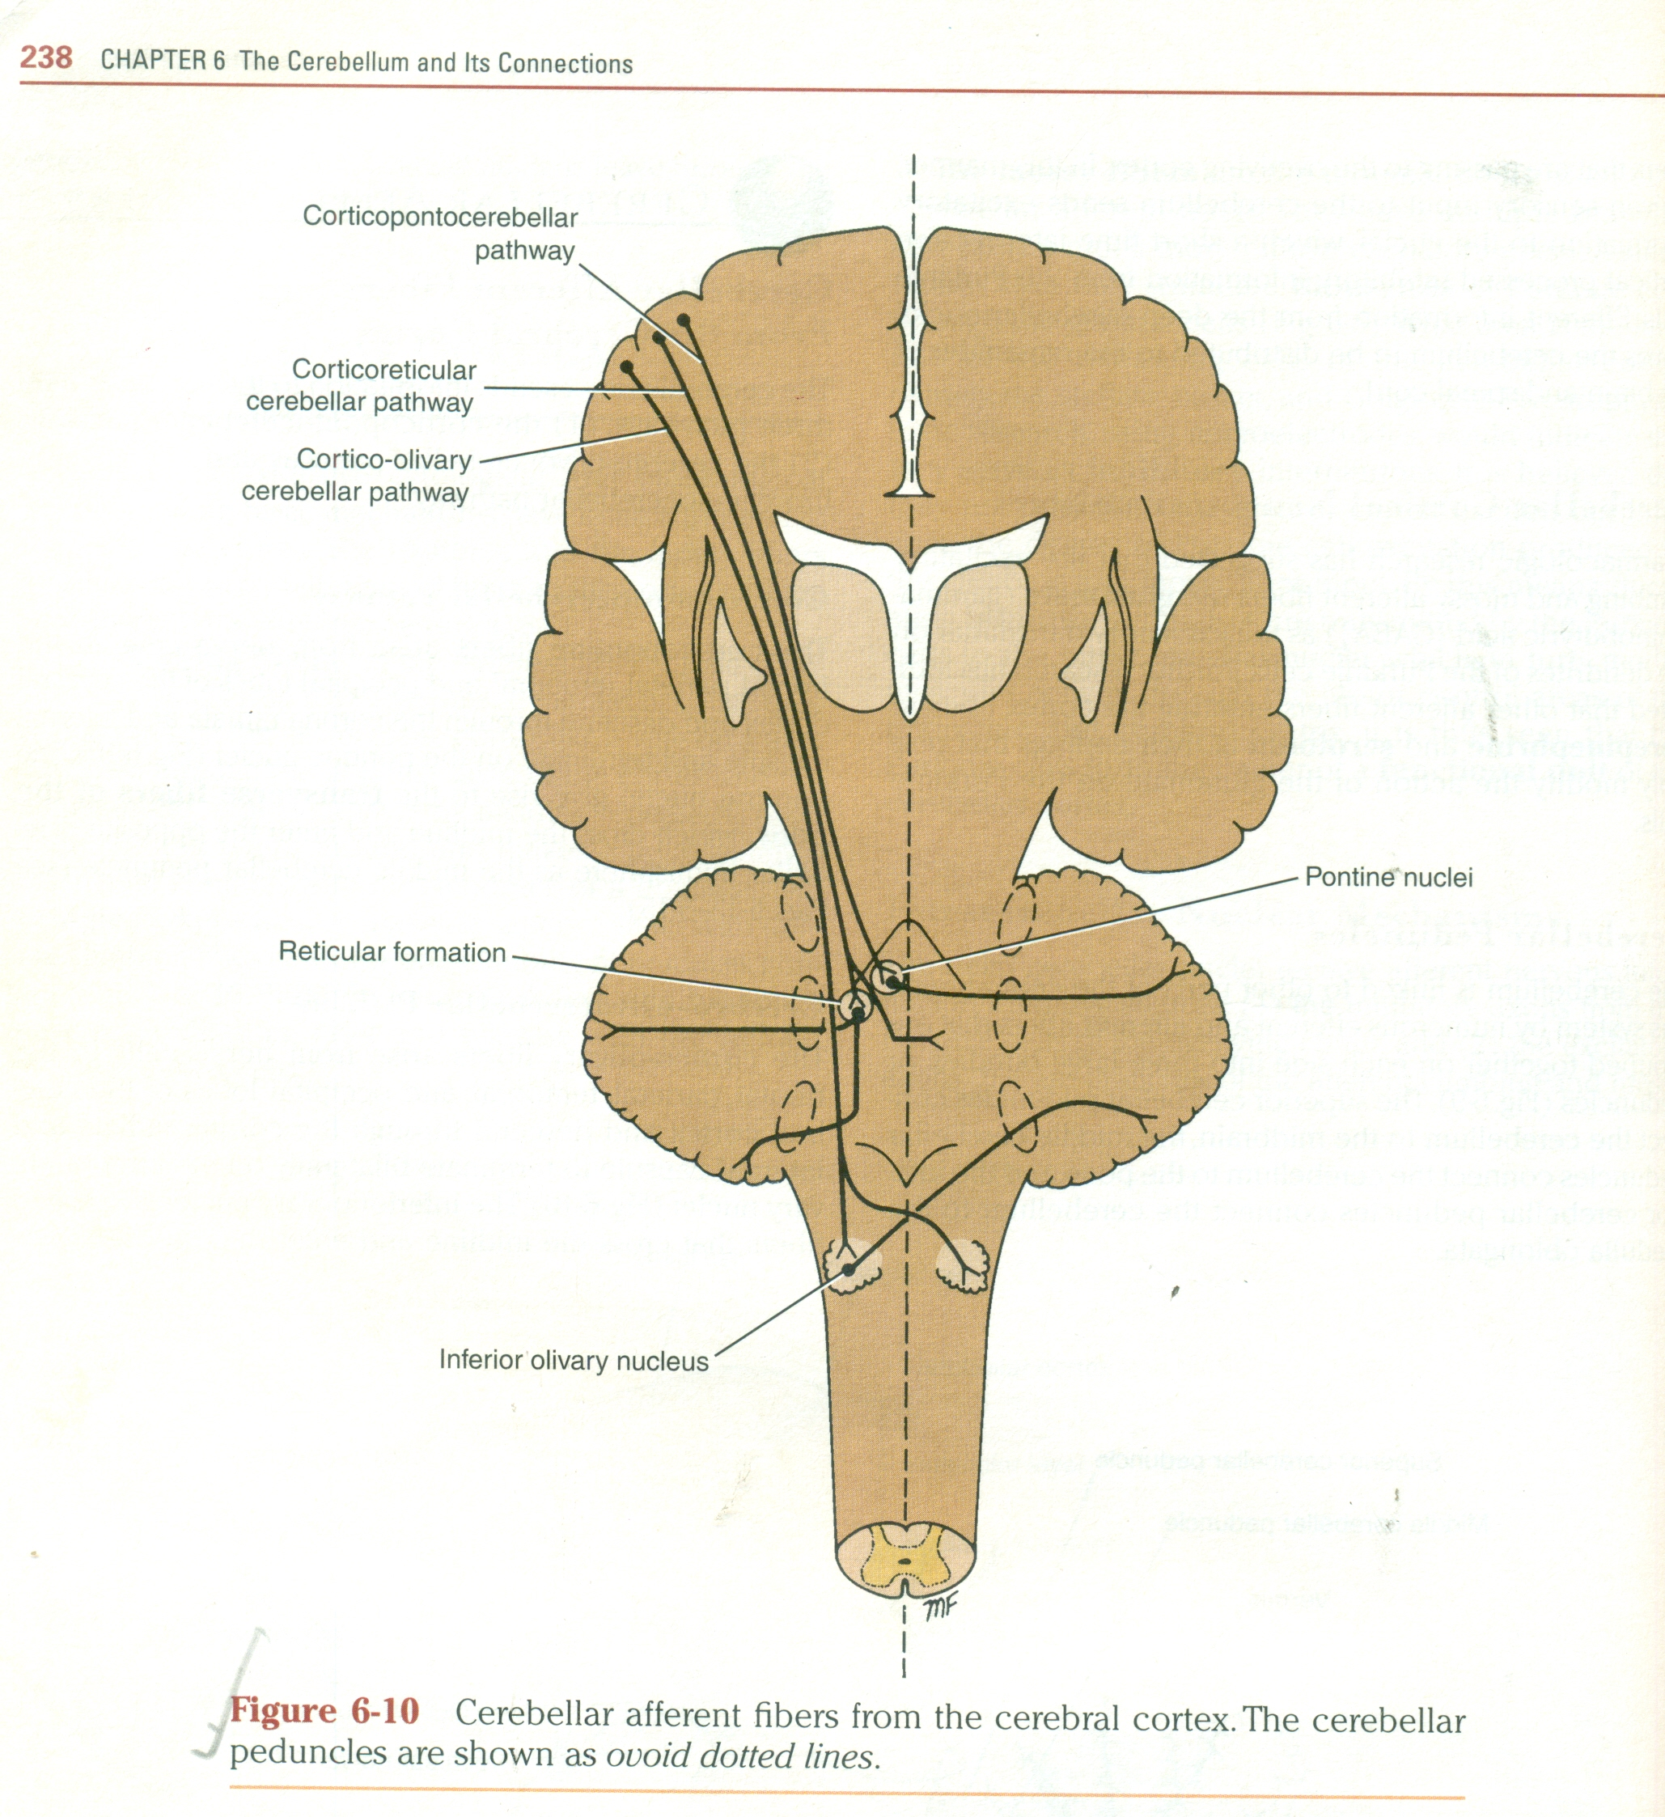
CONT.
The anterior spinocerebellar tract
The posterior spinocerebellar tract
cuneo cerebellar tract
FROM VESTIBULAR NERVE-to flocculonodular lobe
FROM RED NUCLEUS AND THE TECTUM
CEREBELLAR EFFERENT FIBRES-
globose-emboliform-rubral pathway-influence motor activity on the same side of the body
dento thalamic pathway-cordinates muscle activity on the same side of the body

Slide 15
cont.
III. fastigial vestibular pathway-influence ipsilateral extensor muscle tone
IV. fastigial reticular pathway
FUCTIONS OF CEREBELLUM-
Maintaining equilibrium and tone of muscles
Co-ordination of movements
Fine tunning of the motor skills

Slide 16
CEREBELLAR SYNDROME
A condition produced by dysfunction of cerebellar hemispheres and giving rise to typical signs and symptoms,which manifest on the side of the lesion.
Generalized muscular hypotonia leading to staggering gait and ataxia and swaying towards the side of lesion
Intention tremors only during movements(which disappear at rest)
Dysmetria or loss of control over the voluntary act
Dysdiadochokinesis or inability to perform rapidly alternating opposite movements like pronation and supination
Speech defect like dysarthria
Jerky nystagmus

