Slide 1
BRAIN STEM
The brain stem is made up of the medulla oblongata,the pons,and the mid brain and occupies the posterior cranial fossa of the skull.
It is stalk like in shape and connects the narrow spinal cord with the expanded forebrain.
The brain stem has three main functions-
It serves as a conduit for the ascending tracts and descending tracts connecting the spinal cord to the different parts of the higher centers in the fore brain.
It contains important reflex centers associated with the control of respiration and the cardiovascular system and with the control consciousness.
It contains the important nuclei of cranial nerves III toXII.

Slide 2
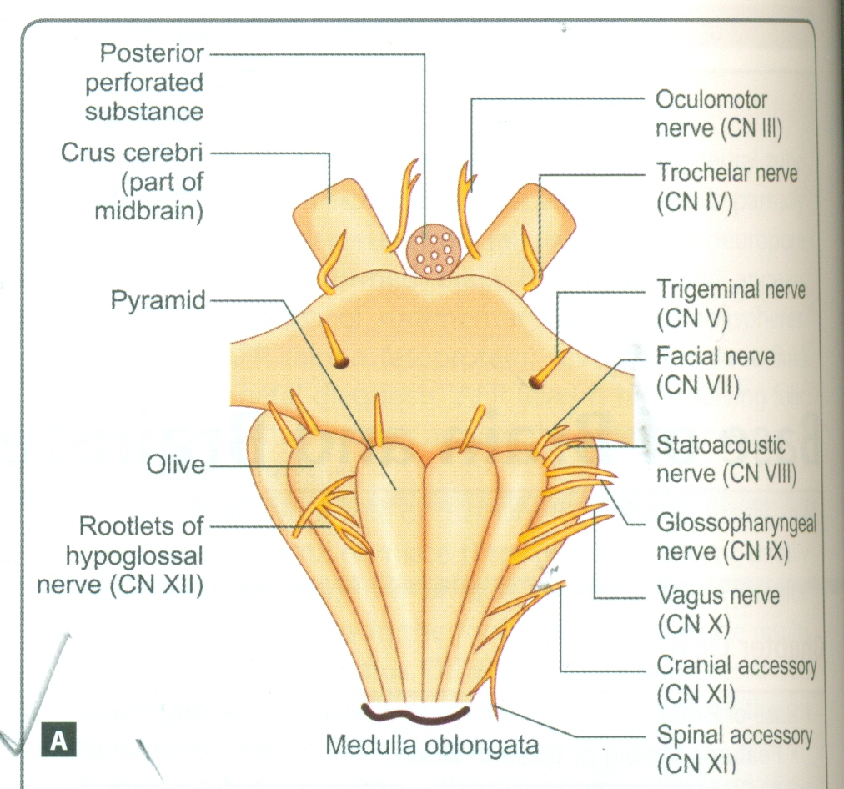
GROSS FEATURES OF MEDULLA
The medulla connects the pons superiorly with the spinal cord inferiorly.
The junction of the medulla and spinal cord is at the origin of the ant and post roots of the first cervical spinal nerves which corresponds approximately to the level of the foramen magnum.
The medulla is conical in shape,its broad extremity being directed superiorly.
The central canal of the spinal cord continues upward in to the lower half of the medulla;in the upper half of medulla,it expands as the cavity of the fourth ventricle.

Slide 3
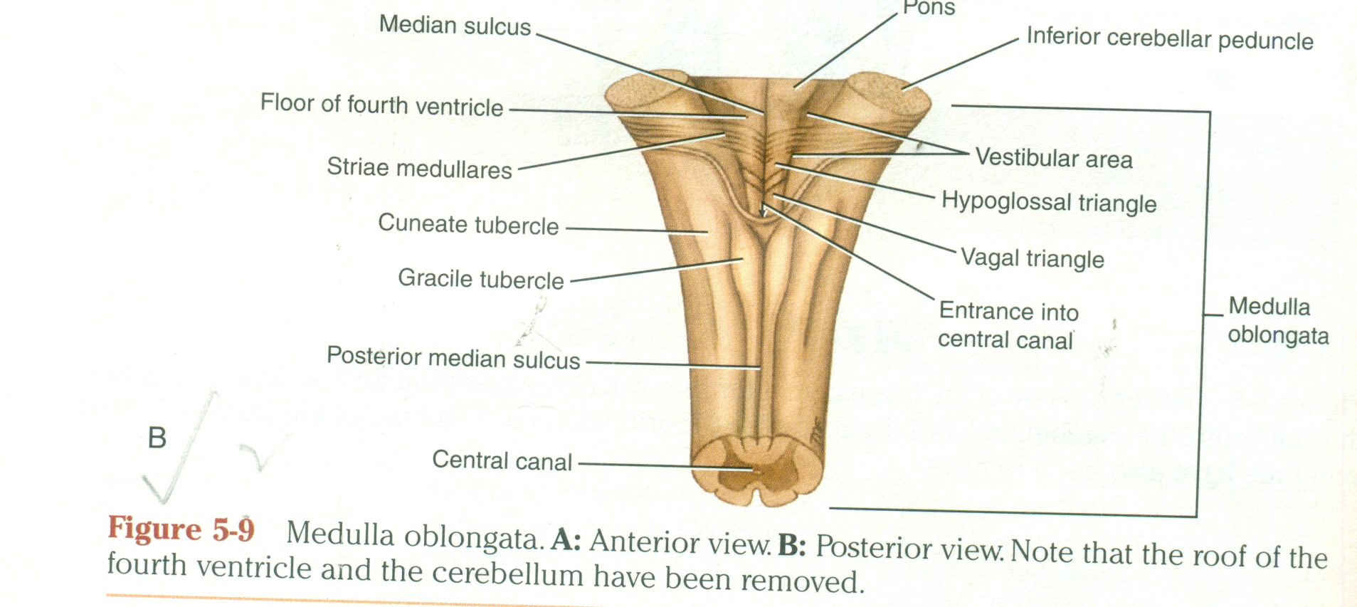
MEDULLA CONT.
On the ant surface of medulla is the ant median fissure,which is continuous inferiorly with the ant median fissure of the spinal cord.
On each side of the median fissure,there is a swelling called the pyramid.
The pyramids are due to underlying corticospinal fibres, which originate in precentral gyrus of cerebral cortex.
The pyramids taper inferiorly,and it is here that the majority of the descending fibres cross over to the opposite side,forming the decussation of fibres.
The ant external arcuate fibres are a few nerve fibres that emerge from the ant median fissure above the decussation and pass laterally over the surface of the medulla to enter the cerebellum.

Slide 4
MEDULLA CONT.
Posterolateral to the pyramid are the olives,which are oval elevations produced by the underlying inferior olivary nucleus.
In the groove between the pyramid and olive emerge the rootlets of hypoglossal nerve.
Post to the olives are the inferior cerebellar peduncle,which connects the medulla to the cerebellum.
In the groove between the olive and the inferior cerebellar peduncle emerge the roots of the glossopharyngeal and vagus nerves and the cranial roots of accessory nerve.
The post surface of sup half of the medulla forms the lower part of the floor of the fourth ventricle.

Slide 5
MEDULLA CONT.
The post surface of the inf half of medulla is continuous with the post aspect of the spinal cord and possesses a post median sulcus.
On each side of post median sulcus there is an elongated swelling,the gracile tubercle,produced by the underlying gracile nucleus.
Lateral to the gracile tuburcle is a similar swelling,the cuneate tubercle,is produced by the underlying cuneate nucleus.

Slide 6
INTERNAL STRUCTURE OF MEDULLA
The transverse section of medulla have been extensively rearranged.
This arrangement can be explained embryologically by the expansion of the neural tube to form the hind brain vesicle,which becomes the fourth ventricle.
The extensive lateral spread of the fourth ventricle results in an alteration in the position of the derivatives of the alar and basal plates of the embryo.
In spinal cord the derivatives of alar and basal plates are situated post and ant to the sulcus limitans and in case of medulla they are situated lateral and medial to the sulcus limitans respectively.

Slide 7
MEDULLA CONT.
The internal structure of medulla can be studied at three level.
At the level of pyramidal decussation.
At the level of dcussation of lemnisci.
At the level of olives.

Slide 8
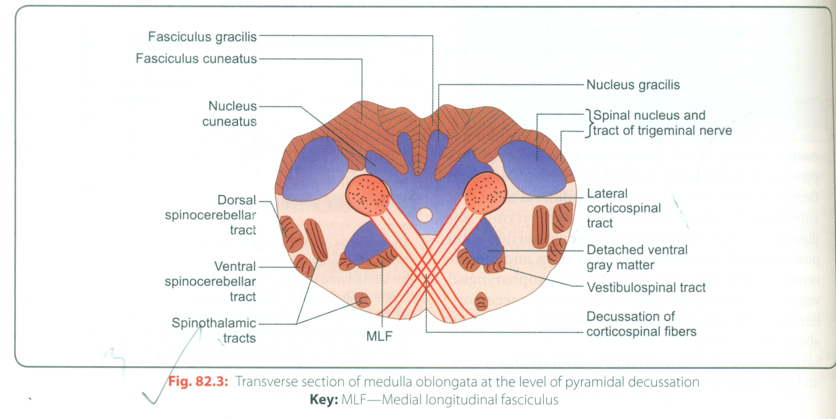
TS OF MEDULLA AT THE LEVEL OF PYRAMIDAL DECUSSATION
In the superior part of the medulla,the corticospinal fibres occupy and form the pyramid,but inferiorly about three fourths of the fibres cross the median plane and continue down the spinal cord in the lateral white column as the lateral corticospinal tract.
As these fibres cross the midline,they sever the continuity between the ant column of the gray matter of the spinal cord and the gray matter that surrounds the central canal.
The fasciculus gracillis and the fasciculus cuneatus continue to ascend superiorly post to the central gray matter.
The nucleus gracilis and the nucleus cuneatus appear as post extensions of the central gray matter.

Slide 9
MEDULLA CONT.
The substantia gelatinosa in the post gray column of the spinal cord becomes continuous with with the inferior end of the nucleus of the spinal tract of trigeminal nerve.
The fibres of the tract of the nucleus are situated between he nucleus and the surface of the medulla oblongata.
The lateral and ant white columns of the spinal cord are easily identified in these sections and their fibre arrangement is unchanged.

Slide 10
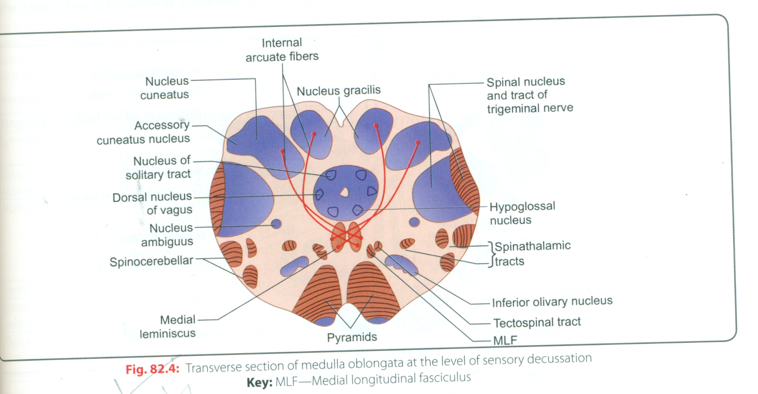
TS OF MEDULLA AT THE LEVEL OF DECUSSATION OF LEMNISCI
A transverse section through the inferior half of the medulla,a short distance above the level of the decussation of the pyramid,passes through the decussation of lemnisci,the great sensory decussation.
The decussation of the lemnisci takes place ant to the central gray matter and posterior to the pyramid.
The lemnisci are formed from the internal arcuate fibres,which have emerged from the ant aspect of the nucleus gracilis and nucleus cuneatus.
The internal arcuate fibres first travel anteriorly and laterally around the central gray matter.they then curve medially toward the midline where they decussate with the corresponding fibres of the opposite side.

Slide 11
CONT.
The nucleus of the spinal tract of trigeminal nerve lies lateral to the internal arcuate fibres.
The spinal tract of trigeminal nerve lies lateral to the nucleus.
The lateral and anterior spinothalamic tracts and the spinotectal tracts occupy an area lateral to the decussation of the lemnisci.
They are very close to each other and collectively are known as the spinal lemniscus.
The spinocerebellar,vestibulospinal and the rubrospinal tract are situated in the anterolateral region of the medulla oblongata.

Slide 12
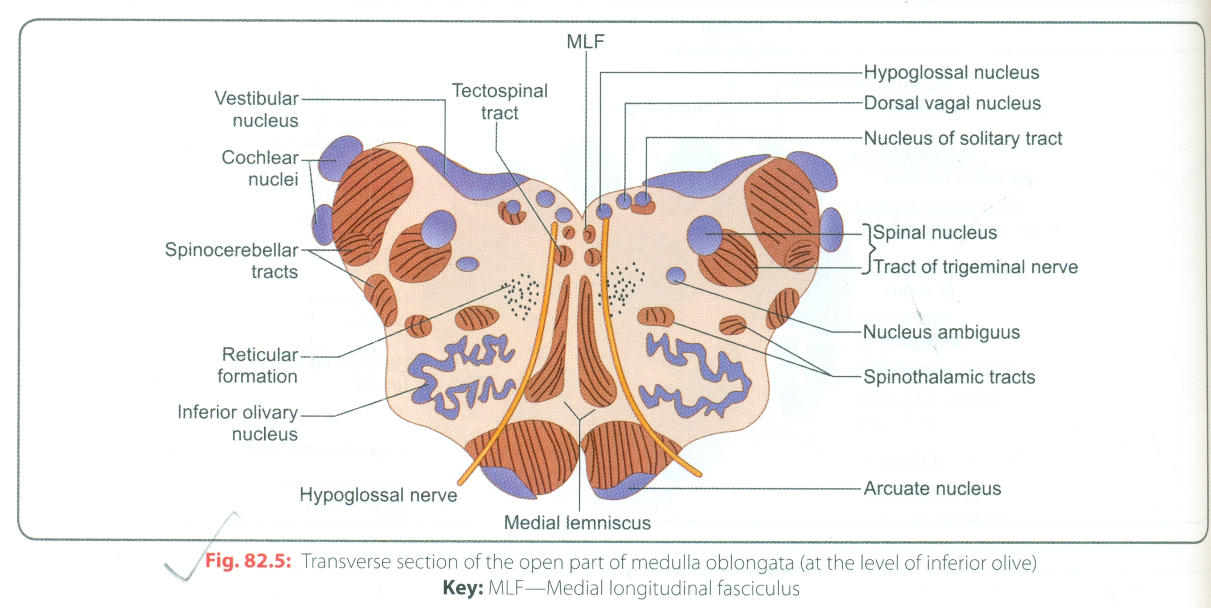
TS OF MEDULLA AT THE LEVEL OF OLIVE
A ts through the olives passes across the inferior part of fourth ventricle.
The amount of gray matter has increased at this level owing to the presence of the olivary nuclear complex;the nuclei of the vestibulocochlear,glossopharyngeal,vagus,accessory,and hypoglossal nerves,and the arcuate nuclei.
OLIVARY NUCLEAR COMPLEX-The largest nucleus of this complex is the inferior olivary nucleus.
The gray matter is shaped like a crumpled bag with its mouth directed medially;it is responsible for the elevation on the surface of the medulla called the olive.
Smaller dorsal and medial accessory olivary nucleus also are present.

Slide 13
CONT.
The cells of The inferior olivary nucleus sends fibres medially across the midline to enter the cerebellum through the inferior cerebellar peduncle.
The afferent fibres reach the inferior olivary nucleus from the spinal cord(spino-olivary tract) and from the cerebellum and cerebral cortex.
The function of the olivary nuclei is associated with voluntary muscle movement.
VESTIBULOCOCHLEAR NUCLEI-The vestibulocochlear nuclear complex is made up of the following nuclei.
Medial vestibular nucleus.
Inferior vestibular nucleus.
Lateral vestibular nucleus.
Superior vestibular nucleus.

Slide 14
CONT.
The medial and inferior vestibular nuclei can be seen on section at this level.
There are two cochlear nuclei.
The ant cochlear nucleus is situated on the anterolateral aspect of the inferior cerebellar peduncle,and the post cochlear nucleus is situated on the post aspect of the peduncle lateral to the floor of the fourth ventricle.
THE NUCLEUS AMBIGUUS-The nucleus ambiguus consists of large motor neurons and is situated deep with in the reticular formation.
The emerging nerve fibres join the glossopharyngeal,vagus,and cranial part of the accessory nerve and are distributed to voluntary skeletal muscle.

Slide 15
CENTRAL GRAY MATTER
The central gray matter lies beneath the floor of the fourth ventricle at this level.
Passing from medial to lateral the following important structures may be recognised.
The hypoglossal nucleus.
The dorsal nucleus of vagus.
The nucleus of the tractus solitarius.
The medial and the inferior vestibular nucleus.
The arcuate nuclei are thought to be inferiorly displaced pontine nuclei and are situated on the ant surface of the pyramids.they receive nerve fibres from the cerebral cortex and send efferent fibres to the cerebellum through the ant external arcuate fibres.

Slide 16
CONT.
The pyramids containing the corticospinal and some corticonuclear fibres are situated in the ant part of the medulla separated by the ant median fissure; the corticospinal fibres descend to the spinal cord,and the corticonuclear fibres are distributed to the motor nuclei of the cranial nerves situated with in the medulla.
The medial lemniscus forms a flattened tract on each side of the midline post to the pyramid.these fibres emerge from the decussation of the lemnisci and convey sensory information to the thalamus.it is main ascending pathway of the brain stem for touch,begins in the lower medulla formed by the axons of the gracile and cuneate nuclei of the opposite side.
The medial longitudinal fasciculus forms a small tract of nerve fibres situated on each side of the midline posterior to the medial lemniscus and anterior to the hypoglossal nucleus. it consists of ascending and descending fibres.it extends from the upper border of the midbrain to the upper cervical part of the spinal cord.it links the vestibular nucleus with the third,fourth,sixth,eleventh and reticular nuclei,to help cordinate head and eye movements.

Slide 17
CONT.
Inferior cerebellar peduncle is situated in the posterolateral corner of the section on the lateral side of the fourth ventricle.
The spinal tract of trigeminal nerve and its nucleus are situated on the antero medial aspect of the inferior cerebellar peduncle.
Anterior spinocerebellar tract is situated near the surface in the interval between the inferior olivary nucleus and the nucleus of the spinal tract of the trigeminal nerve.The spinal lemnisus,consisting of the ant spinothalamic,the lateral spinothalamic,and spinotectal tract is deeply placed.
Reticular formation consisting of a diffuse mixture of nerve fibres and groups of nerve cells,is deeply placed posterior to the olivary nucleus.the reticular formation represents,at this level,only a small part of this system,which is also present in the pons and midbrain.

Slide 18
BLOOD SUPPLY OF MEDULLA
The medulla is supplied ventrally by branches of the vertebral and basilar arteries.
Laterally and dorsally it is supplied by the posterior inferior cerebellar artery.
The anterior spinal branch of the vertebral artery supply the region next to the midline ,i.e. the part containing the pyramid,medial lemniscus,and hypoglossal nucleus.
Damage to these vessels produces the medial medullary syndrome.this includes paralysis of the tongue on the same side and hemiplegia with loss of touch and kinesthetic sense on opposite side.

Slide 19
MEDULLA CONT.
Damage to the vessels of the lateral and dorsal part gives rise to the lateral medullary syndrome or the syndrome of posterior inferior cerebellar artery.
The loss of nucleus ambiguus function paralyses,laryngeal,palatal and pharyngeal muscles on that side,causing dysphonia and dysphagia.loss of the uncrossed spinal tract of the trigeminal and of the crossed spinal lemniscus results in loss of pain and temperature sensation on the same side of face and opposite side of the body.there will also be a horners syndrome on the ipsilateral side due to interruption of descending hypothalamospinal fibres of the sympathetic pathway.involvement of the vestibular nuclei causes vertigo and nystagmus with nausea and vomiting.
The veins drain dorsally to the occipital sinus and ventrally in to the basilar plexus of veins and the inferior petrosal sinus.the medullary veins communicate with the spinal veins.

Slide 20
PONS
GROSS FEATURES OF PONS-The pons is anterior to the cerebellum&connects the medulla to the midbrain.it is about 1 inch long and owes its name due to the appearence presented on the ant surface,which is that of a bridge,connecting the right&lt cerebellar hemisphere.
The ant surface is convex from side to side and shows many transverse fibres that converge on each side to form the middle cerebellar peduncle.
There is a shallow groove in the midline ,the basilar groove,which lodges the basilar artery.
On the anterolateral surface of the pons,the trigeminal nerve emerges on each side.
Each nerve consists of a smaller,medial part known as motor root and a larger lateral part known as sensory root.
In the groove between the pons and medulla there emerge from medial to lateral,the abducent,facial,and vestibulocochlear nerve.

Slide 21
CONT.
The post surface of pons is hidden from view by the cerebellum.it forms the upper half of the floor of the fourth ventricle and is triangular in shape.
The post surface is limited laterally by the sup cerebellar peduncles and is divided in to symmetrical halves by a median sulcus
Lateral to this sulcus is an elongated elevation,the medial eminence,which is bounded laterally by a sulcus the sulcus limitans.
The inferior end of the medial eminence is slightly expanded to form the facial colliculus,which is produced by the root of the facial nerve winding around the nucleus of the abducent nerve.
the floor of the sup part of the sulcus limitans is bluish gray in colour and is called the substantia ferruginea;it owes its colour to a group of deeply pigmented nerve cells.
Lateral to the sulcus limitans is the area vestibuli produced by the underlying vestibular nuclei.

Slide 22
INTERNAL STRUCTURE OF THE PONS
Pons is divided in to a Post part,the tegmentum and an ant basal part by the transversely running fibres of the trapezoid body.
The structure of the pons can be studied at two level.
TS of the pons through the caudal part,passing through the facial colliculus.
TS of the pons through the cranial part ,passing through the tigeminal nuclei

Slide 23
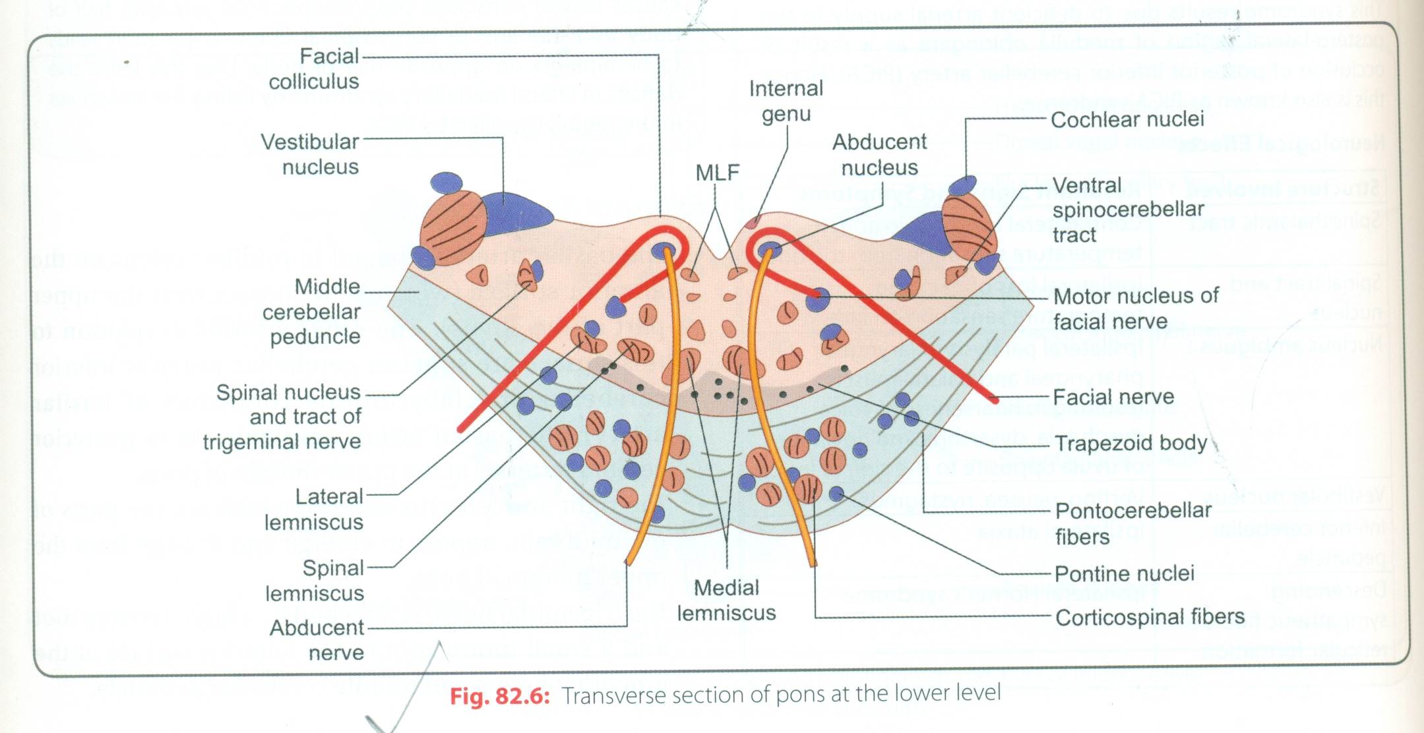
TS THROUGH THE CAUDAL PART
The medial lemniscus rotates as it passes from the medulla in to the pons.it is situated in the most ant part.
The medial lemniscus is accompanied by the spinal and lateral lemnisci.
The facial nucleus lies post to the lateral part of the medial lemniscus.the fibres of the facial nerve wind around the nucleus of the abducent nerve,producing the facial colliculus.
The fibres of the facial nerve then pass anteriorly between the facial nucleus and the superior end of the nucleus of the spinal tract of the trigeminal nerve.
The medial longitudinal fasciculus is situated beneath the floor of the fourth ventricle on either side of the midline.the medial longitudinal fasciculus is the main pathway that connects the vestibular and cochlear nuclei with the nuclei controlling the extraocular muscles.

Slide 24
CONT.
MEDIAL VESTIBULAR NUCLEI-is situated lateral to the abducent nucleus and is in close relationship to the inferior cerebellar peduncle.the sup part of the lateral and the inferior part of the sup vestibular nucleus are found at this level.the post and ant cochlear nuclei are also found at this level.
THE SPINAL NUCLEUS OF THE TRIGEMINAL NERVE AND ITS TRACT-LIE ON THE ANTEROMEDIAL ASPECT OF THE INFERIOR CEREBELLAR PEDUNCLE.
THE TRAPEZOID BODY-is made up of fibres derived from the cochlear nuclei and the nuclei of trapezoid body.they run transversely in the ant part of the tegmentum.

Slide 25
CONT.
The basilar part of the pons ,at this level,contains small masses of nerve cells called pontine nuclei.the corticopontine fibres of the crus cerebri of the midbrain terminate in the pontine nuclei.the axons of these give origin to the transverse fibres of the pons,which cross the midline and intersect the corticospinal and cortico nuclear tracts.breaking them up in to small bundles.the transverse fibres of the pons enter the middle cerebellar peduncle and are distributed to the cerebellar hemisphere.this connection form the main pathway linking the cerebral cortex to the cerebellum.

Slide 26
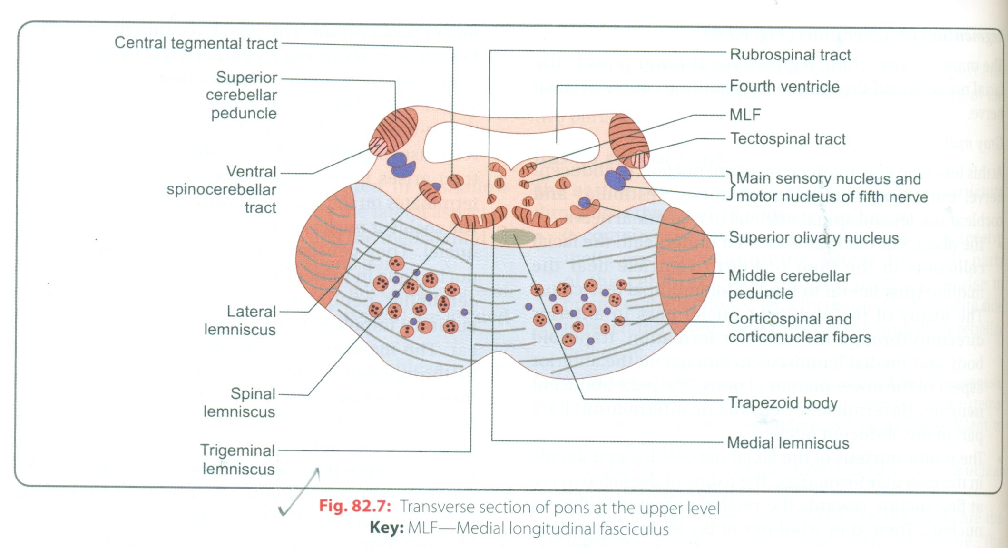
TS THROUGH THE CRANIAL PART OF PONS
The internal structure of the cranial part of the pons is similar to that seen at the caudal level.but it now contains the motor and principal sensory nuclei of the trigeminal nerve.
The motor nucleus of trigeminal nerve is situated beneath the lateral part of the fourth ventricle with in the reticular formation.the emerging motor fibres travel anteriorly through the substance of the pons and exit on its anterior surface.
The principal sensory nucleus of the trigeminal nerve is situated on the lateral side of the motor nucleus;it is continuous inferiorly with the nucleus of the spinal tract.the entering sensory fibres travel through the substance of the pons and lie lateral to the motor fibres.

Slide 27
CONT.
The superior cerebellar peduncle is situated posterolateral to the motor nucleus of the trigeminal nerve.it is joined by the anterior spinocerebellar tract.
The trapezoid body and the medial lemniscus are situated in the same position.
The lateral and spinal lemnisci lie at the lateral extremity of the medial lemniscus.

Slide 28
BLOOD SUPPLY OF PONS
The pons is supplied mainly by pontine branches from the basilar artery,with contributions from the superior cerebellar and anterior inferior cerebellar vessels.
Venous return is in to the inferior petrosal sinuses and the basilar plexus.
Pontine hemorrhage-the rupture of arteries supplying the pons leads to intra pontine bleeding.if massive it is invariably fatal .the patient goes in to coma,has pinpoint pupils and hyperpyrexia.
Milard Gubler syndrome-this is the lesion of pons in which abducent and facial nerves are involved along with corticospinal fibres.
Effects of lesion are as follows.

Slide 29
PONS CONT.
Ipsilateral lower motor neuron paralysis(involving entire face) due to damage to facial nucleus.
Medial squint due to damage to abducent nucleus on the side of the lesion.
Contralateral hemiplegia(upper motor neuron paralysis of opposite half of body)

Slide 30
GROSS APPEARENCE OF MID BRAIN
Length of the mid brain is 2cm.
Mid brain connects the pons and cerebellum with the fore brain.
Its long axis inclines anteriorly as it ascends through the opening in the tentorium cerebellum.
The midbrain is traversed by a narrow channel,the cerebral aqueduct, which is filled with the CSF.
On the posteior surface are four colliculi(corpora quadrigemina).
These are rounded eminences that are divided in to superior and inferior pairs by a vertical and transverse groove.

Slide 31
MID BRAIN CONT.
The superior colliculi are the centers for visual reflexes,and inferior colliculi are lower auditory centers.
In the midline below the inferior colliculi,the trochlear nerves emerge.
the trochlear nerves are small diameter nerves that wind around the lateral aspect of the mid brain to enter the lateral wall of the cavernous sinus.
On the lateral aspect of the mid brain ,the superior and inferior brachia ascend in an anterolateral direction.
The superior brachium passes from the superior colliculus to the lateral geniculate body and the optic tract.
The inferior brachium connects the inferior colliculus to the medial geniculate body.

Slide 32
MID BRAIN CON.
On the anterior aspect of the midbrain ,there is a deep depression in the midline ,the interpeduncular fossa,which is bounded on either side by the crus cerebri.many small blood vessels perforates the floor of the interpeduncular fossa and this region is known as posterior perforated substance.
The oculomotor nerve emerges from a groove on the medial side of the crus cerebri and passes forward in the lateral wall of the cavernous sinus.

Slide 33
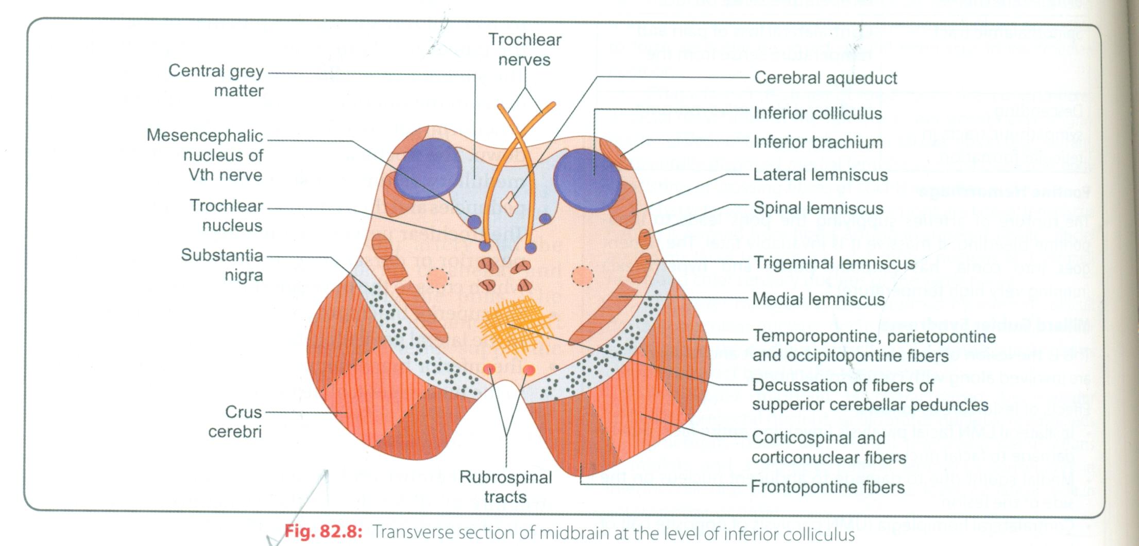
INTERNAL STRUCTURE OF MID BRAIN
The mid brain comprises two lateral halves, called the cerebral peduncles;each of these is divided in to an anterior part ,the crus cerebri,and a posterior part,the tegmentum,by a pigmented band of gray,the substantia nigra.
The narrow cavity of the mid brain is the cerebral aqueduct,which connects the third and fourth ventricles.
The tectum is the part of the mid brain posterior to the cerebral aqueduct;it has four small surface swellings;these are the two superior and two inferior colliculi.
The cerebral aqueduct is lined by ependyma and is surrounded by the central gray matter.
On transverse sections of the mid brain,the interpeduncular fossa can be seen to separate the crura cerebri,whereas the tegmentum is continuous across the median plane.

Slide 34
TS OF MIDBRAIN AT THE LEVEL OF INFERIOR COLLICULI
The inferior colliculus,consisting of a large nucleus of gray matter,lies beneath the corresponding surface elevation and forms part of the auditory pathway.
It receives many of the terminal fibres of the lateral lemniscus.the pathway then continues through the inferior brachium to the medial geniculate body.
The trochlear nucleus is situated in the central gray matter close to the median plane just posterior to the medial longitudinal fasciculus.
The emerging fibres of trochlear nucleus pass laterally and posteriorly around the central gray matter and leave the midbrain just below the inferior colliculi.
The fibres of the trochlear nerve now decussate completely in the superior medullary velum.

Slide 35
TS OF MIDBRAIN CONT.
The mesencephalic nuclei of the trigeminal nerve are lateral to the cerebral aqueduct.
The decussation of the superior crebellar peduncles occupies the central part of the tegmentum anterior to the cerebral aqueduct.
The reticular formation is smaller than that of the pons and is situated lateral to the decussation.
The medial lemniscus ascends posterior to the substantia nigra ;the spinal and trigeminal lemnisci are situated lateral to the medial lemniscus.
The substantia nigra is a large motor nucleus situated between the tegmentum,and the crus cerebri and is found throught the mid brain.

Slide 36
TS OF MID BRAIN CONT.
The crus cerebri contains important descending tracts and is separated from the tegmentum by the substantia nigra.
The coricospinal and corticonuclear fibres occupy the middle two thirds of the crus.
The frontopontine fibres occupy the medial part of the crus,and the temporopontine fibres occupies the lateral part of the crus.
These descending tracts connect the cerebral cortex to the anterior gray column cells of the spinal cord ,the cranial nerve nclei,the pons ,and the cerebellum.

Slide 37
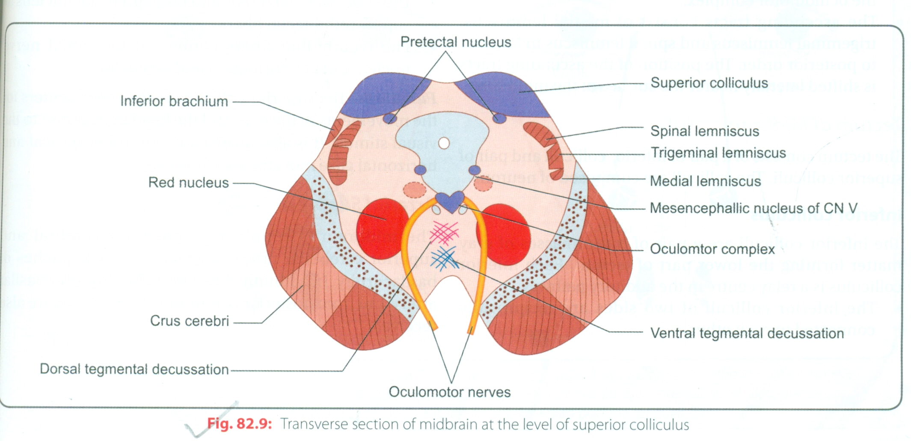
TS OF MIDBRAIN AT THE LEVEL OF THE SUPERIOR COLLICULUI
The superior colliculus,a large nucleus of gray matter that lies beneath the corresponding surface elevation,forms part of the visual reflex.
It is connected to the lateral geniculate body by the superior brachium.
It receives afferent fibres from the optic nerve,the visual cortex,and the spinotectal tract.
The efferent fibres form the tectospinal and tectobulbar tracts,which are responsible for the reflex movements of the eyes,head,and neck in response to visual stimuli.
The afferent pathway for the light reflex ends in the pretectal nucleus.

Slide 38
MID BRAIN CONT.
Pretectal nucleus is a small group of neurons situated close to the lateral part of the superior colliculus.
After relaying in the in the pretectal nucleus,the fibres pass to the parasympathetic nucleus of the oculomotor nerve (Edinger-Westphal nucleus).
The emerging fibres then pass to the oculomotor nerve.
The oculomotor nucleus is situated in the central gray matter close to the median plane just posterior to the medial longitudinal fasciculus.
The of the oculomotor nucleus pass anteriorly through the red nucleus to emerge on the medial side of the crus cerebri in the interpeduncular fossa.
The nucleus of the oculomotor nerve is divisible in to a number of cell groups.

Slide 39
MID BRAIN CONT.
The medial,spinal and trigeminal lemnisci form a curved band posterior to the substantia nigra,but the lateral lemniscus does not extend superiorly to this level.
The red nucleus is a rounded mass of gray matter situated betbeen the cerebral aqueduct and the substantia nigra.
Its reddish hue,seen in fresh specimen,is due to its vascularity and the presence of an iron containing pigment in the cytoplasm of many of its neurons.
Afferent fibres reach the red nucleus from
The cerebral cortex through the corticospinal fibres.
The cerebellum through the superior cerebellar peduncle.
The lentiform nucleus,subthalamic and hypothalamic nuclei,substantia nigra,and spinal cord.

Slide 40
MID BRAIN CONT.
Efferent fibres leave the red nucleus and pass to
Spinal cord through the rubrospinal tract.
The reticular formation through the rubro reticular tract.
The thalamus.
The substantia nigra.
The reticular formation is situated in the tegmentum lateral and posterior to the red nucleus.
The crus cerebri contains the identical important descending tracts -the corticospinal, corticonuclear and corticopontine fibres.

Slide 41
MID BRAIN CONT.
Weber's syndrome-due to infarction in basal region of cerebral peduncle following occulusion of a branch of posterior cerebral artery involving corticospinal fibres in crus cerebri and intra tegmental fibres of oculomotor nerve.this causes contralateral hemiplegia and ipsilateral paralysis of extra ocular muscles supplied by oculomotor nerve(down and out eye with dilated and fixed pupil).
Benedict's syndrome-due to lesion of the tegmentum involving red nucleus,fibres of third nerve and medial lemniscus.this syndrome consists of ipsilateral paralysis of muscles supplied by third nerve,contra lateral hemianaestesia(loss of proprioception,discreminative touch and vibration sense).and involuantry movements like chorea and athetosis on the side of lesion.

Slide 42
MID BRAIN CONT.
Perinaud' syndrome-due to compression of the upper dorsal region of the midbrain including the superior colliculi by the pineal tumour.it presents as a combination of impaired upward or downward gaze(due to compression of vertical gaze center) and pupillary abnormality.

