Slide 1
BASAL GANGLIA
Basal ganglia or the basal nuclei are the collections of grey matter situated inside the cerebral hemisphere.
The basal ganglia belong to the extra-pyramidal system and their lesion results in movement disorders in the body.
Component of basal ganglion-basal ganglia consist of five nuclei
Caudate nucleus
lentiform nucleus
Claustrum
Amygdaloid nucleus
Subthalamic nucleus

Slide 2
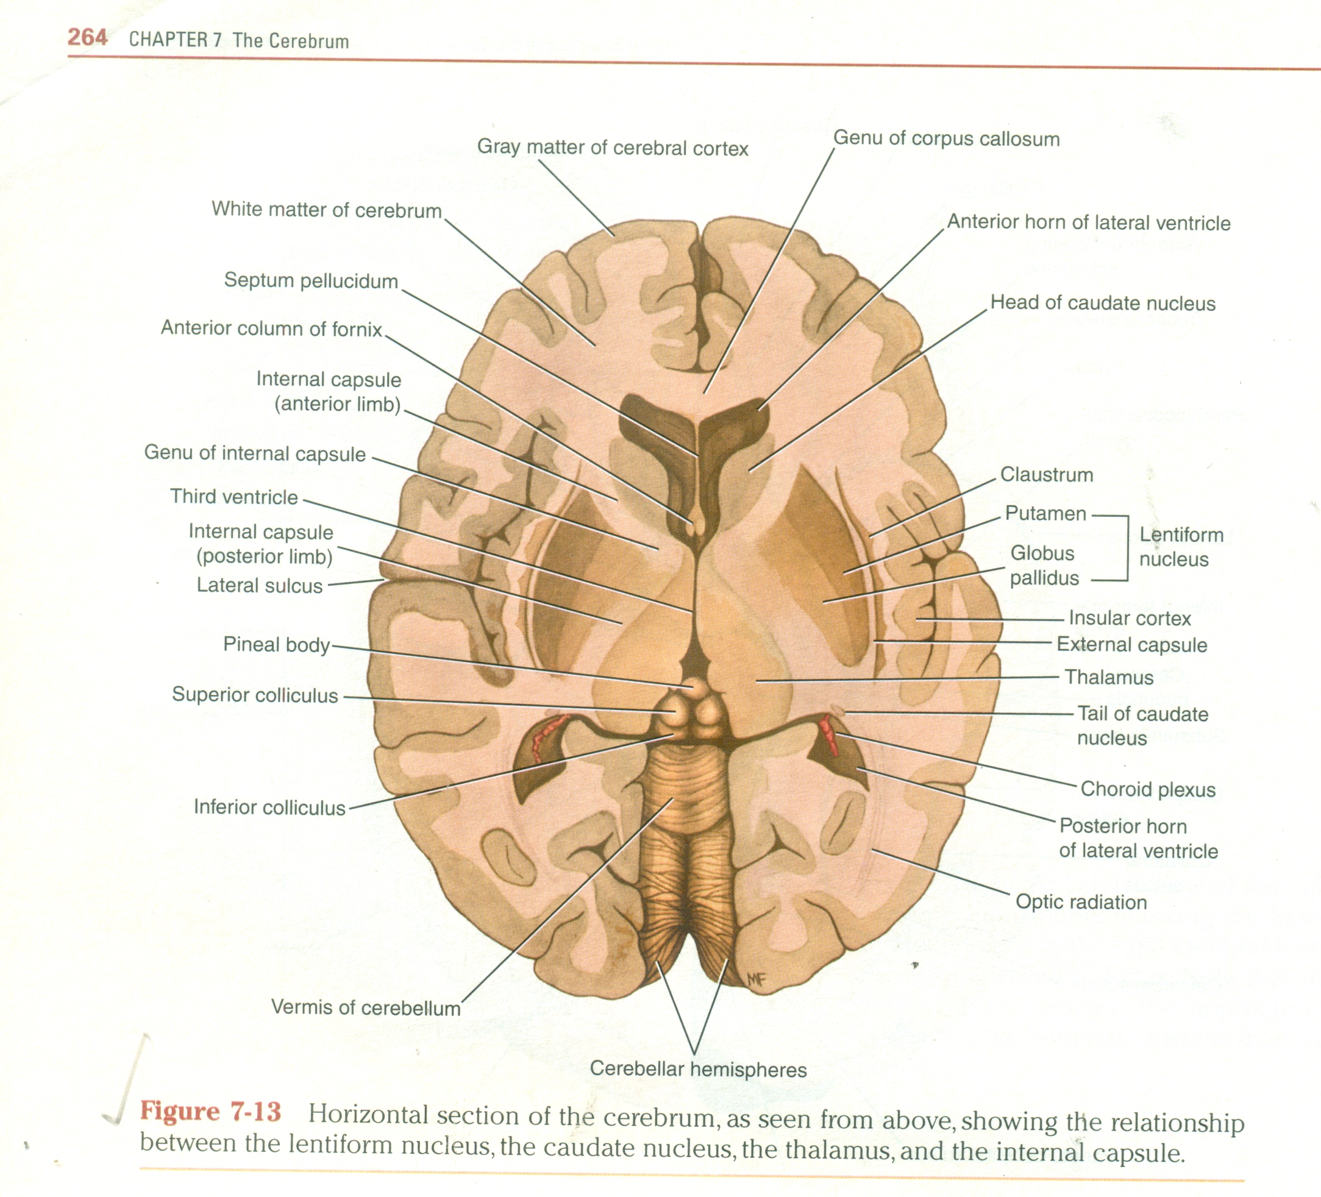
CONT.
The lentiform nucleus consists of the lateral part called putamen and the medial part called the globus pallidus.
The structure and functions of the putamen and globus pallidus are different.
Corpus striatum-it includes the caudate nucleus and the lentiform nucleus.
Striatum-the caudate nucleus and the putamen of the lentiform nucleus are similar in structure and connections.therefore together they are called the striatum.

Slide 3
PALLIDUM
The globus pallidus is known as the pallidum.
The main receiving station of the corpus striatum is the striatum but its main output station is the pallidum.
Caudate nucleus is a comma shaped nucleus having three parts ,the head,body and tail.
Lentiform nucleus has the shape of a biconvex lens.
The lentiform nucleus has a highly convex medial surface and a lateral surface.

Slide 4
CONT.
The lateral surface-is related in succession to the external capsule ,claustrum,extreme capsule and insular cortex(from medial to lateral side).the lateral striate arteries pierce the lateral surface and pass through the substance of lentiform nucleus.
The medial surface-is intimately related to the anterior limb of internal capsule anteriorly and the posterior limb of internal capsule posteriorly(the genu being in contact with the apex).

Slide 5
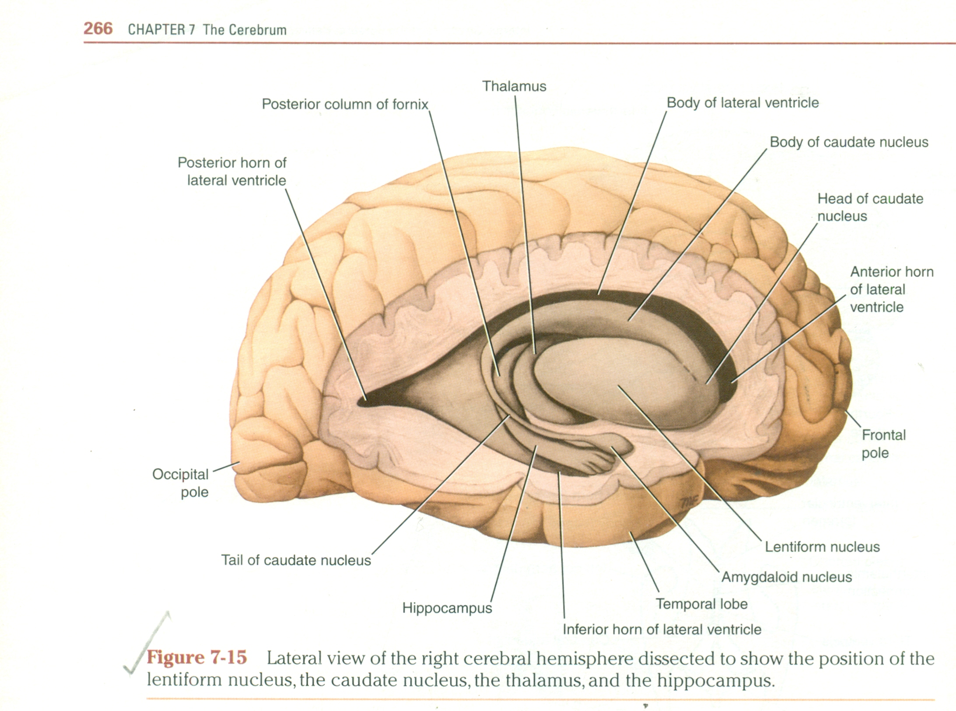
CAUDATE NUCLEUS
The caudate nucleus is large c-shaped mass of gray matter that is closely related to the lateral ventricle and lies lateral to the thalamus.
The lateral surface of the nucleus is related to the internal capsule,which separates it from the lentiform nucleus.te caudate nucleus can be divided in to head,body and tail.
The head of the caudate nucleus is large and rounded and forms the lateral wall of the anterior horn of the lateral ventricle.
The head is continuous inferiorly with the putamen of the lentiform nucleus.
The body is long and narrow and is continuous with the head in the region of the interventricular foramen.the body of the caudate nucleus forms part of the floor of the body of the lateral ventricle.

Slide 6
AMYGDALOID NUCLEUS
The amygdaloid nucleus is situated in the temporal lobe close to the uncus.the amygdaloid nucleus is considered to be part of limbic system.
Through its connections,it can influence the body's response to environmental changes.
In the sense of fear ,for example it can change the heart rate, blood pressure,skin colour and rate of respiration.
Claustrum -the claustrum is a thin sheet of gray matter that is separated from the lateral surface of the lentiform nucleus by the external capsule.lateral to the claustrum is the subcortical white matter of the insula.the function of claustrum is unknown.

Slide 7
SUBTHALAMIC NUCLEI
The substantia nigra of mid brain and the subthalamic nuclei of diencephalon are functionally closely related to the activities of the basal nuclei.
The neurons of the substantia nigra are dopaminergic and inhibitory and have many connections to the corpus striatum.
The neurons of the subthalamic nuclei are glutaminergic and excitatory and have many connections to the globus pallidus and substantia nigra.

Slide 8
FUNCTIONS OF BASAL GANGLIA
The basal nuclei control muscular movements by influencing the cerebral cortex and have no direct control through descending pathways to the brain stem and spinal cord.in this way ,the basal nuclei assist in the regulation of voluntary movement and the learning of motor skills.

Slide 9
CLINICAL CORRELATION
Lesions in the corpus striatum cause disturbances in the initiation and cessation of a motor event,which results in various kinds of abnormal movements.
Parkinsons disease-occurs due to deficiency of dopamine in corpus striatum due to degeneration of neurons of substantia nigra or of the nigrostriate fibres(dopamine is secreted by pigmented neurons of substantia nigra and transported to corpus striatum via nigrostriate fibres).
Since dopamine causes inhibition of cells of corpus striatum, its depletion manifests as increased muscle tone(rigidity,tremors),and slow movements(akinesia).

Slide 10
CONT.
The characterstic features of parkinsonism are cogwheel or lead pipe rigidity,resting tremor(pill-rolling tremor) mask like face with no emotional response and shuffling gait and stooped posture.
Huntington's chorea is an autosomal dominant disorder,which occurs in adults.the basic pathology is severe degeneration of neurons in caudate nucleus and putamen.the disease is characterised by brisk,jerky and purposeless movements.
Sydenhems choreaor st.vitus dance occurs in younger age(more in girls)

Slide 11
CONT.
It occurs due to micro hemorrhages in corpus striatum.
The abnormal movements are relatively less rapid and jerky.
The lesion of the subthalamic nucleus produces abnormal movements called hemiballismus in the opposite side.the involuntary and violent movements (of throwing the limb in all directions or flinging movements of limbs) affect usually the proximal parts of te upper limbs.

